Slide 1
Simulating market competition & collusion using reinforcement learning and bayesian game theory
Lawrence Swaminathan Xavier Prince,
Northeastern University

Slide 2
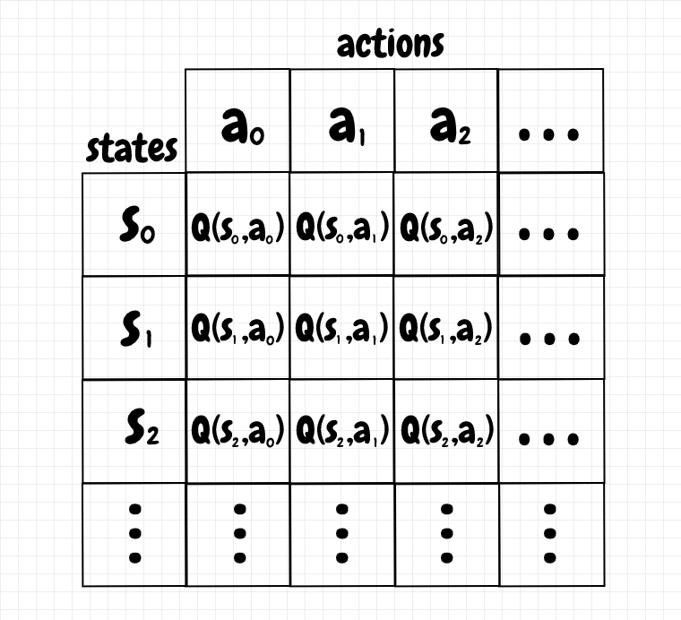
Q-learning and Q-tables
Q-learning is a model-free reinforcement learning algorithm used to learn the optimal action-selection policy
Learn what action to take in a given state to maximize long-term rewards.
Q(s, a) ← Q(s, a) + α [reward + γ * max Q(s’, a’) – Q(s, a)]
Where:
s is current state, a is action,
α is learning rate,
γ is discount factor for future rewards

Slide 3
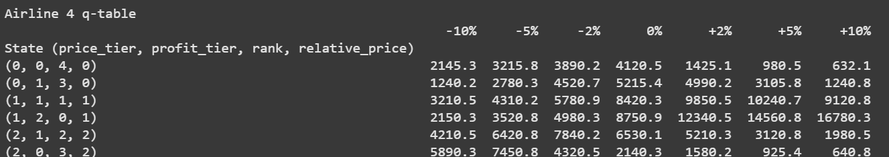
Price determination using Q-tables
States: Decision context is determined by state:
- Price (low/medium/high)
- Profit (losing money/modest/high profit)
- rank (1st through 5th) - relative_price (through prior observation)
Actions: Option to adjust prices by -10%, -5%, -2%, 0%, +2%, +5%, or +10%
First the airlines learn against static competitors who have fixed prices. Data is inserted into a q-table and then they start competing against each other

Slide 4
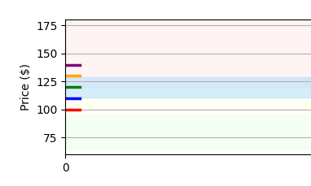
Game setup and rules
5 airlines competing to set ticket prices over several hundred days.
Customers prefer cheaper airlines over expensive ones. Customer demand is continuous.
Low performing airlines try to decrease prices to gain market share. High performing airlines try to increase prices to gain higher profit. Airlines may change price everyday
There is a price floor, airlines must charge at least $75 to stay profitable
Avoid Nash Equilibrium (most commonly used solution)

Slide 5
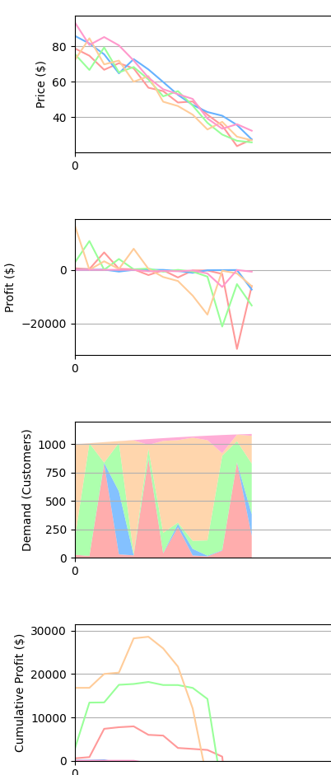
Trial #1
Price war without bounds
Without a bottom ceiling, all airlines indefinitely decrease prices to chase customers
Negative prices & profit
Equilibrium at negative infinity

Slide 6
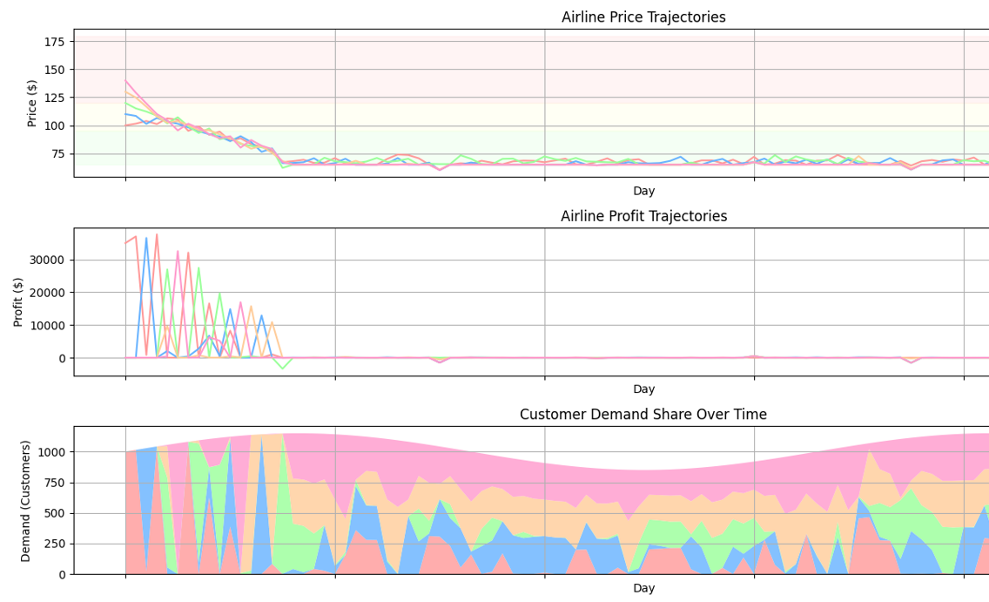
Trial #2 Price war with bottom ceiling
Airlines will quickly decrease prices to their break-even point ($75)
Only noise will disrupt equilibrium at $75

Slide 7
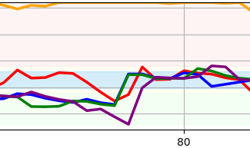
Price war with collusion, price matching
Encourage collusion, penalty for very high and very low prices
Low performing airlines will start to mimic the top performing ones (generally by decreasing prices
Airlines may discover that maintaining similar prices to competitors (collusion) leads to higher profits for everyone
Co-operation as an emergent property

Slide 8
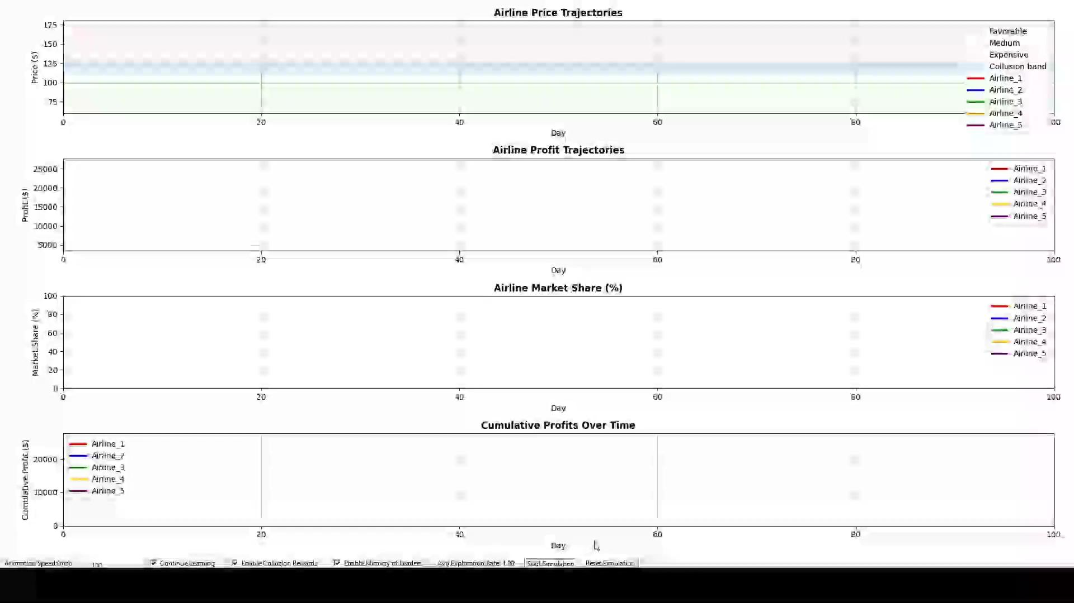

Slide 9
References
https://www.kaggle.com/datasets/shubhambathwal/flight-price-prediction
https://www.kaggle.com/datasets/dilwong/flightprices
Airline Ticket Price Collusion - AntitrustLieff Cabraserhttps://www.lieffcabraser.com › antitrust › air-ticket-pric...
Flight Price Prediction Using Machine LearningAnalytics Vidhyahttps://www.analyticsvidhya.com › blog › 2022/01 › fli...

