Slide 1
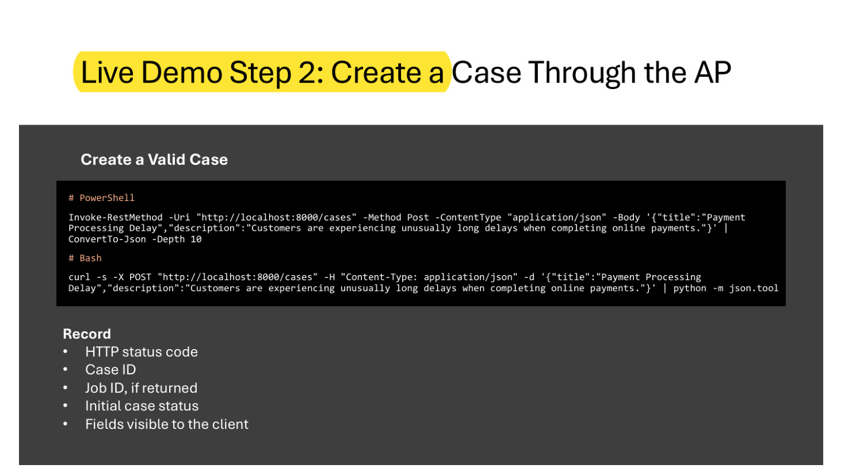
Page 7 has to be true
12 of 12 sampled passages agreed with a PDF library the pipeline does not use
66 pages scanned character by character: 0 dropped glyphs, 0 mojibake
The check refuses to run without a second library
Week 5 Lab page 6, rendered from the original PDF. The yellow box marks where our stored passage was found.
Notes:
Everything we show the user is meant to point at a page and a passage, so the page number has to be right.
We did not check that with our own code, because checking your own output with the same code proves nothing.
We used a second PDF library, one the pipeline does not use, and looked for twelve sampled passages inside the pages they claimed. All twelve agreed. We also went through all sixty-six pages at character level: no dropped glyphs and no mojibake.
Sources: evidence/pdf-quality.md, submissions/week07/m1-evidence.md, scripts/verify_page_attribution.py.

Slide 2
Entity candidates, each with its evidence
47, 44 and 36 raw candidates on three real decks. Skipping line-initial words left 39, 38 and 33. Ranking kept ten.
Type | Candidate | Page
person | Chen | 1
project | File Management Assistant | 1
topic | Schema Design | 1
Each one carries the page and the sentence that produced it: "The File Management Assistant indexes documents. Dr. Chen reviewed the first prototype."
About three in four of the kept ten are right.
Notes:
For the midterm we deliberately built the smallest version: three candidates, one of each type, each carrying the page and the sentence that produced it.
This is a rule, not a model, and we measured it. Most of the raw candidates were sentence openers.
About three in four of the bounded list are right. That is good enough for a list a person reviews, and we are not claiming more than that.
Sources: evidence/relation-candidates.md, scripts/check_relation_candidates.py, tests/fixtures/relations/entities.pdf.

Slide 3
Two reviewers cannot silently overwrite each other
Reviewer A confirms the relation at revision 1
Reviewer B submits against a view that is already stale and is refused
B re-reads, then rejects at revision 2
Revision 1 is still in the history afterwards
Rule results can be recomputed. A person's decision cannot, so it is appended with a revision number and never overwritten.
Notes:
Every rule output in this system can be regenerated, so it is safe to throw away. Human decisions are the exception: once a reviewer confirms or rejects a relation, recomputing it is data loss.
So a decision is appended with a revision number, and whoever submits one has to say which revision they were looking at. In the demo you see reviewer A confirm, reviewer B get refused, then re-read and reject, with A's original decision still in the history.
Sources: evidence/relation-review.md, submissions/week07/review-check.md, scripts/demo_relation_review.py.

