Slide 1
A Hierarchical GP-LVM
applied to motion capture data
Andy Moore
Neil D. Lawrence
The University of Sheffield

Slide 2
Introduction
Motion capture
  Recording live motion
  Most common method involves the subject wearing markers
  Data consists of a set of joint angles for each frame of motion

Slide 3
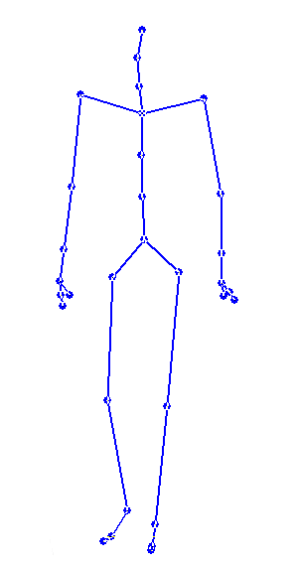
Introduction – example skeleton
31 joints
59 joint angles
3D position of root
Total dimensionality: 62

Slide 4
Latent space modelling
View the n-dimensional data space y as a function of a q-dimensional latent space x.
y = f(x) + ε
Can use for interactive character posing

Slide 5
Interactive character posing
Manipulating a pose directly in real time
  e.g. animators, artists

Slide 6
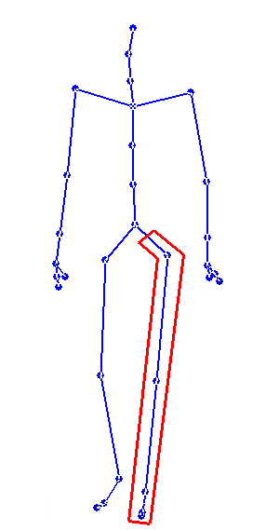
Defining the hierarchy

Slide 7
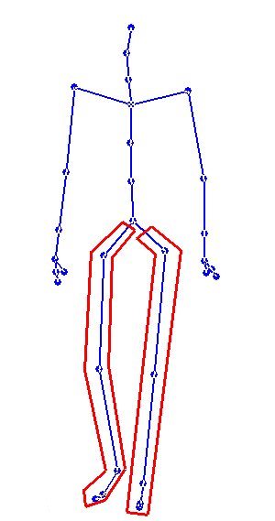
Defining the hierarchy

Slide 8
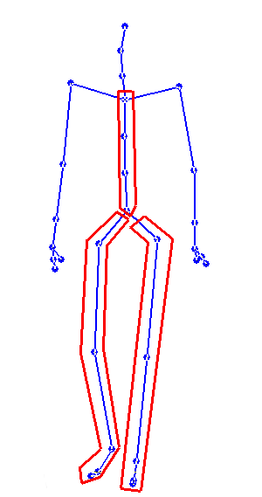
Defining the hierarchy

Slide 9
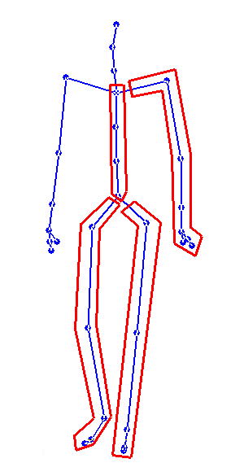
Defining the hierarchy

Slide 10
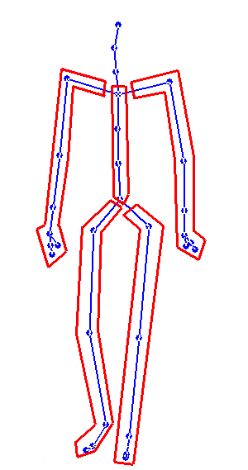
Defining the hierarchy

Slide 11
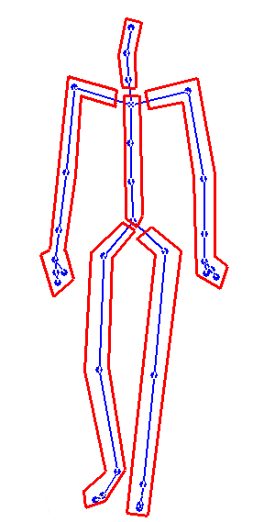
Defining the hierarchy

Slide 12
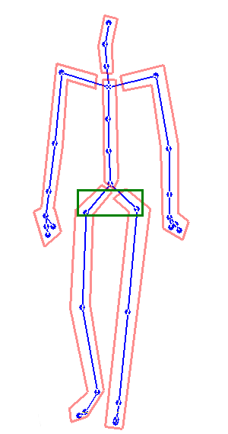
Defining the hierarchy

Slide 13
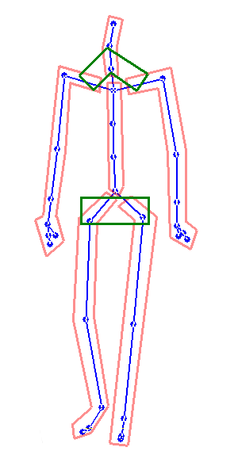
Defining the hierarchy

Slide 14
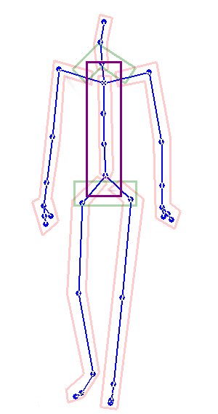
Defining the hierarchy

Slide 15
Defining the hierarchy
Body
Upper
body
Back
Legs
Left
arm
Head
Right
arm
Right
leg
Left
leg

Slide 16
Learning latent spaces
Learn a latent space for each leaf node over joint angle data
Learn a latent space for each parent node over child latent positions

Slide 17
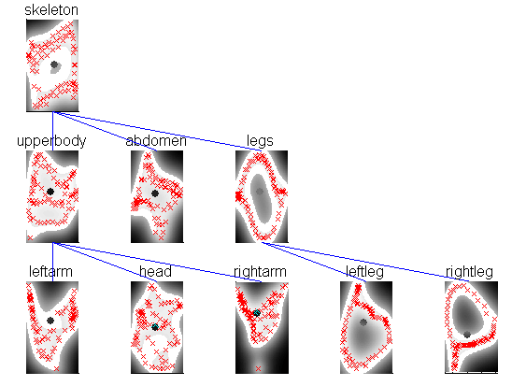
Learning latent spaces

