Slide 1
The Data Delusion
Neil Lawrence
University of Sheffield
Notes:
So Oron has introduced artificial intelligence and some of its successes, in this next section I’d like to turn to some of the challenges of Artificial Intelligence.
My name is Neil Lawrence and I’m a professor of machine learning at the University of Sheffield.
The AlphaGo result is extremely impressive. But as Oren mentioned it was achieved through enormous computer power. The machine built its value network, its intuition, from every recorded professional game of Go, it then honed it through millions of games played against itself.
The end result is that by the time of its first match against the European Champion AlphaGo had already played many more games of Go than any human could possibly play in their lifetime. Indeed, even between its match with the European Champion and the $1 million dollar challenge match wih Lee Seedol AlphaGo was relentlessly working to improve itself. Playing all day and all night in an effort to ready to face Lee.
And yet still Lee managed to win a match.

Slide 2
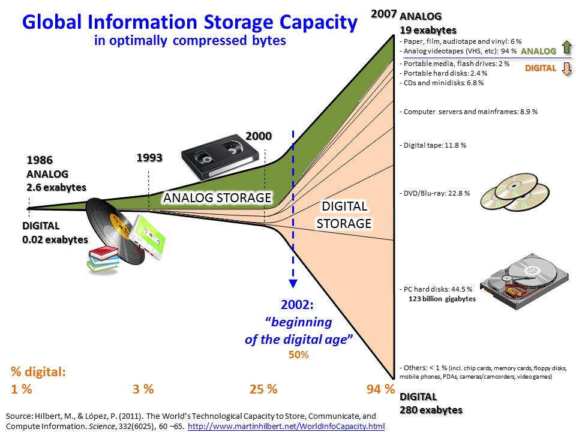
Notes:
Our AI advances, our super human performances in so many domains are being driven by machine learning. And machine learning is being driven by data. An unearthly amount of data. Or certainly an amount of data that was unearthly in 1986 as this diagram from a 2011 Science paper shows.
Our vision systems see far more labeled images than we require to recognize objects, our speech systems require many more words than we do to comprehend what’s being said. Our translation systems require many more examples of translated text than a human could ever read.
So while we are making considerable progress on tasks which were once thought extremely difficult or impossible, the truth is that the progress is driven far more by the availability of data than an improvement in algorithms.
In a very real sense the methodologies we are deploying haven’t changed a great deal since the mid 1990s, what has changed is illustrated in this funnel shaped plot. The wide availability of data. It is the explosion of data that has rendered these challenges achievable.

Slide 3
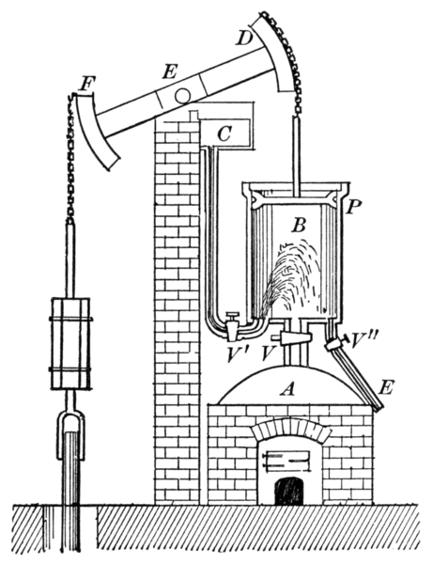
Notes:
To get a perspective on where we are and where we are going I sometimes find historical analogies very useful.
The current situation with data, reminds me very much of the early stage of the industrial revolution. Thomas Newcomen was born in the South West of England, an area well known, since Roman times, for tin mining. As tin was extracted and mines became deeper. Ground water that pumped into the mines needed to be pumped out. In 1712 Newcomen invented a steam engine for doing exactly that.
DESCRIBE ENGINE
His engine consisted of a large piston sitting on top of a boiler. The piston chamber was alternatively filled with steam by the boiler, causing the piston to rise, and then cooled through direct injection of water, causing the piston to fall.
As it happened, Newcomen's engine had relatively little effect at his local tin mines. The engine was so inefficient, that it was impractical. It needed far too much coal.

Slide 4
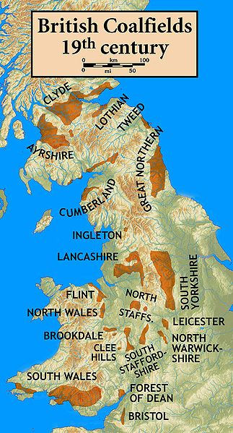
Notes:
These are the coal fields of the UK in the 19th century. The tin mines of Cornwall do not appear on the map.
However, Newcomen’s engine was very widely deployed at the mines associated with these coal fields.
This brings me to mind somewhat of the situation today: the major internet companies can profit from our current generation of inference engines because they are equivalent to the coalfields of yesteryear. They have enormous quantities of data readily available. So we see a lot of interest in today’s deep learning technologies from those companies that have a lot of data.
Our AI systems are learning to emulate humans through watching their behavior. If your language is widely spoken then it is easy to translate. However, for rare languages like Ateso, Lua, and Luganda we do not have functional translation systems.
Just as in 18th Century England distribution of coal over the country was a challenge, sharing and interconnection of some data types remains a challenge. Particularly personal data where there are issues of privacy and ethics.

Slide 5
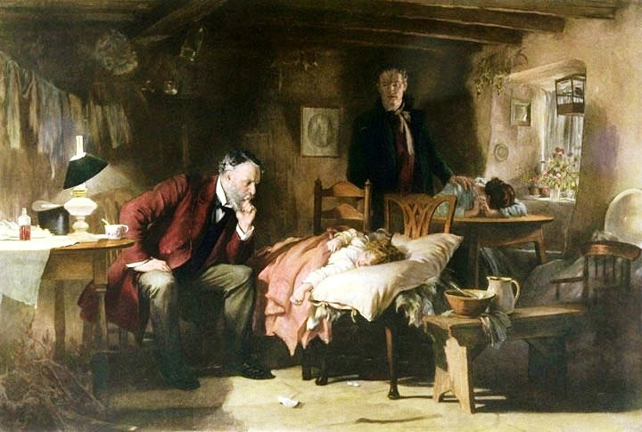
Notes:
With current technologies there is a prospect for peoples to be passed by, but also entire fields.
In application domains such as medicine we face challenges because firstly: the complexity of the system is much greater than speech, vision or even the game of Go. Our interventions are often at a biochemical level, and yet our intent is that they manifest themselves at the level of our overall health.
And yet for rare or complex diseases: diseases that have causes driven by a combination of environmental and genetic causes, we may never have sufficient data to learn unless we improve efficiency.

Slide 6
"I had gone to take a walk on a fine Sabbath afternoon. I had entered the Green by the gate at the foot of Charlotte street, and had passed the old washing‑house. I was thinking upon the engine at the time, and had gone as far as the herd's house, when the idea came into my mind that, as steam was an elastic body, it would rush into a vacuum, and, if a communication were made between the cylinder and an exhausted vessel, it would rush into it, and might be there condensed without cooling the cylinder … I had not walked farther than the Golf‑house, when the whole thing was arranged in my mind."
Notes:
The steam engine is far more associated in our minds with the name of James Watt than Thomas Newcomen, Watt made the steam engine practical by introducing the separate condenser. Rather than directly injecting water into the cylinder he sucked the steam out of the cylinder and cooled it separately. This was more efficient as the cylinder itself no longer had to go through cycles of heating and cooling. The resulting doubling in efficiency made the steam engine practical, not just for cornish tin mines, but for railways and traction engines.
My definition of intelligence is the use of information to save energy. Intelligent decision making implies that we assimilate the facts and make a decision that reduces our expenditure relative to actions we would have taken had we not had those facts.
Under that definition, we can become more intelligent by either saving more energy with our resulting decisions, or by using less information.
In a very real sense there is currently a data efficiency deficit, just as large as, if not larger than, the engine efficiency deficit in Newcomen's engine. What we require is a revolution in data efficiency equivalent to Watt's separate condenser moment.

Slide 7
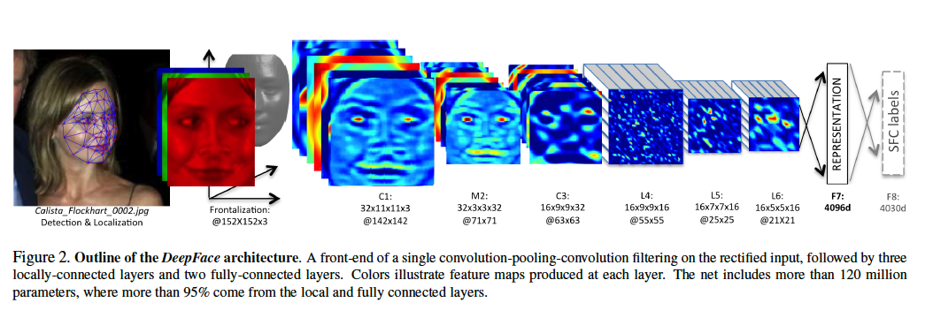
Notes:
Let’s look for a moment at the architecture that is driving so many of the changes in current artificial intelligence.
Deep neural networks, are a set of layered functions that transform incoming data into representations that are more amenable to interpretation by the machine.
By performing the transformation in stages, each component of the transformation can be fairly simple, but a complex transformation can result.
This diagram is from the ‘DeepFace’ paper: DeepFace is Facebook’s face recognition paper that achieved near human performance with a training set of 1 billion faces.
The model involves some prepreprocessing of the face and then a series of cascaded transformations that eventually turn, in this case Calista Flockhart’s face, into a ‘yes’ or a ‘no’.
From a mathematical perspective we can think of this as a deterministic process, indeed it is a mathematical composition of simple processes. That’s what ‘deep learning’ is: mathematical composition of simple deterministic processes.
It is sometimes related to the brain or presented as a fundamental way of thinking about AI, but we can simply think of it as a sensible idea of applying a set of simple transformations to an image to build a complex transformation.
The challenge of machine learning is how to determine what these transformations should be. Each of the simpler deterministic transformations can actually have very many parameters. In the case of DeepFace more than 120 million parameters.

Slide 8
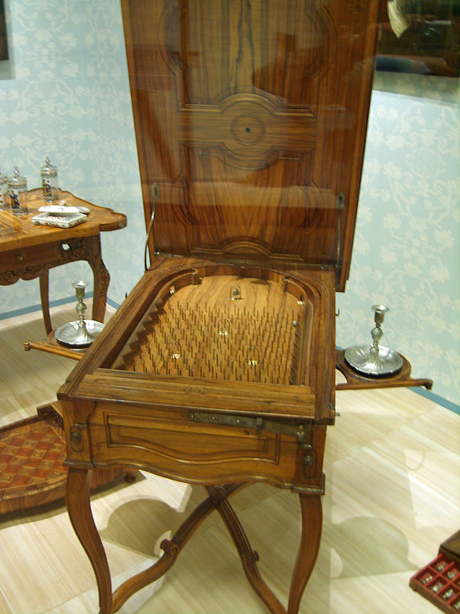
Notes:
When we think of deep learning, we can think of any given data point passing through the deterministic processes like a ball falling through a pinball machine. Each layer of pins is equivalent to a layer in the deep model.
The objective of machine learning, is to reconstruct the configuration of those pins in such a way that Calista's face is correctly detected. Think of the face as a set of initial conditions, and the face passes through each process to emerge in modified form. The task of inference is to ensure that the right set of initial conditions lead to the right conclusion.
So a deep model is like a Pachinko machine, but one where we have control over the location of the pins. The objective in deep learning is to move the pins around in such a way that for the right set of initial conditions, the correct result is achieved.
The network weights are like the positions of the pins. So we can think of DeepFace having 120 million pins. Of course our pin ball system is only one dimensional, real deep networks have many many dimensions. The deep network is like a Pachinko machine where the pins are in a high dimensional space, and the ball drops through the high dimensional space bouncing into ‘hyper-pins’ along the way.
To get the internal structure of the machine right we need to explore full range of initial conditions we wish to test the machine on, for images that must be very many. That’s why we need so much data.

Slide 9
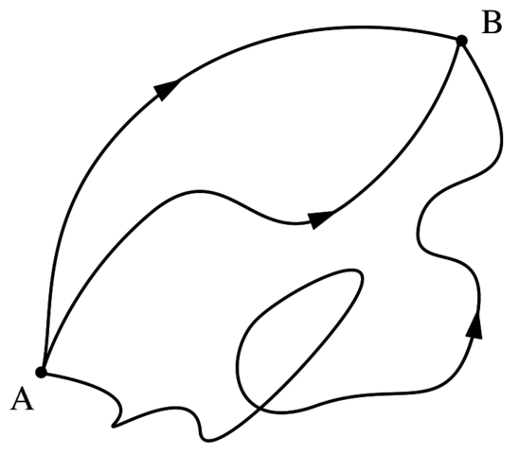
Notes:
The way in which most learning is done, is to assume the path through the machine is deterministic. But to properly determine the functions at each stage you need a lot of data to explore all the initial conditions. A way around this is to ensure that the answer of your machine is robust to small changes in the initial conditions (or the activation further down the network). To do this you introduce stochasticity. You model the machine as a set of stochastic processes.
You consider all the possible paths that the ball could have taken through the machine to get the right result. Considering these paths can make the model far more robust to small variations in the input.
This is a path integral interpretation of the system.

Slide 10
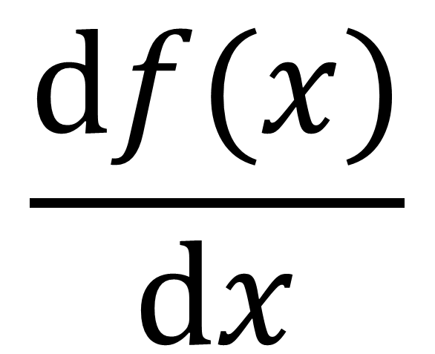
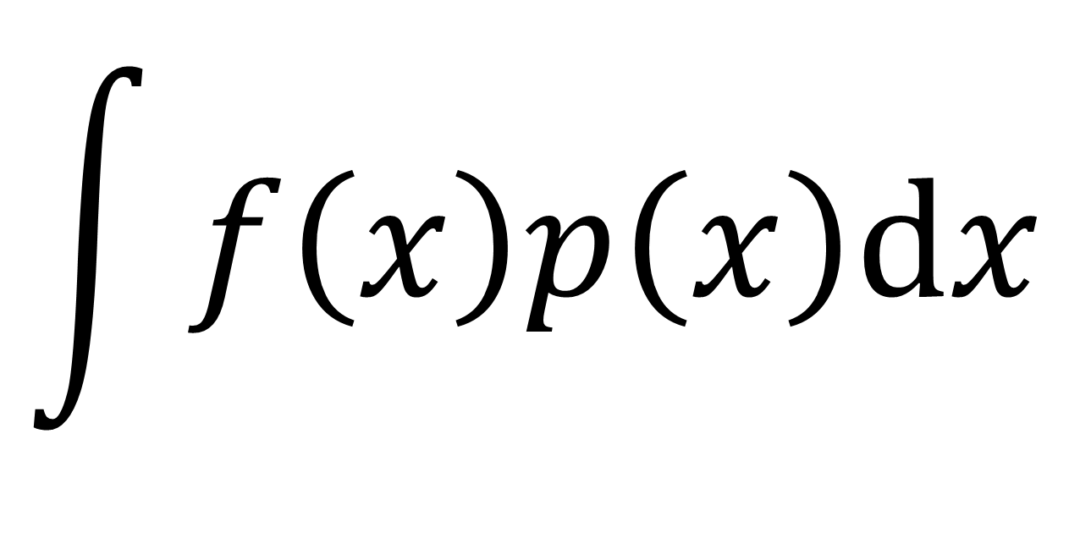
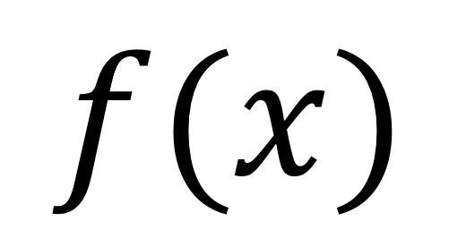
$f(x)$
$$\int{f\left(x\right)p\left(x\right)dx}$$
$$\frac{df(x)}{dx}$$
Notes:
The main algorithmic challenge is that solution of the path integral is far more challenging than finding the most likely path. The most likely path is found through optimization which just requires the gradient.
This means that deep networks only need to be differentiable for training, thus the domination of backpropagation algorithms. The main implementation worry is the challenge of gradients fading as the network gets deeper.
For seeking all possible paths you need to be able to convolve the function with a probability distribution, which is typically far less tractable, particularly in high dimensions.
Approximating this integral is one area of large study in the machine learning community.

Slide 11
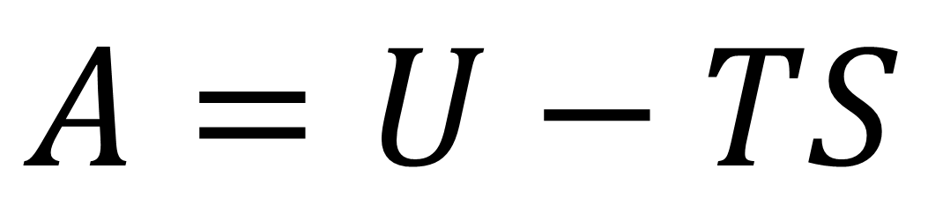
$$A=U−TS$$
Notes:
This beautiful formula is Helmholtz’s free energy. On the left, A stands for Arbeit: the amount of useful work a system can do, on the right the U stands for internal energy, the T temperature and S entropy.
This formula arrived more than a century after Watt developed the separate condenser. It took a long time for the theory of thermodynamics to catch up with Watt's implementation.
But a deep understanding of thermodynamics is vital to our modern world.
Interestingly, when considering the work of Helmholtz and other 19th century physicists such as Gibbs and Boltzmann we again get a strong connection between the thermodynamics and the world of information and uncertainty in machine learning.
One extremely promising approach to solving our path integrals is the use of variational methods. These decompose the path integral into parts that can be replaced by optimizable approximations. In the end they allow us to return to the world of back propagation. These techniques originate with Boltzmann and the field of statistical mechanics: the class of techniques that was derived give us our theoretical understanding of heat.
However, in machine learning we are no where near to a theory that achieves the elegant simplicity of Helmholtz’s free energy.
We do have implementations of these systems today, and they are much more data efficient than neural networks trained by back propagation. The challenge is scaling the implementations up so that they can take advantage of the data on the scale that the deep neural networks do.
It is clear that we are in the midst of an information revolution, but the techniques that are bearing fruit in machine learning now were proposed and first implemented over 20 years ago.
We can easily become deluded about our capabilities due to the vast amounts of data we are handling. The intelligent systems we develop can be super-human in many ways, but one area where we are consistently underperforming is in the data efficiency. If this is not addressed from a methodological stand point then it will severely restring the classes of problems in which we can implement these methods.

