Slide 1
Artificial Intelligence and Commercial Applications
Recent Developments, Future Directions, and the Atomic Human

Slide 2
Today’s Arc
  What AI is — and what it is not
  Commercial applications and organisational change
  Recent developments and future directions

Slide 3
Part 1: What AI Is (and Isn’t) for Commercial Leaders

Slide 4
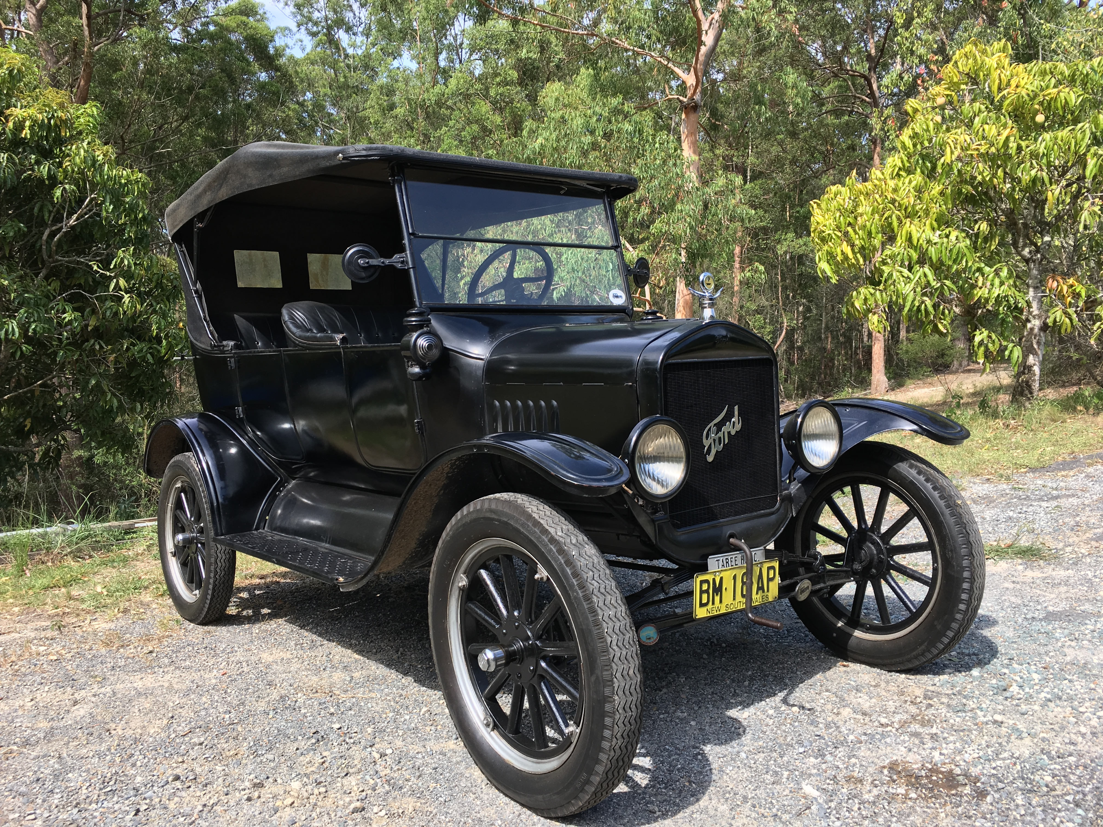

Slide 5
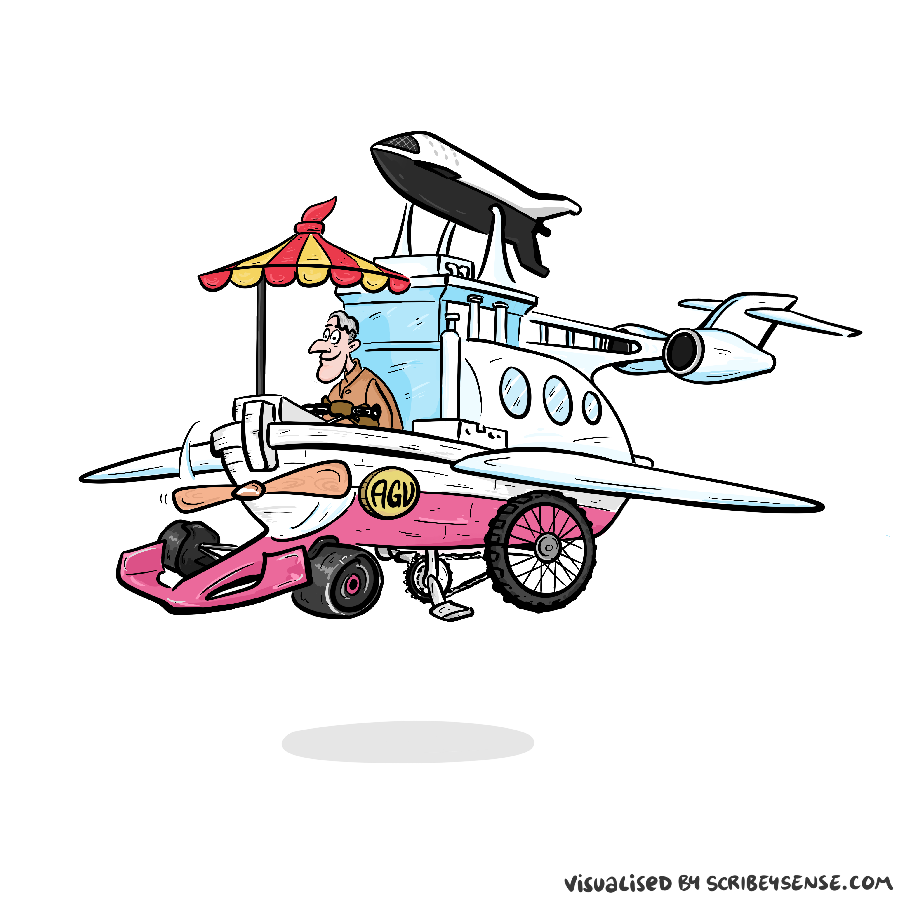

Slide 6


Slide 7
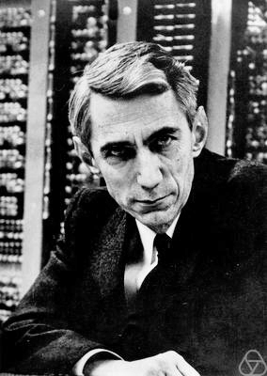
Information and Embodiment

Slide 8
Communication Bandwidth
  Human communication: walking pace (2000 bits/minute)
  Machine communication: light speed (billions of bits/second)
  Our sharing walks, machine sharing …

Slide 9


Slide 10


Slide 11


Slide 12


Slide 13


Slide 14


Slide 15
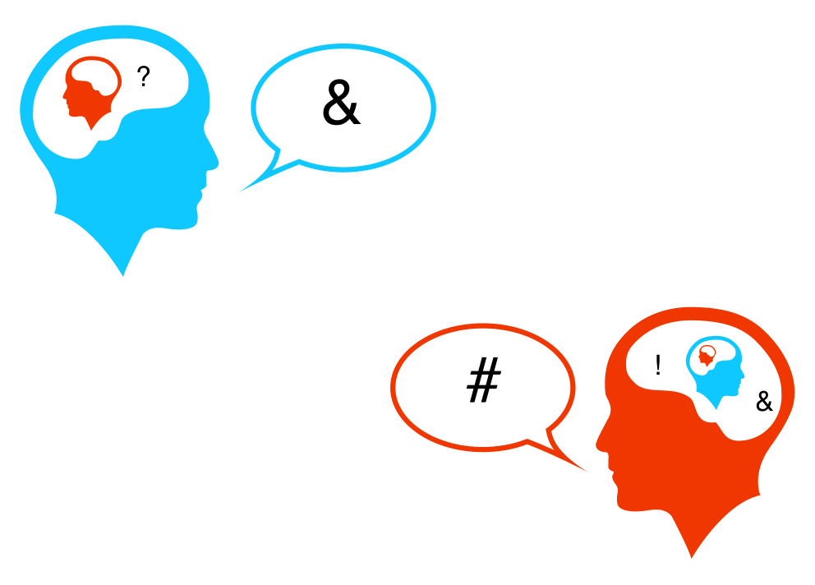

Slide 16
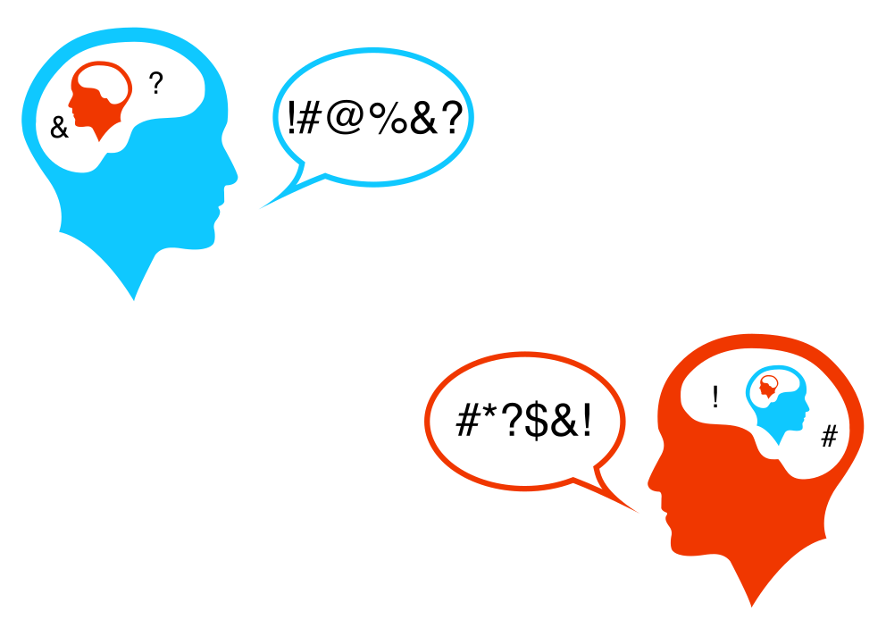

Slide 17
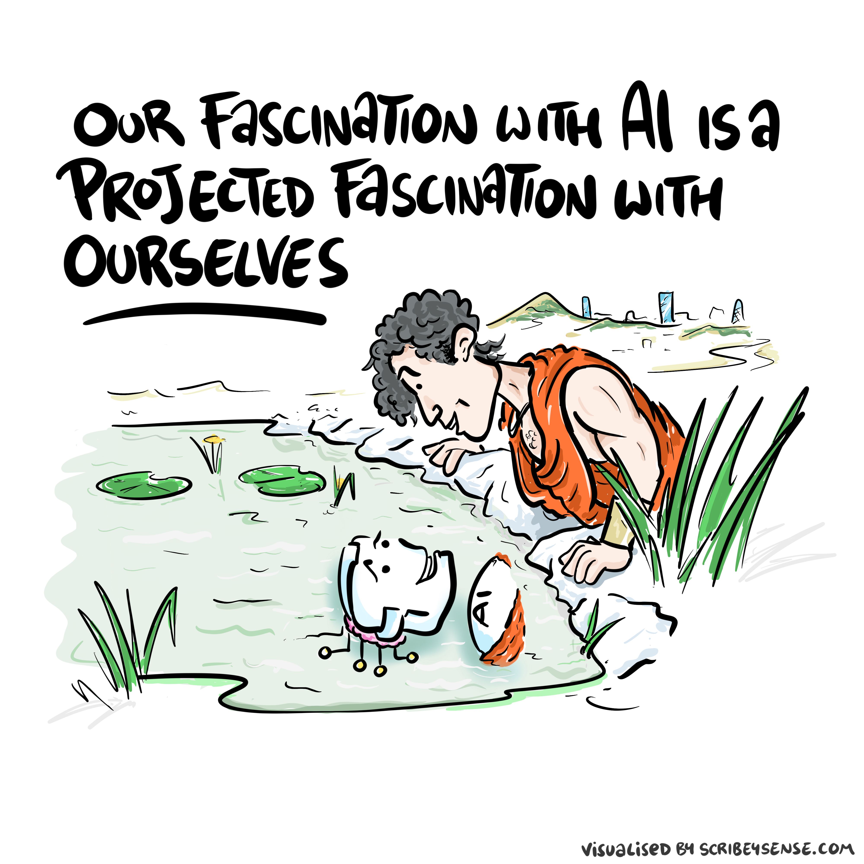

Slide 18
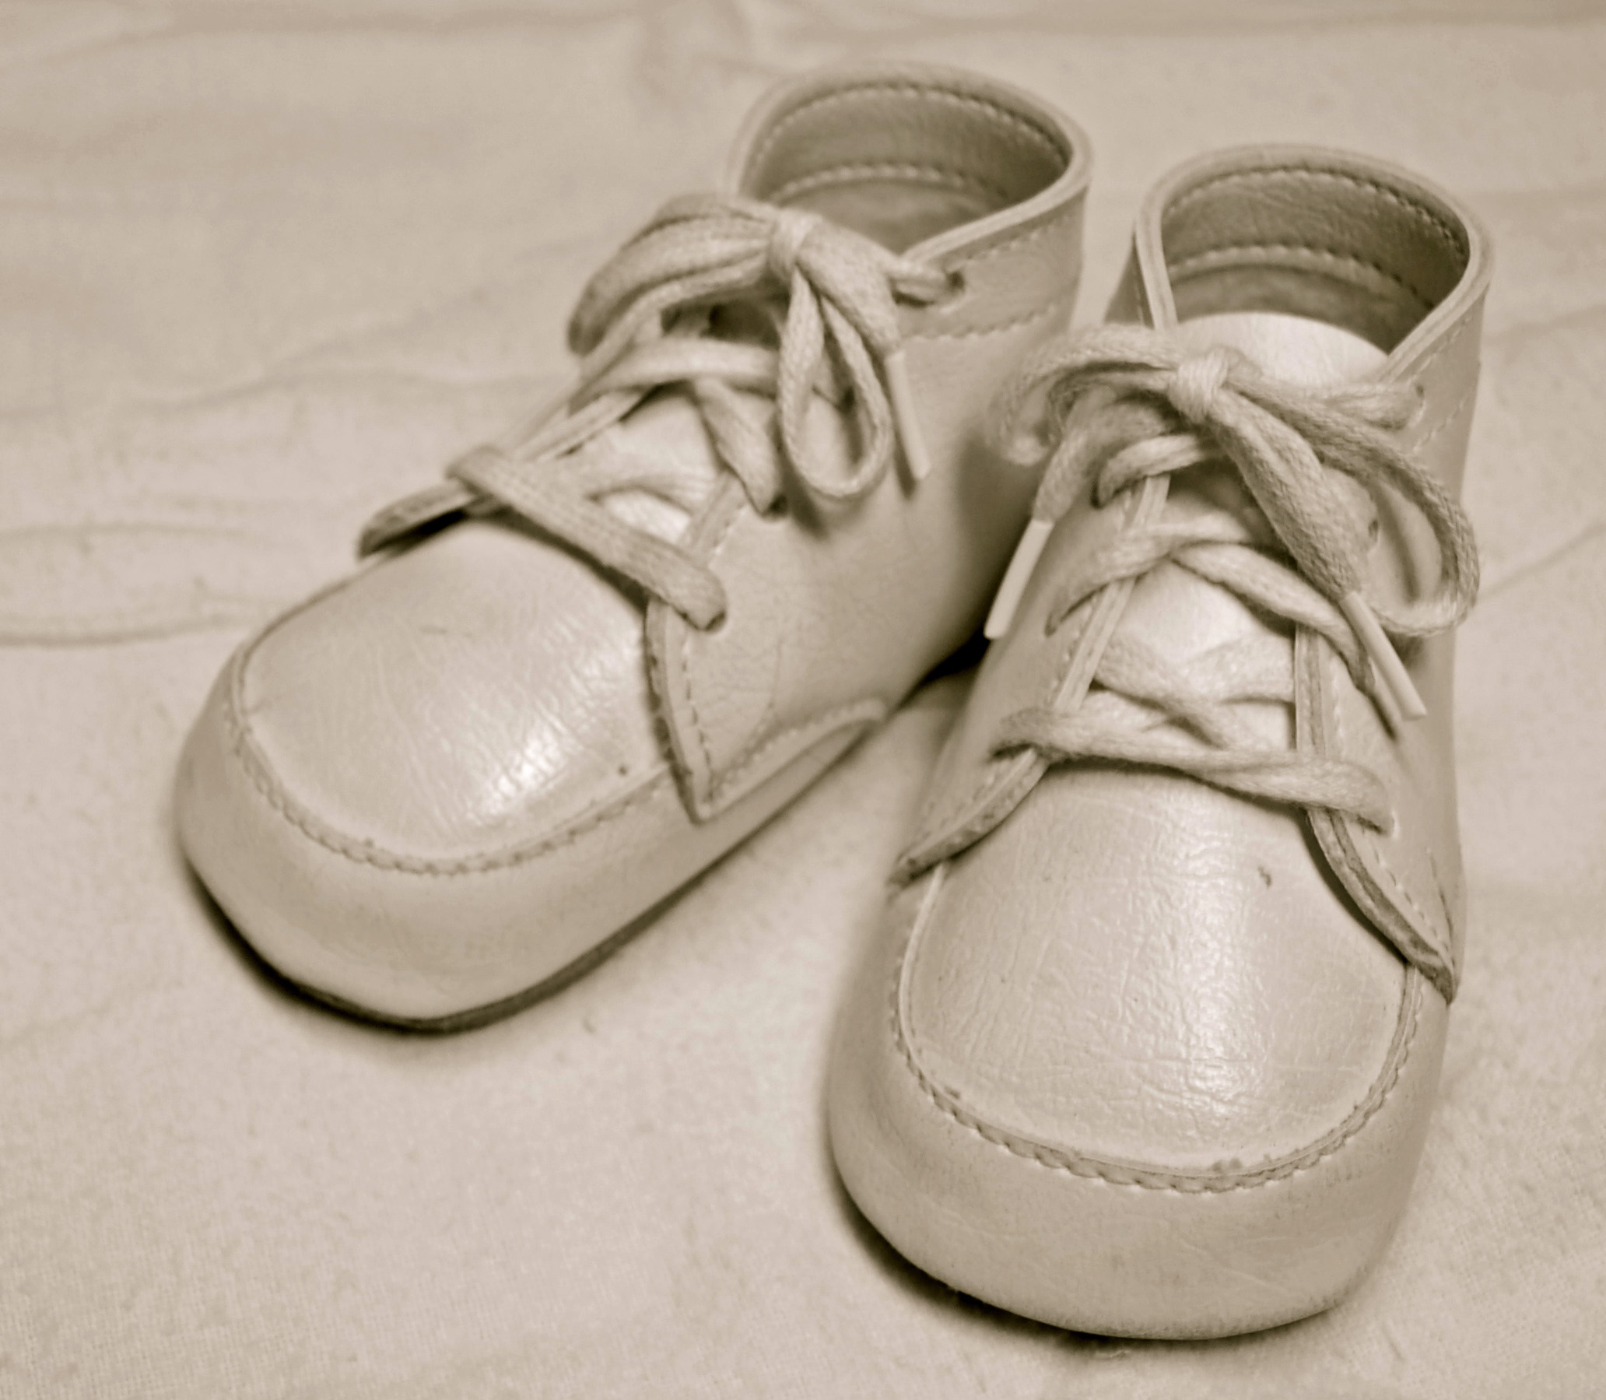
For sale: baby shoes, never worn

Slide 19
Homo Atomicus
  Where we have homo economicus the machine can step in.
  Quantitative vs Qualitative gap
  Homo atomicus is …
    Not in A-level results
    Not in hospital waiting lists
    In the quality of human interaction

Slide 20
Discussion
  Where is the indivisible human contribution in your organisation?
  What would you not automate, even if you could?

Slide 21
Part 2: Commercial Applications and Organisational Change

Slide 22
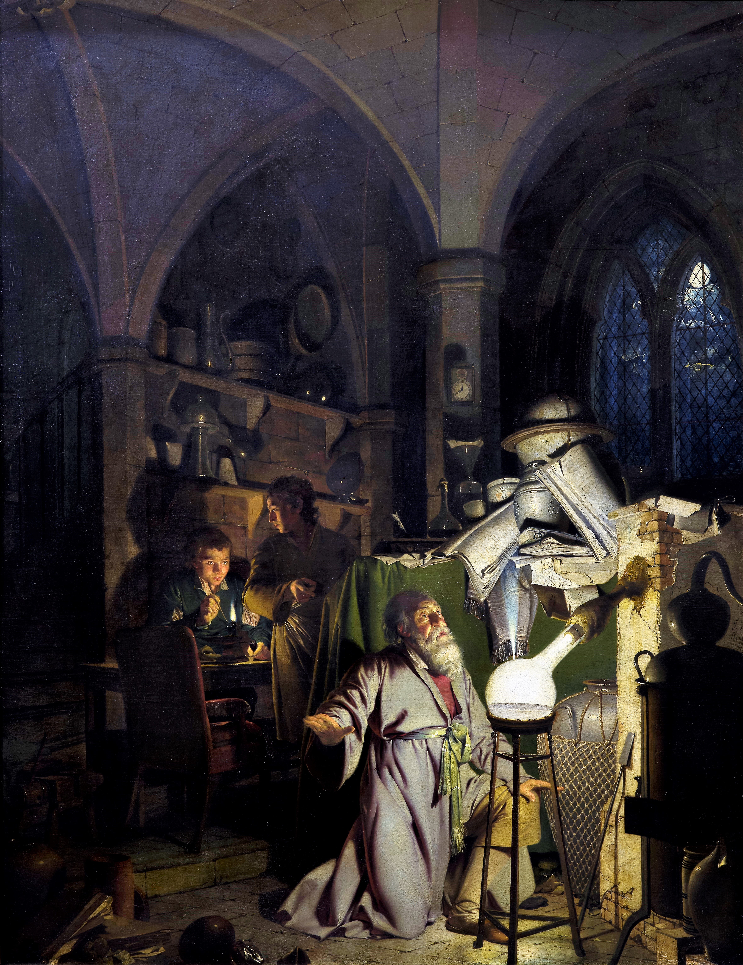

Slide 23
The Attention Economy
  Human intelligence is locked-in
  This makes it a bottleneck

Slide 24
Herbert Simon on Information
What information consumes is rather obvious: it consumes the attention of its recipients. Hence a wealth of information creates a poverty of attention …
Simon (1971)

Slide 25
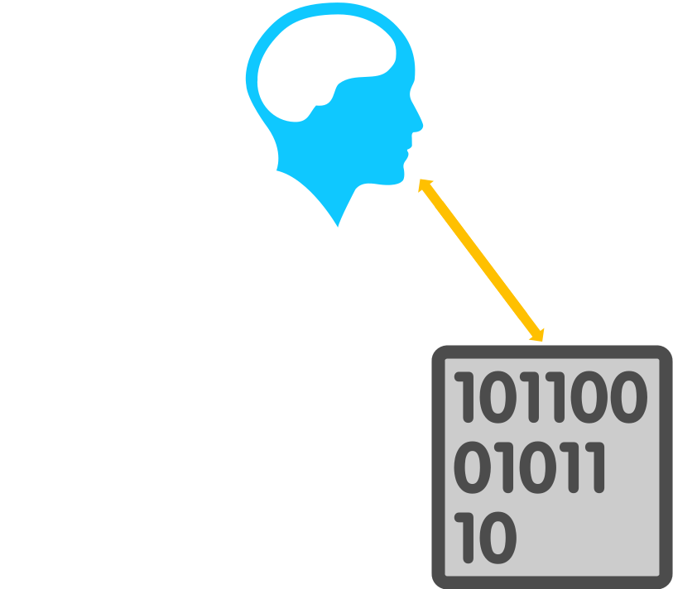

Slide 26
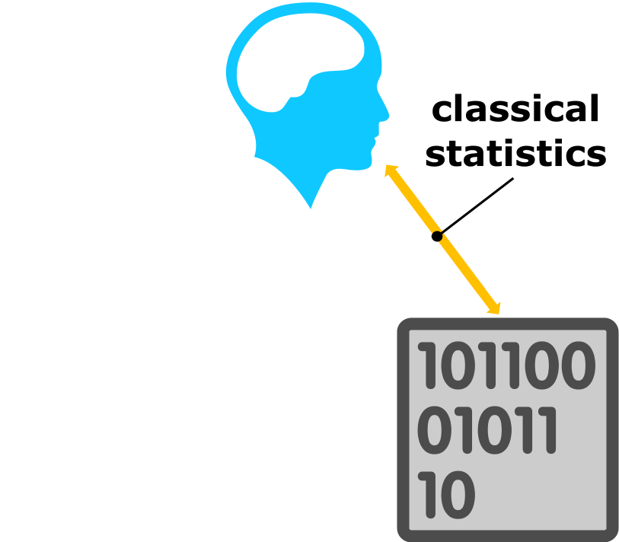

Slide 27
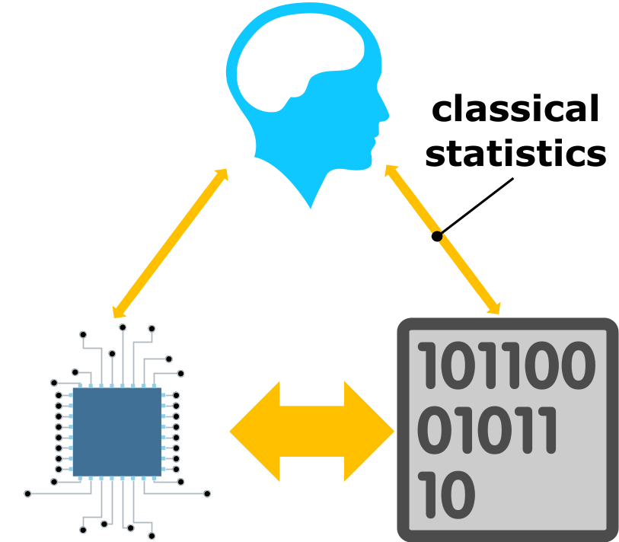

Slide 28
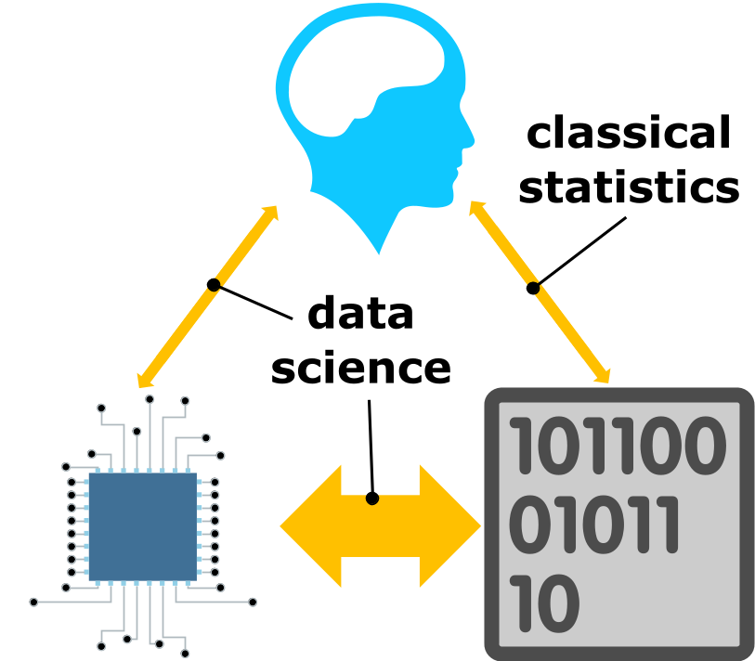

Slide 29
Institutional Character

Slide 30
Bezos memo to Amazon in 2002
  The API Mandate
    All teams will henceforth expose their data and functionality through service interfaces.
    Teams must communicate with each other through these interfaces.
    There will be no other form of inter-process communication allowed:
      no direct linking,
      no direct reads of another team’s data store,
      no shared-memory model,
      no back-doors whatsoever.
    The only communication allowed is via service interface calls over the network.

Slide 31
Bezos memo to Amazon in 2002
  It doesn’t matter what technology they use.
  All service interfaces, without exception, must be designed from the ground up to be externalizable. That is to say, the team must plan and design to be able to expose the interface to developers in the outside world. No exceptions.

Slide 32
Duality of Corporation and Information
  What is less written about is corporate structure.
  This information infrastructure is reflected in the corporation.
  Two pizza teams with devolved autonomy.
  Bound together through corporate culture.

Slide 33
Conway’s Law
Any organization that designs a system (defined broadly) will produce a design whose structure is a copy of the organization’s communication structure.
Conway (n.d.)

Slide 34
Amazon and Agility
  Company prides itself on agility.
  Operates through a system of devolved autonomy
    Teams have defined inputs and outputs.
  Corporate culture bonds them togethether.
    Customer obsession
    Ownership

Slide 35
Alternative Culture: Cambridge
  Over 800 years old.
    Less commonly thought of as agile.
    Reliable institutional character.
    Amazon in comparison is more mecurial.

Slide 36
Organisational Data Science
  Claim:
    For data driven decision making to work there must be an interplay between institutional character and the information infrastructure.
  Sometimes described as “inverse Conway’s Law”

Slide 37
Cultural Transplant
  Claim:
    Transplanting another organisation’s decision-making infrastructure directly leads cultural rejection from the new host.

Slide 38
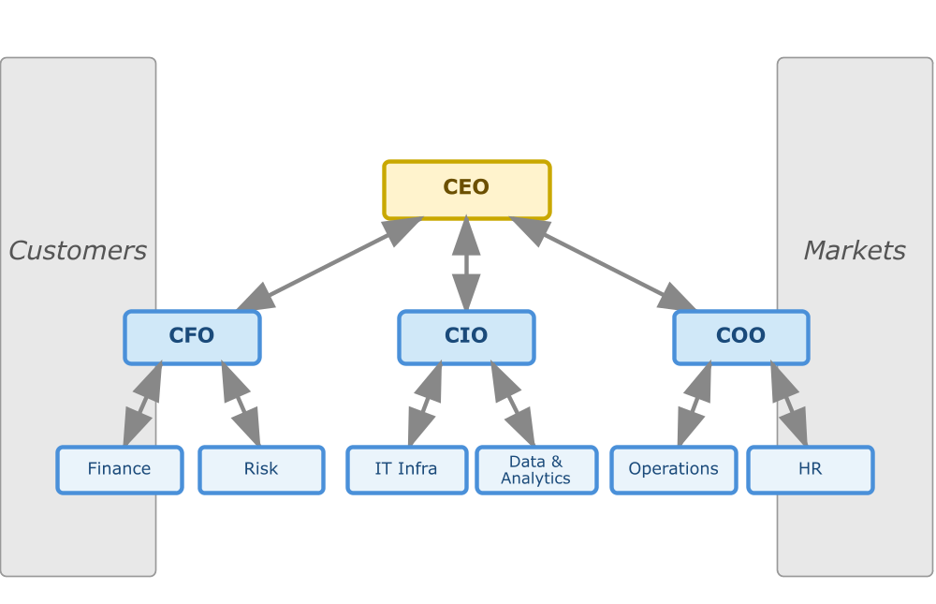
How Information Flows in Organisations

Slide 39
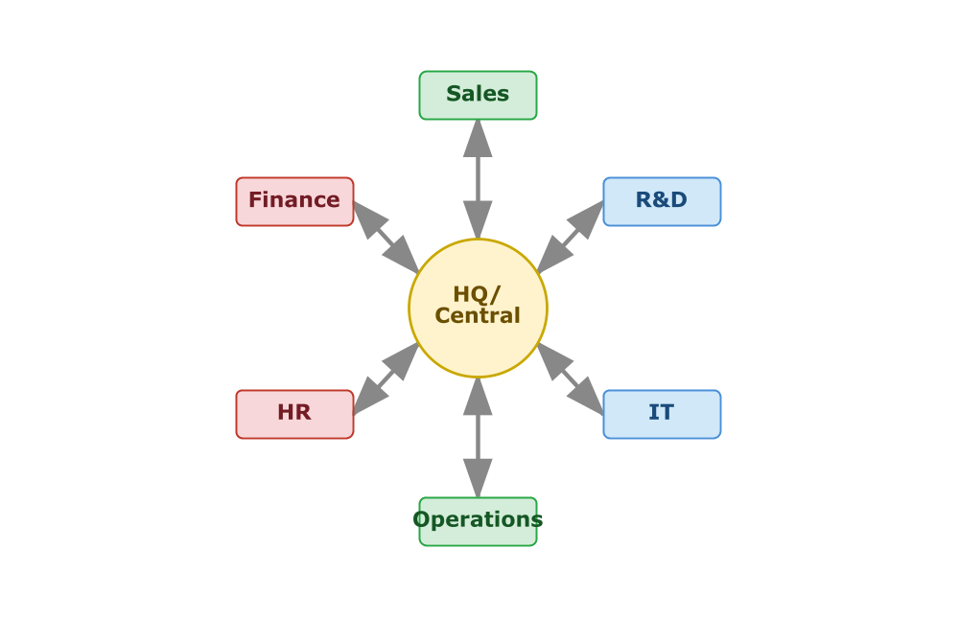
Hub-and-Spoke

Slide 40
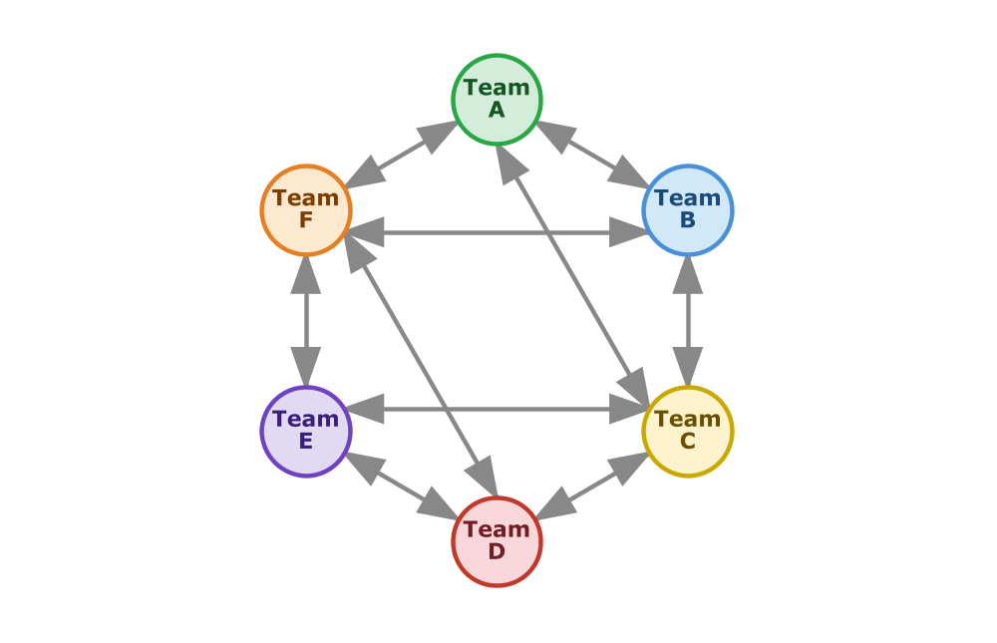
Peer-to-Peer

Slide 41
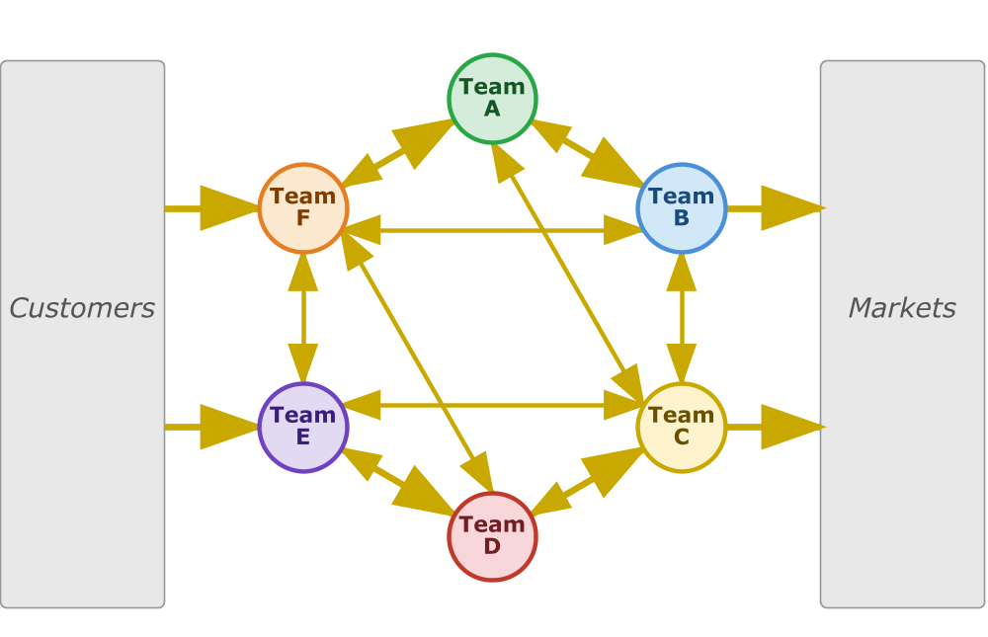
Information and Money Flow Together

Slide 42
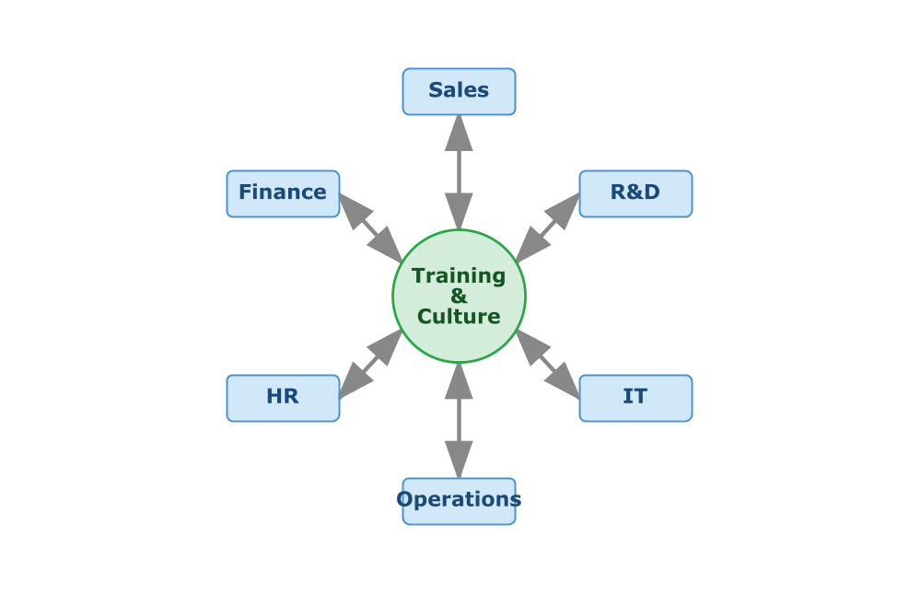
Training and Culture as Hub

Slide 43
Autonomy Depends on Trust
  Trust is not a slogan
  Trust is an infrastructure
  Trust depends on shared culture

Slide 44
Trust, Autonomy and Embodiment
  Trust is not a slogan
  Trust is an infrastructure
  Autonomy depends on Trust
  Trust depends on shared culture

Slide 45
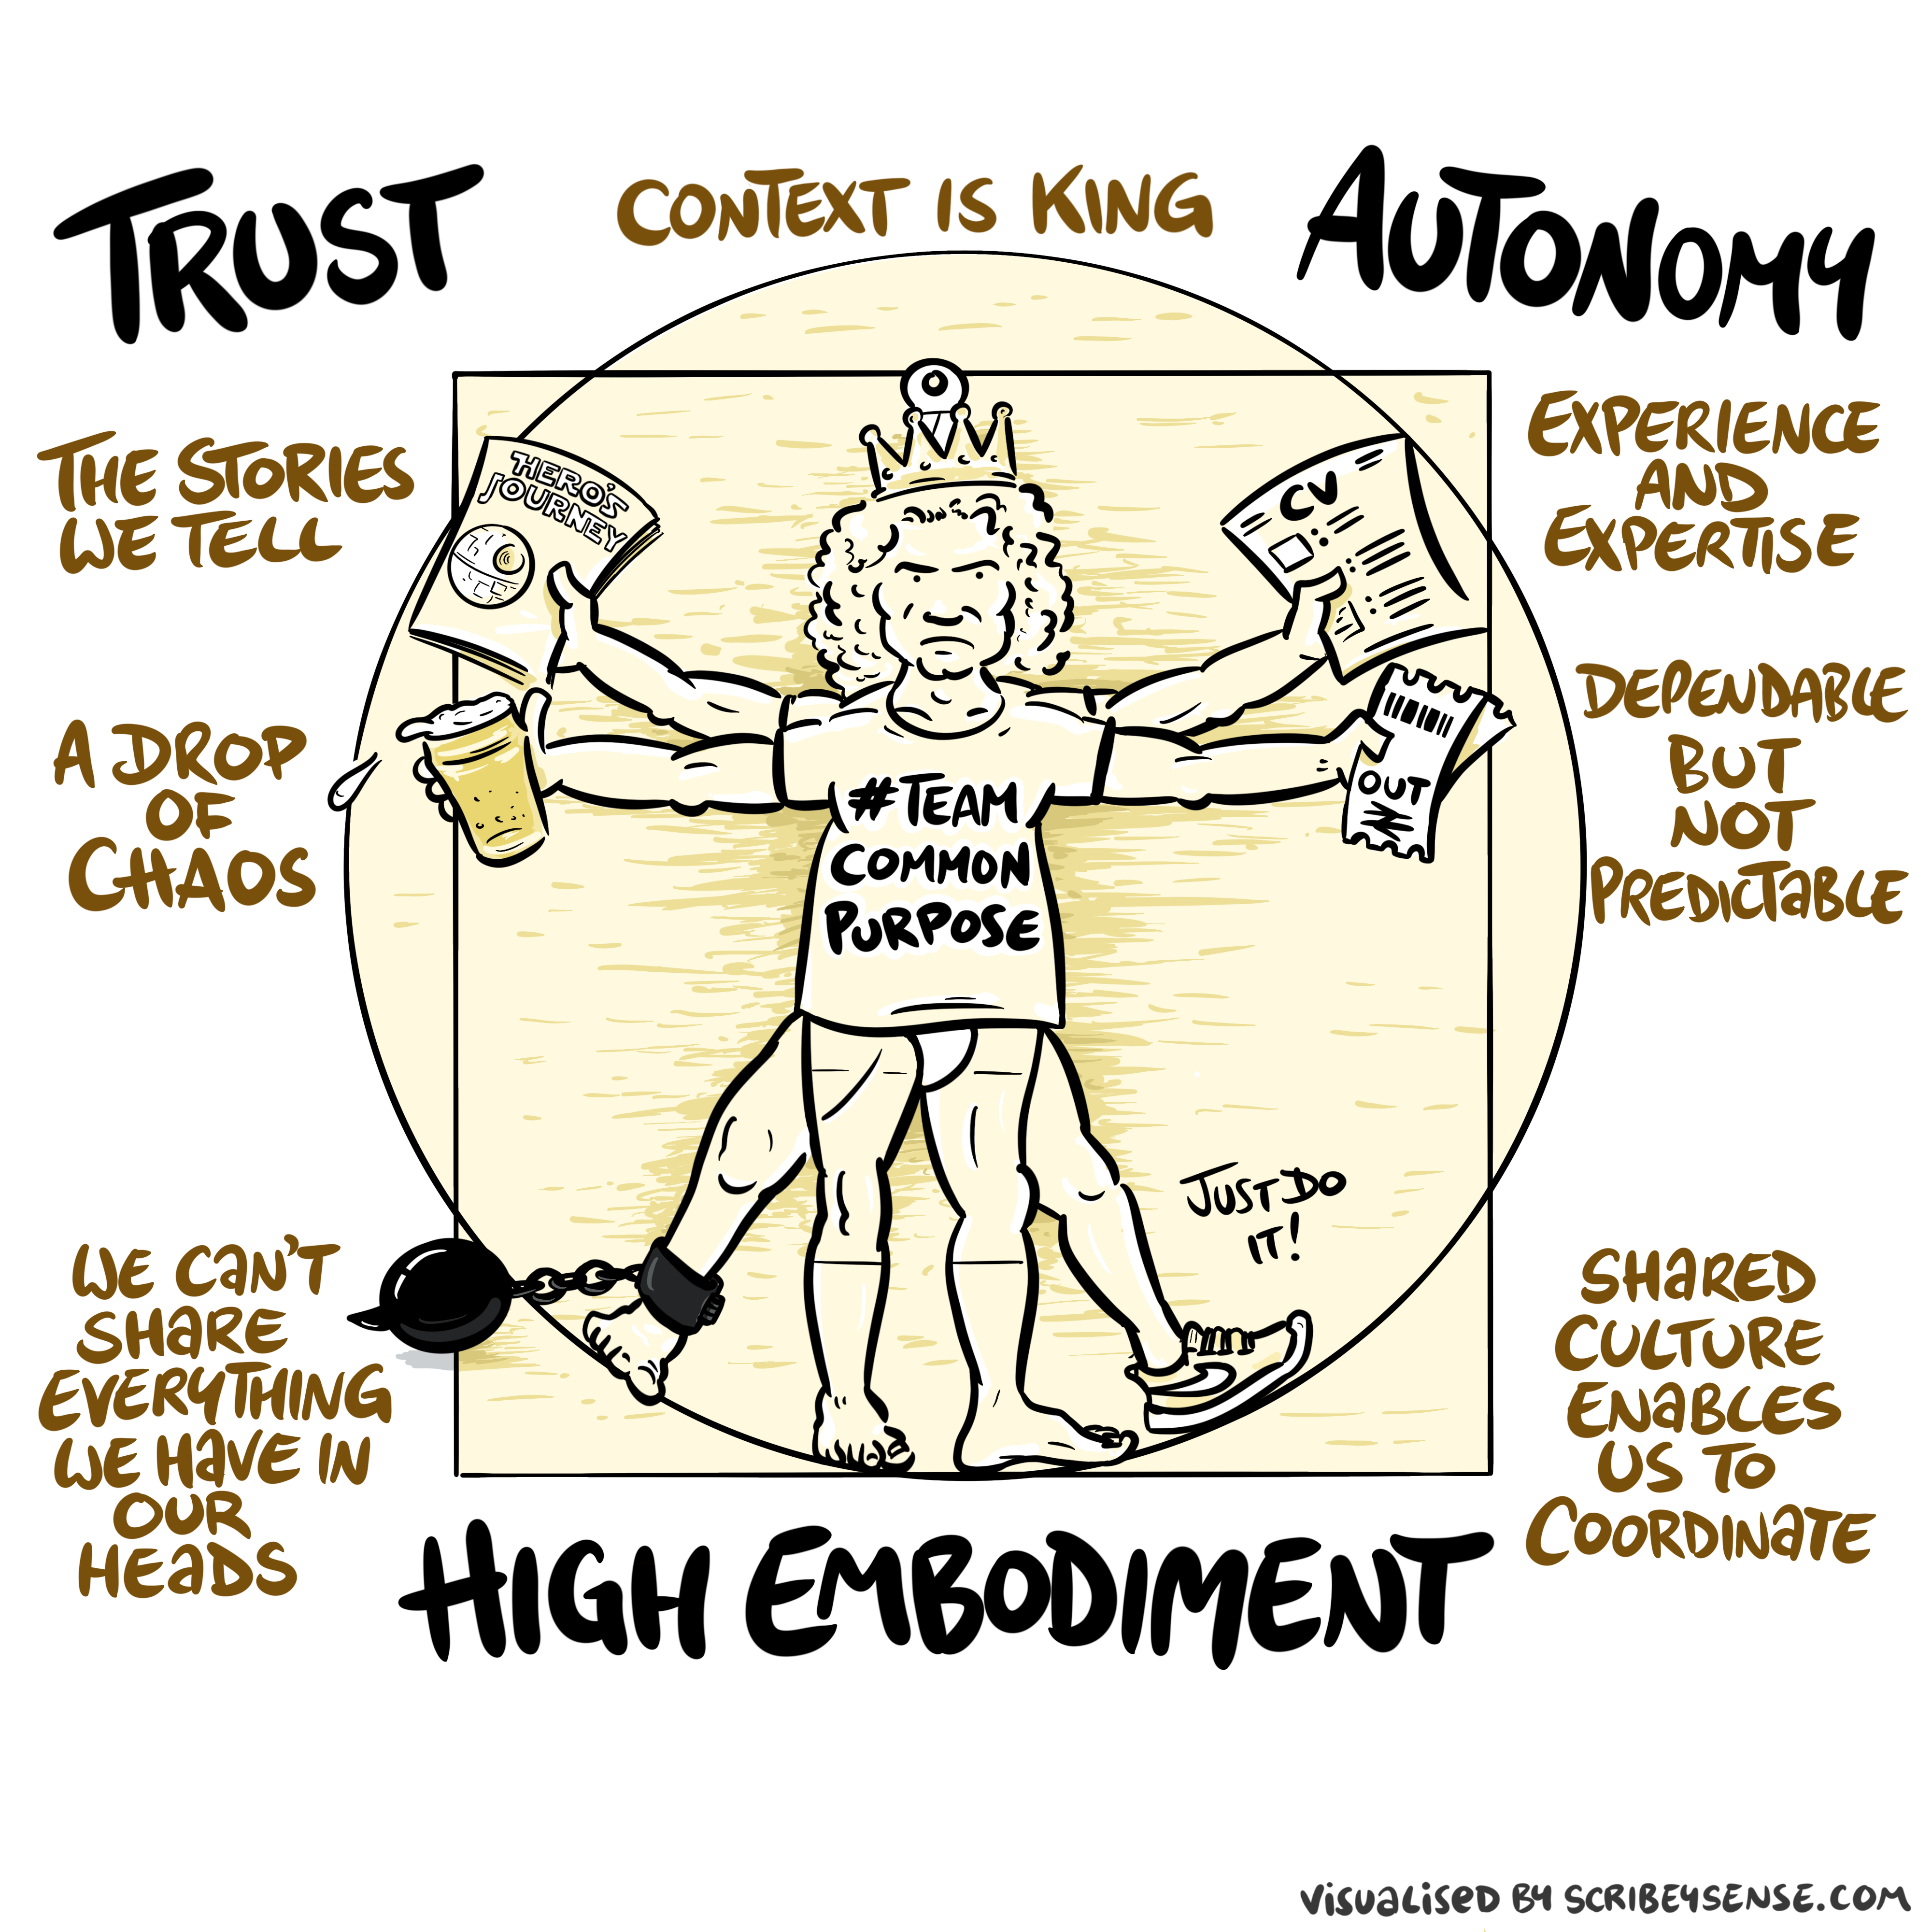

Slide 46
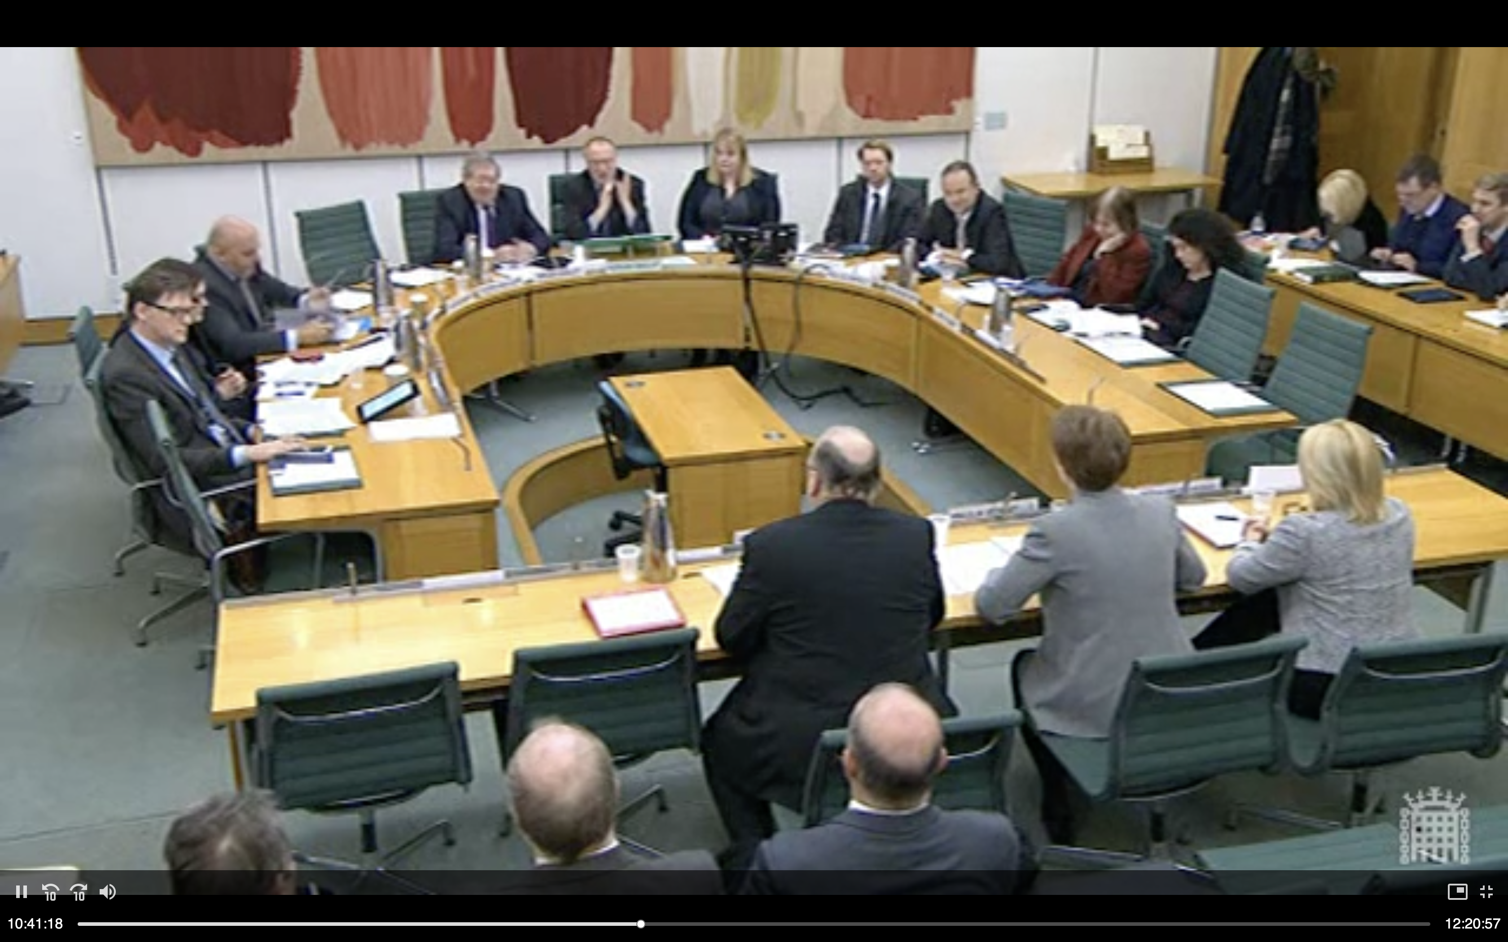
The Horizon scandal

Slide 47
The Automation Challenge
  Complex ≠ Complicated
  Speed isn’t always progress
  Augment humans, don’t replace them
    See e.g. ai@cam public dialogues: https://ai.cam.ac.uk/projects/public-dialogues.html

Slide 48
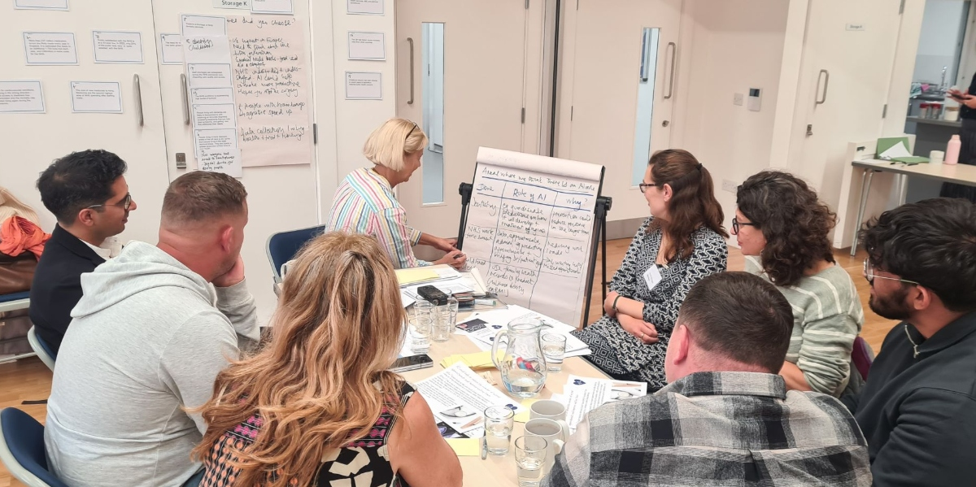
Good Process Drives Purpose

Slide 49
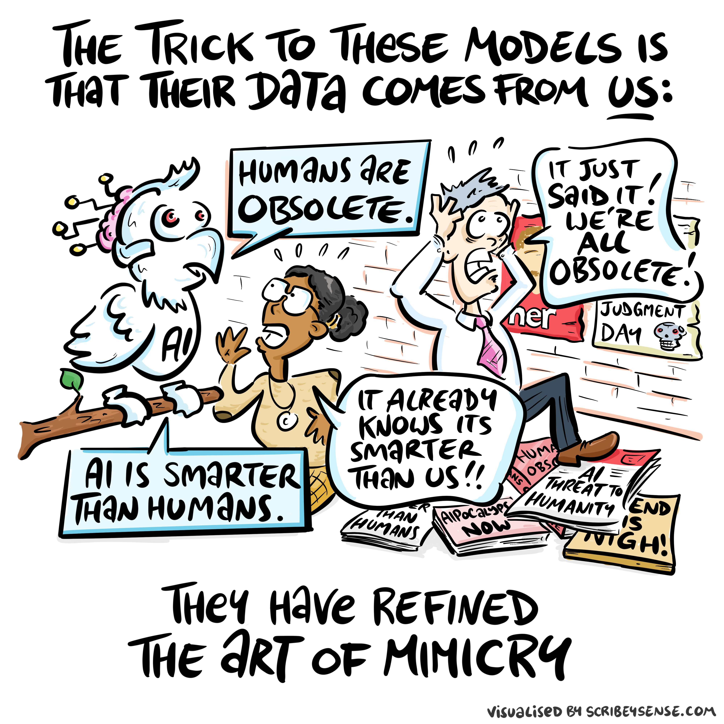
Two Types of Stochastic Parrot

Slide 50
Discussion
  Map one critical information flow in your firm
  Where are the human bottlenecks?
  Where would AI help — and where would it create risk?

Slide 51
Part 3: Recent Developments and Future Directions

Slide 52
Recent Developments
  Generative AI as a human-analogue machine (HAM)
  Progress driven by harnesses and small models, not only scale
  Model minimisation keeps the judgement layer solvent

Slide 53
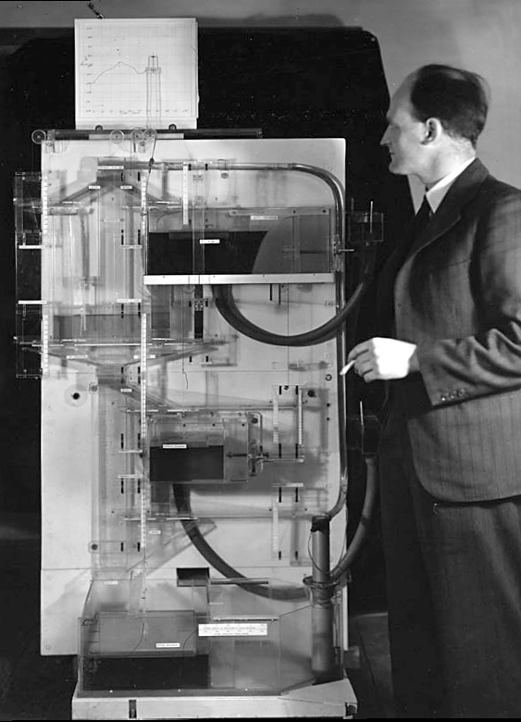
The MONIAC

Slide 54
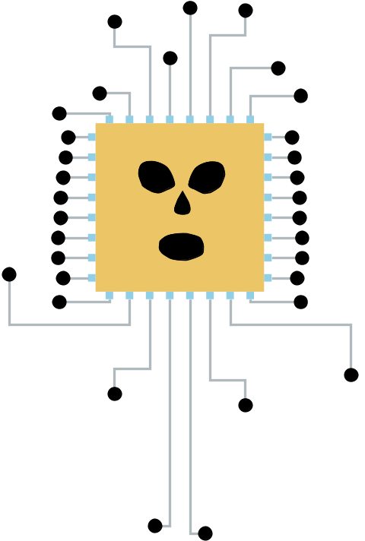
Human Analogue Machine

Slide 55
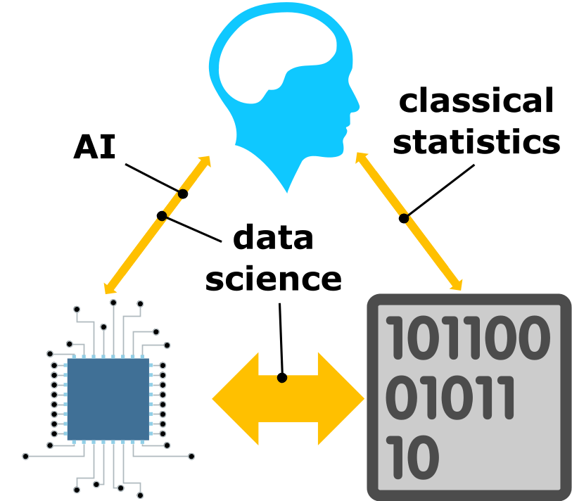
HAM

Slide 56
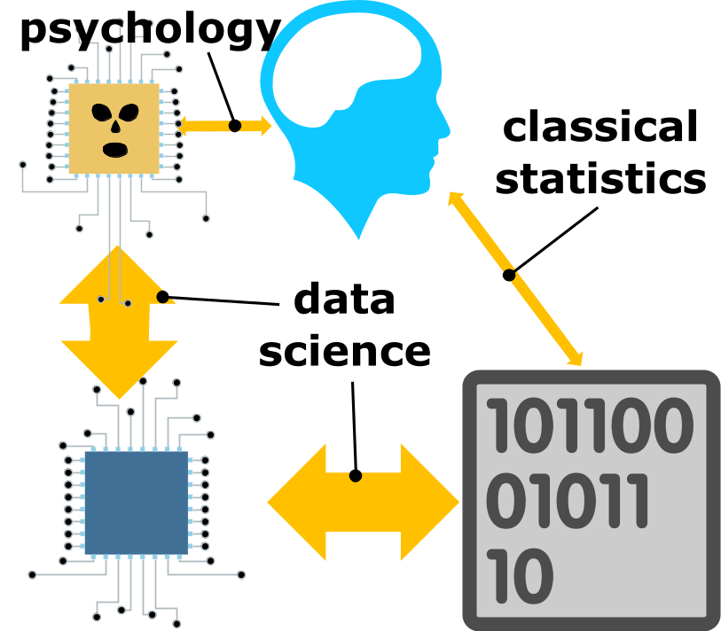
HAM

Slide 57
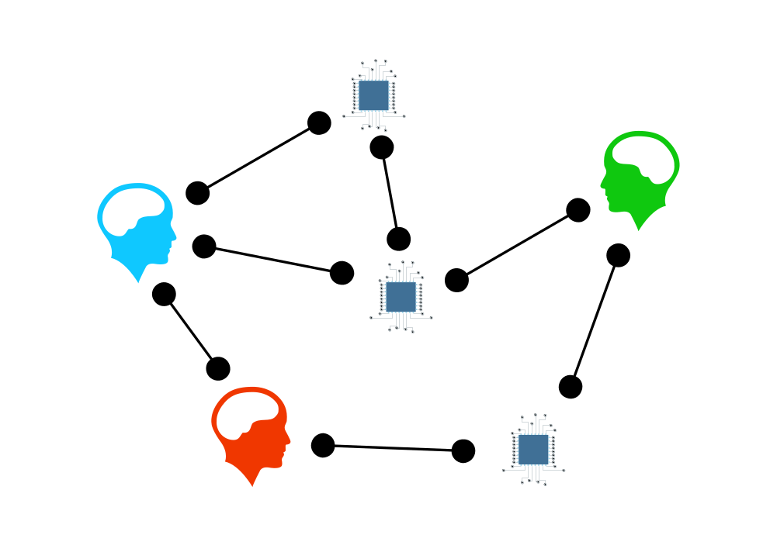
Networked Interactions

Slide 58
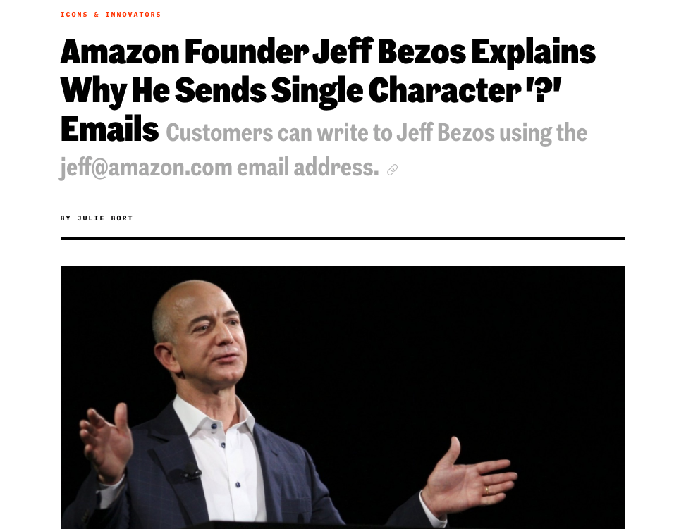
Question Mark Emails

Slide 59
Executive Sponsorship
  Direct sponsorship from the most senior executive.
    This has a cultural effect as well as a direct effect.
  Bring about through involvement
    develops understanding of capabilities of data science in exec team.

Slide 60
Pathfinder Projects
  In executive context: an important project that is interdepartmental.
  Should involve the CEO, CFO, CIO and data science team (or equivalents).
  In executive context: an important project that is interdepartmental.
  Should involve the CEO, CFO, CIO and data science team (or equivalents).

Slide 61
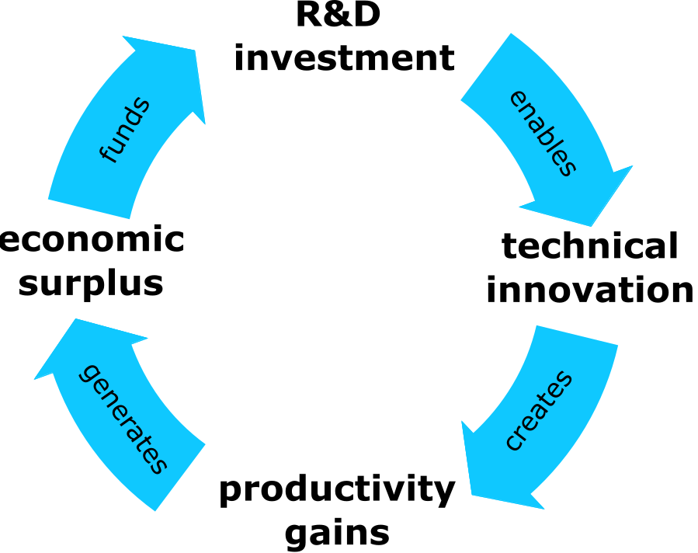
Productivity Flywheel

Slide 62
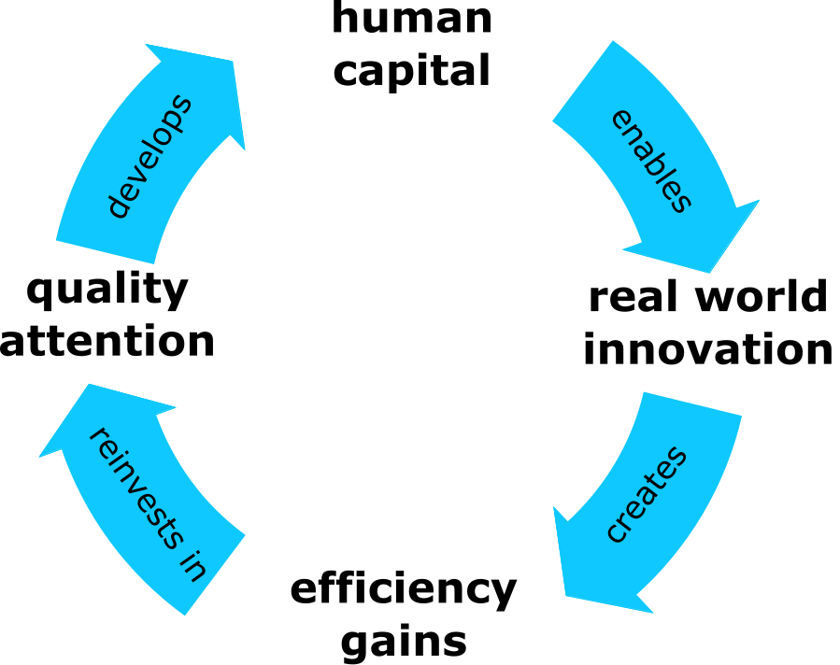
Attention Reinvestment Cycle

Slide 63
Supply Chain of Ideas
  Ideas flow from creation to application like physical supply chains
  Parallels with traditional economic supply chain management
  Particularly relevant for IT and AI solutions
  Current imbalance between supply and demand sides
    Mismatch between macroeconomic interventions and microeconomic need
  Over-Focus on solutionism
    technologies/companies
  Under-focus on real-world needs … disconnect between government and citizens … disconnect between companies and customers

Slide 64
Supply Chain of Ideas
  Need to map idea problems demand to idea supply
  Need to understand … problems (demand) … current “stock” of solutions (supply)
  Requires active management of idea resources
  Shape supply to meet demand

Slide 65
The Good Regulator theorem
  Every good regulator of a system must be a model of that system.
  The judgement layer is the regulator: it must still model what it oversees.
  If the system outruns the model, regulation fails — even if the tools still run.

Slide 66
Why we minimise models
  We minimise so that we can maintain a model.
  Smallest decision-relevant representation that still supports oversight.
  Prefer decomposable systems over opaque monoliths.

Slide 67
Against maximisation by default
  “Use the largest model” is a default, not a design.
  Capability without a modellable envelope is how debt compounds.
  Ask: what is the least system that still earns regulated trust?

Slide 68
Two ideas behind commercial progress
  The unreasonable effectiveness of orchestration
  The model minimisation principle
  Together: harnesses + small models on cognitive toil

Slide 69
The unreasonable effectiveness of orchestration
  Models emulate human behaviour
  Humans collaborate naturally, so the models to too
  A harness is a set of tools and instructions
  Can be specified by a worker with knowledge of job

Slide 70
Example: OSCAR
  OSCAR: Orchestrated Service & Citizen AI Router
  Peterborough City Council — led by Julian Patmore (Digital & Customer Access)
  A governed harness: routes requests to specialist services; staff keep the judgment

Slide 71
Local Government AI Accelerator
  ai@cam programme with local authorities
  Councils as partners from the outset
  Proof-of-concept AI for real operational needs
  Built on public dialogue about AI in local government

Slide 72
Small models on cognitive toil
  Cognitive toil: high-volume, low-novelty mental work that consumes attention.
  Prefer the least model that handles the routine class reliably.

Slide 73
Who introduces and monitors the harness
  Deploy with the people who already manage that role.
  They hold the live model of exceptions, escalation, and “good enough.”
  If they cannot introduce and monitor it, the Good Regulator condition fails.

Slide 74

AI arrives workflow by workflow

Slide 75
Do not lose the judgment
  Workflow-by-workflow only works if the judgment stays with the role.
  Automating toil without preserving exceptions makes judgment invisible, not absent.
  That invisibility is how agentic debt begins.

Slide 76
Agentic Debt
  Agentic AI could pay down technical and intellectual debt.
  But it can create agentic debt: delegation without authority/authorship
  Delegation of workflows without crisp boundaries.
  Agentic debt is about unsafe or illegible delegation.

Slide 77
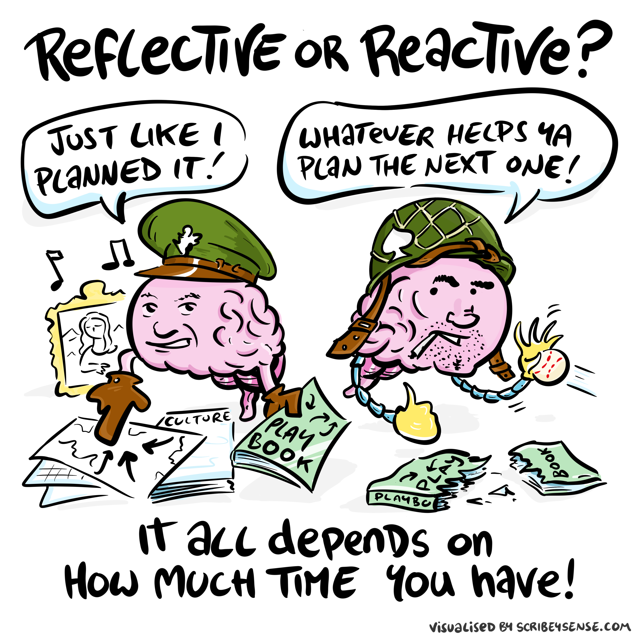

Slide 78
Strategic Priorities for Leaders
  People first, not AI first
  Prefer harnesses and small models for cognitive toil
  Let role-holders introduce and monitor those harnesses
  Watch for agentic debt as systems begin to act

Slide 79

AI cannot replace atomic human

Slide 80
The Commercial Imperative
  Human attention is the differentiator
  Adapt human capital — do not only automate tasks
  Use AI on hard problems, not only on easy ones

Slide 81
Wicked Problems

Slide 82
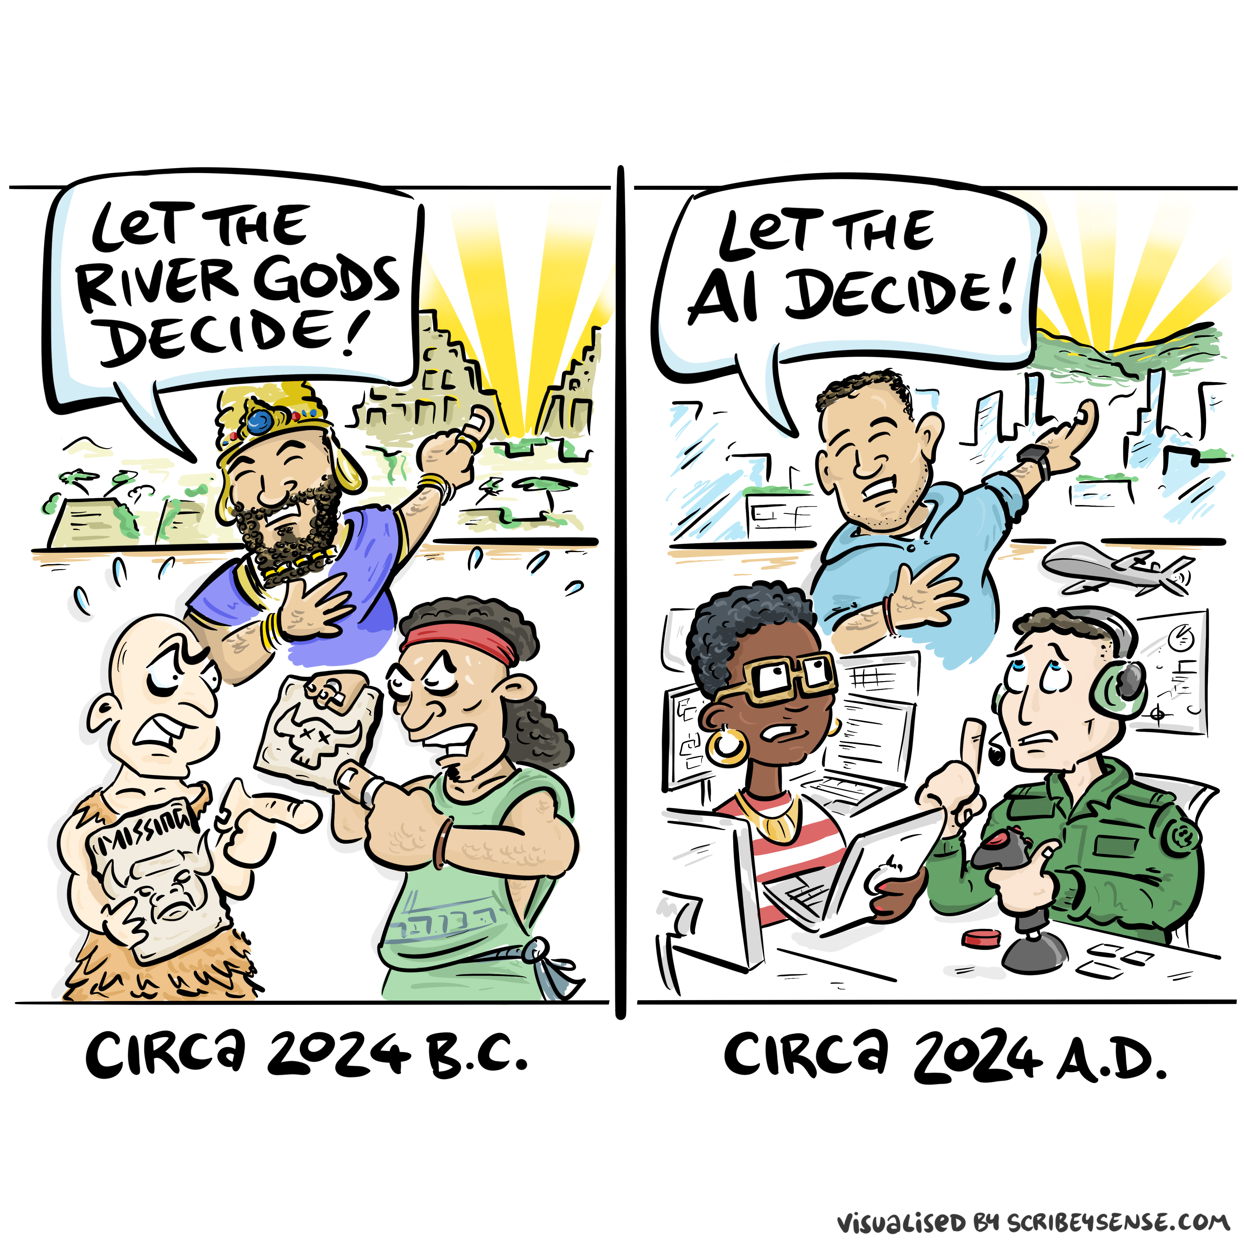

Slide 83
Takeaways
  Commercial progress is harnesses + small models on cognitive toil
  Good Regulator: minimise so judgement can still model the system
  Advantage sits in the atomic human contribution
  Agentic debt accrues when regulation runs without a live model

Slide 84
Questions
  What will you stop automating?
  What will you redesign first?
  Where should human judgment remain non-negotiable?

Slide 85
Thanks!
  company: Trent AI
  book: The Atomic Human
  twitter: @lawrennd
  The Atomic Human pages atomic human, the 13 , baby shoes 368, topography, information 34-9, 43-8, 57, 62, 104, 115-16, 127, 140, 192, 196, 199, 291, 334, 354-5, anthropomorphization (‘anthrox’) 30-31, 90-91, 93-4, 100, 132, 148, 153, 163, 216-17, 239, 276, 326, 342, trust 43, 79, 100, embodiment factor 13, 29, 35, 79, 87, 105, 197, 216-217, 249, 269, 327, 353, 363, 369, topography, information 34-9, 43-8, 57, 62, 104, 115-16, 127, 140, 192, 196, 199, 291, 334, 354-5, Horizon scandal 371, MONIAC 232-233, 266, 343, ignorance: HAMs 347, test pilot 163-8, 189, 190, 192-3, 196, 197, 200, 211, 245, human-analogue machine (HAMs) 343-347, 359-359, 365-368.
  A mistake markets make when they value software groups
  blog posts:
  Dan Andrews image of our reflective obsession with AI
  Dan Andrews image from Chapter 3
  Dan Andrews image from Chapter 3
  Balancing Reflective and Reflexive
  Racing, Fast and Slow
  Who is Stepping Up?
  Playing in People’s Backyards

Slide 86
References
Conway, M.E., n.d. How do committees invent? Datamation 14, 28–31.
Simon, H.A., 1971. Designing organizations for an information-rich world. Johns Hopkins University Press, Baltimore, MD.

