Slide 1
Machine Learning Systems Design

Slide 2
}

Slide 3
The Promise of AI
Automation forces humans to adapt, we serve.
We can only automate by systemizing and controlling environment.
AI promises to be first wave of automation that adapts to us rather than us to it.

Slide 4
That Promise …
… will remain unfulfilled with current systems design.

Slide 5
Artificial vs Natural Systems
Consider natural intelligence, or natural systems
Contrast between an artificial system and an natural system.
The key difference between the two is that artificial systems are designed whereas natural systems are evolved.

Slide 6
Natural Systems are Evolved
Survival of the fittest
?

Slide 7
Natural Systems are Evolved
Survival of the fittest
Herbet Spencer, 1864

Slide 8
Natural Systems are Evolved
Non-survival of the non-fit

Slide 9
Mistake we Make
Equate fitness for objective function.
Assume static environment and known objective.

Slide 10
Technical Consequence
Classical systems design assumes decomposability.
Data-driven systems interfere with decomponsability.

Slide 11
Bits and Atoms
The gap between the game and reality.
The need for extrapolation over interpolation.

Slide 12
Ride Allocation Prediction

Slide 13
Machine Learning Systems Design

Slide 14
Fragility of AI Systems
They are componentwise built from ML Capabilities.
Each capability is independently constructed and verified.
Pedestrian detection
Road line detection
Important for verification purposes.

Slide 15
The Software Crisis
The major cause of the software crisis is that the machines have become several orders of magnitude more powerful! To put it quite bluntly: as long as there were no machines, programming was no problem at all; when we had a few weak computers, programming became a mild problem, and now we have gigantic computers, programming has become an equally gigantic problem.
Edsger Dijkstra (1930-2002), The Humble Programmer

Slide 16
The Data Crisis
The major cause of the data crisis is that machines have become more interconnected than ever before. Data access is therefore cheap, but data quality is often poor. What we need is cheap high-quality data. That implies that we develop processes for improving and verifying data quality that are efficient.
There would seem to be two ways for improving efficiency. Firstly, we should not duplicate work. Secondly, where possible we should automate work.
Me

Slide 17
Computer Science Paradigm Shift
Turing machine:
Code and data integrated
Today:
Code and data separated for security

Slide 18
Computer Science Paradigm Shift
Machine learning:
Software is data
Machine learning is a high level breach of the software/data separation.

Slide 19
Peppercorns
A new name for system failures which aren’t bugs.
Difference between finding a fly in your soup vs a peppercorn in your soup.

Slide 20

Peppercorns

Slide 21
Emulation

Slide 22
Emulation

Slide 23
Emulation

Slide 24
Emulation

Slide 25
Emulation

Slide 26
Emulation

Slide 27
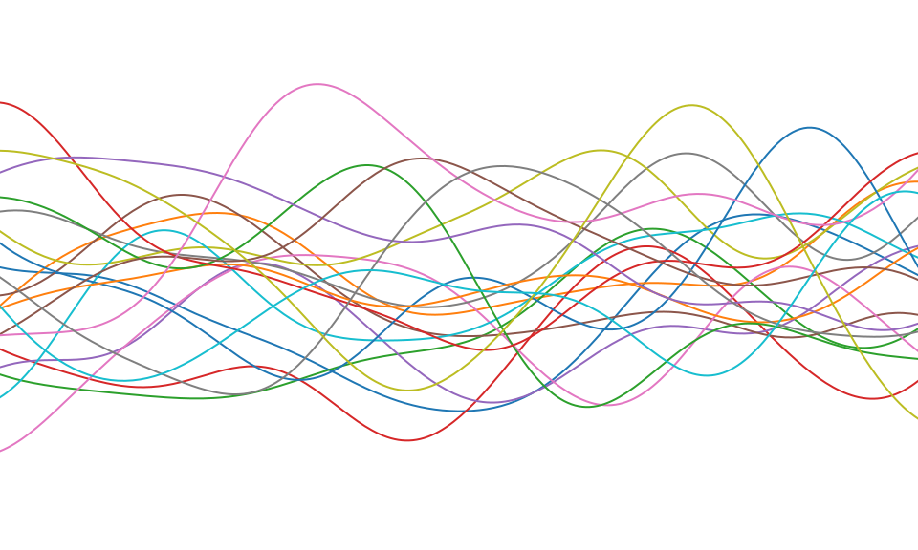

Slide 28
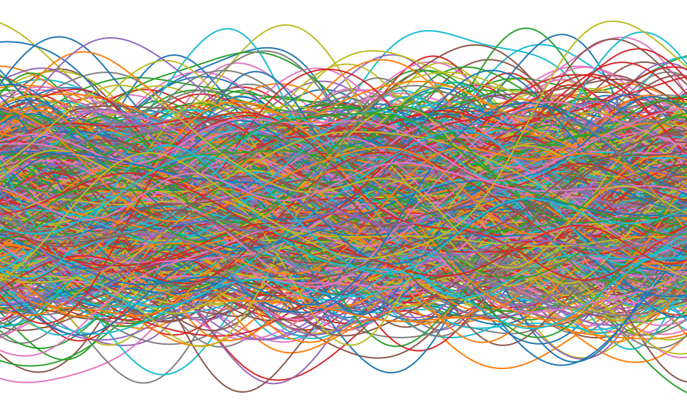

Slide 29
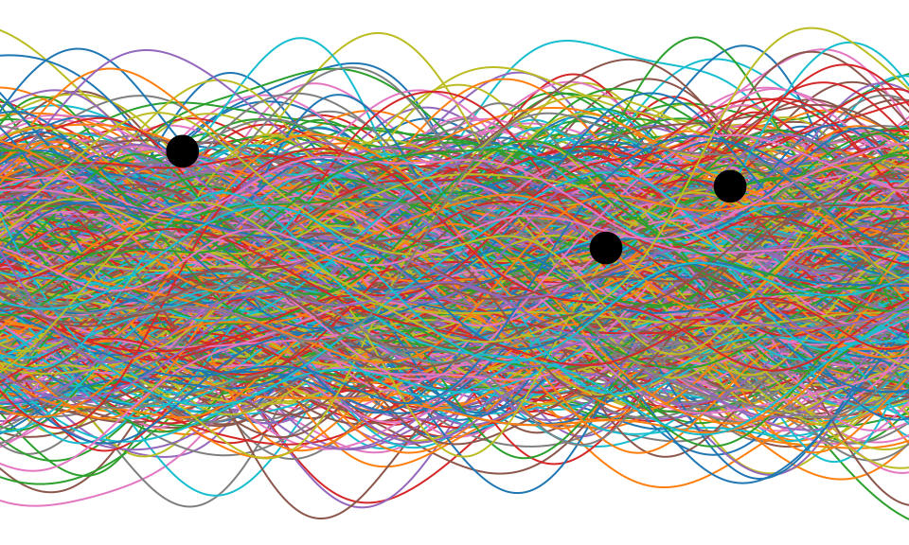

Slide 30
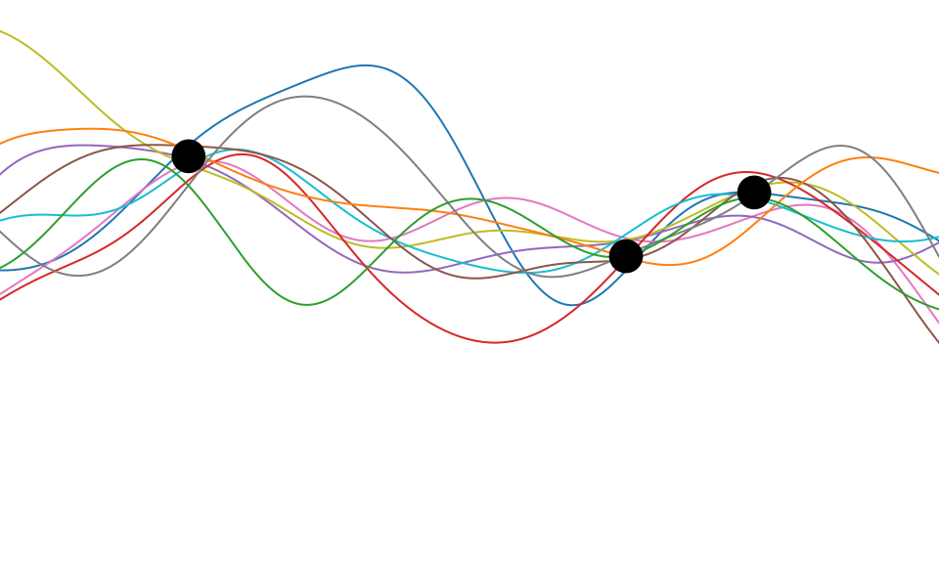

Slide 31
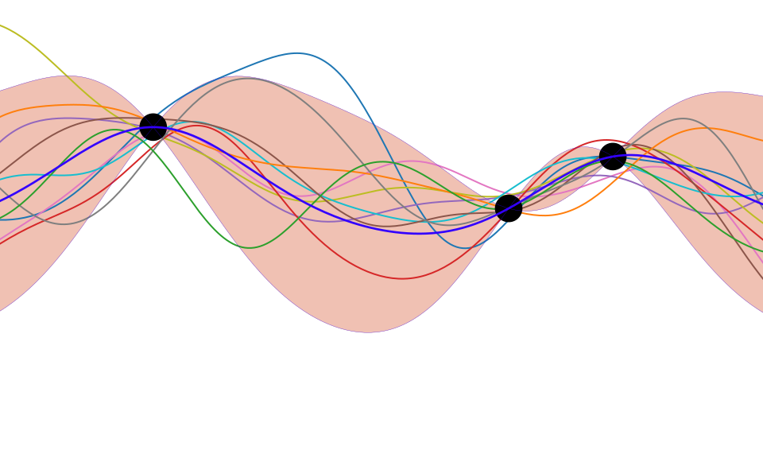

Slide 32
Deep Emulation

Slide 33
Deep Emulation

Slide 34
Deep Emulation

Slide 35
Emulation

Slide 36
Conclusion
AI is fundamentally ML System Design
We are not ready to deploy automation in uncontrolled environments.
Until we can monitoring and update will be key.

Slide 37
Thanks!
twitter: @lawrennd
podcast: The Talking Machines
newspaper: Guardian Profile Page
Blog post on Natural and Artificial Intelligence
Blog post on Decision Making and Diversity
Blog post on Natural vs Artifical Intelligence

Slide 38
References

