Slide 1
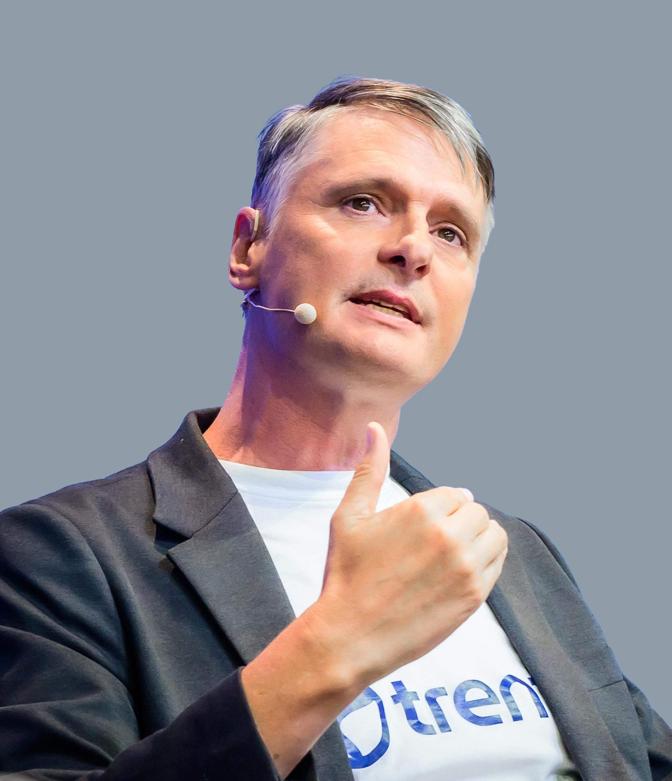
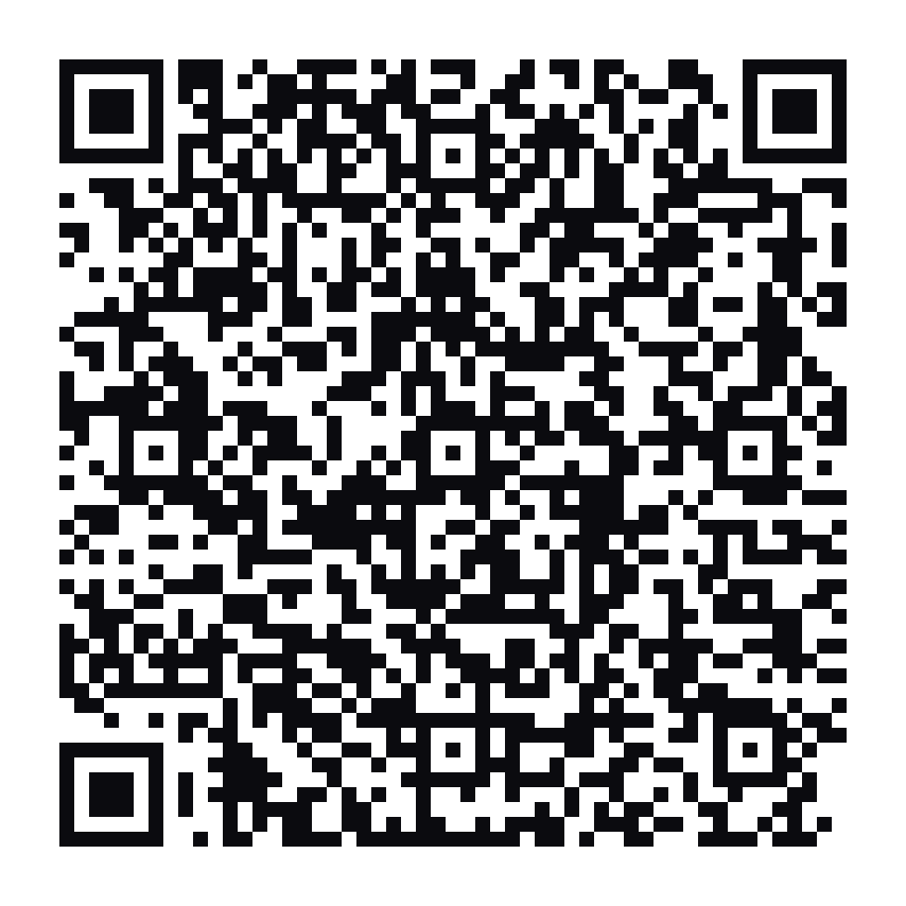
Viable Systems,
Judgment, & AI Safety
Neil Lawrence
Co-Founder & Chief Scientist
Trent AI

Slide 2
AI safety – an accountability problem
“Accounting is the numbers. Accountability is the human authority and the judgment.

Slide 3
Agentic debt
“devolving authority without judgment undermines accountability creates agentic debt

Slide 4
Augmented engineers
“delegation requires understanding, augmentation supplies understanding

Slide 5
Thank You
Neil Lawrence
Co-Founder & Chief Scientist, Trent AI

