Slide 1
Innovation to Deployment
Machine Learning Systems Design

Slide 2
Fellowship Vision
Develop the Field of ML Systems Design
Steer the International Community
Be a beacon for UK AI Research
Be an advocate for UK AI Research
An inclusive programme
Provide tools and exemplar problems
Educate students, RSDEs and PDRAs in modern ML design

Slide 3
How?
Bridge between Academia, Industry, Public Sector & 3rd Sector
Influence beyond the fellowship
Leverage the Alan Turing Institute

Slide 4
Partners
Element AI
Data Science Africa
OpenML
Prof Sylvie Delacroix

Slide 5
Advisors
User Group
Fusion Group, CitizenMe, Renault F1, HDR UK
Advisors
Chris Holmes (ATI Programme Director for Health and Medical Sciences)
Mark Girolami (ATI Programme Director for Data-Centric Engineering)

Slide 6
Lay Description
It used to be true that computers only did what we programmed them to do, but today AI systems are learning from our data.
This introduces new problems in how these systems respond to their environment.
We need to better monitor how data is influencing decision-making and take corrective action as required.
This fellowship addresses that challenge

Slide 7
Technical Consequence
Classical systems design assumes decomposability
Data-driven systems are not decomposable

Slide 8


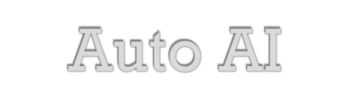

Technical Consequence
Bayesian Optimization
$$\text{Auto} \text{ML}$$
$$→$$
$$\text{Auto} \text{AI}$$
$$\text{Bayesian} \text{System} \text{Optimization}$$

Slide 9
Applications
traffic
maps
wait
pickup status
driver availability
driver locations
current journeys
journey route
rider destinations
available drivers
journey demand
rider-driver allocations

Slide 10
Emulation
Real
World
ML Model
Optimization
Simulator
Simulator
Simulator
OR Model
Statistical Emulators

Slide 11


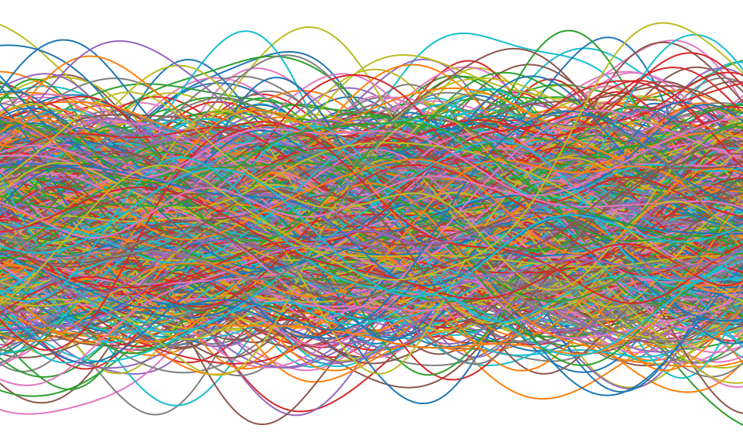
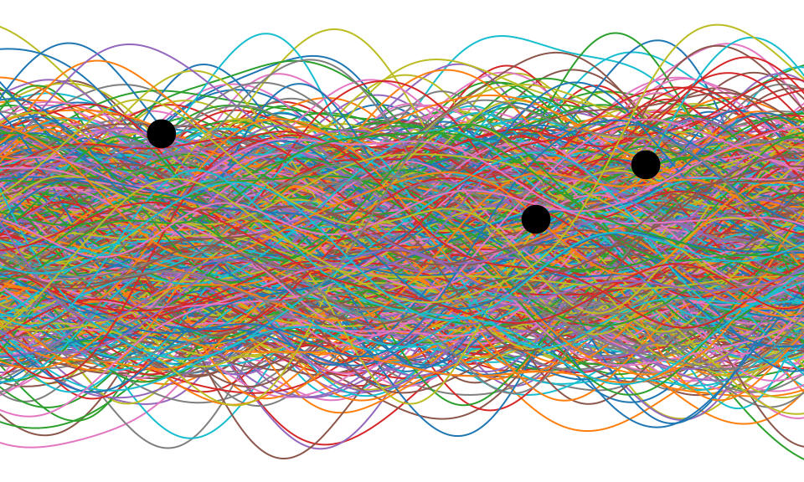
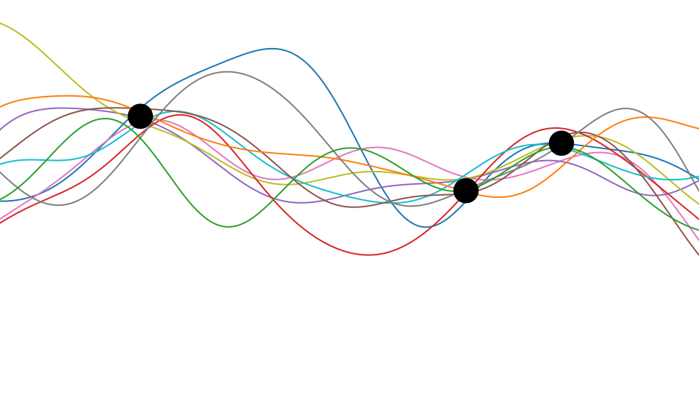
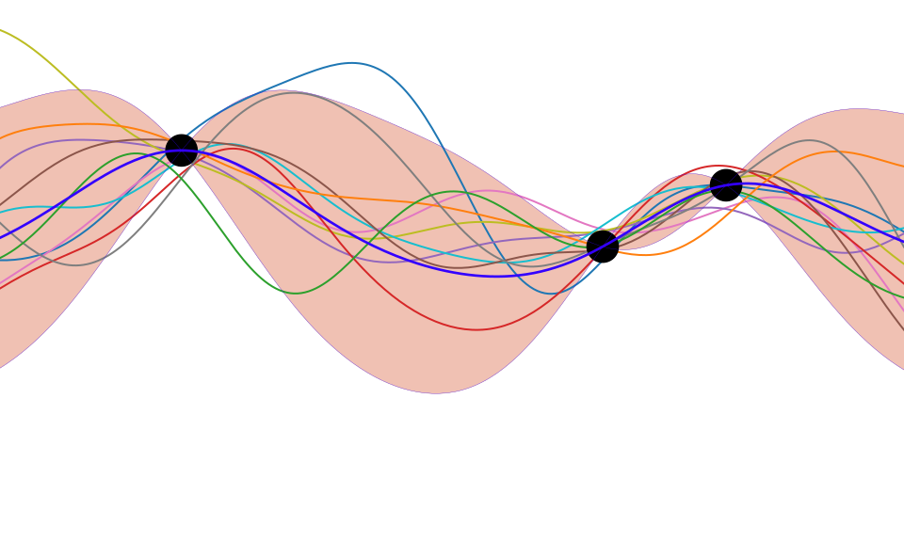

Slide 12
Deep Emulation
driver
availability
customer
demand
wait
predication
total
demand

Slide 13

Stochastic Process Composition
$$y=f_{4}\left(f_{3}\left(f_{2}\left(f_{1}\left(x\right)\right)\right)\right)$$

Slide 14
Bayesian Optimisation
Bayesian Systems Optimisation
Acquisition function influenced by component, upstream and downstream objectives.
Acquisition function influenced by
each component’s objectives.
customer
demand

Slide 15
Thanks!
podcast: The Talking Machines
newspaper: Guardian Profile Page
advocacy: UK AI Council, Royal Society ML Working Group

