Slide 1
Building a custom Risc-V open source FPGA SOC

Slide 2
Introduction
Risc-V
System on a Chip
Open source hardware
Open source tools
VexRiscv, SaxonSoc and Blackice Mx

Slide 3
Risc-V
Open source Instruction Set Architecture (ISA)
Full-featured mature ISA
Supported by Linux
Supported by real-time Operating Systems
  e.g. Zephyr
Increasing industry support
GCC and other tools support
Rival to ARM

Slide 4
System-on-a-Chip (SOC)
CPU plus peripherals on one chip
There is one in your phone
There is one in a Raspberry Pi
Microcontrollers are simple SOCs

Slide 5
Risc-V implementations
Sifive
Picorv32
Icicle
VexRiscv
Lots of others
  see https://github.com/riscv/riscv-cores-list

Slide 6
Why build a custom FPGA SOC
Open source all the way down
Exactly those peripherals that you want
As many of each peripheral as you want
Hardware implementations - no bit-banging
Simpler software device drivers
Much faster peripherals like LED panels
Complete control

Slide 7
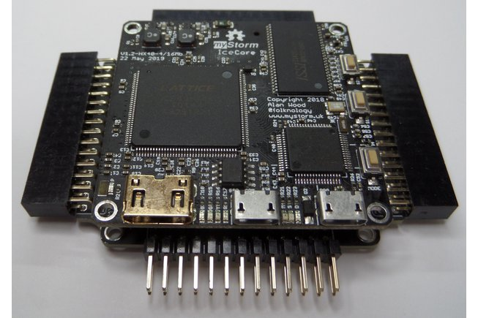
My choices
VexRiscv
SaxonSoc
Blackice Mx board

Slide 8
Why VexRiscv
Fastest 32-bit FPGA implementation
Most configurable implementation
Full featured, e.g. supervisor mode and MMU
Will run Linux
Written in SpinalHDL

Slide 9
Why Blackice Mx
Open source Ice40 board with SDRAM
Scalable and modular with carrier boards
Compatible with Linux-capable BlackEdge
HDMI support
Lots of I/O
.. but also runs on many other boards
  like TinyFPGA BX, iCEBreaker, Fomu, etc.

Slide 10
Why SaxonSoc
Same author as VexRiscv (Charles Papon)
Written in SpinalHDL
Supports many peripherals and memory types
Will run Linux
Banana Memory Bus and APB3 peripheral bus
Concise description of custom SOCs
Generation of BSPs
Experience from Murax and Briey SOCs
SaxonSoc is currently experimental

Slide 11
SpinalHDL
Uses Scala language
  designed to support Domain Specific Languages
Runs in Java VM
Much nicer semantics than Verilog
Much less error-prone than Verilog
Real software-engineering tool
Rivals: Chisel and Python Migen with Litex

Slide 12
Installation on Linux
Install Icestorm
Install dfu & latest firmware for Blackice board
Install SpinalTemplateSbt
Install SaxonSoc Bmb branch
Build SOC with make file
Can also use IDEs
  e.g. IntelliJ and Visual Studio

Slide 13
Open Source toolchain
SpinalHDL generates Verilog
Yosys synthesises netlist
Nextpnr place and route for specific FPGA chip
Icepack produces ice40 bitstream

Slide 14
SaxonSoc code extract
//Add components
val ramA = BmbOnChipRamGenerator(0x80000000l)
val uartA = Apb3UartGenerator(0x10000)
val gpioA = Apb3GpioGenerator(0x00000)
val spiA = Apb3SpiMasterGenerator(0x20000)
val spiB = Apb3SpiMasterGenerator(0x30000)
// Configure components
ramA.size.load(8 KiB)
ramA.hexInit.load("software/standalone/readSdcard/build/readSdcard.hex")
uartA.parameter load UartCtrlMemoryMappedConfig(
baudrate = 115200,
txFifoDepth = 32,
rxFifoDepth = 32
)
spiA.parameter load SpiMasterCtrlMemoryMappedConfig(
SpiMasterCtrlGenerics(
dataWidth = 8,
timerWidth = 32,
ssWidth = 1
)
)

Slide 15
SaxonSoc variants for Blackice Mx
BlackiceMxSocMinimal - blinkAndEcho
BlackiceMxSocSdram - writeFlash utility
BlackiceMxXip - blinkAndEcho from flash
BlackiceMxZephyr - runs Zephyr OS
BlackiceMxArduino - supports Arduino IDE
  based on f32c/arduino
Produce your own

Slide 16
Demo of Zephyr OS
Philosophers sample

Slide 17
Questions
?

