Slide 1

Images photography studio: Project design
100%
By:
Ryan Lawson, Christie Sutton, Austin bowman, and trey watson

Slide 2
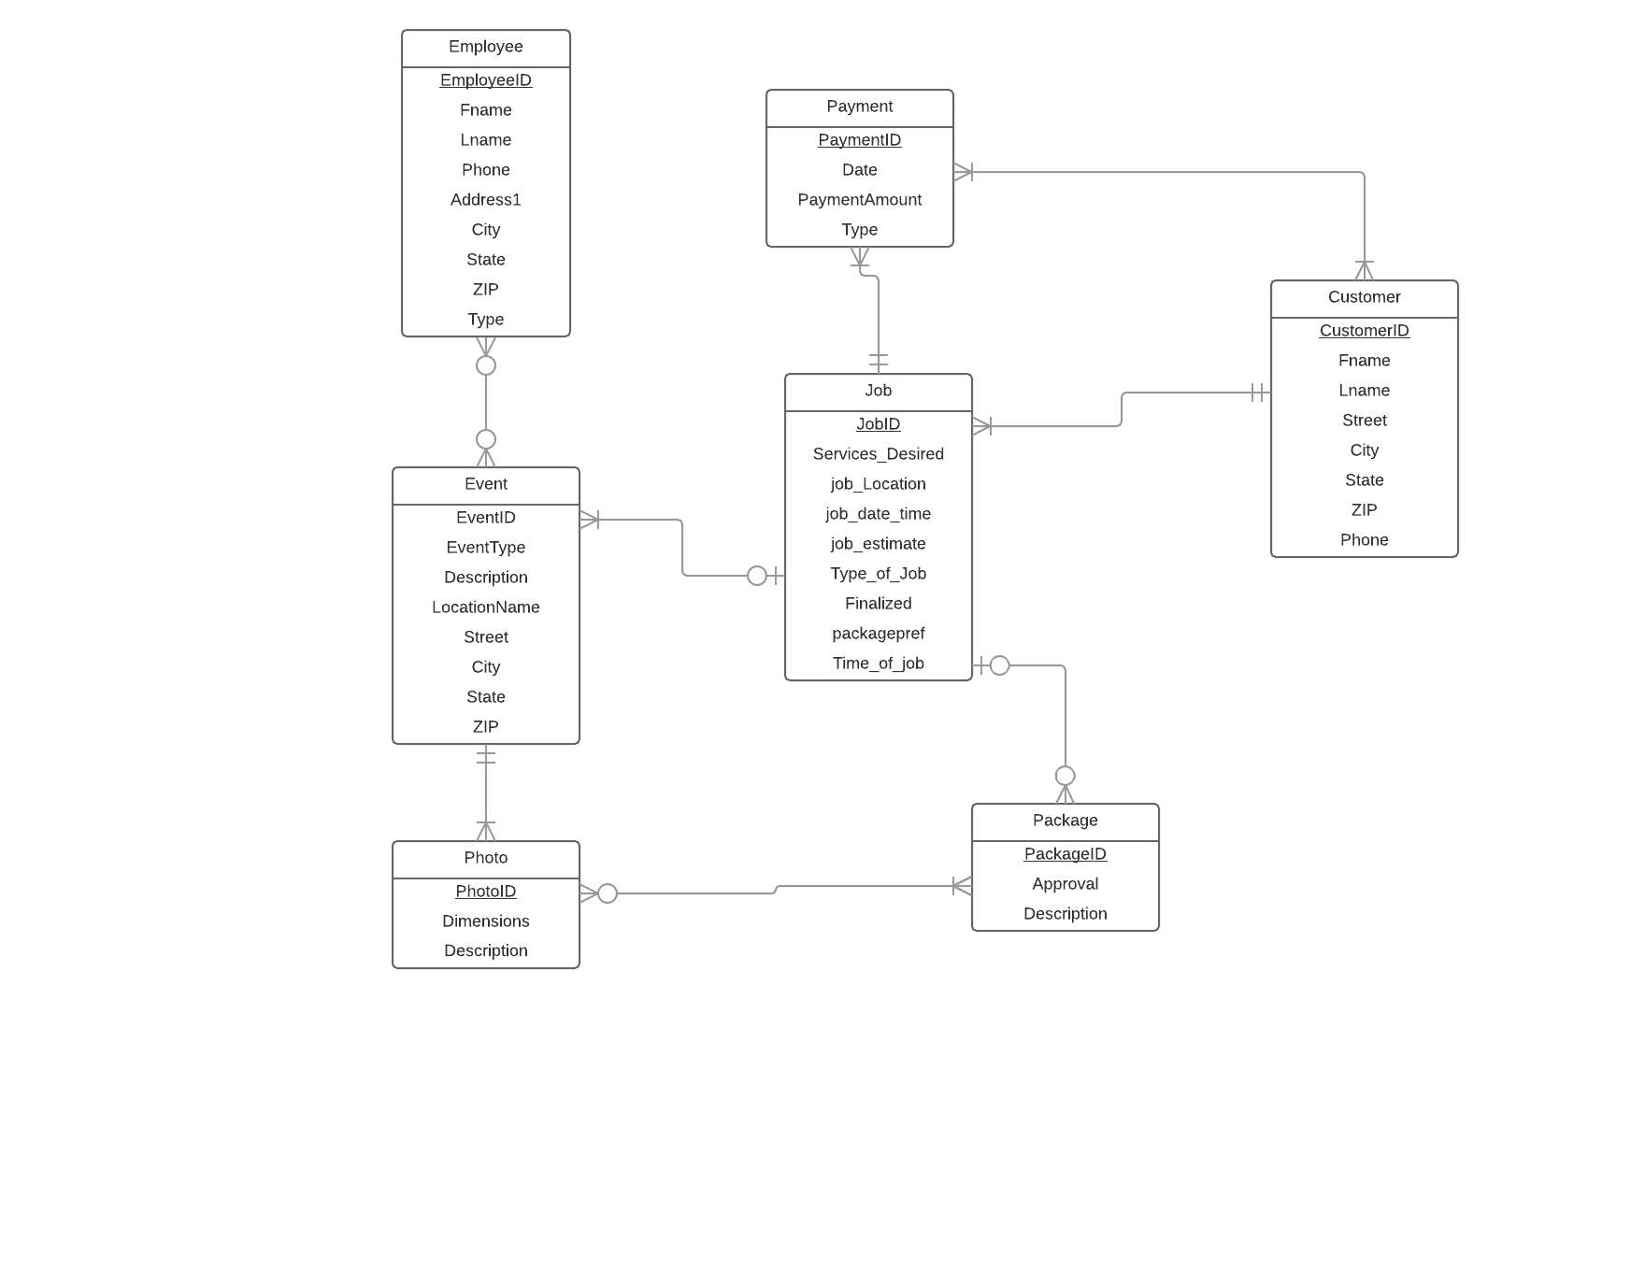
Database Design
Required Changes:
The greatest changes occurred in the connection of the tables to the job table.
Also, we originally had a few other tables that we combined into others to make it more efficient in design

Slide 3
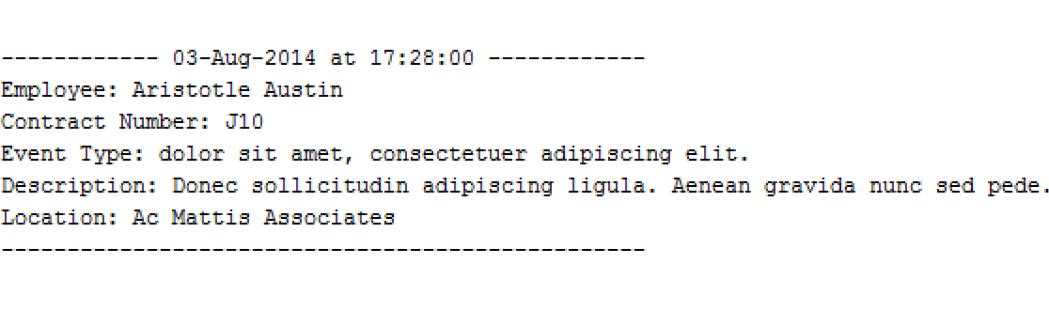
Reporting Option 1: Photography schedule
How it is useful to customers:
It would allow the customer to view what their photographers schedule is like or for the photographer they have in mind.
Also, it lets the customer see the type of events and locations the photographer is used.

Slide 4
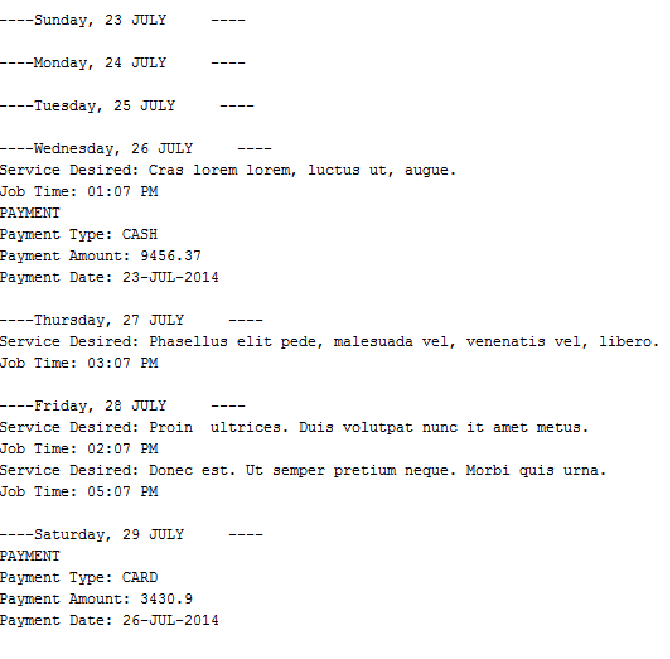
Reporting Option 2: weekly schedule
How it is useful to customers:
The weekly schedule is useful for customers in that it shows the jobs taking place for a specific week and allows them to view if the day or week needed is available and if any other jobs may be occurring that may interfere with what they are planning

Slide 5
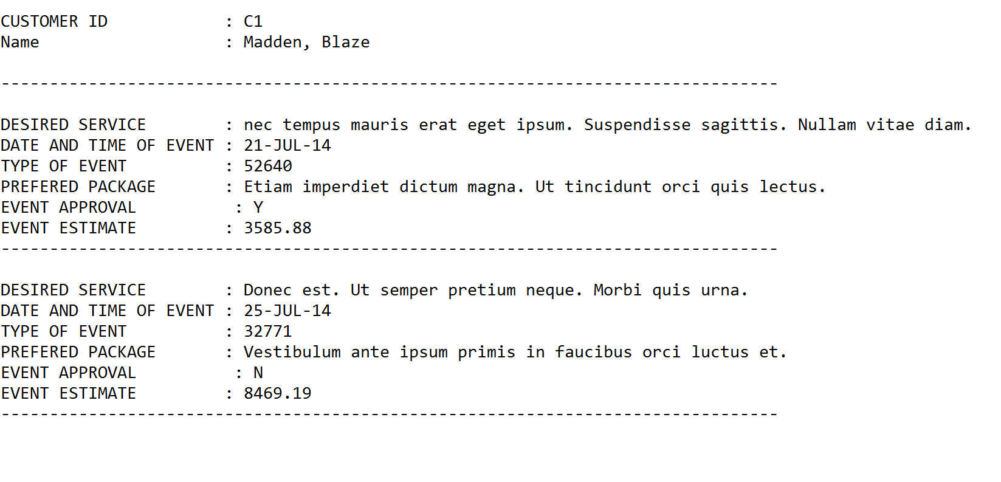
Reporting Option 3: Client report
How it is useful to customers:
This will bring up all jobs with Image Photography Studios that they have or have ever had allowing them to see a detail summary of each job requested.

Slide 6
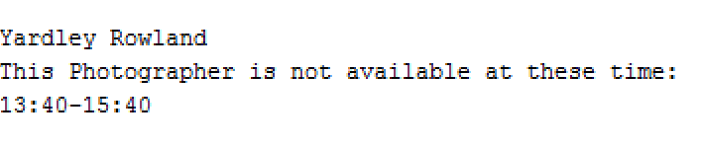
Reporting Option 4: pat photographer availability Transaction
How it is useful to customers:
It shows the hours the customers photographer of choice is not available for the day they have selected.

Slide 7
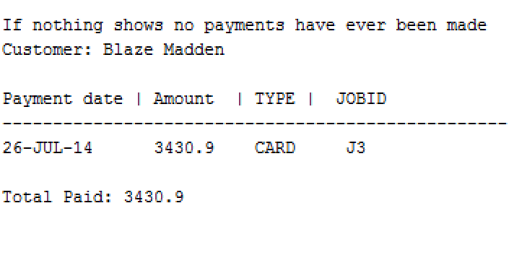
Reporting Option 5: customer balance report
How it is useful to customers:
It allows the customer to see any and all payments that they have ever made.
When it was made
How much was paid and the payment method used
And for which job the payment was made.

Slide 8
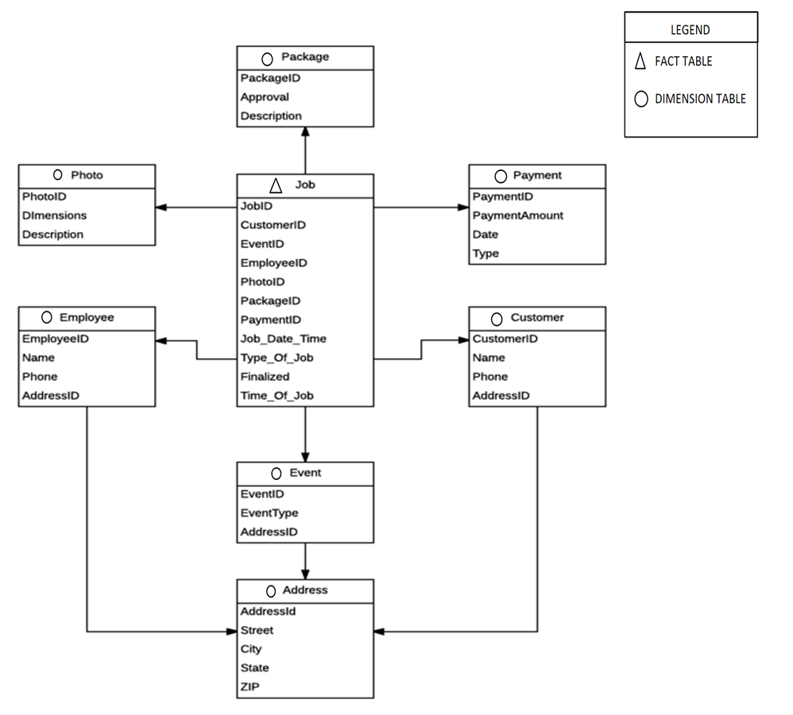
Data Warehouse design Snowflake Schema
ETL Process (Extract-Transform-Load)
Consist of a series of insert-select statements. The easiest being the Package, photo, and the payment tables because of the limited connections. While the address table would require a 3 union join using the ID’s of the Employee, Event, and Customer tables to connect the address table to the jobs table.
Update Needs
It would be best to update every 24 to 48 hours preferably.

Slide 9
nOsql
NoSQL, specifically MongoDB, would not be a good fit for Image Photography Studio’s. One reason for this is that NoSQL permits any data to be saved anywhere at any time without verification, while an SQL database is more secure because it implements data integrity rules. This would limit the access to the company’s data without verifying who is trying to change or manipulate the data. A second reason being that NoSQL is a newer technology, where an SQL database offers plenty of support, expertise, and tools. NoSQL is more exciting because it is new, but SQL would be better for a company that is just starting out because they offer so much support and tools, when running into any issues that could arise. The final reason would be that NoSQL offers less flexibility when querying data verses an SQL database that allows the use of joins, which provides greater flexibility when manipulating data.
etl process plan
In the future if Image Photography Studio is moving to the NoSQL, MongoDB, then the plan would be to export all the desired queries to the required format. Then to import them into the desired collections within the NoSQL database. This completes the ETL because MongoDB is already partially set up for a data warehouse.
Comparisons
The assumption we made with the ETL of both the SQL data warehouse and the NoSQL is that SQL is better to use in the beginning, because converting it to the NoSQL verses starting from scratch is easier. NoSQL is a complex system and requires a better understanding of your documents to query data, while the SQL database is more in depth and simpler by design. Image Photography Studio’s current amount of data being produced is not large enough to need NoSQL therefore it would create unneeded expenses for the company at this time.

Slide 10

Conclusion
2%
Any questions?

