Slide 1
Optical Character Recognition for Japanese Syllabic Writing Systems
Team members:
Law Smith, Kimberly Toy

Slide 2
Topic/Question
How to recognize Japanese characters (kana) from an input image?
[TODO: Explain goals, use-cases]
Members: Law Smith, Kim Toy

Slide 3
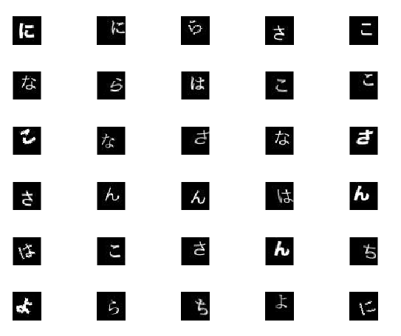
Approach/Method
Train a Neural Net on a small subset of kana
「こ」,「ん」,「に」,「ち」,「は」(konnichiwa->hello)
「さ」、「よ」、「な」、「ら」(sayonara -> goodbye)
Train NN on different versions of kana
Various fonts
Rotation, Skew, and Translation
Members: Law Smith, Kim Toy

Slide 4
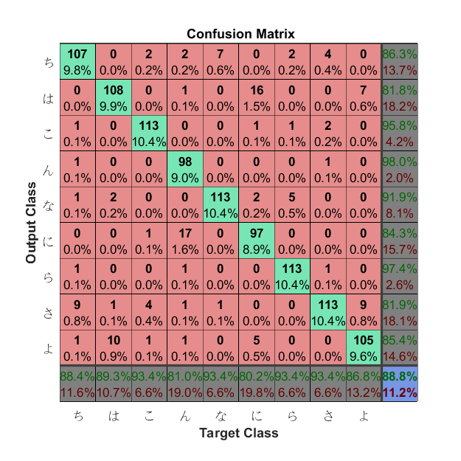
Results
Tested on ~4500 30x30 images
Potential source of errors:
Similarity of kana:
「ち」vs「ら」
「こ」vs「に」
Not enough detail in test images
Members: Law Smith, Kim Toy

Slide 5
Conclusion/Further plan
[TODO]
Members: Law Smith, Kim Toy

