Slide 1



Fast Neutron Scatter Contribution to RSM Response
NENG 685 – Fall 2018
CPT Lawton Drake
Air Force Institute of Technology
7 December 2018

Slide 2
Outline
Introduction
Problem Description
Description of Work
Results
Conclusions
References

Slide 3
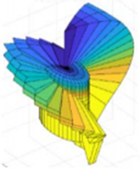
Introduction
The Rotating Scatter Mask, is designed to determine the direction of a radiation source via a 4π field of view.
The focus of the experiment is to calculate the amount of fast neutrons scattered by the mask surface and collected by the EJ-309 detector.
The results collect fast neutrons by the
RSM through three methods, neutrons
directly striking the detector, front scattered
and back scattered neutrons.
Notes:
Explain difference between direct, front scatter and back scatter
Direct – neutrons that go straight from the source to the detector
Front Scatter – neutrons that were collected on the “front half” of the via collision with the RSM
Back Scatter – neutrons that pass through the detector and collide on the “far side” before hitting the detector

Slide 4
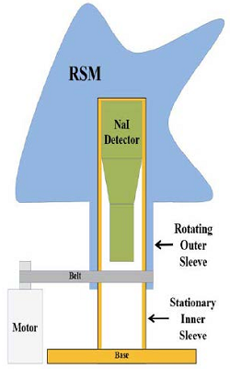
Problem Description
The graphic at the right, shows the RSM as it fits over the current Sodium-Iodine detector and the general detector layout.
The RSM helps to “guide” neutrons into the detector, which was replaced with the EJ-309 detector.
EJ-309
Notes:
The switch from NaI to EJ-309 was a simple fix in MCNP, just a find NaI and replace
The “guide” means that via collisions the neutrons will be detected

Slide 5
Problem Description
The problem of RSM geometry and calculating neutron flux across surfaces.
Issues:
Geometry of fin
and wall
Notes:
The energy cut code: was designed to calculate the neutrons that went directly into the detector and did not scatter at all
w_file.write('ELPT:n j j 13.9999 9j\n') # Kill neutrons with E < 14 MeV inside the sleeve
Weight Windows: there are 4, this is due to having to divide the detector geometry in half so that I could calculate low energy and high energy neutrons on both the front of the detector and the back of the detector
w_file.write('WWN1:n 0 0 1 0 -1 0 0 0 0 0 0 0 0 \n') # Weight window for front scattered
Surface Tally: this tally calculates total flux seen by the detector across all three surfaces (cylinder)
w_file.write('f2:n (551.1 551.2 551.3) \n') # Surface tally for detector over all surfaces

Slide 6
Problem Description
The problem of RSM geometry and calculating neutron flux across surfaces.
Issues:
Direct Neutrons
Front Scatter Neutrons
Back Scatter Neutrons

Slide 7
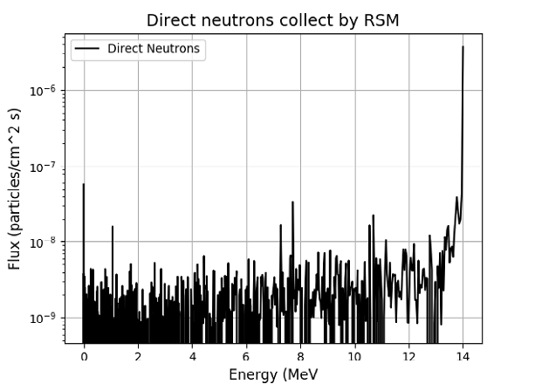
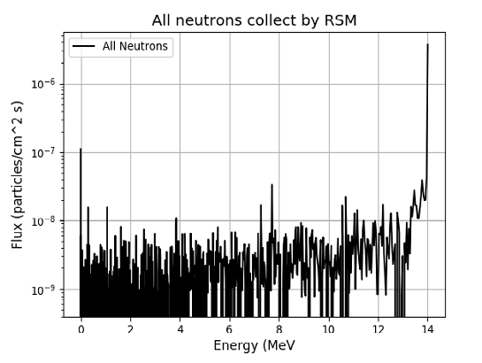
Results
Results from Direct Neutrons and Scattered Neutrons
Notes:
Other than using the code, I plotted the data gathered for direct neutrons to show that the detector was collecting the 14MeV neutrons (direct)
Scattered Neutrons were also plotted to show their relationship
The rationale for using energy vs flux: this relationship shows the spectrum seen by the detector

Slide 9
Conclusion
When the source is placed perpendicular to the detector and centered on the mask wall, there is minimal neutron scatter
Due to using only one angle 22.5º for source direction
Minimal scatter when source pointed at center of the wall
These results validate the code’s ability to capture and tally neutrons across the fast neutron spectrum

Slide 10
References
https://eljentechnology.com/products/liquid-scintillators/ej-301-ej-309
“Characterization of Novel Rotating Scatter Mask Designs for Gamma Direction Identification”, Olesen, Robert J.
Capt. James Bevins
Dr. Darren Holland

Slide 11
Review
Introduction
Problem Description
Description of Work
Results
Conclusions
References

Slide 12
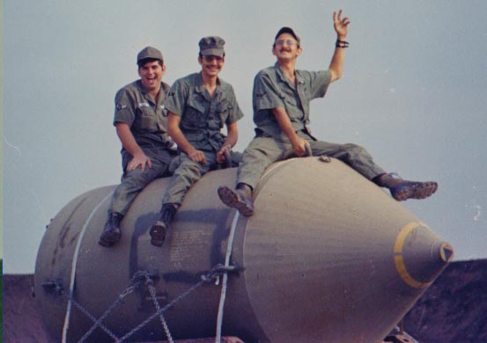

Questions?
Notes:
BLU-82/B

