Slide 1
递归函数复杂度分析方法
树状图分析法
递归表达式分析法
推导法
数学归纳法
主定理

Slide 2
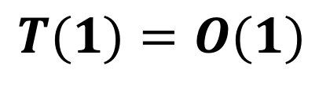
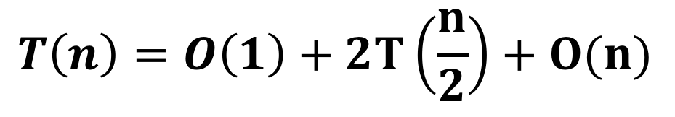
function merge_sort(A, p, r){
if(r - p < 2) {
return
}
const q =
Math.ceil( (p + r) / 2)
merge_sort(A, p, q)
merge_sort(A, q, r)
merge(A,p,q,r)
}
$$T(1)=O(1)$$
$$T\left(n\right)=O\left(1\right)+2T\left(\frac{n}{2}\right)+O(n)$$

Slide 3
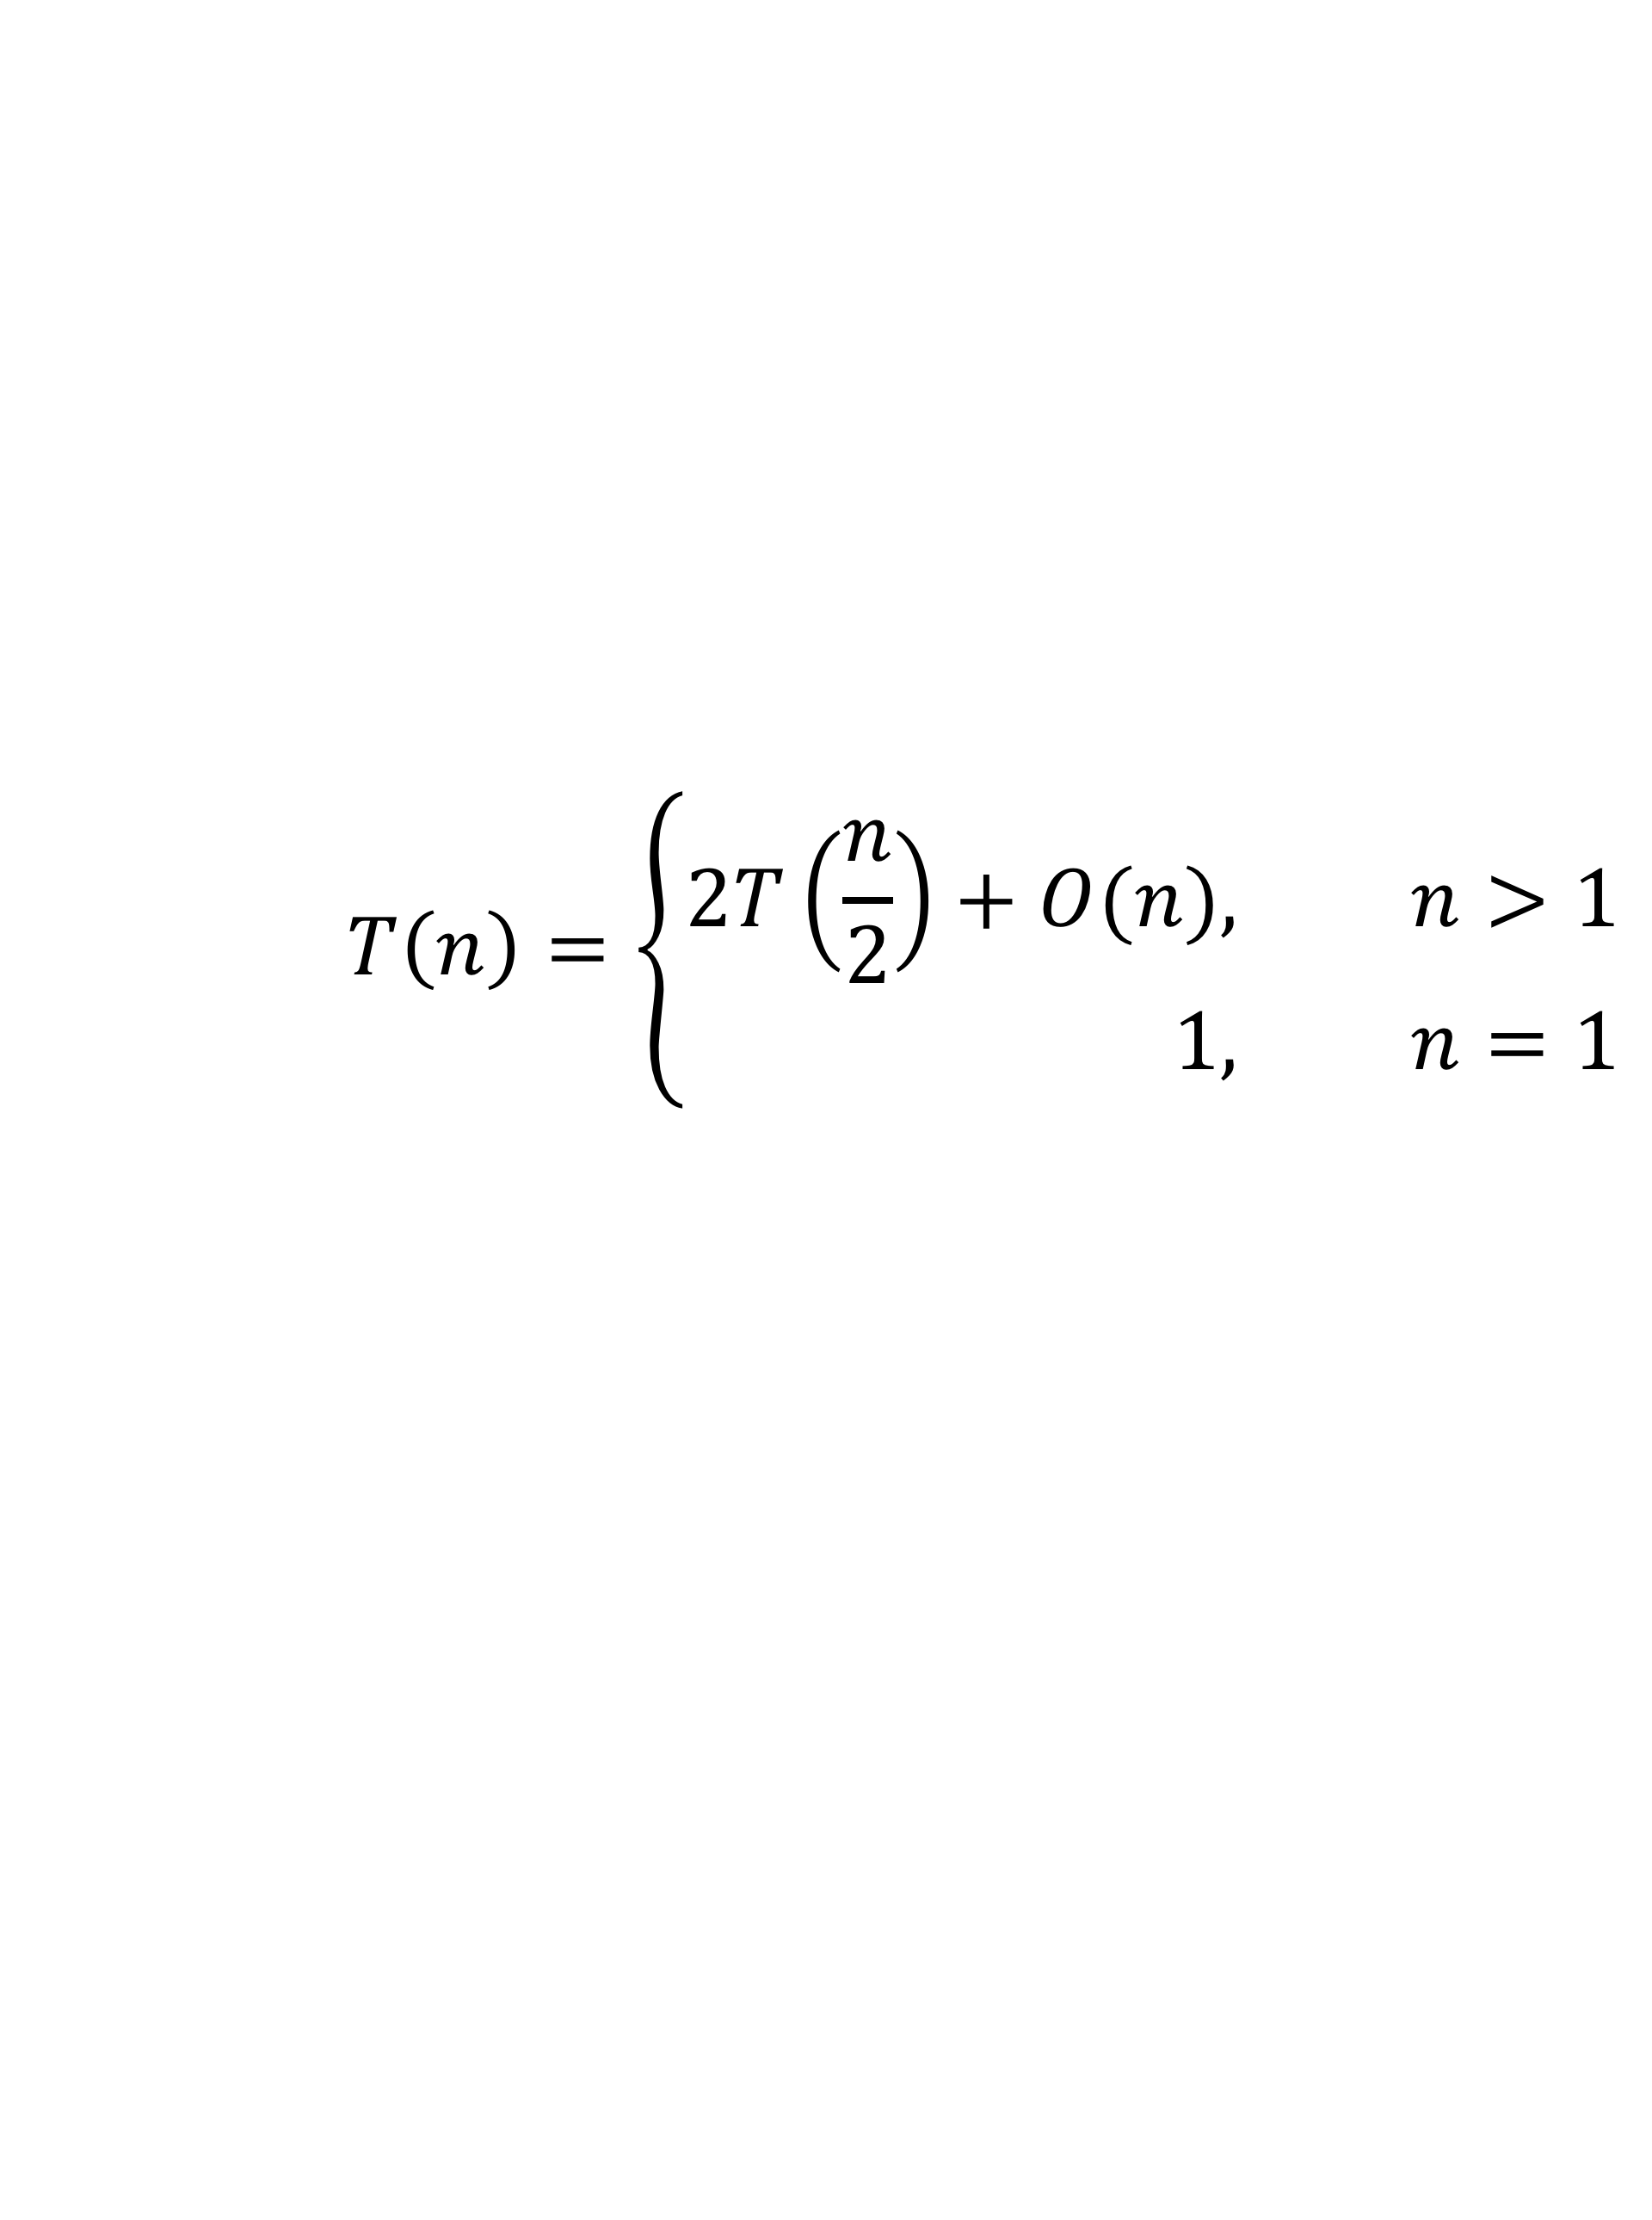
递归表达式
$$T\left(n\right)=\left\{\begin{aligned}2T\left(\frac{n}{2}\right)+O(n), &n>1 \\ 1, &n=1\end{aligned}\right.$$

Slide 4

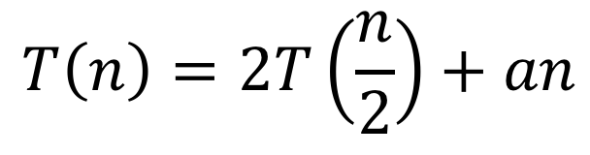
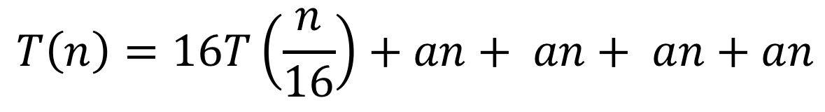
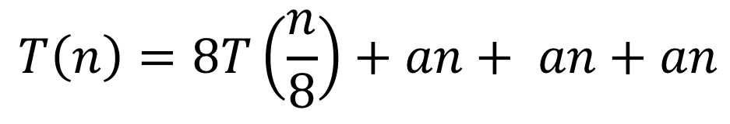
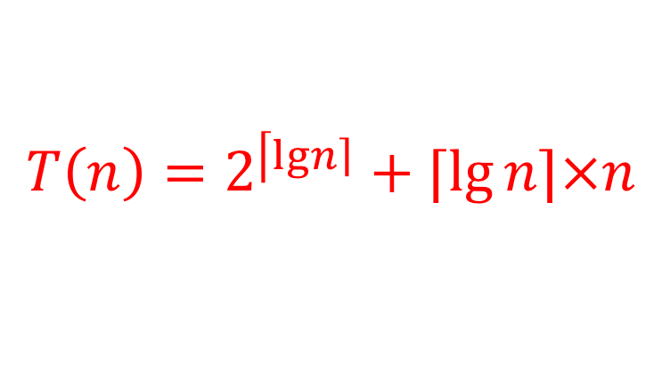
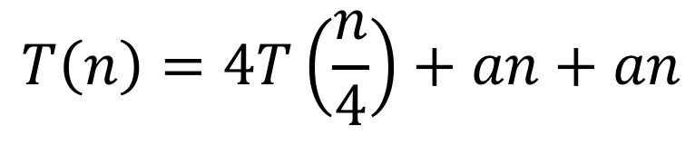
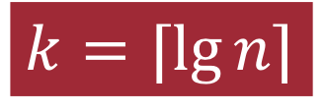
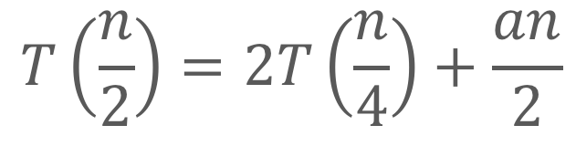
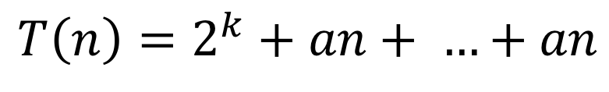
$$T\left(n\right)=2T\left(\frac{n}{2}\right)+an$$
$$T\left(\frac{n}{2}\right)=2T\left(\frac{n}{4}\right)+\frac{an}{2}$$
$$T\left(n\right)=4T\left(\frac{n}{4}\right)+an+an$$
$$T\left(n\right)=8T\left(\frac{n}{8}\right)+an+ an+an$$
$$T\left(n\right)=16T\left(\frac{n}{16}\right)+an+ an+ an+an$$
­$k=⌈lg{n⌉}$
$$…$$
$$T\left(n\right)=2^{\left\lceil \lg\left.n\right\rceil \right.}+⌈\lg{n⌉×n}$$
$$T\left(n\right)=2^{k}+an+ …+an$$
k个

Slide 5
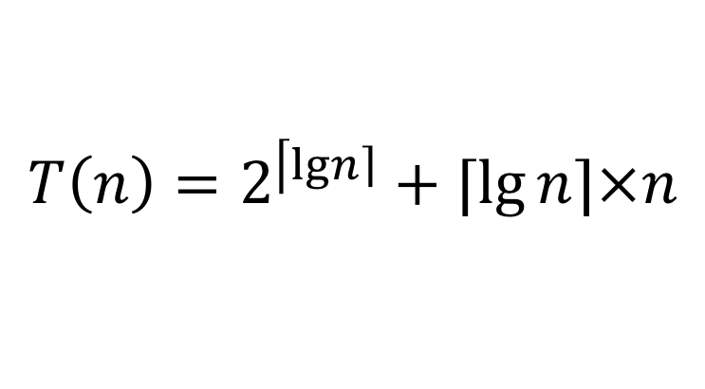
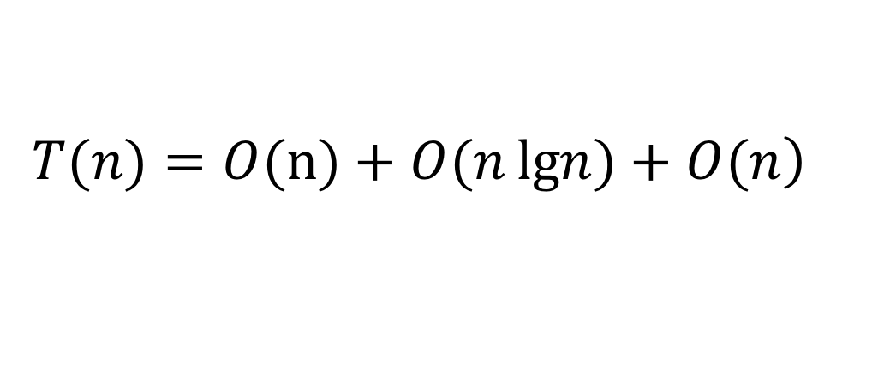
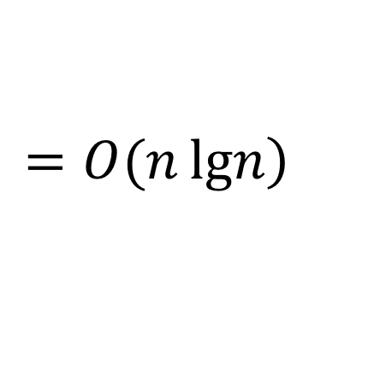
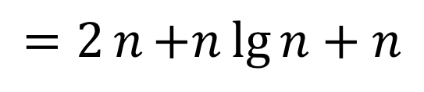
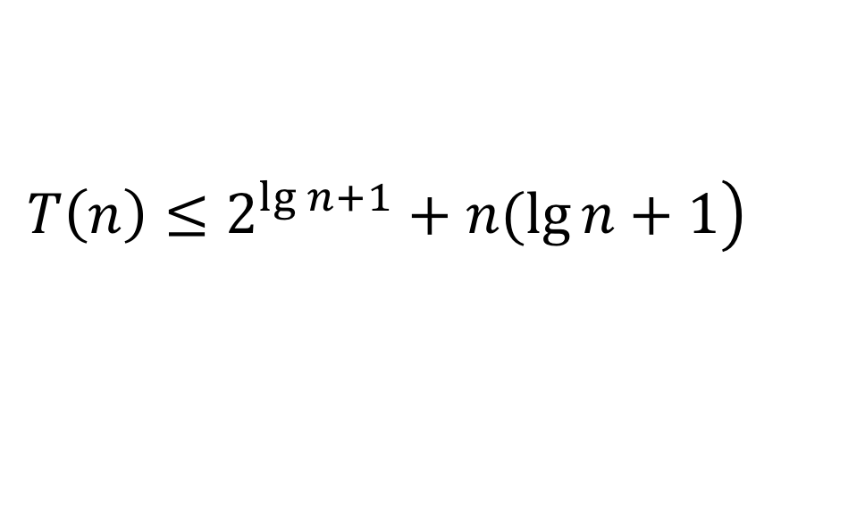
上界推导
$$T\left(n\right)=2^{\left\lceil \lg\left.n\right\rceil \right.}+⌈\lg{n⌉×n}$$
$$\left.T\left(n\right)≤2^{\lg{n+1}}+n(\lg{n}+1\right)$$
$$=2n{+n\lg{n}+n}$$
$$T(n)=O(n{)+O(n\lg\left.n)+O(n\right)}$$
$$=O(n\lg\left.n\right)$$

Slide 6
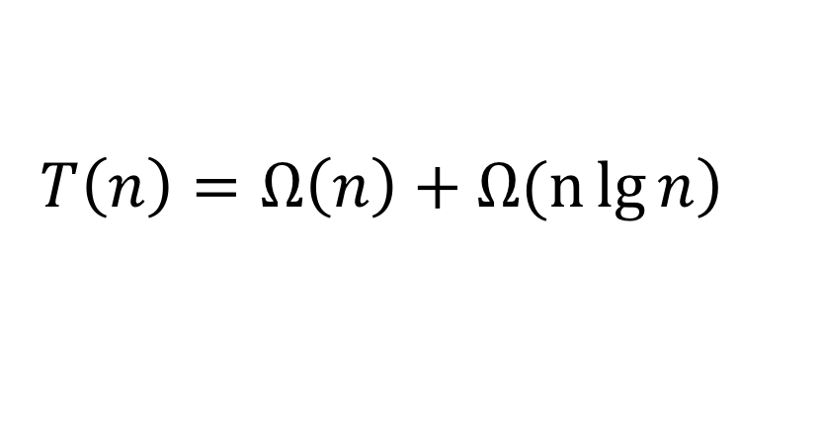
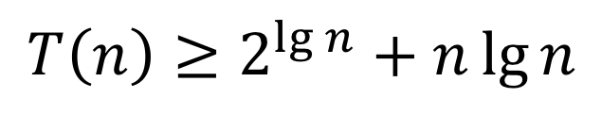
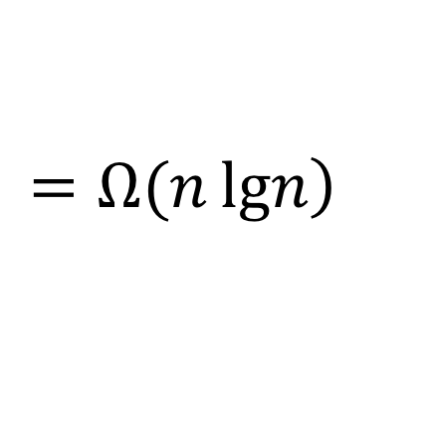
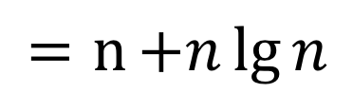
下界推导
$$T\left(n\right)=2^{\left\lceil \lg\left.n\right\rceil \right.}+⌈\lg{n⌉×n}$$
$$T\left(n\right)≥2^{\lg{n}}+n\lg{n}$$
$$=n{+n\lg{n}}$$
$$\left.T\left(n\right)=Ω\left(n\right)+Ω(n\lg{n}\right)$$
$$=Ω(n\lg\left.n\right)$$

Slide 7
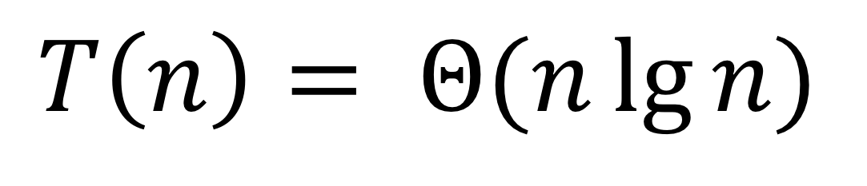
$$T\left(n\right)= Θ(n\lg{n)}$$

Slide 8

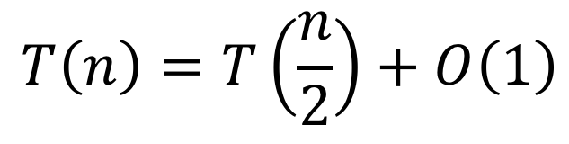

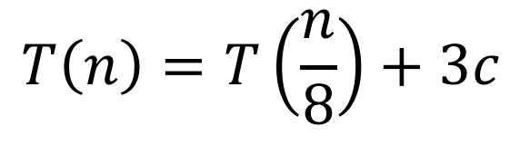
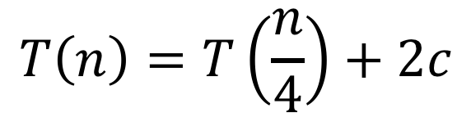
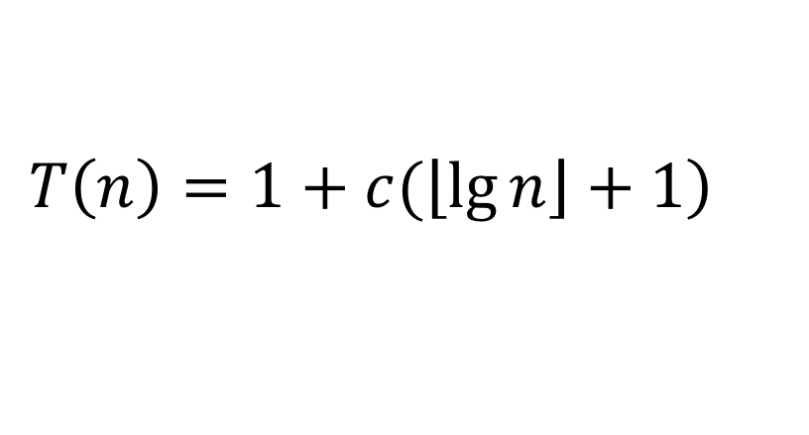
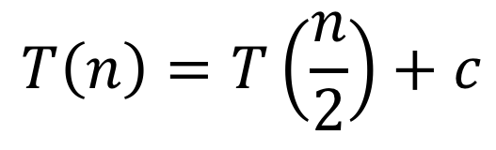
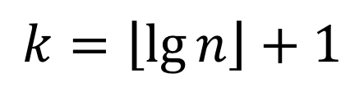
直接推导-二分查找
$$T\left(n\right)=T\left(\frac{n}{2}\right)+O\left(1\right)$$
$$T\left(n\right)=T\left(\frac{n}{2}\right)+c$$
$$T\left(n\right)=T\left(\frac{n}{4}\right)+2c$$
$$T\left(n\right)=T\left(\frac{n}{8}\right)+3c$$
$$…$$
$$k=\left\lfloor \lg{n}\right\rfloor +1$$
$$T\left(n\right)=1+kc$$
$$\left.T\left(n\right)=1+c(\left\lfloor \lg{n}\right\rfloor +1\right)$$

Slide 9
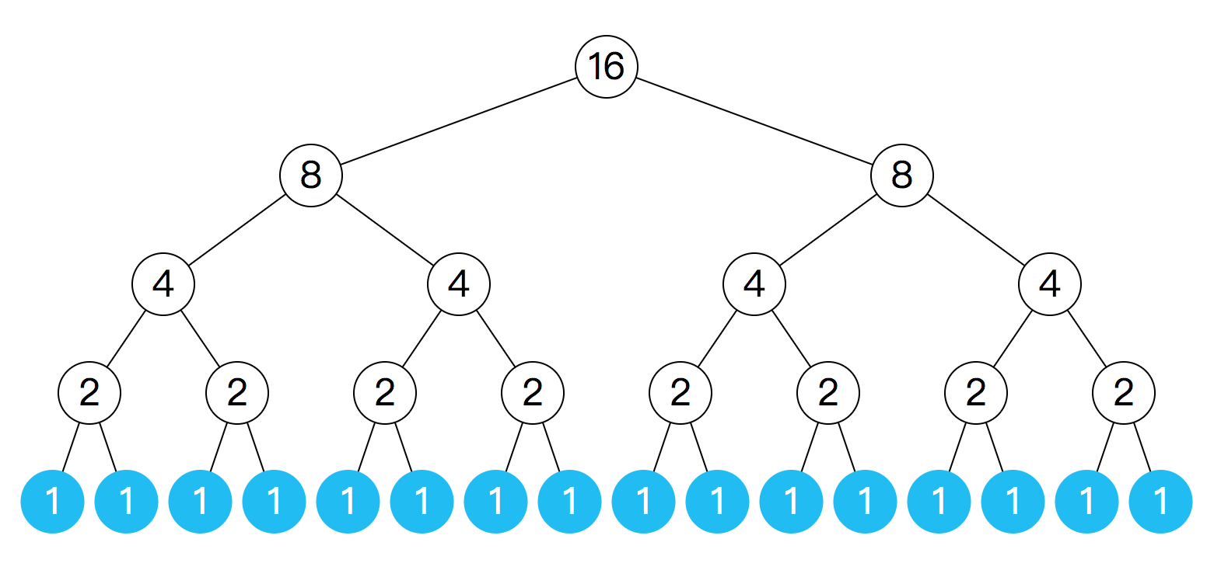
本质上是树状图

Slide 10
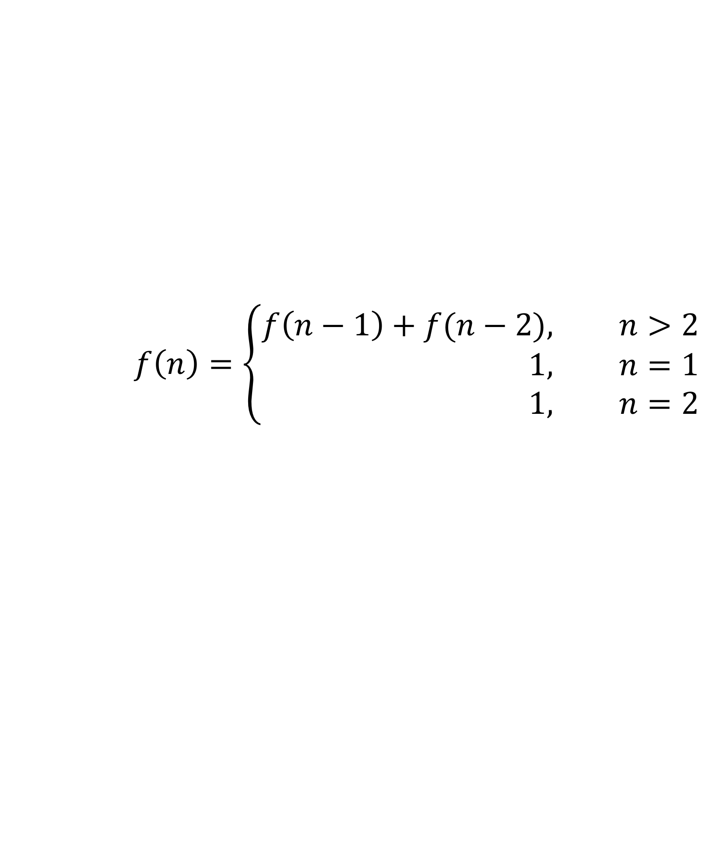
斐波那契数列
1,1,2,3,5,8,13,21……
$$f\left(n\right)=\left\{\begin{aligned}f\left(n−1\right)+f(n−2), &n>2 \\ 1, &n=1 \\ 1, &n=2\end{aligned}\right.$$
function fib(n){
return n <2 ? 1 : fib(n-1) + fib(n-2)
}

Slide 11
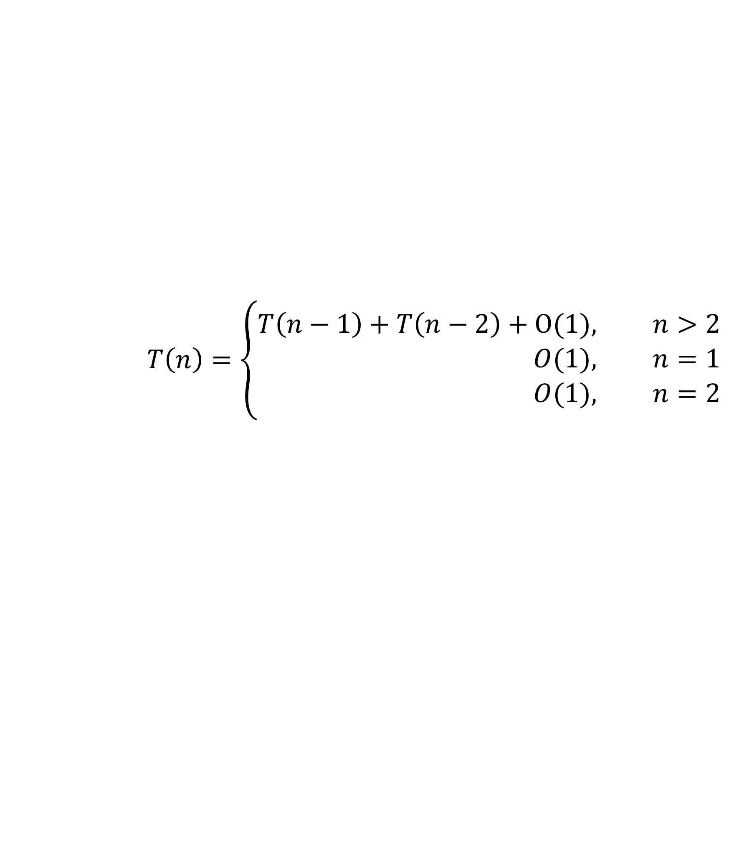
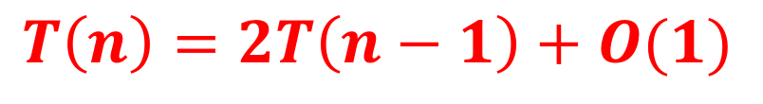
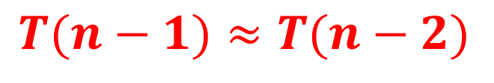
$$T\left(n\right)=\left\{\begin{aligned}T\left(n−1\right)+T\left(n−2\right)+O(1), &n>2 \\ O(1), &n=1 \\ O(1), &n=2\end{aligned}\right.$$
思考？
$$T(n−1)≈T(n−2)$$
$$T\left(n\right)=2T\left(n−1\right)+O(1)$$

Slide 12
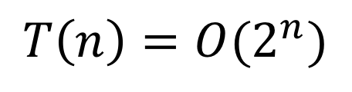
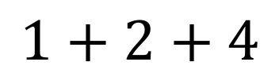
$$1+2+4$$
$$T\left(6\right)<2^{0}+2^{1}+2^{2}+…+2^{4}$$
$$T\left(n\right)<c\left(2^{0}+2^{1}+2^{2}+…+2^{n−2}\right)=c\left(2^{n−1}−1\right)$$
$$T\left(n\right)=O(2^{n})$$

