Slide 1
MOTION IN A STRAIGHT LINE

Slide 2
WHAT IS MOTION
Motion is change in position of an object with time.
How does the position change with time ?
We are going to learn about :
Position

Slide 3
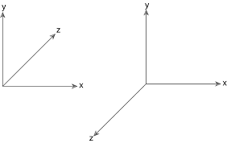
Position
To specify positions we need
a reference point
a set of axes.
Coordinate system:
This is a rectangular coordinate
system also known as cartesian
coordinate system.

Slide 4
It has three mutually perpendicular ( 90° ) axes. These axes are known as X, Y and Z axis.
The point of intersection of these three axes is called origin (O). This serves as the reference point.

Slide 5
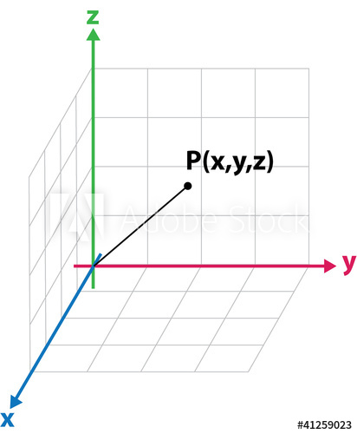
The coordinates (x, y, z) of an object describe the position
of the object with respect to this coordinate system.

Slide 6
Frame of reference :
car is moving on a road

Slide 7
If one or more coordinates of an object change with time, we say that the object is in motion.
If they don't change with time, the object is said to be at rest with respect to this frame of reference.
Types of motion-
1 -dimensional motion
2 -dimensional motion
3-dimensional motion

Slide 8
Type of motions | No. of axes that are required to describe the type of motion | Axes
1-dimensional (1D) | 1 | x
2-dimensional (2D) | 1+1=2 | x and y
3-dimensional (3D) | 1+1+1=3 | x, y and z

Slide 9
1D, 2D and 3D motions:

Slide 10
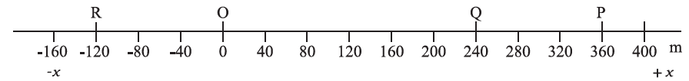
Steps to describe position of an object (Moving/stationary):
Choose an axis which coincides with the path of the moving/stationary object.
Choose the origin O.
Positions to the right of O are taken as positive
( Point P and Q) and to the left of O,
as negative (Point R).

Slide 11
THANK YOU FOR WATCHING THIS.
References:
NCERT Class-11 Physics Part-1
Mathematical physics with classical mechanics by Satya Prakash
Wikipedia
If you have any doubts or suggestions reach out to me at:
laxitamahehswari@gmail.com

