Slide 1
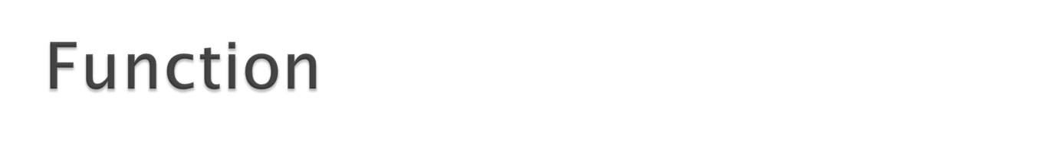
In this chapter, you will learn about
  Introduction to function
  User define function
    Function prototype (declaration)
    Function definition
    Function call and return
  Formal and Actual Parameters
  Local and Global Variables
  Storage classes
1

Slide 2

A function is a block of code which is used to perform a specific task.
It can be written in one program and used by another program without having to rewrite that piece of code. Hence, it promotes usability!!!
Functions can be put in a library. If another program would like to use them, it will just need to include the appropriate header file at the beginning of the program and link to the correct library while compiling.

Slide 3
Functions can be divided into two categories :
  Predefined functions (standard functions)
    Built-in functions provided by C that are used by programmers without having to write any code for them. i.e: printf( ), scanf( ), etc
  User-Defined functions
    Functions that are written by the programmers themselves to carry out various individual tasks.

Slide 4
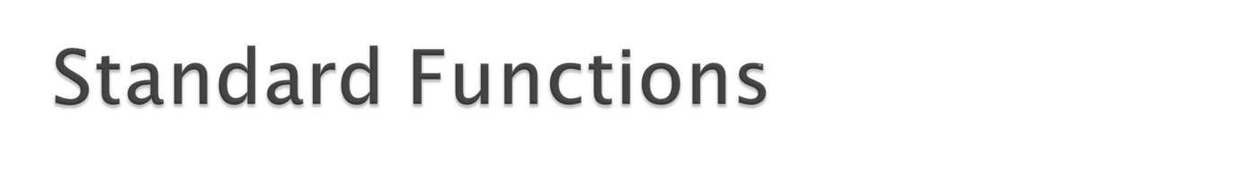
Standard functions are functions that have been pre-defined by C and put into standard C libraries.
  Example: printf(), scanf(), pow(), ceil(), rand(), etc.
What we need to do to use them is to include the appropriate header files.
  Example: #include <stdio.h>, #include <math.h>
What contained in the header files are the prototypes of the standard functions. The function definitions (the body of the functions) has been compiled and put into a standard C library which will be linked by the compiler during compilation.

Slide 5
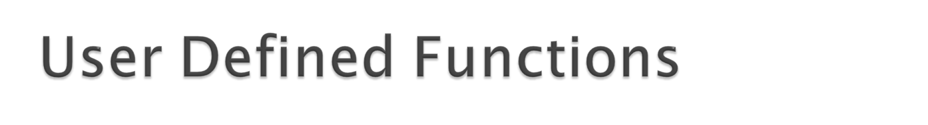
A programmer can create his/her own function(s).
It is easier to plan and write our program if we divide it into several functions instead of writing a long piece of code inside the main function.
A function is reusable and therefore prevents us (programmers) from having to unnecessarily rewrite what we have written before.
In order to write and use our own function, we need to do the following:
  create a function prototype (declare the function)
  define the function somewhere in the program (implementation)
  call the function whenever it needs to be used

Slide 6
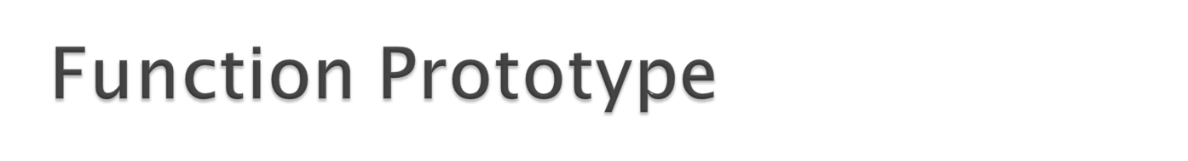
A function prototype will tell the compiler that there exist a function with this name defined somewhere in the program and therefore it can be used even though the function has not yet been defined at that point.
Function prototypes need to be written at the beginning of the program.
If the function receives some arguments, the variable names for the arguments are not needed. State only the data types

Slide 7
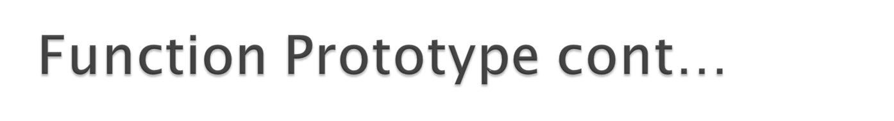
Function prototypes can also be put in a header file.Header files are files that have a .h extension.
The header file can then be included at the beginning of our program.
To include a user defined header file, type:
    #include “header_file.h”
Notice that instead of using < > as in the case of standard header files, we need to use “ ”. This will tell the compiler to search for the header file in the same directory as the program file instead of searching it in the directory where the standard library header files are stored.

Slide 8
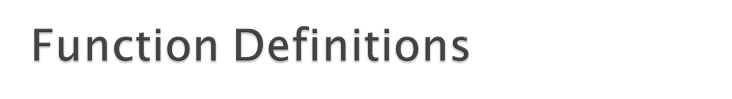
Is also called as function implementation
A function definition is where the actual code for the function is written. This code will determine what the function will do when it is called.
A function definition consists of the following elements:
  A function return data type (return value)
  A function name
  An optional list of formal parameters enclosed in parentheses (function arguments)
  A compound statement ( function body)

Slide 9
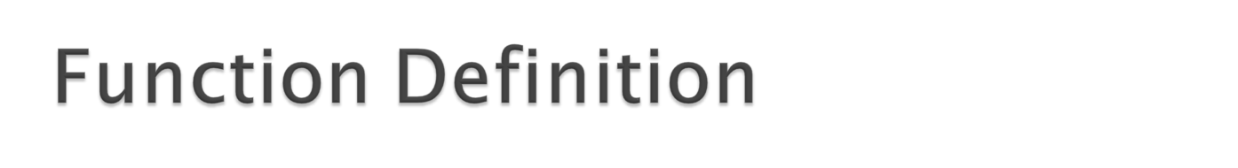
A function definition has this format:
return_data_type FunctionName(data_type variable1, data_type variable2, data_type variable3, …..)
{
local variable declarations;
statements;
}
The return data type indicates the type of data that will be returned by the function to the calling function. There can be only one return value.
Any function not returning anything must be of type ‘void’.
If the function does not receive any arguments from the calling function, ‘void’ is used in the place of the arguments.

Slide 10
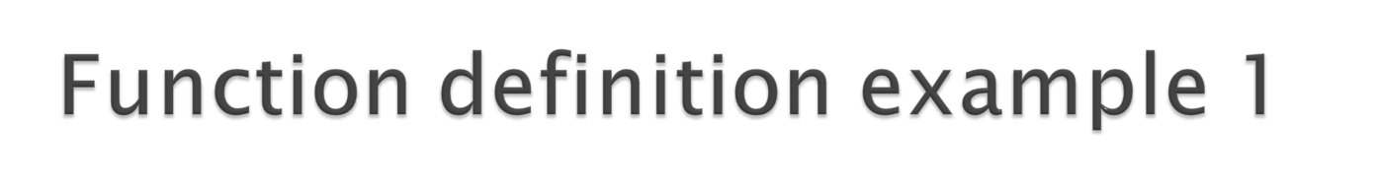
A simple function is :
    void print_message (void)
    {
    printf(“Hello, are you having fun?\n”);
    }
Note the function name is print_message. No arguments are accepted by the function, this is indicated by the keyword void enclosed in the parentheses. The return_value is void, thus data is not returned by the function.
So, when this function is called in the program, it will simply perform its intended task which is to print Hello, are you having fun?

Slide 11
Consider the following example:
  int calculate (int num1, int num2)
  {
  int sum;
  sum = num1 + num2;
  return sum;
  }
The above code segments is a function named calculate. This function accepts two arguments i.e. num 1 and num2 of the type int. The return_value is int, thus this function will return an integer value.
So, when this function is called in the program, it will perform its task which is to calculate the sum of any two numbers and return the result of the summation.
Note that if the function is returning a value, it needs to use the keyword ‘return’.

Slide 12
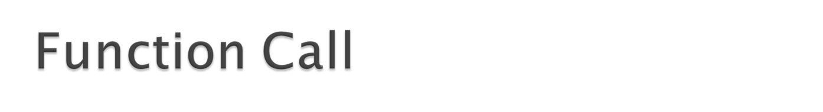
Any function (including main) could utilize any other function definition that exist in a program – hence it is said to call the function (function call).
To call a function (i.e. to ask another function to do something for the calling function), it requires the FunctionName followed by a list of actual parameters (or arguments), if any, enclosed in parenthesis.

Slide 13
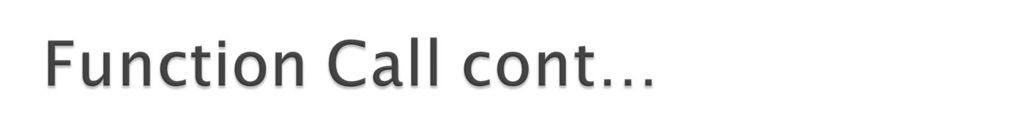
If the function requires some arguments to be passed along, then the arguments need to be listed in the bracket ( ) according to the specified order. For example:
void Calc(int, double, char, int);
void main(void) {
int a, b;
double c;
char d;
…
Calc(a, c, d, b);
}
Function Call

Slide 14
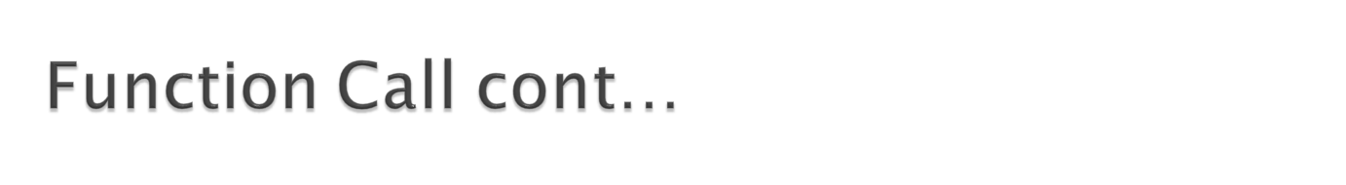
If the function returns a value, then the returned value need to be assigned to a variable so that it can be stored. For example:
int GetUserInput (void); /* function prototype*/
void main(void) {
int input;
input = GetUserInput( );
}
However, it is perfectly okay (syntax wise) to just call the function without assigning it to any variable if we want to ignore the returned value.
We can also call a function inside another function. For example:
printf(“User input is: %d”, GetUserInput( ));

Slide 15
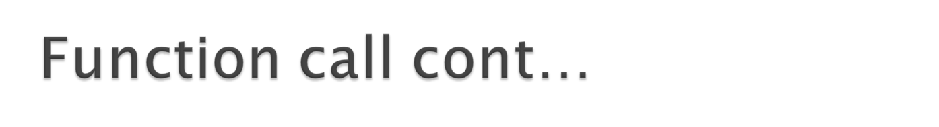
There are 2 ways to call a function:
  Call by value
    In this method, only the copy of variable’s value (copy of actual parameter’s value) is passed to the function. Any modification to the passed value inside the function will not affect the actual value.
    In all the examples that we have seen so far, this is the method that has been used.
  Call by reference
    In this method, the reference (memory address) of the variable is passed to the function. Any modification passed done to the variable inside the function will affect the actual value.
    To do this, we need to have knowledge about pointers and arrays, which will be discussed in chapter pointer.

Slide 16
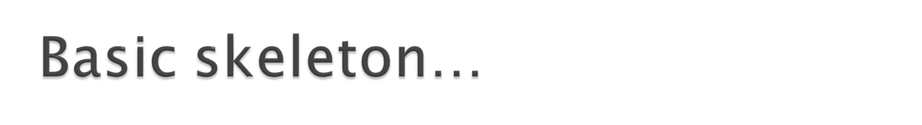
#include <stdio.h>
//function prototype
//global variable declaration
void main(void)
{
local variable declaration;
statements;
fn1( );
fn2( );
}
void fn1(void)
{
local variable declaration;
statements;
}
void fn2(void)
{
local variable declaration;
statements;
}

Slide 17
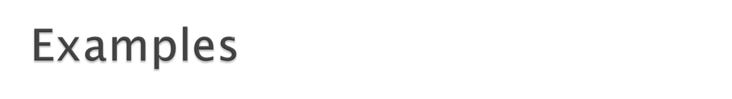
A function may
  Receive no input parameter and return nothing
  Receive no input parameter but return a value
  Receive input parameter(s) and return nothing Receive input parameters(s) and return a value

Slide 18
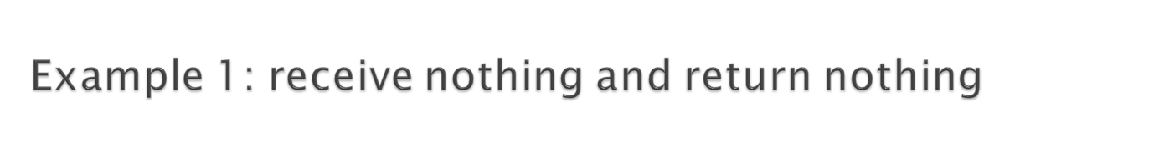
#include <stdio.h>
void greeting(void); /* function prototype */
void main(void)
{
greeting( );
greeting( );
}
void greeting(void)
{
printf("Have fun!! \n");
}
In this example, function greeting does not receive any arguments from the calling function (main), and does not return any value to the calling function, hence type ‘void’ is used for both the input arguments and return data type.
The output of this program is:
  Have fun!!
  Have fun!!

Slide 19

#include <stdio.h>
int getInput(void);
void main(void)
{
int num1, num2, sum;
num1 = getInput( );
num2 = getInput( );
sum = num1 + num2;
printf("Sum is %d\n",sum);
}
int getInput(void)
{
int number;
printf("Enter a number:");
scanf("%d“,&number);
return number;
}
Sample Output:
Enter a number: 3
Enter a number: 5
Sum is 8

Slide 20
#include <stdio.h>
int getInput(void);
void displayOutput(int);
void main(void)
{
int num1, num2, sum;
num1 = getInput();
num2 = getInput();
sum = num1 + num2;
displayOutput(sum);
}
int getInput(void)
{
int number;
printf("Enter a number:");
scanf("%d",&number);
return number;
}
void displayOutput(int sum)
{
printf("Sum is %d \n",sum);
}

Slide 21
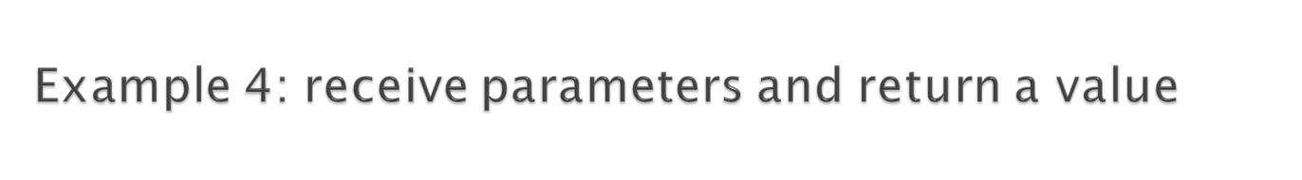
#include <stdio.h>
int calSum(int,int); /*function protototype*/
void main(void)
{
int sum, num1, num2;
printf(“Enter two numbers to calculate its sum:”);
scanf(“%d%d”,&num1,&num2);
sum = calSum(num1,num2); /* function call */
printf(“\n %d + %d = %d”, num1, num2, sum);
}
int calSum(int val1, int val2) /*function definition*/
{
int sum;
sum = val1 + val2;
return sum;
}

Slide 22
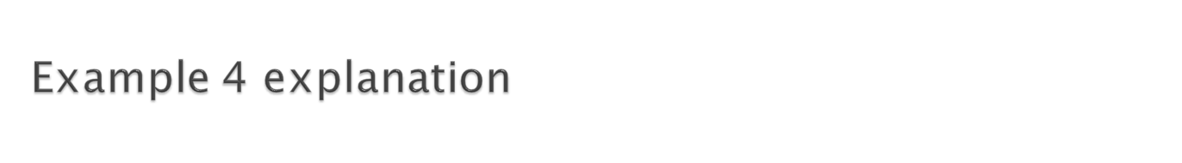
In this example, the calSum function receives input parameters of type int from the calling function (main).
The calSum function returns a value of type int to the calling function.
Therefore, the function definition for calSum:
      int calSum(int val1, int val2)
Note that the function prototype only indicates the type of variables used, not the names.
      int calSum(int,int);
Note that the function call is done by (main) calling the function name (calSum), and supplying the variables (num1,num2) needed by the calSum function to carry out its task.

Slide 23
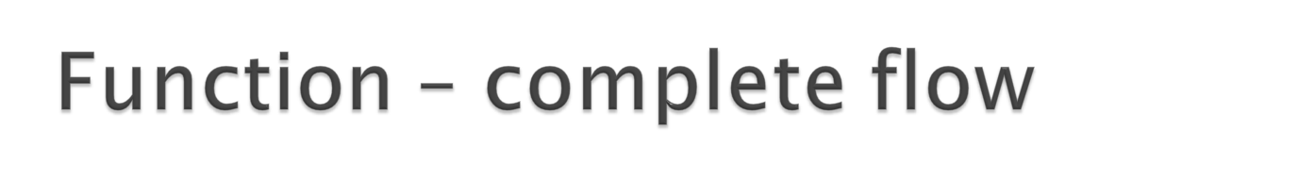
#include<stdio.h>
int calSum(int, int);
void main( );
{
int num1, num2, sum;
printf(“Enter 2 numbers to calculate its sum:”);
scanf(“%d %d”, &num1, &num2);
sum = calSum (num1, num2);
printf (“\n %d + %d = %d”, num1, num2, sum);
}
int calSum(int val1, int val2)
{
int sum;
sum = val1 + val2;
return sum;
}

Slide 24
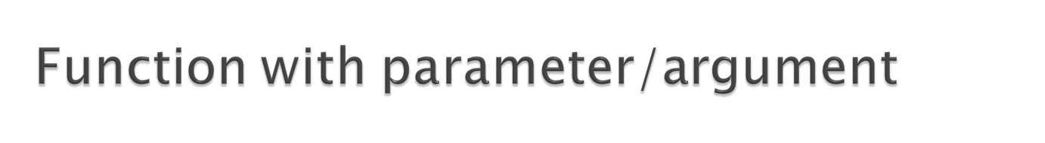
When a function calls another function to perform a task, the calling function may also send data to the called function. After completing its task, the called function may pass the data it has generated back to the calling function.
Two terms used:
  Formal parameter
    Variables declared in the formal list of the function header (written in function prototype & function definition)
  Actual parameter
    Constants, variables, or expression in a function call that correspond to its formal parameter

Slide 25
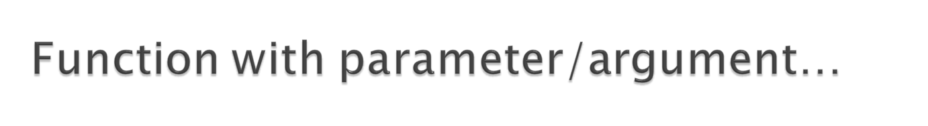
The three important points concerning functions with parameters are: (number, order and type)
  The number of actual parameters in a function call must be the same as the number of formal parameters in the function definition.
  A one-to-one correspondence must occur among the actual and formal parameters. The first actual parameter must correspond to the first formal parameter and the second to the second formal parameter, an so on.
  The type of each actual parameter must be the same as that of the corresponding formal parameter.

Slide 26
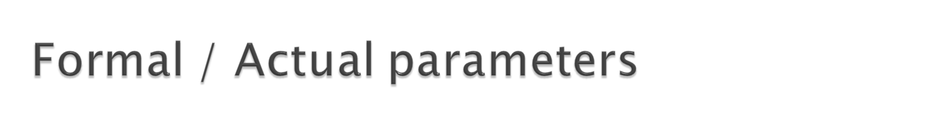
#include <stdio.h>
int calSum(int,int); /*function protototype*/
void main(void)
{
int sum, num1, num2;
printf(“Enter two numbers to calculate its sum:”);
scanf(“%d%d”,&num1,&num2);
sum = calSum(num1,num2); /* function call */
printf(“\n %d + %d = %d”, num1, num2, sum);
}
int calSum(int val1, int val2) /*function definition*/
{
int sum;
sum = val1 + val2;
return sum;
}

Slide 27

Up until now, we have learnt to declare our variables within the braces of segments (or a function) including the main.
It is also possible to declare variables outside a function. These variables can be accessed by all functions throughout the program.

Slide 28

Local variables only exist within a function. After leaving the function, they are ‘destroyed’. When the function is called again, they will be created (reassigned).
Global variables can be accessed by any function within the program. While loading the program, memory locations are reserved for these variables and any function can access these variables for read and write (overwrite).
If there exist a local variable and a global variable with the same name, the compiler will refer to the local variable.

Slide 29

#include <stdio.h>
void initialise(void);
void getInputs(void);
void calSum(void);
int sum, num1, num2;
void main(void)
{
/* initialise sum to 0 */
initialise( );
/* read num1 and num2 */
getInputs( );
calSum( );
printf("Sum is %d\n",sum);
}
void initialise(void)
{
sum = 0;
}
void getInputs(void)
{
printf("Enter num1 and num2:");
scanf("%d%d",&num1,&num2);
}
void calSum(void)
{
sum = num1 + num2;
}

Slide 30

In the previous example, no variables are passed between functions.
Each function could have access to the global variables, hence having the right to read and write the value to it.
Even though the use of global variables can simplify the code writing process (promising usage), it could also be dangerous at the same time.
Since any function can have the right to overwrite the value in global variables, a function reading a value from a global variable can not be guaranteed about its validity.

Slide 31

#include <stdio.h>
void initialise(void);
void getInputs(void);
void calSum(void);
int sum, num1, num2;
void main(void)
{
/* initialise sum to 0 */
initialise( );
/* read num1 and num2 */
getInputs( );
calSum( );
printf("Sum is %d\n",sum);
}
void initialise(void)
{
sum = 0;
}
void getInputs(void)
{
printf("Enter num1 and num2:");
scanf("%d%d",&num1,&num2);
}
void calSum(void)
{
sum = num1 + num2;
initialise( );
}
Imagine what would be the output of this program if someone ‘accidently’ write the following function call inside calSum?

Slide 32
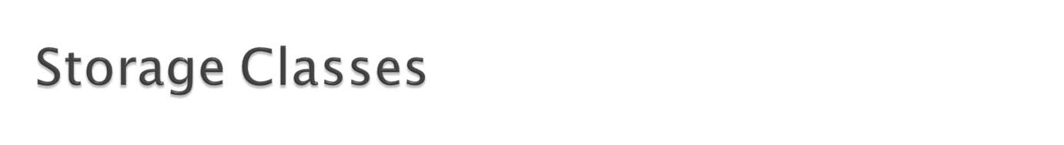
Local variables only exist within a function by default. When calling a function repeatedly, we might want to
  Start from scratch – re-initialise the variables
    The storage class is ‘auto’
  Continue where we left off – remember the last value
    The storage class is ‘static’
Another two storage classes (seldomly used)
  register (ask to use hardware registers if available)
  extern (global variables are external)

Slide 33
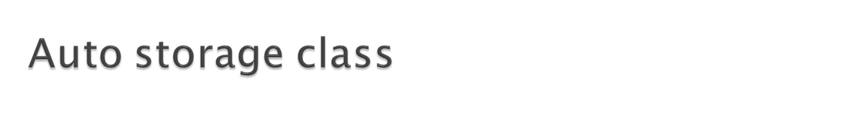
Variables with automatic storage duration are created when the block in which they are declared is entered, exist when the block is active and destroyed when the block is exited.
The keyword auto explicitly declares variables of automatic storage duration. It is rarely used because when we declare a local variable, by default it has class storage of type auto.
  “int a, b;” is the same as “auto int a, b;”

Slide 34
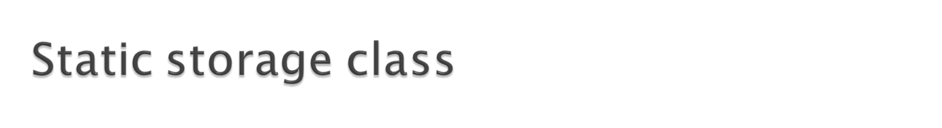
Identifiers with static storage duration exist from the point at which the program begin execution.
All the global variables are static, and all local variables and functions formal parameters are automatic by default. Since all global variables are static by default, in general it is not necessary to use the static keyword in their declarations.
However the static keyword can be applied to a local variable so that the variable still exist even though the program has gone out of the function. As a result, whenever the program enters the function again, the value in the static variable still holds.

Slide 35
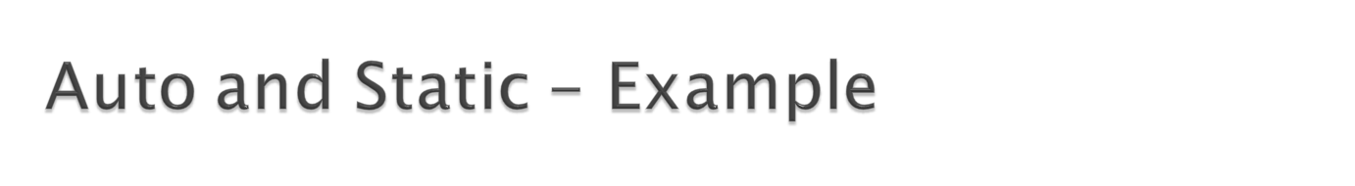
#include <stdio.h>
void auto_example(void);
void static_example(void);
void main(void)
{
int i;
printf("Auto example:\n");
for (i=1; i<=3; i++)
auto_example( );
printf(“\nStatic example:\n");
for (i=1; i<=3; i++)
static_example( );
}
void auto_example(void)
{
auto int num = 1;
printf(“ %d\n”,num);
num = num + 2;
}
void static_example(void)
{
static int num = 1;
printf(“ %d\n”,num);
num = num + 2;
}
Output:
Auto example:
1
1
1
Static example:
1
3
5

Slide 36
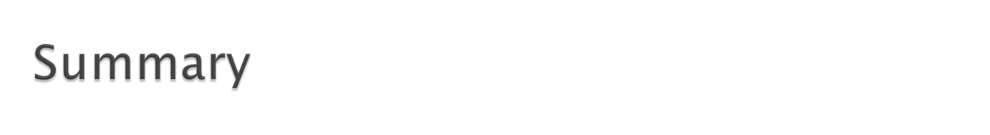
In this chapter, you have learnt:
  Standard vs User Define functions
  Function prototype, function definition and function call
  Formal vs Actual parameters
  Local vs Global variables
  Auto vs Static storage class

