Slide 1

UNC-CH-DA Project 1: Age vs Heart Disease
A Data Analysis Comparing Age to Prevalence of Heart Disease

Slide 2
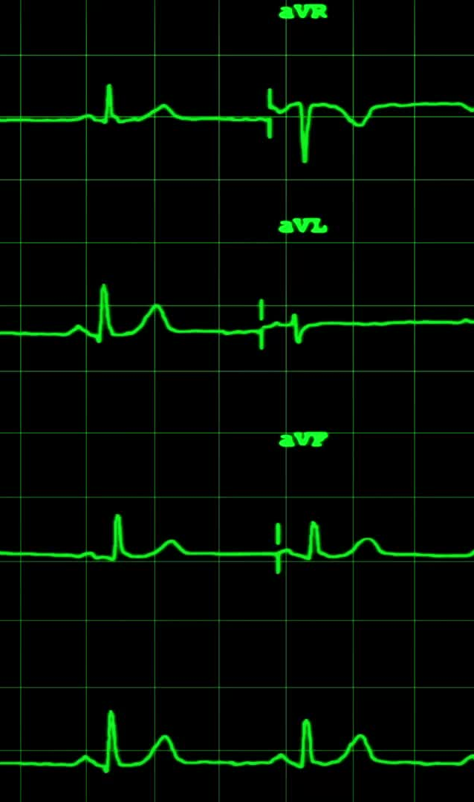
BACKGROUND
Start with a mostly clean dataset from kaggle.com, "Cardiovascular Diseases Risk Prediction Dataset”:
derived from the "2021 BRFSS Dataset from the CDC”
author chose 19 of the 304 unique variables relating "to lifestyle factors of a person that can be contributed to being at risk with any form of Cardiovascular Diseases".
Each Team Member tasked with asking a question of the data, then use data and statistical analysis, and visualization to:
Answer the question
Verify confidence in the results
Use graphs/charts to clearly, visually display the results

Slide 3

Question: Is there a relationship between Age and Heart Disease?
Based on the Dataset of approximately 309K respondents, determine if there is a relationship between the respondents Age and the Incidence of Heart Disease.

Slide 4
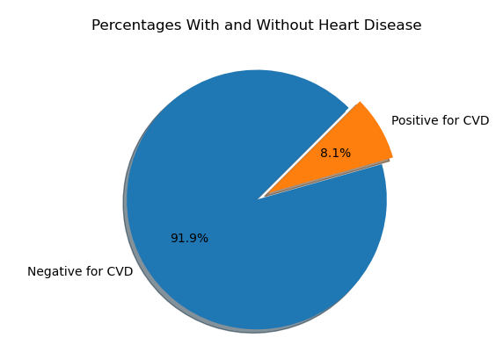
Percentage Positive for Heart Disease
Total Respondents = 308,854
# of Respondents who answered ‘Yes’ to Heart Disease.
24,971 or 8.1%
# of Respondents who answered ‘No’ to Heart Disease.
283,883 or 91.9%

Slide 5
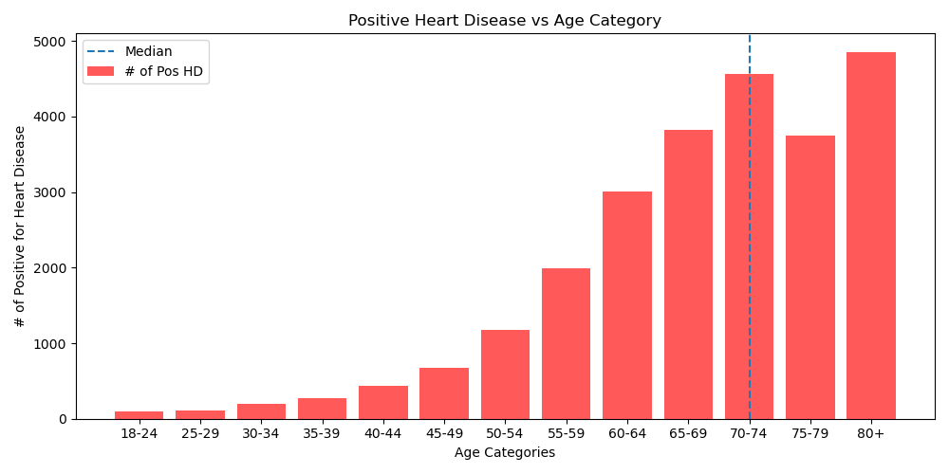
Positive Heart Disease vs Age
We see a definite skew towards a higher prevalence with increase in age.
The Median line shows more than 50% of the positive cases lie somewhere above the 70-year-old mark.
88% of the Positive cases lie above the age of 55.
Further questions:
Is the distribution of respondents equal across all ‘Age Categories’?
If not, do these numbers represent a normal percentage distribution among the # of respondents in each Age Category (based on total sample percentage of positive cases)?

Slide 6
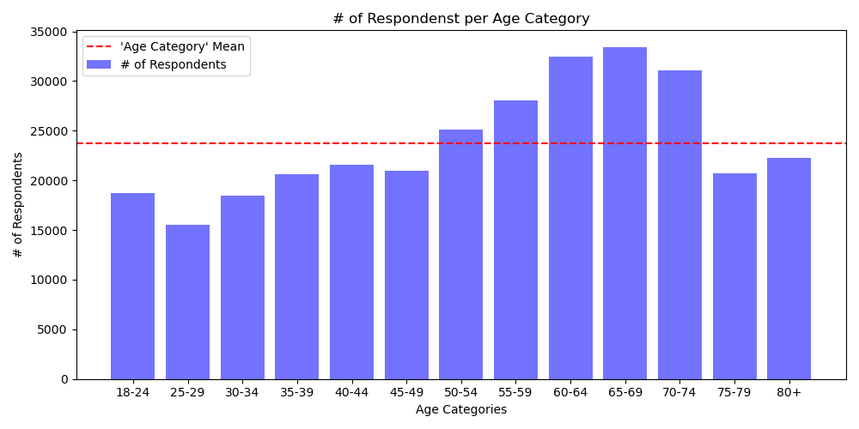
# of Respondents per Age Category
Here we see the # of Respondents in each age category is slightly skewed towards the older age groups.
Although it is clear the skew is not as pronounced as we see when comparing age to positive cases.

Slide 7
Chi Square Testing
Null Hypothesis:
The number of positive cases of heart disease per age group will be 8.1% of the total number of respondents in the age group.
Alternative Hypothesis:
There is a higher prevalence of heart disease as a respondent’s age increases, and therefore we will not see the number of positive cases of heart disease for each age group evenly distributed as 8.1%.
Results:
The resulting statistical value is WELL ABOVE the calculated statistical value, and the p-value is so low as to be reported as 0.0. Therefore, we can REJECT the NULL HYPOTHESIS that the observed number of positive case per age group follows the overall distribution of 8.1%. Supporting the Alternative Hypothesis there is a possible relationship between an increase in age and incidence of heart disease.
The expected number of positive cases for the Null Hypothesis were calculated by taking the actual # of respondents in each age category and multiplying by 8.1%.
The observed values were taken directly from the actual counts of positive cases from each age group
12 degrees of freedom; 95% confidence
Statistical Value = 21.03
Chi squared results:
Statistical Value = 16574.54
p-value = 0.0

Slide 8
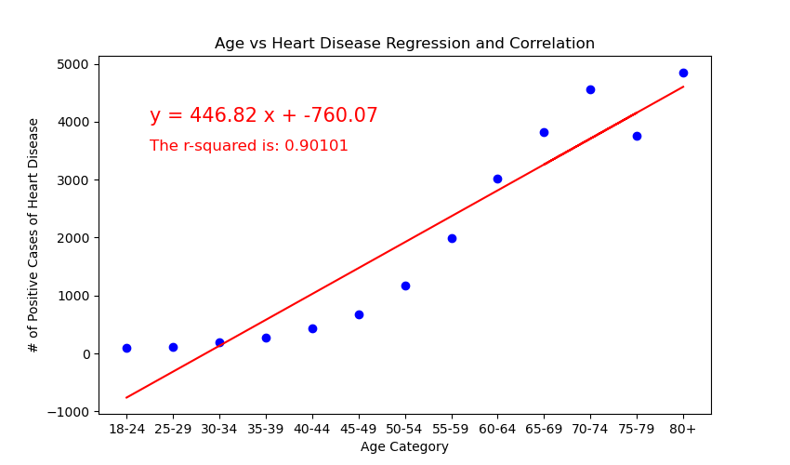
Linear Regression and Correlation Analysis
The categorical ‘Age Category’ data was first converted to Ordinal Data, to allow for plotting of a linear regression.
Results:
y = 446.82x + -760.07
r-squared is: 0.90101
There is a strong positive correlation between an increase in age of the respondents and the prevalence of heart disease.
Additional regression should be conducted to find the best curve fit.

