Slide 1

Zillow Housing Data
Aubrey Leary, Gabrellea Norman,
Hannah Burgess
Notes:
https://www.zillow.com/research/strategy-best-time-to-buy-15066/

Slide 2
Project Goal
In this project, we will explore housing data provided by Zillow through NASDAQ. The data set contains data concerning housing prices and availability specified by region, housing type (including sales/rentals), and region type. Our goal is to create an interactive app that would allow users to view solutions/answers to the following research questions in order to help them identify housing potentials and trends.

Slide 3
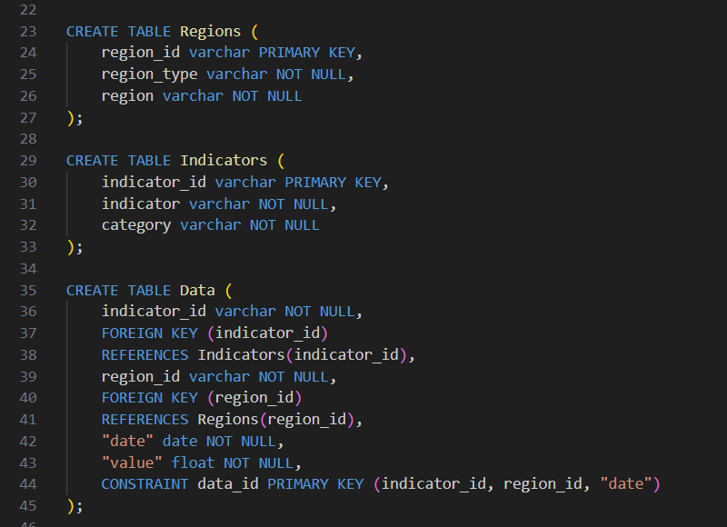
Data Gathering
From NASDAQ api, 3 csv files were downloaded, displaying different data values.
These files showed Zillow regions, indicators, and an overall data csv.
Zillow Region Data
Region ID, Region Type, and Region
Example: 99999, Zip, 98847; WA;Wenatchee, WA
Zillow Indicators
Indicator ID, Indicator, Category
Example: ZSFH, Single Family Homes, Home Values
Zillow Data
Region ID, Date, Value
Example: 99999, 2005-01-31, $164,988.00

Slide 4
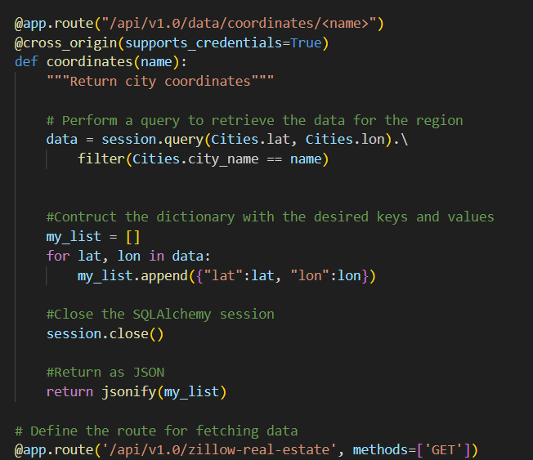
Data Gathering
After the csv files were imported into a SQL database, the data was extracted and cleaned by Python and SQLAlchemy.
Geoapify was used to retrieve coordinates for city locations.
A Flask API was created that runs SQLAlchemy, and was used to retrieve data for an adaptive map and line graph.

Slide 5
Questions
How have trends in housing prices changed over time by state breakdown?
What housing is currently available by region?
What are the market trends in housing prices across the US over time by housing type?
What are the current housing prospects in a given area?

Slide 6
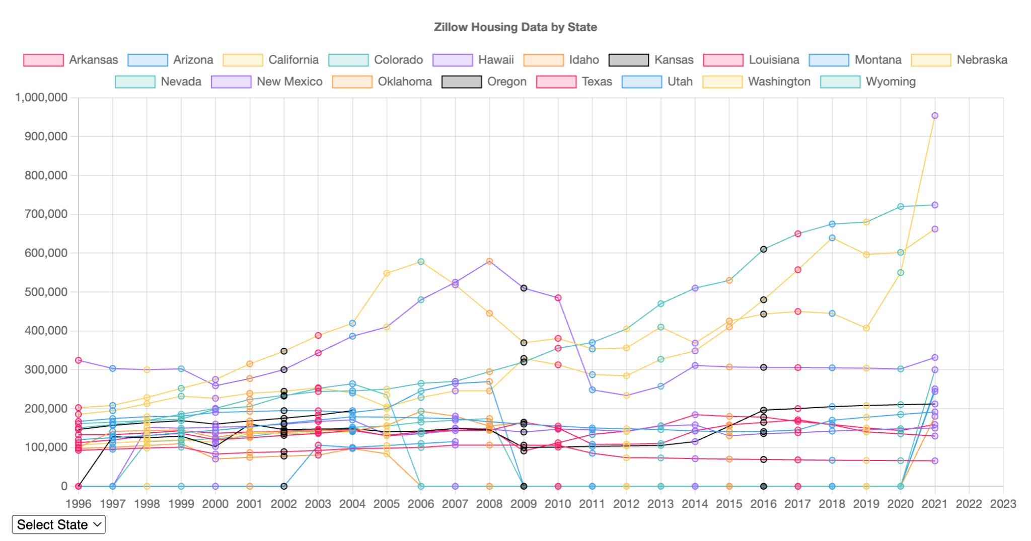
How have trends in housing prices changed over time, by state?

Slide 7
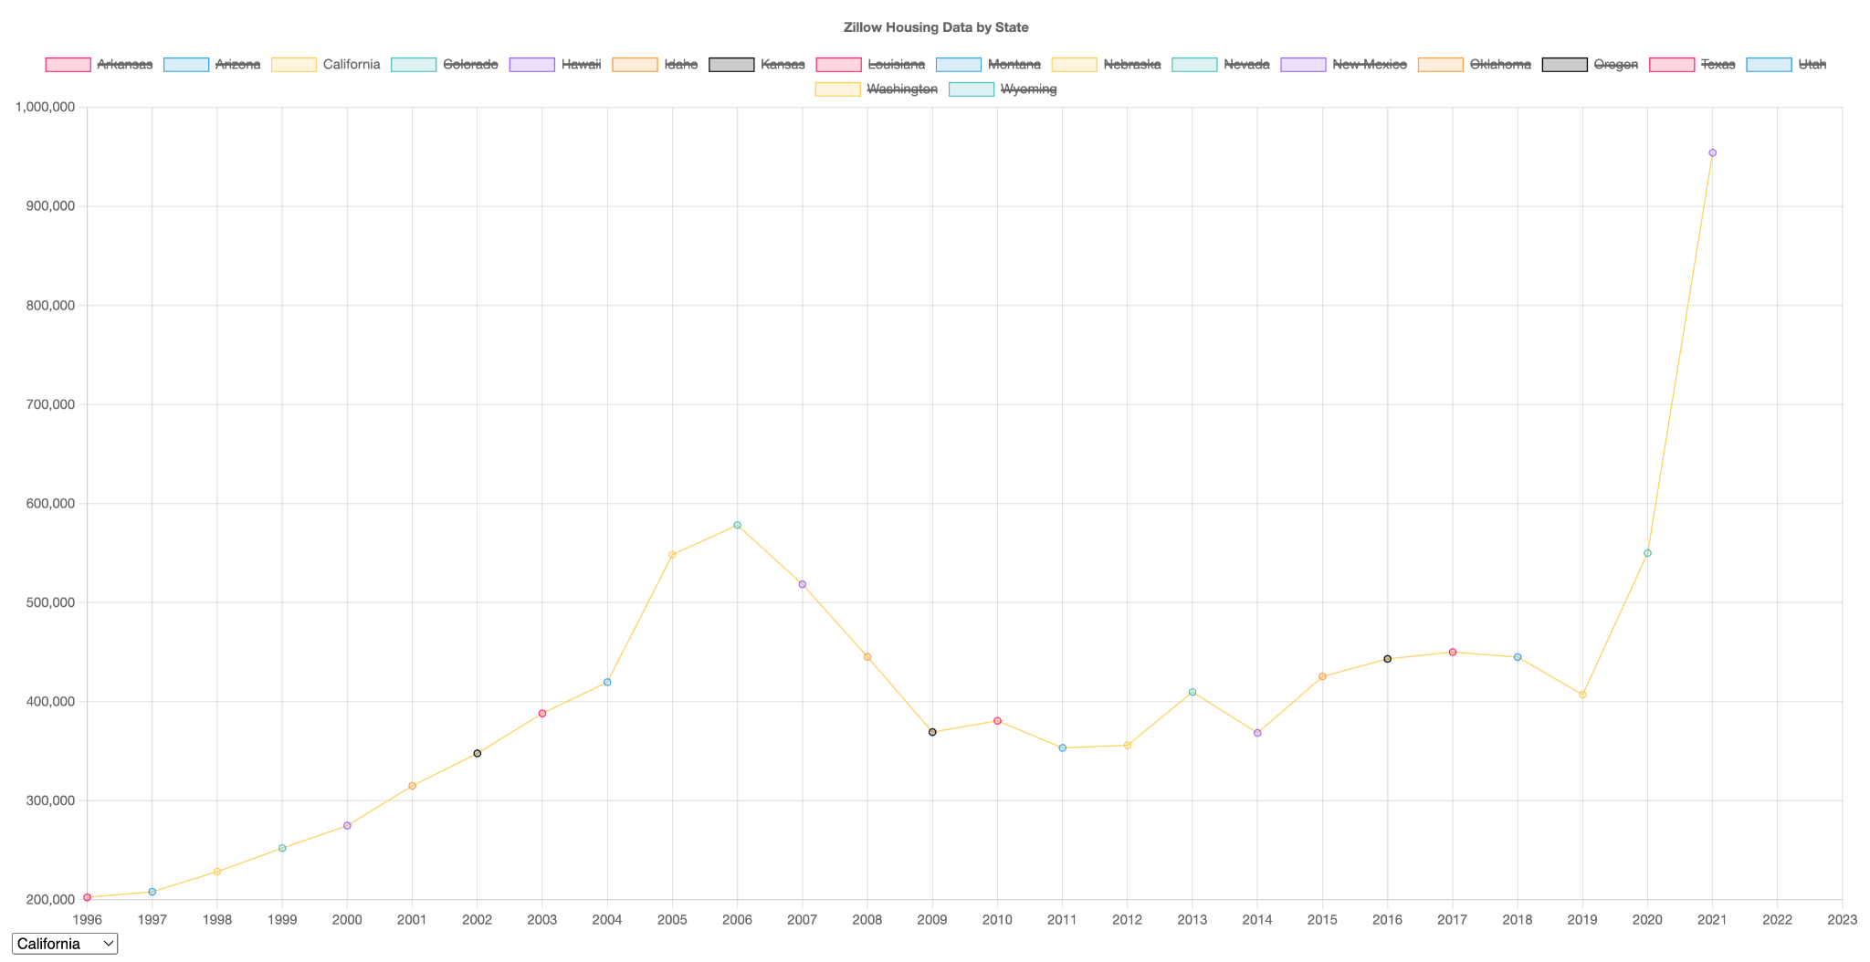
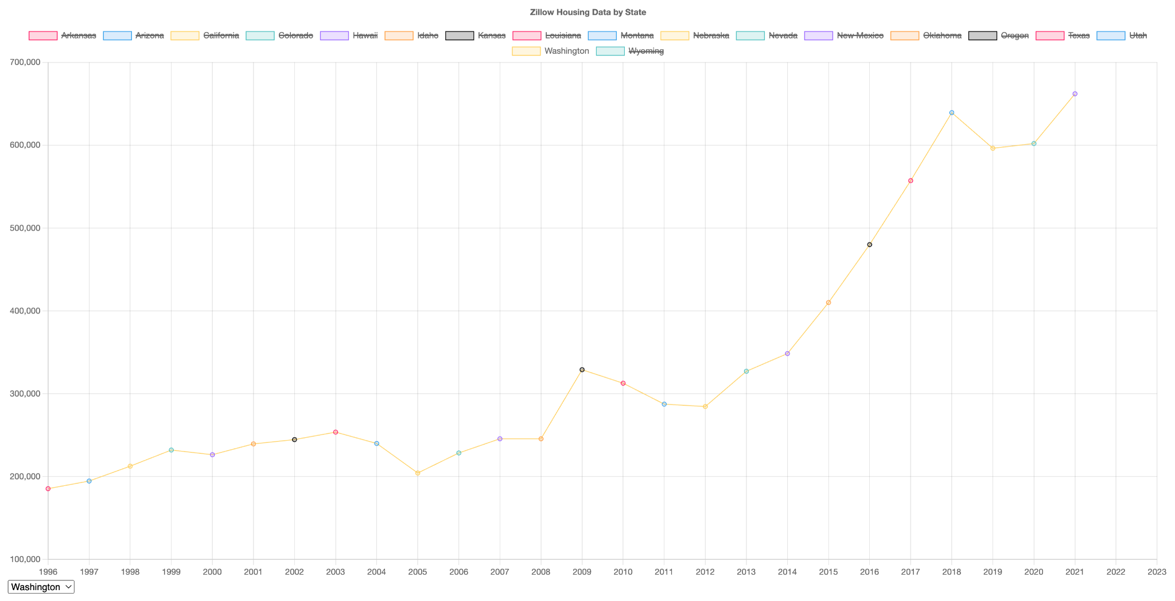
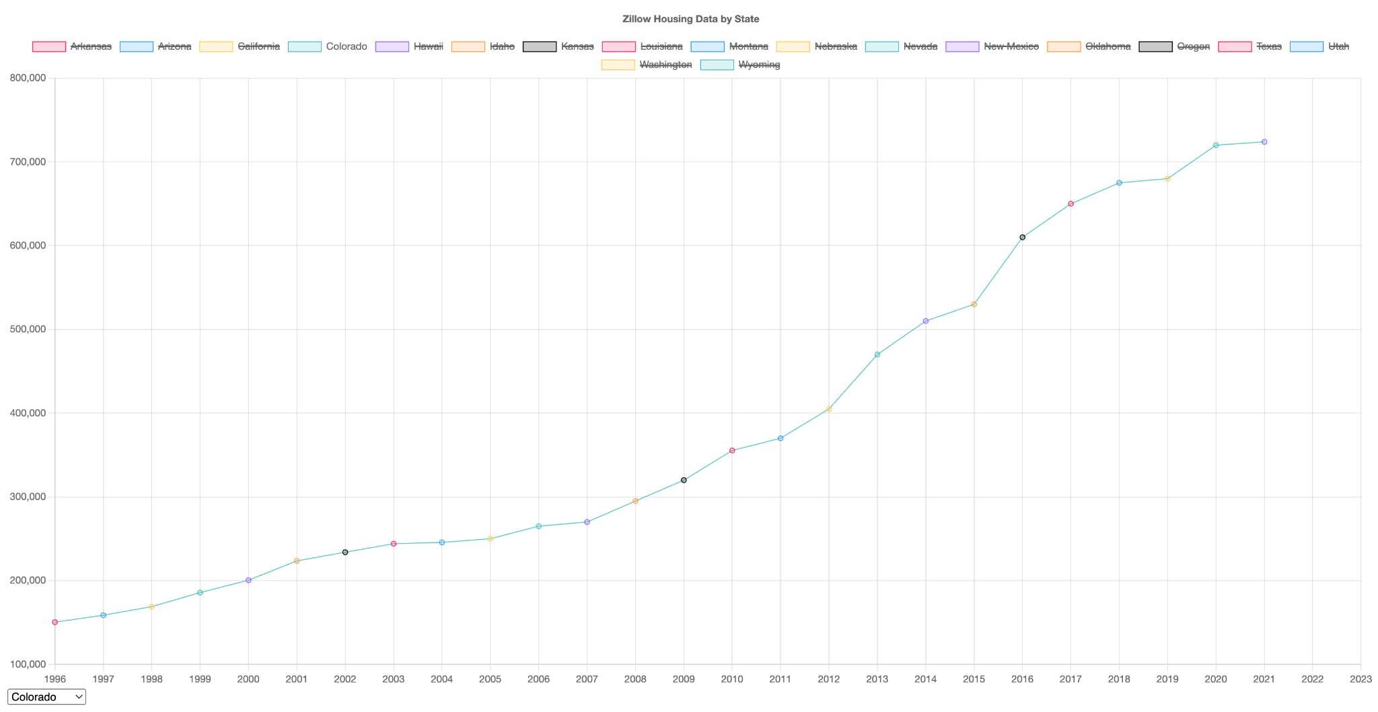
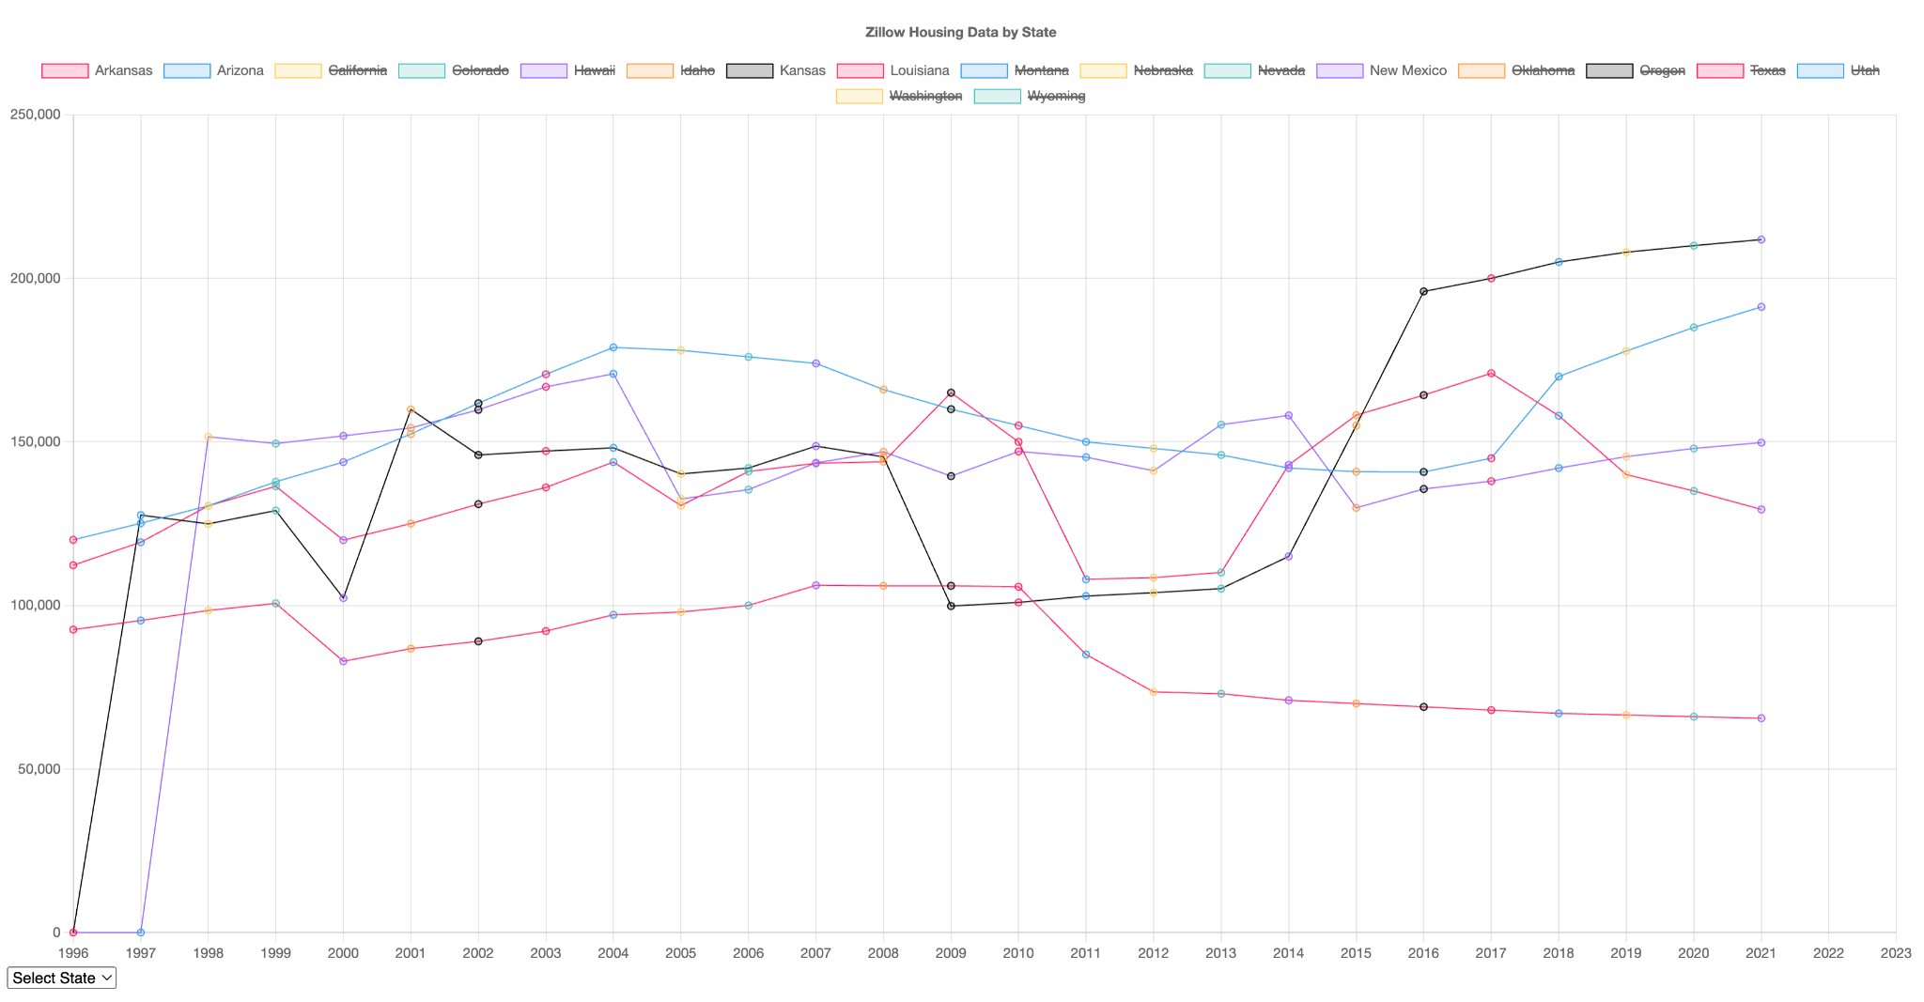
How have trends in housing prices changed over time, by state?
From this line graph, we can see that some states, such as Arkansas, Arizona, Kansas, Louisiana, and New Mexico have roughly all stayed the same price over the years.

Slide 8
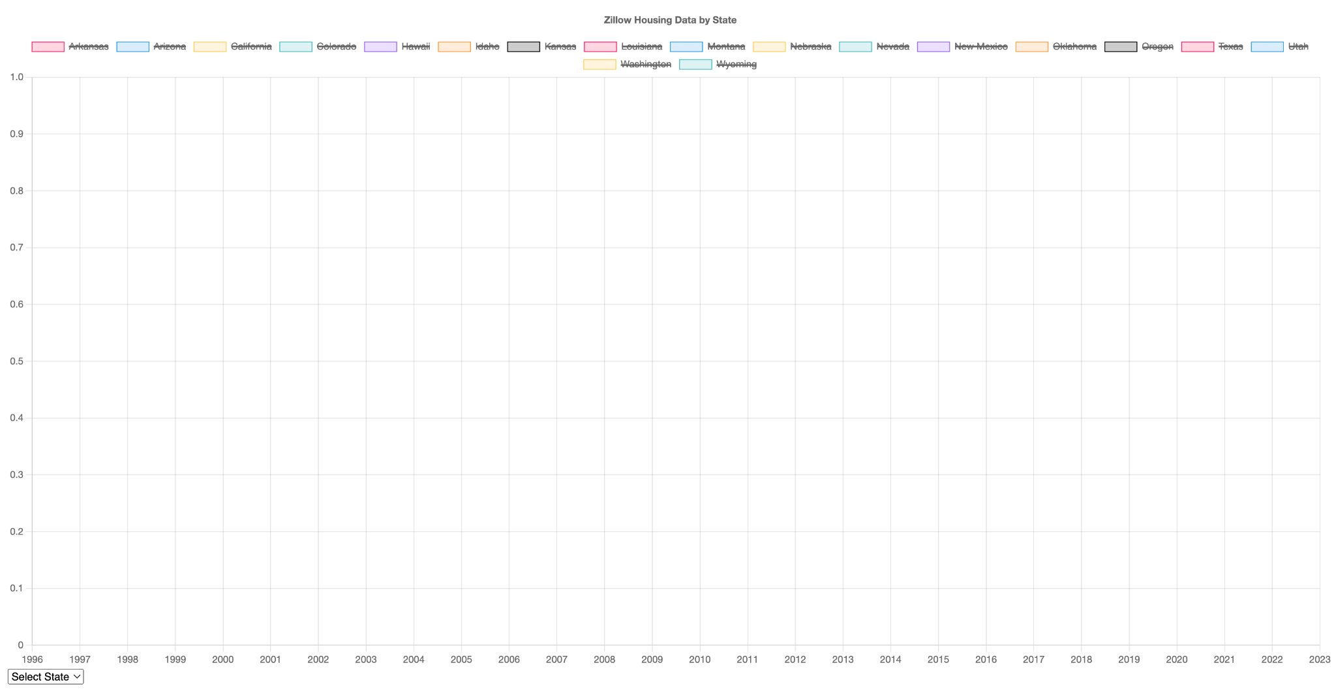
How have trends in housing prices changed over time, by state?
However, with states like California, Colorado, and Washington, we can see a gradual increase as the year increases.

Slide 9
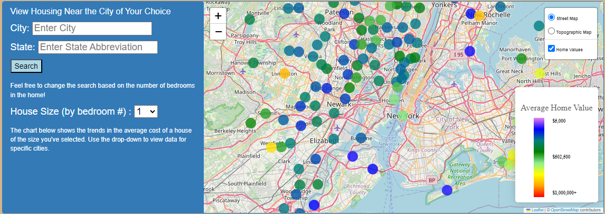
What housing is currently available by region?
This map shows the color-coded average cost of housing in each city nearby to the searched city, limited to houses of specific size as selected in the dropdown. Selecting a city brings up a pop-up with the numerical average cost of a house, the name of the city, and the date of last update, so that users can see how recent the data is. The map includes layers, so that home values can be filtered on and off, and users can toggle between street and topographic views. Searching a new city keeps past searches on the map (so if I search New York and then Boston, I can zoom out and see both result sets), but changing house size resets the results to avoid confusion from mixed housing types on the map. The map responds to cities not contained in our data set or improperly entered with an error message.

Slide 10
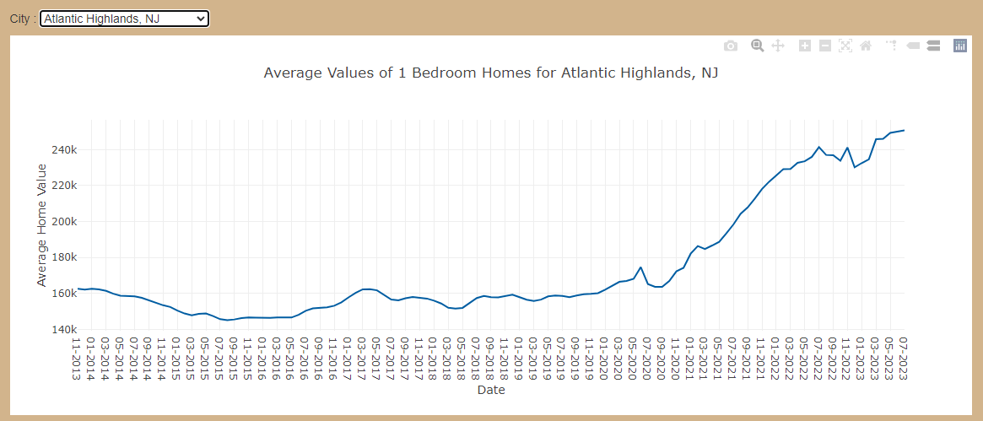
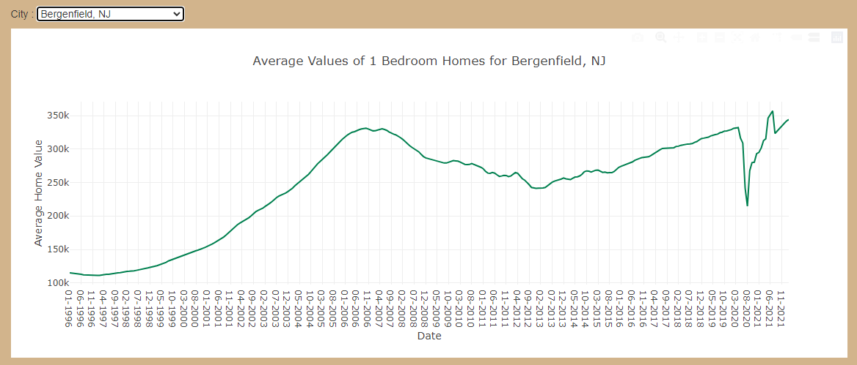
A Deeper Dive into Local Housing Trends
The line graph below the map shows time series data for housing cost in cities based on house size. This graph shares controls with the map with its default city the same as the most recent search, but also contains an alphabetized list of all nearby locations so that users can view the trends in housing prices for the city of their choice.
This way, users can search for promising trends in housing values. Someone who flips houses might be inspired by an upward trend in home values, while a first time home-buyer might be looking for unprecedented low prices.

Slide 11
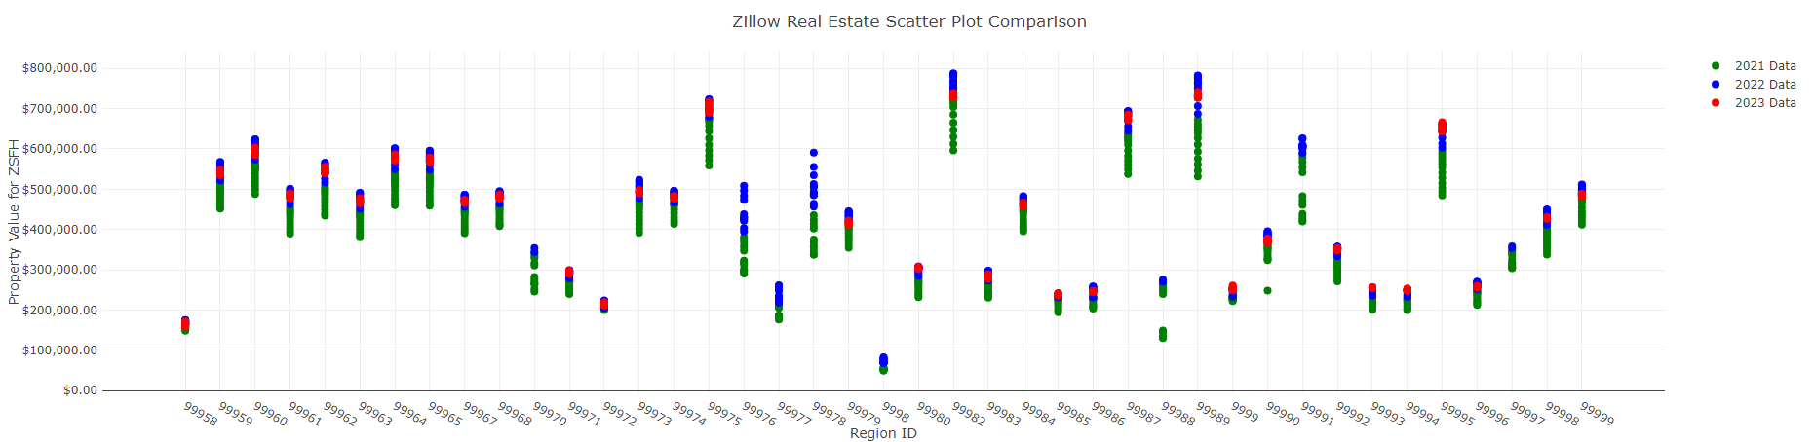
Market Trends in Property Value For Single Family Homes

Slide 12
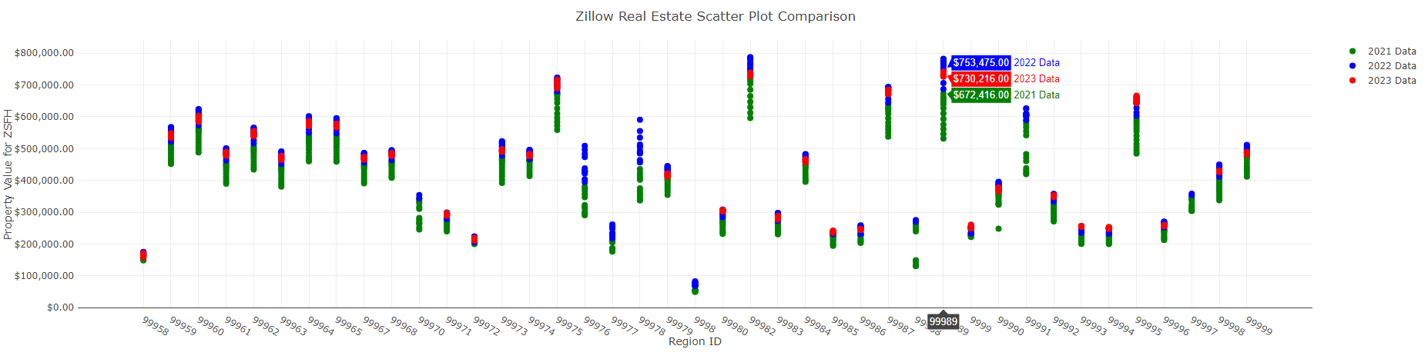
Example of Price Change in Specific Region…

Slide 13
Descriptive Statistics for ZSFH
Mean: $258,173
Minimum: $49,942 (2021, Region ID - 9998, Birchleaf, VA, Dickenson County)
Maximum: $787,198 (2022, Region ID - 99982, Wenatchee, WA, Chelan County)

Slide 14
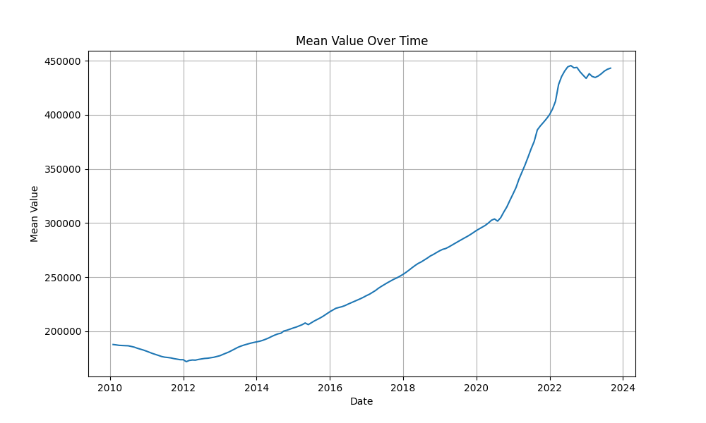
Average Values for Single Family Homes

