Slide 1
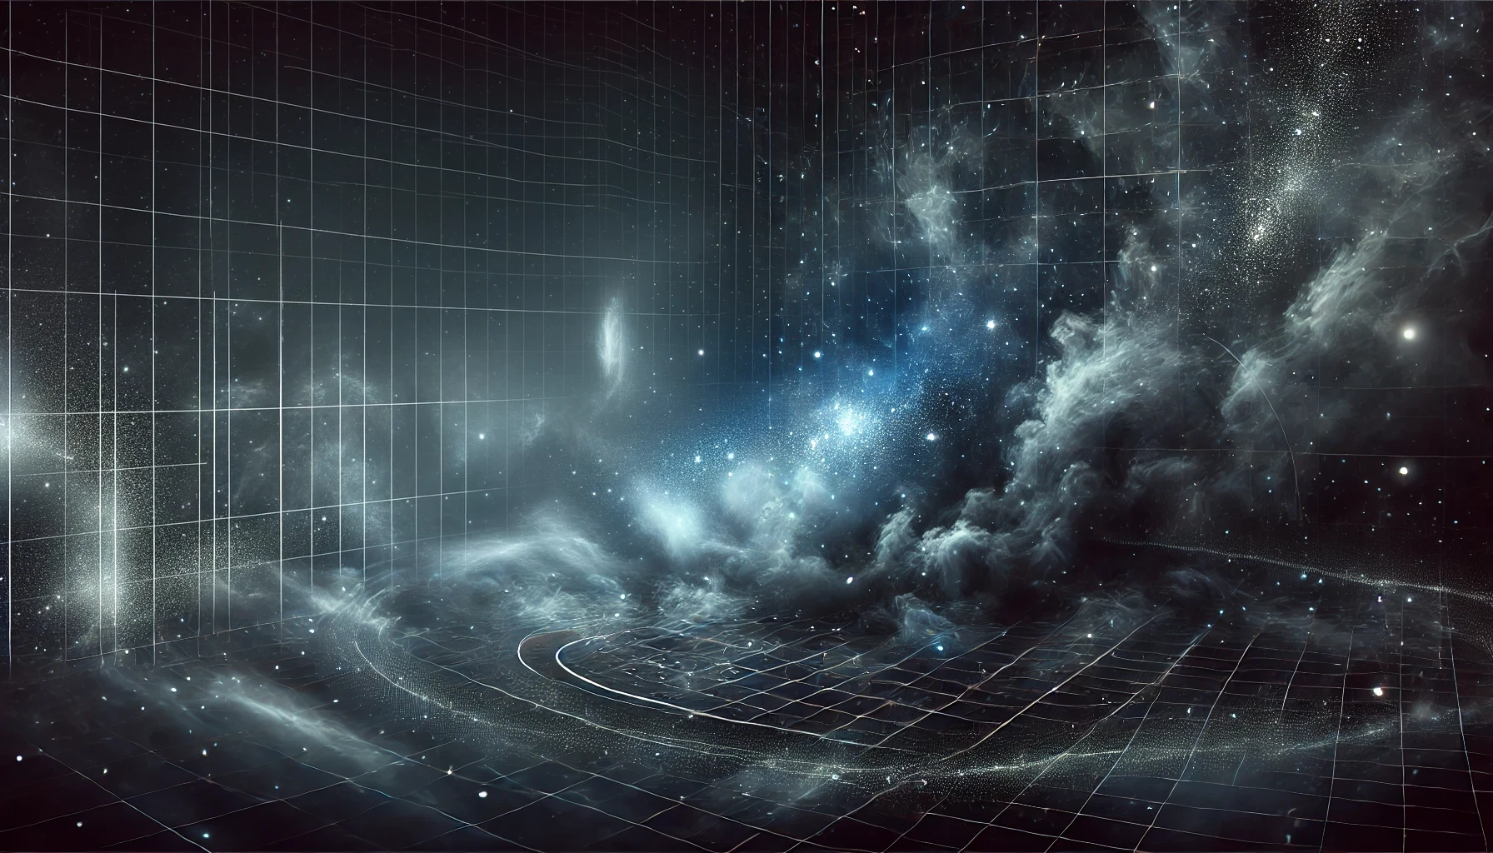
Regions of the stellar initial mass function
Chiara, Felix, Laxman

