Slide 1
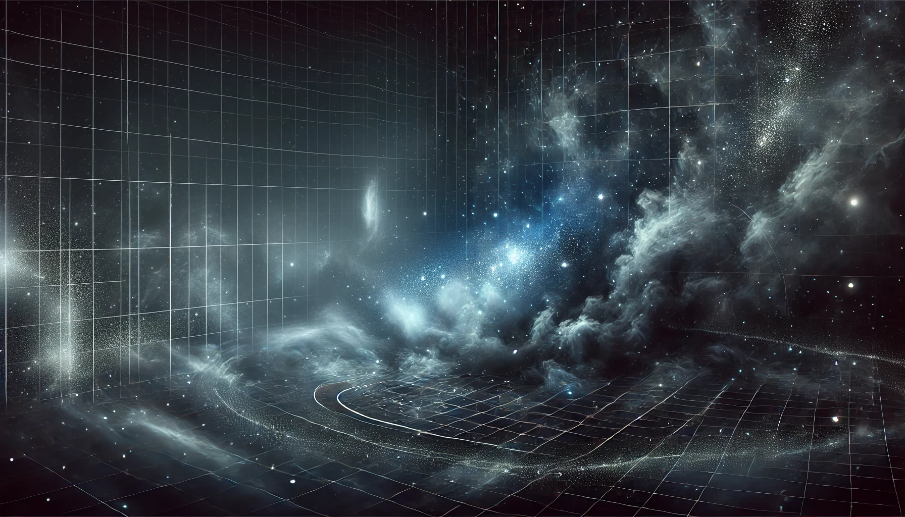
Regions of the stellar initial mass function
Chiara, Felix, Laxman
University of Vienna

Slide 2
The Stellar Initial Mass Function (IMF)
What is the IMF?
The IMF describes how many stars of each mass form in a star cluster.
Why is it important?
Information about star formation, galaxy evolution, and the chemical elements in the universe [1,3]
How is it used?
Estimate the masses of the stars, predict how galaxies evolve over time,…
[1] Review paper 2024 (Hennebelle et al.): The Physical Origin of the Stellar Initial Mass Function
[3] Original paper 1955 (Salpeter): The Luminosity Function and Stellar Evolution [6] Recent Study 2024 (Kroupa et al.): The initial mass function of stars

Slide 3

Foundations of the IMF: Salpeter (1955)
Salpeter’s Discovery
Edwin Salpeter first described the IMF as a power law.
He found that the number of stars decreases with increasing mass:
Salpeter Slope: $N(M) ∝M^{−2.35}$
This means there are many low-mass stars and few high-mass stars [3].
Impact
Salpeter’s work helped us understand the basic structure of star populations.

Slide 4
What do we know about the IMF
Does the IMF change?
New studies show that the IMF may vary depending on the type of galaxy [2].
In Massive Galaxies:
The IMF can be «bottom-heavy», with more low-mass stars, especially in massive galaxies called early-type galaxies [2].
What causes this?
Turbulance, magnetic fields, and gravity in star-forming clouds can influence the IMF’s shape [1].
[2] Review paper 2020 (Russell J. Smith): Evidence for Initial Mass Function Variation in Massive Early-Type Galaxies
[1] Review paper 2024 (Hennebelle et al.): The Physical Origin of the Stellar Initial Mass Function

Slide 5
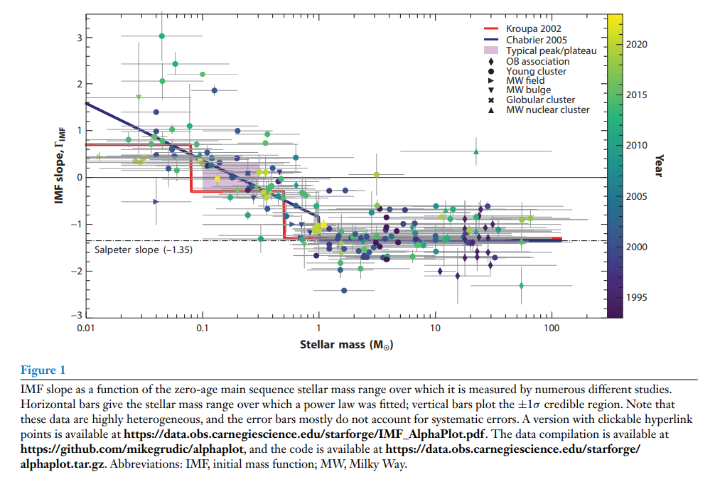
Figure from Hennebelle et al. (2024)
Illustration of how the IMF slope changes with stellar mass, highlighting the debate over IMF universality
[1] Review paper 2024 (Hennebelle et al.): The Physical Origin of the Stellar Initial Mass Function

Slide 6
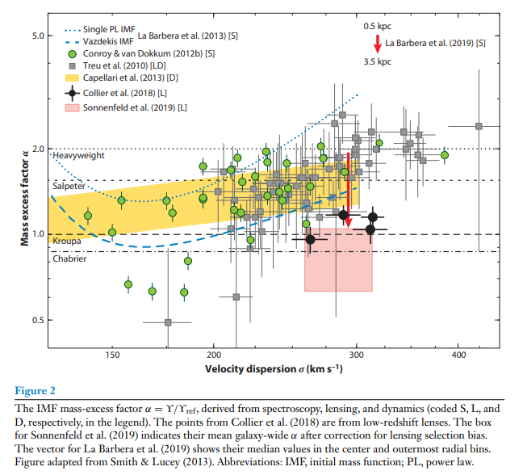
Figure from Russell J. Smith (2024)
Visualization of the IMF mass-exess factor in early-type galaxies, supporting the idea of IMF variability across galaxy types.

Slide 7
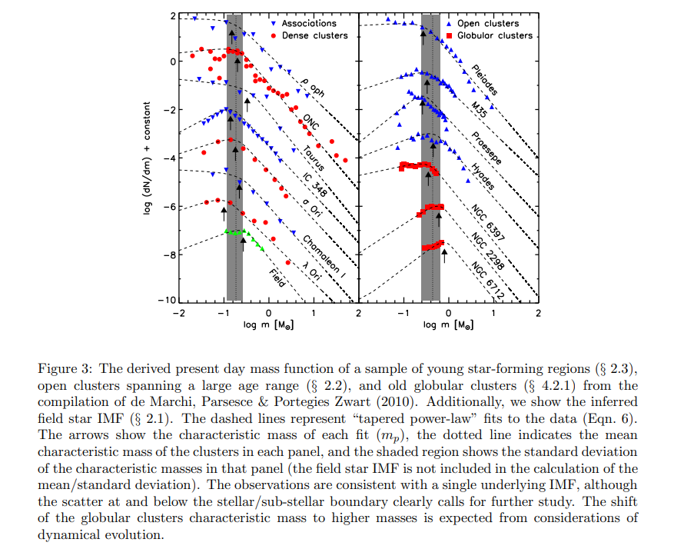
Figure from Bastian et.al. (2010)
IMF for different regions within the Milky Way
[7] Review paper 2010 (Bastian et.al.) A Universal Stellar Initial Mass Function? A Critical Look at Variations

Slide 8
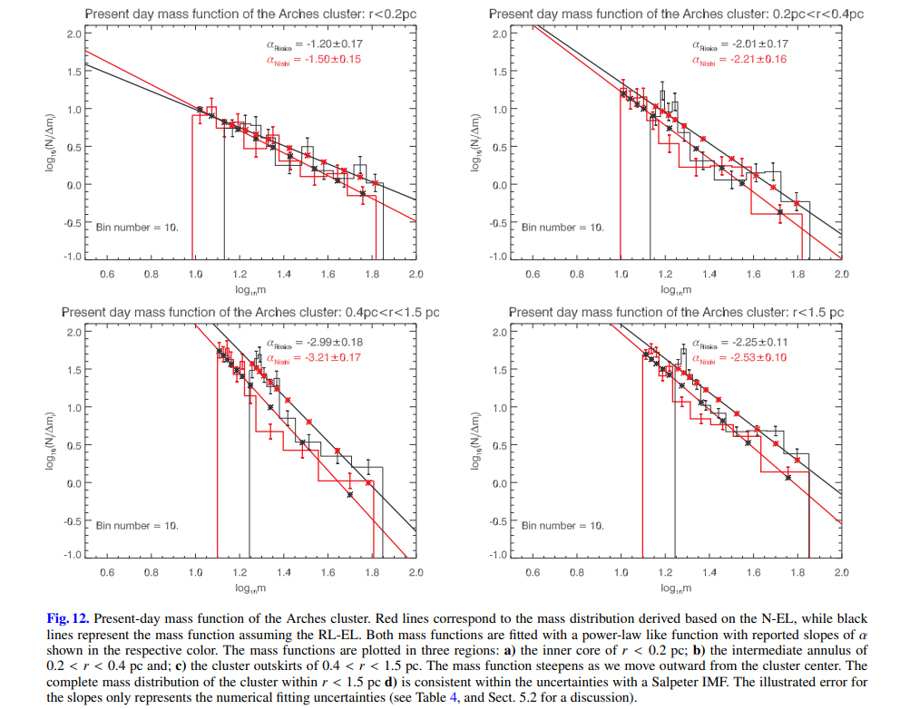
Figure from Habibi (2013)
IMF for Arches Cluster (Galactic Centre)
[8] Paper 2013 (Habibi et. al.) The Arches cluster out to its tidal radius: dynamical mass segregation and the effect of the extinction law on the stellar mass function?,??

Slide 9
Recent Advances in IMF
New Tools for IMF study:
Upcoming instruments, like MICADO on the ELT, will allow us to study dense star clusters with more detail [4].
Mass Segregation:
Studies suggest that massive stars in clusters form closer to the center. This process, called mass segregation, affects the evolution of star clusters [5].
Modern IMF Models:
Recent models explore the IMF as a statistical distribution, shaped by the conditions in star-forming regions. This may explain why the IMF is not the same in all galaxies [6].
[4] Recent Study 2020 (Leschinski et al.): The future of IMF studies with the ELT and MICADO. I. The local Universe as a resolved IMF laboratory
[5] Recent Study 2019 (Pavlik et al.): Do star clusters form in a completely mass-segregated way?
[6] Recent Study 2024 (Kroupa et al.): The initial mass function of stars

Slide 10
Summary and Conclusion
The IMF helps us understand how stars form and evolve.
Salpeter’s original IMF model describes the general pattern of many low-mass stars and few high-mass stars [3].
New research shows that the IMF may vary across different environments [1,2].
Future of the IMF:
New telescopes and models may help us answer open questions about the IMF’s variability and its role in galaxy formation [4,6].
[1] Review paper 2024 (Hennebelle et al.): The Physical Origin of the Stellar Initial Mass Function
[2] Review paper 2020 (Russell J. Smith): Evidence for Initial Mass Function Variation in Massive Early-Type Galaxies
[3] Original paper 1955 (Salpeter): The Luminosity Function and Stellar Evolution
[4] Recent Study 2020 (Leschinski et al.): The future of IMF studies with the ELT and MICADO. I. The local Universe as a resolved IMF laboratory
[6] Recent Study 2024 (Kroupa et al.): The initial mass function of stars

