Slide 1
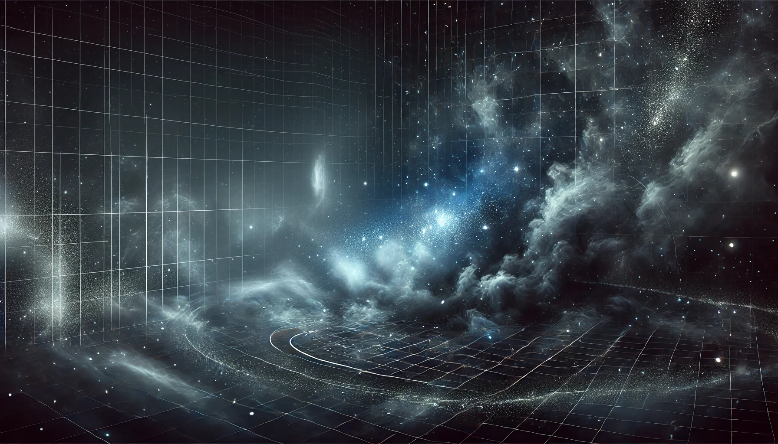
Regions of the stellar initial mass function
Chiara, Felix, Laxman
University of Vienna

Slide 2
Introduction to the Stellar Initial Mass Function (IMF)

Slide 3
The Original Paper by Salpeter (1955)

Slide 4
Insights from Review Papers

Slide 5
Recent Studies

Slide 6
Summary and Conclusion

