Slide 1
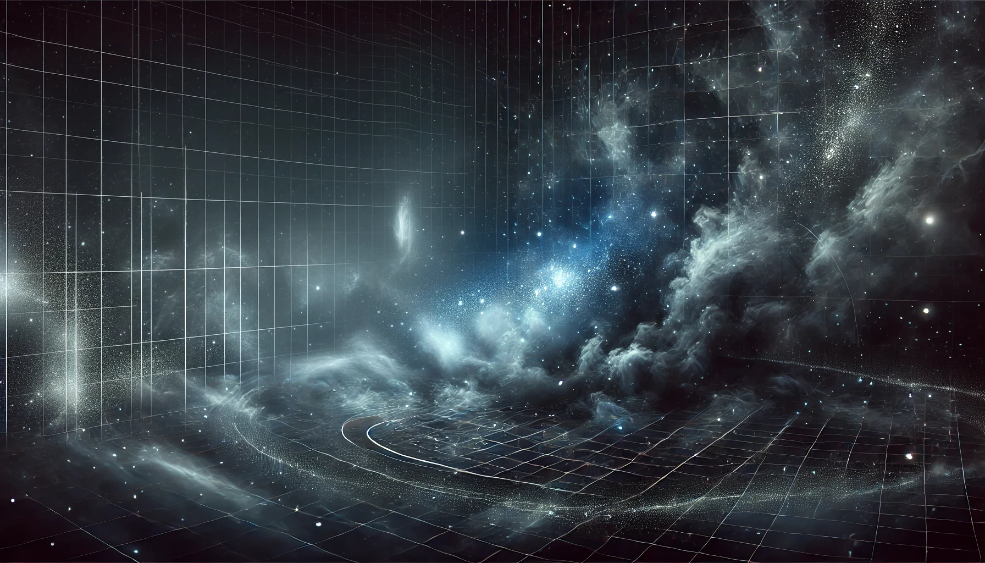
Regions of the stellar initial mass function
Chiara, Felix, Laxman
University of Vienna

Slide 2
The Stellar Initial Mass Function (IMF)
What is the IMF?
The IMF describes how many stars of each mass form in a star cluster.
Why is it important?
It tells us about star formation, galaxy evolution, and the chemical elements in the universe [1,3].
How is it used?
Scientists use it to estimate the masses of the stars and predict how galaxies evolve over time.

Slide 3

Foundations of the IMF: Salpeter (1955)
Salpeter’s Discovery
Edwin Salpeter first described the IMF as a power law.
He found that the number of stars decreases with increasing mass:
Salpeter Slope: $N(M) ∝M^{−2.35}$
This means there are many low-mass stars and few high-mass stars [3].
Impact
Salpeter’s work helped us understand the basic structure of star populations.

Slide 4
What do we know about the IMF
Does the IMF change?
New studies show that the IMF may vary depending on the type of galaxy [2].
In Massive Galaxies:
The IMF can be «bottom-heavy», with more low-mass stars, especially in massive galaxies called early-type galaxies [2].
What causes this?
Turbulance, magnetic fields, and gravity in star-forming clouds can influence the IMF’s shape [1].

Slide 5
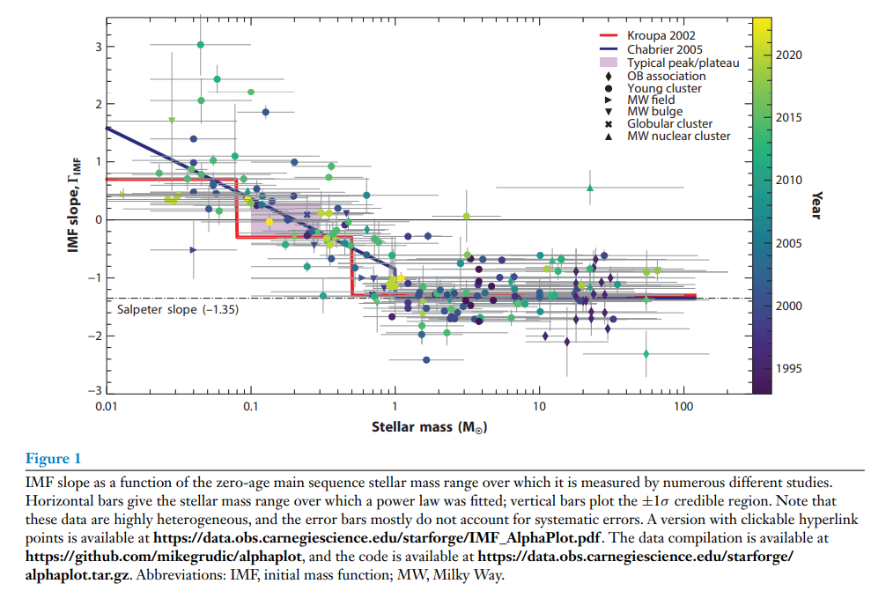
Figure 1 from Hennebelle et al. (2024)
Illustration of how the IMF slope changes with stellar mass, highlighting the debate over IMF universality

Slide 6
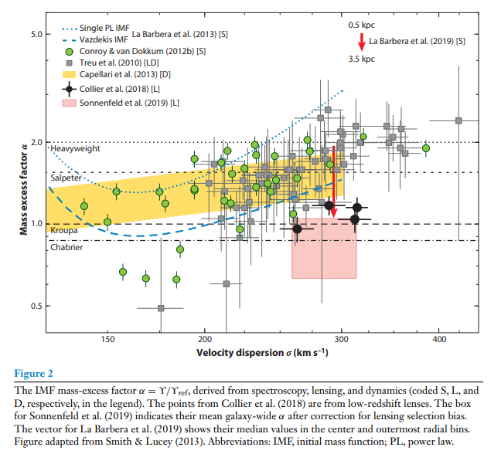
Figure 2 from Russell J. Smith (2024)
[2] Review paper 2020 (Russell J. Smith): Evidence for Initial Mass Function Variation in Massive Early-Type Galaxies
Visualization of the IMF mass-exess factor in early-type galaxies, supporting the idea of IMF variability across galaxy types.

Slide 7
Recent Advances in IMF
New Tools for IMF study:
Upcoming instruments, like MICADO on the ELT, will allow us to study dense star clusters with more detail [4].
Mass Segregation:
Some studies suggest that stars in clusters form with massive stars closer to the center. This process, called mass segregation, affects the evolution of star clusters [5].
Modern IMF Models:
Recent models explore the IMF as a statistical distribution, shaped by the conditions in star-forming regions. This may explain why the IMF is not the same in all galaxies [6].

Slide 8
Summary and Conclusion
The IMF helps us understand how stars form and evolve.
Salpeter’s original IMF model describes the general pattern of many low-mass stars and few high-mass stars [3].
New research shows that the IMF may vary across different environments [1,2].
Future of the IMF:
New telescopes and models will help us answer open questions about the IMF’s variability and ist role in galaxy formation [4,6].

