Slide 1
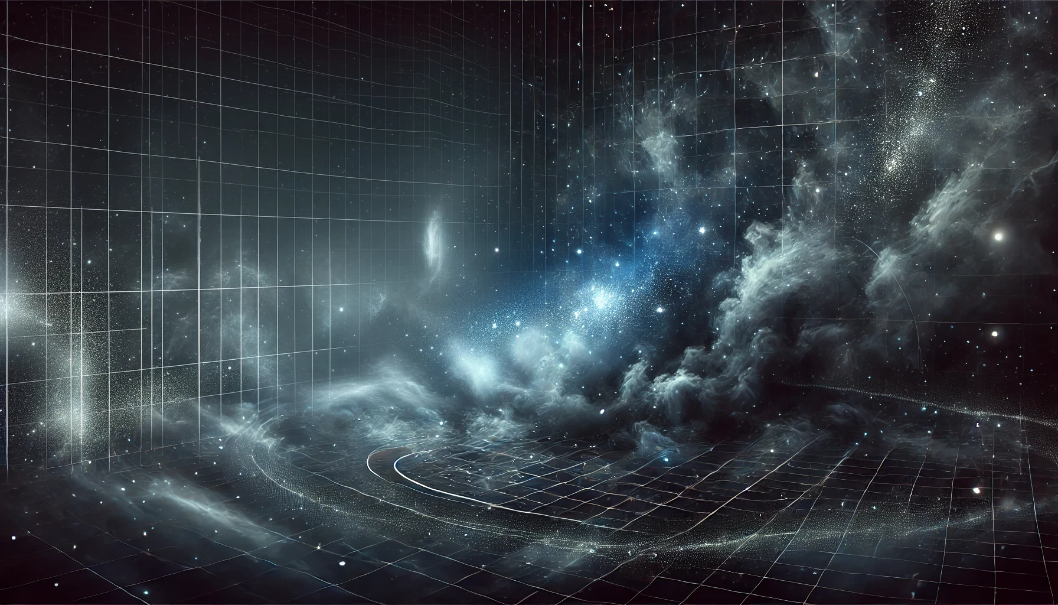
Regions of the stellar initial mass function
Chiara, Felix, Laxman
University of Vienna

Slide 2
The Stellar Initial Mass Function (IMF)
What is the IMF?
The IMF describes how many stars of each mass form in a star cluster.
Why is it important?
It tells us about star formation, galaxy evolution, and the chemical elements in the universe [1,3].
How is it used?
Scientists use it to estimate the masses of the stars and predict how galaxies evolve over time.

Slide 3

Foundations of the IMF: Salpeter (1955)
Salpeter’s Discovery
Edwin Salpeter first described the IMF as a power law.
He found that the number of stars decreases with increasing mass:
Salpeter Slope: $N(M) ∝M^{−2.35}$
This means there are many low-mass stars and few high-mass stars.
Impact
Salpeter’s work helped us understand the basic structure of star populations.

Slide 4
Review of IMF Variability and Origins
Does the IMF change?
New studies show that the IMF may vary depending on the type of galaxy.
In Massive Galaxies:
The IMF can be «bottom-heavy», with more low-mass stars, especially in massive galaxies called early-type galaxies.
What causes this?
Turbulance, magnetic fields, and gravity in star-forming clouds can influence the IMF’s shape.

Slide 5
Recent Advances in IMF
New Tools for IMF study:
Upcoming instruments, like MICADO on the ELT, will allow us to study dense star clusters with more detail.
Mass Segregation:
Some studies suggest that stars in clusters form with massive stars closer to the center. This process, called mass segregation, affects the evolution of star clusters.
Modern IMF Models:
Recent models explore the IMF as a statistical distribution, shaped by the conditions in star-forming regions. This may explain why the IMF is not the same in all galaxies.

Slide 6
Summary and Conclusion
The IMF helps us understand how stars form and evolve.
Salpeter’s original IMF model describes the general pattern of many low-mass stars and few high-mass stars.
New research shows that the IMF may vary across different environments.
Future of the IMF:
New telescopes and models will help us answer open questions about the IMF’s variability and ist role in galaxy formation.

