Slide 2
Job Portal
Laxman Rumba

Slide 3

Problem Statements
Difficulty in finding jobs that matches job
job seekers skills and experience.
Struggle to rank candidates based on skills
experience and relevance.

Slide 4
Objective
To automate the process of matching job seekers with relevant job opportunities based on their skills and experience.
To help recruiters quickly find the most suitable candidates, saving time and effort in the hiring process.

Slide 5
Introduction
Job Portal is designed to help job seekers find relevant job opportunities based on their skills, experience, and qualifications, while also assisting recruiters in finding the most suitable candidates. The system uses an algorithm to analyze data from user resumes and match it with job descriptions.

Slide 6
Technology Used
Frontend
React JS
Tailwind CSS
Context API
Axios
Backend
Node JS
Express JS
MongoDB (Mongoose)
Cloudinary

Slide 7

Features
Client Side:
Job Seeker
1. Register, login and manage profile.
2. Search and filter jobs.
3. Apply to jobs.
4. Receive notifications.
Recruiters
1.Register, login and manage company profiles.
2. Manage job listing.
3. View and manage applicants.

Slide 8

Features
Admin Side:
1. Manage users.
2. View Reports (e.g., number of applications, active users)
3. Manage contents.

Slide 9
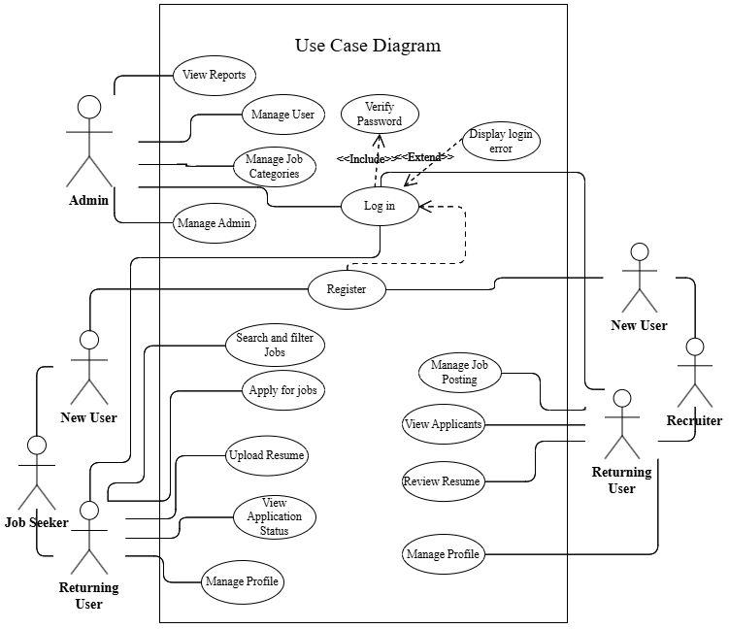

Slide 10
Algorithm used
TF-IDF (Term Frequency-Inverse Document Frequency) algorithm
TF-IDF is a statistical algorithm used to evaluate how important a word is in a document relative to a collection of documents (corpus). It helps rank resumes by analyzing the relevance of keywords from job descriptions in candidate resumes.
TF (Term Frequency): Measures how often a term appears in a document.
IDF (Inverse Document Frequency): Reduces the importance of common words and highlights unique terms.
By multiplying TF × IDF, we get the TF-IDF score, which ranks resumes based on how closely they match the job description.

Slide 11

Mathematical expression of TF-IDF algorithm
TF - IDF(t, d) = TF(t, d) × IDF(t)
Where:
TF (Term Frequency):
TF(t, d) = $\frac{f_{t}}{N}$
​ $f_{t}$= Number of times term t appears in document d N = Total number of words in document d
IDF (Inverse Document Frequency):
IDF(t)= $\log\left(\frac{D}{1+d_{t}}\right)$
D = Total number of documents $d_{t}$= Number of documents containing term t

Slide 12
Final Ranking for Resume Ranking & Job Recommendation
1. Resume Ranking for Recruiters
Step 1: Calculate the TF-IDF score for each term in a resume based on the job description.
Step 2: Sum up the TF-IDF scores for all terms in each resume.
Result: The higher the score, the more relevant the resume is for the job.
2. Job Recommendation for Job Seekers
Step 1: Calculate the TF-IDF score for each term in a job description based on the candidate’s resume.
Step 2: Sum up the TF-IDF scores for all terms in each job posting.
Result: The higher the score, the more relevant the job is for the candidate.

Slide 13
Expected output
Accurate Resume Ranking
Recruiters can see a ranked list of candidates based on relevance to the job description.
Higher-ranked resumes match better with the job requirements.
Personalized Job Recommendations:
Job seekers receive a list of jobs ranked by relevance to their skills and experience.
The system ensures that job seekers find the most suitable opportunities.
Efficient Matching Process:
Automated ranking reduces manual effort for recruiters.
Job seekers can quickly find jobs without searching extensively.
Seamless User Experience:
Fast and efficient search and recommendation system.
Improved hiring decisions through data-driven matching.

Slide 14

Conclusion
This MERN stack job portal leverages TF-IDF ranking to enhance resume filtering and job recommendations. It simplifies recruitment and job searching, making the hiring process faster, smarter, and more effective.

