Slide 1
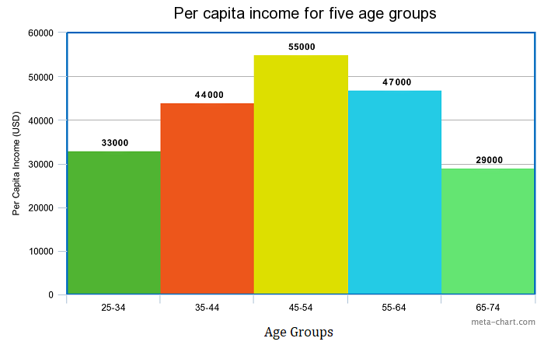
Chart 1- I like
ChaAttribitues of Chart 1rt 1- I like
Self-explanatory title on the top
X-axis and Y-axis labelled properly
The chart is not cluttered.
Both axis are stated on equal intervals
Colorful and visual appealing

Slide 2
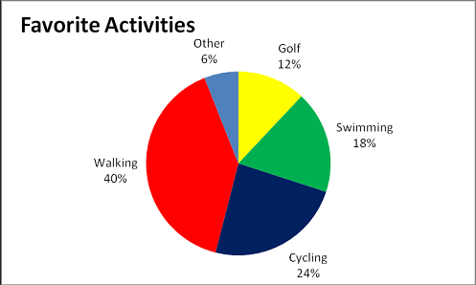
Chart 2- I like
ChaAttribitues of Chart 2rt 1- I like
Relevant title on the top
The chart is well labelled
The chart is simple & informative
The sum of total percentage is 100%
Colorful and visual appealing

Slide 3
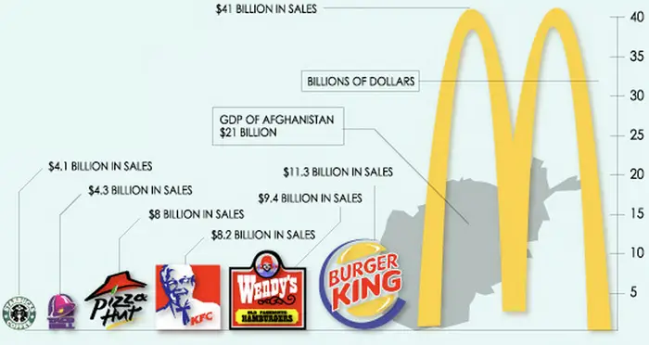
Chart 1- I don’t like
ChaAttribitues of Chart 1rt 1- I like
No chart title on the top
The chart is not well labelled
The chart is very cluttered
The company logo is not same size
Not informative at a first glance

Slide 4
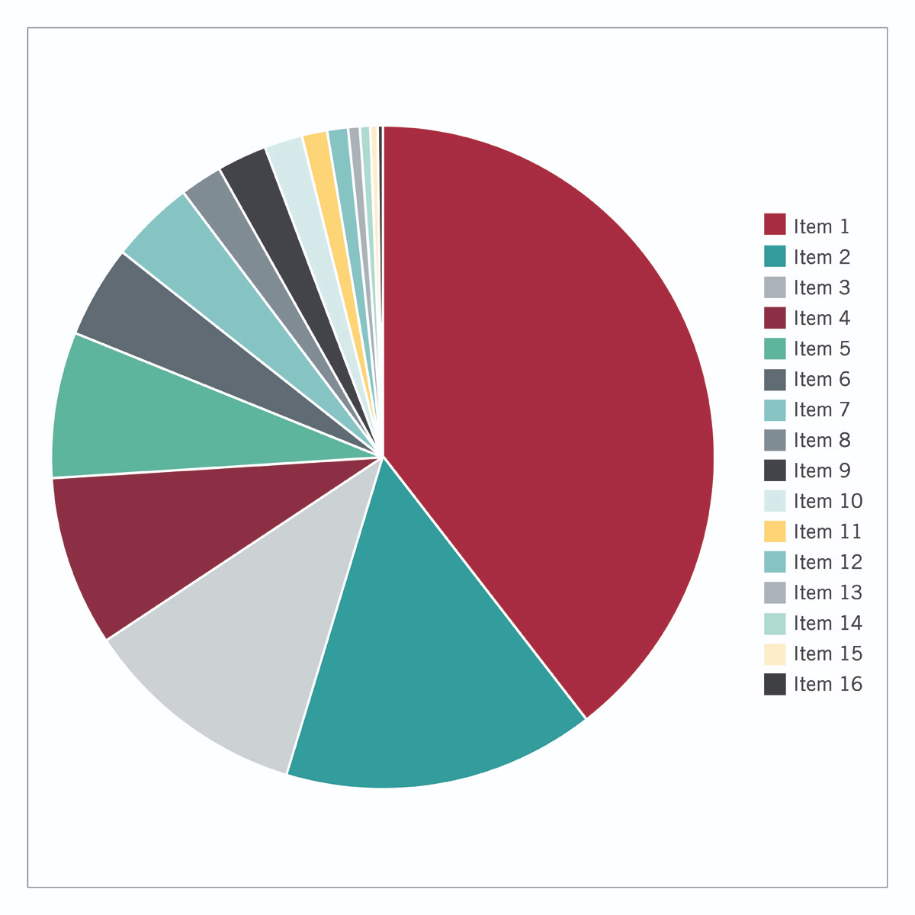
Chart 2- I don’t like
ChaAttribitues of Chart 2rt 1- I like
Absence of title on the top
Similar colors used for different items
The chart looks very cluttered
The chart is not well labelled
Information is limited on chart

Slide 5
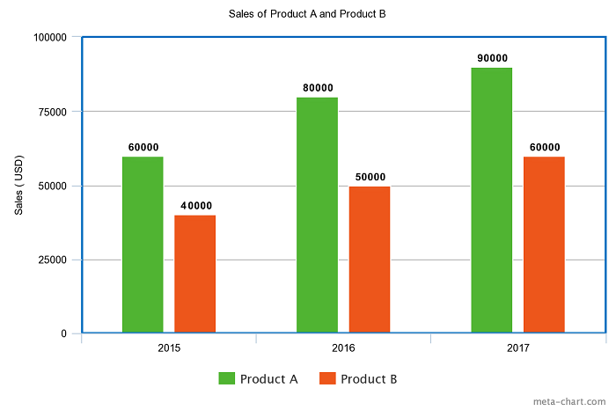
Chart 1- clear chart
ChaAttribitues of Chart 1rt 1- I like
Good chart title on the top
Both axis are labelled properly
No cluttered on the chart.
Product A & B can be compared clearly
Visual appealing to audience

Slide 6
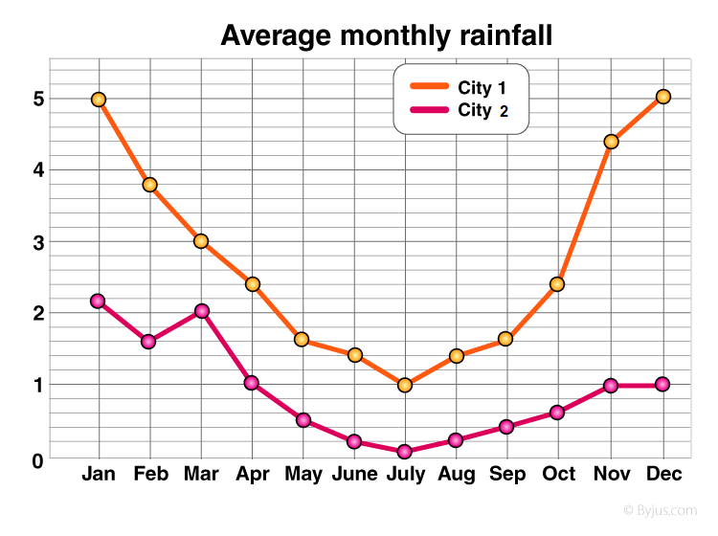
Chart 2- clear chart
ChaAttribitues of Chart 2rt 1- I like
Appropriate chart title on the top
Both axis are well labelled
The chart is simple and clean
City 1 & City 2 can be compared clearly
The chart is visually informative

Slide 7
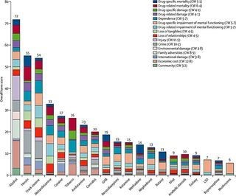
Chart 1- muddled chart
ChaAttribitues of Chart 1rt 1- I like
No chart title on the top
Both axis label are not visible
The chart is way too cluttered
Different factors can’t be compared clearly
The chart is not informative at all

Slide 8
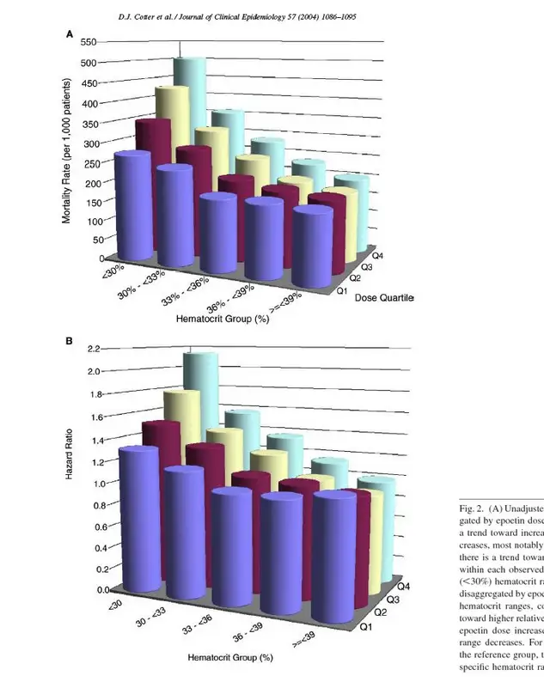
Chart 2- muddled chart
ChaAttribitues of Chart 2rt 1- I like
Visual distraction on the chart
Both axis label are too messy
The chart is unnecessarily cluttered
Different factors can’t be precisely compared
Complicated & hard to understand

Slide 9
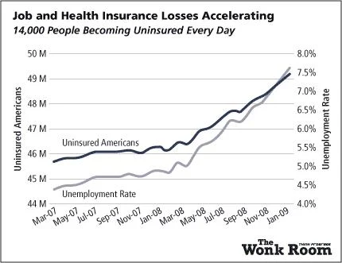
Chart 1- deceptive chart
ChaDeceptive technique - Chart 1rt 1- I like
The chart looks like unemployment rate & uninsured Americans are rising at the same proportion
The chart has two y-axes
Unemployment increase more rapidly from 4.5% to 7.5%
Uninsured Americans increase only from 15 % to 16% by calculation
Classic way of deception on chart

Slide 10
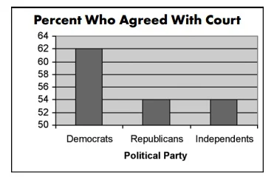
Chart 2- deceptive chart
ChaDeceptive technique - Chart 2rt 1- I like
The chart looks like 3 times Democrats agreed with court
Only slight more democrats agreed
Democrats vs Republicans / Independents is only 62% vs 54%
The baseline is not zero on y-axis
Not true representation of data

