Slide 1
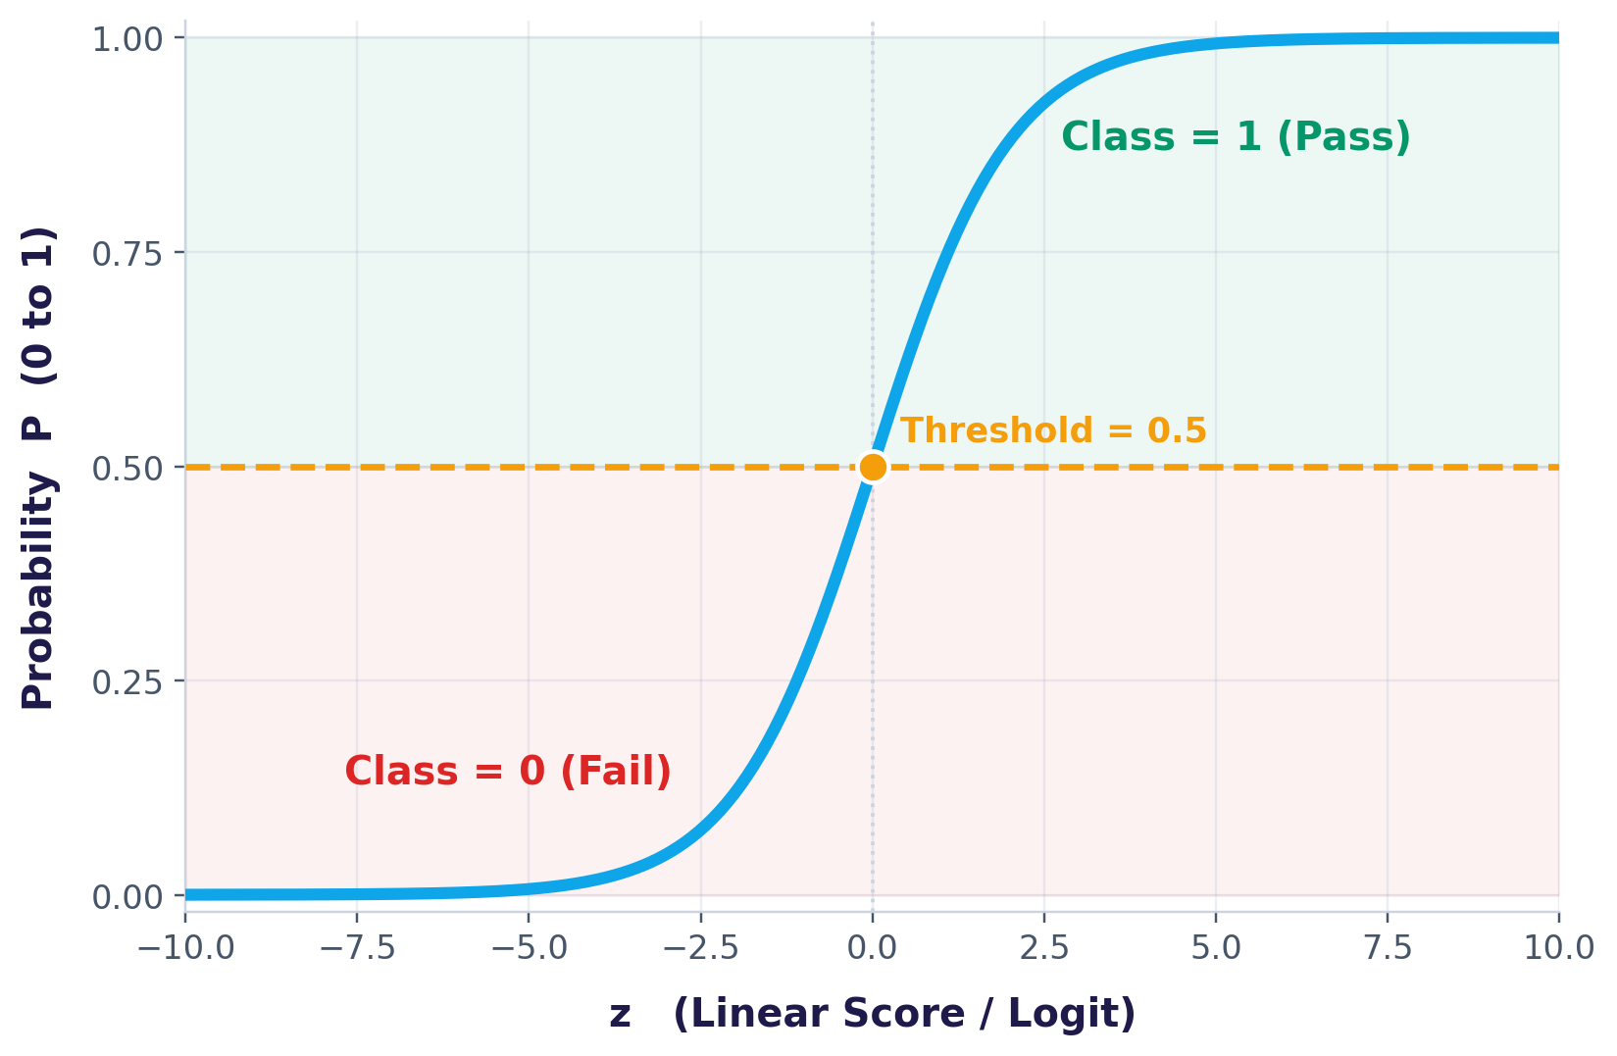
MACHINE LEARNING NOTES
Complete Logistic
Regression Notes
Beginner to Intermediate
Gradient Descent · Maximum Likelihood Estimation · Cross-Entropy Loss

Slide 2
ROADMAP
From a Straight Line to a Classifier
1-4
5-7
8-12
13-14
Foundations
The Sigmoid
Learning the Model
Optimization
Why linear regression fails at classification, and why we keep its equation
Turning the linear score (logit) into a bounded probability, and a decision boundary
Loss, cost, cross-entropy, and why Maximum Likelihood replaces MSE
Gradient Descent and the full end-to-end training workflow
Logistic Regression
2

Slide 3

STEP 1
STEP 1
Start with Linear Regression
Goal: Predict House Price (a continuous output).
PREDICTION EXAMPLE
House Size (x₁) | Bedrooms (x₂) | Price (y)
1000 | 2 | 40 Lakhs
1200 | 2 | 50 Lakhs
1500 | 3 | 65 Lakhs
Assume β₀=5, β₁=0.03, β₂=4
y = 5 + 0.03(1500) + 4(3)
= 62 Lakhs
Linear Regression Equation
y = β₀ + β₁x₁ + β₂x₂
Linear Regression works because price is continuous.
β₀ = Intercept β₁ = Weight of House Size β₂ = Weight of Bedrooms
Logistic Regression
3

Slide 4

STEP 2
Convert the Problem into Classification
Predict Pass (1) or Fail (0).
The Twist
Hours (x₁) | Attendance (x₂) | Pass (y)
1 | 40 | 0
2 | 55 | 0
3 | 75 | 1
4 | 90 | 1
5 | 95 | 1
The output is no longer a smooth continuous number like price. It's a binary label — exactly two possible outcomes: Pass or Fail.
0 — Fail
1 — Pass
This is exactly the kind of problem Linear Regression was never designed for.
Logistic Regression
4

Slide 5

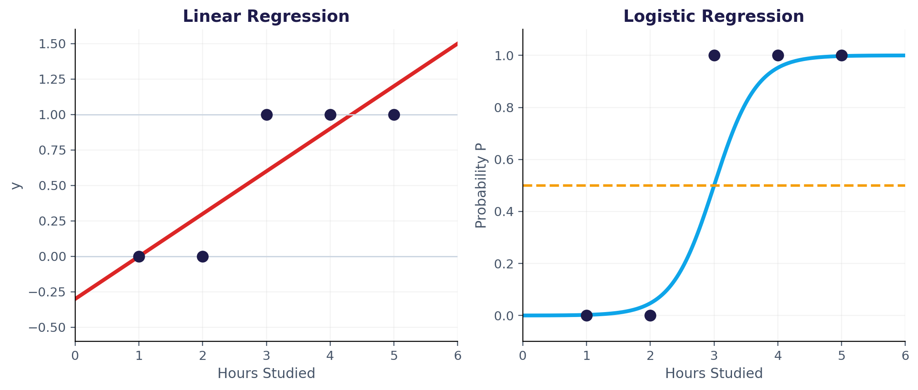
STEP 3
Why Linear Regression Fails
Using y = β₀ + β₁x₁ + β₂x₂ with β₀=-4, β₁=1.5, β₂=0.05:
Hours = 6, Attendance = 95
y = 9.75
Impossible
Hours = 0, Attendance = 20
y = -3
Impossible
Linear Regression can predict values outside [0, 1]; Logistic Regression stays bounded.
Reason: Linear Regression predicts values from (-∞, +∞), but classification requires probabilities between 0 and 1.
Logistic Regression
5

Slide 6

STEP 4 - 5
Keep the Equation — Meet the Logit
STEP 4 · Keep the Linear Equation
STEP 5 · Linear Score (Logit)
Scientists kept the linear equation because β coefficients measure feature importance.
Rename the output as z:
z = β₀ + β₁x₁ + β₂x₂
Only the output transformation changes.
z is called the Linear Score or Logit. It is an intermediate score — not the final prediction.
The weights β₀, β₁, β₂ keep the same meaning — only what happens to their output changes next.
Logistic Regression
6

Slide 7

STEP 6
The Sigmoid Function
Sigmoid converts any real number into a probability.
P = 1 / (1 + e^-z)
PROPERTIES
Output is always between 0 and 1
z = 0 → P = 0.5
Large positive z → Probability near 1
Large negative z → Probability near 0
EXAMPLE
z = 9.75 → P ≈ 0.99994
z = -1 → P ≈ 0.269
Probability (Y-axis: 0 to 1) vs. z (X-axis) — the classic S-shaped curve
Logistic Regression
7

Slide 8

STEP 7
Decision Boundary
After obtaining the probability, we choose a threshold. The threshold is called the Decision Boundary — it separates the two classes.
Probability ≥ 0.5
Probability < 0.5
Class = 1 (Pass)
Class = 0 (Fail)
Threshold sits at the exact midpoint of the sigmoid curve — where z = 0 and P = 0.5.
Logistic Regression
8

Slide 9

STEP 8 - 9
Loss Function & Cost Function
STEP 8
STEP 9
Loss Function
Cost Function
A Loss Function measures the error for a single training example.
The Cost Function is the average loss over all training samples.
Close prediction → small lossWrong prediction → large loss
Training aims to minimize the cost by finding the best β₀, β₁, β₂ values.
Logistic Regression
9

Slide 10

STEP 10
Why Not Mean Squared Error (MSE)?
The Problem
The Solution
Logistic Regression does not use MSE because it creates a non-convex optimization problem, making optimization difficult.
Instead, Logistic Regression uses Cross-Entropy Loss — a smooth, convex function with a single global minimum.
Many local minima — hard to optimize
One clear global minimum — easy to optimize
Logistic Regression
10

Slide 11

STEP 11
Cross-Entropy Loss (Log Loss)
For one sample:
Loss = -[ y · log(p) + (1 - y) · log(1 - p) ]
If the model predicts the correct probability, loss is very small. Wrong, confident predictions produce a large loss.
Correct & Confident
Wrong & Confident
y = 1, p = 0.98
y = 1, p = 0.02
Loss ≈ 0.02 (tiny)
Loss ≈ 3.91 (huge)
Logistic Regression
11

Slide 12

STEP 12
Maximum Likelihood Estimation (MLE)
Instead of minimizing squared error, Logistic Regression maximizes the likelihood of observing the training data.
What MLE Does
The Key Insight
MLE chooses β values that make the observed labels most probable.
Maximizing likelihood is mathematically equivalent to minimizing Cross-Entropy Loss.
MLE ≡ Min. Cross-Entropy
Logistic Regression
12

Slide 13

STEP 13
Gradient Descent
The optimization algorithm used to update β values.
1
Initialize β values
UPDATE RULE
2
Compute z
β_new = β_old - α × Gradient
3
Apply Sigmoid to get probability
4
Compute Cross-Entropy Loss
5
Compute gradients
α is the Learning Rate — it controls how big each update step is.
6
Update β values
7
Repeat until the cost stops decreasing
Too large α → overshoots. Too small α → slow convergence.
Logistic Regression
13

Slide 14

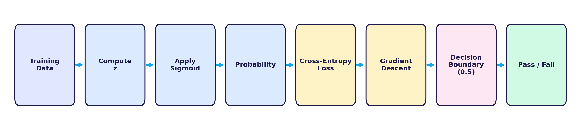
STEP 14
Complete Workflow
The end-to-end pipeline, from raw training data to the final Pass / Fail decision.
Logistic Regression
14

Slide 15

SUMMARY
Key Concepts Summary
Concept | Purpose
β₀, β₁, β₂ | Model parameters (weights)
z | Linear Score / Logit
Sigmoid | Converts score to probability
Probability | Chance of belonging to Class 1
Decision Boundary | Converts probability into class
Loss Function | Error for one sample
Cost Function | Average loss over dataset
Cross-Entropy | Loss used in Logistic Regression
MLE | Finds best parameters
Gradient Descent | Optimizes model parameters
Logistic Regression
15

Slide 16
You now know how Logistic
Regression really works.
From a straight line, to a logit, to a probability, to a trained classifier.
THANK YOU

