Slide 1
Movie Recommendation System CS550 – Final Project
Presented By:
Laxman Pottimuthi (lp642) - Representative
Ashmimtha Shetty (ajs660)
Sreeram Maddineni (sm2323)
Krishnamurthy Subramanian (ks1437)

Slide 2
Experimental Setup
Amazon Movie and TV Review dataset (~1.7M reviews)
(http://snap.stanford.edu/data/amazon/productGraph/categoryFiles/reviews_Movies_and_TV_5.json.gz)
Training Set: 75%; Test Set: 25%
Dataset | #Reviewers | #Movies | #Reviews | Sparsity
Movies & TV Rating | 123,960 | 50,052 | 1,697,533 | 0.02736%

Slide 3
Data Characteristics
Reviewer
Minimum 5 reviews
Maximum 2,213 reviews
Row Sparsity – 0.00999% - 4.42140%
Movie
Minimum 5 reviews
Maximum 2,368 reviews
Column Sparsity – 0.00403% - 1.1903%

Slide 4
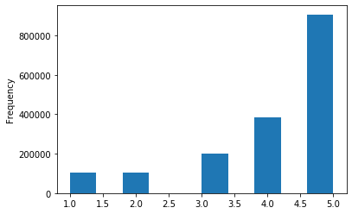
Data Characteristics - Ratings
Mean Ratings - 4.1106

Slide 5
Rating Prediction
Initial Model
Collaborative filtering using reviewer, movie and rating information will be used to fill in predictions for each reviewer for movies they haven’t rated, using the training data (75%).
The Model’s accuracy will be evaluated by calculating the MAE and RMSE
NOTE: User and Reviewer are used interchangeably in this presentation.

Slide 6
Movie Recommendation
For each user, using the predicted ratings, the top 10 movies (with highest predicted rating) that haven’t been rated by the user will be recommended.
Evaluate the quality of recommendation by using the test data and calculating precision, recall, F-measure and NDCG.

Slide 7
Model Refinements
Apply correction for User bias based on difference between users mean rating and overall mean rating for all users.
Apply correction for Movie bias based on difference between mean rating for the Movie and over all mean rating for all movies.
Evaluate the new model by calculating MAE and RMSE.
Generate new recommendation list for all users.
Evaluate quality of the recommendation using test data by calculating Precision, Recall, F-measure and NDCG.
Compare against prior model’s performance.

Slide 8
Refinements using supplemental data
Review Summary - NLP
Review Text – Use NLP techniques
Timestamps – Seasonal patterns of review frequency as a movie attribute? Month?
ASIN – Get movie attributes from Amazon and add it as another factor.
MovieLens – If we can link the 2 databases, the movie tags in MovieLens data will be an additional factor.

Slide 9
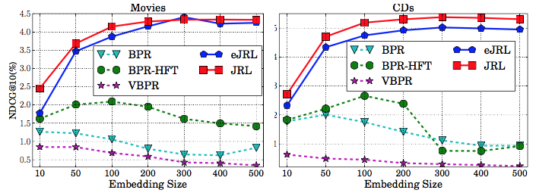
Impact of Embedding Size – Need equivalent
Tune embedding size from 10 to 500
Observations
Our model: performance keeps increasing until about 300 dimension, and does not decrease when using more dimensions.
Shallow baselines: best performance when dimension less than 100, performance decreases when using more dimensions.
What we learn
Deep models can capture more complex interaction from data
Learning ability of shallow models is limited and may over-fit if model complexity is too high.

Slide 10

Summary and Future Works - TBF
Used various heterogeneous data to provide
Significant personalization performance.
Develop a Joint Representation Learning framework for recommendation based on heterogeneous information sources.
Not only ratings, review, and images, but also extendable to new information sources.
Achieved significant improve for top-N recommendation.
Future work
Consider other representation learning architectures for recommendation
Consider other information sources for recommendation

Slide 11


Slide 12
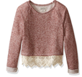

Deep Representation Learning
Deep
Representation
Learning
Deep
Representation
Learning
Deep
Representation
Learning
…
…
…

Slide 13








Joint Representation Learning
A Multi-View Machine Learning Framework with Heterogeneous Information Sources
Entity₁
Entity₂
Entity₃
Entity₄
…
Entity_{N-1}
Entity_{N}
(Deep) Representation Learning
…
…
…
…
…
…
…
V₁
…
…
…
+Item $v_{j1}$
User $u_{i}$
-Item $v_{j2}$
V₂
…
…
…
+Item $v_{j1}$
User $u_{i}$
-Item $v_{j2}$
V₃
…
…
…
+Item $v_{j1}$
User $u_{i}$
-Item $v_{j2}$
…
…
…
+Item $v_{j1}$
User $u_{i}$
-Item $v_{j2}$
S₁
>
S₂

Slide 14
Joint Representation Learning
A Multi-View Machine Learning Framework with Heterogeneous Information Sources
Review₁
Review₂
Review₃
Review₄
…
Review_{N-1}
Review_{N}
(Deep) Representation Learning
…
…
…
…
…
…
…
V₁
…
…
…
+Item $v_{j1}$
User $u_{i}$
-Item $v_{j2}$
V₂
…
…
…
+Item $v_{j1}$
User $u_{i}$
-Item $v_{j2}$
V₃
…
…
…
+Item $v_{j1}$
User $u_{i}$
-Item $v_{j2}$
…
…
…
+Item $v_{j1}$
User $u_{i}$
-Item $v_{j2}$
S₁
>
S₂

Slide 15
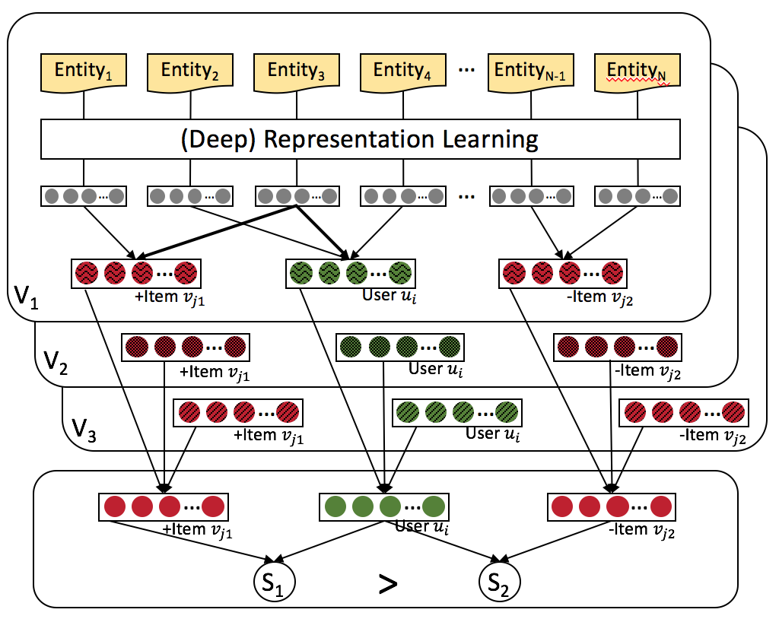


Joint Representation Learning
A Multi-View Machine Learning Framework with Heterogeneous Information Sources
L₁
L₂
L₃

Slide 16
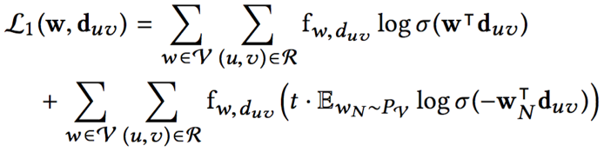








Modeling of Textual Reviews (View V₁)
Review $d_{uv}$
$$w_{uv}^{1}$$
$$w_{uv}^{2}$$
$$w_{uv}^{3}$$
…
$$w_{uv}^{n_{uv}−1}$$
$$w_{uv}^{n_{uv}}$$
Projection
…
V₁
…
…
User $u$
Item $v$
Word Embedding by Paragraph Vector Learning

Slide 17
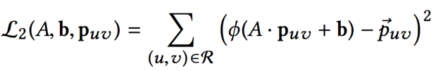



Modeling of Visual Images (View V₂)
Image $p_{uv}$
Multi-Layer Convolutional Neural Network
Multiple Fully Connected Layers
…
Fully Connected Layer
…
V₂
…
…
User $u$
Item $v$
Image Embedding by Convolutional Neural Network

Slide 18




Modeling of Numerical Ratings (View V₃)
Rating $r_{uv}$
Fully Connected Layer 2
Fully Connected Layer 1
…
…
V₃
…
…
User $u$
Item $v$
Rating Embedding by Fully Connected Layers

Slide 19
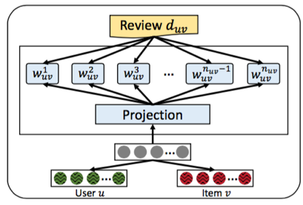
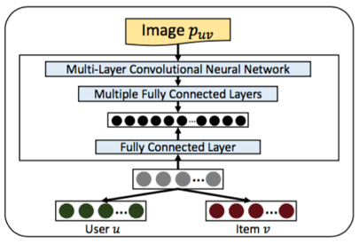
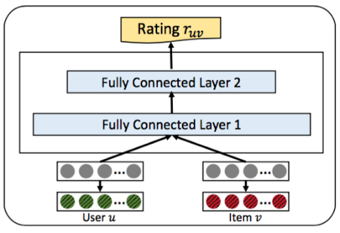
Joint Representation Learning
V₁
V₂
V₃

Slide 20
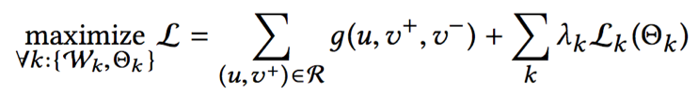
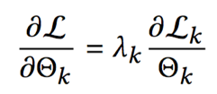
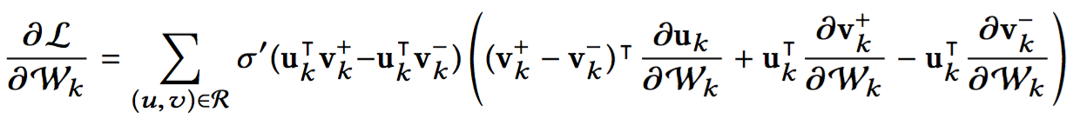
Extendable to New Information Sources
Voice
➕
Video
Text
Image
Ratings
Gradient on parameters from view k
Only contains parameters of view k itself
Independent from other views

Slide 21
Baseline methods
Baseline Methods
BPR: Bayesian Personalized Ranking with implicit feedback.
HFT: Hidden factor and topics model integrated into BPR, because the original model is designed for rating prediction. It relies on reviews.
VBPR: Visual Bayesian Personalized Ranking method based on images.

Slide 22
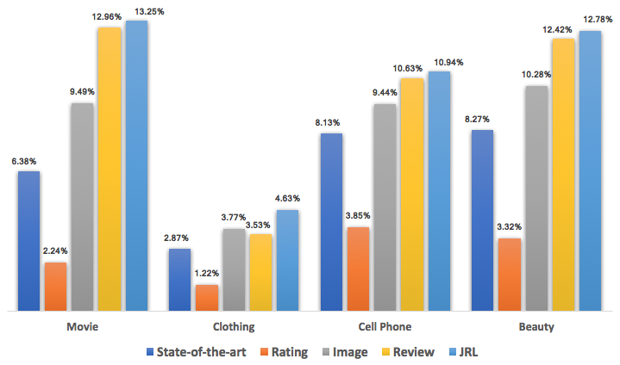
Compare with Shallow Models on NDCG
Times of
Improvement
2.08 1.61 1.34 1.54
State-of-the-art = Best of {BPR (by rating), HFT (by review), VBPR (by image)}

