Slide 1
Large-scale Data Analytics in Recommendation Systems
Project description is available at Sakai

Slide 2
Build up your team (Due by Mar 6th, next Friday)
At most 4 persons per team
Email TA the members and the representative of your team by next Friday (Mar 6)
sx86@scarletmail.rutgers.edu
Each team works on a project and give a presentation together

Slide 3
Project (Due by 4/22, Presentation on 4/24 and 5/1)
Dataset
Amazon (24 product categories: 24 sub-datasets)
MovieLens (a movie rating and review dataset)
Only need to choose one (sub-)dataset
Basic data format (Actually it is a sparse matrix)
user-id: which is denoted as “reviewerID” in the dataset
product-id: which is denoted as “asin” in the dataset
rating: a 1-5 integer star rating, which is the rating that the user rated on the product, it is denoted as “overall” in the dataset
review: a piece of review text, which is the review content that the user commented about the product, it is denoted as “reviewText” in the dataset
title: the title of the review, which is denoted as “summary” in the dataset
timestamp: time that the user made the rating and review
image: image of the product
description: a piece of text description of the product
….....

Slide 4
Project Description - Tasks
Basic Requirements
Step 1: Data prepressing and split, create a training dataset and a testing dataset for experiment
Step 2: Rating prediction, develop an algorithm to predict the ratings in the testing set based on the information (ratings and others) in the training dataset, and evaluate the predictions based on MAE and RMSE.
Step 3: Item Recommendation, construct a recommendation list for each user, and then evaluate the recommendation quality based on precision, recall, F-measure, and NDCG.
Project Presentation
4/24, 5/1, about 15 min for each team, depending on the number of teams
Submission
Code, a project report, and presentation slides

Slide 5
An example project implementation Joint Representation Learning for Recommendation with Heterogeneous Information Sources

Slide 6
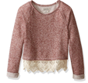

Deep Representation Learning
Deep
Representation
Learning
Deep
Representation
Learning
Deep
Representation
Learning
…
…
…

Slide 7








Joint Representation Learning
A Multi-View Machine Learning Framework with Heterogeneous Information Sources
Entity₁
Entity₂
Entity₃
Entity₄
…
Entity_{N-1}
Entity_{N}
(Deep) Representation Learning
…
…
…
…
…
…
…
V₁
…
…
…
+Item $v_{j1}$
User $u_{i}$
-Item $v_{j2}$
V₂
…
…
…
+Item $v_{j1}$
User $u_{i}$
-Item $v_{j2}$
V₃
…
…
…
+Item $v_{j1}$
User $u_{i}$
-Item $v_{j2}$
…
…
…
+Item $v_{j1}$
User $u_{i}$
-Item $v_{j2}$
S₁
>
S₂

Slide 8
Joint Representation Learning
A Multi-View Machine Learning Framework with Heterogeneous Information Sources
Review₁
Review₂
Review₃
Review₄
…
Review_{N-1}
Review_{N}
(Deep) Representation Learning
…
…
…
…
…
…
…
V₁
…
…
…
+Item $v_{j1}$
User $u_{i}$
-Item $v_{j2}$
V₂
…
…
…
+Item $v_{j1}$
User $u_{i}$
-Item $v_{j2}$
V₃
…
…
…
+Item $v_{j1}$
User $u_{i}$
-Item $v_{j2}$
…
…
…
+Item $v_{j1}$
User $u_{i}$
-Item $v_{j2}$
S₁
>
S₂

Slide 9
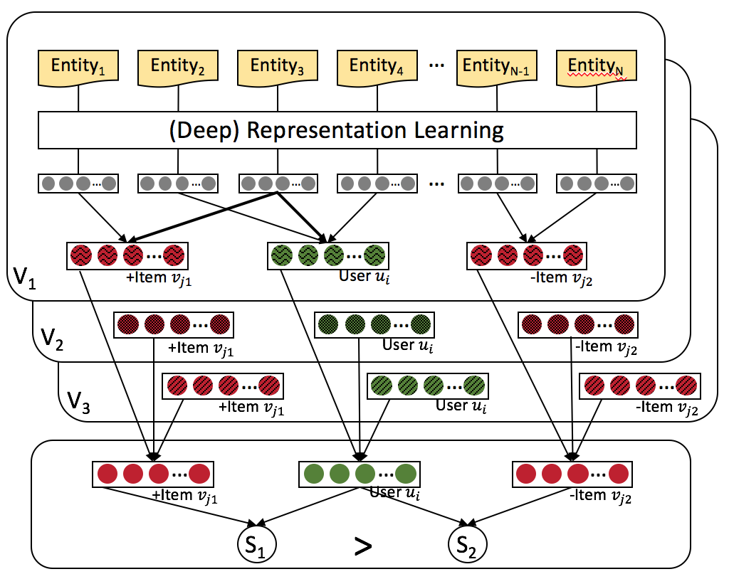


Joint Representation Learning
A Multi-View Machine Learning Framework with Heterogeneous Information Sources
L₁
L₂
L₃

Slide 10
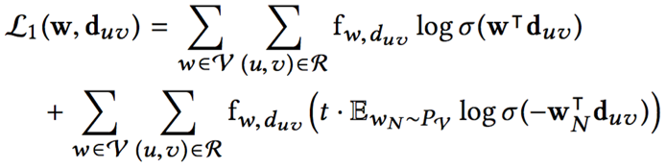








Modeling of Textual Reviews (View V₁)
Review $d_{uv}$
$$w_{uv}^{1}$$
$$w_{uv}^{2}$$
$$w_{uv}^{3}$$
…
$$w_{uv}^{n_{uv}−1}$$
$$w_{uv}^{n_{uv}}$$
Projection
…
V₁
…
…
User $u$
Item $v$
Word Embedding by Paragraph Vector Learning

Slide 11
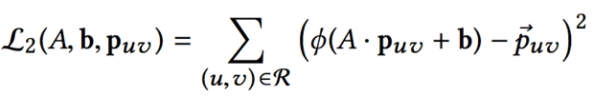



Modeling of Visual Images (View V₂)
Image $p_{uv}$
Multi-Layer Convolutional Neural Network
Multiple Fully Connected Layers
…
Fully Connected Layer
…
V₂
…
…
User $u$
Item $v$
Image Embedding by Convolutional Neural Network

Slide 12




Modeling of Numerical Ratings (View V₃)
Rating $r_{uv}$
Fully Connected Layer 2
Fully Connected Layer 1
…
…
V₃
…
…
User $u$
Item $v$
Rating Embedding by Fully Connected Layers

Slide 13
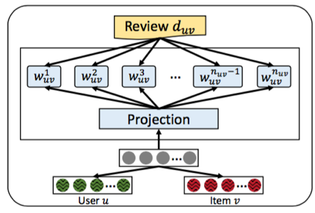
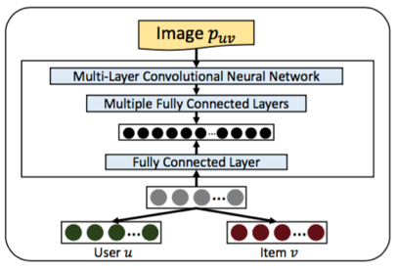
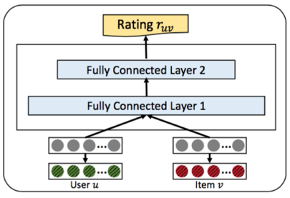
Joint Representation Learning
V₁
V₂
V₃

Slide 14
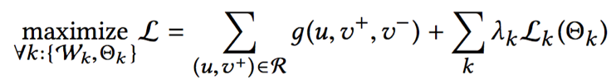
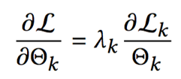
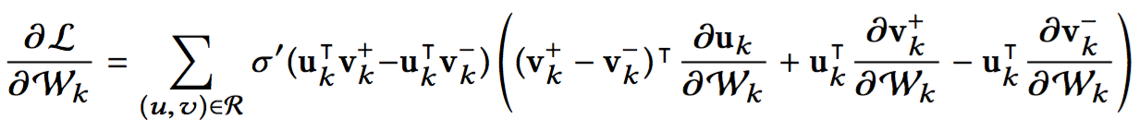
Extendable to New Information Sources
Voice
➕
Video
Text
Image
Ratings
Gradient on parameters from view k
Only contains parameters of view k itself
Independent from other views

Slide 15
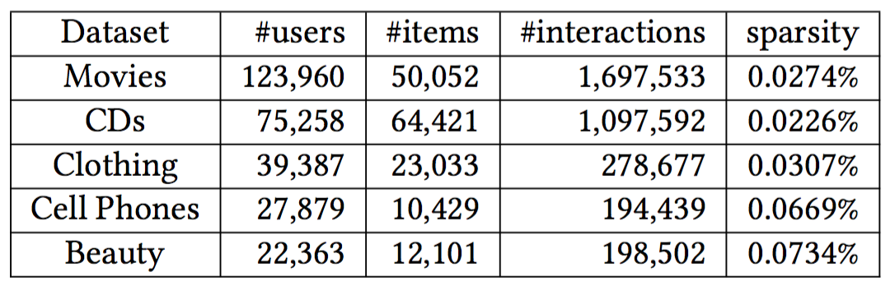
Experimental Setup
We take the Amazon dataset for experiments

Slide 16
Baseline methods
Baseline Methods
BPR: Bayesian Personalized Ranking with implicit feedback.
HFT: Hidden factor and topics model integrated into BPR, because the original model is designed for rating prediction. It relies on reviews.
VBPR: Visual Bayesian Personalized Ranking method based on images.

Slide 17
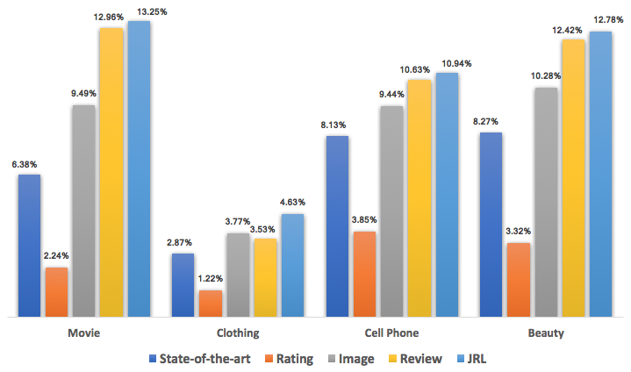
Compare with Shallow Models on NDCG
Times of
Improvement
2.08 1.61 1.34 1.54
State-of-the-art = Best of {BPR (by rating), HFT (by review), VBPR (by image)}

Slide 18
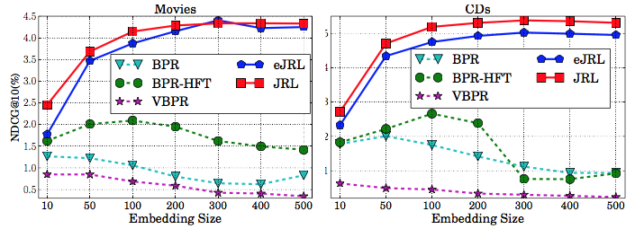
Impact of Embedding Size
Tune embedding size from 10 to 500
Observations
Our model: performance keeps increasing until about 300 dimension, and does not decrease when using more dimensions.
Shallow baselines: best performance when dimension less than 100, performance decreases when using more dimensions.
What we learn
Deep models can capture more complex interaction from data
Learning ability of shallow models is limited and may over-fit if model complexity is too high.

Slide 19

Summary and Future Works
Use various heterogeneous data to provide
Significant personalization performance.
Develop a Joint Representation Learning framework for recommendation based on heterogeneous information sources.
Not only ratings, review, and images, but also extendable to new information sources.
Achieved significant improve for top-N recommendation.
Future work
Consider other representation learning architectures for recommendation
Consider other information sources for recommendation

Slide 20


