Slide 1

Creating an Online Tour Guide for Domestic Tourists Project Synopsis Presentation Date: 05/12/2023
Internship (ECS 599)
Degree : <B.Tech/ MCA/ ….>
Laxman Singh Negi (TCA2165008)
Sujal Jain(TCA2165023)
Ayush Jain(TCA2165004)
Project Guide:
Mr. Vivek kumar
FACULTY OF ENGINEERING & COMPUTING SCIENCES
TEERTHANKER MAHAVEER UNIVERSITY, MORADABAD

Slide 2

Team Details
Student Name | Role
1-Laxman Singh Negi | Developer, Testing etc.
2-Sujal Jain | Developer , Testing etc.
3-Ayush Jain | Developer , Testing etc.
Guidelines: Mention Team Names & their role in project
2
T011A/ Template Version 5.0

Slide 3
Project Brief
Objective: Develop a user-friendly online tour guide portal for domestic tourists that helps folks to travel around their own country easily.
Enhancements: Focus on user experienced and convenience.
Platform Features:
*User-friendly website with comprehensive local information.
*Integrated hotel room booking system.
Booking Convenience: Direct hotel reservation through the platform.
Dynamic Content: Use JS to dynamically load content without refreshing the page.
Responsive Design: Utilizing the bootstrap for creating a layout that adapts to various screens.
Functionality: The Main Menu and Navigation serve as the backbone of the user interface, providing intuitive access to various sections of the platform.
Guidelines: Mention brief about the project and it’s functions/ modules
3
T011A/ Template Version 5.0

Slide 4
Methodologies/ Technologies/ Tools to be used
Front-end Technologies:
1-HTML (Hyper Text Markup Language)
2- CSS (Cascading Style Sheets)
3-JavaScript
Frame Work: Bootstrap
Software Requirement: Visual Studio(VS) Code
4
T011A/ Template Version 5.0

Slide 5
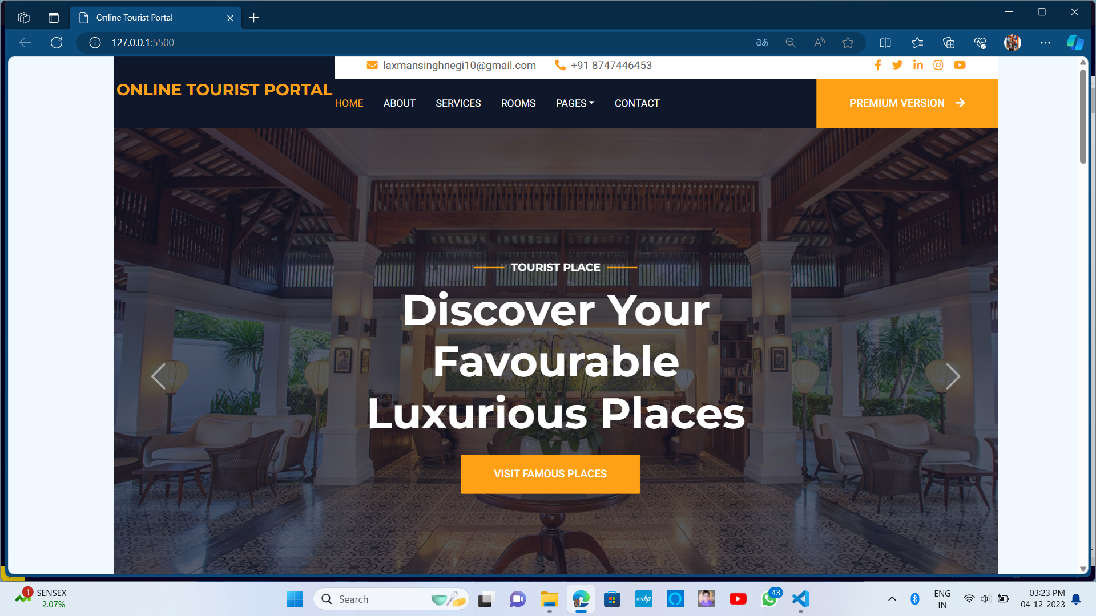
Context Diagram (Overall Project)
5
T011A/ Template Version 5.0

Slide 6
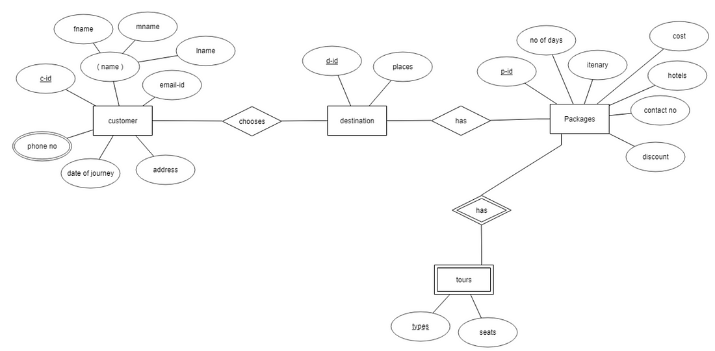
Entity Relationship Diagram (ERD)
6
T011A/ Template Version 5.0

Slide 7
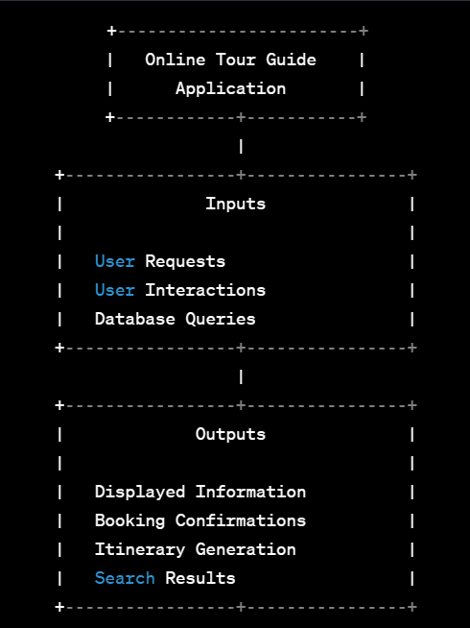
Data Flow Diagram (DFD)
Guidelines: Add more slides, if required to show all DFDs
7
T011A/ Template Version 5.0

Slide 8
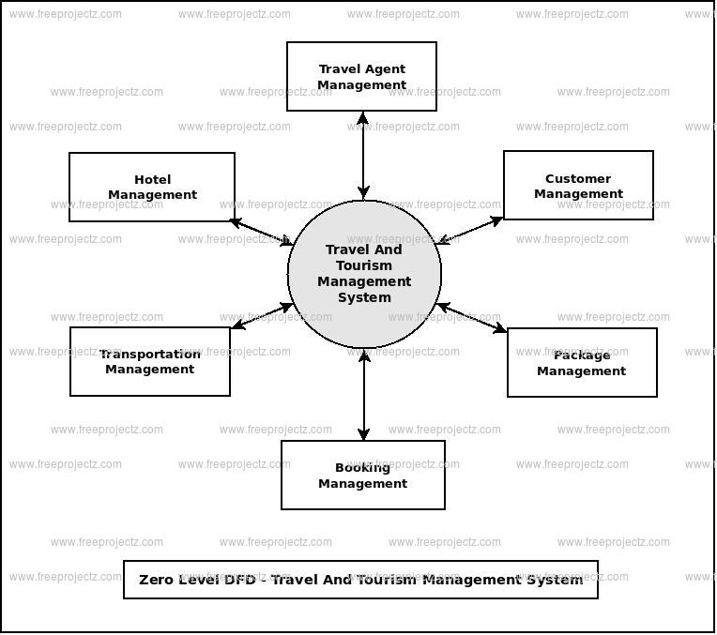
Flow Chart
Guidelines: This slide is optional
8
T011A/ Template Version 5.0

Slide 9
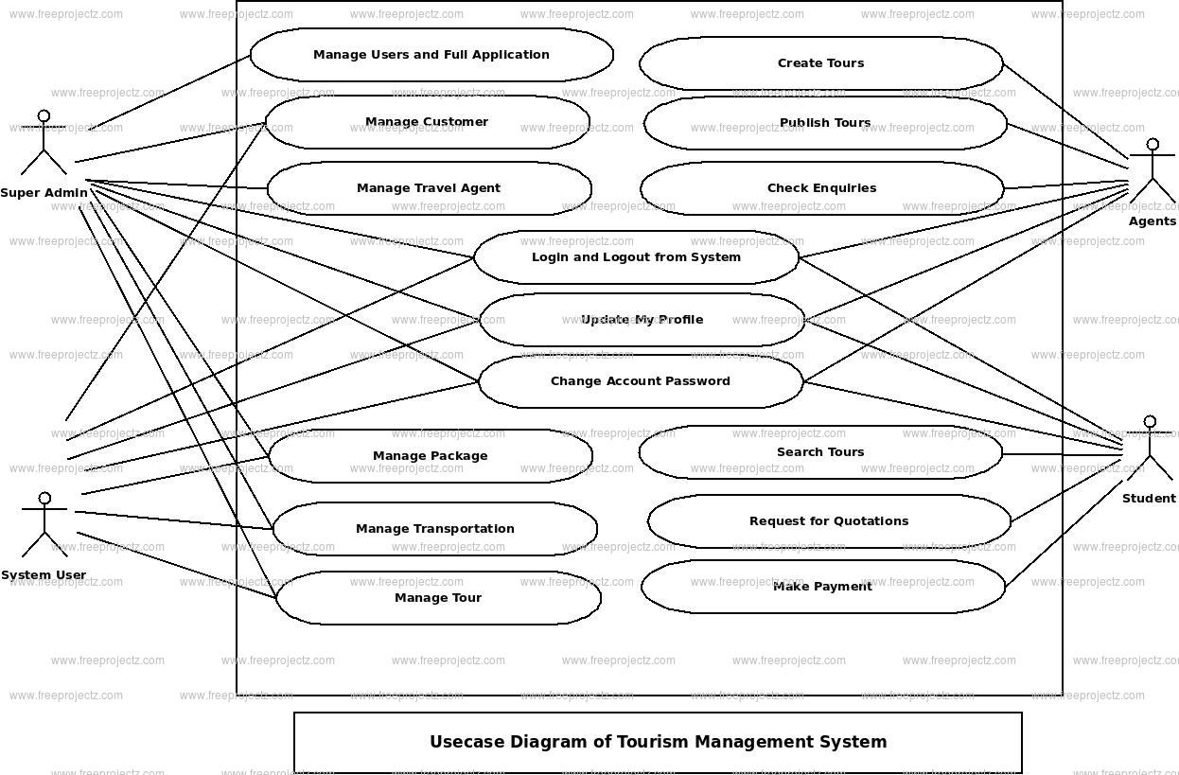
Use Case Diagram
Guidelines: This slide is optional. May add more slide, if the details are available
9
T011A/ Template Version 5.0

Slide 10
\
Advantage of The Project
Direct Booking: Integration of a hotel booking system allows users to book accommodations directly through the portal, ensuring convenience and reliability.
Responsive Design: Bootstrap's grid system and CSS enable responsive layouts, ensuring the website looks good and functions well on various devices, from desktops to mobile phones.
Interactive Elements: Enables the addition of interactive features like dynamic content loading, form validation, and real-time updates without page reloads, enhancing user experience.
User Experience Enhancement: By combining these technologies(HTML , CSS, JavaScript and Bootstrap), the portal offer a smooth, visually appealing, and interactive user experience.
Consistency and Branding: CSS and Bootstrap help maintain consistency in styling.
Cost-Effectiveness: Utilizing open-source technologies like HTML, CSS, JavaScript, and Bootstrap can reduce licensing costs and overall expenses in website development.
Guidelines: Mention advantage from this project, the audience/ users who will get benefitted
10
T011A/ Template Version 5.0

Slide 11
ds
References, if any
1-HTML: From Youtube (https://youtu.be/HD13eq_Pmp8?feature=shared)
2- CSS: From Youtube (https://youtu.be/wRNinF7YQqQ?feature=shared)
3-JavaScript: From Youtube (https://youtu.be/8dWL3wF_OMw?feature=shared)
4-BootStrap: From Youtube(https://youtu.be/-qfEOE4vtxE?feature=shared)
5-Visual Studio Code: From Youtube (https://youtu.be/VqCgcpAypFQ?feature=shared)
11
T011A/ Template Version 5.0

Slide 12
THANKS

