Slide 1
Introduction
I’m Laxmi Narayan, and I’m excited to share some insights about your business. Thank you for providing the guiding questions. It was helpful to see what types of insights you are looking to gain from the data. I hope you find the analysis compelling and helpful as you make decisions regarding future business opportunities.
Data Cleaning
First off, I want to assure you that I’ve provided the most up-to-date and error-free analysis. After I loaded the data into my software, I changed any records that have negative quantities and unit prices, as these records needed to be removed to provide helpful analysis.

Slide 2
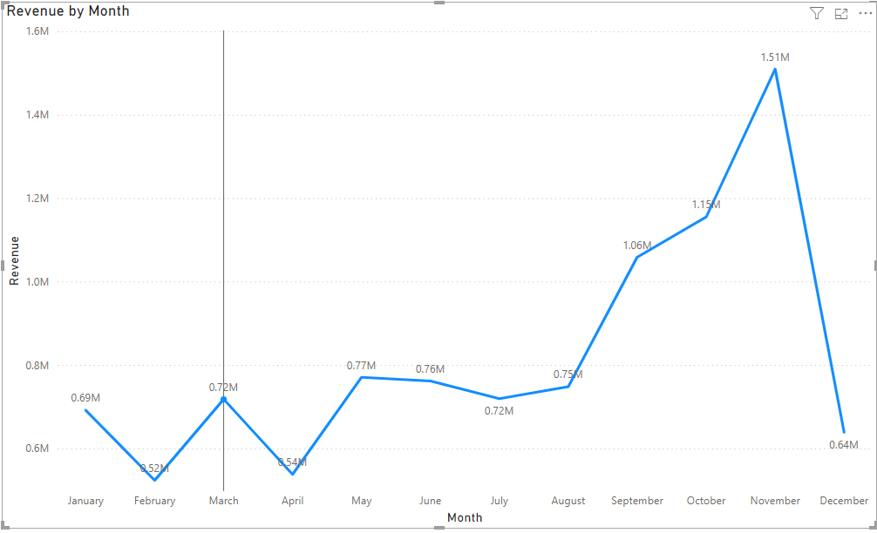
Monthly Revenue Trends for 2011
Key findings:
Revenue constant for the first 8 months (~$685k average).
Revenue increase starts in September (+40% over August).
Peak revenue in November ($1.5 million).
Recommendations :
Increase marketing efforts in the last quarter of the year to capitalize on the higher seasonal demand.
Increase inventory for Q4.

Slide 3
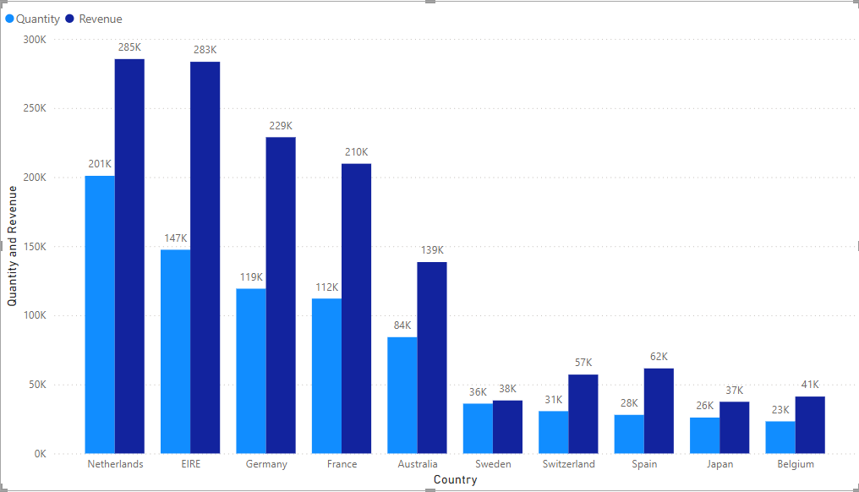
Top 10 Countries by Revenue (Excluding the UK)
Key Findings:
Focus on countries with growth opportunities (excluding the UK).
High revenue and volume countries:
Netherlands
Ireland
Germany
France
Recommendation:
Focus on these countries to increase market share.
Implement localized marketing strategies and partnerships.

Slide 4
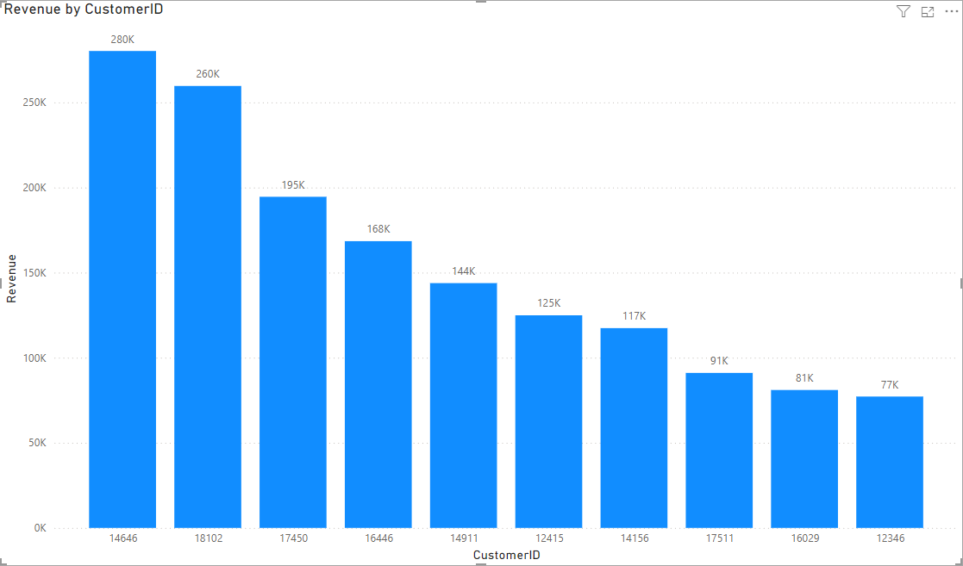
Top 10 Customers by Revenue
Key Findings:
Minimal difference between top customers.
Highest customer revenue only 17% more than the second highest.
Low bargaining power of customers.
Business not reliant on a few customers for revenue.
Recommendations:
Provide personalized customer service and attention.
Offer points, discounts, and special offers to loyal customers.

Slide 5
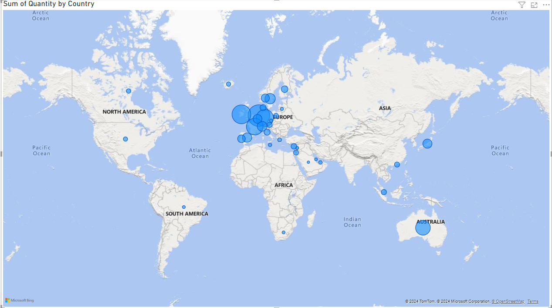
Product Demand by Country (Excluding the UK)
High revenue countries:
Netherlands
Ireland
Germany
France
Australia
Low revenue regions:
America
Africa
Asia
Russia
Recommendations :
Invest more in high-revenue areas.
Explore new strategies for low-revenue regions to boost sales.

Slide 6
Thank You

