Slide 1
INTELLIGENT CANDIDATE
RANKING SYSTEM
System Design & Technical Deep-Dive
ISY5001 — IRS Practice Module | Group 04 | NUS-ISS
Lakshmi B. Chamoli · Sangeeta Bahrani · Stalin Sagayaraj · Muthaiah M.
Supervisor: Dr. Gary Leung

Slide 2
End-to-End Pipeline (6 Steps)
0
RAG / Vector Store
ChromaDB persists résumé embeddings; SHA-256 deduplication; cosine retrieval scoped per JD
1
Eligibility Engine
4 forward-chaining production rules with SBERT fallback; filter fundamentally unrelated profiles
2
Expert Flags
6 strict T/F flags: Relocation, Work-Visa, Leadership, High-Potential, Overqualification, Availability-Risk
3
5-D Scoring
Technical Skills (SBERT + Apriori), Experience (bell curve), Education (ordinal), Availability (tiered), Miscellaneous(SBERT)
4
GA Weights
Offline per-category weight optimisation via Genetic Algorithm; Kendall-τ + MAE composite fitness
5
Best-First Ranking
heapq priority queue (Greedy Best-First Search); O(N log N); N/A candidates appended at end

Slide 3
IRS Technique Group Mapping
Decision Automation
Knowledge Discovery
Business Optimisation
Cognitive / XAI
- Forward-chaining eligibility rules.
- Expert-flag KB
- Deterministic reasoning trace
- Sentence-BERT (all-MiniLM-L6-v2)
- Apriori skill co-occurrence rules
- Content-based similarity
Genetic Algorithm (offline)
Greedy Best-First Search (runtime)
Per-category weight lookup
Rule-based Justification Engine
XAI Dashboard (HTML/JS)
Full reasoning-chain rendering

Slide 4
Step 1: Eligibility Engine — Forward Chaining
eligibility_engine.py · 516 lines · 4 sequentially-fired production rules
Rule 1 — Unrelated Profession
N/A if fundamentally unrelated
Word-boundary regex + profession-family detection (PROFESSION_FAMILIES dict). SBERT semantic-similarity fallback at threshold 0.30 for unseen professions. Example: 'yoga teacher' applying for 'backend engineer' → N/A.
Rule 2 — Zero Skill Overlap
N/A if zero intersection
Fires only when the candidate has ≥3 listed skills AND zero match with JD skills across keyword + SBERT (0.65) matching. Protects cross-domain applicants who have some overlap.
Rule 3 — Experience Window
N/A if outside tolerance
10% tolerance band on the JD floor. Range-mode JDs ('4–11 years') enforce both lower and upper bounds. Pure freshers (0y) against senior roles → N/A.
Rule 4 — Education Floor
N/A if gap too large
Specialised-stream guard (LLB, MBBS, B.Arch). Strict Masters floor when JD requires Masters or above. Ordinal comparison: PhD > Masters > Bachelors > Diploma.
Each rule produces a RuleFiring record (rule name, condition, result, explanation) → assembled into the reasoning trace.

Slide 5
Step 2: Expert Flags — Knowledge-Based T/F Signals
expert_flags.py · 6 strict True/False flags per candidate · each produces a score modifier + human-readable reason
Flag | Trigger Condition | Score Effect
RELOCATION_FLAG | TRUE if candidate's location ≠ JD location | Penalises availability/logistics
WORK_VISA_FLAG | TRUE if visa/sponsorship keywords found in résumé | Signals potential HR overhead
LEADERSHIP_MATCH | TRUE if leadership keywords present AND JD requires leadership | Boosts miscellaneous score
HIGH_POTENTIAL | TRUE if experience < JD requirement but skills score ≥ 70% | Marks 'stretch' candidates
OVERQUALIFICATION | TRUE if experience ≥ 2× JD requirement | Flags flight-risk concern
AVAILABILITY_RISK | TRUE if notice period exceeds JD max | Penalises availability dimension
Validated against Calypso-banking HR: 24/24 flag predictions matched (100% agreement)

Slide 6
Step 3: Five-Dimensional Scoring Engine
scoring_engine.py · 711 lines · each candidate scored on 5 independent dimensions
Overall(c, j) = Σ Dᵢ(c, j) × wᵢ(category(j)) × 100 for i = 1..5
D1 — Technical Skills
4-pass cascade: keyword → soft-skill (0.75) → SBERT (0.60) → latent-phrase (0.55). +0.03 per Apriori implied skill.
clamp₀.₃₀,₁.₀(0.75 × match_ratio + relevance + apriori)
D2 — Experience
Lenient below requirement (50% floor for juniors); optimal at 1–1.5× JD; decays above 2.5× (overqualification).
Piecewise bell curve (50% floor → 1.0 optimal → 0.55 decay)
D3 — Education
PhD=5, Masters=4, Bachelors=3, Diploma=2, HighSec=1. Eligibility already filtered extreme mismatches.
Ordinal: ≥req→1.0, −1→0.75, −2→0.55, ≤−3→0.35
D4 — Availability
Immediate=1.0, ≤14d=0.95, ≤30d=0.90, ≤60d=0.85, ≤90d=0.80, >90d=0.65. 0.85× if exceeds JD max.
Tiered: immediate=1.0 → >90d=0.65 × 0.85 penalty
D5 — Miscellaneous
SBERT title alignment + relevance + cert bonus (+0.05/cert, max 0.20) − career-gap penalty (−0.05/gap, max 0.20).
clamp₀.₃₀,₁.₀(0.40×title_sim + 0.30×rel + cert − gap)

Slide 7
D1 — Technical Skills: 4-Pass Cascade + Apriori
Pass 1
Keyword Overlap
Threshold: Exact
python == python
Lower-cased exact match between résumé skill set and JD required skills.
Pass 2
Soft-Skill Equivalence
Threshold: ≥ 0.75
k8s ↔ kubernetes
Lexical-similarity heuristic catches pluralisation, abbreviations, aliases.
Pass 3
SBERT Semantic
Threshold: ≥ 0.60
predictive modelling ↔ machine learning
Dense embedding cosine similarity on residual unmatched JD skills.
Pass 4
Latent-Phrase Mining
Threshold: ≥ 0.55
'banking' from 'Bank of America'
SBERT compare JD skills vs sentence-level résumé raw text segments.
Apriori Bonus: 11 mined rules (e.g. {python, scikit-learn} → numpy, conf=0.82, lift=2.1). +0.03 per implied skill when antecedent present in résumé AND consequent in JD.

Slide 8
Step 4: Genetic Algorithm — Weight Optimisation
Chromosome Representation
Parameter | Value
Population | 80
Max Generations | 200
Tournament k | 3
Crossover | BLX-α (α=0.5), p=0.75
Mutation | Gaussian σ=0.08, rate=0.15
Elitism | Top-2
Early-Stop Patience | 12 (τ) / 25 (MAE)
[ w_skills | w_exp | w_edu | w_avail | w_misc ]
Constraint: Σ wᵢ = 1.0 | Each wᵢ ∈ [0.05, 0.60]
Fitness (v10.4): Kendall τ rank correlation
between GA-induced ranking and
ground-truth ranking
Output: per-category CATEGORY_WEIGHTS dict loaded at runtime — data_science, software_engineering, senior, contract, finance, management, entry_level, default

Slide 9
GA Output: Per-Category Weight Lookup (CATEGORY_WEIGHTS)
Category | Tech | Exp | Edu | Avail | Misc
data_science | 0.40 | 0.20 | 0.20 | 0.10 | 0.10
software_engineering | 0.35 | 0.25 | 0.20 | 0.08 | 0.12
senior | 0.28 | 0.32 | 0.15 | 0.12 | 0.13
contract | 0.32 | 0.23 | 0.12 | 0.22 | 0.11
finance | 0.20 | 0.30 | 0.25 | 0.12 | 0.13
management | 0.18 | 0.28 | 0.20 | 0.14 | 0.20
entry_level | 0.28 | 0.12 | 0.28 | 0.15 | 0.17
default | 0.35 | 0.25 | 0.15 | 0.10 | 0.15
detect_job_category() infers category from JD title + body via keyword scoring (title weighted 3×) with SBERT semantic fallback for unseen titles.

Slide 10
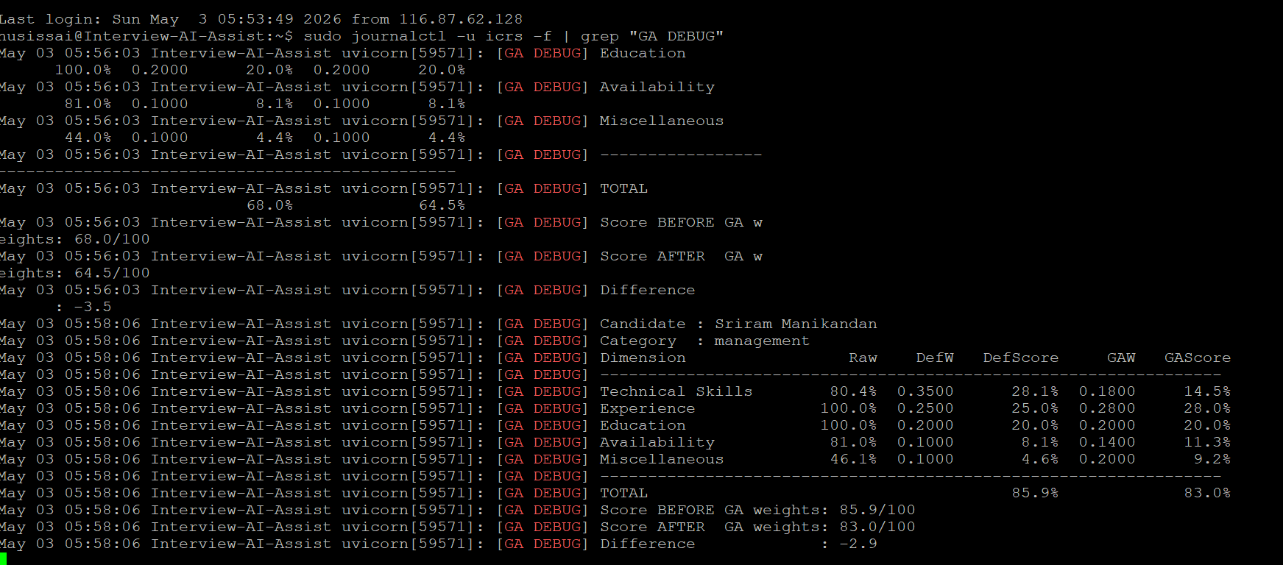
GA Output Comparison

Slide 11
Step 5: Greedy Best-First Search Ranking
Algorithm
Why Best-First (not A*)?
1. For each eligible candidate, compute:
overall = Σ Dᵢ × wᵢ(category)
2. Push (−overall, idx, candidate)
into a min-heap (heapq)
3. Pop candidates in descending
score order: rank 1, 2, 3, …
4. N/A candidates bypass the heap
and are appended at the end
Candidates are independent entities.
There is no cumulative path cost — each candidate's overall score is computed independently, so the A* formulation f(n) = g(n) + h(n) collapses to f(n) = h(n), which is exactly Greedy Best-First Search.
Complexity: O(N log N)
heappush + heappop across N candidates = O(N log N), identical to sorting but implemented via a priority queue for the correct IRS technique framing.

Slide 12
Step 0: RAG Pipeline & ChromaDB Vector Store
rag_pipeline.py — Orchestration
chroma_resume_store.py — Storage
SHA-256 deduplication
Candidate-ID minting (UUID-based)
Ingestion: parse → chunk → embed → store
Retrieval scoped by:
• uploaded-only (new batch)
• uploaded + existing (full pool)
Async store_uploaded_resumes()
ChromaDB persistent client on disk
Chunking: skills, experience, education, summary
Cosine similarity search (top-k)
Per-candidate score aggregation across chunks
Metadata: file_hash, name, email, skills list
Persists across sessions: no re-upload needed for multiple JDs

Slide 13
Technology Stack
Concern | Technology
Backend API | FastAPI 0.104 + Uvicorn
Resume Parsing | pdfplumber 0.11, python-docx 1.1
Semantic Similarity | sentence-transformers (all-MiniLM-L6-v2)
Vector Store / RAG | ChromaDB 0.5.5
Optimisation | Custom GA + scipy.stats.kendalltau
Informed Search | Python heapq (Best-First)
Association Rules | Apriori rules in apriori_rules.json
Frontend / XAI | Single-file HTML/CSS/JS (no framework)
Validation / Schema | Pydantic 2.5, Python 3.10+

Slide 14
ICRS
Smart · Transparent · Optimised
4 IRS technique groups · 6-step pipeline · 120-row ground truth
MAE 6.73 · Kendall τ = 1.00 · 100% eligibility agreement
100% flag agreement · Per-category GA weights · Full XAI trace
Group 04 | NUS-ISS | ISY5001 | Dr. Gary Leung

