Slide 1
                PROJECT
                TRACE
                Task Recognition & Activity Capture Engine
OCR
UI
Visual
Interaction
Practice Project Group 21
M.Tech in Artificial Intelligence Systems | National University of Singapore
Pattern Recognition Systems | September 2026
Notes:
[Title — 15 sec | SHOW: logo, 4 modality icons, NUS ISS branding]
"Good afternoon, Professor. Group 21 — TRACE: Task Recognition and Activity Capture Engine. We automatically classify what happens in server screen recordings using a multimodal pipeline and 14 models."

Slide 2
Agenda
1
Background & Problem Statement
7
Dataset — CUA-Suite
2
Project Objectives
8
Evaluation Pipeline & Results
3
System Architecture
9
Progress
4
Feature Extraction Pipeline
10
Challenges & Solutions
5
Models and Model Training
11
Future Work & Conclusion
6
Training Results
Notes:
[Agenda — 10 sec | SHOW: slide content, let audience read]
"Here's our agenda. We'll move through background, objectives, the pipeline, training results, dataset, evaluation, and a live product demo."

Slide 3
Background
Privileged users have deleted core systems, on purpose and by mistake
S$918,000
INTENTIONAL | SINGAPORE, 2023
A fired admin whose access was never revoked ran a script to delete all 180 servers of a test system, one by one.
Loss after a dismissed system administrator deleted 180 virtual servers at a Singapore IT firm (2023)
INTENTIONAL | UNITED STATES
A former worker deleted critical boot files on company servers, crippling operations for two weeks and forcing paper records.
ACCIDENTAL | EVERYWHERE
Sentenced to 2 years 8 months in jail
Well-meaning admins also run destructive commands on the wrong server. Different intent, same damage.
Why this project: admin sessions can be recorded, but no one can review hours of video for risky actions.
Sources: CNA | DataBreaches.net | TechRadar | G5 Cyber Security (citing CSO Online)
Notes:
[Background — 45 sec]
"The motivation is real. In 2023, a dismissed administrator in Singapore deleted 180 virtual servers at an IT firm — S$918,000 in damages, nearly 3 years in jail.
In the US, a former employee deleted critical boot files, crippling operations for two weeks.
Both sessions were recorded. Nobody reviewed the footage in time. Manual review doesn't scale. That's the gap."

Slide 4
Problem Statement
PROBLEM 1 | SECURITY
PROBLEM 2 | KNOWLEDGE
Users with privileged access can accidentally or knowingly delete core Windows and Linux files and trigger security incidents, usually found only after the damage is done.
We routinely record videos of admin activities, but turning them into documents or knowledge-base articles is manual, slow and inconsistent, so the knowledge stays locked in video.
Privileged action
Risky action
Found too late
Recorded video
Manual write-up
Stays locked in video
→
→
→
→
Both problems share one gap: what happens in a recorded session is not automatically understood.
Notes:
[Problem Statement — 30 sec]
"Two problems, one root cause.
Security: privileged users can delete core files and the damage is found only after the fact.
Knowledge: admin sessions are recorded but never turned into documentation — knowledge stays locked in video.
Root cause: what happens in a recorded session is not automatically understood."

Slide 5
Objective
Automatically understand what was done in server screen recordings, so risky actions are caught early and every recording becomes reusable knowledge. Transform the recognized workflows into structured, searchable SOPs, runbooks, and troubleshooting guides, with traceability to support security, compliance, and proactive incident prevention.
1
2
3
Identify
Explain
Prevent
Analyse recorded sessions with a tiered pipeline (frame features, sequence model, classifier) to recognise which action was performed.
Generate a plain-language summary of the actions so reviewers do not have to watch the full video.
Flag high-risk actions such as deleting core files early, across many admins and organisations, not only after an incident.
Scope: Windows and Linux server administration recordings
Notes:
[Objective — 25 sec]
"Three objectives: Identify what activity is happening per segment. Explain it in plain language so reviewers don't watch full recordings. Prevent by flagging high-risk actions early at scale.
Scope: Windows and Linux server administration recordings."

Slide 6
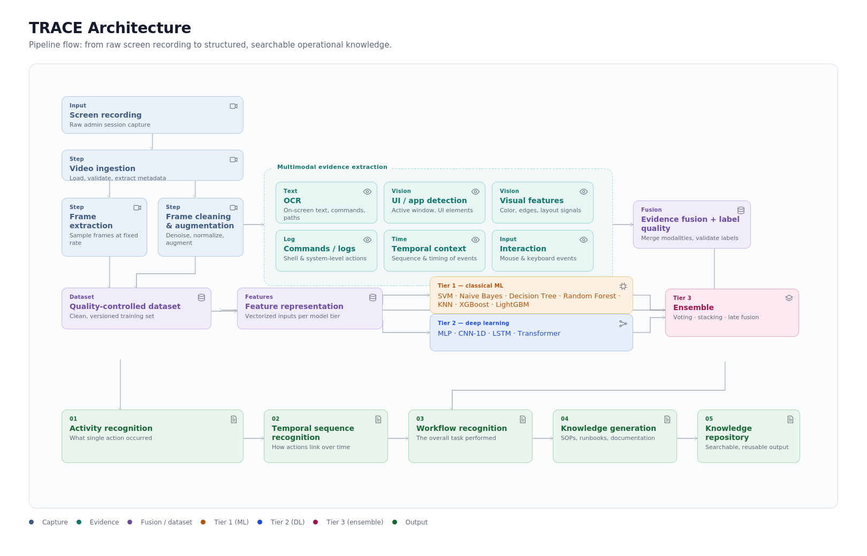
Notes:
[SHOW SILENTLY — section divider, click through in ~3 sec]
Next section: Feature Extraction Pipeline.

Slide 7
Multimodal Feature Extraction Pipeline
EasyOCR (text)
TF-IDF → 50 dims
Video Input
VideoProcessor
Segments + Keyframes
14
Classifiers
(3 tiers)
Activity
Label
+
Confidence
YOLOv8 (UI elements)
counts/layout → 30 dims
Concatenate
→ 150-dim
feature vector
OpenCV (visual)
color/edge/texture → 40 dims
Action Parser (behavior)
freq/temporal → 30 dims
Each video segment is independently processed through all 4 extractors in parallel, producing a unified 150-dimensional feature vector
Notes:
[60 sec — longest slide]
"Every video segment passes through four parallel extractors.
EasyOCR reads on-screen text — terminal output, filenames — converted to 50 dimensions via TF-IDF.
YOLOv8 detects UI elements — buttons, terminals, menus — 30 dimensions.
OpenCV captures color, edges, texture — 40 dimensions.
The Action Parser reads the action log for mouse clicks, keystrokes, timing — 30 dimensions.
These concatenate into a single 150-dimensional feature vector. All 14 models receive the same input, so comparisons are fair."

Slide 8



Classification Models — 14 Models, 3 Tiers
Tier 1
Classical ML (7 models)
Tier 2
Sequential Layer
Tier 3
Ensemble (3 models)
SVM
Naive Bayes
Decision Tree
Random Forest
KNN
XGBoost
LightGBM
LSTM
Transformer
Voting
Soft voting: SVM + RF + MLP
Boosting
Late Fusion
All 14 models run on the same 150-dim feature vector and produce comparable predictions with confidence scores
Notes:
[40 sec]
"We benchmark 14 models across 3 tiers.
Tier 1: 7 classical ML models — SVM, Random Forest, XGBoost and 4 others. Fast, strong baselines.
Tier 2: LSTM and Transformer — to test whether deep learning finds patterns classical ML misses.
Tier 3: 3 ensembles — Voting, Late Fusion, Stacking — combining predictions from Tiers 1 and 2.
All models output a class label plus a confidence score."

Slide 9
Model Training
Notes:
[SHOW SILENTLY — section divider, click through in ~3 sec]
Next section: Model Training.

Slide 10
Training Overview — 4 Steps
End-to-end pipeline from raw dataset to evaluated classifiers
Step 1
Step 2
Step 3
Step 4
Data Preparation
Feature Extraction
Model Training
Evaluation
→
→
→
Split 9,609 tasks
80% train / 20% test
Video + actions
→ 150-dim vectors
14 models learn
from feature vectors
Test set → metrics
→ model comparison
$ python -m app.train --dataset-root ./dataset --model-dir ./models
One command trains all 14 models, evaluates on held-out test set, and logs results to MLflow
Notes:
[20 sec | WHY + OUTCOME]
WHY: Raw video is unstructured — we need a repeatable automated pipeline from raw data to evaluated models.
OUTCOME: One command trains all 14 models, evaluates on held-out data, and logs to MLflow. Fully reproducible.

Slide 11
Step 1 — Data Preparation
Stratified Train/Test Split
9,609 Tasks
→
7,685 train (80%)
Stratified Split
1,924 test (20%)
Same label proportions in both train and test
Ensures test set is representative of real data
sklearn.model_selection.train_test_split(stratify=y)
Label Distribution
Label
Count
Pct
other
5,441
57%
Class Imbalance Problem
coding_editing
3,240
34%
"other" dominates at 57% — model can just predict "other"
jenkins_ci_cd has only 1 sample
Data augmentation applied when < 100 training samples (5x)
documentation
449
4.7%
docker_workflow
299
3.1%
git_operations
87
0.9%
aws_console
45
0.5%
debugging
38
0.4%
Data Augmentation
kubernetes_ops
9
0.1%
Classes with < 100 samples get 5x augmentation
Adds noise to feature vectors to create synthetic samples
jenkins_ci_cd
1
0.01%
Notes:
[30 sec | WHY + OUTCOME]
WHY: Class imbalance means a model predicting 'other' always gets 57% accuracy without learning anything. We need a fair split and a way to handle rare classes.
OUTCOME: Stratified 80/20 split preserves label proportions. Classes with under 100 samples get 5x augmentation so rare activities like kubernetes_ops remain visible to the model.

Slide 12
Step 2 — Feature Extraction
Converting raw video + actions into numeric vectors
Visual
Frames, UI layout,
screen regions
4 Extractors → 150 Dimensions
Video +
action_log
150-dim
Feature Vector
→
→
Visual extractor: ~40 dims
OCR extractor: ~40 dims
Interaction extractor: ~40 dims
Action log extractor: ~30 dims
---
Total: 150 dims
OCR
Text on screen,
command output
Interaction
Mouse, keyboard,
timing patterns
Action Log
CLI commands,
file operations
Result Matrices
X_train shape: (7685, 150)
y_train shape: (7685,)
Sample Row
X[0] = [0.82, 0.75, 0.03, 0.91, ..., 0.29] # 150 features
y[0] = 0 # git_operations
Each row is one task, each column is one feature
This matrix is what every model trains on
Notes:
[28 sec | WHY + OUTCOME]
WHY: Models need numeric inputs, not raw video. Every model must train on identical inputs so comparisons are fair.
OUTCOME: Four extractors produce a 7,685 × 150 matrix — one row per task, 150 features per row. This single matrix is the input to all 14 models.

Slide 13
Step 3 — SVM: Finding the Optimal Boundary
Support Vector Machine with RBF kernel
2D Visualization (simplified from 150D)
Key Concepts
Maximize Margin
Finds the hyperplane that maximizes the gap between classes
RBF Kernel
K(x,x') = exp(-γ||x-x'||²) — maps to higher dimensions for non-linear boundaries
Support Vectors
The boundary points closest to the hyperplane that define the decision
Multi-class
← margin →
150-dim space → find separating hyperplanes for all 9 classes (one-vs-one)
■ git_ops
■ coding
— Boundary
Training time: 52.6 seconds
Notes:
[25 sec | WHY + OUTCOME]
WHY: SVM is a strong baseline for high-dimensional data. We test if a kernel method finds better boundaries in 150-dim space.
OUTCOME: RBF SVM achieves F1 0.146, trains in 52 sec. Competitive but slow at inference (1,392ms) due to kernel computation over support vectors.

Slide 14
Step 3b — Decision Tree & Random Forest
Greedy splitting and ensemble aggregation
Decision Tree
Random Forest
Greedy recursive splitting
At each node: pick feature + threshold that maximizes
Information Gain
100 trees, each trained on random bootstrap sample
Each split considers only √150 ≈ 12 random features
Prediction = majority vote of 100 trees
Diversity + aggregation = robustness
IG = Entropy(parent) - Σ(weighted × Entropy(children))
Tree 1
Tree 2
Tree 3
Tree 4
Tree 5
...
OCR[3] > 0.5 ?
↙
↘
L
R
L
R
L
R
L
R
L
R
Yes
No
↓ Majority Vote ↓
Mostly: git_ops
Mostly: coding_editing
Final Prediction: coding_editing
Training: 0.2 seconds
Training: 0.8 seconds
+ Interpretable: you can read the rules
+ Fastest inference (2ms)
- Prone to overfitting on training data
+ Reduces overfitting via bagging (bootstrap aggregation)
+ Handles high-dimensional data well
- Less interpretable than a single tree
Notes:
[28 sec | WHY + OUTCOME]
WHY: Decision Tree gives interpretability. Random Forest tests whether aggregating many trees beats one.
OUTCOME: Decision Tree: 2ms inference, F1 0.161 — fastest model, viable for real-time. Random Forest: F1 0.160 in 0.8s — bagging reduces overfitting. Both outperform deep learning on this dataset.

Slide 15
Step 3c — XGBoost: Sequential Error Correction
Gradient Boosted Decision Trees
Boosting Process: Each tree corrects the previous tree's mistakes
Round 1
Tree₁ predicts
60% correct
↓
Round 2
Tree₂ on RESIDUALS of Tree₁
fixes 20% more
↓
Round 3
Tree₃ on remaining errors
fixes 10% more
↓
...
100 rounds total
↓
Final
F(x) = Tree₁ + 0.1×Tree₂ + 0.1×Tree₃ + ...
93% correct
Key Formula
Key Parameters
F_m(x) = F_{m-1}(x) + η × h_m(x)
η = 0.1 (learning rate) — small steps prevent overfitting
Regularization Ω(h) penalizes complex trees
100 boosting rounds total
Training: 3.7 seconds
Notes:
[22 sec | WHY + OUTCOME]
WHY: Boosting corrects errors sequentially — each tree focuses on what previous trees got wrong.
OUTCOME: XGBoost has the highest accuracy (59.3%) but ranks 6th on F1-macro (0.158) — it's biased toward the majority class, not minority-class recall.

Slide 16
Step 3d — MLP: Forward Pass + Backpropagation
Multi-Layer Perceptron (feed-forward neural network)
Input
150
→
Hidden 1
256 neurons
→
Hidden 2
128 neurons
→
Output
9 classes
Forward Pass
Loss Function
h₁ = ReLU(W₁·x + b₁) # 256 neurons
h₂ = ReLU(W₂·h₁ + b₂) # 128 neurons
ŷ = Softmax(W₃·h₂ + b₃) # 9 class probs
CrossEntropy = -log(predicted prob of true class)
Backward Pass (Backpropagation)
1. Compute gradient ∂Loss/∂W for each layer
2. Update: W = W - learning_rate × gradient
Network Statistics
Total parameters:
72,448
Layer 1 (150→256):
150×256 + 256 = 38,656
Training Process
Layer 2 (256→128):
256×128 + 128 = 32,896
Layer 3 (128→9):
128×9 + 9 = 1,161
7,685 samples × 50 epochs = 384,250 weight updates
Training time: 14 seconds
Notes:
[22 sec | WHY + OUTCOME]
WHY: MLP tests whether learned representations improve over our hand-crafted 150-dim vector.
OUTCOME: F1 0.148 in 14 sec — below Decision Tree and Random Forest. Conclusion: well-engineered features are sufficient; learned representations add no advantage here.

Slide 17
Step 3e — LSTM: Learning Sequences with Memory
Long Short-Term Memory recurrent neural network
Input Reshape
(150,) flat
→
(10 timesteps, 15 features)
LSTM Cell: 4 Gates Control Information Flow
Forget Gate
Input Gate
Cell Update
Output Gate
f_t = σ(W_f · [h_{t-1}, x_t])
i_t = σ(W_i · [h_{t-1}, x_t])
C̃_t = tanh(W_c · [h_{t-1}, x_t])
o_t = σ(W_o · [h_{t-1}, x_t])
What to forget from memory
What new info to store
New candidate information
What to output
Cell State Update
C_t = f_t ⊙ C_{t-1} + i_t ⊙ C̃_t # forget old + add new
After 10 steps: final hidden state → Linear(64, 9) → prediction
Training: 16 seconds
Backpropagation Through Time (BPTT) — gradients flow back through all 10 timesteps
Notes:
[22 sec | WHY + OUTCOME]
WHY: LSTM tests whether treating the 150 features as a sequence captures temporal dependencies in screen activity.
OUTCOME: F1 0.140 — below classical ML. Artificial timesteps don't reveal meaningful sequential patterns; temporal structure is already captured by the interaction extractor.

Slide 18
Step 3f — Transformer: Self-Attention
Learning which feature pairs matter for each class
Self-Attention Mechanism
Query
Key
Value
Q_i = W_Q · x_i
K_j = W_K · x_j
V_j = W_V · x_j
"What am I looking for?"
"What do I contain?"
"What do I offer?"
Attention Computation
Attention weights: α = softmax(Q·Kᵀ / √d_k)
Output: z = α · V # weighted combination
Training: 60 seconds
2 attention heads, 2 encoder layers
Example: How Attention Helps Classification
OCR feature "git" attends to Interaction feature "typing commands" → strong signal for git_operations
Learns WHICH feature pairs matter for each class — no manual feature engineering needed
Notes:
[22 sec | WHY + OUTCOME]
WHY: Transformer tests whether cross-feature attention adds signal beyond the raw vector — can it learn that OCR 'git' + interaction 'typing' = git_operations?
OUTCOME: F1 0.142, 60 sec training. Marginally better than LSTM but still below classical ML on our feature size.

Slide 19
Step 3g — Stacking: Learning Which Model to Trust
Two-phase meta-learning ensemble
National University
of Singapore
Phase A: Train Base Models on X_train
SVM
Random Forest
MLP
Phase B: Each base model predicts on X_train → probability outputs
SVM → (7685, 9)
RF → (7685, 9)
MLP → (7685, 9)
→ Stack
meta_X
(7685, 27)
Phase C: Train LogisticRegression on meta_X
Meta-learner discovers which model to trust for each class:
git_operations:
trust RF (0.6) > MLP (0.3) > SVM (0.1)
coding_editing:
trust SVM (0.5) > RF (0.3) > MLP (0.2)
documentation:
trust MLP (0.5) > SVM (0.3) > RF (0.2)
Training: 90 seconds
Stacking learns to combine strengths of different model families
Notes:
[35 sec | WHY + OUTCOME]
WHY: No single model is best for all 9 classes. Stacking tests whether a meta-learner can exploit complementary strengths — trusting different models for different classes.
OUTCOME: Best model overall — F1 0.189. Meta-learner assigns weights per class: RF trusted for git_operations, SVM for coding_editing, MLP for documentation. Combining diverse families reduces overall error.

Slide 20
Step 4 — How Models Are Evaluated
Testing on held-out data with standardized metrics
National University
of Singapore
X_test (1924, 150)
→
model.predict()
→
y_pred (1924,)
→
Metrics
Metrics Explained
Accuracy
correct / total
Simple but misleading with imbalanced classes
F1 per Class
2 × (Precision × Recall) / (Precision + Recall)
Balances false positives and false negatives
F1 Macro
Average of all 9 class F1 scores
PRIMARY METRIC — treats all classes equally
Why F1 Macro, not Accuracy?
A model always predicting "other" gets 57% accuracy but F1 Macro ≈ 0.06
F1 Macro treats all 9 classes equally — minority classes matter
Latency measured with time.perf_counter() around predict()
Notes:
[22 sec | WHY + OUTCOME]
WHY: Accuracy is misleading with 57% imbalance — a model always predicting 'other' scores 57% without learning anything.
OUTCOME: F1-macro is primary — averages F1 equally across all 9 classes. It exposes useless models that accuracy would hide.

Slide 21
Training Results — 14 Models Compared
Sorted by F1 Macro (primary metric)
#
Model
Tier
Accuracy
F1 Macro
Latency
1
stacking
tier3
0.566
0.189
6951ms
2
late_fusion
tier3
0.568
0.186
2551ms
3
knn
tier1
0.518
0.165
344ms
4
decision_tree
tier1
0.490
0.161
2ms
5
random_forest
tier1
0.587
0.160
103ms
6
xgboost
tier1
0.593
0.158
59ms
7
naive_bayes
tier1
0.295
0.152
9ms
8
mlp
tier2
0.570
0.148
12ms
9
svm
tier1
0.558
0.146
1392ms
10
transformer
tier2
0.560
0.142
18ms
11
lstm
tier2
0.535
0.140
15ms
12
lightgbm
tier1
0.574
0.137
37ms
13
cnn
tier2
0.530
0.131
10ms
14
logistic_reg
tier1
0.549
0.128
4ms
Ensembles achieve best F1 — combining models reduces errors
XGBoost has best raw accuracy but lower F1 (biased toward majority class)
Decision Tree is fastest (2ms) — good for real-time
Deep learning didn't outperform classical ML with engineered features
Notes:
[35 sec | WHY + OUTCOME]
WHY: We need to compare all 14 models on the same test set to find the best approach under real-world class imbalance.
OUTCOME: Stacking wins at F1 0.189 — 3.3× over baseline. Ensembles beat single models. Classical ML beats deep learning with engineered features. Decision Tree is fastest at 2ms for real-time deployment.

Slide 22
Trained Models → .pkl Files
What gets saved after training completes
models/ directory
Each .pkl contains the learned weights/parameters
File
Size
Contents
Backend loads these on startup — no retraining needed. Inference uses the saved model directly.
svm.pkl
~2.1 MB
Support vectors + kernel params
naive_bayes.pkl
~15 KB
Class priors + likelihoods
decision_tree.pkl
~180 KB
Tree structure + thresholds
random_forest.pkl
~12 MB
100 tree structures
End-to-End Flow
knn.pkl
~8.5 MB
Full training data (lazy learner)
xgboost.pkl
~1.2 MB
100 boosted trees
train.py
→
models/*.pkl
→
ml_service loads
→
Ready for
Inference
lightgbm.pkl
~900 KB
Gradient boosted trees
logistic_reg.pkl
~12 KB
Weight matrix (150 x 9)
mlp.pkl
~350 KB
72,448 learned weights
lstm.pkl
~500 KB
Gate weights + cell states
What's Inside a .pkl?
cnn.pkl
~280 KB
Conv filters + FC weights
Serialized with Python's pickle / joblib
Contains:
- Model architecture & hyperparameters
- Trained weights / learned parameters
- Feature scaler (if applicable)
- Label encoder mapping
Load: model = joblib.load('models/svm.pkl')
transformer.pkl
~600 KB
Attention weights + FFN
stacking.pkl
~15 MB
Base models + meta-learner
late_fusion.pkl
~10 MB
Base models + fusion weights
Notes:
[25 sec | WHY + OUTCOME]
WHY: The backend must serve predictions instantly without retraining on every request — trained models must be serialized and loaded once at startup.
OUTCOME: Each model saves to a .pkl file (12 KB to 15 MB). Loaded at startup, inference is sub-100ms for most models. SHA-256 checksum verification prevents tampering before deserialization.

Slide 23
DataSet And Evaluation
Notes:
[SHOW SILENTLY — section divider, click through in ~3 sec]
Next section: Dataset and Evaluation.

Slide 24
Dataset — CUA-Suite (VideoCUA)
7,021
Tasks
6,991
Videos
~48 GB
Total Size
MIT
License
Source: ServiceNow/VideoCUA · Datasets at Hugging Face
9 Activity Labels
git_operations
docker_workflow
kubernetes_ops
documentation
aws_console
jenkins_ci_cd
coding_editing
debugging
other
Labels derived from task instructions via keyword matching in dataset_loader.py
Notes:
[Dataset overview — 25 sec]
"CUA-Suite by ServiceNow, MIT license. 6,991 video recordings across 70 desktop applications, ~48 GB total.
Nine activity classes: git, Docker, Kubernetes, AWS, Jenkins, coding, debugging, documentation, and other. Labels are derived from task instructions via keyword matching."

Slide 25






Dataset — Video Properties
8–30 s
30 FPS
1920 × 1008
7,890
Video duration (approx., per video)
Frame rate
Frame resolution (pixels)
Data rate (as provided in the video metadata)
Application
Videos contain different activities performed within the same software environment.
Activity
Each video represents a different workflow or sequence of user interactions.
Notes:
[Video properties — 15 sec | SHOW: table of specs, let audience read]
"Each video is 8 to 30 seconds at 30 FPS, 1920×1008 resolution. One video per recorded task — same app, different activity each time."

Slide 26



Dataset — Annotation Files
The dataset contains three main types of annotation/metadata files:
video_metadata.json
action.json
label.json
Technical information about each video:
Duration / length
File size
Bitrate
Frame rate
Frame width and height
Ground-truth timestamps for individual user actions, e.g.:
Mouse clicks
Mouse movements
Pressing Enter
Text typing
Other interaction events
The actual workflow-level label for the activity in the video.
The intended workflow / event that the sequence of user actions accomplishes
Video frames
Low-level user actions
High-level workflow labels
Suitable for screen activity recognition, user-action detection, and workflow understanding.
Notes:
[Annotation files — 20 sec | SHOW: three-column diagram]
"Three annotation files per recording: video_metadata for technical specs, action.json for ground-truth mouse and keyboard events with timestamps, and label.json for the workflow-level activity label. These three layers give us everything for multimodal classification."

Slide 27
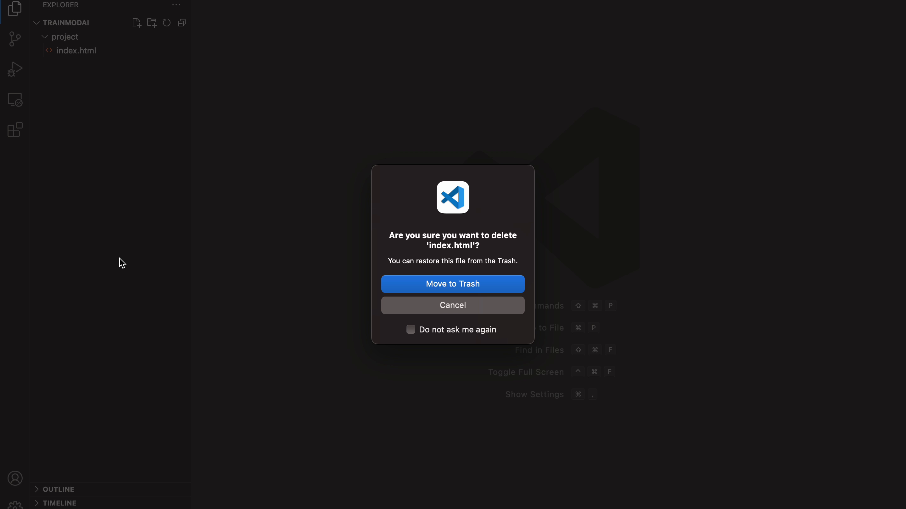
Dataset Structure
Three levels on disk — 70 applications, 6,991 recordings, a video and its logs.
VideoCUA/
VideoCUA/VSCode/
VSCode/71881/
Blender
71881
action_log.json
GIMP
71884
video/
LibreOffice Writer
71891
video.mp4
VSCode
71894
video_metadata.json
… 70 applications
… 106 in VSCode
one folder per app
one folder per recording
what one recording holds
action_log.json
video/video.mp4
task_instruction
"Delete the index.html file"
action_log
1.0s MOVE_TO (327, 265)
1.0s CLICK right
… 6 actions in all
Labels are derived from the task instruction by keyword matching — the same 10 classes.
Notes:
[Dataset structure — 15 sec | SHOW: folder tree diagram]
"Three levels on disk: application → recording → files. Each recording folder holds the video, action log, and metadata. Labels come from the task instruction field."

Slide 28
Evaluation Pipeline
Five-fold cross-validation over all 6,991 recordings.
1
Split into 5 folds
The 6,991 rows go into 5 folds, grouped so a recording is never split in two.
2
Run 5 rounds — every fold is the test set exactly once
Inside every round
Round 1
TEST
train
train
train
train
fit
vocabulary and scaler,
from 4 training folds
Round 2
train
TEST
train
train
train
train
the classifier on
those rows
Round 3
train
train
TEST
train
train
Round 4
train
train
train
TEST
train
transform
the held-out fold
through the same ones
Round 5
train
train
train
train
TEST
predict
1,398 recordings it
has never seen
3
All 6,991 recordings predicted exactly once — scored together as one macro-F1.
Notes:
[Evaluation pipeline — 30 sec]
"5-fold cross-validation over all 6,991 recordings. Recordings are grouped so no video appears in both train and test in the same fold. TF-IDF, scaler, and label encoder are fitted strictly inside each training fold — no leakage. Every recording is predicted exactly once."

Slide 29
Evaluation — Full Dataset
9 activity classes · 6,991 recordings · 5-fold cross-validation
0.2629
3.3×
6,991
macro-F1, Stacking
over the majority baseline
recordings, 70 apps
Top 4 — full table on the next slide
How to read these numbers
Model | Tier | macro-F1 | Accuracy
Stacking | 3 | 0.2629 | 0.7400
XGBoost | 1 | 0.2498 | 0.7452
LightGBM | 1 | 0.2449 | 0.7432
MLP | 2 | 0.2400 | 0.7344
Majority baseline | — | 0.0792 | 0.5533
Averaged over all nine classes, not just the eight present
Folds grouped by recording, so no video sits on both sides
TF-IDF, scaler and encoder fitted inside the training fold only
Notes:
[Full dataset results — 25 sec]
"On the full dataset, Stacking achieves F1-macro 0.2629 — 3.3 times better than the majority-class baseline. These are higher than the held-out test numbers because cross-validation uses more training data. The 3.3× improvement over baseline is the key signal."

Slide 30
Challenges
Data and Infrastructure Challenges
Challenge
Impact
Solution
Cannot fit in memory or train locally
Streaming dataset loader; AWS EC2 for cloud training; Google Colab as free alternative
Large Dataset (48 GB)
Frames from one recording landing in both splits
Task-grouped 5-fold CV; TF-IDF, scaler and label encoder fitted inside each training fold; leakage asserted by unit tests
Train/Test Leakage
Uneven activity label distribution
Stratified train/test split; 5x augmentation for datasets < 100 samples; F1-macro as primary metric
Class Imbalance
Different Processing Techniques for diff models
Not all models need same preprocessing
Every model has different preprocessing steps
Notes:
[Challenges — 35 sec | SHOW: table, read alongside]
"Three main challenges.
48 GB dataset can't fit in memory — solved with streaming loader and AWS EC2.
Class imbalance: 'other' is 57%, jenkins_ci_cd has 1 sample — handled with stratified splits, 5x augmentation for rare classes, and F1-macro as primary metric.
Train/test leakage risk — prevented by task-grouped cross-validation, asserted by unit tests."

Slide 31




Future Work
Training and education
Turn demonstrations into searchable tutorials, step-by-step instructions, or feedback on how a task was performed.
Automatic documentation
Generate a draft runbook, incident timeline, or change summary from the recognized workflow
Context-aware assistance
When the system recognizes a likely error or repeated troubleshooting pattern, it could surface relevant documentation, a prior solution, or a suggested next step.
Real Time Activity Analysis
Process screen frames and interaction events incrementally, identify activities such as editing code, running tests, debugging, or deploying, and update predictions as new evidence arrives.
Compliance and audit
Create reviewable timelines of operational actions, subject to consent, access controls, and appropriate redaction
Notes:
[Future work — 25 sec | SHOW: four bullet cards]
"Four directions: real-time incremental analysis during a live session; compliance audit timelines; automatic runbook and documentation generation; and context-aware assistance that surfaces prior solutions when it detects a repeated error pattern."

Slide 32
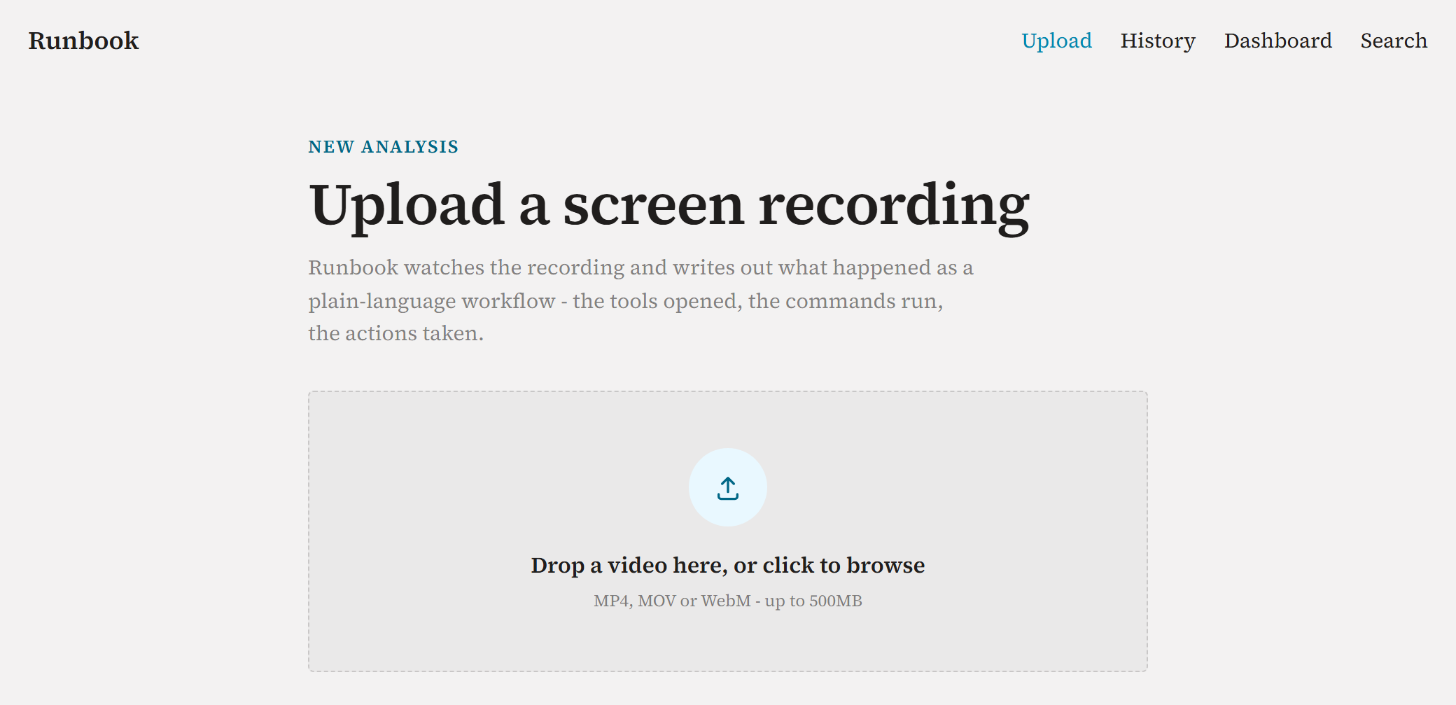
THE PRODUCT · 1 / 6
Upload
Drop a screen recording. Nothing else is asked for.
The application running on feat/frontend; the analysis is its built-in mock, so figures are placeholders.
Notes:
[Upload — 10 sec | SHOW: UI screenshot]
"Step 1 — upload. Drop a screen recording. Nothing else needed."

Slide 33
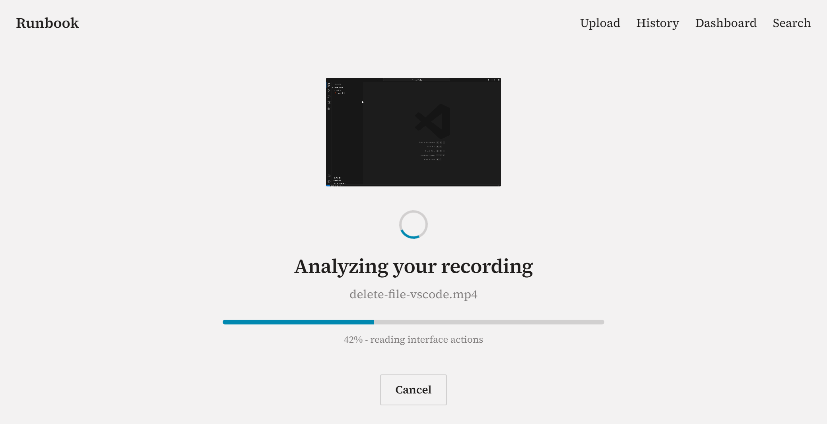
THE PRODUCT · 2 / 6
Analyze
Frames, on-screen text and the action log are read.
Notes:
[Analyze — 10 sec | SHOW: UI screenshot]
"Step 2 — the pipeline reads frames, OCR text, and the action log."

Slide 34
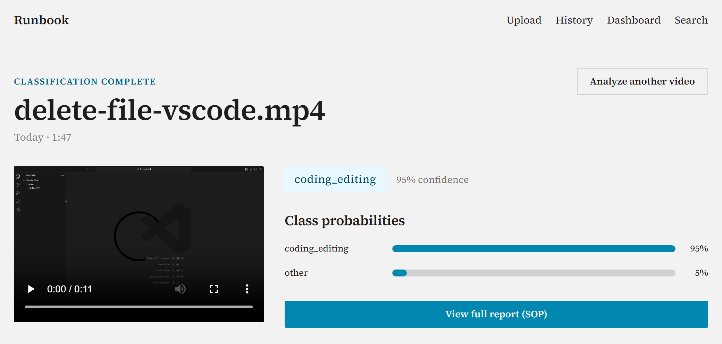
THE PRODUCT · 3 / 6
Classify
An activity label, with its confidence and the runners-up.
Notes:
[Classify — 10 sec | SHOW: UI screenshot]
"Step 3 — the model outputs an activity label with confidence score and top runner-up predictions."

Slide 35
THE PRODUCT · 2 / 6
Analyze
Frames, on-screen text and the action log are read.
Notes:
[SHOW SILENTLY — animation continuation of slide 33, click through in ~3 sec]

Slide 36
THE PRODUCT · 3 / 6
Classify
An activity label, with its confidence and the runners-up.
Notes:
[SHOW SILENTLY — animation continuation of slide 34, click through in ~3 sec]

Slide 37
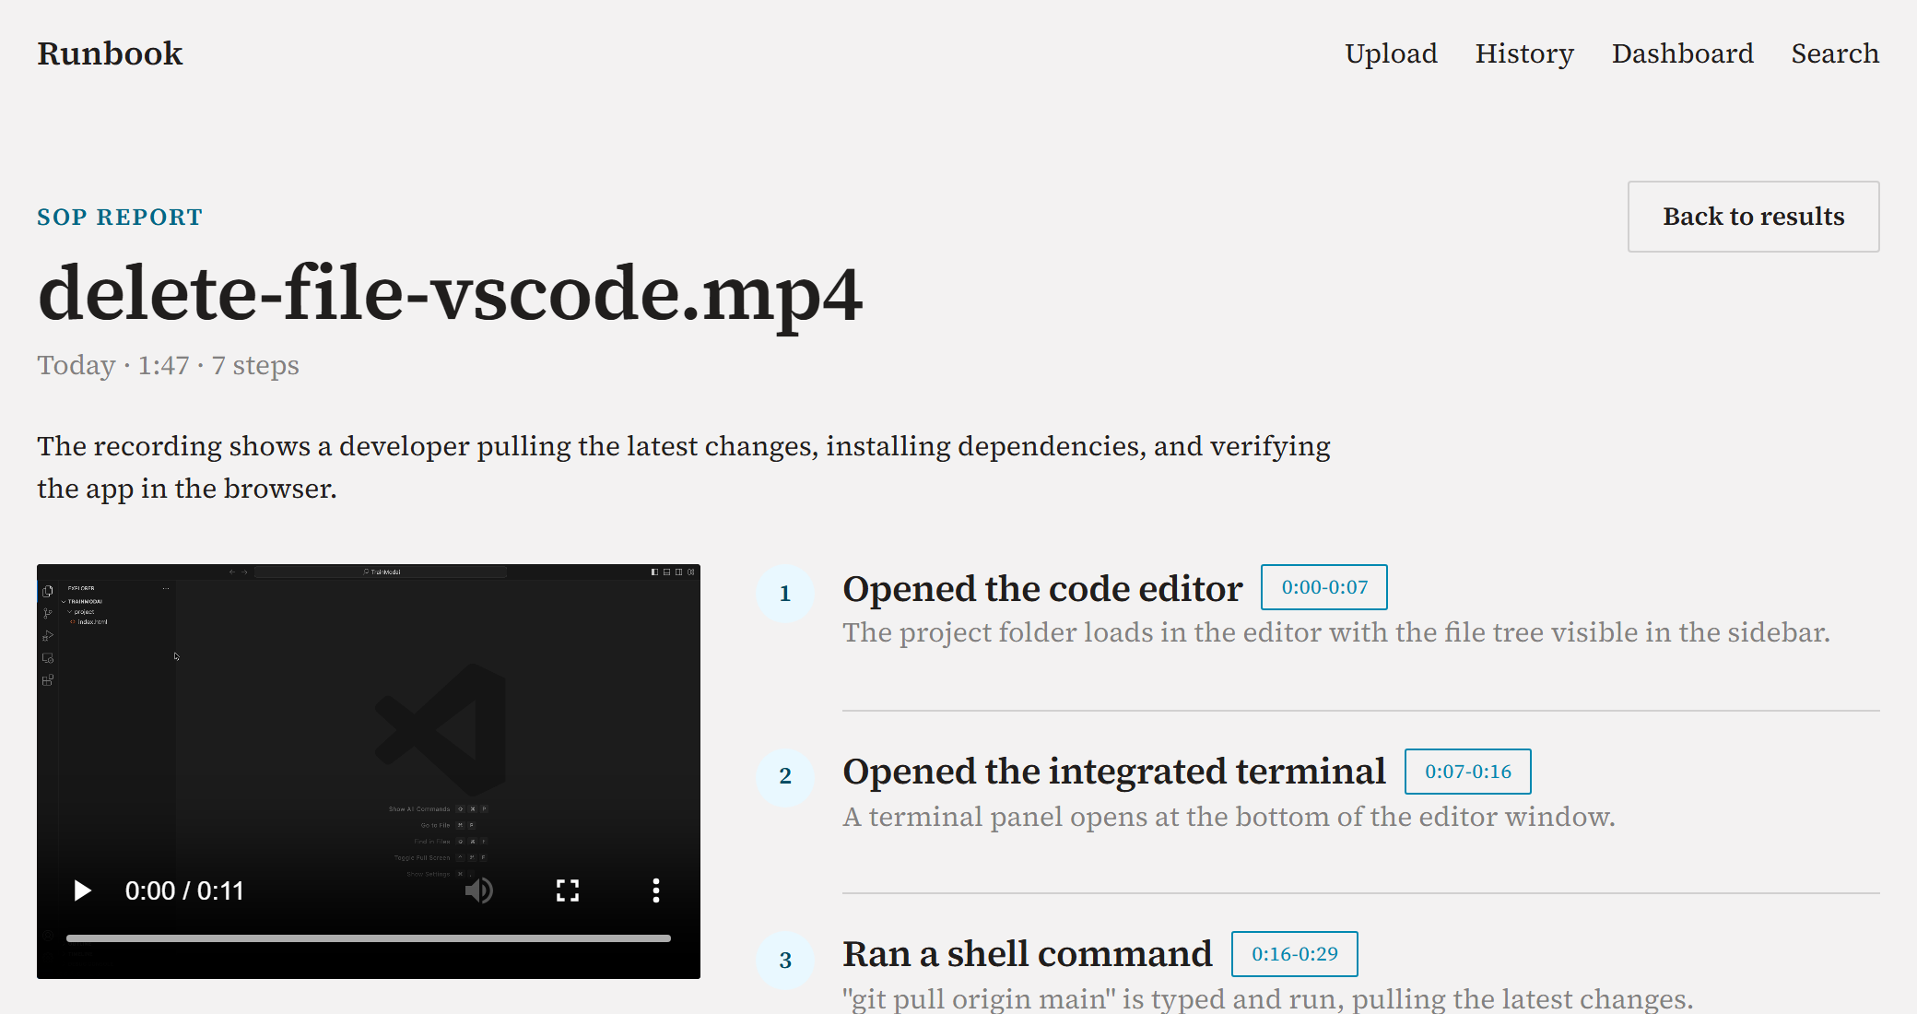
THE PRODUCT · 4 / 6
The SOP report
The recording becomes a numbered procedure.
Seven steps in all, each carrying the timestamps it was read from.
Notes:
[SOP report — 15 sec | SHOW: UI screenshot]
"Step 4 — the recording becomes a numbered Standard Operating Procedure, each step timestamped back to the original video."

Slide 38
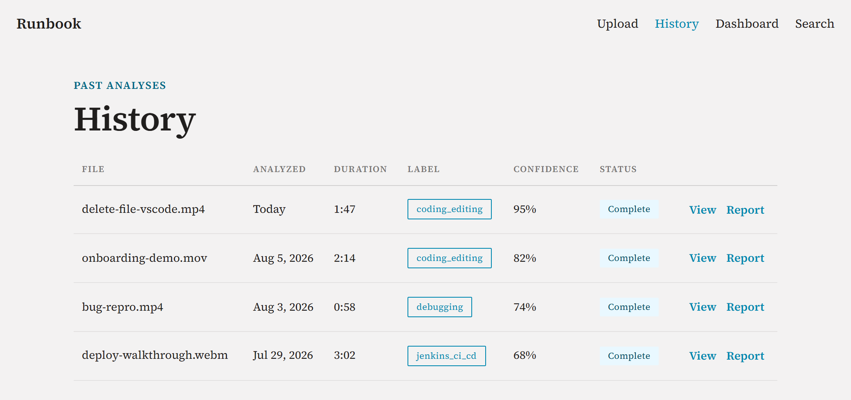
THE PRODUCT · 5 / 6
History
Every recording analysed so far, with the label it was given.
Notes:
[History — 10 sec | SHOW: UI screenshot]
"Step 5 — every analyzed recording is logged with its label. A full audit trail."

Slide 39
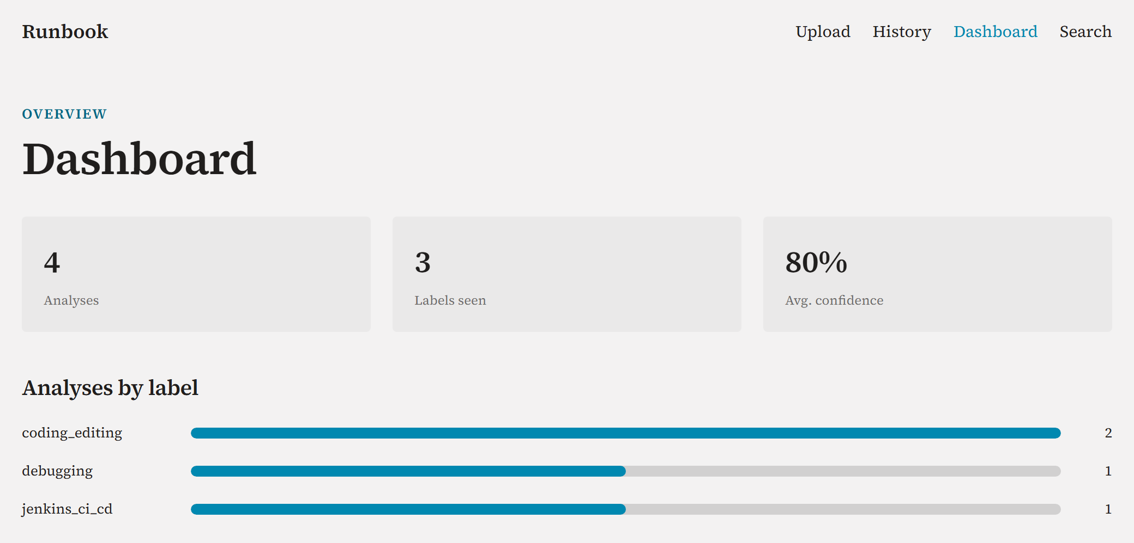
THE PRODUCT · 6 / 6
Dashboard
How many recordings, which labels, average confidence.
Notes:
[Dashboard — 10 sec | SHOW: UI screenshot]
"Step 6 — the dashboard shows recording counts, label distribution, and average confidence at a glance."

Slide 40
Thank You
Group Members (name, Student ID):
1. Lakshmi Barthwal Chamoli (A0340664E)
2. Yuan Zilin (A0283899Y)
3. Stalin Sagayaraj (A0340115X)
4. Muthaiah Muneeswaran (A0019650J)
github.com/laxmi1707/PatternRecognSystem-Video2Text
Notes:
[Thank You — 20 sec]
"To summarize: 4 modalities, 150 features, 14 models, one command to train. Ensembles outperform any single model. Classical ML competes with deep learning when features are well-engineered. And the gap between recording and understanding is now automated.
Thank you, Professor. We're happy to take questions."

Slide 41
References
Full source artefacts for the background incidents (slide 1)
CNA — primary report. Singapore/NCS case, S$918,000 loss.
https://www.channelnewsasia.com/singapore/former-employee-hack-ncs-delete-virtual-servers-quality-testing-4402141
DataBreaches.net — secondary coverage of the CNA report.
https://databreaches.net/2024/06/14/insider-threat-months-after-being-fired-former-employee-accessed-companys-computer-test-system-and-deleted-servers-causing-it-to-lose-s918000/
TechRadar Pro — secondary coverage, NCS case.
https://www.techradar.com/pro/security/ex-employee-of-major-south-east-asian-it-firm-jailed-after-he-brings-down-its-test-servers-with-scripts-found-on-google
CSO Online — original report, US/Pratt-Read case (site not directly fetchable; cited via G5 below).
https://www.csoonline.com/article/2123366/former-worker-sentenced-for-wrecking-servers.html
G5 Cyber Security — reproduces the CSO Online report, US/Pratt-Read case.
https://blog.g5cybersecurity.com/former-worker-sentenced-for-wrecking-servers/
Notes:
[SHOW IF ASKED — References slide]
"References for the background incidents are here. CNA, DataBreaches.net, and TechRadar for the Singapore NCS case; CSO Online and G5 Cyber Security for the US Pratt-Read case."

Slide 42
Appendix
Notes:
[SHOW SILENTLY — Appendix header, click through]

Slide 43
AI Tool Declaration:
Figures: TRACE system architecture and pattern-recognition landscape diagrams, created by the project team with generative-AI assistance.
The project team also used Claude Code (Opu 4.6 ), ChatGPT, Gemini to support project ideation, review the proposed technical approach, improve the clarity and structure of selected sections, and assist with document formatting and refinement. The project team reviewed and revised the generated suggestions and is responsible for the final project presentation, technical decisions, implementation, evaluation, content, and quality of the submitted work.
Notes:
[SHOW IF ASKED — AI Declaration]
"We used Claude Code, ChatGPT, and Gemini for ideation, document formatting, and diagram assistance. All technical decisions, implementation, and evaluation were done by the team."

