Slide 1
DEVELOPMENT OF FARMER ASSISTANCE SYSTEM USING SMART TECHNOLOGY

Slide 2
ABSTRACT
Agriculture has become much more than simply a means to feed ever growing population. The main objective of the project is to provide assistance to the farmers using smart technology which helps in providing information to the farmers about the field requirements and its respective solution.
The problems of agriculture include irrigation, lack of mechanization, plant diseases, lack of knowledge of manures, fertilizers and seeds. Identification of plant disease is very difficult in agriculture field. If identification is incorrect then there is a huge loss on the production of crop and economical value of market.

Slide 3
INTRODUCTION
Problem:
Identifying plant disease wrongly leads to huge loss of yield, time, money and quality of product.
Identifying the condition of plant plays an important role for successful cultivation.
In olden days identification is done manually by the experienced people but due to the so many environmental changes the prediction is becoming tough.

Slide 4
SOLUTION-
A platform for mutual interface between farmers and control station is provided.
The farmers update the status of the field to the control station by capturing the images of the field. The control station analyses the data provided by the farmers by using image processing techniques.
After processing the images, the required solution for field management and the respective precautions for the problems detected is provided.

Slide 5
MODULES
Farmer module
Control station module

Slide 6
ADVANTAGES
It is helpful in reducing the problems such as irrigation, plant diseases and weather condition there by providing assistance to the farmer.
It also helps to acknowledge the farmers with the condition of their field on everyday basis and because of the smart technology usage in the farming techniques, it provides employment to the younger generation there by increasing the agriculture rate in the world.

Slide 7
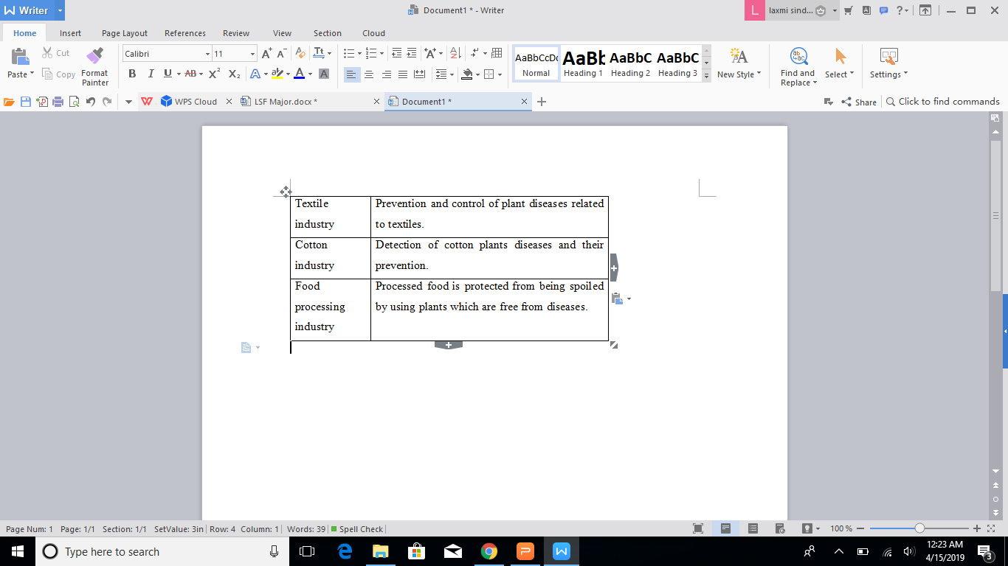
APPLICATIONS
Few examples:

Slide 8
INPUT
Image

Slide 9
OUTPUT
FEEDBACK/STATUS AS-
Image(After comparision)
Text:
Criteria
Description
Symptoms
Solution

Slide 10
CONCLUSION
Indian economy is highly dependent of agricultural productivity. Therefore in field of agriculture, detection of disease in plants plays an important role. To detect a plant disease in very initial stage, use of automatic disease detection technique is beneficial.

Slide 11
THANK YOU

