Slide 1
CUSTOMER SHOPPING BEHAVIOR
Five practical
growth moves
A leadership readout from 3,900 purchases.

Slide 2
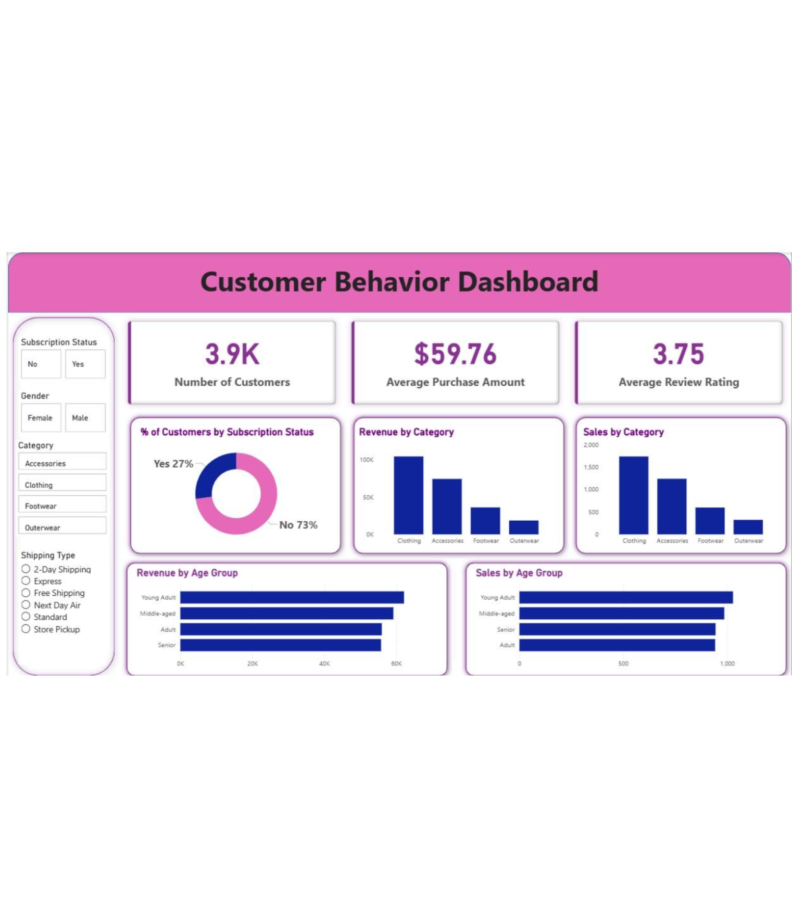
Customer shopping behavior points to five practical growth moves
THE DATASET
3,900 purchases reveal a broad but highly repeat-driven customer base
3,900
$59.76
purchases across 4 categories, 50 locations, and 25 products
average purchase · 3.75 average review rating
Data quality: 37 review ratings were filled using category medians.
02

Slide 3
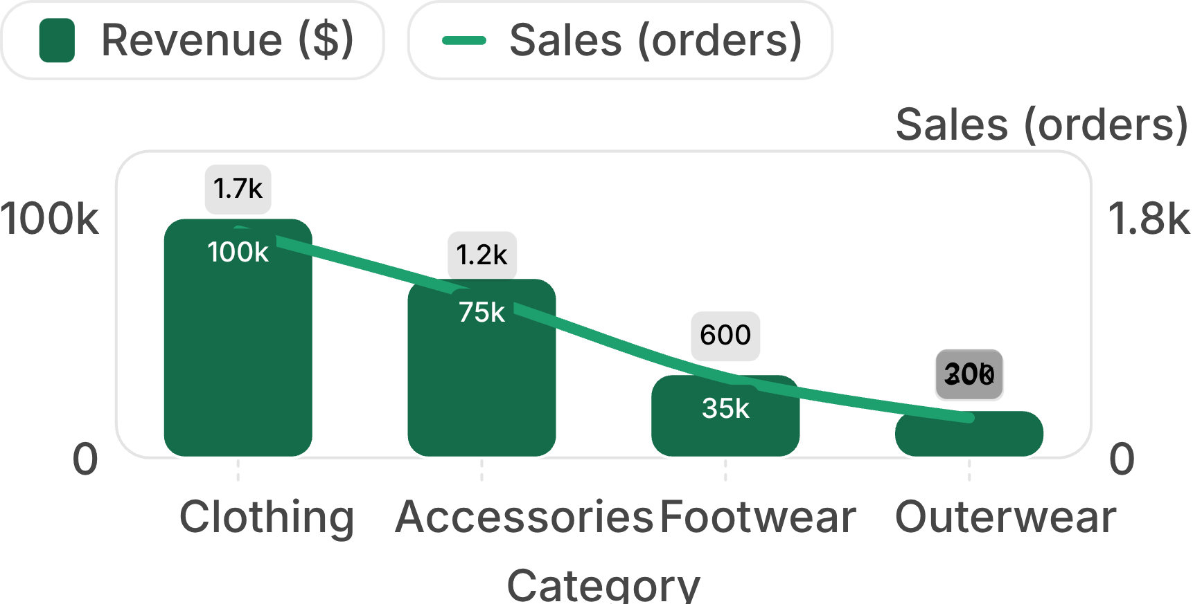
Customer shopping behavior points to five practical growth moves
COMMERCIAL ENGINE
Clothing is the commercial engine, with accessories a strong second
Clothing leads both revenue and order volume; accessories is the clear second engine.
$100K
clothing revenue · roughly 1,700 orders
$75K
accessories revenue · roughly 1,200 orders
Best-selling products: jewelry, sunglasses, belt, blouse, pants, shirt, sandals, shoes, sneakers, jacket, and coat.
03

Slide 4
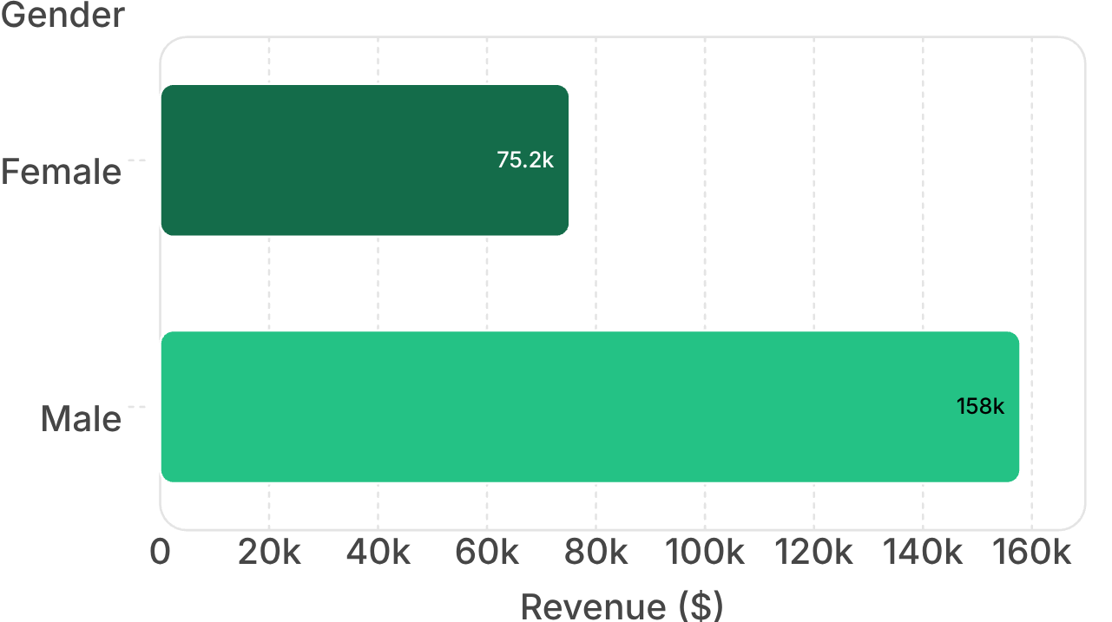
Customer shopping behavior points to five practical growth moves
TARGETING QUESTION
Male customers generate more revenue, but the gap is a targeting question
$157,890
Male revenue
Use the difference to guide campaign allocation, then test whether it reflects customer mix, basket size, or both.
Female revenue: $75,191
04

Slide 5
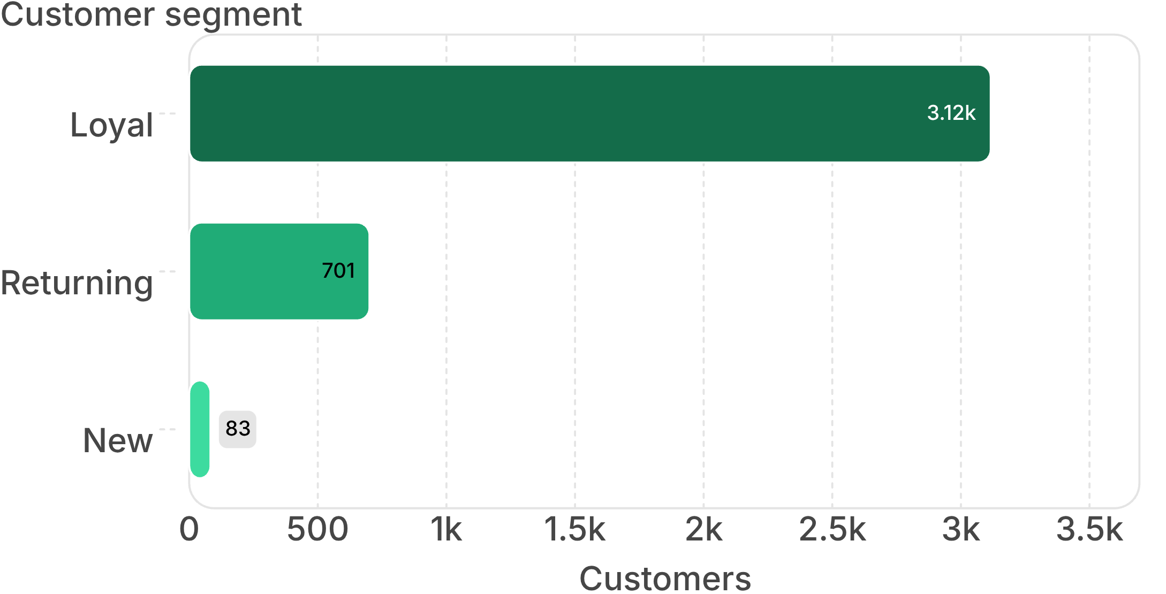
Customer shopping behavior points to five practical growth moves
RETENTION ADVANTAGE
Loyal customers dominate the base, creating a retention advantage
The immediate opportunity is not only acquisition: it is converting returning buyers into loyal customers and rewarding repeat behavior.
05

Slide 6
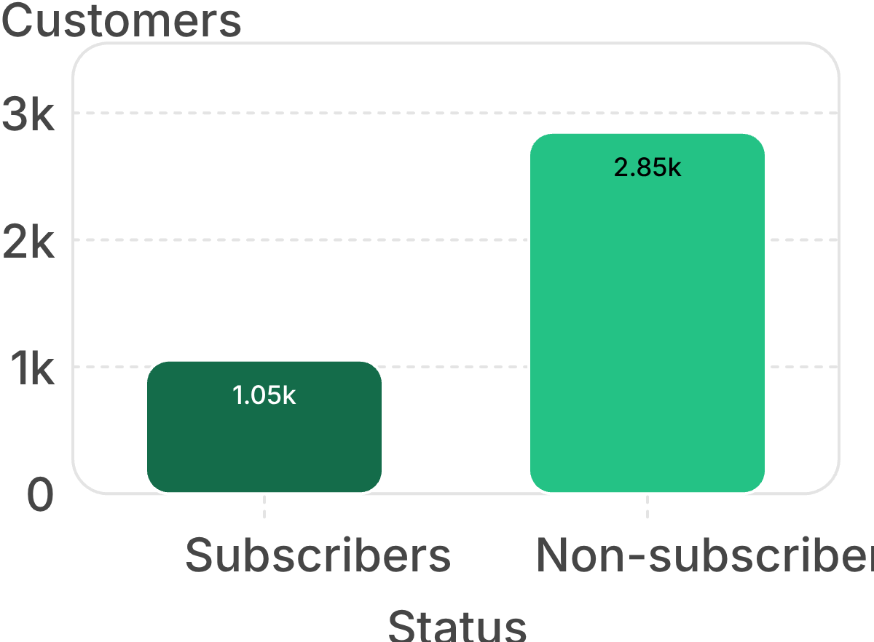
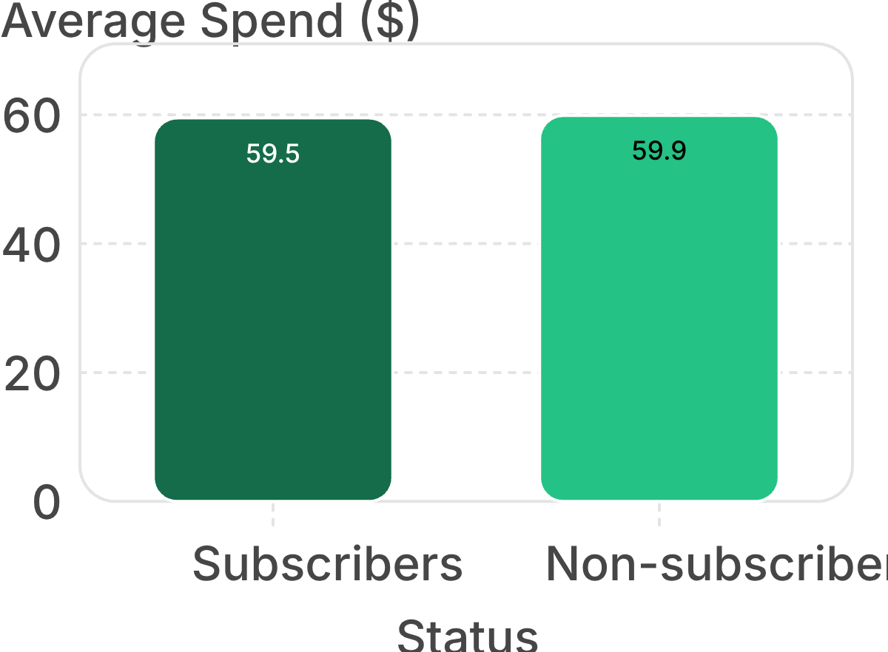
Customer shopping behavior points to five practical growth moves
SUBSCRIPTION GAP
Subscriptions are underpenetrated despite a large repeat-buyer pool
There is a conversion opportunity, but the offer must create value beyond a lower price.
27% subscribers · 73% non-subscribers
Average spend is nearly flat: $59.49 vs $59.87
06

Slide 7
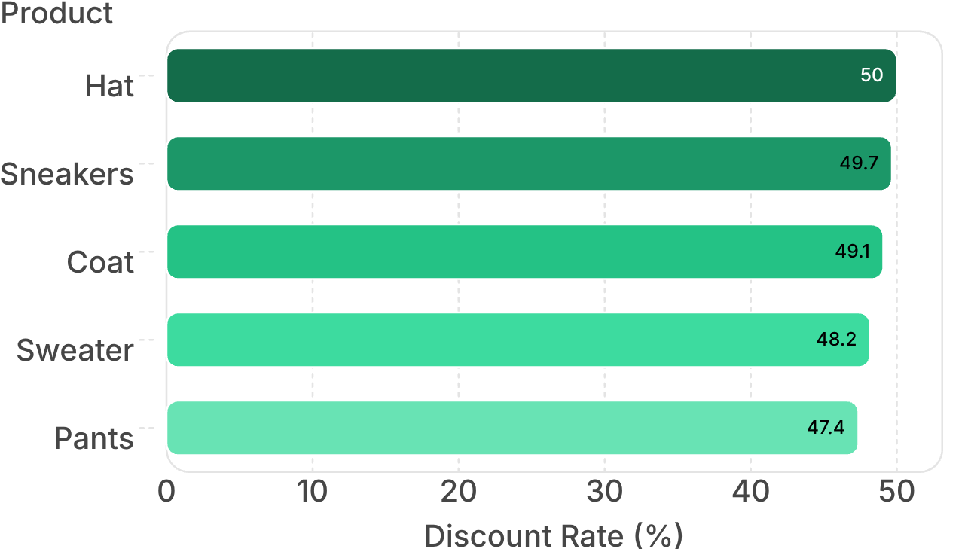
Customer shopping behavior points to five practical growth moves
MARGIN SENSITIVITY
Discounts attract high spenders, but several products may be margin-sensitive
839
high-spending discount users spent above the average purchase amount while using discounts
Keep discounts where they lift conversion, but test thresholds, bundles, and targeted offers on discount-dependent products.
07

Slide 8

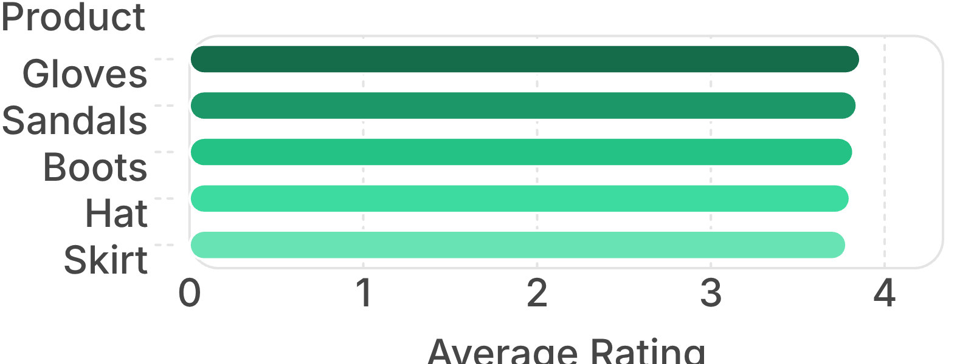
Customer shopping behavior points to five practical growth moves
MERCHANDISING PROOF
Top-rated products create a ready-made merchandising story
Pair product ratings with the category leaders to build campaigns around proof, not just price. Feature best-rated items in recommendations, bundles, and post-purchase follow-ups.
08

Slide 9
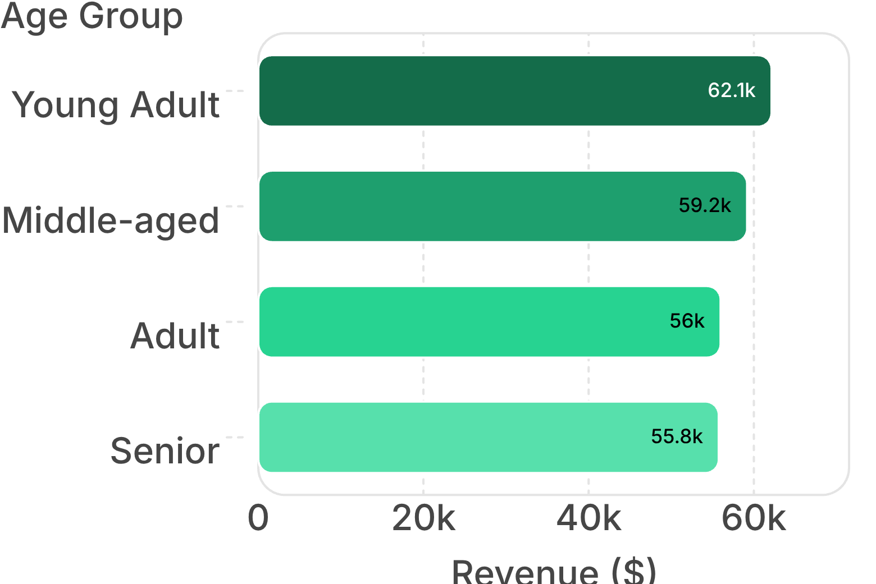
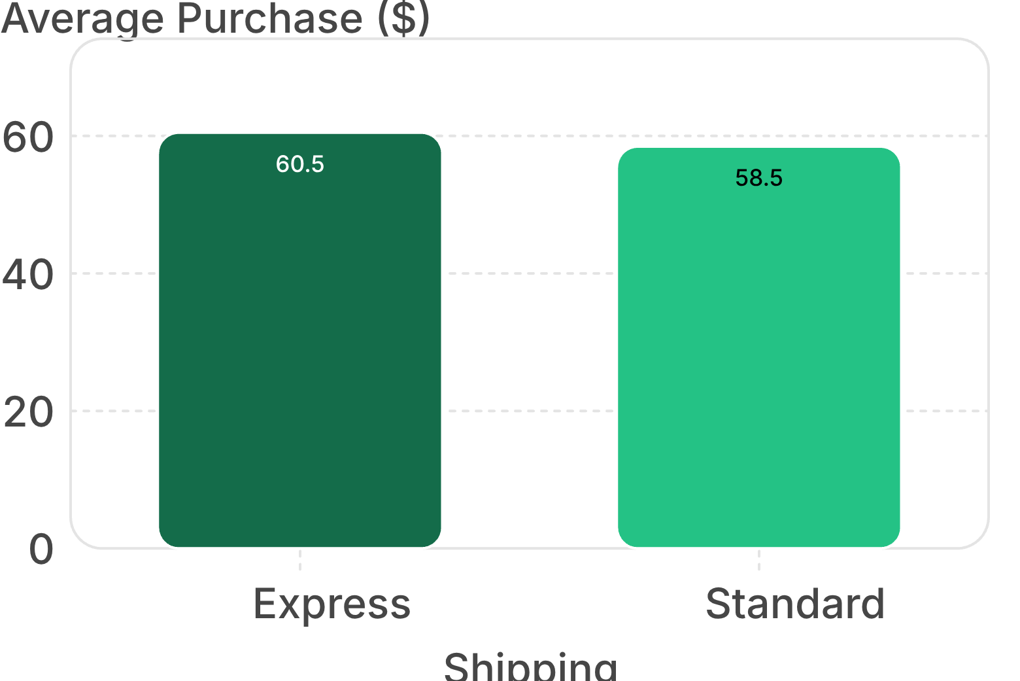
Customer shopping behavior points to five practical growth moves
DEMAND SIGNALS
Young adults lead revenue, while express shipping correlates with a slightly higher basket
Prioritize young-adult campaigns and test express-shipping messaging as a value signal.
09

Slide 10

Customer shopping behavior points to five practical growth moves
FROM ANALYSIS TO ACTION
Five actions can turn the analysis into measurable growth
Grow subscriptions: design exclusive benefits for the 73% of customers who are not subscribed
Reward loyalty: move returning buyers toward the loyal segment with milestone-based benefits.
Protect margin: review discount depth on hats, sneakers, coats, sweaters, and pants
Merchandise proof: feature top-rated and best-selling products in campaigns
Target demand: focus marketing on young adults and test express-shipping positioning
10

