Slide 1

A Final Year Intern Report Presentation on
Dynamic website
Presented By:
Laxmi Dhakal(8173/072)

Slide 2

Dynamic Website

Slide 3
Contents
About Project
System Analysis
System Design
System Implementation
Testing
Conclusion and Future Enhancement
Appendix

Slide 4
ABOUT PROJECT

Slide 5
Introduction
“Real time payment system that directly connects the bank account and make payment through unique transaction id which focuses on virtual money transaction.”

Slide 6
Objective
To Provide website that is more dynamic and userfriendly.
To overcome the problem faced during manual system.

Slide 7
Scope
Admin can have full control over the content.
Easy to add,change,control all the content.
As the navigation is simple,it is very user-friendly.
It is mobile responsive.

Slide 8
SYSTEM ANALYSIS

Slide 9
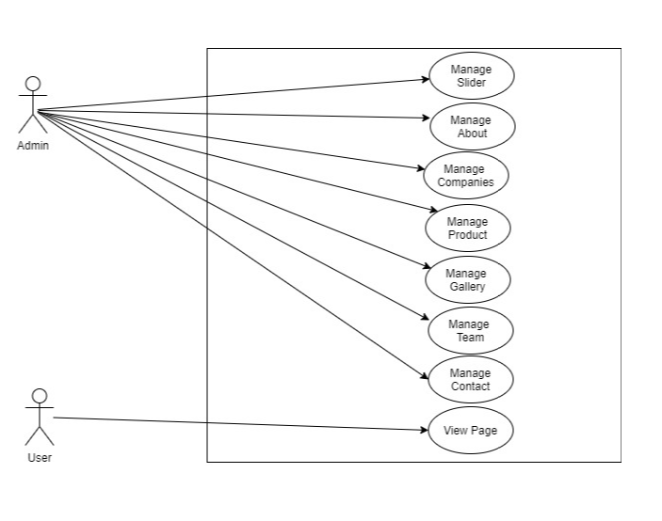
Use-case diagram

Slide 10
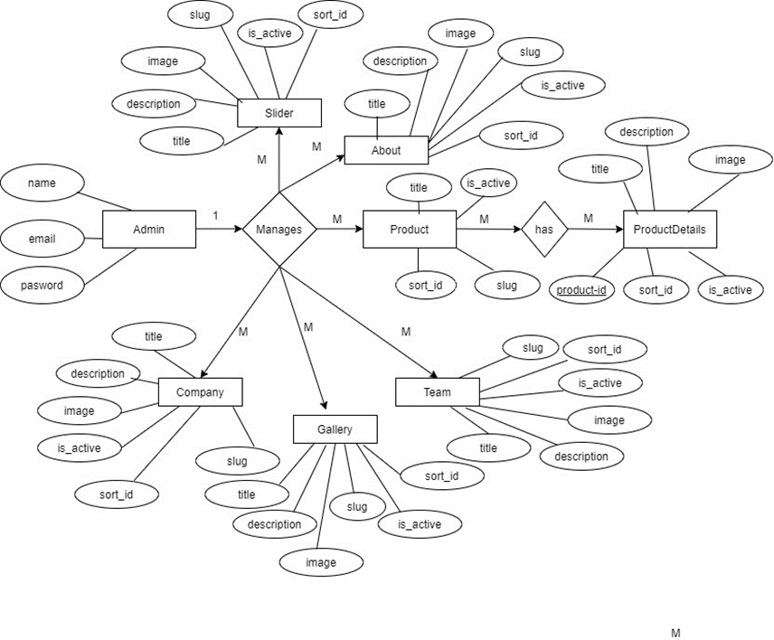
ER Diagram

Slide 11
SYSTEM DESIGN

Slide 12
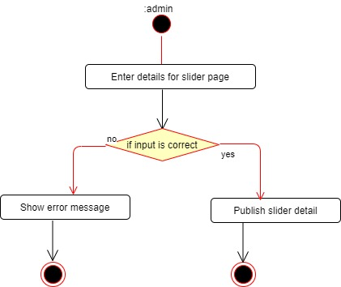
Activity Diagram
Activity Diagram for Publishing the slider page by the admin.

Slide 13
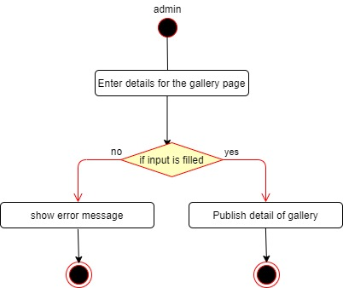
Activity Diagram
Activity Diagram for Publishing the gallery page by the admin.

Slide 14

Activity Diagram
Activity Diagram for Publishing product page by the admin.

Slide 15
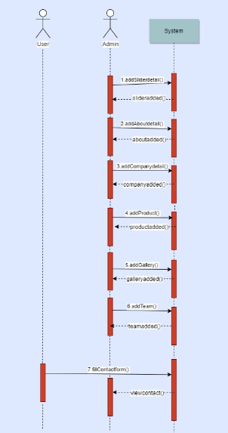
Sequence Diagram

Slide 16
SYSTEM IMPLEMENTATION

Slide 17
Tools And Technologies
Front End
Html
Bootstrap
Css
Back End
php
mysql
Framework
Laravel

Slide 18
TESTING

Slide 19
Unit Testing
Objective | Check Login Process
Input | Email and Password
Expected output | Login page if user is valid
Original output | Wrong email or password
Error info | -
Objective | Check login process
Input | Email and password
Expected output | Login page if user is valid or else displays error message
Original output | User was successfully logged in
Error info | -
Login
Login after correction

Slide 20
System Testing
Objective | Check Slider
Input | Title,Image
Expected Output | Slider Detail Created Successfully

Slide 21
CONCLUSION
&
FUTURE ENHANCEMENT

Slide 22
Conclusion
It will provide a seamless, cashless transaction to the citizens.
It will create a user-friendly environment to make a simple payment and every people will be able to use it without any difficulties.
It will provide the platform to pay the bill through online .

Slide 23
Limitation
Difficult to Manage.
Development Time and cost comparatively high.

Slide 24
APPENDIX

Slide 25
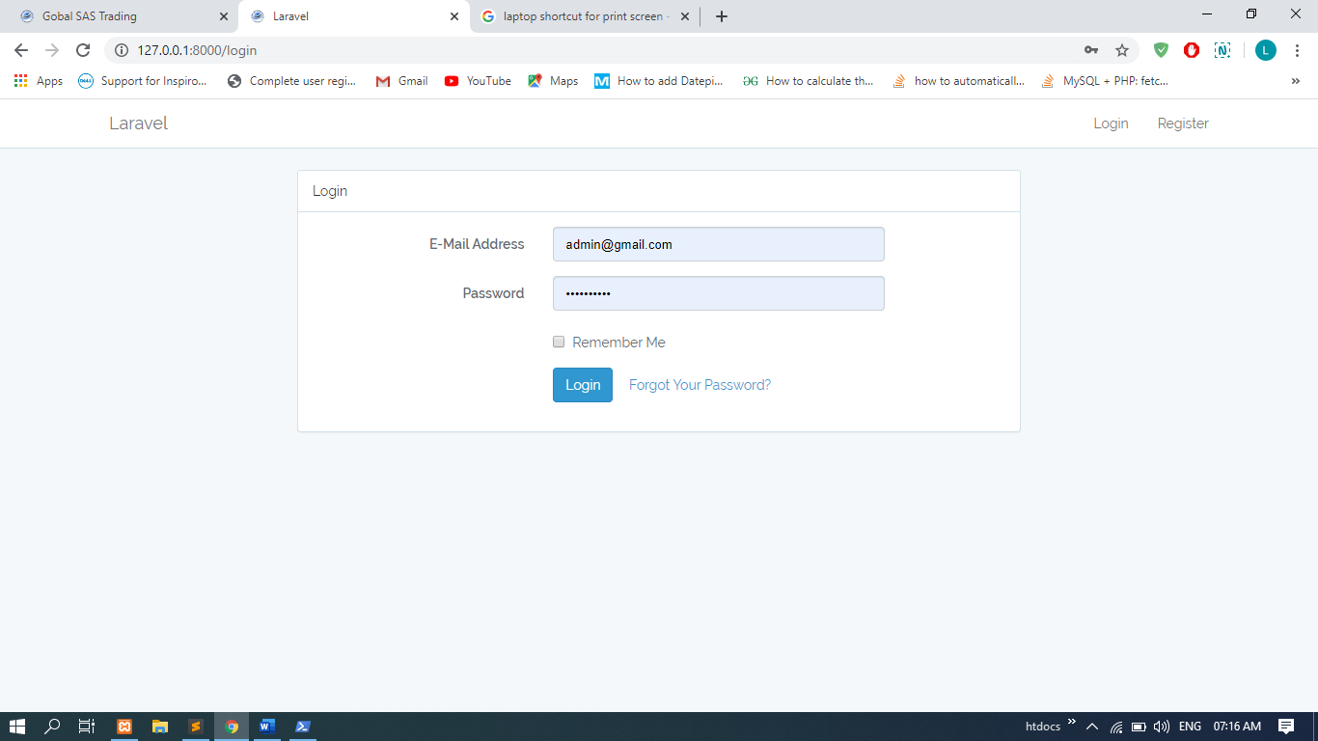
Login and Registration

Slide 26
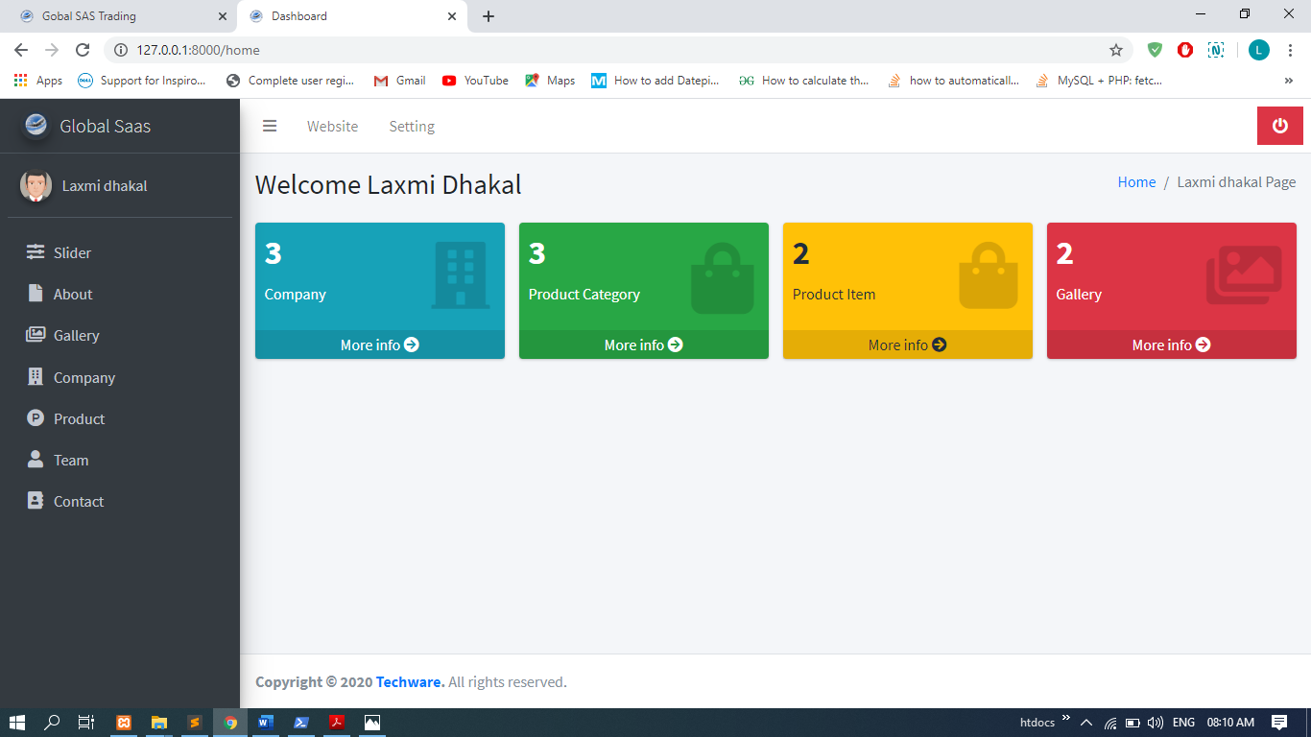
Dashboard

Slide 27
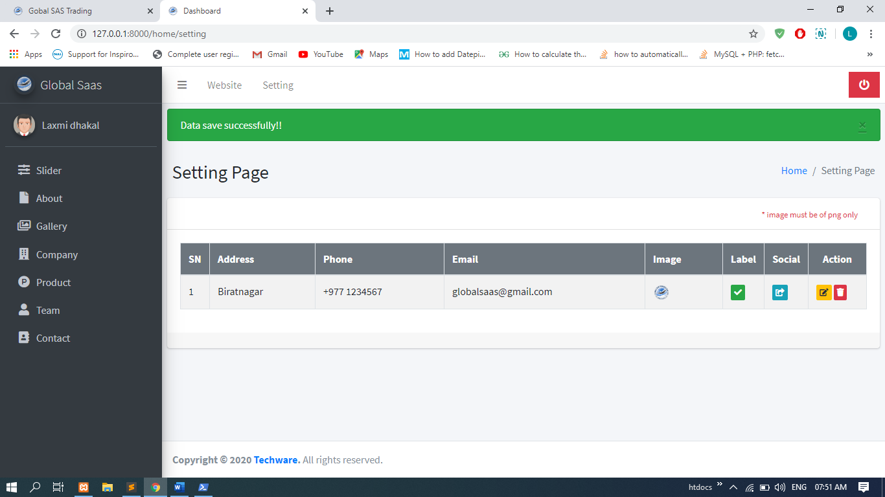
Entering Setting details

Slide 28
Thank You

