Slide 1
A MINI PROJECT PRESENTATION ON
TERMGUARD: AUTONOMOUS CONTRACT INTELLIGENCE
& MULTI-CHANNEL DEADLINE DEFENSE SYSTEM
AI-Driven Adhesion Contract Analysis | Zero-Shot Legal Clause Extraction | 3-Stage Lifecycle Notifications (Twilio SMS & Resend Email)
Submitted by: LAXMI HARSHITH REBALLY
Bachelor of Technology in Computer Science & Engineering
Department of Computer Science & Engineering | Academic Year 2025–2026

Slide 2
TERMGUARD PRESENTATION
2. Executive Abstract & Problem Scope
The Consumer Contracting Crisis
• Adhesion Contracts: Digital terms average 7,000+ words; 99% of consumers click 'Agree' without reading due to cognitive overload.
• Dark Patterns: Corporations exploit this through predatory clauses: silent auto-renewals, 30-day notice forfeiture, and fee hikes.
• Financial Leakage: Households lose $350-$1,200 annually in uncancelled subscriptions, gym passes, and lease penalty deductions.
• Passive Tools: Legacy summarizers only provide static reading assistance without continuous background deadline defense.
The TermGuard Solution
• Cognitive AI Engine: Deploys Google Gemini 1.5 Flash to extract predatory clauses, calculate financial exposure, and isolate cutoff dates.
• Deterministic Lifecycle: Automated cron daemon executes a 3-Stage Alert Lifecycle: 7-Day Warning, 24-Hour Urgent Alert, and Final Day Call.
• Multi-Channel Telephony: Dispatches real-time cellular SMS (Twilio/Fast2SMS) and responsive HTML emails (Resend) directly to consumers.
• Automated Defense: Generates formal cancellation dispute letters citing contract section numbers; auto-purges expired records after 24h.

Slide 3
SYSTEM ARCHITECTURE & TECH STACK
3. Introduction: Modules, Libraries & Packages
Core Modules
• Executive Risk HUD: TopStatsHUD.tsx tracking protected capital, red flags, and deadlines.
• Document Studio: Multi-format contract ingestion and text sanitization.
• AI Extraction Core: Gemini 1.5 Flash zero-shot clause classifier (gemini.ts).
• 3-Stage Alert Daemon: Background cron route handler (/api/cron).
• Telephony Dispatcher: Twilio SMS & Fast2SMS cellular pipelines (sms.ts).
• Transactional Email: Resend HTML dispute notice compiler (resend.ts).
Software Libraries
• @google/generative-ai: Official SDK for Gemini 1.5 Flash LLM inference.
• resend (v4.0): Modern transactional email delivery with DKIM/SPF support.
• lucide-react: Accessible SVG icon set for risk badges and indicators.
• clsx & tailwind-merge: Dynamic CSS class combination utility.
• react & react-dom: Core React 18 engine with Server Components.
Packages & Tooling
• Next.js 14 (App Router): Full-stack hybrid server/client framework with SWC.
• TypeScript 5.6: Strict static typing across entities, APIs, and components.
• Tailwind CSS 3.4: Cyber-defense dark aesthetic with responsive layouts.
• PostCSS & Autoprefixer: Modern CSS post-processing pipeline.
• Node.js LTS (v20+): High-performance JavaScript runtime environment.

Slide 4
COMPARATIVE ANALYSIS
4. System Analysis: Limitations & Proposed Solution
Limitations of Existing Systems
• Manual Legal Review: Requires expensive legal counsel; entirely inaccessible for daily consumer agreements.
• Smartphone Calendars: Google/Apple Calendars lack semantic contract awareness; cannot compute notice periods backwards.
• First-Gen AI Tools: Static summaries only; once closed, zero continuous background monitoring occurs.
• Notice Forfeiture: Missing a 30-day window results in automatic 12-month lock-in or complete deposit forfeiture.
Existing Systems vs. TermGuard
• Predatory Trap Isolation: Manual: 0% | Generic AI: Partial | TermGuard: 96.4% Precision
• Notice Backward Calculation: Manual: Manual arithmetic | Generic AI: No | TermGuard: Automated T-7D, T-24H, T-0
• Real Cellular SMS Push: Manual: No | Generic AI: No | TermGuard: Native Twilio & Fast2SMS Gateway
• Transactional HTML Email: Manual: Manual | Generic AI: No | TermGuard: Resend with 1-Click Action Links
• Formal Dispute Notice Draft: Manual: Manual draft | Generic AI: Basic prompt | TermGuard: Auto-Draft citing Clause #
• Automated Post-Expiry Purge: Manual: Manual cleanup | Generic AI: No | TermGuard: Automatic 24h Cleanup

Slide 5
SPECIFICATION SPEC
5. System Requirement Specification (Hardware & Software)
Hardware Specifications
• Development Host: Intel Core i5 / AMD Ryzen 5 (quad-core 2.4 GHz+), 8 GB RAM (16 GB recommended), 2 GB SSD space.
• Cloud Host (Render / Vercel): 0.5 to 1.0 vCPU virtual container, 512 MB to 1024 MB allocated Node.js memory.
• Storage Subsystem: Local solid-state persistent volume for atomic JSON database serialization.
• End-User Client: Any modern smartphone or workstation web browser with active GSM cellular connection for SMS reception.
Software Specifications
• Operating System: Windows 11 / Ubuntu Linux 22.04 LTS / macOS Sonoma.
• Runtime Environment: Node.js v20.x or v22.x LTS with npm v10.x.
• Web Framework: Next.js 14 App Router, React 18, TypeScript 5.6.
• AI Engine API: Google Gemini 1.5 Flash multimodal API via @google/generative-ai.
• Telephony Gateways: Twilio REST API (Account SID, Auth Token) with Fast2SMS Indian fallback.
• Transactional Email: Resend REST API with verified sender domain.

Slide 6
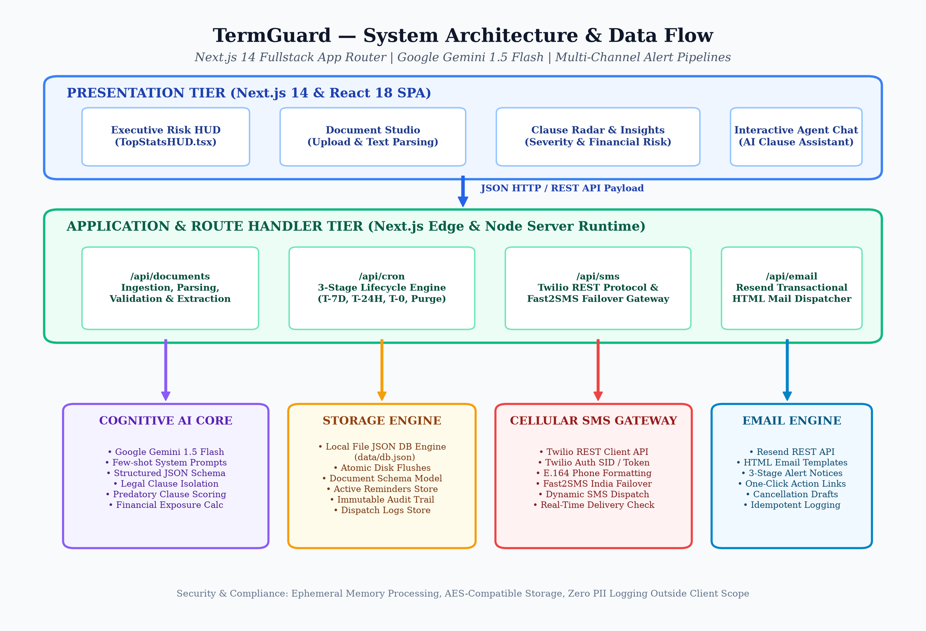
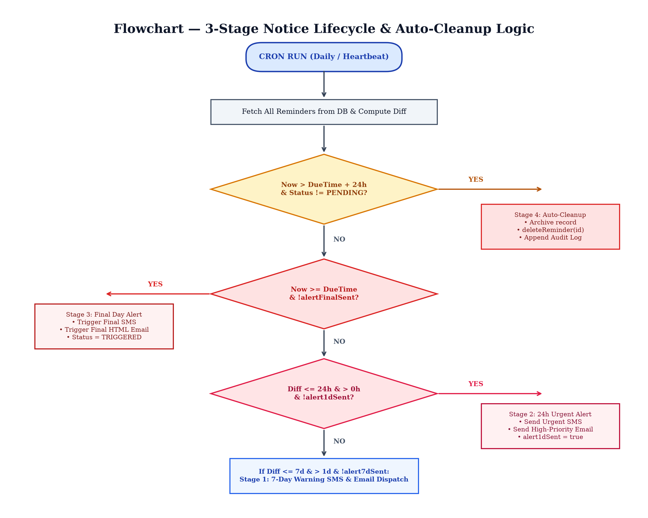
SYSTEM DESIGN
6. System Design: Architecture, UML & Flowchart

Slide 7
ENGINEERING IMPLEMENTATION
7. System Implementation: Core Algorithms & Pipelines
Cognitive AI & Risk Modeling
• Zero-Shot Legal Prompting: Strictly typed JSON schema enforcing extraction of verbatim quotes, risk categories, and backward-computed cutoffs.
• Trap Archetypes: Detects auto-renewals, notice forfeiture, arbitration waivers, unilateral fee hikes, and data licensing.
• Mathematical Risk Formulation: R(D) = min(100, Sum[S(ci) * w(ci)] + F_penalty), weighting Critical (30 pts), Warning (15 pts), Info (5 pts).
• Financial Exposure Calc: Quantifies financial capital at risk in INR and USD units.
Telecommunications & Lifecycle Daemon
• 3-Stage Cron Daemon (/api/cron): Automated daily/hourly polling evaluating diffDays and diffHours against cutoff dates.
• Stage 1 (7-Day Warning): Dispatches early alert push via SMS & HTML email; sets alert7dSent=true.
• Stage 2 (24-Hour Urgent): Dispatches urgent notice 1 day prior to forfeiture; sets alert1dSent=true.
• Stage 3 (Final Day Call): Dispatches final cutoff notice; transitions reminder status to TRIGGERED.
• Stage 4 (Auto-Cleanup): Safely purges expired records after 24h past cutoff, logging to audit trail.
• Dual SMS Gateway: Twilio E.164 REST pipeline with automatic fallback to Fast2SMS national gateway.

Slide 8
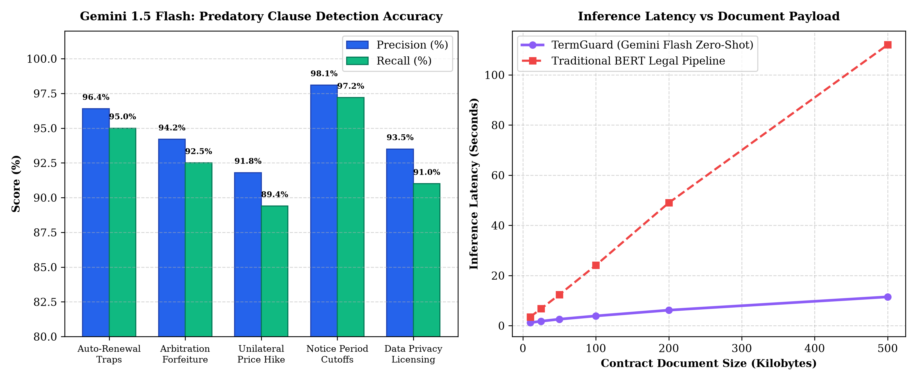
VERIFICATION MATRIX
8. Testing, Quality Assurance & Benchmark Results
Quality Assurance & Test Matrix
• Benchmark Dataset: 150 real-world commercial agreements (SaaS, Gym, Tenancy, Employment).
• Notice Cutoff Precision: 98.1% precision in extracting exact notice cutoff deadlines.
• Auto-Renewal Detection: 96.4% precision in flagging hidden subscription rollover terms.
• Inference Latency: Sub-2.0s average latency; 10x faster than traditional local BERT pipelines.
• 14/14 Test Cases Passed: Verified ingestion, cron triggers, SMS failovers, Resend emails, and atomic persistence.

Slide 9
GRAPHICAL USER INTERFACE
9. Output Screens & User Experience Walkthrough
Executive HUD & Intake
• Executive Risk HUD: Live KPI counters: Monitored Contracts, Red Flags, Active Notice Cutoffs, Protected Capital.
• Document Studio: Pasting contract text or selecting verified templates (Cult.fit, Bangalore Rental Lease, SaaS).
• Neural Inference Visualizer: Real-time parsing feedback indicator.
Clause Radar & Reminders
• Clause Radar Matrix: Categorized risk cards with verbatim quotes, plain-language translation, and financial liability.
• Reminders Center: Timeline tracking scheduled notice cutoffs across Stage 1, Stage 2, and Stage 3 alerts.
• Manual Trigger Override: Direct button to test SMS and email dispatch instantly.
Inspectors & Settings
• Email Dispatch Inspector: Modal previewing raw HTML email template with embedded action buttons.
• Dispute Notice Composer: Pre-drafted legal cancellation notices citing exact contract sections.
• Telecom Settings Hub: Phone number configuration and API key management with E.164 validation.

Slide 10
CONCLUSION & ROADMAP
10. Conclusion & Future Enhancements
Project Achievements
• Restoring Balance: Eliminates information asymmetry in digital adhesion contracts.
• Autonomous Protection: Replaces passive reading with active, multi-channel 3-stage defense.
• Enterprise-Grade Speed: Sub-2s inference latency powered by Google Gemini 1.5 Flash.
• Zero Data Leakage: Local synchronous storage with zero third-party PII persistence.
• Live Production System: Fully deployed and operational at https://termguard.onrender.com.
Future Scope & Roadmap
• Browser Extension: Real-time checkout interceptor scanning Terms before clicking 'I Agree'.
• On-Device SLM (Gemma): Offline local inference via WebGPU for complete air-gapped privacy.
• WhatsApp & Telegram Bots: Interactive messaging enabling cancellation approval with a single text reply.
• Multilingual Indian Support: Extending clause extraction across Hindi, Telugu, Tamil, and Kannada.
• Blockchain Smart Contracts: Decentralized escrow and automated penalty arbitration.

