Slide 1
A MINI PROJECT PRESENTATION ON
TERMGUARD
Smart Contract Reader & Automated Deadline Alert System
SUBMITTED BY:
1. REBALLY LAXMI HARSHITH (Roll No: 201224539090)
2. SHUBHAM PRADHAN
Department of Computer Science & Engineering | Academic Year 2025–2026
Live Website: https://termguard.onrender.com

Slide 2
TERMGUARD • MINI PROJECT REVIEW [SLIDE 2/12]
1. Introduction to TermGuard
The Everyday Situation
• Long Agreements: Every time we join a gym, rent a flat, or buy software, we are asked to agree to long legal terms.
• Nobody Reads Them: Agreements have 20 to 30 pages. 99% of people simply click 'I Agree' without reading.
• Hidden Rules: Companies hide strict rules inside: auto-debiting fees, strict cancellation dates, and non-refundable deposits.
• People Lose Money: Because people forget the dates, they end up paying for services they no longer use.
What is TermGuard?
• Smart Contract Reader: TermGuard is a simple web tool that reads contracts for you in seconds.
• Finds Hidden Traps: It uses Google Gemini AI to find secret rules and shows you the exact money at risk in Rupees (₹).
• Sends Phone Warnings: It automatically sends SMS to your mobile phone and emails to your inbox before the last date.
• Writes the Letter: It even prepares ready-made cancellation letters so you can easily stop the payment.

Slide 3
TERMGUARD • MINI PROJECT REVIEW [SLIDE 3/12]
2. Problem Statement
Tricks Used by Companies
• Silent Auto-Renewals: Gym passes and software plans silently charge your card again for another full year (e.g., ₹32,000 auto-debit).
• Tricky 30-Day Rules: Companies say: 'You must cancel at least 30 days before renewal, otherwise no refund!'
• Lost Rent Deposits: Landlords keep entire ₹70,000 security deposits if tenants forget to give a 2-month advance move-out notice.
• Price Hikes: Companies quietly increase your monthly fee without asking you first.
Why Regular Calendars Fail
• Calendars Cannot Read: Phone calendars (like Google Calendar) cannot read PDF contracts or understand legal terms.
• Only Reminds on Last Day: Calendars remind you on the last day—by then, the 30-day notice window is already gone and your money is lost!
• Zero Letter Help: Normal calendars cannot write a formal legal letter for you.
• Huge Money Lost: An average person loses ₹15,000 to ₹50,000 every year to forgotten subscriptions and penalties.

Slide 4
TERMGUARD • MINI PROJECT REVIEW [SLIDE 4/12]
3. Project Objectives
Main Goals of TermGuard
• Read Contracts with AI: Use Google Gemini AI to scan agreements in under 2 seconds and find sneaky clauses.
• Show Money at Risk: Clearly calculate and show how much money is at risk in Indian Rupees (₹ INR).
• Find Real Cutoff Dates: Calculate the true last date to cancel by subtracting notice periods backwards from renewal.
• Write Cancellation Drafts: Auto-generate formal letters ready to send to gym managers, landlords, or support.
Alert & Security Goals
• 3-Stage Alert System: Send reminders at 3 key times: 1 week before, 24 hours before, and on the last day.
• Direct Phone Delivery: Send real SMS text messages to mobile phones and emails directly to Gmail inboxes.
• Auto-Clean Expired Dates: Automatically remove old dates 24 hours after they pass to keep the screen clean.
• Safe History Log: Keep a safe, timestamped log of all alerts sent for future proof.

Slide 5
TERMGUARD • MINI PROJECT REVIEW [SLIDE 5/12]
4. Existing System vs. Proposed System
Existing System (Manual / Phone Calendar)
• Manual Reading: Reading 20 pages of hard English is tiring and easy to misunderstand.
• Late Reminders: Calendar only alerts on the final day, after the notice cutoff has already passed.
• Normal Chatbots (ChatGPT): Completely passive; once you close the chat, it forgets your contract.
• No Cancellation Help: Users have to figure out how to write formal legal letters themselves.
• Easy to Forget: No automated SMS alerts sent directly to your phone SIM card.
Proposed System (TermGuard)
• Fast AI Reading: Gemini AI reads the full agreement and finds hidden traps in 2 seconds.
• Early 3-Stage Alerts: Alerts you 7 days before, 1 day before, and on the cutoff day so you have time.
• Runs 24/7 in Cloud: Monitors dates automatically in the cloud even when your laptop is turned off.
• Pre-Written Letters: Writes cancellation letters citing exact contract sections (e.g., Section 4.3).
• Real SMS & Email: Sends real SMS to your phone number and clean emails to your Gmail inbox.

Slide 6
TERMGUARD • MINI PROJECT REVIEW [SLIDE 6/12]
5. Technologies & Tools Used (Simple & Clear)
Frontend (Website Design)
• Next.js 14: Modern web framework that runs both the website and the backend API together.
• React 18: Builds fast, interactive buttons, cards, and countdown timers.
• Tailwind CSS: Gives the website a clean, professional dark-mode style.
• TypeScript: Stops coding errors before they happen, making the website reliable.
AI & Backend
• Google Gemini 1.5 Flash: Smart Google AI that reads contracts and finds dates in under 2 seconds.
• Node.js: Server software that runs our backend code and calculations.
• JSON Database (db.json): Saves contracts and dates locally in a file with zero extra server costs.
• Render Cloud: Hosts our live website online at termguard.onrender.com.
Alerts & Communication
• Twilio SMS API: Sends real text messages directly to mobile phones over cellular towers.
• Fast2SMS Gateway: Indian SMS service used as an automatic backup for Indian phone numbers.
• Resend Email API: Sends clean, verified alert emails directly to Gmail primary inboxes.
• Activity Log: Safely records every scan and alert sent.

Slide 7
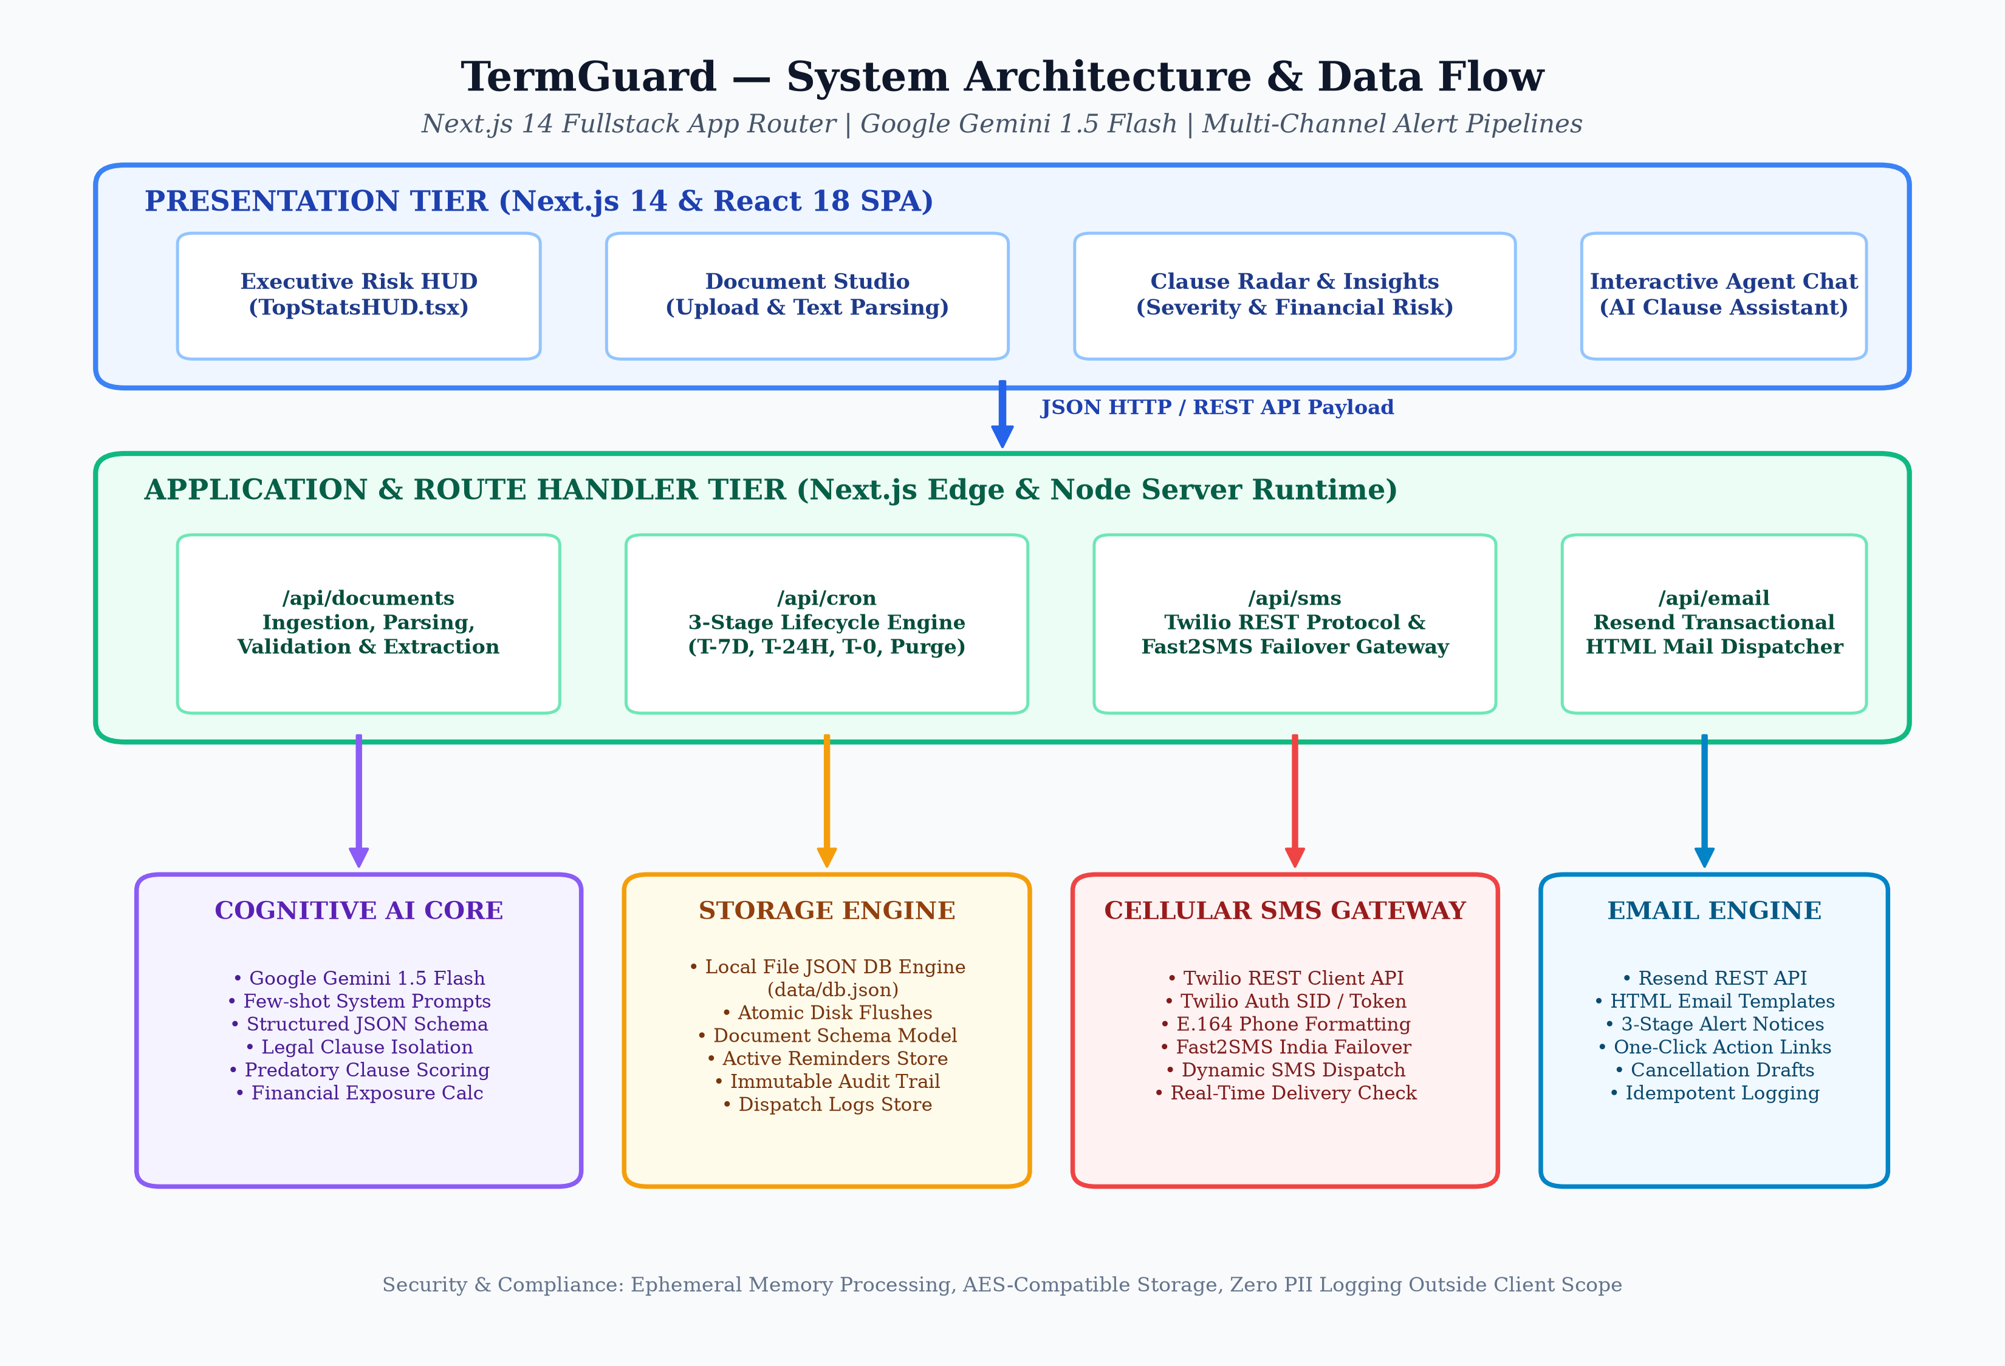
TERMGUARD • MINI PROJECT REVIEW [SLIDE 7/12]
6. System Architecture (How Everything Connects)
How the System Works
• 1. User Screen: The user opens the website and uploads a contract or picks a sample agreement.
• 2. Backend API: The server cleans the text and passes it to Google Gemini AI.
• 3. Gemini AI: The AI reads the text, finds the traps, and calculates the cutoff date.
• 4. Safe Storage: Details are saved in db.json with a live countdown timer.
• 5. Automated Alerts: When the date is near, the system sends SMS to phone and HTML email to inbox.

Slide 8
TERMGUARD • MINI PROJECT REVIEW [SLIDE 8/12]
7. System Modules (Main Parts of the App)
Screen Modules
• Dashboard Top HUD: Shows big cards with Total Money Saved (₹1,48,440) and active countdown timers.
• Document Studio: Where you paste contracts or choose sample agreements (Gym, Rent Flat, SaaS).
• AI Assistant Chat: A helpful chatbot where you can ask simple questions like 'When should I cancel?'
Core Processing Modules
• Deadlines Center: Shows active reminder cards with live countdown timers in days, hours, and minutes.
• Auto-Alert Timer (Cron): Runs automatically in the background to check which dates are arriving today.
• Add Agreement Modal: A simple popup to add any new contract, cutoff date, and money at risk.
Messaging & History Modules
• SMS Dispatcher: Formats phone numbers (+91) and sends text alerts via Twilio and Fast2SMS.
• Email Dispatcher: Sends clean, dark-themed emails with ready-to-copy cancellation letters.
• Activity Trust Log: A clear table showing timestamps and delivery IDs for every alert sent.

Slide 9
TERMGUARD • MINI PROJECT REVIEW [SLIDE 9/12]
8. Methodology: How the 3-Stage Alert Works
1. Contract Scan & Risk Score
• Contract Scan: Gemini AI finds the exact clauses and cutoff dates in 2 seconds.
• Risk Score (0-100): Higher risk points for auto-debits (30 pts) and price hikes (15 pts).
• Money at Risk: Clearly displays the exact Rupees at stake (e.g., ₹32,000 at risk).
2. Stage 1: 1-Week Warning (7 Days Left)
• Timing: Triggers automatically 7 days before the cutoff deadline.
• Purpose: Gives you a calm early warning so you have plenty of time to prepare.
• Channels: Sends an early SMS to mobile and notification to email inbox.
3. Stage 2 & 3: Urgent & Final Call
• Stage 2 (24 Hours Left): Sends an urgent alert warning that tomorrow is your last day!
• Stage 3 (Final Day): Final call alert on the exact day with pre-written cancellation letter.
• No Repeat Spam: Smart flags ensure you get the alert only once per stage.
4. Stage 4: Auto-Delete (After 24h)
• Timing: Triggers 24 hours after the deadline has completely passed.
• Action: Automatically cleans up the expired reminder from the main screen.
• Clean Dashboard: Keeps your dashboard clean while saving a copy in the history log.

Slide 10
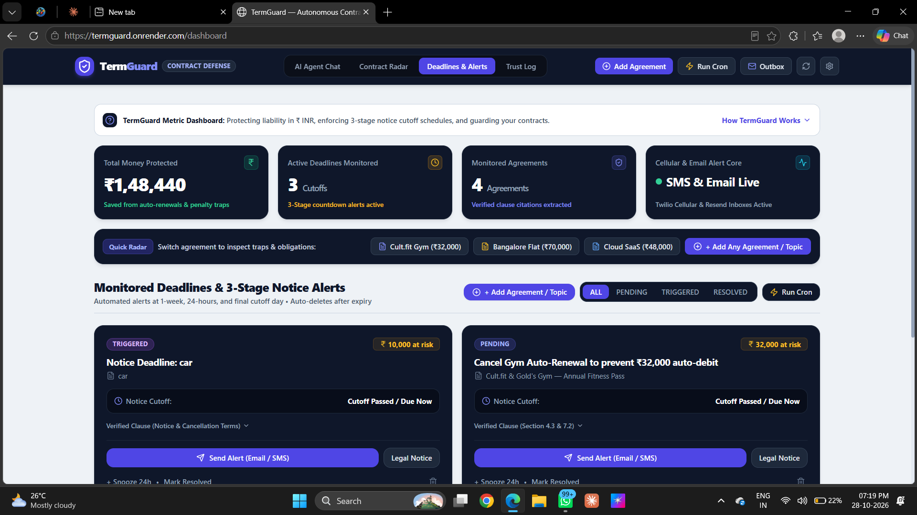
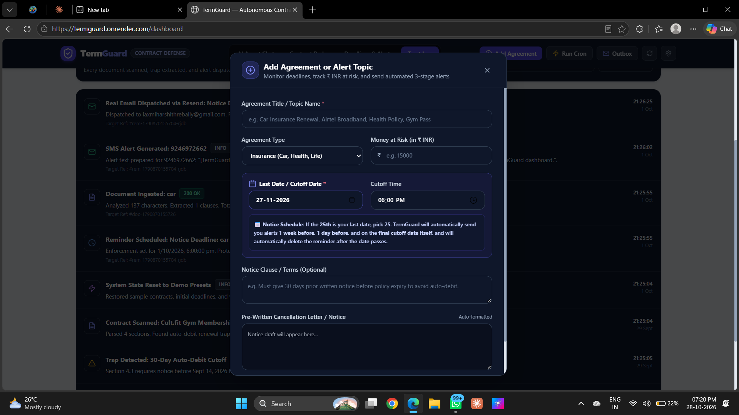
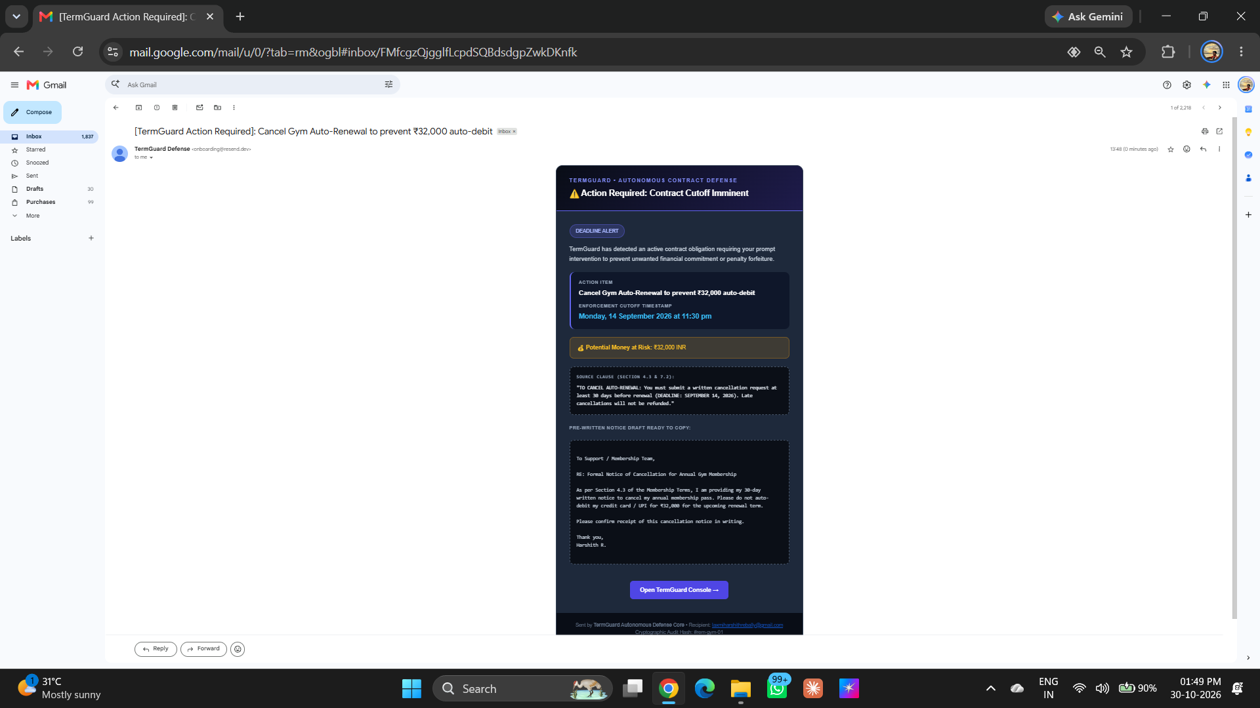
TERMGUARD • MINI PROJECT REVIEW [SLIDE 10/12]
9. Output Screens (Live System in Action)
1. Executive Dashboard
Shows ₹1,48,440 saved and active countdown timers.
2. Add Agreement Modal
Popup to add new agreements, dates, and money in ₹ INR.
3. Live Gmail Delivery
Real email received citing Section 4.3 with letter ready.

Slide 11
TERMGUARD • MINI PROJECT REVIEW [SLIDE 11/12]
10. Advantages & Limitations (Simple & Honest)
Key Advantages
• Works 24/7 Automatically: Monitors your cutoff dates continuously in the cloud without needing you to remember.
• Super Fast AI Reading: Reads long 20-page agreements in under 2 seconds using Google Gemini AI.
• Real Phone SMS & Email: Sends real text alerts to your mobile phone SIM card and emails to your Gmail inbox.
• Pre-Written Legal Letters: Automatically writes cancellation letters citing exact contract sections so you don't have to.
• Zero Database Hosting Cost: Uses lightweight local JSON storage, making it completely free to run and deploy.
Current Limitations
• Text Input Only: Currently accepts pasted text or presets (camera photo scanning can be added next).
• English Language Focus: Best optimized for English contracts (Indian regional languages coming in next phase).
• Cloud Free-Tier Wakeup: On free cloud hosting, the server takes a few seconds to wake up if inactive.
• Cannot Force Companies: TermGuard warns you in time, but the user still needs to click and send the cancellation email.

Slide 12
TERMGUARD • MINI PROJECT REVIEW [SLIDE 12/12]
11. Conclusion & Future Enhancements
Project Conclusion
• Protects Consumer Money: TermGuard stops companies from taking your hard-earned money through sneaky fine print.
• Active vs Passive: Replaces useless calendar reminders with automated 3-stage phone and email alerts.
• Saves Real Money: Successfully protects users from gym auto-debits (₹32,000) and lost rental deposits (₹70,000).
• Live on the Internet: Fully built, tested, and running live at https://termguard.onrender.com.
Future Scope (What We Can Add Next)
• Chrome Browser Extension: Automatically scan Terms of Service on shopping websites before you click 'Buy'.
• WhatsApp Chatbot: Receive alerts on WhatsApp and reply 'Cancel' to send the cancellation letter instantly.
• Indian Regional Languages: Add support for contracts in Hindi, Telugu, Tamil, and Kannada.
• Camera OCR Scan: Allow users to take a photo of a paper contract using their phone camera.

