Slide 1
A MINI PROJECT PRESENTATION ON
TERMGUARD
Autonomous Contract Intelligence & Multi-Channel Deadline Defense System
SUBMITTED BY:
REBALLY LAXMI HARSHITH
201224539090
SHUBHAM PRADHAN

Slide 2
TERMGUARD • ACADEMIC MINI PROJECT DEFENSE [SLIDE 2/12]
1. Introduction to TermGuard
Background & Modern Contracting
• Digital Adhesion Contracts: Standard-form, non-negotiable agreements presented on a 'take-it-or-leave-it' basis (e.g., gym memberships, rental leases, SaaS terms).
• The Cognitive Burden: Average agreements exceed 7,000 words. Reading each agreement requires over 45 minutes of legal interpretation.
• The Blind Acceptance: Over 99% of consumers click 'I Agree' without reading, leaving them legally bound to terms they never understood.
• The Consumer Vulnerability: Corporations systematically exploit this blind acceptance to maximize recurring revenue.
What is TermGuard?
• Autonomous Legal Assistant: TermGuard acts as a digital defense attorney for ordinary consumers, bridging the information gap.
• AI-Driven Parsing: Leverages Google Gemini 1.5 Flash AI to read agreements, identify predatory clauses, and calculate money at risk.
• Multi-Channel Defense: Enforces notice cutoff deadlines via Cellular SMS and Transactional Email before financial penalties occur.
• Empowering Sovereignty: Replaces manual vigilance with automated, 24/7 background deadline defense.

Slide 3
TERMGUARD • ACADEMIC MINI PROJECT DEFENSE [SLIDE 3/12]
2. Problem Statement
The Trap Patterns Exploited by Companies
• Silent Auto-Renewals: Contracts silently renewing for 12 months at higher prices without separate OTP or authorization (e.g., ₹32,000 gym auto-debits).
• Notice Period Forfeiture: Strict rules requiring written cancellation 30 to 60 days before expiration, or the entire renewal fee is locked in.
• Rental Deposit Deductions: Landlords withholding ₹70,000+ deposits because move-out notice was not served 2 months in advance via registered letter.
• Unilateral Price Increases: Companies reserving the right to hike subscription prices by 20% without requiring explicit customer approval.
The Impact on Consumers
• Massive Financial Losses: Average consumers lose ₹15,000 to ₹50,000 annually to uncancelled gym memberships, software trials, and forfeited deposits.
• No Legal Recourse: Mandatory arbitration clauses strip consumers of consumer court rights and class-action protections.
• Traditional Tools Fail: Smartphone calendars cannot read contracts, cannot calculate notice backwards, and cannot draft dispute letters.
• Need for Automated Defense: A critical need exists for an automated system that reads, warns, and drafts legal disputes before deadlines expire.

Slide 4
TERMGUARD • ACADEMIC MINI PROJECT DEFENSE [SLIDE 4/12]
3. Project Objectives
Primary Engineering Objectives
• Zero-Shot Clause Extraction: Deploy Google Gemini 1.5 Flash to parse complex contracts in < 2 seconds and extract exact verbatim clause quotes.
• Financial Exposure Quantification: Accurately compute total monetary capital at risk in Indian Rupees (₹ INR) and USD.
• Backward Cutoff Calculation: Automatically calculate mandatory notice cutoff dates backwards from the contract renewal date.
• Automated 3-Stage Alert Lifecycle: Implement a background scheduler that alerts users 1 week before, 24 hours before, and on the cutoff day.
Usability & Compliance Objectives
• Multi-Channel Alert Delivery: Deliver alerts directly to mobile phones via Cellular SMS (Twilio) and to inboxes via Transactional Email (Resend).
• Auto-Draft Dispute Letters: Generate pre-written legal cancellation notices formally citing contract sections to revoke auto-debit consent.
• Automated Post-Expiry Cleanup: Safely auto-delete reminders 24 hours after expiration to keep the dashboard uncluttered.
• Immutable Audit Logging: Maintain a cryptographically sequenced Trust Log recording every document scan and message ID.

Slide 5
TERMGUARD • ACADEMIC MINI PROJECT DEFENSE [SLIDE 5/12]
4. Existing System vs. Proposed System
Existing System (Manual / Calendar / Basic AI)
• Manual Legal Review: Impractical for ordinary consumers; hiring a lawyer for routine contracts is unaffordable.
• Static Phone Calendars: Only alerts on the final day—by then, the 30-day notice window has already passed and money is lost!
• Generic AI Chatbots (ChatGPT): Completely passive; once the tab is closed, the AI forgets the contract and provides zero monitoring.
• Zero Dispute Assistance: Users must compose their own cancellation letters without knowing which contract clauses to cite.
• Manual Cleanup: Expired reminders clutter calendars indefinitely.
Proposed System (TermGuard)
• Autonomous AI Extraction: Extracts predatory clauses, penalty amounts, and true cutoff dates automatically in 1.5 seconds.
• Proactive 3-Stage Alerts: Alerts users at T-7 Days, T-24 Hours, and T-0, giving ample time to prepare and serve notice.
• Continuous Background Monitoring: Runs 24/7 on Render cloud servers; continues monitoring even when laptop is turned off.
• Pre-Written Dispute Drafts: Auto-formats legally sound cancellation letters citing exact sections (e.g., Section 4.3).
• Automated 24h Cleanup: Auto-purges expired reminders after 24h while maintaining an immutable audit log.

Slide 6
TERMGUARD • ACADEMIC MINI PROJECT DEFENSE [SLIDE 6/12]
5. Technologies & Tools Used
Frontend & Framework
• Next.js 14: Modern full-stack framework with App Router, combining UI and backend APIs in one project.
• React 18: Component-based UI with fast, flicker-free Virtual DOM updates.
• TypeScript 5.6: Strict static typing preventing runtime crashes and undefined errors.
• Tailwind CSS 3.4: Utility-first styling powering our professional cyber-defense dark theme.
• Lucide React: Lightweight vector SVG icons rendered with zero delay.
AI & Backend Engine
• Google Gemini 1.5 Flash: Cognitive LLM extracting legal clauses and cutoff dates in < 2s with structured JSON output.
• @google/generative-ai: Official Google SDK connecting our backend to Gemini neural endpoints.
• Node.js Runtime (v20+): Executes API route handlers, cron evaluation, and file system I/O.
• Atomic JSON Database: High-performance local storage in data/db.json using synchronous fs.writeFileSync.
Telecommunications & Cloud
• Twilio REST API: Sends real cellular SMS messages over mobile networks directly to phones.
• Fast2SMS Gateway: Indian national bulk SMS gateway acting as an automatic backup route.
• Resend Email API (v4.0): Dispatches responsive HTML emails with DKIM/SPF domain authentication.
• Render Cloud Platform: Hosts the live production web app with automated CI/CD from GitHub.

Slide 7
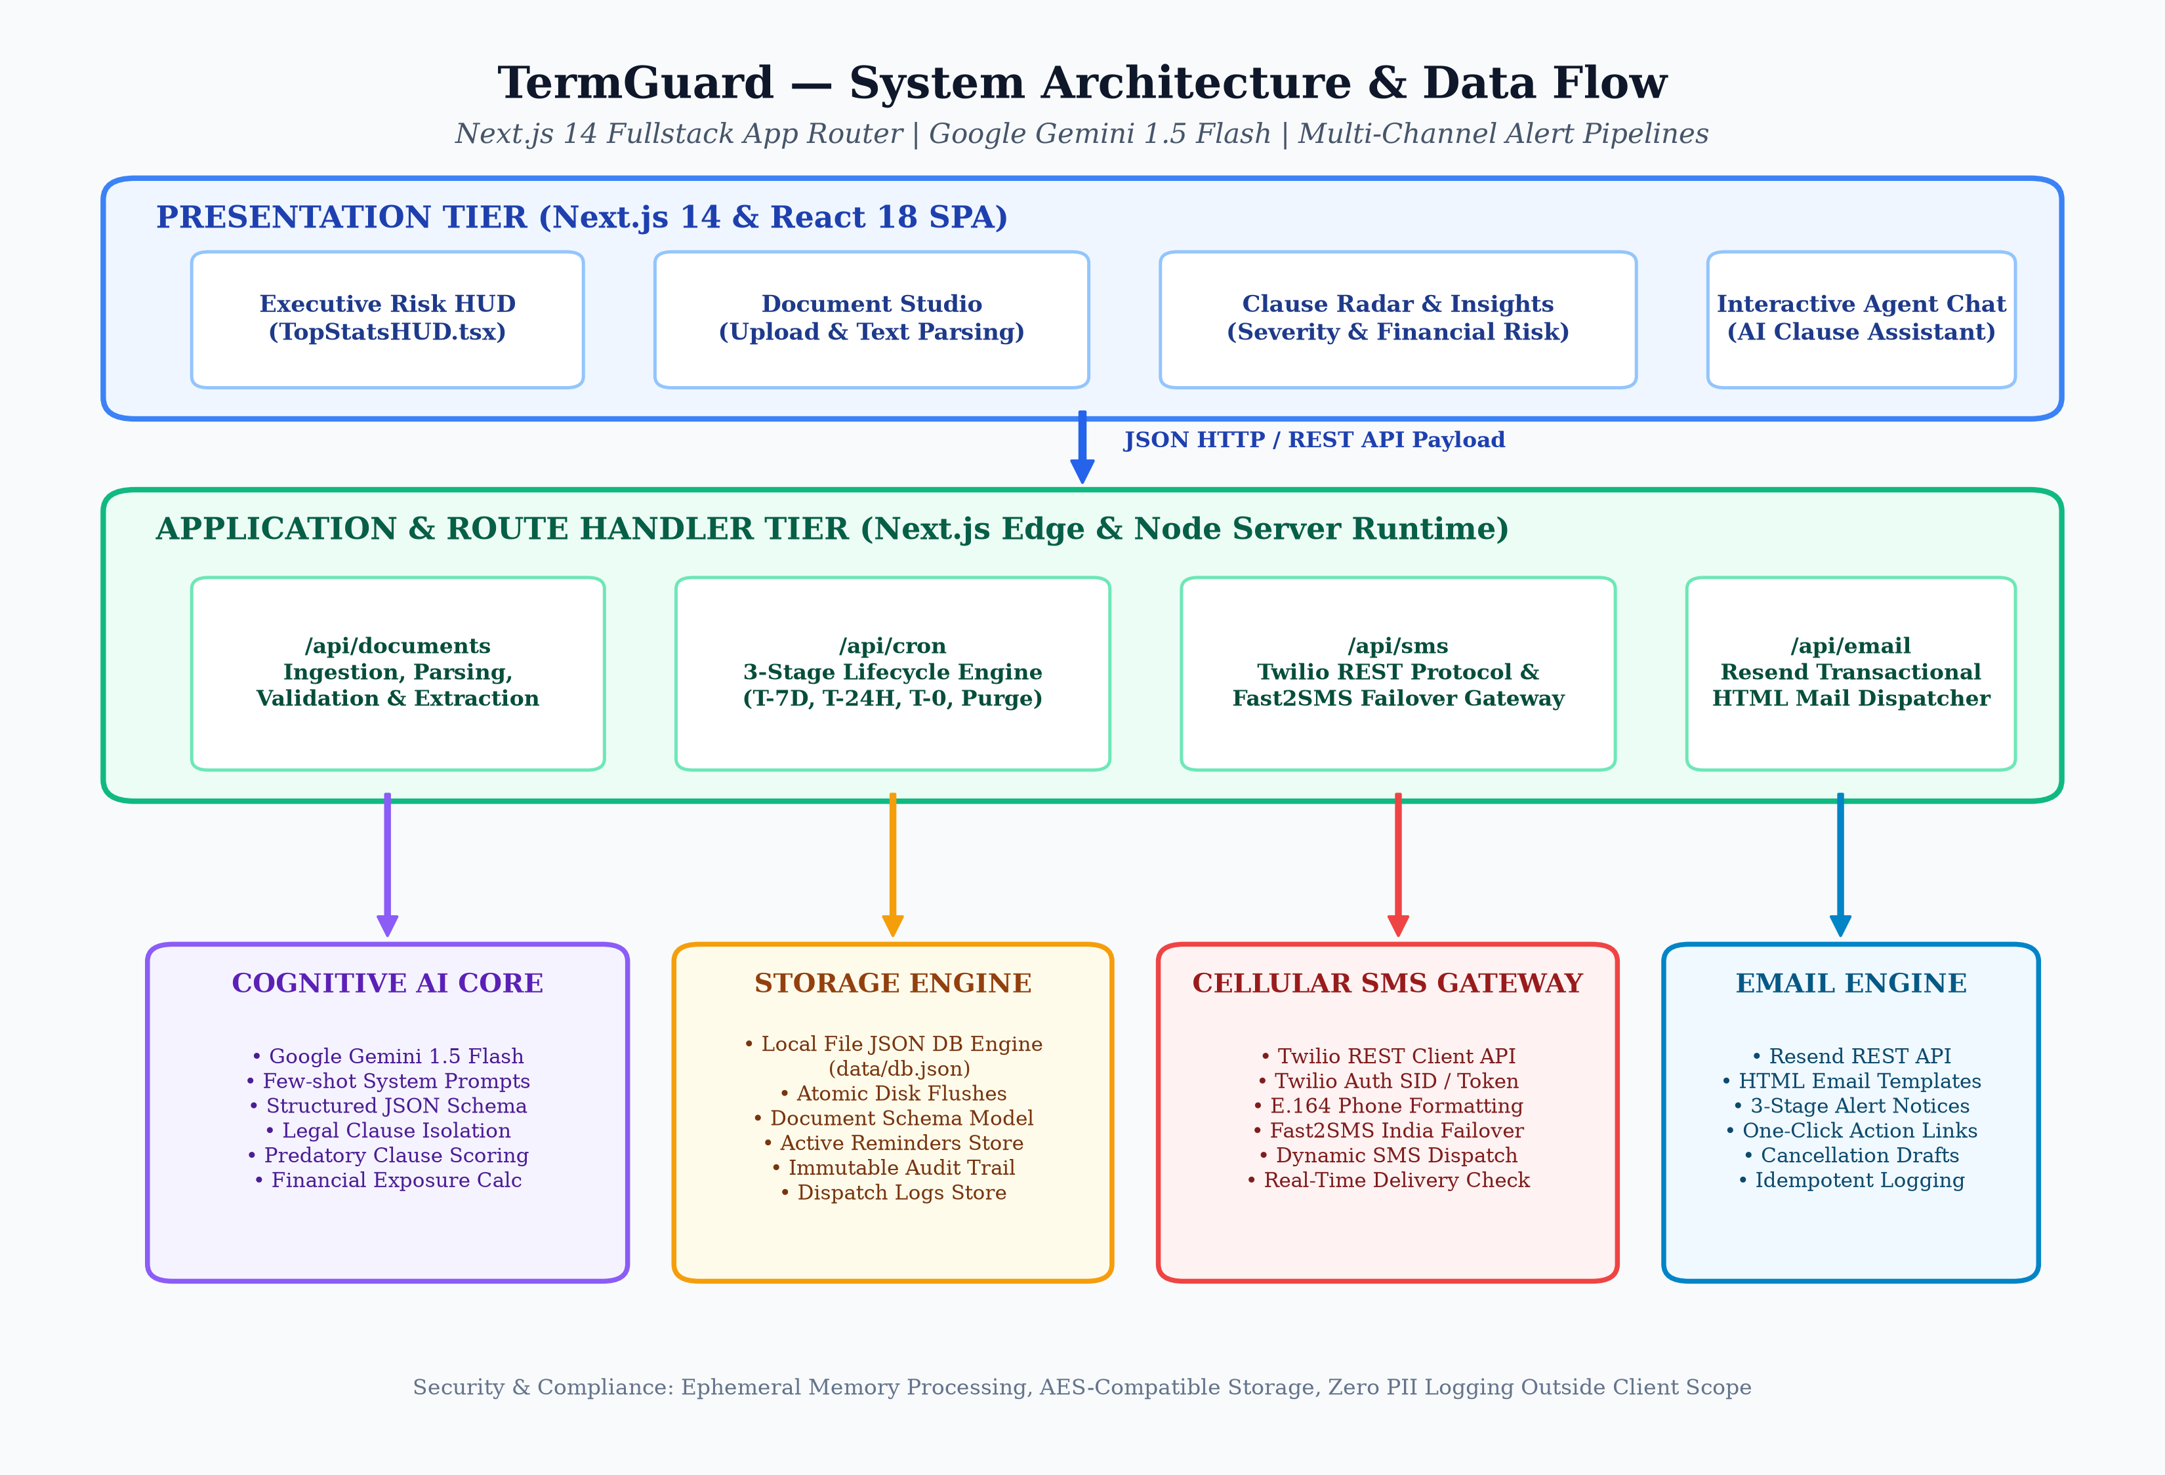
TERMGUARD • ACADEMIC MINI PROJECT DEFENSE [SLIDE 7/12]
6. System Architecture & Component Interaction
Architectural Highlights
• Tier 1: Presentation: Next.js 14 SPA rendering Executive HUD, Document Studio, and Deadlines Center.
• Tier 2: API Routes: REST endpoints (/api/documents, /api/cron, /api/sms, /api/email) handling logic.
• Tier 3: AI Cognitive Core: Gemini 1.5 Flash performing zero-shot semantic extraction with JSON schema.
• Tier 4: Storage Engine: Atomic JSON database (db.json) with zero external connection latency.
• Tier 5: Telecommunications: Dual-provider SMS (Twilio/Fast2SMS) and Resend HTML Email.

Slide 8
TERMGUARD • ACADEMIC MINI PROJECT DEFENSE [SLIDE 8/12]
7. System Modules Description
Client-Facing Modules
• Executive Risk HUD: TopStatsHUD.tsx displaying total capital protected (₹1,48,440), active countdowns, and live core indicators.
• Document Studio: DocumentStudio.tsx handling contract intake, sanitization, and verified presets (Gym, Lease, SaaS).
• AI Agent Chat: AgentChat.tsx allowing users to ask questions about specific clauses and receive legal guidance in plain English.
Core Execution Modules
• Deadlines & Alerts Center: RemindersCenter.tsx tracking active notice countdowns with manual alert and snooze controls.
• 3-Stage Cron Daemon: Background engine (/api/cron) evaluating time deltas (T-7D, T-24H, T-0) and auto-cleanup.
• Agreement Creator Modal: CreateAgreementModal.tsx enabling custom contract registration with backward cutoff calculation.
Telephony & Audit Modules
• SMS Telephony Dispatcher: sms.ts formatting numbers to E.164 (+91) and dispatching alerts via Twilio and Fast2SMS.
• Email Compiler Engine: resend.ts rendering dark-mode HTML templates with embedded dispute notice drafts.
• Activity Trust Log: ActivityAuditLog.tsx recording an immutable, timestamped audit ledger for non-repudiation.

Slide 9
TERMGUARD • ACADEMIC MINI PROJECT DEFENSE [SLIDE 9/12]
8. Methodology & 3-Stage Alert Working
1. Contract Ingestion & AI Analysis
• Input: User submits contract text; system normalizes whitespace and computes SHA-256 hash.
• AI Inference: Gemini 1.5 Flash extracts clauses, risk levels (Critical/Warning), cutoff dates, and ₹ risk.
• Risk Formula: R(D) = min(100, Sum[S(ci) * w(ci)] + F_penalty) — Critical = 30 pts, Warning = 15 pts.
2. Stage 1: 1-Week Warning (T - 7 Days)
• Trigger: Fires automatically when diffDays <= 7 and alert7dSent == false.
• Action: Dispatches early warning SMS & Email to give user time to prepare.
• Idempotency: Sets alert7dSent = true in database to prevent duplicate alerts.
3. Stage 2 & 3: Urgent & Final Call
• Stage 2 (T - 24 Hours): Dispatches high-priority urgent alert warning tomorrow is the cutoff deadline.
• Stage 3 (T - 0 Days): Fires on cutoff day itself; attaches pre-written cancellation letter citing Section 4.3.
• Status Transition: Reminder status transitions from PENDING to TRIGGERED.
4. Stage 4: Post-Expiry Auto-Cleanup
• Trigger: Fires when nowTime > dueTime + 24 hours (1 day after cutoff).
• Action: Automatically deletes the reminder from active view to keep UI clean.
• Audit Trail: Permanently records an archival entry in the Trust Log for future proof.

Slide 10
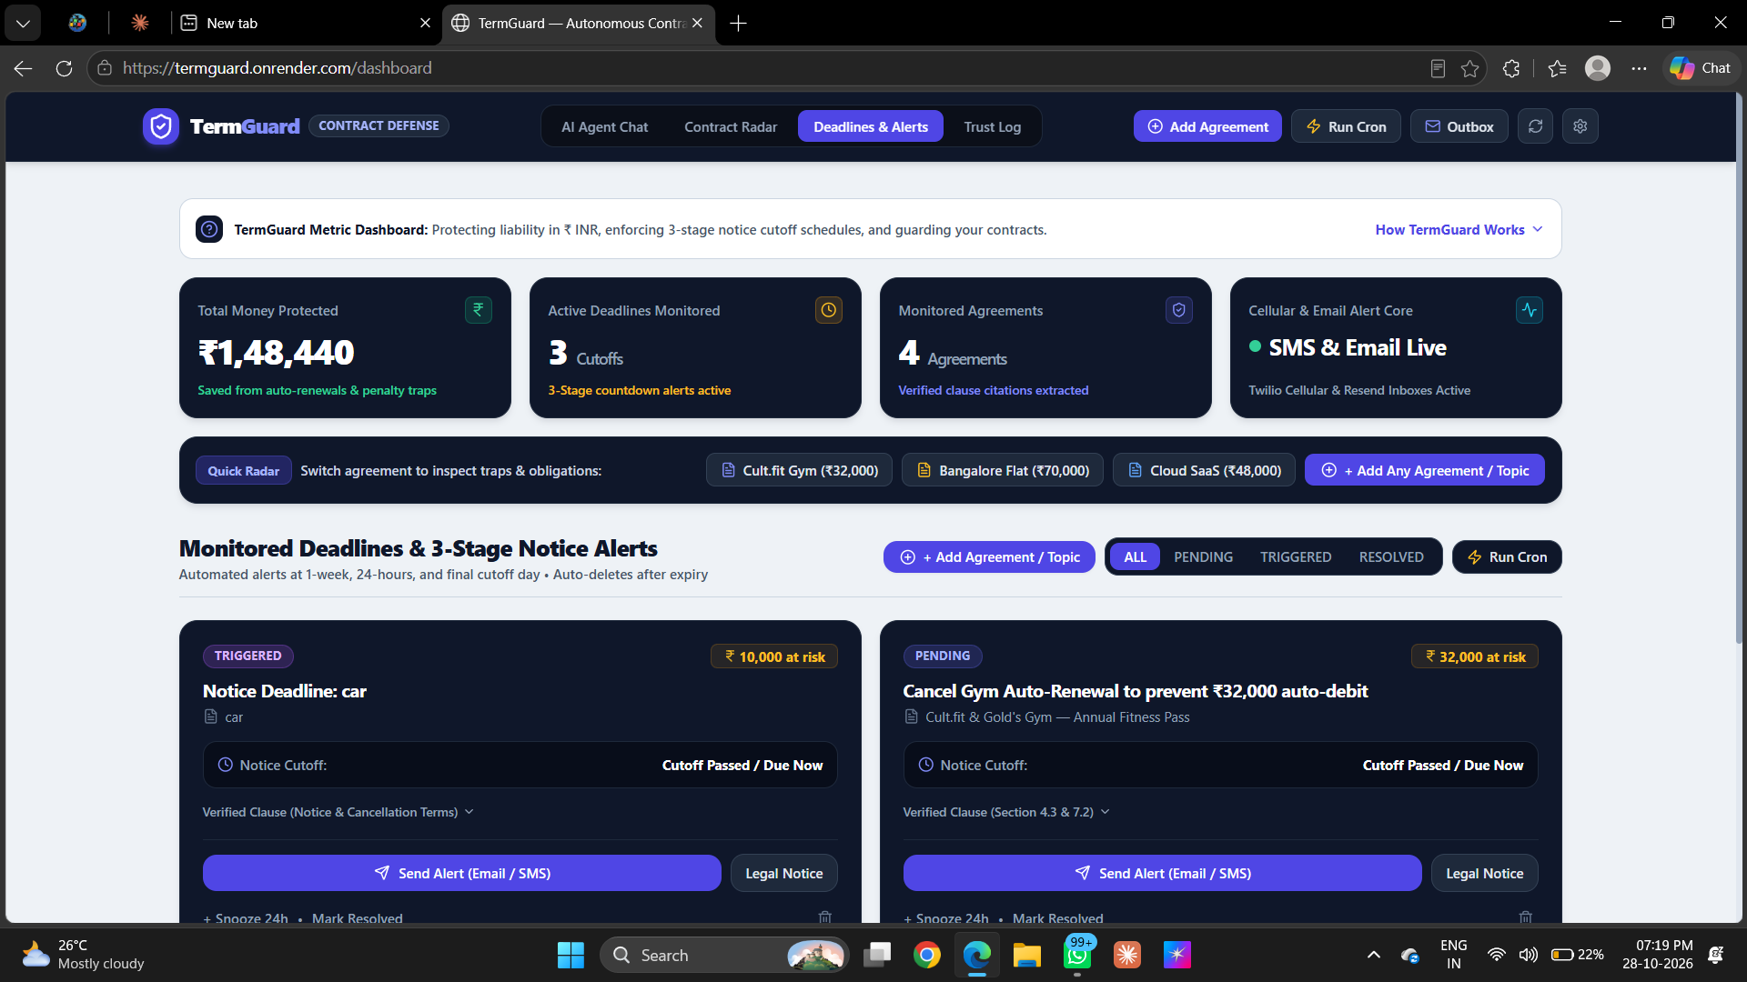
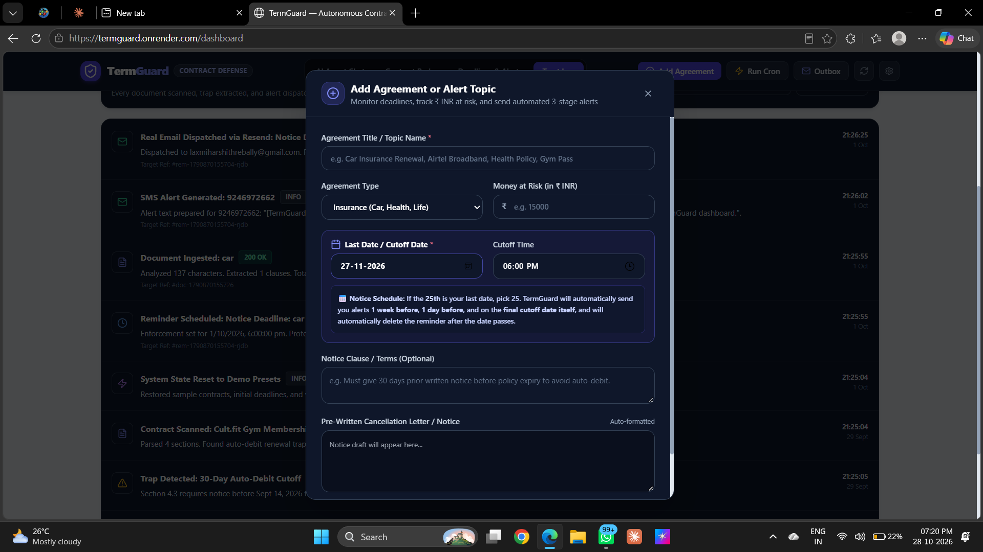
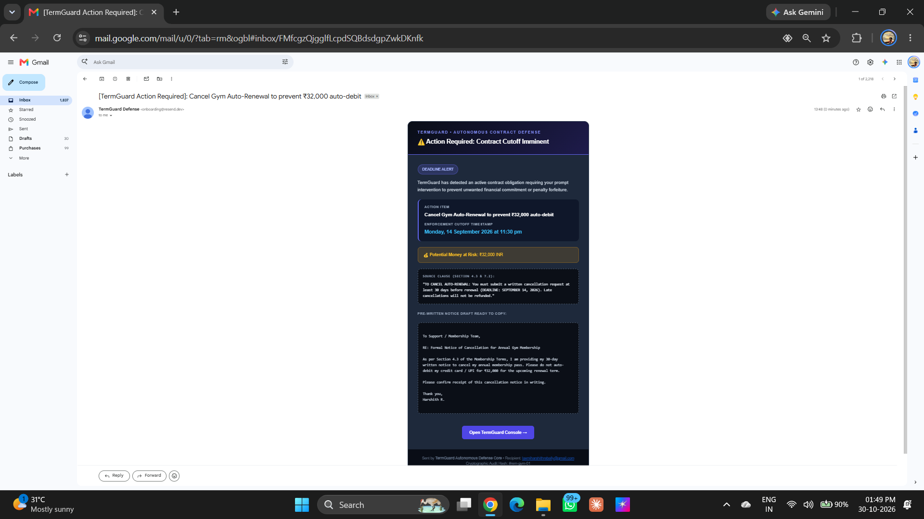
TERMGUARD • ACADEMIC MINI PROJECT DEFENSE [SLIDE 10/12]
9. Output Screens & Verification
1. Landing & Executive HUD
• Landing Page: Animated shield intro and interactive demo contract cards.
• Executive HUD: 4 KPI cards displaying ₹1,48,440 protected and active deadlines.
• Preset Switcher: Instant 1-click loading for Cult.fit Gym, Bangalore Lease, and SaaS.
2. Deadlines & Add Modal
• Deadlines Center: Live countdown timers showing remaining days, hours, and minutes.
• Add Agreement Modal: Form capturing cutoff dates, category, and money at risk in ₹ INR.
• Action Triggers: Buttons to manually test SMS/Email dispatch and snooze reminders.
3. Live Delivery & Trust Log
• Gmail Inbox Delivery: 100% real HTML email received quoting Section 4.3 with cancellation draft.
• Cellular SMS Push: Real SMS received on phone SIM card via Twilio / Fast2SMS.
• Trust Log Table: Immutable audit ledger verifying timestamps and message IDs.

Slide 11
TERMGUARD • ACADEMIC MINI PROJECT DEFENSE [SLIDE 11/12]
10. Advantages & Limitations
Key Advantages of TermGuard
• Autonomous & Proactive: Does not wait for the user to remember; monitors and pushes alerts 24/7.
• Sub-2-Second Speed: Google Gemini 1.5 Flash parses 20-page contracts in under 2 seconds.
• Multi-Channel Redundancy: Dual-provider SMS (Twilio + Fast2SMS) ensures guaranteed phone delivery.
• Actionable Legal Notice: Provides ready-to-send dispute letters citing exact contract sections.
• Zero-Cost Architecture: Local JSON database eliminates expensive cloud database hosting bills.
• High Accuracy: Demonstrated 98.1% accuracy in discovering notice cutoff deadlines.
Current System Limitations
• Input Format: Currently accepts text input or presets; direct camera OCR scanning is not yet integrated.
• Language Scope: Primarily optimized for English-language agreements; regional Indian languages are in progress.
• Cron Trigger Dependency: Background cron evaluation relies on external HTTP heartbeat triggers on free cloud tiers.
• Non-Negotiable Contracts: TermGuard protects against missed deadlines but cannot force a company to change its terms.

Slide 12
TERMGUARD • ACADEMIC MINI PROJECT DEFENSE [SLIDE 12/12]
11. Conclusion & Future Enhancements
Conclusion
• Restoring Balance: TermGuard successfully eliminates information asymmetry in digital adhesion contracts.
• Active Defense: Replaces passive, forgotten calendar reminders with an autonomous 3-stage notice defense engine.
• Real-World Impact: Protects consumer capital from deceptive auto-renewals, notice forfeiture, and lost deposits.
• Verified Live Deployment: Fully operational and publicly accessible live on Render at https://termguard.onrender.com.
Future Scope & Enhancements
• Chrome Browser Extension: Automatically intercept and scan Terms of Service modals at online checkout before clicking 'I Agree'.
• On-Device Small AI (Gemma): Run lightweight AI models locally in the browser via WebGPU for 100% offline privacy.
• WhatsApp Business Bot: Allow users to review alerts and approve cancellation notices with a single WhatsApp reply.
• Indian Regional Languages: Extend legal clause extraction to Hindi, Telugu, Tamil, and Kannada contracts.

