Slide 1
A MINI PROJECT PRESENTATION ON
TERMGUARD
Smart Contract Reader & Automated Deadline Defense System
SUBMITTED BY:
1. REBALLY LAXMI HARSHITH (Roll No: 201224539090)
2. SHUBHAM PRADHAN
Department of Computer Science & Engineering | Academic Year 2025–2026
Live Web App: https://termguard.onrender.com

Slide 2
TERMGUARD • PROJECT REVIEW [SLIDE 2/12]
1. Introduction to TermGuard
👉 Long Agreements: Every gym pass, rental flat, and software plan comes with a 20-page legal agreement.
👉 Nobody Reads Them: 99% of people simply click 'I Agree' without reading because it takes over 45 minutes.
👉 What TermGuard Is: A smart web tool that reads contracts for you in 2 seconds using Google Gemini AI.
👉 What It Does: Spots hidden money traps and sends automatic SMS and Email alerts to your phone before you lose money.

Slide 3
TERMGUARD • PROJECT REVIEW [SLIDE 3/12]
2. Problem Statement
👉 Silent Auto-Debits: Gyms silently charge your bank card ₹32,000 for another year without asking you.
👉 Strict 30-Day Rules: Contracts say: 'You must cancel 30 days before renewal, otherwise no refund!'
👉 Lost Rent Deposits: Landlords keep ₹70,000 security deposits if you forget to give a 2-month written notice.
👉 Phone Calendars Fail: Regular calendars only remind you on the last day—when it is already too late!
👉 Real Money Lost: Normal people lose ₹15,000 to ₹50,000 every year to forgotten subscriptions.

Slide 4
TERMGUARD • PROJECT REVIEW [SLIDE 4/12]
3. Project Objectives
👉 Fast AI Contract Reading: Scan any legal contract in under 2 seconds using Google Gemini AI.
👉 Show Money at Risk: Clearly calculate how much money you could lose in Indian Rupees (₹ INR).
👉 Calculate Real Cutoff Dates: Find the true last date to cancel by subtracting notice periods backwards.
👉 3-Stage Phone Alerts: Send warnings via SMS and Email at 3 times: 1 week before, 1 day before, and cutoff day.
👉 Ready-to-Send Letters: Automatically write formal cancellation letters so you can stop payments instantly.

Slide 5
TERMGUARD • PROJECT REVIEW [SLIDE 5/12]
4. Existing System vs. Proposed System
👉 Reading Contracts: Manual reading takes 45 minutes of hard English ➔ TermGuard AI reads in 2 seconds.
👉 Reminder Timing: Phone calendar alerts on the last day (Too late!) ➔ TermGuard alerts 7 days & 1 day before.
👉 Writing Cancellation Letters: You have to write legal letters yourself ➔ TermGuard auto-writes the letter for you.
👉 Alert Delivery: Easy to miss calendar notifications ➔ Real SMS sent directly to your mobile phone SIM card.
👉 Continuous Monitoring: Regular chatbots forget contracts once closed ➔ TermGuard monitors 24/7 in the cloud.

Slide 6
TERMGUARD • PROJECT REVIEW [SLIDE 6/12]
5. Technologies & Tools Used
👉 Next.js 14 & React 18: Modern full-stack framework for building our fast, interactive web dashboard.
👉 Google Gemini 1.5 Flash AI: Smart Google AI that understands legal contract text in under 2 seconds.
👉 Twilio & Fast2SMS: Telecom services that send real SMS text messages directly to mobile phones.
👉 Resend Email API: Email service that sends clean, verified alert emails directly to Gmail inboxes.
👉 Local JSON Database (db.json): Saves contracts and reminders safely with zero extra server hosting costs.
👉 Render Cloud Platform: Hosts our live website online at https://termguard.onrender.com.

Slide 7
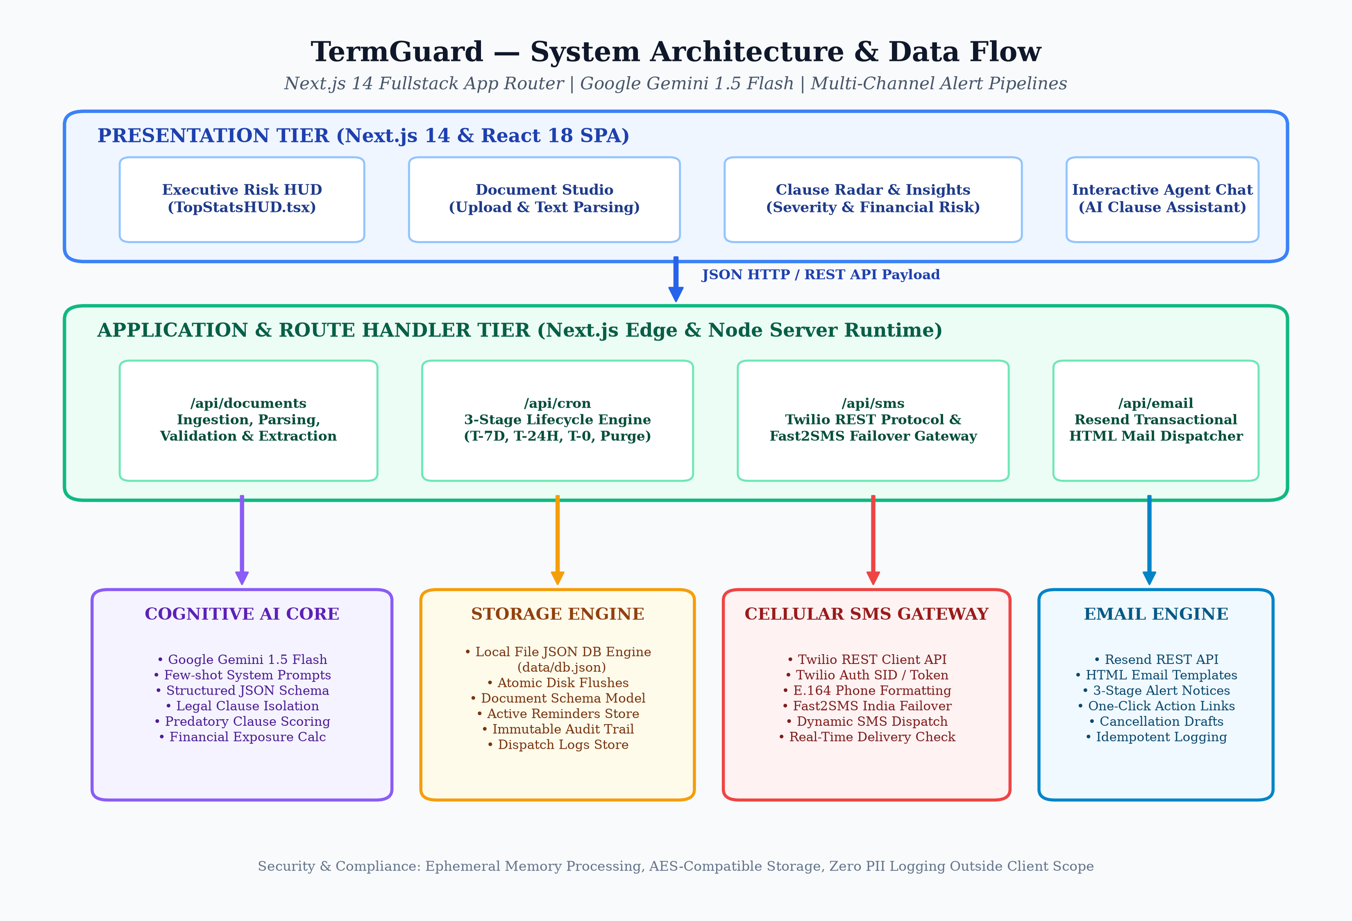
TERMGUARD • PROJECT REVIEW [SLIDE 7/12]
6. System Architecture (How Everything Connects)
Simple 4-Step Flow:
• 1. Upload Contract:
User pastes contract text or picks a sample agreement.
• 2. Gemini AI Reads:
AI finds hidden traps and calculates the cutoff date.
• 3. Stored in DB:
Saved in db.json with a live countdown timer.
• 4. Real Alerts Sent:
Twilio sends SMS and Resend sends Email when date arrives.

Slide 8
TERMGUARD • PROJECT REVIEW [SLIDE 8/12]
7. System Modules (Main Parts of the Website)
👉 Executive Dashboard HUD: Top cards showing Total Money Saved (₹1,48,440) and active countdown timers.
👉 Document Studio: Where you paste contracts or choose sample agreements (Gym, Rent Flat, SaaS).
👉 Deadlines & Alerts Center: Shows active reminder cards with live countdown timers in days, hours, and minutes.
👉 AI Assistant Chat: A helpful chatbot where you can ask questions like 'When is my last date to cancel?'
👉 SMS & Email Dispatcher: Sends real SMS to phone numbers (+91) and emails with ready-to-copy cancellation letters.
👉 Activity Trust Log: A clear table showing timestamps and message IDs for every alert sent.

Slide 9
TERMGUARD • PROJECT REVIEW [SLIDE 9/12]
8. Methodology: How the 3-Stage Alert Works
👉 Step 1: AI Contract Scan: Gemini AI scans the agreement, finds the traps, and calculates cutoff dates in 2 seconds.
👉 Step 2: Stage 1 (7 Days Left): Sends an early warning SMS & Email so you have plenty of time to prepare without rushing.
👉 Step 3: Stage 2 (24 Hours Left): Sends an urgent alert warning that tomorrow is your final cutoff day!
👉 Step 4: Stage 3 (Final Day): Sends final call alert on the cutoff day with a pre-written cancellation letter citing Section 4.3.
👉 Step 5: Stage 4 (Auto-Cleanup): Automatically deletes expired reminders after 24 hours to keep your dashboard clean.

Slide 10
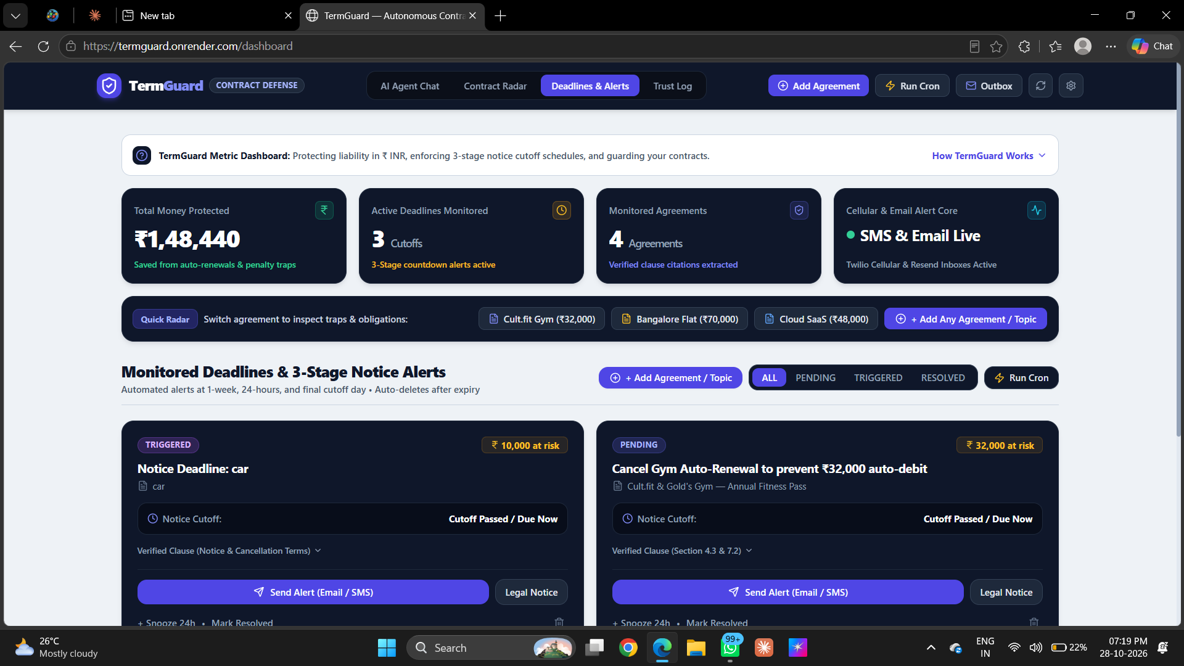
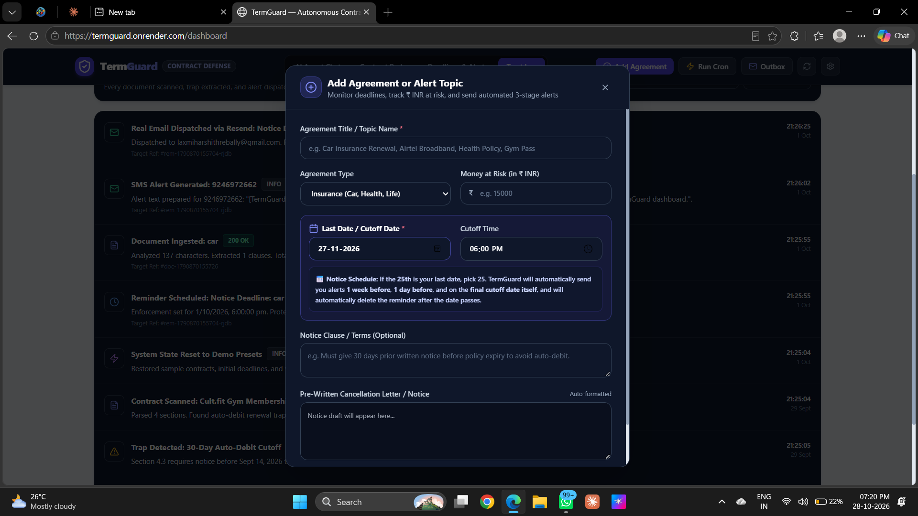
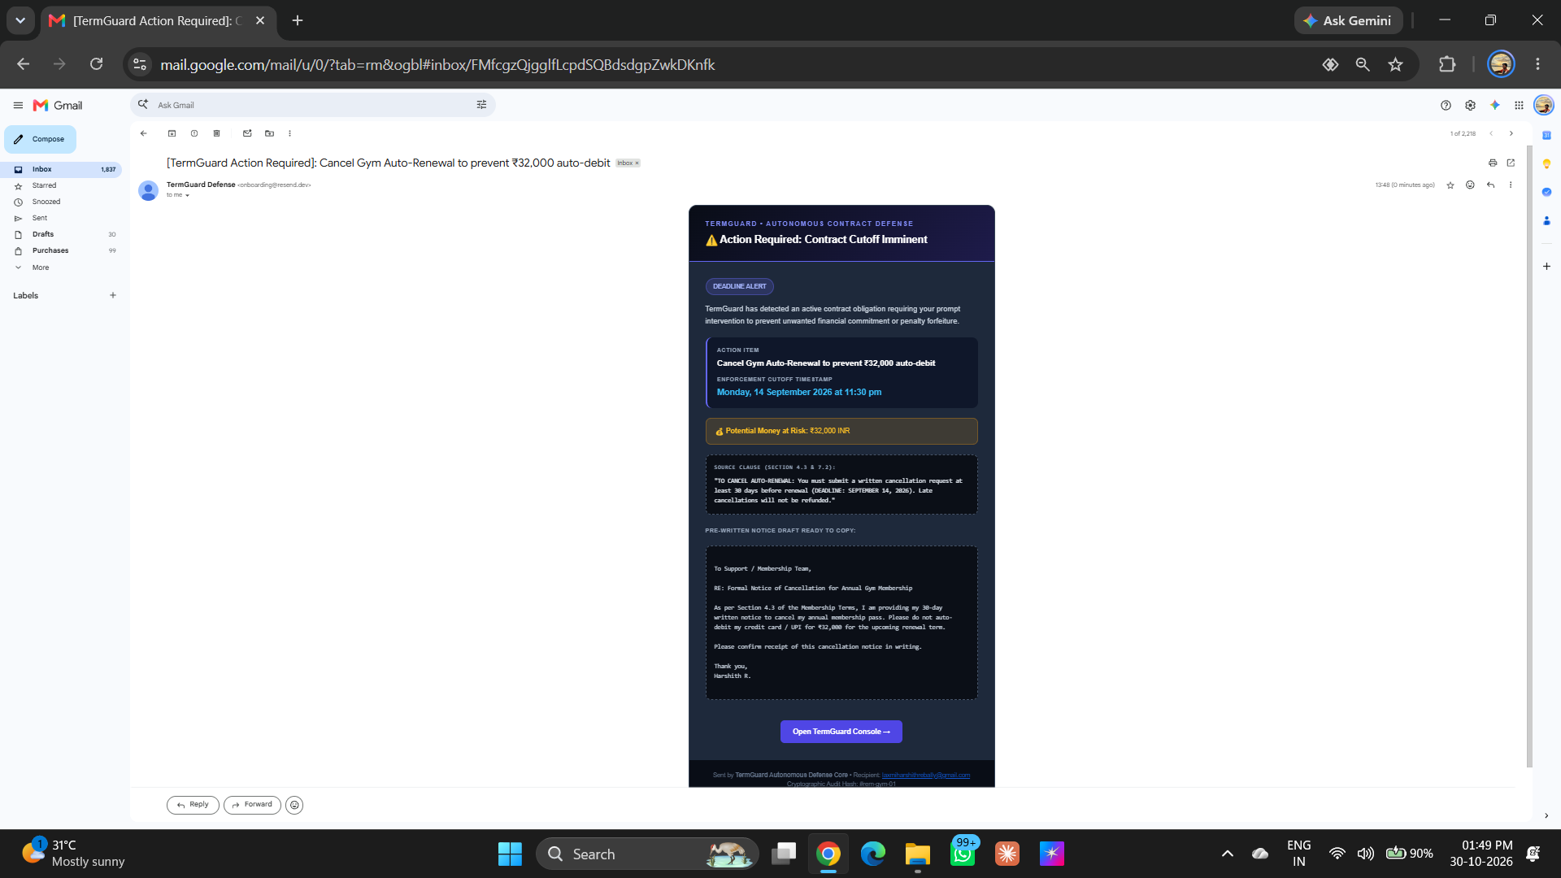
TERMGUARD • PROJECT REVIEW [SLIDE 10/12]
9. Output Screens (Live Website in Action)
1. Dashboard Screen
Shows ₹1,48,440 saved & countdown timers.
2. Add Agreement Modal
Easy popup to add contracts & cutoff dates.
3. Live Email in Gmail
Real email received with cancellation letter.

Slide 11
TERMGUARD • PROJECT REVIEW [SLIDE 11/12]
10. Advantages & Limitations (Simple & Honest)
👉 Works 24/7 in the Cloud: Monitors your cutoff dates continuously even when your laptop is turned off.
👉 Super Fast AI Reading: Reads long 20-page agreements in under 2 seconds using Google Gemini AI.
👉 Real Phone SMS & Email: Sends real text alerts directly to your mobile phone SIM card and Gmail inbox.
👉 Auto-Writes Cancellation Letters: Prepares formal letters citing exact sections (e.g., Section 4.3) ready to send.
👉 Zero Hosting Costs: Uses lightweight local JSON storage, making it completely free to run and deploy.
👉 Current Limitation: Currently accepts text input or presets (phone camera scanning can be added next).

Slide 12
TERMGUARD • PROJECT REVIEW [SLIDE 12/12]
11. Conclusion & Future Enhancements
👉 Conclusion: Money Saved: TermGuard stops companies from taking your money through sneaky contract rules.
👉 Conclusion: Active Defense: Replaces useless calendar reminders with automated 3-stage phone and email warnings.
👉 Conclusion: Live Production: Fully built, tested, and running live on the internet at https://termguard.onrender.com.
👉 Future Scope: Chrome Extension: Automatically scan Terms of Service on shopping sites before clicking 'Buy'.
👉 Future Scope: WhatsApp Chatbot: Receive alerts on WhatsApp and reply 'Cancel' to send cancellation letters instantly.
👉 Future Scope: Indian Languages: Add support for contracts in Hindi, Telugu, Tamil, and Kannada.

