Slide 1
IMDB Movies Database Analysis Using SQl Submitted by: Laxmi Kaddoni Tools Used SQL

Slide 2
1.Project Overview
This project focuses on analyzing IMDB Movies data using SQL. The goal is to extract meaningful insights about:
Movies
Directors
Popularity
Revenue (Bankability)
Ratings
Gender diversity among directors

Slide 3
2.Database Information
The project uses a relational database named project_movie_database
The database is designed to manage information related to movies and their
directors
It consists of two main tables:
Directors
Movies
Directors Table
Stores information about movie directors
ID – Unique identifier (Primary Key)
Name – Name of the director
Gender –
0 / 2 = Male
1 = Female
Department – Department associated with the director

Slide 4
Movies Table
Stores detailed information about movies
ID – Movie identifier
Original_title – Original name of the movie
Budget – Budget allocated for the movie
Popularity – Popularity score
Release_date – Movie release date
Revenue – Total revenue collected
Vote_average – Average IMDB rating
Vote_count – Number of votes received
Overview – Brief description of the movie
Tagline – Movie tagline
UID – Unique movie identifier
Director_id – Foreign Key linking to the Directors table

Slide 5
3.Table Relationship
The Directors and Movies tables are connected through a Primary Key–Foreign Key relationship.
The ID column in the Directors table acts as the Primary Key, while the Director_id column in the Movies table serves as the Foreign Key.
This relationship ensures that each movie record is associated with a valid director, enabling efficient data integration and allowing meaningful analysis of movies based on their respective directors.

Slide 6
4.SQL Operations Performed
Used SELECT statements to retrieve required data
Applied WHERE conditions to filter records
Used COUNT() to calculate totals
Applied LIKE operator for pattern-based searches
Used ORDER BY to sort data
Applied LIMIT to fetch top records
Used GROUP BY for aggregation
Applied SUM() to calculate total revenue
Used JOIN operations to combine Directors and Movies tables

Slide 7
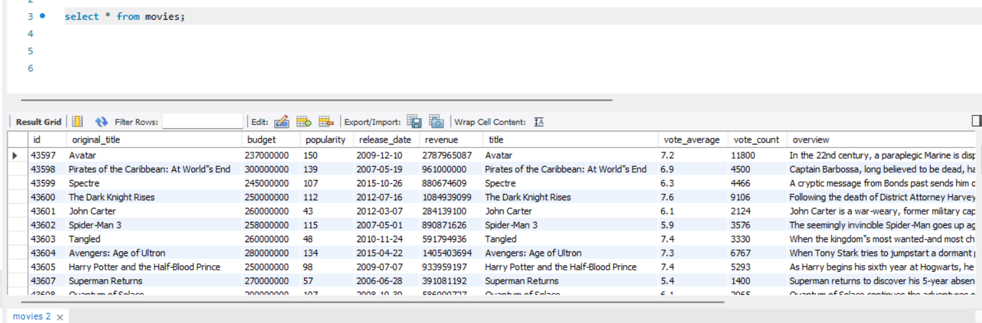
5.Retrieve All Movies Data

Slide 8
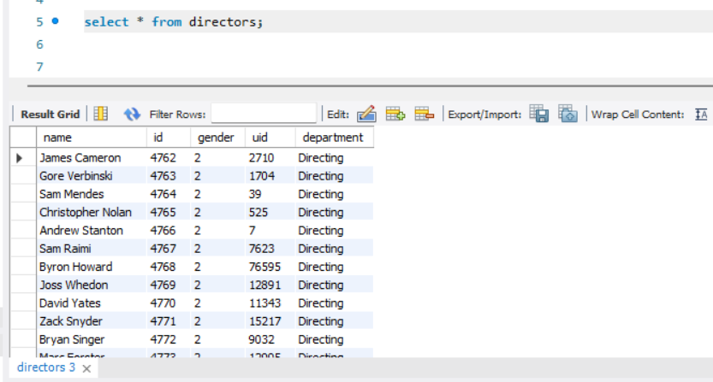
6.Retrieve All Directors Data

Slide 9
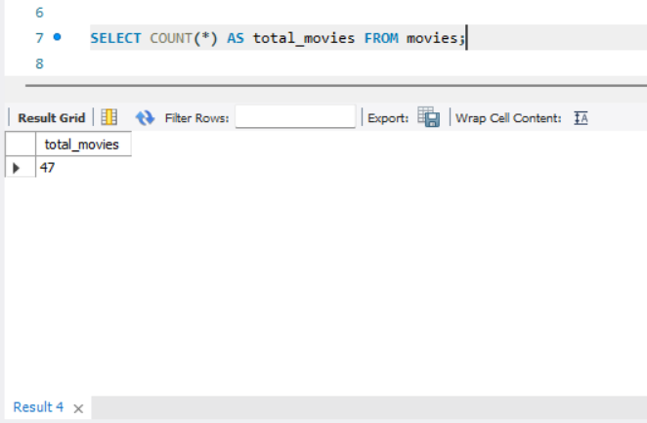
7.Count Total Number of Movies in IMDB

Slide 10
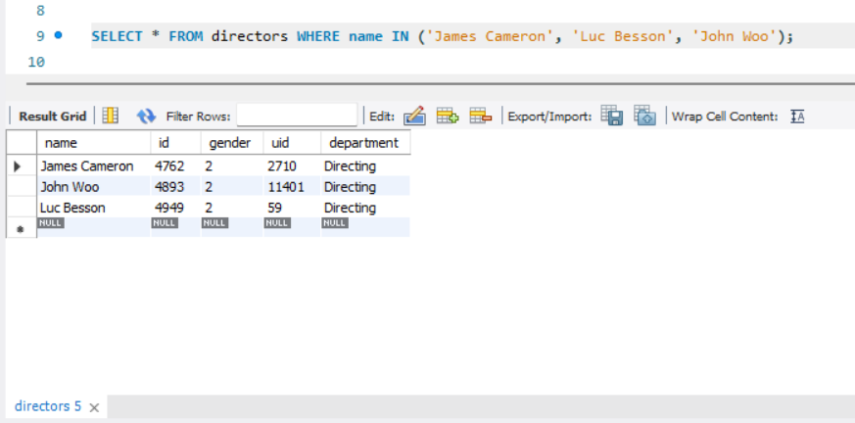
8.Find Specific Directors (James Cameron, Luc Besson, John Woo)

Slide 11
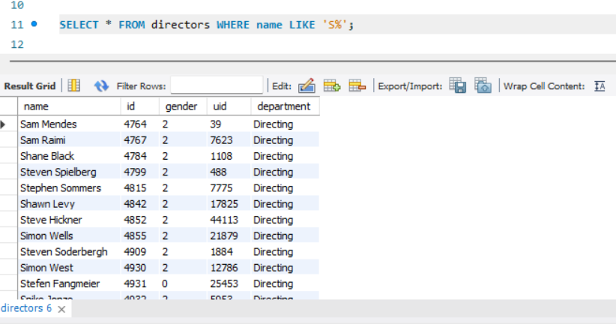
9.Find Directors Whose Name Starts With 'S'

Slide 12
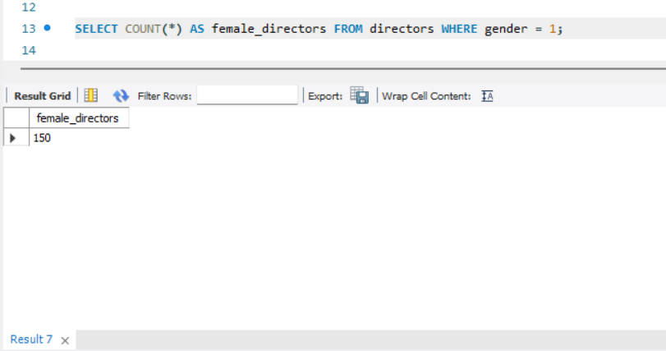
10.Count Number of Female Directors

Slide 13
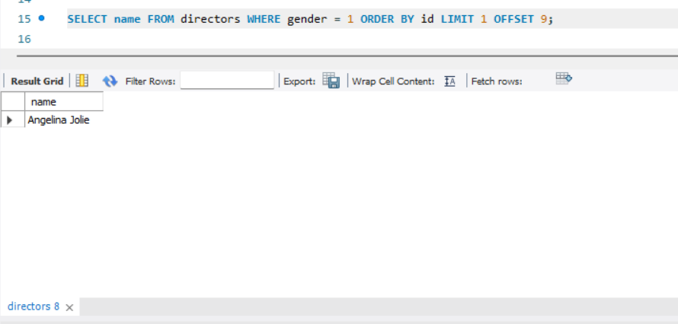
11.Find the 10th Female Director

Slide 14
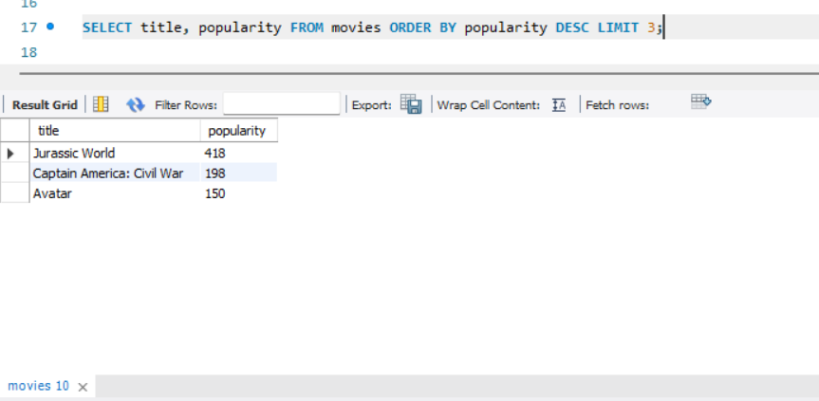
12.Find the Top 3 Most Popular Movies

Slide 15
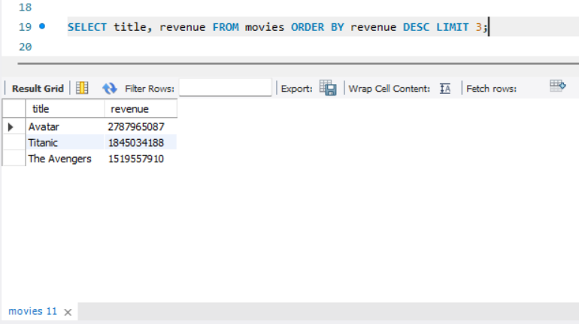
13.Find the Top 3 Most Bankable Movies

Slide 16
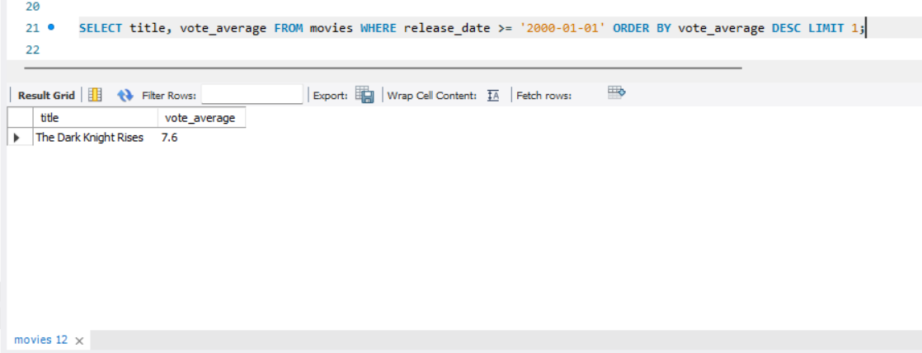
14.Find the Highest Rated Movie Since January 1, 2000

Slide 17
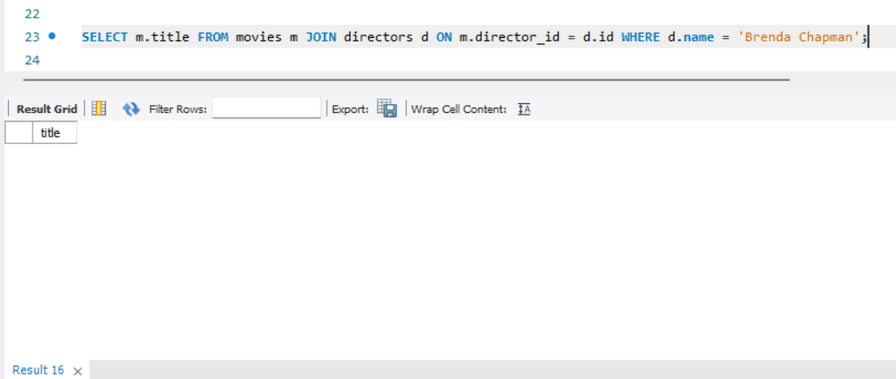
15.Find Movies Directed by Brenda Chapman

Slide 18
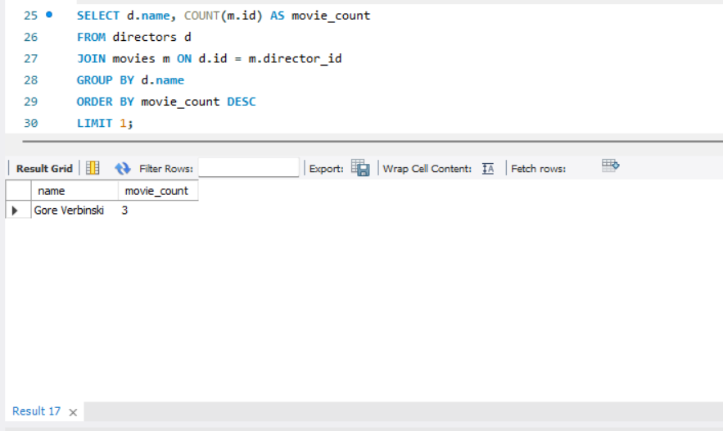
16.Find the Director Who Made the Most Movies

Slide 19
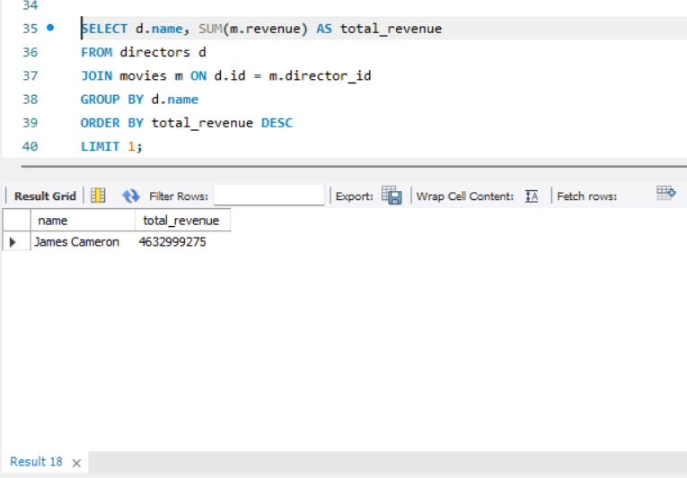
16.Find the Most Bankable Director

Slide 20
17.Key Insights
1. Comprehensive Movie Records
IMDB database contains a large collection of movies with detailed attributes such as popularity, revenue, ratings, and release dates.
This helps in analyzing movie success from both audience and business perspectives.
2. Director Diversity Analysis
The Directors table enables gender-based and name-based analysis.
Female directors are significantly fewer compared to male directors, indicating a gender imbalance in the film industry.
3. Popular vs Bankable Movies
The most popular movies (high popularity score) are not always the most bankable (high revenue).
Popularity reflects audience interest, while revenue reflects commercial success.

Slide 21
4. Post-2000 Movie Quality Trend
Movies released after January 1, 2000 show higher average vote ratings.
This suggests improvement in content quality, technology, and audience engagement in modern cinema.
5. Director Influence on Movie Success
Certain directors have directed multiple movies, showing strong dominance in the industry.
Directors with more movies often contribute consistently to the IMDB database.
6. Most Bankable Director Impact
The most bankable director generates the highest cumulative revenue across all movies.
This highlights the importance of director reputation in a movie’s financial success.

Slide 22
7. Female Director Contributions
Even though the number of female directors is low, their movies maintain competitive ratings.
This indicates quality over quantity in their contributions.
8. Targeted Director Search Capability
Searching directors by name or starting letter helps in quick filtering and data retrieval.
Useful for casting, research, and analytical reporting.
The IMDB database effectively supports movie performance analysis, director impact evaluation, and industry trend identification, making it a powerful tool for data-driven decision-making in the film industry.

Slide 23
18.Skills Demonstrated
SQL Query Writing
Ability to write basic and advanced SQL queries using SELECT, WHERE, JOIN, GROUP BY, ORDER BY, LIMIT, and OFFSET.
Relational Database Understanding
Strong understanding of relational database concepts such as tables, primary keys, foreign keys, and relationships between Movies and Directors.
Data Retrieval & Filtering
Efficient extraction of required data using conditions, pattern matching (LIKE), and set operations (IN).
Data Aggregation & Analysis
Use of aggregate functions like COUNT(), SUM(), and AVG() to derive meaningful insights from raw data.
Sorting & Ranking Techniques
Identifying top and bottom records using sorting and ranking methods to find most popular, most bankable movies and directors.

Slide 24
Date-Based Analysis
Filtering data based on release dates to analyze trends over time (e.g., post-2000 movie performance).
Gender-Based Analysis
Analysis of gender distribution among directors to understand diversity patterns in the film industry.
Performance & Business Analysis
Evaluating commercial success using revenue data and audience reception using popularity and vote averages.
Problem-Solving Skills
Translating real-world analytical questions into efficient SQL queries.
Analytical Thinking
Interpreting query results to derive actionable insights and meaningful conclusions.

Slide 25
19.Future Scope
Integration of Additional Tables
Extend the database by adding tables such as Actors, Genres, Production Companies, and Awards for deeper analysis.
Advanced Movie Recommendation System
Build a recommendation engine using popularity, ratings, genres, and user preferences to suggest movies.
Time-Series Trend Analysis
Analyze movie performance trends across years to understand changes in audience preferences and industry growth.
Director & Actor Performance Analytics
Evaluate success patterns of directors and actors based on ratings, revenue, and audience engagement.

Slide 26
Gender & Diversity Analytics
Perform in-depth diversity analysis across directors, actors, and crew members to identify representation gaps.
Predictive Analytics
Use machine learning models to predict movie success based on budget, director history, and genre.
Real-Time Data Integration
Connect with live IMDB or TMDB APIs to keep the database updated with the latest movies and ratings.
Dashboard & Visualization Enhancement
Create interactive dashboards using tools like Power BI, Tableau, or Python (Matplotlib/Seaborn) for better insights.

Slide 27
Revenue & ROI Analysis
Include movie budget data to calculate ROI and identify highly profitable movies and directors.
Scalability & Performance Optimization
Optimize queries using indexing and normalization to handle large-scale datasets efficiently.
With further enhancements, this project can evolve into a full-scale movie analytics and decision-support system useful for studios, analysts, and streaming platforms.

Slide 28
20.Conclusion
The IMDB Movies and Directors database project successfully demonstrates how structured data stored in a relational database can be effectively analyzed using SQL. By performing various queries, meaningful insights were extracted related to movies, directors, popularity, revenue, ratings, and gender distribution.
The project highlights the ability to retrieve, filter, sort, and aggregate large volumes of movie data to answer real-world analytical questions. It also shows how directors play a crucial role in both the creative and commercial success of movies. Analysis of popularity and revenue helped differentiate between audience interest and financial performance.
Additionally, the project sheds light on industry trends such as the dominance of certain directors, the relatively low representation of female directors, and the improvement in movie ratings after the year 2000. Overall, this project builds a strong foundation in SQL querying, analytical thinking, and database management.
This work can be further extended into advanced analytics, dashboards, and predictive models, making it highly relevant for careers in Data Analytics, Business Intelligence, and Database Development.

