Slide 1

Advanced Data Analytics using Machine Learning
Presented by:
Aruna Tiwari
Associate Professor
Discipline of Computer Science & Engineering
Indian Institute of Technology Indore
Indian Institute of Technology Indore

Slide 2
Machine Learning is…
Machine learning is programming computers to optimize a performance criterion using example data or past experience.
-- Ethem Alpaydin
The goal of machine learning is to develop methods that can automatically detect patterns in data, and then to use the uncovered patterns to predict future data or other outcomes of interest.
-- Kevin P. Murphy
The field of pattern recognition is concerned with the automatic discovery of regularities in data through the use of computer algorithms and with the use of these regularities to take actions.
-- Christopher M. Bishop

Slide 3
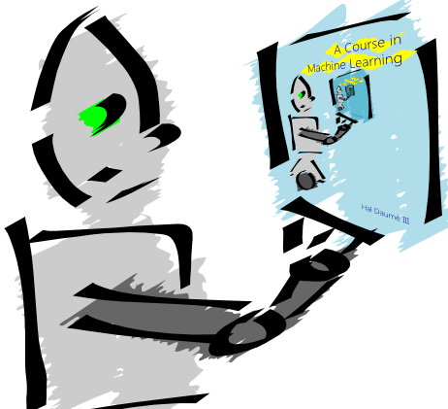
Machine Learning is…
Machine learning is about predicting the future based on the past.
-- Hal Daume III

Slide 4
Machine Learning is…
Machine learning is about predicting the future based on the past.
-- Hal Daume III
past
future
predict
learn
Training
Data
model/
predictor
Testing
Data
model/
predictor

Slide 5
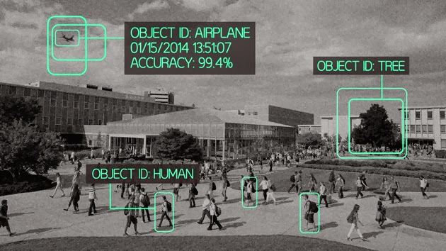
Recent challenges…

Slide 6
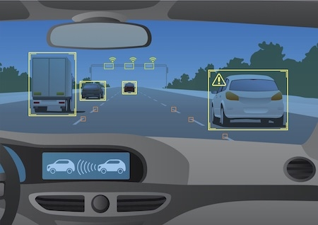
Autonomous car

Slide 7
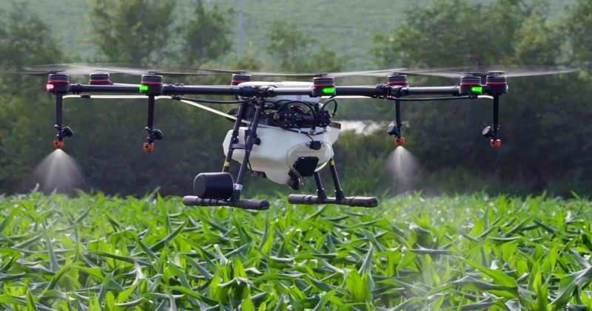
Drone: multiple applications

Slide 8
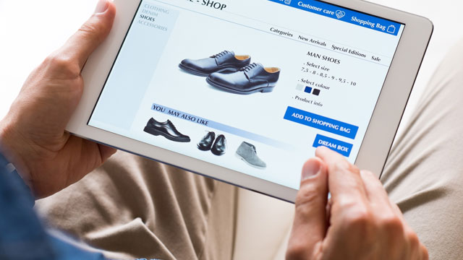
Recommender System
Indian Institute of Technology Indore

Slide 9
Recent challenges in machine learning….
Concept drift / online learning
Handling big data
Optimization
Hardware realization
Perfomance
Indian Institute of Technology Indore

Slide 10
Alternative terms:
  Computational Intelligence
  Natural Computation
  Nature-Inspired Computing
  Soft Computing
  Adaptive Systems

Slide 11
Switching to Computational Intelligence
Traditional AI (Symbolic AI)
  uncertainty, or missing information
  noisy/erroneous information
  the analogue world
    temporal change, inexact, adaptive
Indian Institute of Technology Indore

Slide 12

Soft Computing
Approach to construct computationally intelligent systems.
Intelligent systems that possess human like expertise within a specific
domain, adapt themselves and learn to perform better in changing
environments.
These systems explain how they make decisions or take actions.
They are composed of two features: adaptivity & knowledge.
Dr. Aruna Tiwari
(CSE)
Indian Institute of Technology Indore
March 1, 2016
7 / 65

Slide 13

Advantages of SC
Conceptual Simplicity.
Broad Applicability.
Hybridization with Other Methods.
Parallelism.
Robust to Dynamic Changes.
Solves Problems that have no Solutions.
Dr. Aruna Tiwari
(CSE)
Indian Institute of Technology Indore
March 1, 2016
8 / 65

Slide 14

Applications
Control/Industry.
Design.
Scheduling.
Robotics.
Medical Domain.
Signal Processing.
Game Playing etc.
Dr. Aruna Tiwari
(CSE)
Indian Institute of Technology Indore
March 1, 2016
9 / 65

Slide 15
Unique Features of CI
Approaches for constructing systems which are
  computationally intelligent,
  possess human like expertise in particular domain,
  can adapt to the changing environment and can learn to do better
  can explain their decisions
Indian Institute of Technology Indore

Slide 16
Components of Soft Computing
Components of soft computing include:
  Neural Network (NN)
  Fuzzy Logic (FL)
  Evolutionary Computation (EC) - based on the origin of the species
    Genetic Algorithm
    Swarm Intelligence
    Ant Colony Optimizations
  Machine Learning (ML)
Indian Institute of Technology Indore

Slide 17
Artificial Neural Networks
Fuzzy logic
Machine Learning
Computational Intelligence
Probabilistic Reasoning
Evolutionary computation
Heuristics
Indian Institute of Technology Indore

Slide 18
Innovative approach to construct computationally intelligent systems
Intelligent systems that possess humanlike expertise within a specific domain, adapt themselves and learn to perform better in changing environments
They are composed of two features: “adaptivity” & “knowledge
Indian Institute of Technology Indore

Slide 19
Neural networks
Neural network: information processing paradigm inspired by biological nervous systems, such as our brain
Structure: large number of highly interconnected processing elements (neurons) working together
Like people, they learn from experience (by example)
Indian Institute of Technology Indore

Slide 20
Neural networks
Neural networks are configured for a specific application, such as pattern recognition or data classification, through a learning process
In a biological system, learning involves adjustments to the synaptic connections between neurons
➔ same for artificial neural networks (ANNs)
Indian Institute of Technology Indore

Slide 21
Fuzzy Logic
Professor Lotif Zadeh, UC Berkeley, 1965
  “People do not require precise, numerical information
  input, and yet they are capable of highly adaptive control.”
  -proposed the generalization of classical set theory
Accepts noisy, imprecise input!
Uncertain situation
Indian Institute of Technology Indore

Slide 22
Evolutionary Computation
Genetic and Swarm Computing
Indian Institute of Technology Indore

Slide 23
Evolutionary Computation -EC
General term for several computational techniques inspired by biological evolution
Mostly involve meta-heuristic optimization algorithms such as:
  Evolutionary algorithms
    comprising genetic algorithms, evolutionary programming, etc)
  Swarm intelligence
    comprising ant colony optimization and particle swarm optimization)
Indian Institute of Technology Indore

Slide 24
Evolutionary Computation
Inspired by biological genetics
Species survive by reproducing and evolving over time by passing on new information through their genes
  i.e. In genetic algorithm, operators are used to obtain the new child offspring
Indian Institute of Technology Indore

Slide 25
Advantages of CI
Conceptual Simplicity
Broad Applicability
Hybridization with Other Methods
Parallelism
Robust to Dynamic Changes
Solves Problems that have no Solutions
Indian Institute of Technology Indore

Slide 26
Applications
Control
Design
Scheduling
Robotics
Medical
Signal Processing
Game Playing etc.
Indian Institute of Technology Indore

Slide 27
Common Issues in working with CI Algorithms
Analysis of Domain
Input Data Preparation
Generalization Capability
(Exploration/Exploitation)
Training time
Indian Institute of Technology Indore

Slide 28
Continued…..
(Working with CI Systems)
Implementing Training Algorithm
Implementing Testing Algorithm
(Verification and validation)
Developed System (For end User)
Indian Institute of Technology Indore

Slide 29
Work going on…..
Indian Institute of Technology Indore

Slide 30
Design of Novel Soft-computing Algorithms and its Application
Indian Institute of Technology Indore

Slide 31
Collaboration with ICAR
(Indian Council of Agriculture Research)
Genome data in text form ??
Indian Institute of Technology Indore

Slide 32
Application of scalable fuzzy clustering algorithm for the classification of Plant genome
  Analysis of complex plant genome data.
  Collecting complex plant genome data in GBs.
  Preprocessing of complex plant genome data.
  Design of Feature Extraction Approach for complex plant genome data.
  Applying proposed scalable clustering algorithm on complex plant genome data.
  Experimental evaluation and identification of putative functions
Indian Institute of Technology Indore

Slide 33
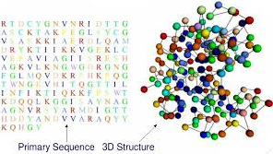
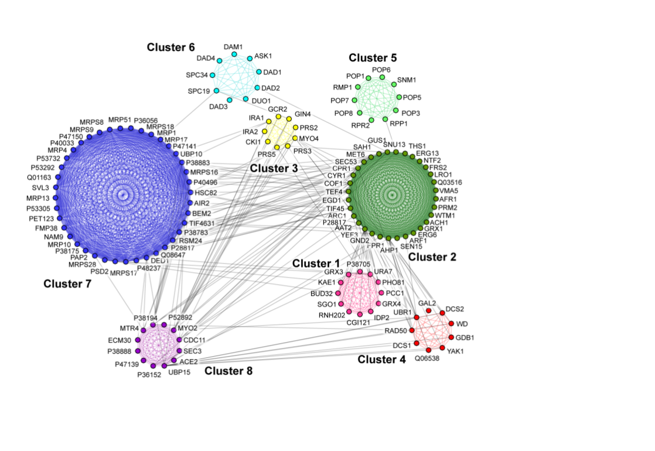
Application of Scalable Clustering on Protein data
To deal with the classification of protein sequences of complex plant genome.
To analyze the huge protein
sequences of different species
of plant.
Perform the alignment to find
the conserved motifs.
Perform the feature extraction
approach on huge protein
sequences.
To investigate the performance
of scalable clustering algorithms
in terms of phylogenetic tree,
speedup and sizeup.
Indian Institute of Technology Indore

Slide 34
Collaboration with CSIR-CEERI Pilani
(Central Electronics Engineering Research Institute)
Neural Network learning algorithms
  Quantum based algorithm
  ELM based algorithm
Hardware realization
Indian Institute of Technology Indore

Slide 35
Continued…......
Application of scalable clustering algorithm for the classification of Plant genome
  Analysis of complex plant genome data.
  Collecting complex plant genome data in GBs.
  Preprocessing of complex plant genome data.
  Design of Feature Extraction Approach for complex plant genome data.
  Applying proposed scalable clustering algorithm on complex plant genome data.
  Experimental evaluation and identification of putative functions
Indian Institute of Technology Indore

Slide 36
Experimental setup
Apache Spark Cluster with each node has following configuration:
Intel Xenon ® CPU ES-1607 v3@ 3.10 GHz x 4, 64 GB RAM
System name: Dell precision Tower 5810
Operating system: Ubuntu 14.04
Number of nodes:3
Number of processing cores:12
Total memory: 192 GB
Total disk:5TB
Indian Institute of Technology Indore

Slide 37
Performance Factors
Developed analytical formulation for the evaluation of space and time complexity .
Analyze the performance in terms of following parameters:
Size up
Speedup
NMI
ARI
F-measure
Run-time
Indian Institute of Technology Indore

Slide 38
Application of Scalable Clustering on Protein data
To deal with the classification of protein sequences of complex plant genome.
To analyze the huge protein
sequences of different species
of plant.
Perform the alignment to find
the conserved motifs.
Perform the feature extraction
approach on huge protein
sequences.
To investigate the performance
of scalable clustering algorithms
in terms of phylogenetic tree,
speedup and sizeup.
Indian Institute of Technology Indore

Slide 39
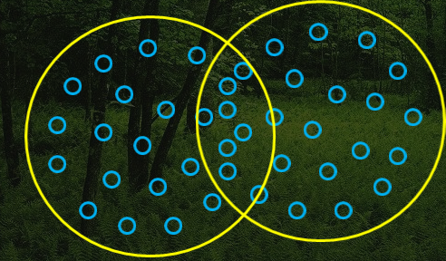
Cost function/ Objective Function Example :Fuzzy Clustering
The most well-known fuzzy clustering algorithm is fuzzy c-means, developed by Dunn in 1973 a modification by Bezdek in 1981 of an original crisp clustering methodology.
Fig. 10 Fuzzy clusters
Dr. Aruna Tiwari (CSE) Indian Institute of Technology Indore 32/65

Slide 40
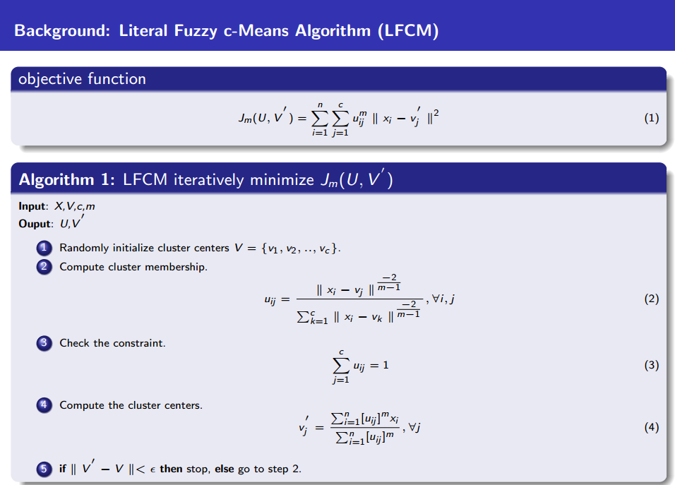
Dr. Aruna Tiwari (CSE) Indian Institute of Technology Indore 33/65

Slide 41

Disadvantage of LFCM and Solution
Problem
Processing entire data at once.
Clustering of Big Data is not feasible.
Out of memory problem.
Solution
Process data in chunks.
Dr. Aruna Tiwari (CSE) Indian Institute of Technology Indore 34/65
Dr. Aruna Tiwari
(CSE)
Indian Institute of Technology Indore
March 1, 2016
27 / 65

Slide 42

Scalable Soft Computing algorithms: Handling Big
Data
Dr. Aruna Tiwari (CSE) Indian Institute of Technology Indore 35/65
Dr. Aruna Tiwari
(CSE)
Indian Institute of Technology Indore
March 1, 2016
30 / 65

Slide 43
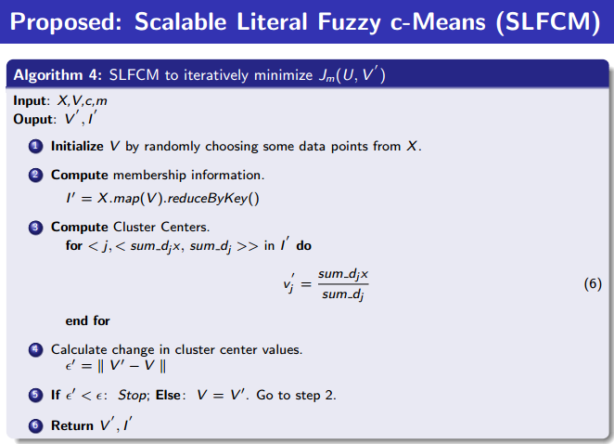
Dr. Aruna Tiwari (CSE) Indian Institute of Technology Indore 36/65

Slide 44
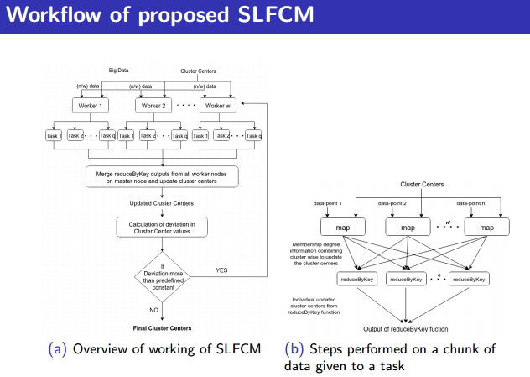
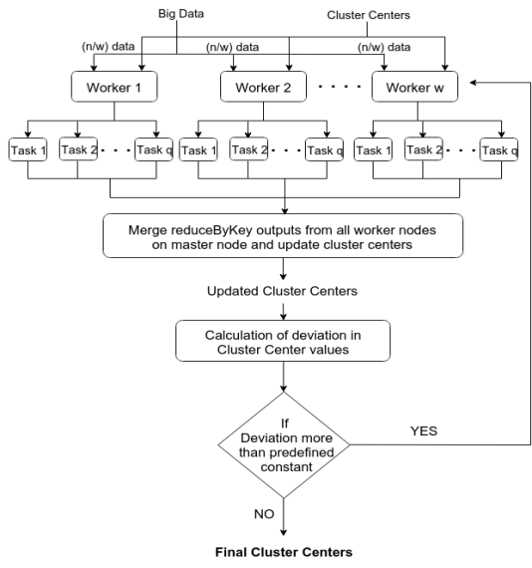
Fig. 11 SLFCM Algorithm implemented on Apache Spark Cluster
Dr. Aruna Tiwari (CSE) Indian Institute of Technology Indore 37/65

Slide 45
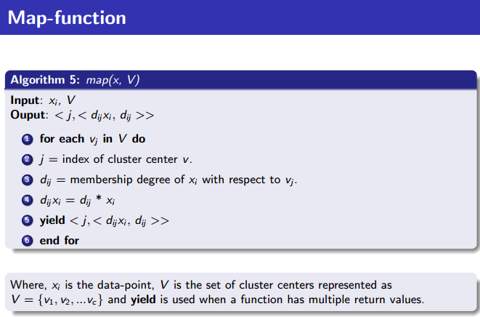
Dr. Aruna Tiwari (CSE) Indian Institute of Technology Indore 38/65

Slide 46
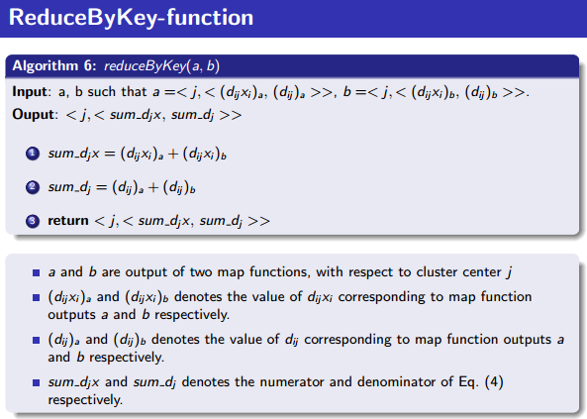
Dr. Aruna Tiwari (CSE) Indian Institute of Technology Indore 39/65

Slide 47
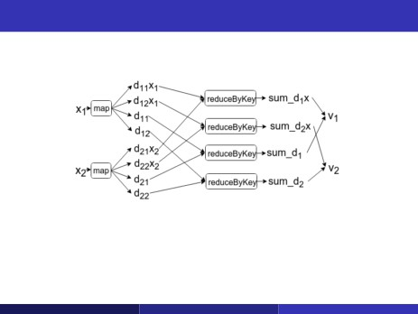
Storage space optimization
Fig 12: Storage space optimization by avoiding storage of membership matrix of
subsets
Dr. Aruna Tiwari (CSE) Indian Institute of Technology Indore 40/65
Dr. Aruna Tiwari
(CSE)
Indian Institute of Technology Indore
March 1, 2016
35 / 65

Slide 48
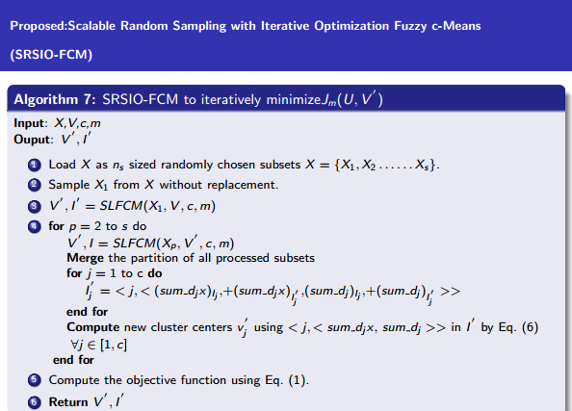
Dr. Aruna Tiwari (CSE) Indian Institute of Technology Indore 41/65

Slide 49
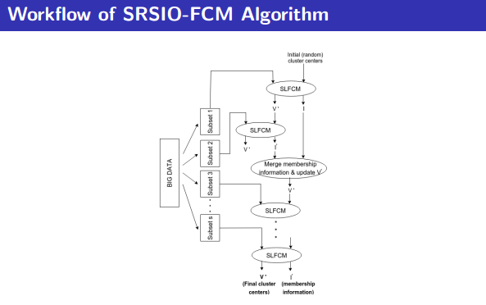
Workflow of SRSIO-FCM Algorithm
Fig13. Workflow of SRSIO-FCM
Dr. Aruna Tiwari (CSE) Indian Institute of Technology Indore 42/65
Dr. Aruna Tiwari
(CSE)
Indian Institute of Technology Indore
March 1, 2016
37 / 65

Slide 50
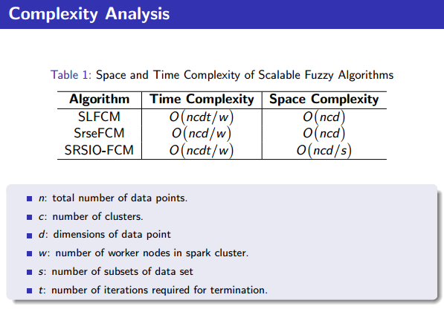
Dr. Aruna Tiwari (CSE) Indian Institute of Technology Indore 43/65

Slide 51

Experimental environment
Table 2: System Specification
Configuration
Spark cluster
3 nodes
Processor
Intel Xenon CPU ES-1607 v3@3.10 GHZ
RAM
32 GB
Storage
2TB
Hadoop version
2.4
Apache Spark version
1.4.0
Dr. Aruna Tiwari (CSE) Indian Institute of Technology Indore 44/65
Dr. Aruna Tiwari
(CSE)
Indian Institute of Technology Indore
March 1, 2016
41 / 65

Slide 52
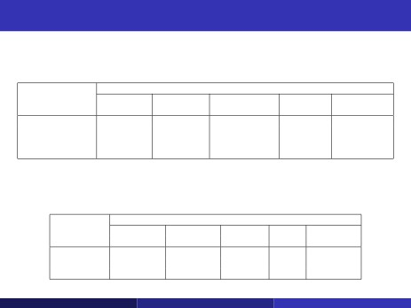
Datasets Description and Parameters Specification
Table 3: Description of the Data sets
Parameters
Data sets
MNIST8m Replicated Monarch SUSY Replicated
USPS Skin dim32
No. of instances
No. of features
No. of classes
Data set Size
8,100,000 14,582,000 1,470,342,000 5,000,000 104,448,000
784 256 3 18 32
10 10 2 2 16
19GB 34GB 25.4GB 2.4GB 11.5GB
Table 4: Parameters Specification for Various Data sets
Parameters
Data sets
MNIST8m Replicated Monarch SUSY Replicated
USPS Skin dim32
ϵ
0.001 0.001 0.001 0.001 0.001
m
1.75 1.75 1.75 1.75 1.75
c
10 10 2 3 16
Dr. Aruna Tiwari (CSE) Indian Institute of Technology Indore 45/65
Dr. Aruna Tiwari
(CSE)
Indian Institute of Technology Indore
March 1, 2016
42 / 65

Slide 53
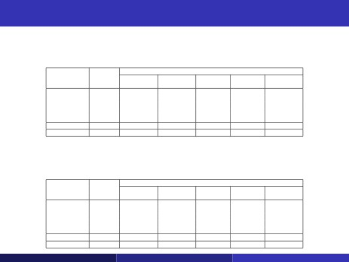
Experimental Results
Table 5: NMI for SLFCM, SrseFCM and SRSIO-FCM with various chunk sizes on different
data sets
Chunk
Data sets
Algorithm
size
MNIST8m Replicated Monarch SUSY Replicated
USPS Skin dim32
1%
0.117094
0.365415
0.012703
0.028723
0.967859
2.5%
0.125052
0.365966
0.012703
0.029032
1.000000
SRSIO-FCM
5%
0.122007
0.365119
0.012703
0.028674
1.000000
10%
0.118471
0.365557
0.012705
0.028667
1.000000
20%
0.126027
0.365292
0.012703
0.028798
1.000000
SLFCM
100%
0.122540
0.396155
0.012703
0.025895
1.000000
SrseFCM
0.001%
0.118607
0.253252
0.013281
0.001194
0.883591
Table 6: F-measure for SLFCM, SrseFCM and SRSIO-FCM with various chunk sizes on
different data sets
Chunk
Data sets
Algorithm
size
MNIST8m Replicated Monarch SUSY Replicated
USPS Skin dim32
1%
0.362525
0.787940
0.648496
0.641601
1.000000
2.5%
0.365356
0.788448
0.648497
0.642083
1.000000
SRSIO-FCM
5%
0.363194
0.788653
0.648496
0.640909
1.000000
10%
0.364882
0.788539
0.648508
0.641277
1.000000
20%
0.379519
0.788608
0.648497
0.641660
1.000000
SLFCM
100%
0.381972
0.842952
0.648497
0.607977
1.000000
SrseFCM
0.001%
0.380723
0.565469
0.619401
0.453477
0.947917
Dr. Aruna Tiwari (CSE) Indian Institute of Technology Indore 46/65
Dr. Aruna Tiwari
(CSE)
Indian Institute of Technology Indore
March 1, 2016
45 / 65

Slide 54
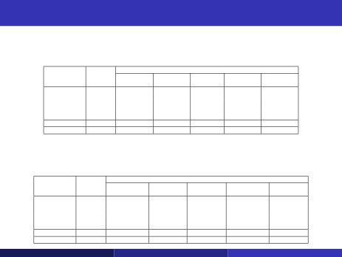
Experimental Results Cont..
Table 7: ARI for SLFCM, SrseFCM and SRSIO-FCM with various chunk sizes on different data
sets
Chunk
Data sets
Algorithm
size
MNIST8m Replicated Monarch SUSY Replicated
USPS Skin dim32
1%
0.048867
0.215461
0.035881
0.042860
0.915891
2.5%
0.052707
0.215343
0.035882
0.043153
1.000000
SRSIO-FCM
5%
0.051061
0.215777
0.035881
0.042747
1.000000
10%
0.049511
0.215533
0.035889
0.043010
1.000000
20%
0.053534
0.215607
0.035883
0.042879
1.000000
SLFCM
100%
0.052189
0.268365
0.035881
0.038094
1.000000
SrseFCM
0.001%
0.049464
0.294295
0.022201
0.0314584
0.679988
Table 8: Objective Function value for SLFCM, SrseFCM and SRSIO-FCM with various chunk
sizes on different data sets
Chunk
Data sets
Algorithm
size
MNIST8m Replicated Monarch SUSY Replicated
USPS Skin dim32
1%
74556041.35
83800629
9.53E+016
24522339.61
1.61E+011
2.5%
74556041.52
83800623
9.53E+016
24522336.73
2.36E+010
SRSIO-FCM
5%
74556038.97
83800617
9.53E+016
24522337.77
2.36E+010
10%
74556042.40
83800622
9.53E+016
24522346.13
2.36E+010
20%
74556036.17
83800622
9.53E+016
24522338.22
2.36E+010
SLFCM
100%
74556031.67
83800498
9.53E+016
24522337.10
2.36E+010
SrseFCM
0.001%
74647034.95
173762000
1.52e+17
24556967.02
1.21E+010
Dr. Aruna Tiwari (CSE) Indian Institute of Technology Indore 47/65
Dr. Aruna Tiwari
(CSE)
Indian Institute of Technology Indore
March 1, 2016
46 / 65

Slide 55
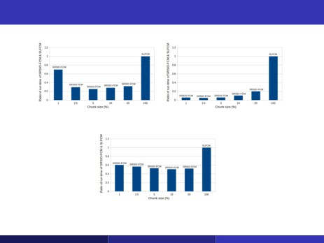
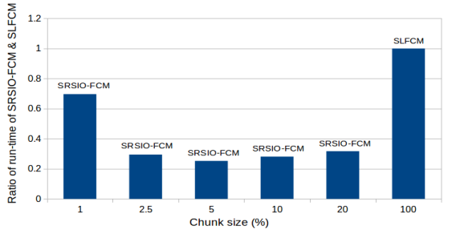
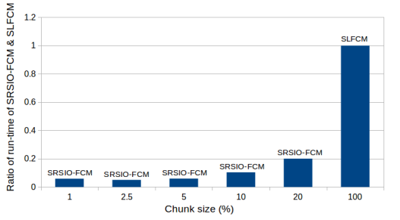
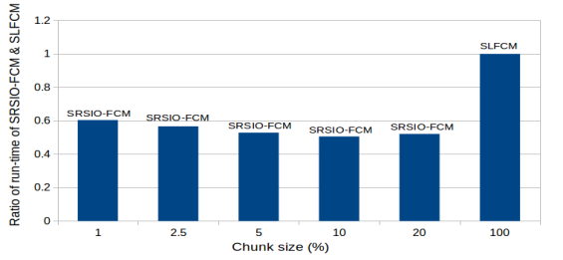
Experimental Results Cont..
(a) MNIST8m data
(b) Replicated-USPS data
(c) Monarch-Skin data
Fig 14: Comparison of run-time with varying chunk size
Dr. Aruna Tiwari (CSE) Indian Institute of Technology Indore 48/65
Dr. Aruna Tiwari
(CSE)
Indian Institute of Technology Indore
March 1, 2016
47 / 65

Slide 56
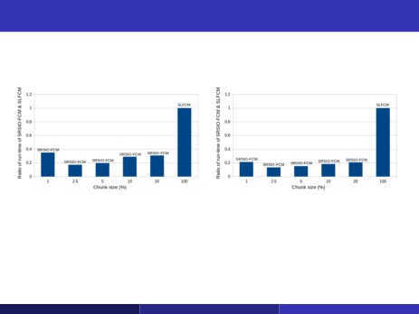
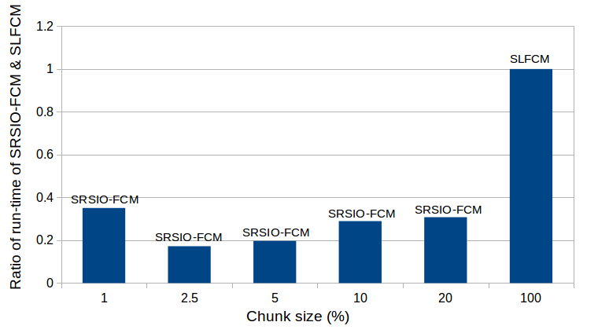
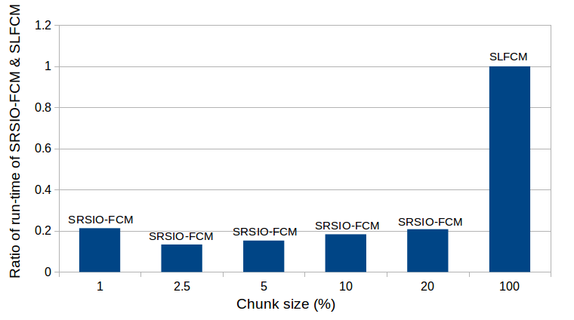
Experimental Results Cont..
(a) SUSY data
(b) Replicated-dim32 data
Fig 15: Comparison of run-time of SRSIO-FCM and SLFCM with varying
chunk size on different data sets
Dr. Aruna Tiwari (CSE) Indian Institute of Technology Indore 49/65
Dr. Aruna Tiwari
(CSE)
Indian Institute of Technology Indore
March 1, 2016
48 / 65

Slide 57
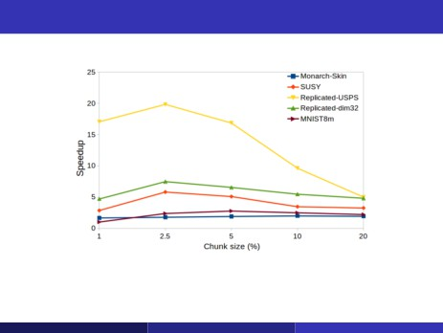
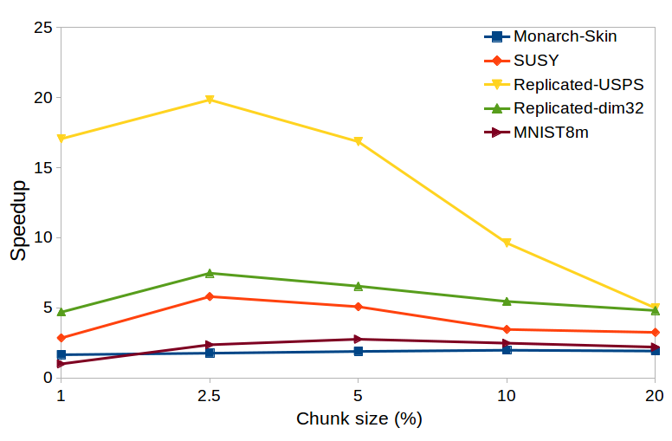
Experimental Results Cont..
Fig 16: Speedup of SRSIO-FCM with various chunk size on different data sets
Dr. Aruna Tiwari (CSE) Indian Institute of Technology Indore 50/65
Dr. Aruna Tiwari
(CSE)
Indian Institute of Technology Indore
March 1, 2016
49 / 65

Slide 58
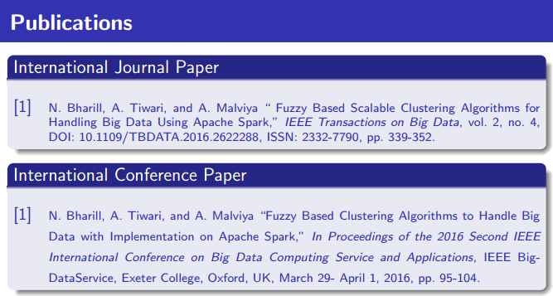
Dr. Aruna Tiwari (CSE) Indian Institute of Technology Indore 51/65

Slide 59
Linear Algebra & its application to machine learning
-Problems solved by linear functions
i.e. matrices, vectors, geometry, linear equations

Slide 60
Different Areas of Neural Network
Here the problem is to make a description of a training set of objects and to detect which (new) objects resemble this training set.
Binary Classification
Multiclass Classification
One Class Classification
Regression
Indian Institute of Technology Indore

Slide 61

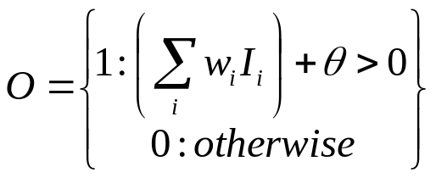
Perceptrons
Initial proposal of connectionist networks
Rosenblatt, 50’s and 60’s
Essentially a linear discriminant composed of nodes, weights
I1
W1
I1
W1
or
W2
W2
O
I2
O
I2
W3
W3
I3
Activation Function
I3
1

Slide 62
Perceptron Example
2
.5
.3
=-1
1
2(0.5) + 1(0.3) + -1 = 0.3 , O=1
Learning Procedure:
Randomly assign weights (between 0-1)
Present inputs from training data
Get output O, nudge weights to gives results toward our desired output T
Repeat; stop when no errors, or enough epochs completed

Slide 63
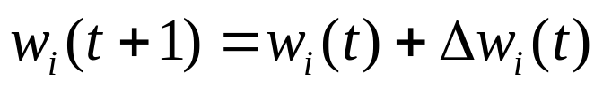
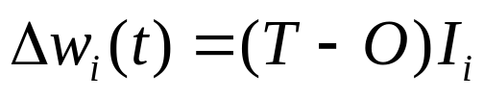


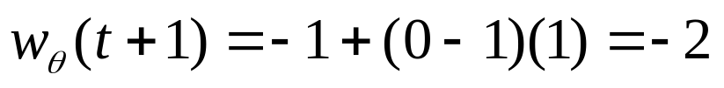
Perception Training
Weights include Threshold. T=Desired, O=Actual output.
Example: T=0, O=1, W1=0.5, W2=0.3, I1=2, I2=1,Theta=-1
If we present this input again, we’d output 0 instead

Slide 64
How might you use a perceptron network?
This (and other networks) are generally used to learn how to make classifications
Say you have collected some data regarding the diagnosis of patients with heart disease
  Age, Sex, Chest Pain Type, Resting BPS, Cholesterol, …, Diagnosis (<50% diameter narrowing, >50% diameter narrowing)
  67,1,4,120,229,…, 1
  37,1,3,130,250,… ,0
  41,0,2,130,204,… ,0
Train network to predict heart disease of new patient

Slide 65
Perceptrons
Can add learning rate to speed up the learning process; just multiply in with delta computation
Essentially a linear discriminant
Perceptron theorem: If a linear discriminant exists that can separate the classes without error, the training procedure is guaranteed to find that line or plane.
Class1
Class2

Slide 66
Concept of Gradient Descent
Example:
Back Propagation Algorithm
(For Multilayer Feedforward network)

Slide 67
- gradient descent on the error function to find the correct weights:
Δ w_{ji} = (t_{j} - y_{j}) x_{i}
x₁
(t_{j} - y_{j})
x₁
x₂
x_{n}
There is no direct error signal for the first layers!!!!!

Slide 68
deciding which weights should be altered, by how much and in which direction.
Analogous to deciding how much a weight in the early layer contributes to the output and thus the error
How weight w_{ij} affects the error

Slide 69
Backpropagation learning algorithm ‘BP’
Solution to credit assignment problem in MLP
Rumelhart, Hinton and Williams (1986)
BP has two phases:
Forward pass phase: computes ‘functional signal’, feedforward
propagation of input pattern signals through network

Slide 70
Backpropagation learning algorithm ‘BP’
Inventors- Rumelhart, Hinton and Williams (1986)
BP has two phases:
Forward pass phase: computes ‘functional signal’, feedforward
propagation of input pattern signals through network
Backward pass phase: computes ‘error signal’, propagates the error backwards through network starting at output units (where the error is the difference between actual and desired output values)

Slide 71
Three-layer network
x₁
Outputs of 1st layer z_{i}
x₂
y₁
Inputs x_{i}
Outputs y_{j}
y_{m}
2nd hidden layer weights w_{ij} from i to j
x_{n}
1st hidden layer weights v_{ij} from i to j

Slide 72
concentrate on three-layer, but could easily generalize to more layers
z_{i} (t) = g( Σ _{j} v_{ij} (t) x_{j} (t) ) at time t
= g ( u_{i} (t) )
y_{i} (t) = g( Σ _{j} w_{ij} (t) z_{j} (t) ) at time t
= g ( a_{i} (t) )

Slide 73
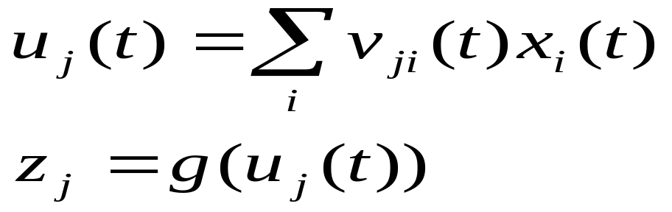
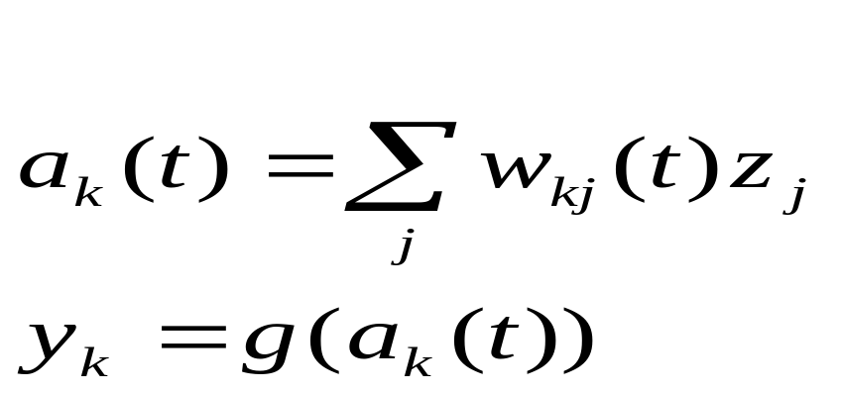
Forward pass
Weights are fixed during forward and backward pass at time t
1. Compute values for hidden units
2. compute values for output units
y_{k}
w_{kj}(t)
z_{j}
v_{ji}(t)
x_{i}

Slide 74
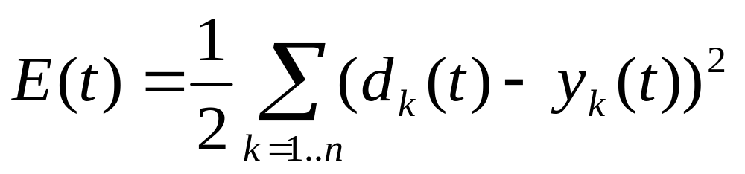
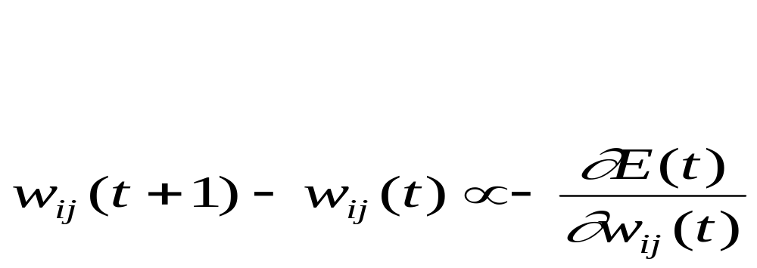
Backward Pass
Will use a sum of squares error measure. For each training pattern we have:
where d_{k} is the target value for dimension k. We want to know how to modify weights in order to decrease E. Use gradient descent ie
both for hidden units and output units

Slide 75
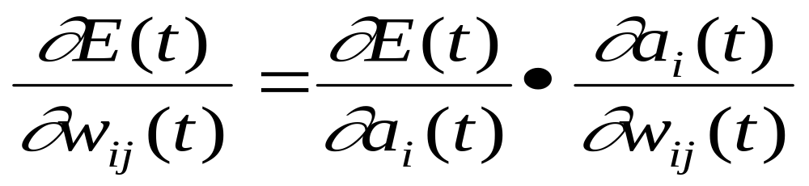
The partial derivative can be rewritten as product of two terms using chain rule for partial differentiation
both for hidden units and output units

Slide 76
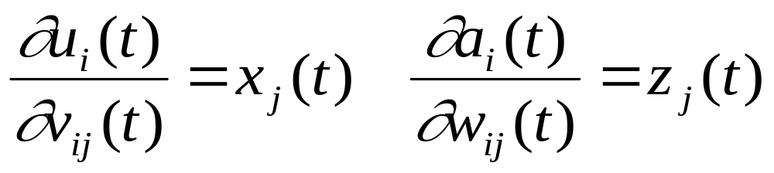
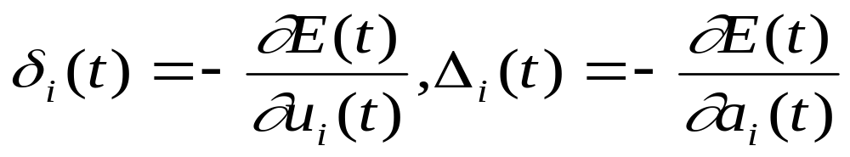
Term B first:
Term A Let
(error terms). Can evaluate these by chain rule:

Slide 77
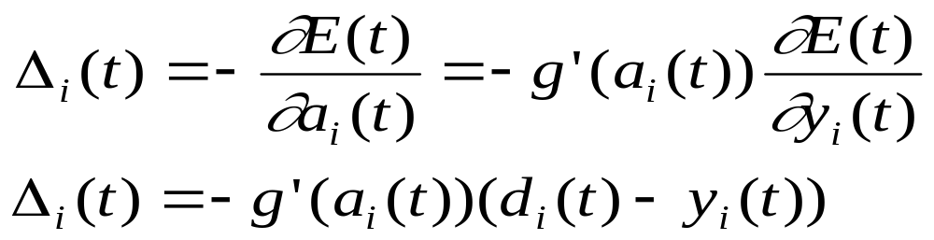
For output units we therefore have:

Slide 78
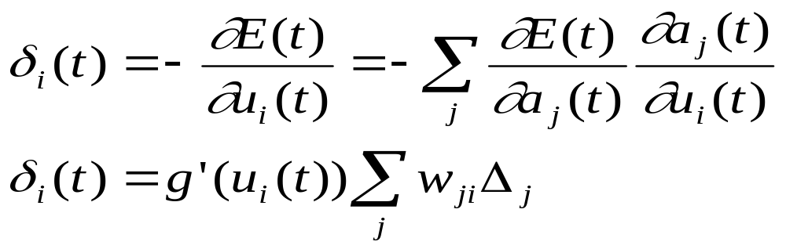
For hidden units must use the chain rule:

Slide 79
Backward Pass
w_{ki}
w_{ji}
Δ_{k}
Δ_{j}
Weights here can be viewed as providing
degree of ‘credit’ or ‘blame’ to hidden units
δ_{i}
δ_{i} = g’(a_{i}) Σ_{j} w_{ji} Δ_{j}

Slide 80
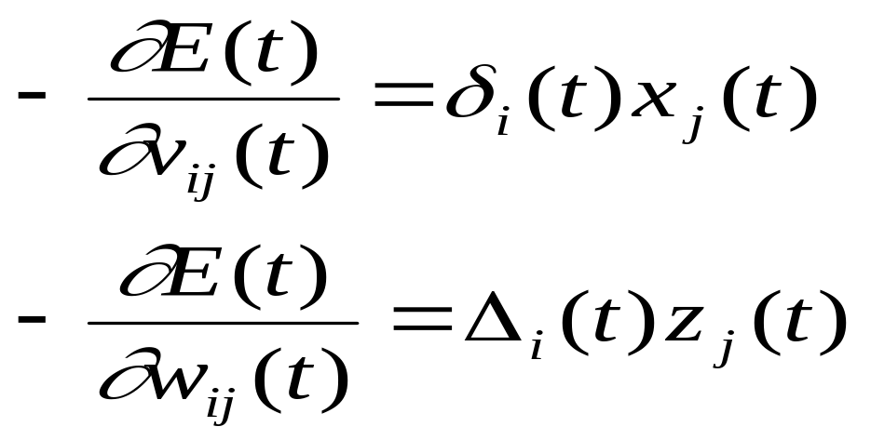
Combining A+B using chain rule gives
So to achieve gradient descent in E should change weights by
v_{ij}(t+1)-v_{ij}(t) = η δ _{i} (t) x_{j} (t)
w_{ij}(t+1)-w_{ij}(t) = η Δ _{i} (t) z_{j} (t)
Where η is the learning rate parameter (0 < η <=1)

Slide 81
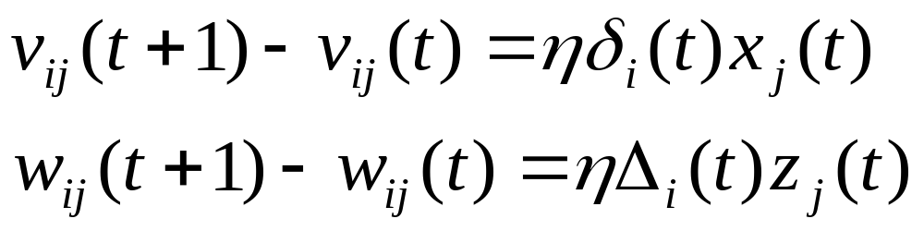
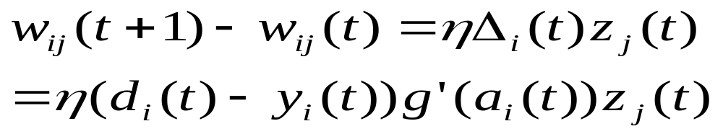
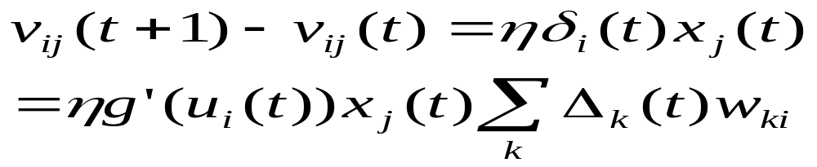
Summary
Weight updates are local
output unit
hidden unit

Slide 82
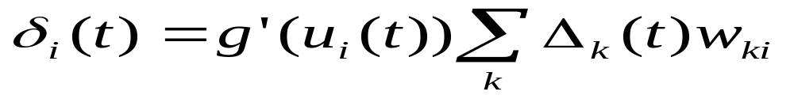
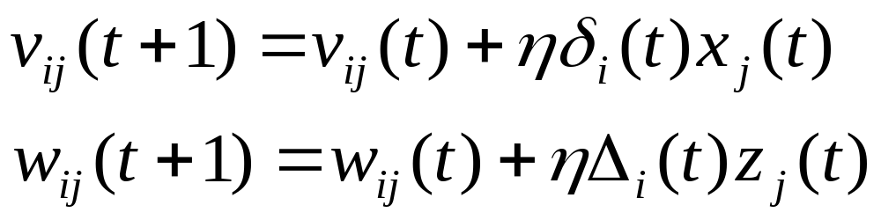
Algorithm
1. Apply an input vector and calculate all activations, a and u
2. Evaluate Δ_{k} for all output units via:
(Note similarity to perceptron learning algorithm)
3. Backpropagate Δ_{k}s to get error terms δ for hidden layers using:
4. Evaluate changes using:

Slide 83
Publication: Journals
O. P. Patel, A. Tiwari, R. Chaudhary, S. V. Nuthalapati, N. Bharill, M. Prasad, F. K. Hussain, and O. K. Hussain, “Enhanced Quantum based Neural Network Learning and its Application to Signature Verification”, Soft Computing, Springer, DOI: 10.1007/s00500-017-2954-3, ISSN: 1433-7479, pp. 1-14, 2017. (SCIE Index)
A. Saxena, M. Prasad, A. Gupta, N. Bharill, O.P. Patel, A. Tiwari, et al., “A Review of Clustering Techniques and Developments,” Neurocomputing, Elsevier, vol. 267, DOI: 10.1016/j.neucom.2017.06.053, ISSN: 0925-2312, pp. 664-681, 2017. (SCI Index).
O. P. Patel, A. Tiwari, V. Bagade, Quantum inspired Stacked Auto-encoder based Deep Neural Network Algorithm (Q-DNN), Arabian Journal for Science and Engineering, Springer, DOI: 10.1007/s13369-017-2907-2, ISSN: 2193-567X, pp. 1-15, 2017. (SCIE Index)
Indian Institute of Technology Indore

Slide 84
Publication: Journals
O. P. Patel, and A. Tiwari, Novel Quantum Inspired Binary Neural Network Algorithm, Sadhana - Academy Proceedings in Engineering Sciences, Springer, ,vol. 41(11), DOI: 10.1007/s12046-016-0561-0, ISSN: 0256-2499 pp. 1299–1309, 2016. (SCIE Index)
N. Bharill, O. P. Patel, and A. Tiwari, “Quantum-inspired Evolutionary Approach for Selection of Optimal Parameters of Fuzzy Clustering,” International Journal of System Assurance Engineering and Management, Springer, DOI: https://doi.org/10.1007/s13198-017-0681-x, ISSN: 0975-6809, pp. 1-13, 2017. (Scopus, and Emerging Sources Citation Index )
Indian Institute of Technology Indore

Slide 85
Publication :Conferences
O. P. Patel, A. Tiwari,, O. Gupta, and V. Patel, A Quantum-based Neural Network Classifier and its application for Firewall to Detect Malicious Web Request, IEEE Symposium Series on Computational Intelligence (SSCI), Cape Town, South Africa , pp. 67 - 74, Dec 2015 (Rank C).
N. Bharill, O. P. Patel, and A. Tiwari, An Enhanced Quantum-Inspired Evolutionary Fuzzy Clustering, IEEE Symposium Series on Computational Intelligence (SSCI), Cape Town, South Africa, pp. 772 - 779, Dec 2015 (Rank C).
O. P. Patel, N. Bharill, and A. Tiwari, A Quantum-Inspired Fuzzy Based Evolutionary Algorithm for Data Clustering, IEEE International Conference on Fuzzy Systems (FUZZ-IEEE), IEEE Computational Intelligence Society Conference (CIS), Istanbul, Turkey, pp. 1 - 8, Aug. 2015 (Rank A).
Indian Institute of Technology Indore

Slide 86
Publication :Conferences
O. P. Patel and A. Tiwari, Advance Quantum inspired binary neural network algorithm, 16th International Conference on Software Engineering, Artificial Intelligence, Networking and Parallel/Distributed Computing (SNPD), IEEE Computational Intelligence Society Conference (CIS), Takamatsu, Japan, pp. 1-6, June 2015 (Rank B).
O. P. Patel and A. Tiwari, “Quantum Inspired Binary Neural Network Algorithm”, 13th International Conference on Information Technology (ICIT), Bhubaneswar, India, IEEE, pp. 270-274, Dec. 2014 (Double-Blind Review Conference).
Indian Institute of Technology Indore

Slide 87
Book Chapters
O.P. Patel and A. Tiwari, “Liver Disease Diagnosis using Quantum based Binary Neural Network Learning Algorithm”, e-book: Proceedings of Fourth International Conference on Soft Computing for Problem Solving: (SocProS 2014), Springer-Verlag Berlin Heidelberg, DOI 10.1007/978-81-322-2220-0_34, ISBN 978-81-322-2220-0, vol. 2, no. 5, 2015, pp. 425-434.
O.P. Patel and A. Tiwari, “Quantum Based Learning with Binary Neural Network”, e-book: Proceedings of the International Conference on Computational Intelligence in Data Mining (CIDM 2014), Springer-Verlag Berlin Heidelberg, DOI 10.1007/978-81-322-2208-8_43, ISBN 978-81-322-2208-8, vol. 2, 2014 pp. 473-482.
Indian Institute of Technology Indore

Slide 88
Selected Publications
Neha Bharill, Aruna Tiwari, and Aayushi Malviya, Fuzzy Based Scalable Clustering Algorithms for Handling Big data using Apache Spark, IEEE Transactions on Big Data, vol. 2, no. 4, pp. 1-14, 2016.
Om Prakash Patel, and Aruna Tiwari, A Novel Quantum Inspired Binary Neural Network Algorithm, Sadhana Published by Indian Academy of Sciences, Springer, vol. 41, no. 11, pp. 1299-1309, 2016.
Chandan Gautam, and Aruna Tiwari, On The Construction of Extreme Learning Machine for Online and Offline One Class Classifier, Neurocomputing, Elsevier, 2016. ( In Press)
Arpit Bhardwaj, and Aruna Tiwari, A Genetically Optimized Neural Network Model for Multi-class Classification, Expert Systems with Applications, Elsevier, vol. 60, pp. 211-221, 2016.
Arpit Bhardwaj, Aruna Tiwari, M. Vishaal Varma, and M. Ramesh Krishna, A Novel Genetic Programming Approach for Epileptic Seizure Detection, Journal Computer methods and programs in biomedicine, Elsevier, vol. 124, pp. 2-18, 2016.
Arpit Bhardwaj, and Aruna Tiwari, Breast Cancer Diagnosis using Genetically Optimized Neural Network model, Journal Expert Systems with Applications, Elsevier, vol. 42, pp. 4611-4620, 2015.
Indian Institute of Technology Indore

Slide 89
Continued….
Chandan Gautam, Aruna Tiwari and Sriram Ravindran, Construction of Multi-class Classifiers by Extreme Learning Machine Based One Class Classifiers, International Joint Conference on Neural Networks (IJCNN 2016), Sponsored by the IEEE Computational Intelligence Society (CIS), IEEE WCCI 2016, Vancouver, Canada, pp. 2001-2007, July 2016.
Neha Bharill, Aruna Tiwari, and Aayushi Malviya, Fuzzy Based Clustering Algorithms to Handle Big Data with Implementation on Apache Spark, IEEE BigDataService 2016, Sponsored by the IEEE Computer Society Conference, Exeter College, Oxford, UK, pp. 95-104, March 2016.
Chandan Gautam, and Aruna Tiwari, On The Construction of Extreme Learning Machine for One Class Classifier, The International Conference on Extreme Learning Machines (ELM 2015), Springer, Hangzhou, China, vol. 6, pp. 447-461, Oct 2015.
Neha Bharill, Om Prakash Patel, and Aruna Tiwari, An Enhanced Quantum-Inspired Evolutionary Fuzzy Clustering, IEEE Symposium Series on Computational Intelligence (SSCI 2015), Sponsored by the IEEE Computational Intelligence Society (CIS), Cape Town, South Africa, pp. 772-779, Dec 2015.
Sriram Ravindran, Chandan Gautam, and Aruna Tiwari, Keystroke User Recognition through Extreme Learning Machine and Evolving Cluster Method, IEEE International Conference on Computational Intelligence and Computing Research (ICCIC 2015), IEEE, Madurai, Tamilnadu, India, pp. 1-5, Dec 2015. (Best Paper Award)
Omprakash Patel, Aruna Tiwari, Ojas Gupta, and Vikram Patel, A Quantum-based Neural Network Classifier and its Application for Firewall to Detect Malicious Web Request, IEEE Symposium Series on Computational Intelligence (SSCI 2015), Sponsored by the IEEE Computational Intelligence Society (CIS), Cape Town, South Africa, pp. 67-74, Dec 2015.
Arpit Bhardwaj, Aruna Tiwari, M. Vishaal Varma, and M. Ramesh Krishna, An Analysis of Integration of Hill Climbing in Crossover and Mutation Operation for EEG Signal Classification, Genetic and Evolutionary Computation Conference (GECCO 2015), IEEE, pp. 209-216, July 2015
Indian Institute of Technology Indore

Slide 90
Cont…
Omprakash Patel, and Aruna Tiwari, Advance Quantum-Inspired Binary Neural Network Algorithm, 16th International Conference on Software Engineering, Artificial Intelligence, Networking and Parallel/Distributed Computing (SNPD 2015), Sponsored by the IEEE Computational Intelligence Society (CIS), Takamatsu, Japan, pp. 1-6, June 2015.
Omprakash Patel, Neha Bharill, and Aruna Tiwari, A Quantum-Inspired Fuzzy Based Evolutionary Algorithm for Data Clustering, IEEE International Conference on Fuzzy Systems (FUZZ-IEEE 2015), Sponsored by the IEEE Computational Intelligence Society (CIS), Istanbul, Turkey, pp. 1-8, Aug 2015.
Neha Bharill, Aruna Tiwari, Anshul Rawat, A Novel Technique of Feature Extraction with Dual Similarity Measures for Protein Sequence Classification, in Proceeding of International Conference on Computer, Communication and Convergence (ICCC 2014), Procedia Computer Science, Elsevier, Bhubaneshwar, India, vol. 48, pp. 795-801, Dec 2014.
Omprakash Patel, and Aruna Tiwari, Quantum Inspired Binary Neural Network Algorithm, International Conference on Information Technology (ICIT 2014), IEEE, Bhubaneswar, India, pp. 270-274, Dec 2014.
Omprakash Patel, and Aruna Tiwari, Liver Disease Diagnosis using Quantum based Binary Neural Network Learning Algorithm, 4th International Conference on Soft Computing for Problem Solving, Springer, NIT Silchar, India, vol. 336, pp. 421-430, Dec 2014. (Two Awards: Best Paper in the Track, Overall Best Paper),
Omprakash Patel, and Aruna Tiwari, Quantum Based Learning with Binary Neural Network, International Conference on Computational Intelligence in Data Mining, Springer, Sambalpur, India, vol. 32, pp. 473-482, Dec 2014.
Arpit Bhardwaj, Aruna Tiwari, M Vishaal Varma, and M Ramesh Krishna, An Innovative Genetic Programming Framework in Modeling a Real Time Epileptic Seizure Detection System, International Conference on Big Data Social Informatics/ PASSAT BioMedCom, Academy of Science and Engineering, Harvard University, USA, pp. 1-10, Dec 2014.
Indian Institute of Technology Indore

Slide 91
Thanks
Any Queries ????
Indian Institute of Technology Indore

