Slide 1
NoteShare
Group Project Presentation
CMPE 281
Team - Cloud Traders

Slide 2
Team Members
Laxmikant Bhaskar Pandhare(013859989)
Prachi Chouksey(013828945)
Ruchika Hazariwal(013728923)
Sai Manvith(013848211)
Suyash Srivastava(013591474)

Slide 3
App Features and description
Users - Register and login user
Notes - Add and view your notes
Profile - View and update profile
Search - Search other users and view their notes
Follow - Follow/Unfollow other users

Slide 4
DEMO

Slide 5
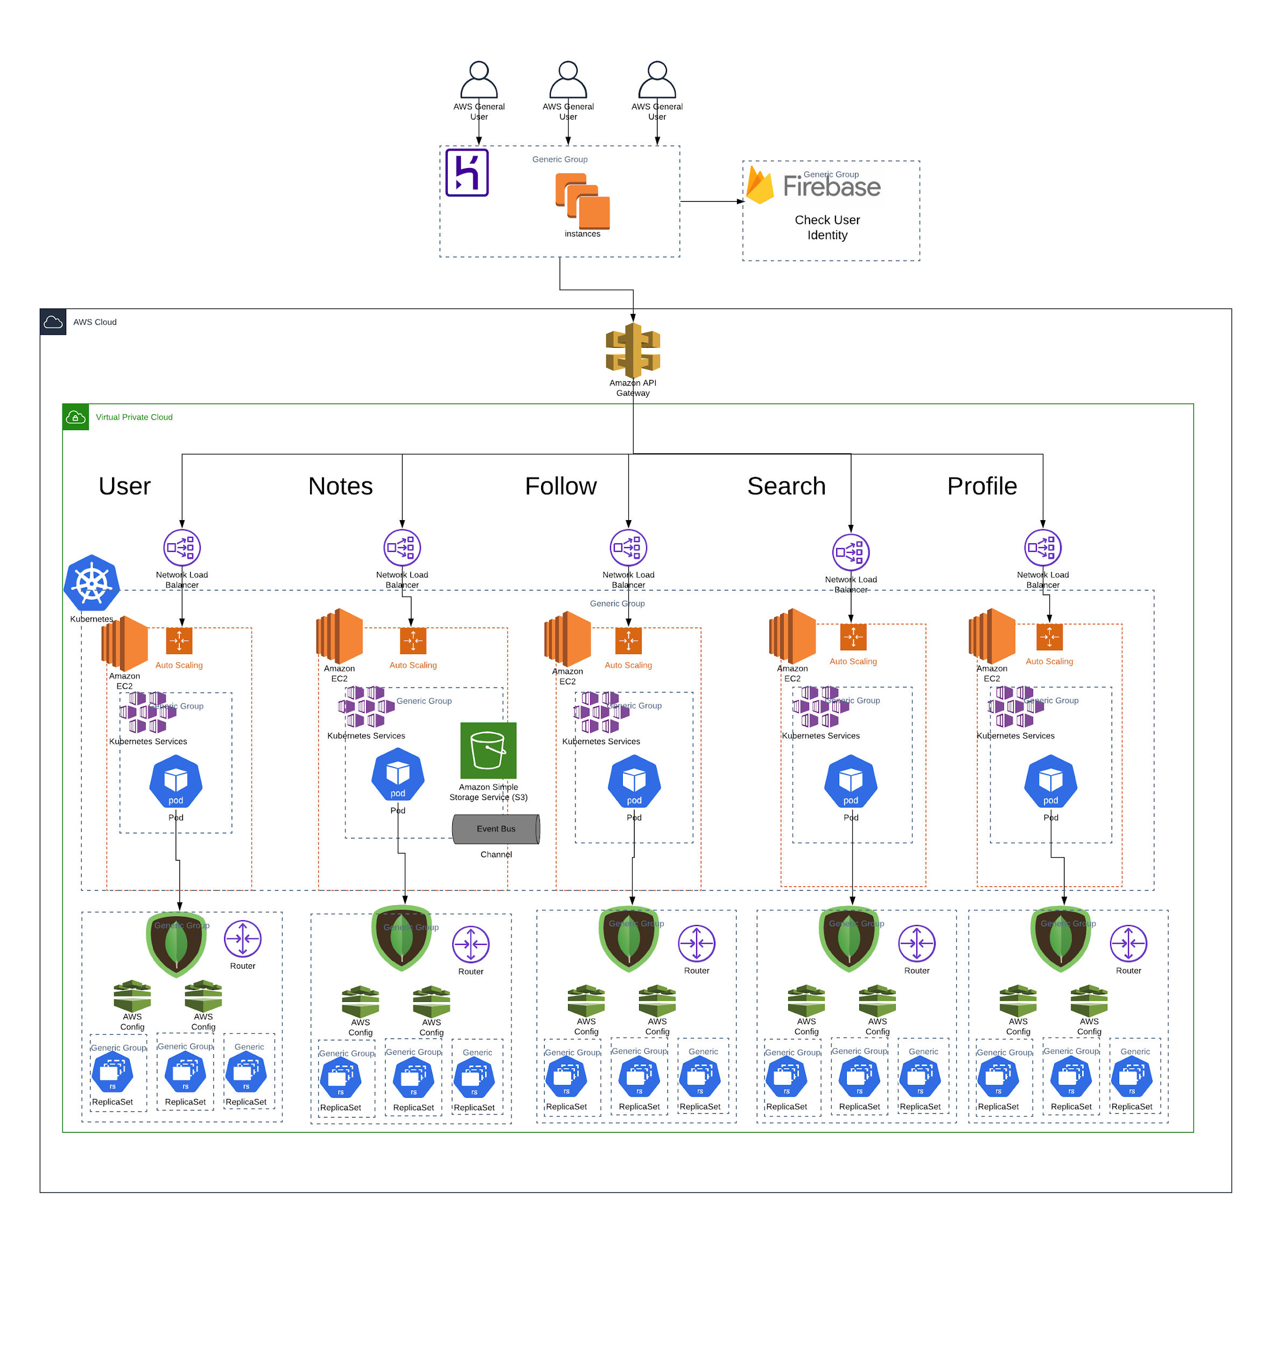
Architecture
Heroku
MongoDB Cluster
Firebase
Docker
Kubernetes
Amazon S3
AWS API Gateaway
AWS Network Load Balancer
VPC Peering
Prometheus & Grafana

Slide 6
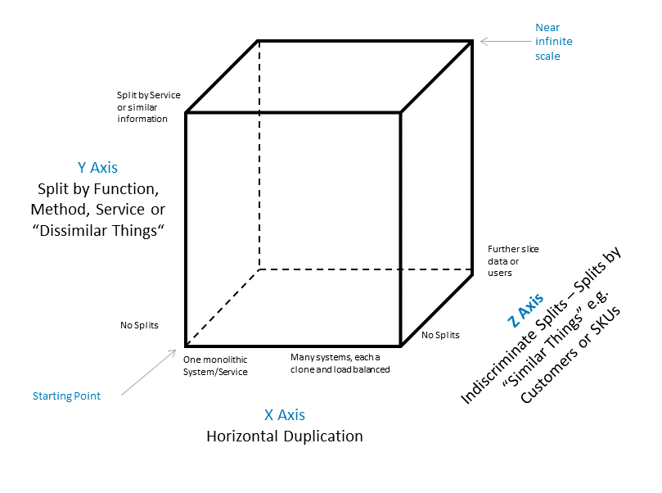
AFK Scale Cube
X axis
Network load balancer provided by deployment kind in the kubernetes
Y axis
Decoupled microservices and deployed as separate kubernetes services
Z axis
Database sharding for all the microservices

Slide 7
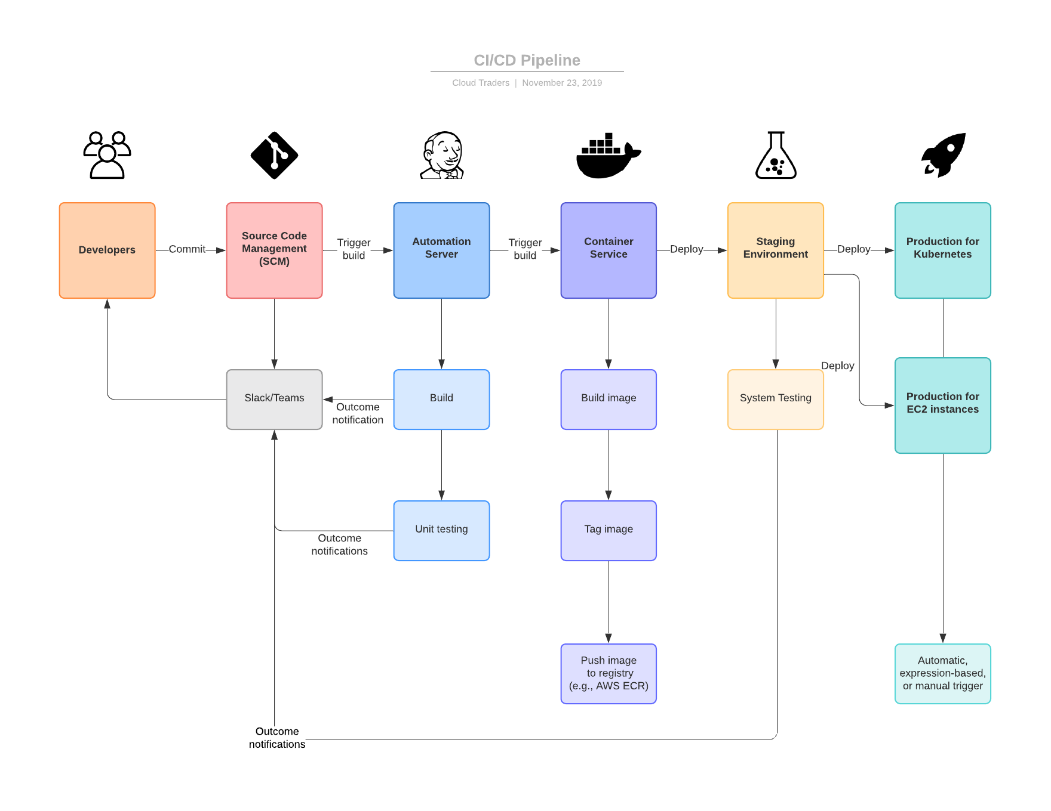
CI/CD Pipeline - Jenkins

Slide 8
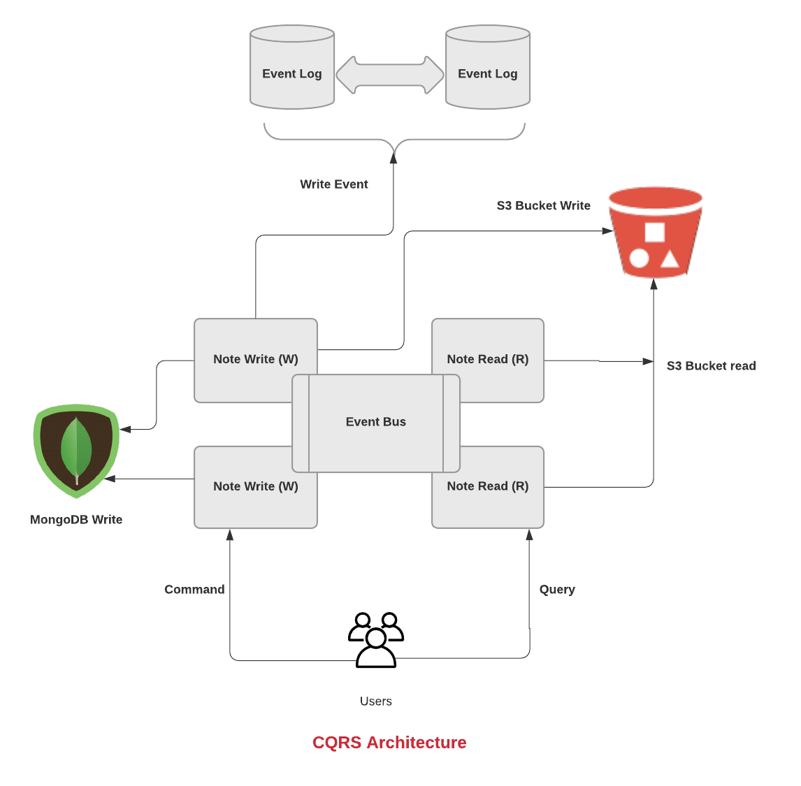
CQRS Pattern

Slide 9
Challenges
Adding CQRS to a domain that doesn’t have much difference between read and write, increases the complexity of the application and the events handling a little tedious.
Using JenkinsX to build code pipeline to directly deploy to kubernetes cluster
Assigning external IP to Kubernetes service. We use the type LoadBalancer in the service yaml file to generate

Slide 10
Thank You

