Slide 1
NoteShare
Group Project Presentation
CMPE 281
Team - Cloud Traders

Slide 2
Team Members
Laxmikant Bhaskar Pandhare(013859989)
Prachi Chouksey(013828945)
Ruchika Hazariwal(013728923)
Sai Manvith(013848211)
Suyash Srivastava(013591474)

Slide 3
App Features and description
Users - Register and login user
Notes - Add and view your notes
Profile - View and update profile
Search - Search other users and view their notes
Follow - Follow/Unfollow other users

Slide 4
DEMO

Slide 5
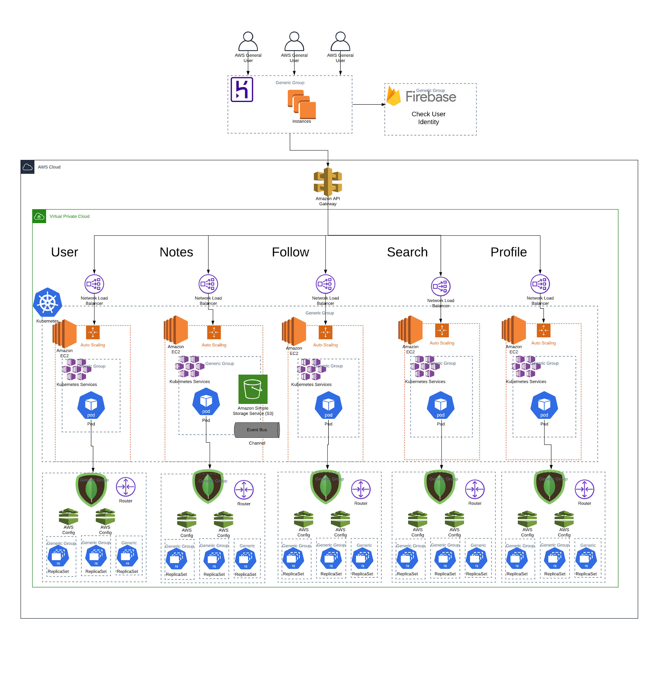
Architecture
Heroku
MongoDB Cluster
Firebase
Docker
Kubernetes
Amazon S3
AWS API Gateaway
AWS Network Load Balancer
VPC Peering
Prometheus & Grafana

Slide 6
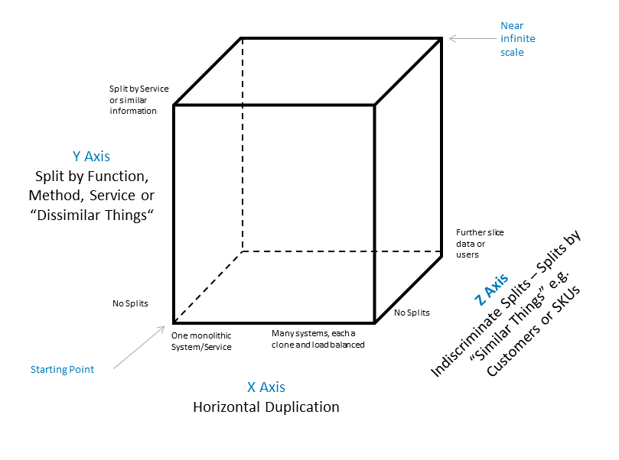
AFK Scale Cube
X axis
Network load balancer provided by deployment kind in the kubernetes
Y axis
Decoupled microservices and deployed as separate kubernetes services
Z axis
Database sharding for all the microservices

Slide 7
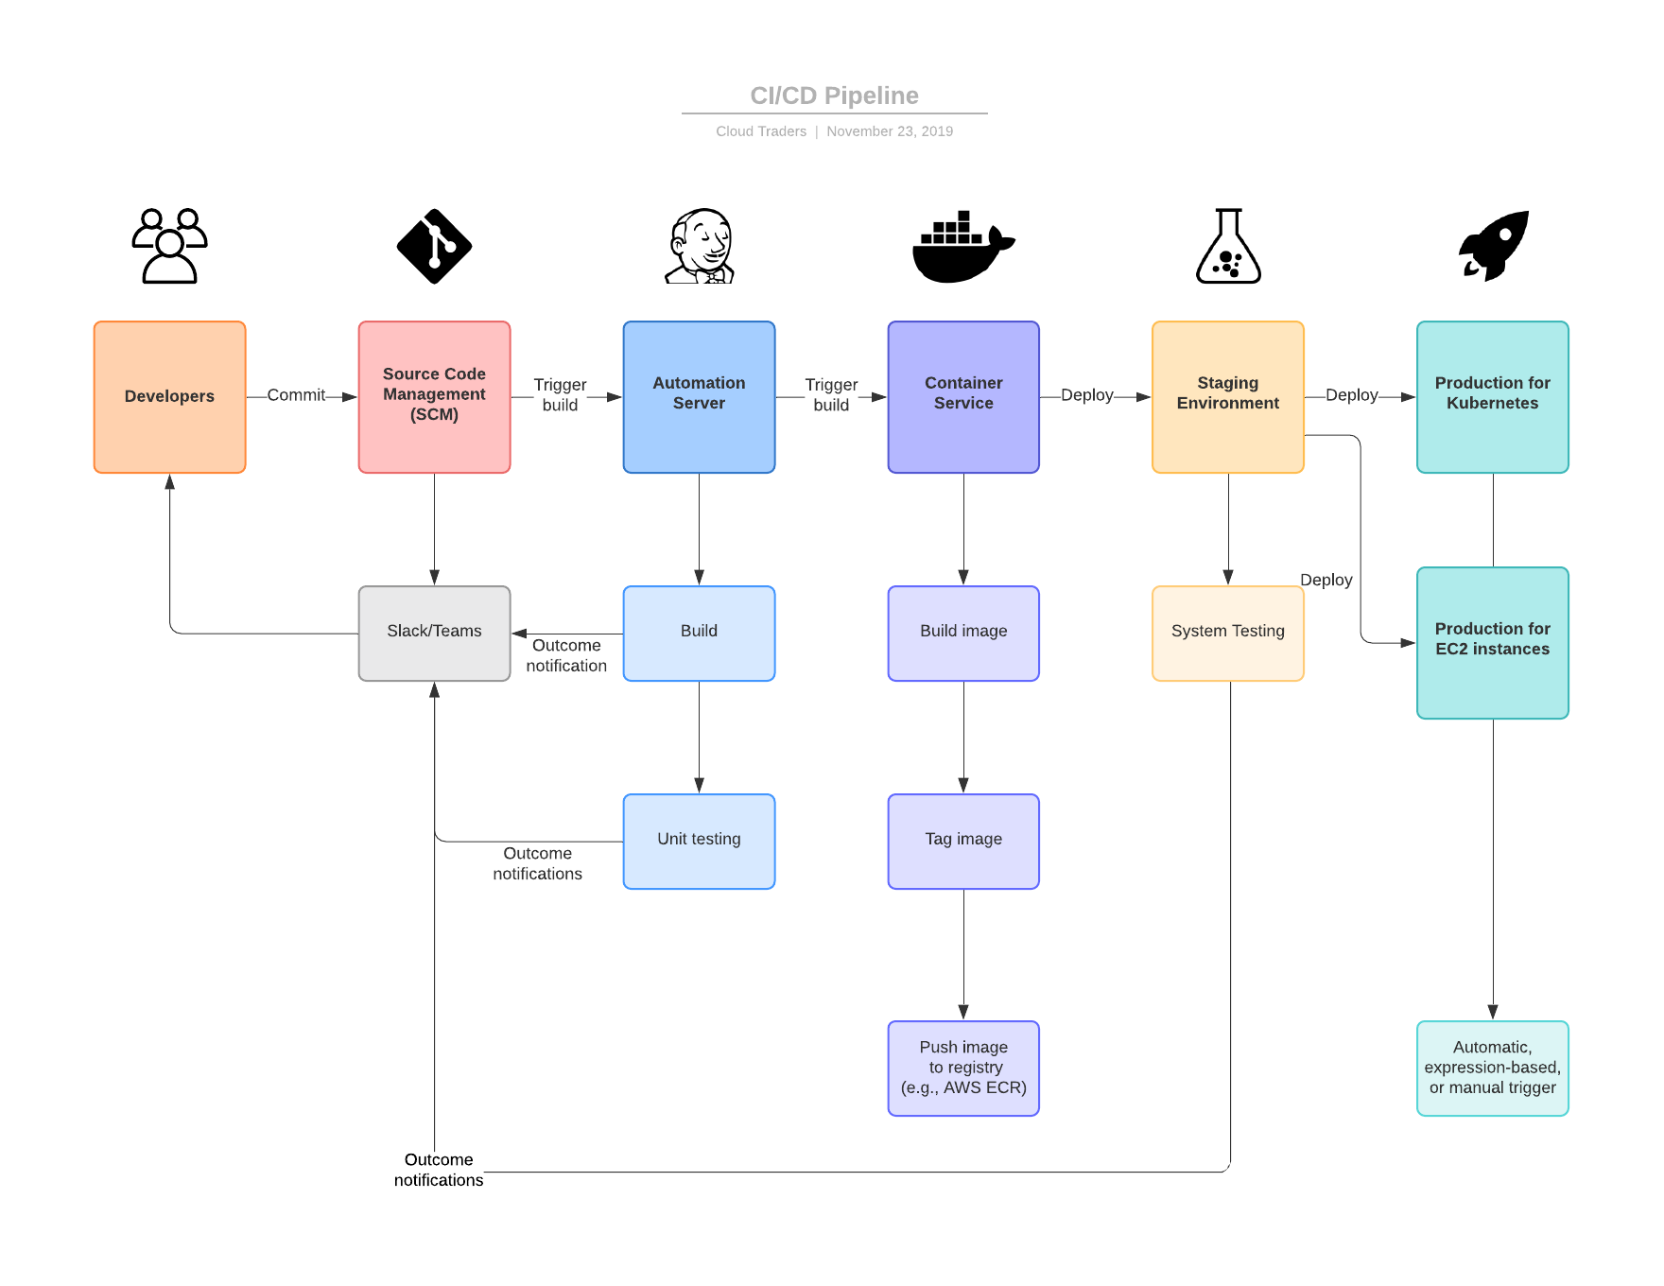
CI/CD Pipeline - Jenkins

Slide 8
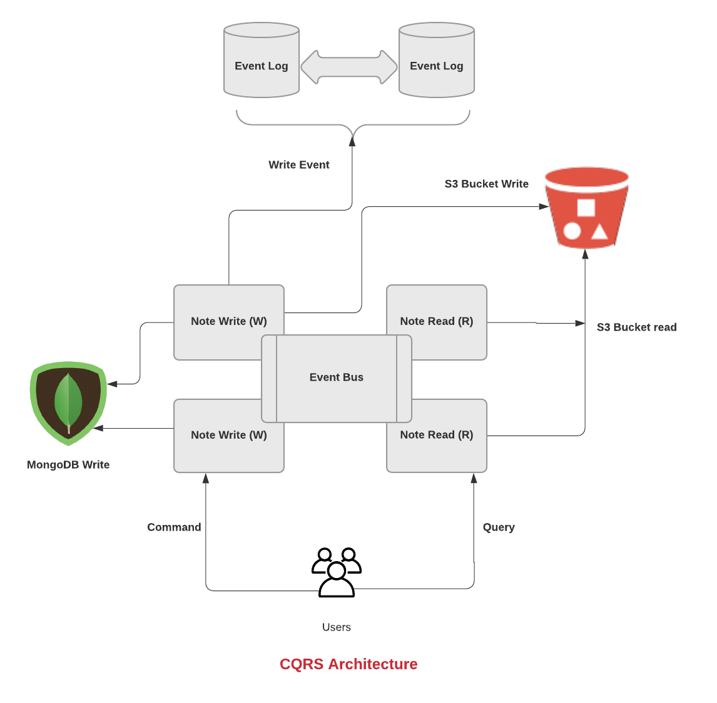
CQRS Pattern
The NoteShare application has been split into one part that handles all the writing and one that handles all the reading. This is usually done through Command and Query messages/objects.
Creating Notes: API interface receives the request and converts the payload to a CommandMessage and passes it on to the responsible command handler. The handler creates an event, and then persists it to the eventlog. The eventbus is then notified of the event and publishes it to all listeners of that type of event.
Reading Notes: API interface receives the request and handles the event using event handler. The JSON file for all the notes is read from the s3 bucket and rendered at client side. User is able to view all the notes.

Slide 9
Challenges
Adding CQRS to a domain that doesn’t have much difference between read and write, increases the complexity of the application and the events handling a little tedious.
Using JenkinsX to build code pipeline to directly deploy to kubernetes cluster
Assigning external IP to Kubernetes service. We use the type LoadBalancer in the service yaml file to generate

Slide 10
Thank You

