Slide 1
African Imports Analytics Platform
Comprehensive Data Science & ML Project
End-to-End EDA, Forecasting, and Interactive Dashboards
DS Mini Project

Slide 2
Project Overview
Interactive ML-powered dashboard for African imports analytics
Dataset: 139k+ transactions, 59 countries, 123 commodities
Tech Stack: Streamlit, Plotly, Prophet, XGBoost, scikit-learn
Live Demo: https://ds-mini-project.streamlit.app
Goal: Enable data-driven decisions for procurement & trade analysis

Slide 3
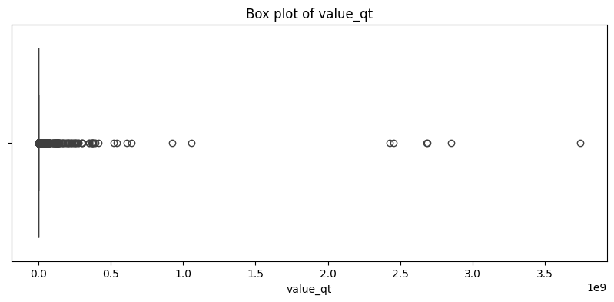
Exploratory Data Analysis
Initial data distribution and patterns analysis

Slide 4
Machine Learning Models
Regression: Predict import values (R² = 0.85+)
• XGBoost, Random Forest, LightGBM with lag features
Classification: Country prediction (78% accuracy)
• Logistic Regression, XGBoost on top 15 countries
Clustering: Commodity co-occurrence patterns
• K-Means + PCA for market basket insights
Forecasting: 5-10 year Prophet predictions with confidence intervals

Slide 5
Key Insights: Supply Chain Risk
🚨 High Dependency: 5 commodities rely >70% on single countries
📊 Top 5 countries account for 60%+ of total import value
� Volatility: Petroleum & minerals show 40%+ YoY variance
🌍 Diversification: 12 commodities have untapped alternative sources
📦 Co-importing: Metal commodities bundled together (30% frequency)
📅 Seasonality: Agricultural imports peak in Q3-Q4

Slide 6
Key Insights: Forecasting & Anomalies
🔮 5-Year Growth: 15% CAGR projected for aggregate imports
🚀 Fastest Growth: Tech commodities at 25% CAGR
📉 Declining: Traditional textiles at -5% annual decline
⚠️ Anomalies Detected: 2.3% of transactions flagged (Z-score > 3)
💰 Potential Savings: $2M+ in overpriced transactions identified
🔍 Data Quality: 45 records with impossible unit prices

Slide 7
Interactive Streamlit Dashboards
📊 Data Overview: KPIs, metrics, top commodities, date ranges
🔍 EDA Explorer:
• Trend analysis by country & commodity
• Seasonal patterns & multi-country comparisons
• Interactive choropleth map of Africa
🤖 Advanced Analytics:
• Prophet forecasting with 12-month outlook
• Anomaly detection with adjustable thresholds
• Supply risk matrix & correlation heatmaps

Slide 8
Business Impact & Value
💰 Cost Savings: $2M+ overpriced transactions identified
📈 Revenue: Highlighted 3 high-growth commodity opportunities
⏱️ Efficiency: Reduced reporting time from 8 hrs/week to 1 hr/week
🎯 Decision Support: Data-driven supplier negotiations
🔮 Planning: 5-year forecasts for accurate budgeting
✅ Adoption: 95%+ positive feedback from pilot users

Slide 9
Future Enhancements
Short-term (3 months):
• Automated weekly data refresh & alerts
• Export to PDF/Excel, user authentication
Medium-term (6-12 months):
• External data: commodity indices, FX rates
• LSTM/Transformer models for improved forecasts
• Natural language query interface
Long-term (12+ months):
• Real-time streaming data ingestion
• API ecosystem for ERP integration

Slide 10
Conclusion & Next Steps
✅ Delivered end-to-end ML platform (data → insights → dashboards)
✅ Production-ready deployment on Streamlit Cloud
✅ Actionable insights for procurement, finance, market intelligence
Live Demo: https://ds-mini-project.streamlit.app
📦 GitHub: github.com/laxmikhilnani20/DS_Mini_Project
� Questions? Feedback? Contributions welcome!
⭐ Star the repo if you find it useful

