Slide 1


WELCOME
TECHNOLOGIES PRIVATE LIMITED

Slide 2


COMPANY OVERVIEW

Slide 3
THIS SESSION
CTPL Technical Skills and Experiences
CTPL Commercial & Background Strengths
Focus on Industries

Slide 4
TECHNICAL SESSION
Introduction
CTPL Team Expertise
CTPL Teams (Core & Execution)
CTPL Quality Policy
General Process Flow
CTPL Project Expereinces & Case Studies
Process Flows
Application Team Devlopments

Slide 5
TECHNICAL SESSION
INTRODUCTION
CTPL Has Initiated and implementing the Technical Team to provide
  RFP study,
  Technical Bidding support,
  Sample data Preparation,
  Process, Research & Application Development and
  Guidance to where an operational Quality policy or Improvement in efficiency is required i.e. Technical Team will advise on what to do and the best way to carry out that advice.

Slide 6
TECHNICAL SESSION
EXPERTISE
AutoDesk-Products
  AutoCAD R5, 12 & 2000 ,
  Map-2005
  Map 2010 and
  CAD overlay
  BENTLY –Products
  Micro station 5, 95 ,V8 & SE
  IRASB
  IRASC and
  Sewer GEMS V8 XM

Slide 7
TECHNICAL SESSION
EXPERTISE
  GE-Product
    GE-SmallWorld3.0.0
    GE-SmallWorld4.0.0 and
    GE-Small World PNI
ESRI-Products
  Arc View,
  Arc FM,
  Arc info and
  Arc GIS

Slide 8
TECHNICAL SESSION
EXPERTISE
Photogrammetry –Products
  Summit PC and Evaluation (DATEM)
  Virtuzont 3.2.5
  SSK -ZI Imaging
  DVP
Map Info – PB Products

Slide 9
TECHNICAL SESSION
EXPERTISE
Erdas Imagine
Lidar Point
  Terra Scan
  Terra Model
  Data Base-Products
  Oracle
  Oracle Spatial and
  MsAcess

Slide 10
TECHNICAL SESSION
EXPERTISE
  Development
  Autolisp,
  VBA,
  ESRIArcObjects,
  Magic
  MDL Development
  Arc SDE
  Arc Server and
  Open GIS Required Developments
  Having Excellent experience in GIS projects like: Spatial Reposition, Utility Mapping, Road Network, Parcel Mapping, PID Drawings, Telecom, Gas ,Electrical Utilities, Topo Mappings And Navigation charts.

Slide 11
TECHNICAL SESSION
TEAMS
  CORE TEAM
  Core team has 4 member team with different expertises in Most of GIS projects. This team taking care to Intiate and make smooth flow of work then passing to Execution Team.
  EXCUTION TEAM
  Excution team contain groupe of team members with Leads and Manager to make Ontime Deliveries and to meet CTPL Quality Policy with Out fail.

Slide 12
TECHNICAL SESSION
QUALITY POLICY
  We have commited to exceed customer satisfaction by providing excellent quality In CAD/GIS,IT services our processes are aligned to seek continual improvement in response to changing customer needs and evolving industry standards.

Slide 13
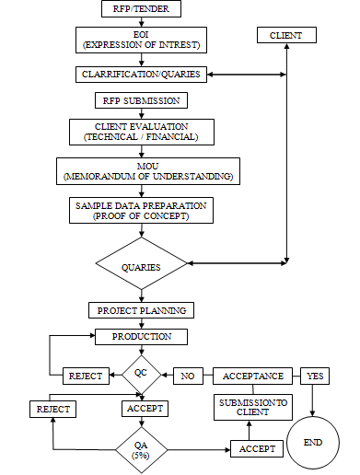
TECHNICAL SESSION
GENARAL PROCESS FLOW

Slide 14
TECHNICAL SESSION
Project Expereinces
  RAPDRP
  Clutter Classification
  DEM Landuse Vector Creation
  Land Base Creation
  Satellite Image Classification
  Traffic Lighting
  Sewer Collection Network

Slide 15
TECHNICAL SESSION
Project Expereinces
  Electrical Distribution Network
  Gas Distribution Network
  Telecom Cable Network
  OFC Route Tracing

Slide 16
TECHNICAL SESSION
Case Studies
  RAPDRP
  Clutter Classification
  DEM Landuse Vector Creation
  Land Base Creation
  Sewer Network

Slide 17
TECHNICAL SESSION
Process Flows
  RAPDRP
  RCY-Integrated Utility Network Information Management System
  GaS Network

Slide 18
TECHNICAL SESSION
Application Devlopments
  ESRI
    Creating the PDF plots for different scales
    Creating Lines between two Points
    Service Line Genaration Between Pole to Consumer Point.
  Auto Desk
    Intersections
    Convert Spline to Poly Line
    Insert and Delete vertex

Slide 19
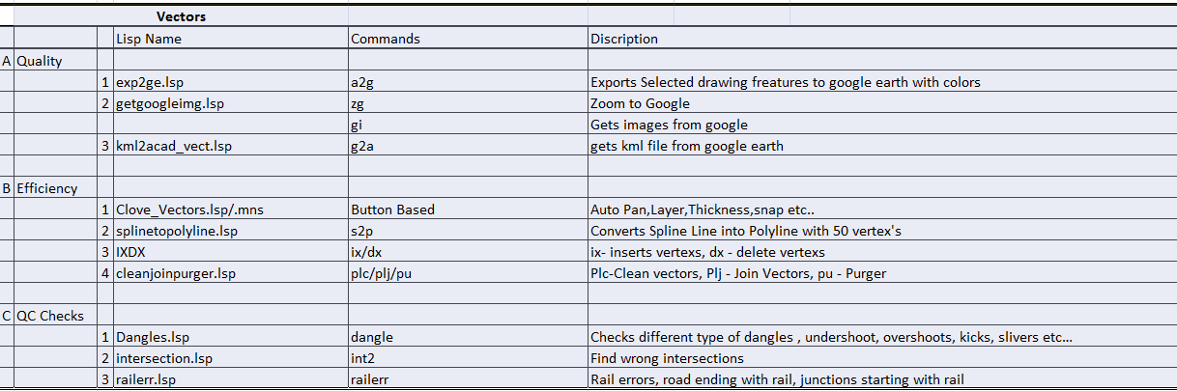
TECHNICAL SESSION
Application Devlopments

Slide 20
COMMERIAL SESSION
Board of Directors
1) Gopi Krishna.Lagisetti
2) Rajya laxmi.Lagisetti
3) Siva Guru.Lagisetti
4) Eshwariah.Gubba
5) Padmaja.Kamisetti
6) Harish Kumar.Bilakanti

Slide 21
COMMERIAL SESSION
Board of Directors
1) Gopi Krishna.Lagisetti:
Having More than 17 Years of Experinece in the feild of CAD,GIS,Photogrammetry and Remotesensing.
Worked with Infotech,Avineon and RMSI
Responsible for Techo commerical.

Slide 22
COMMERIAL SESSION
Board of Directors
2) Rajya laxmi.Lagisetti :
Completed Bachelor of Engineering and Intiated to Form this Organistion.
Taking care of Production department on Textile industry located in Hyderabad
She is responsible for HR.

Slide 23
COMMERIAL SESSION
Board of Directors
3) Siva Guru.Lagisetti :
Completed Bachelor of Arts and He is Taking care of Geo Tourisum business devlopment.
He Is Non executive director .

Slide 24
COMMERIAL SESSION
Board of Directors
4) Eshwariah.Gubba :
Completed Bachelor of Commerce.
Managing Director For Textile Industry.

Slide 25
COMMERIAL SESSION
Board of Directors
5) Padmaja.Kamisetti::
Completed Bachelor of Civil Engineering .
Responsible for Indo Russian Diffence Projects.

Slide 26
COMMERIAL SESSION
Board of Directors
6) Harish Kumar.Bilakanti
Completed Masters in Business Administration.
He has worked with Ing-Vysya bank.
He is responsible for International Corporate communications.

Slide 27
COMMERIAL SESSION
Financial Back Grounds
1) Textile Industries in
a) Delhi
b) Hyderabad
c) Rajasthan
For Manufactures of Tie Cloths and Schooling Materials like Belts,Socks and Bags etc. with Turn over of 3.0 to 3.5 Crore

Slide 28
COMMERIAL SESSION
Financial Back Grounds
2) Transport and Geo Tourisum
Having Local Trasporation Business and Tourisum business for Domestic travellers like South India and North India Packages.

Slide 29
COMMERIAL SESSION
Financial Back Grounds
3) Rice Millers
Having Milling Industries with turnover of 1.5 to 2.0 Crore

Slide 30
FOCUS ON INDUSTRIES
CLICK HERE

Slide 31
THANK YOU
TECHNOLOGIES PRIVATE LIMITED

