Slide 1

DOCINSIGHT
- Informed Doctor Selection
Navya Sree Arugonda (U58747657)
Laxmi Pranitha Sareddy (U28892205)
Venkata Naga Sai Vyshnavi Kurivella (U70370821)

Slide 2

INTRODUCTION
PROBLEM STATEMENT
OBJECTIVE/FOCUS
CONSIDERATIONS
FEATURES
DATA COLLECTION
DATA VISUALIZATION
CHALLENGES
SHORT TERM GOALS
LONG TERM GOALS
WEB FRAMES
CONCLUSION
TABLE OF CONTENTS

Slide 3

INTRODUCTION
Overview of Healthcare Decision-Making Challenge.
Importance of Informed Choices.
Role of DocInsight.

Slide 4
PROBLEM STATEMENT
Limited Information
Uninformed Decisions
Lack of Transparency
Risk of Suboptimal Care

Slide 5
OBJECTIVE / FOCUS
To create a comprehensive platform for individuals seeking healthcare services that aggregates detailed information about doctors.
Aggregating Data on Doctors
Visualizing Data for Informed Decisions
Chosen Constraints for Visualization

Slide 6
CONSIDERATIONS
Target Audience: Individuals seeking healthcare services
Importance of data accuracy and relevance
User-friendly design for ease of navigation

Slide 7
FEATURES
Search Filters: Specialization
Doctor Profiles: Detailed information, patient reviews, ratings
Data Visualization: Graphs depicting surgical outcomes, patient volume

Slide 8
DATA COLLECTION
Data Sources:
Professional Background: Education, years of experience.
Patient Reviews: Feedback from patients about their experiences.
Surgical Outcomes: Number of surgeries, success rates categorized by difficulty levels.
Data Integrity:
Ensuring accurate and up-to-date information from reliable sources.

Slide 9
DATA VISUALIZATION
Data Presentation:
Graphs: Visualize surgical outcomes and success rates.
Charts: Display patient reviews and ratings.
User-Friendly Interfaces: Easy-to-navigate design for data interpretation.
Customization:
Filters: Allow users to customize data based on preferences (specialty).
Interactivity: Enable interactive elements for dynamic data exploration.

Slide 10
DEVICES: Mobile, Laptop
STUDY DESIGN : Cross-Sectional Study Design

Slide 11
CHALLENGES
Data Integrity: Ensuring accurate and up-to-date information
User Adoption: Encouraging users to utilize the platform for decision-making
Technical Implementation: Addressing scalability and performance issues

Slide 12

SHORT TERM GOALS
Enhancing Search Filters: Adding more criteria for refinement
Improving User Experience: Streamlining navigation and interface
Partnering with Healthcare Providers: Integrating real-time data feeds

Slide 13
LONG TERM GOALS
AI Integration: Implementing AI for personalized recommendations
Expansion: Scaling the platform to cover a broader range of healthcare services
Collaboration: Partnering with research institutions for data-driven insights

Slide 14
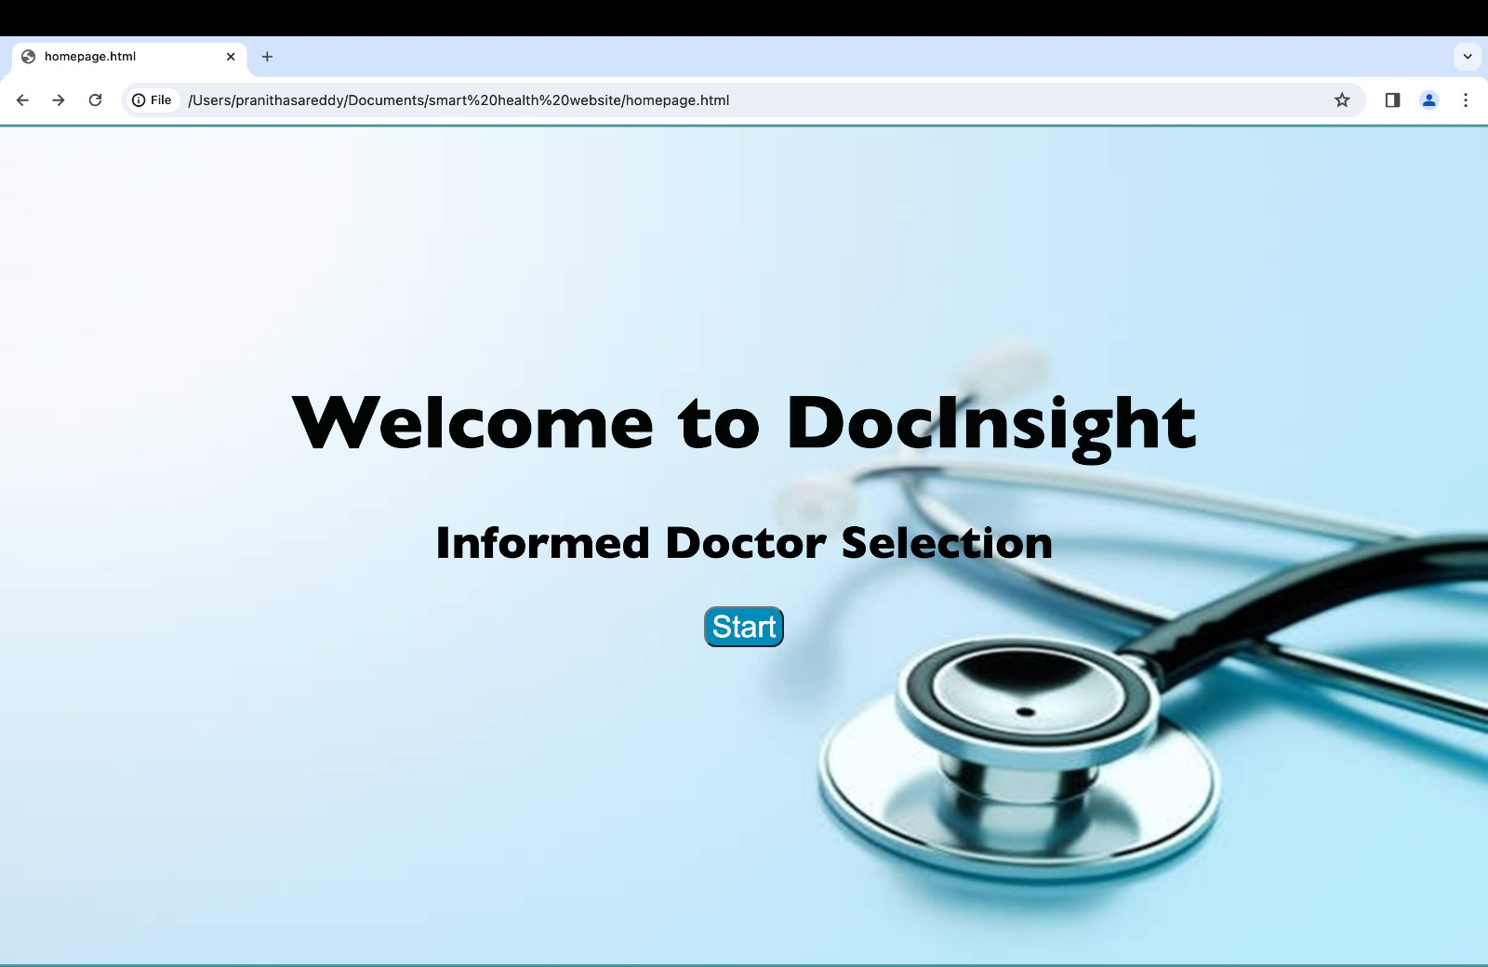
WEB FRAMES

Slide 15
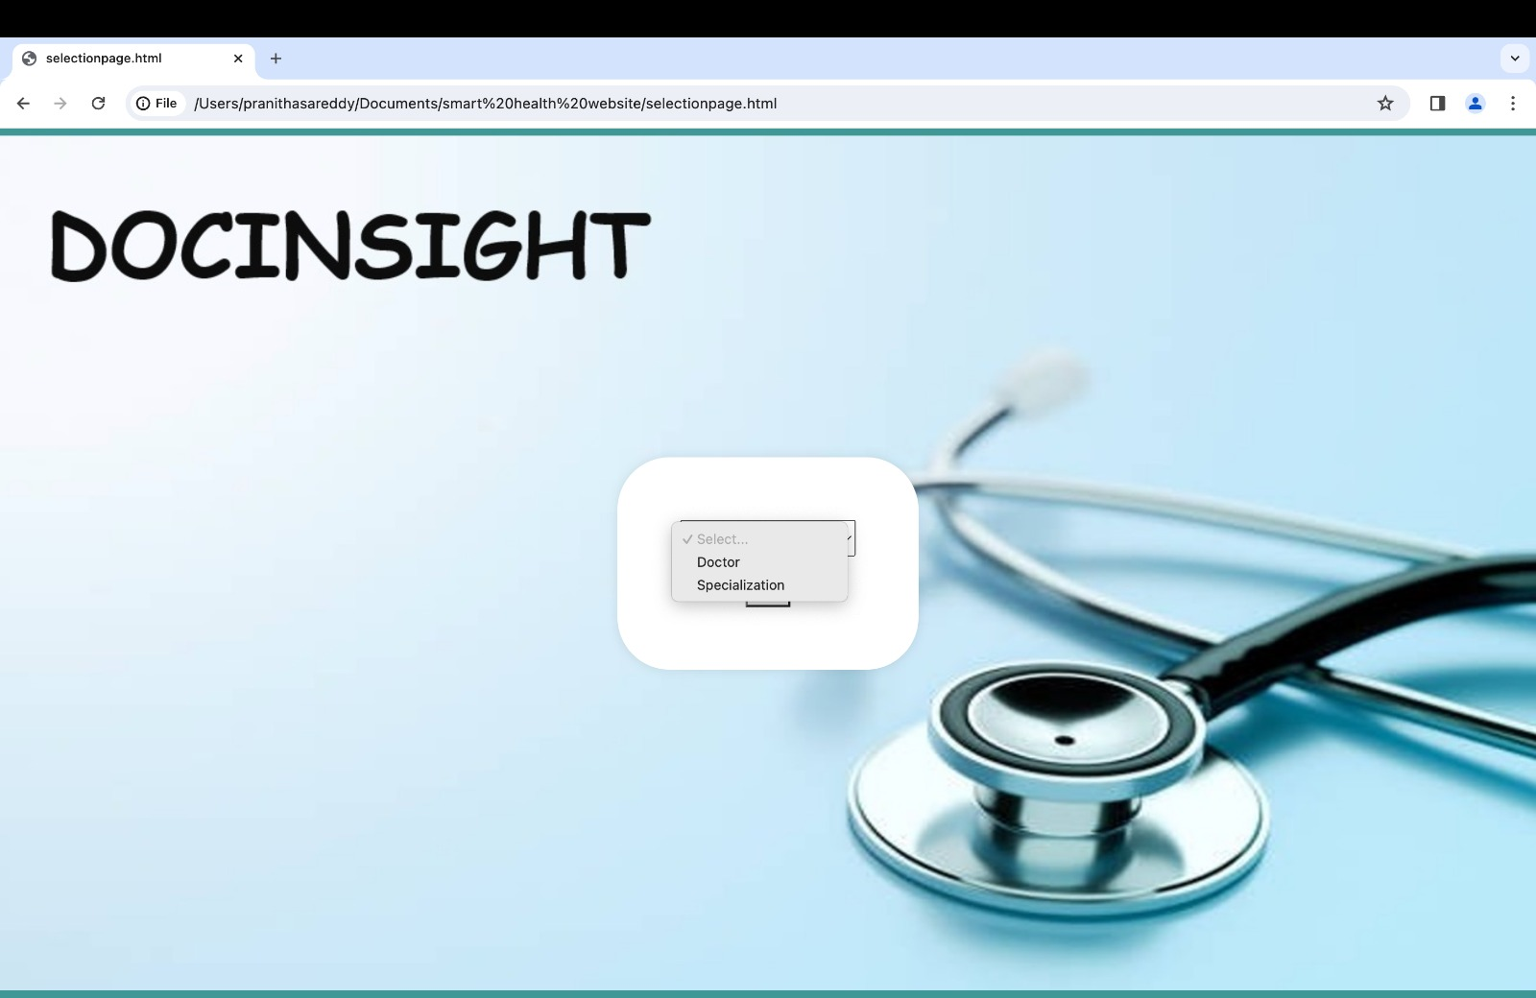
After selecting Start button:

Slide 16
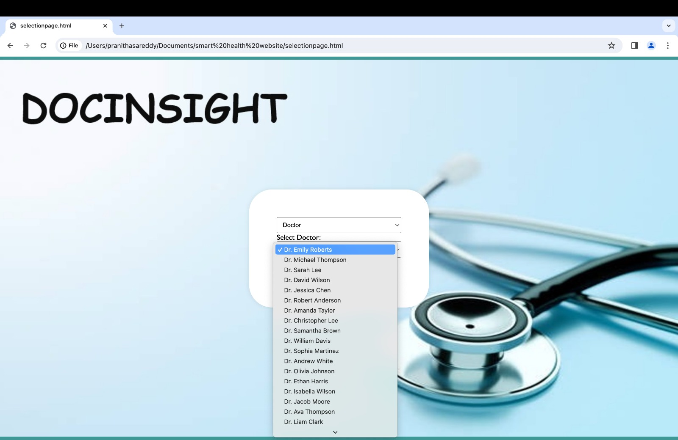
Selecting doctor option in the dropdown will provide another dropdown with doctors:

Slide 17
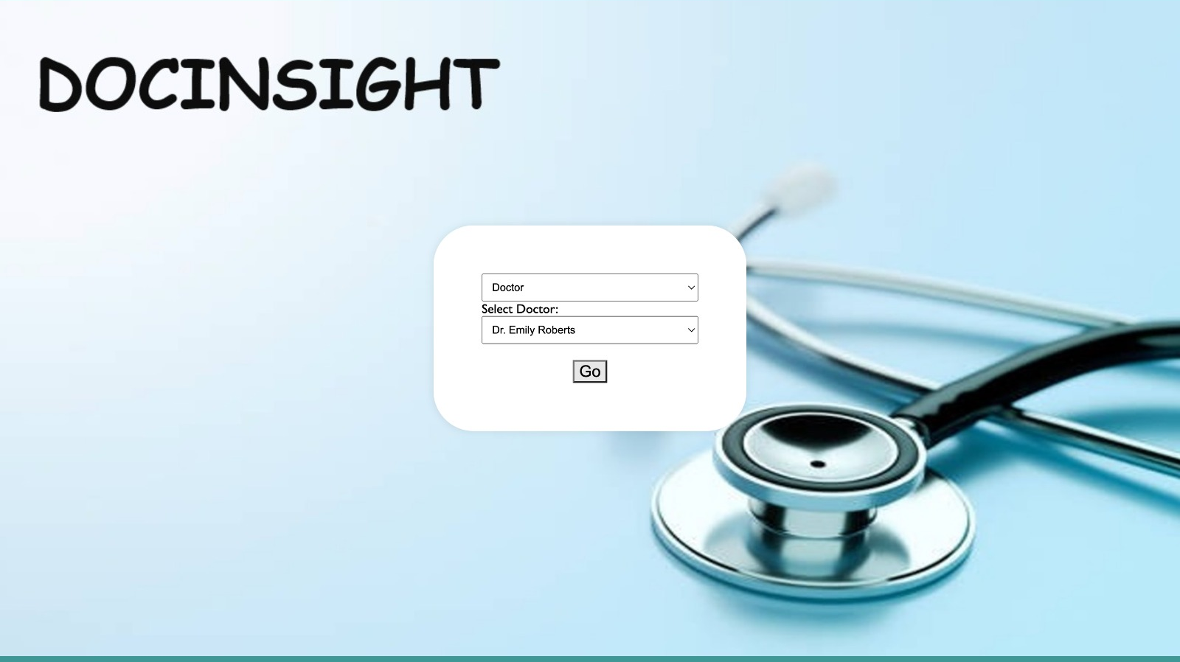

Slide 18
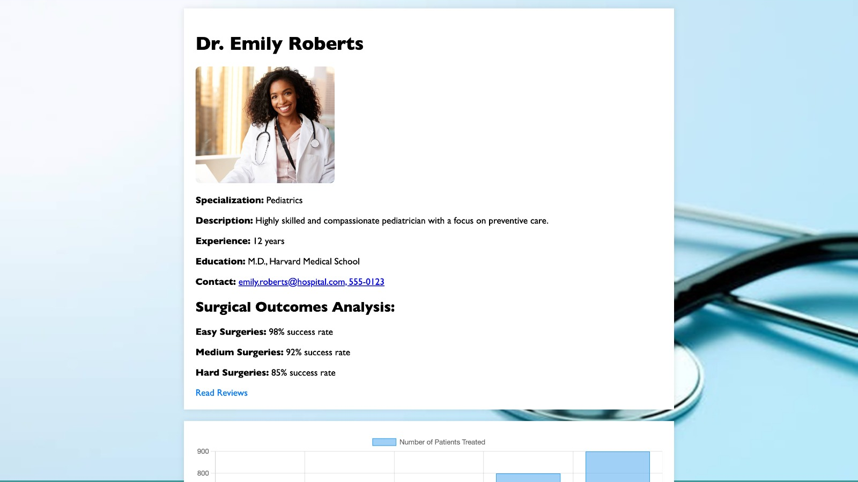

Slide 19
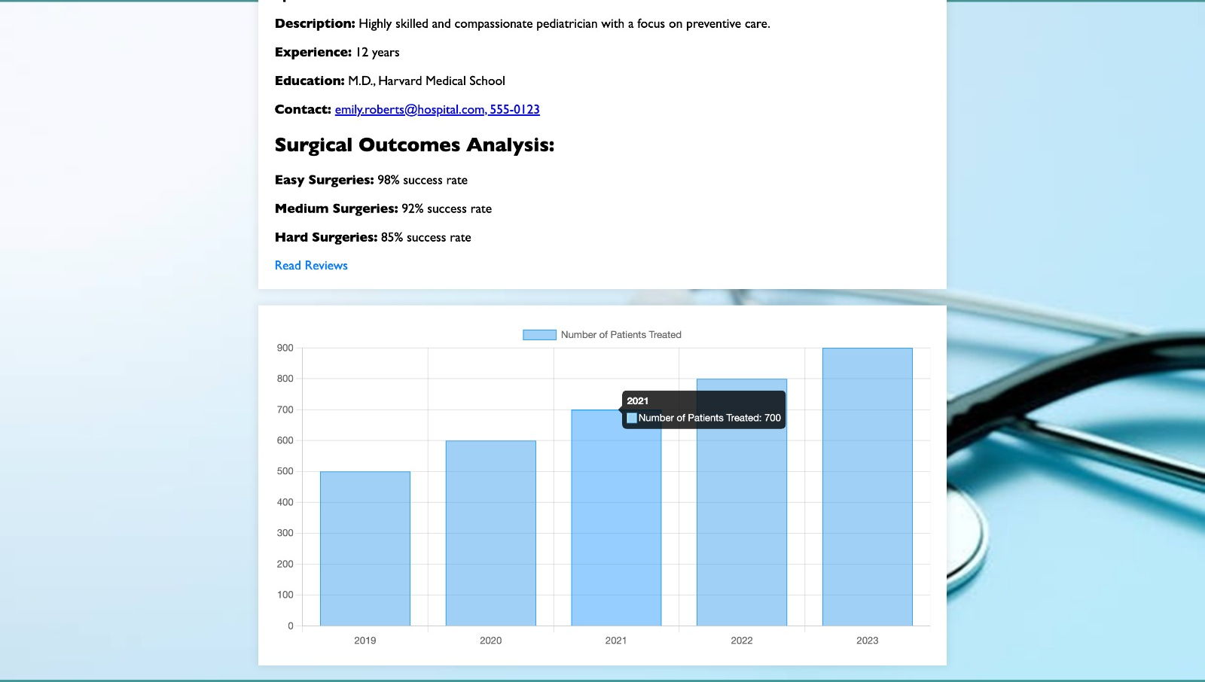

Slide 20
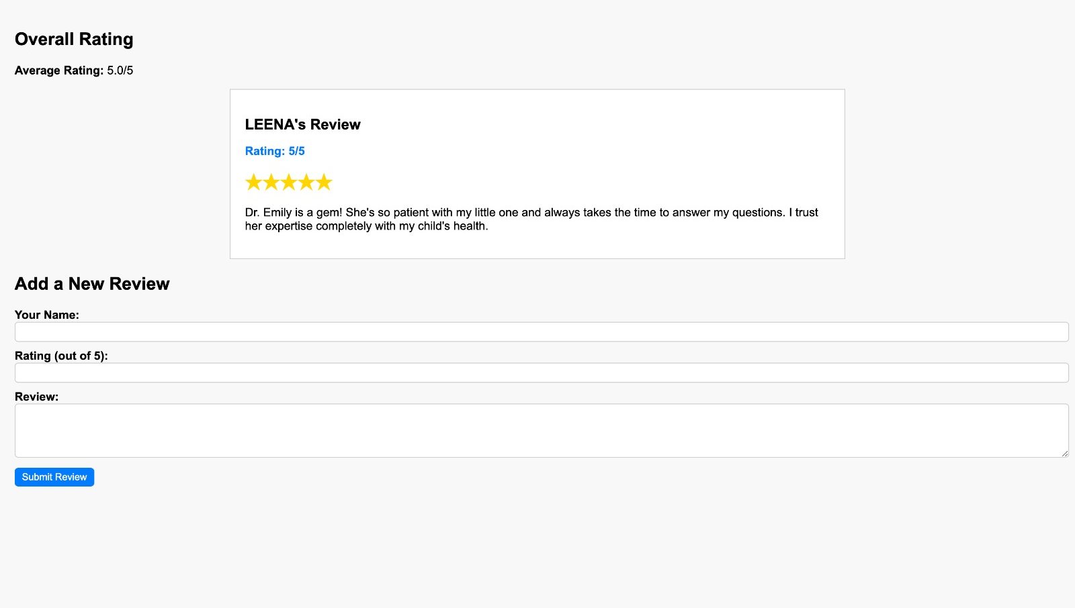

Slide 21


Slide 22
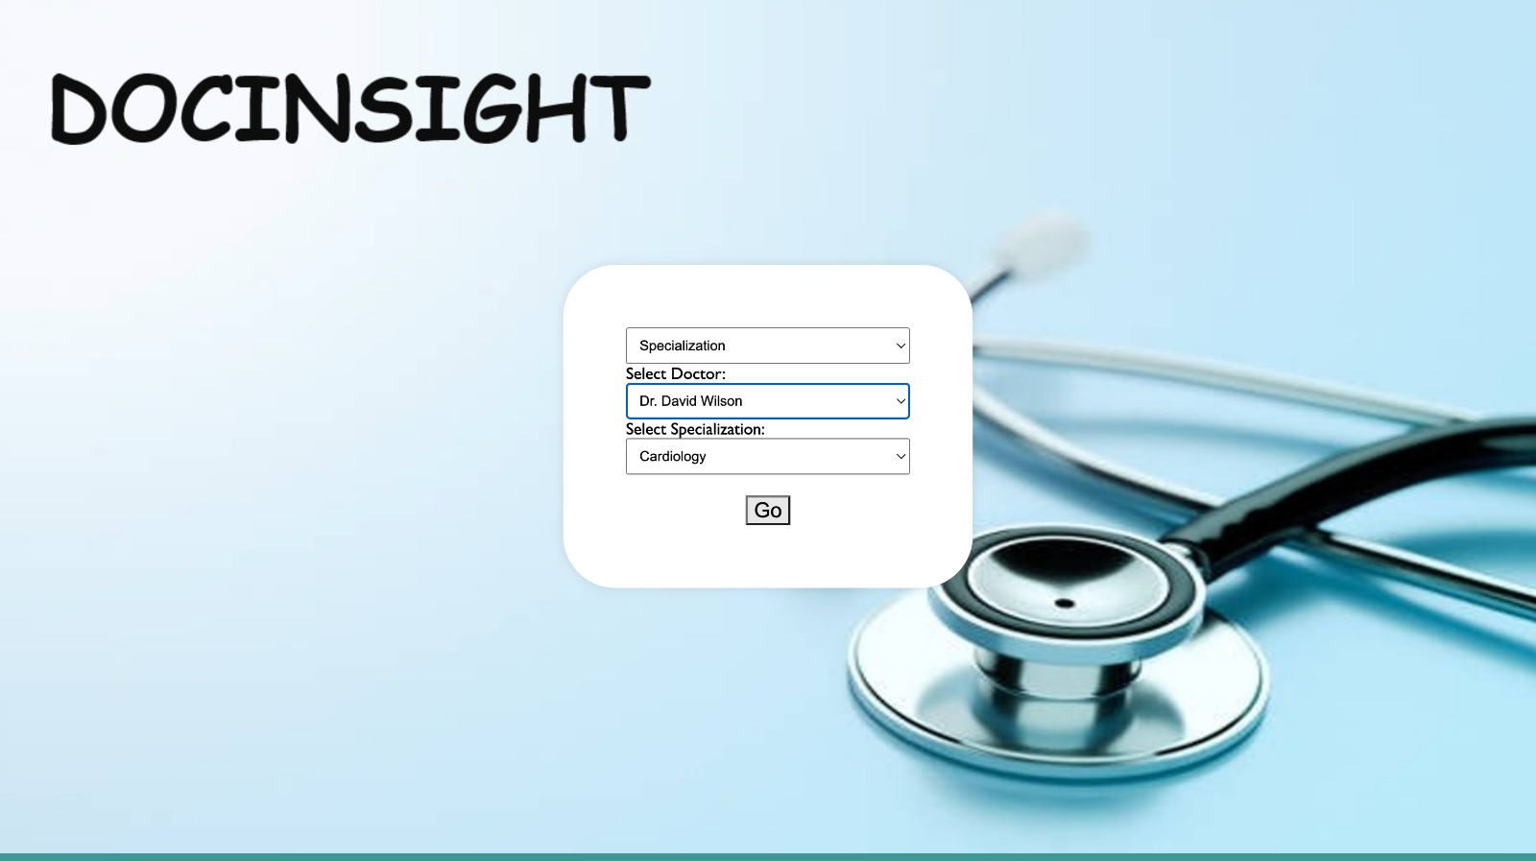

Slide 23
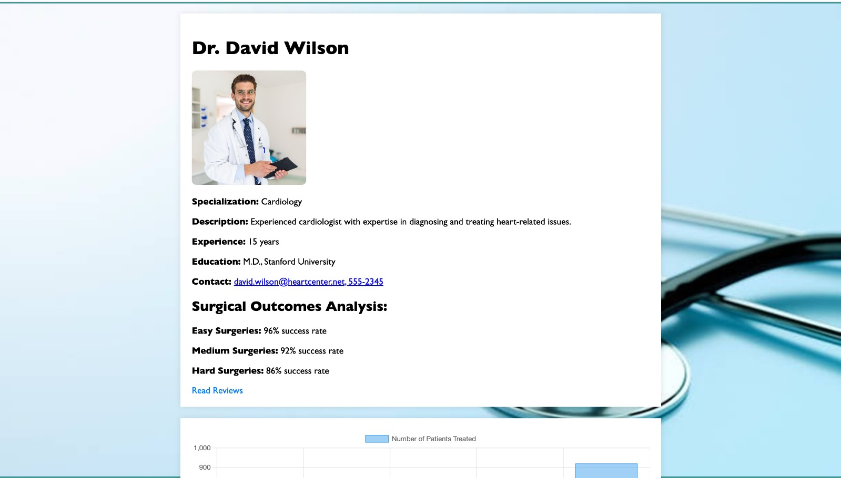

Slide 24
CONCLUSION
Empowering informed Healthcare decisions.
User-friendly interface and data visualization tools enable easy access and interpretation of information.
Continuous improvement and integration of real-time data feeds enhance healthcare quality and patient satisfaction.

Slide 25


