Slide 1
Car Selling Price Prediction using Car Details Dataset
Laxmiprasad Iyer
Email:coderedocbt@gmail.com
Mob:9920427809

Slide 2
GitHub Repository Link
https://github.com/laxmiprasad-iyer/data-science-capstone-project
Streamlit app cloud link
https://data-science-capstone-project-gaxwq7o84zuexkdzrj5v82.streamlit.app

Slide 3
Objective
To predict selling price of car from car details dataset. First, to perform EDA on the dataset and then ML Modelling with regression models. To evaluate multiple ML models and select the best model. To deploy a streamlit app to predict the selling price given the various fields.

Slide 4
Motivation
To understand the car details dataset using Excel
To perform EDA on the car details dataset using Python
To perform ML modelling for selling price using Linear Regression, Decision Tree Regression, KNN Regression, Ridge Regression, Lasso Regression, Bagging Regression and Boosting Regression
To evaluate the models and choose the best model
To deploy a web app for prediction by selecting multiple models

Slide 5
Steps
1. To understand the dataset using Excel
2. Data Preprocessing
3. EDA using python
4. Outlier Treatment
5. One Hot Encoding
6. Split data into X,y
7. Choose Train and Test datasets
8. Apply various ML Regression Models
9. Save the various models along with the best model

Slide 6
10. Sample 20 datapoints and store in sample.csv file
11. Load the best model and perform prediction on sample dataset
12. Create app.py file,requirements.txt
13. Upload the app.py, requirements.txt, pickle files to github repo
14. Deploy on streamlit cloud

Slide 7
Step 1
To understand the data using Excel

Slide 8
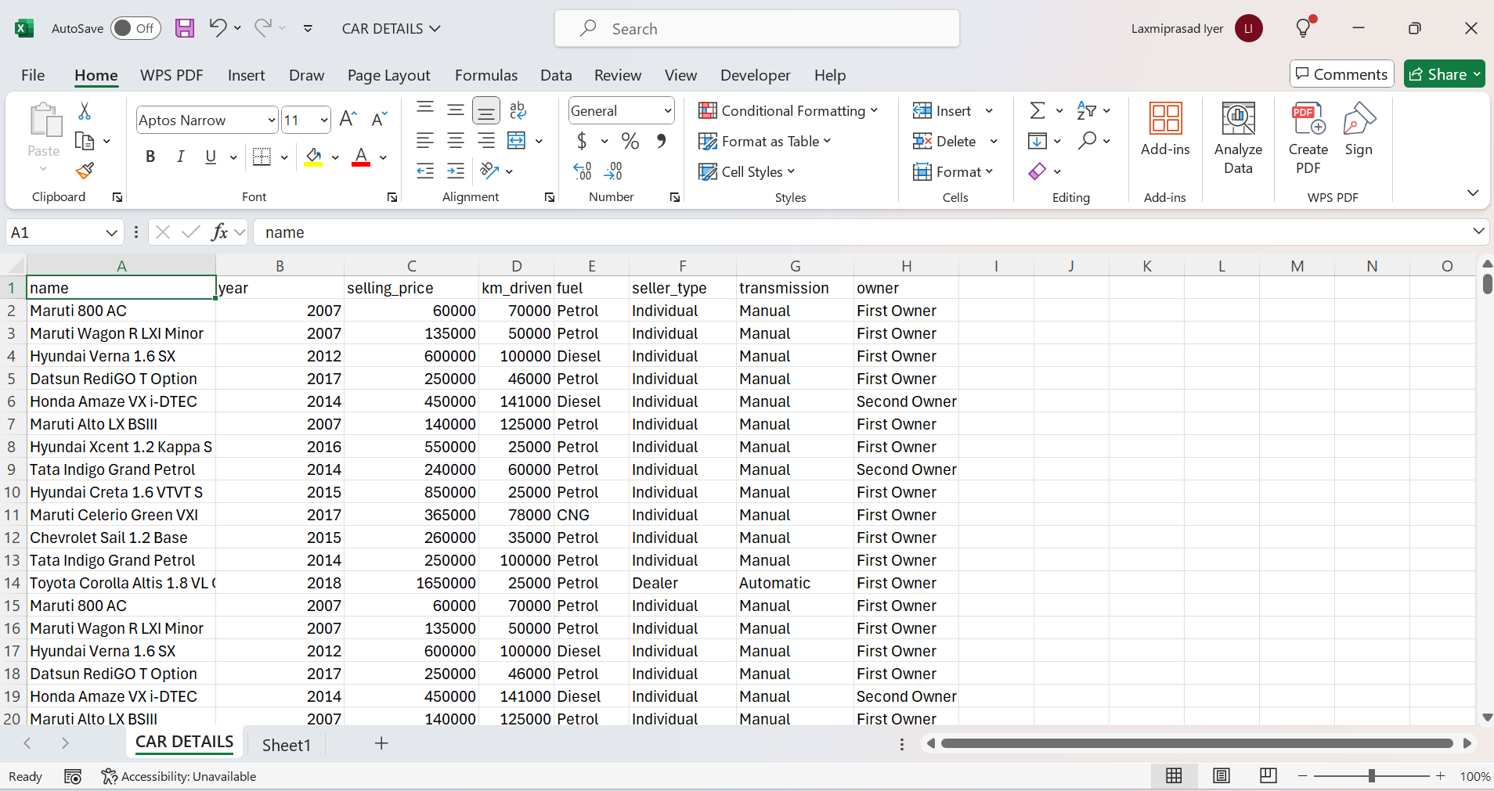
Open File in Excel

Slide 9
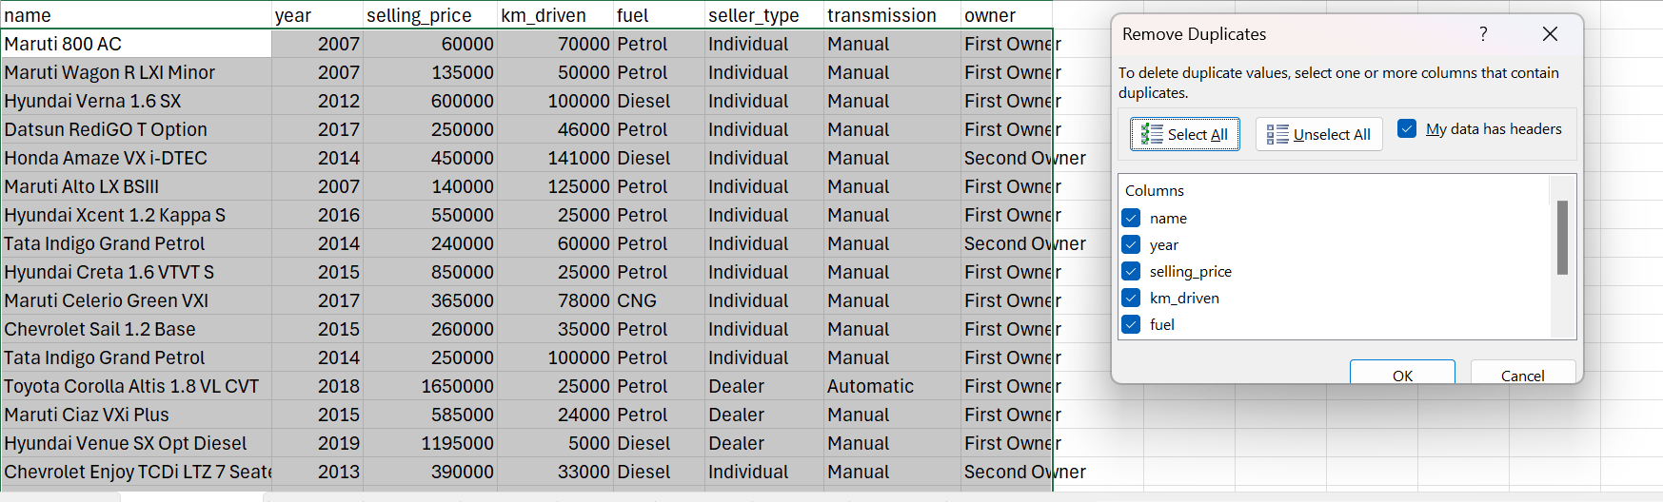
Remove duplicates

Slide 10
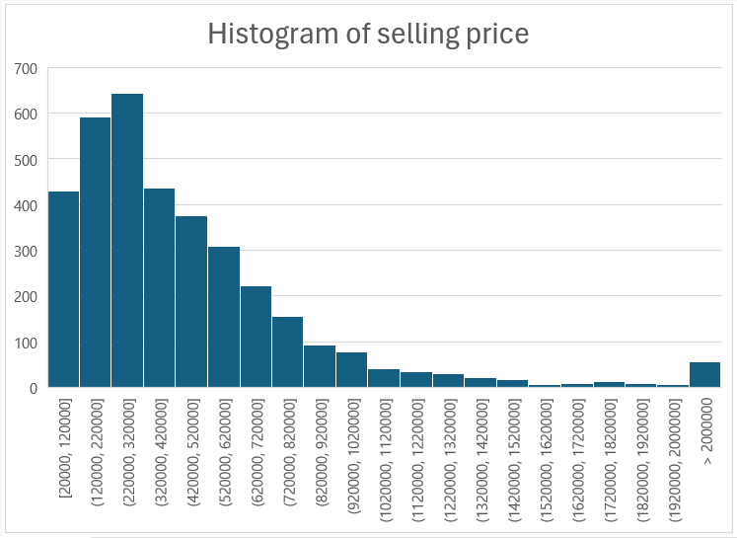
Histogram of Selling price

Slide 11
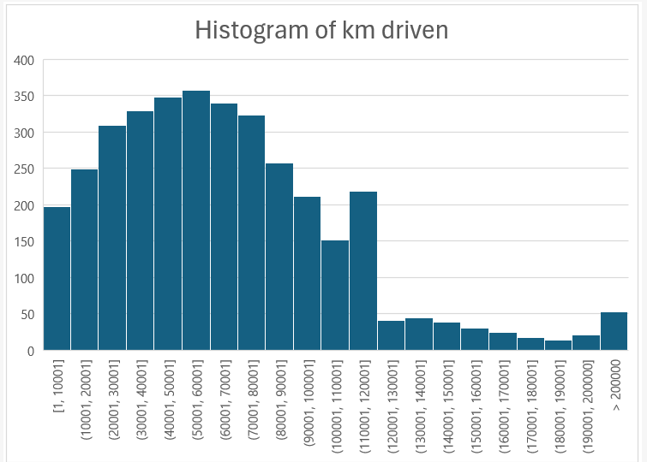
Histogram of Km driven

Slide 12
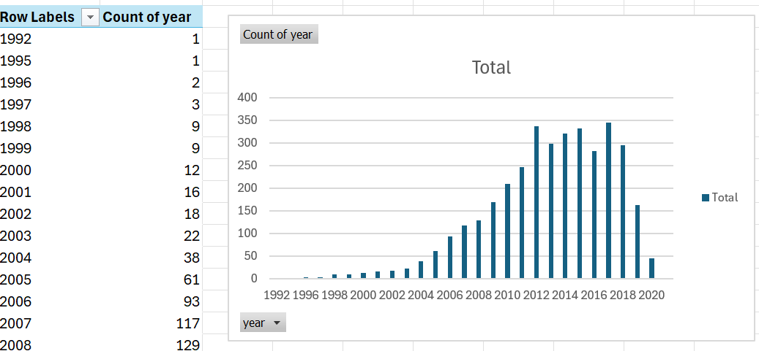
Pivot Chart of Year

Slide 13
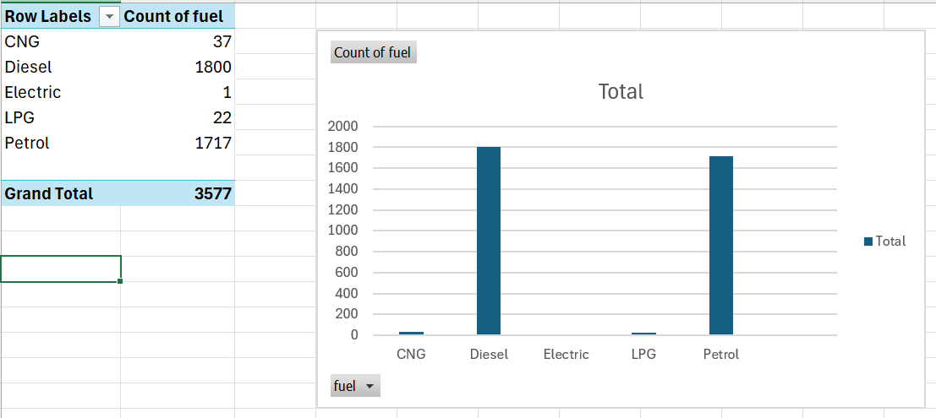
Pivot Chart of Fuel

Slide 14
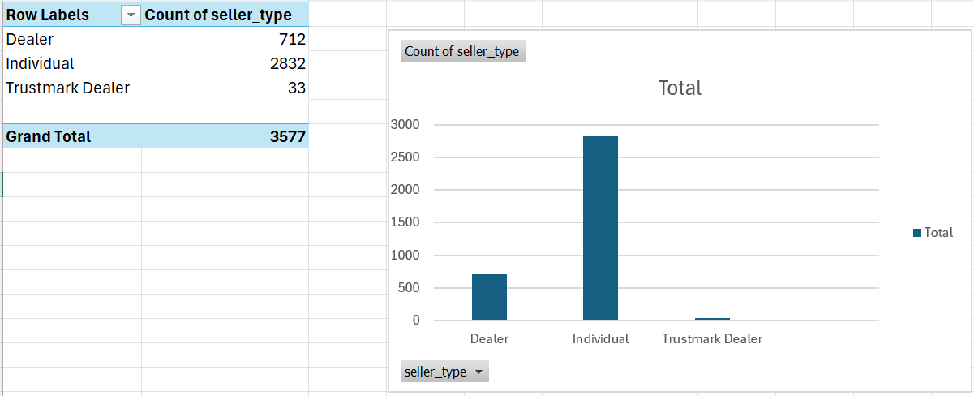
Pivot Chart of Seller type

Slide 15
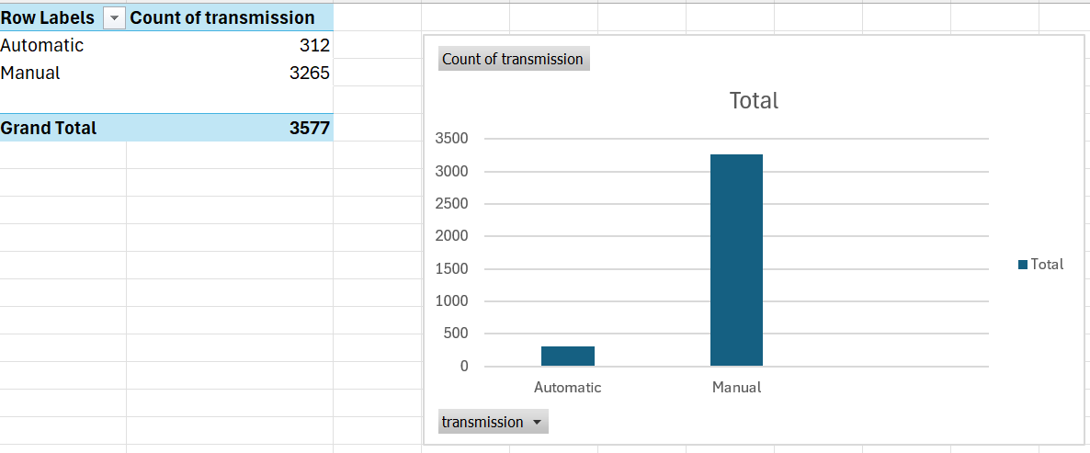
Pivot Chart of Transmission

Slide 16
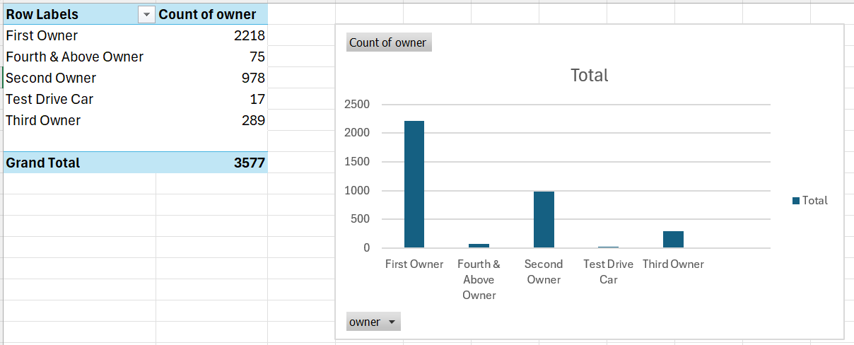
Pivot Chart of Owner

Slide 17
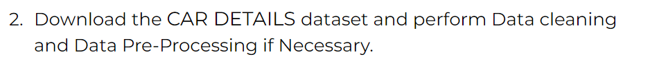
Step 2
Data Preprocessing

Slide 18
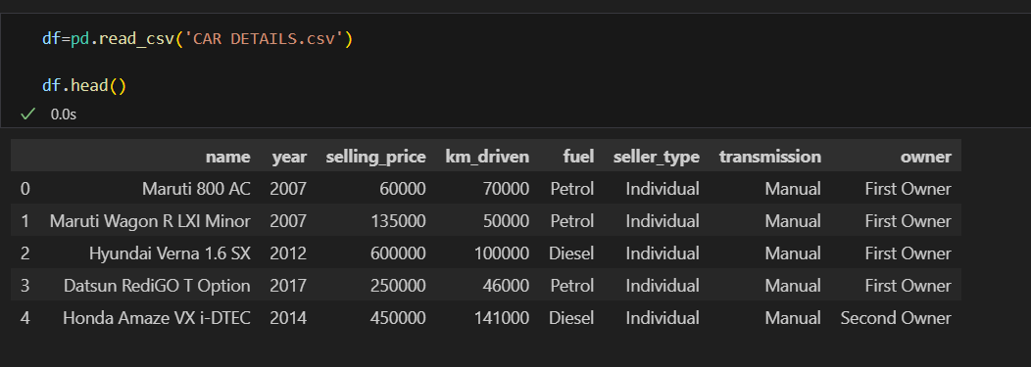
Open Dataset csv

Slide 19
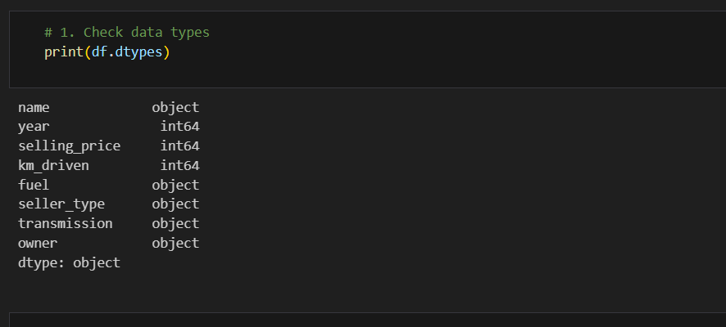
Check Data types

Slide 20
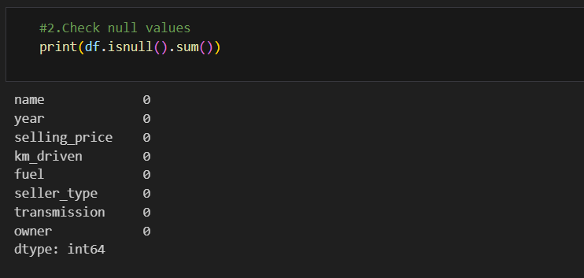
Check Null Values

Slide 21
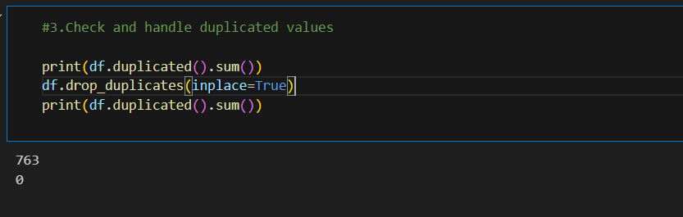
Check and Handle Duplicate Values

Slide 22
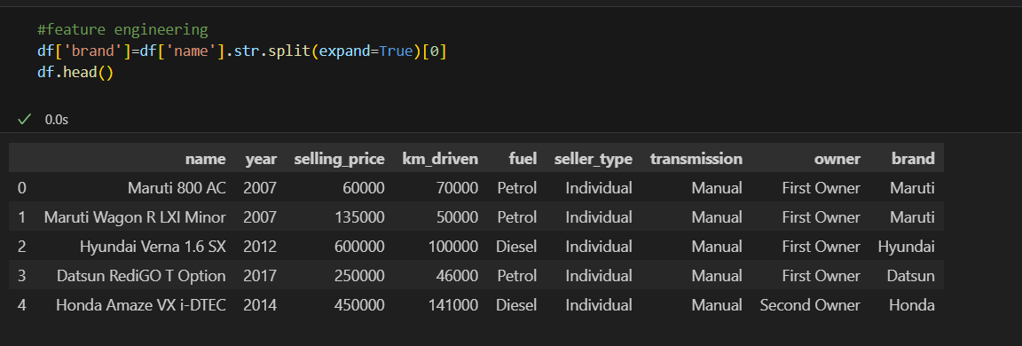
Perform feature engineering(brand)

Slide 23
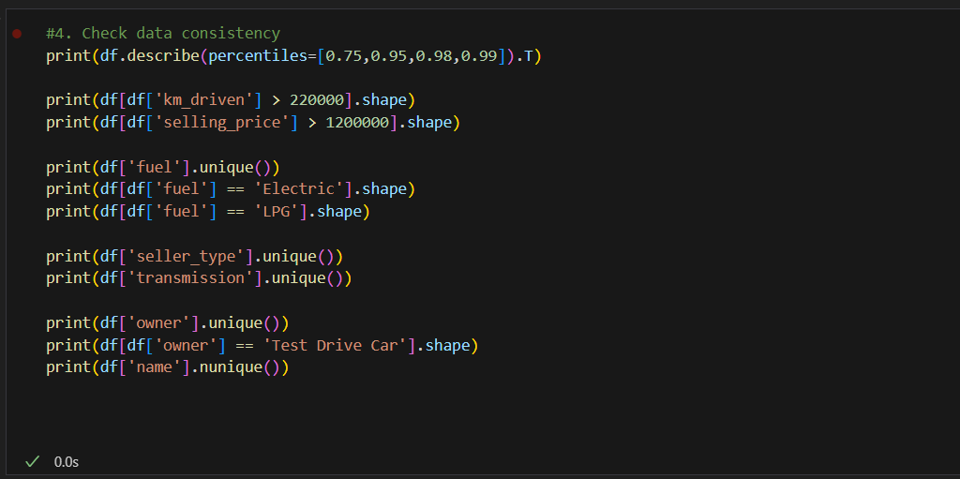
Check Data consistency

Slide 24
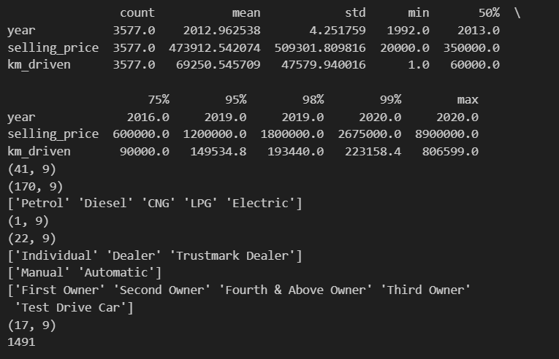

Slide 25
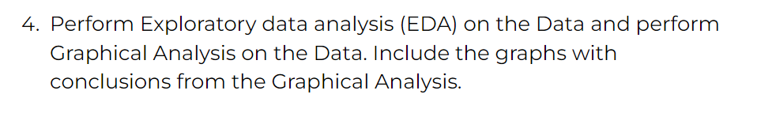
Step 3
EDA using Python

Slide 26
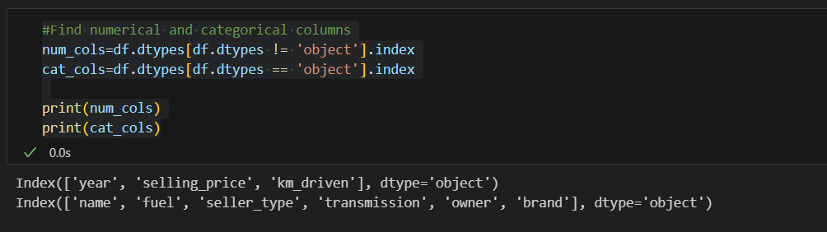
Find numerical and categorical columns

Slide 27
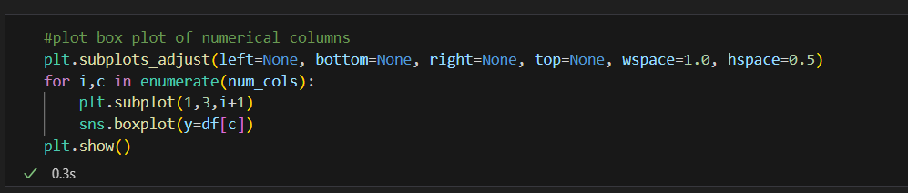
Plot box plot of numerical columns

Slide 28
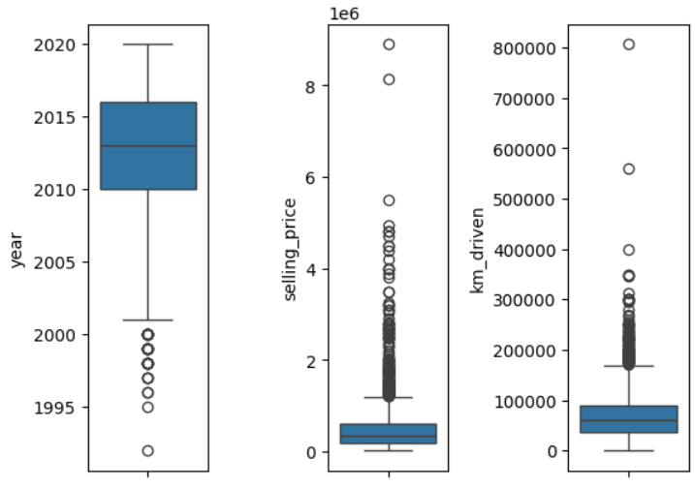
Plot Box plot of numerical columns
Insight:
For selling price a significant portion lies between 0 and 6 lakhs and the rest above 12 lakhs are outliers

Slide 29
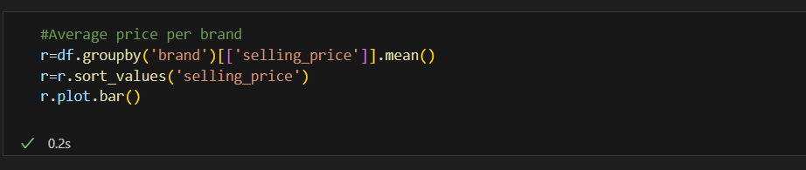
Plot average price per brand

Slide 30
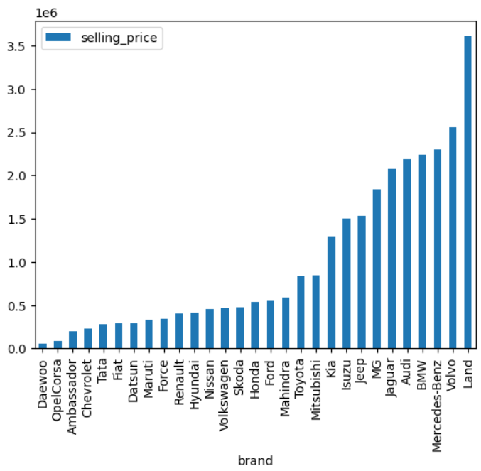
Plot average price per brand
Insight: There are many brands which have average price above 15 lakh

Slide 31
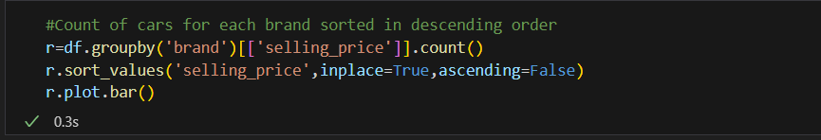
Count of cars for each brand sorted by count

Slide 32
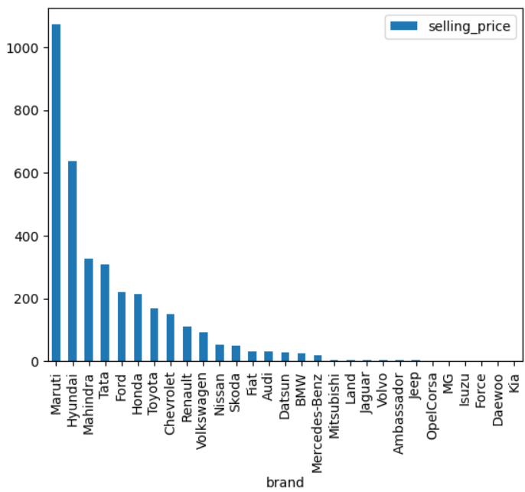
Count of cars for each brand sorted by count
Insight: Maruti is the brand which has more than 1000 data points, followed by Hyundai which has more than 600 data points. This is followed by Mahindra, Tata etc. Brands like Kia, Jeep have hardly any data points

Slide 33
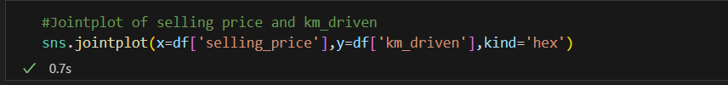
Jointplot of selling price and km_driven

Slide 34
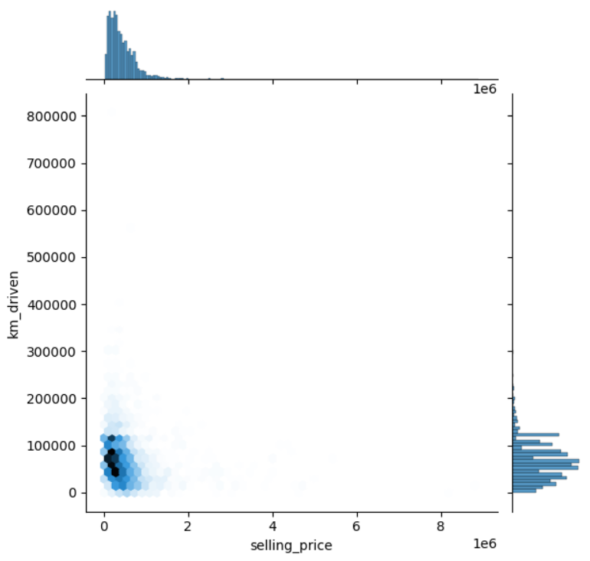
Jointplot of selling price and km_driven
Insight: The km_driven varies from 0 to 1 lakh irrespective of the selling price of the car

Slide 35
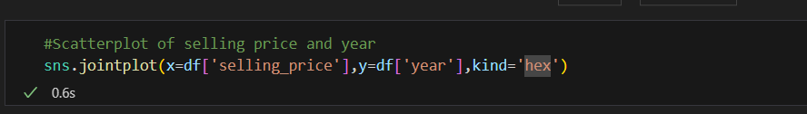
Jointplot of selling price and year

Slide 36
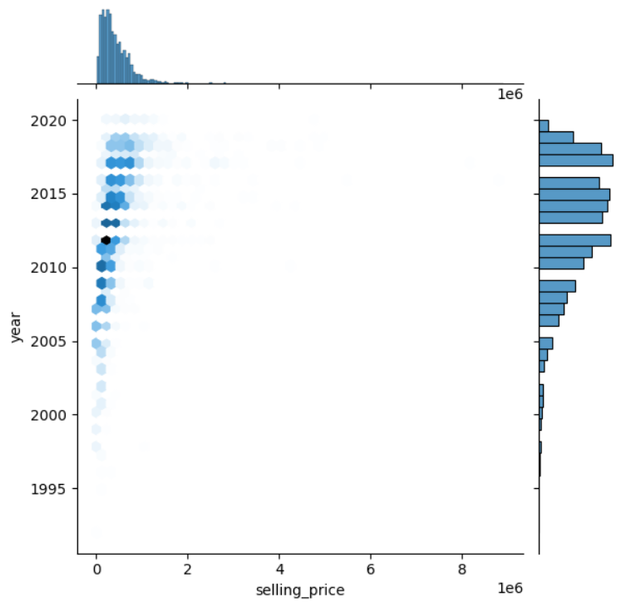
Jointplot of selling price and year
There is an increasing trend in the selling price as year increases with the year 2020 having fewer number of cars.

Slide 37
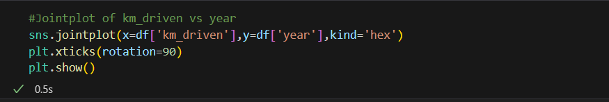
Jointplot of year and km_driven

Slide 38
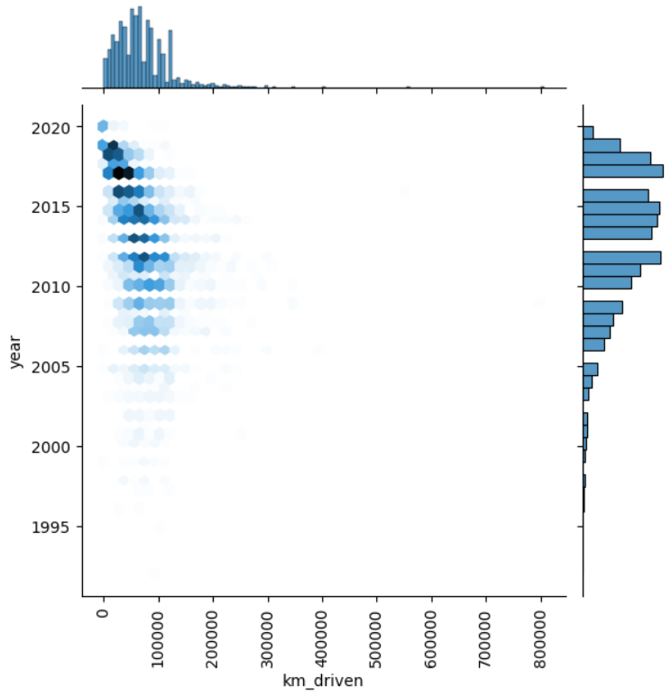
Jointplot of year and km driven
Insight: There is no increasing pattern between km driven and year of the car

Slide 39
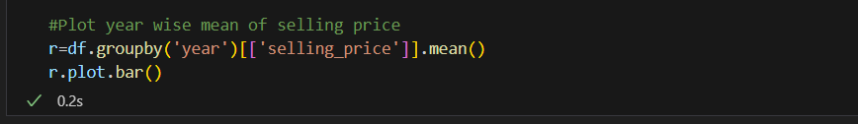
Plot year-wise mean of selling price

Slide 40
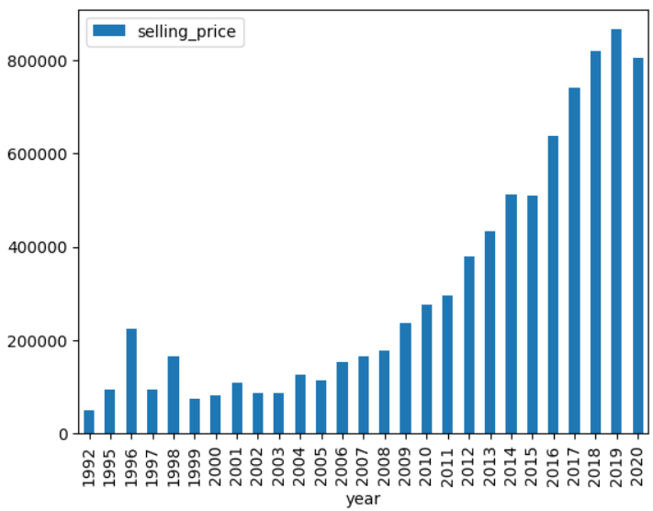
Plot year-wise mean of selling price
Insight: Starting from 2005 upto 2019, the average selling price increases almost linearly

Slide 41
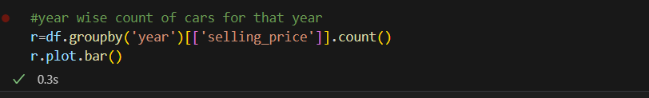
Year wise count of cars for that year

Slide 42
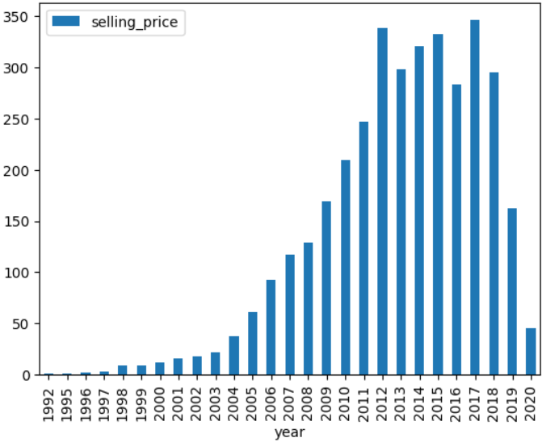
Year-wise count of cars for that year
Insight: It is observed that many of the cars are between 2011 and 2018. Before 2011 there is a decrease in the count of cars of each year.

Slide 43
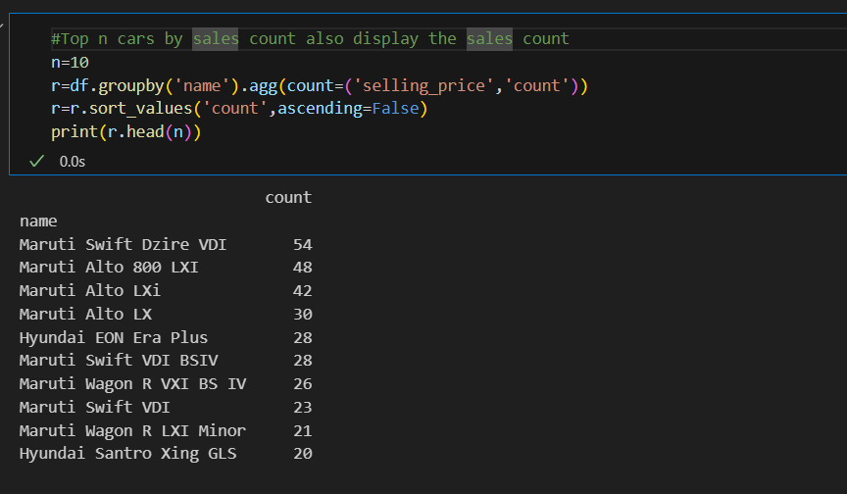
Top n cars(not brands) by sales count

Slide 44
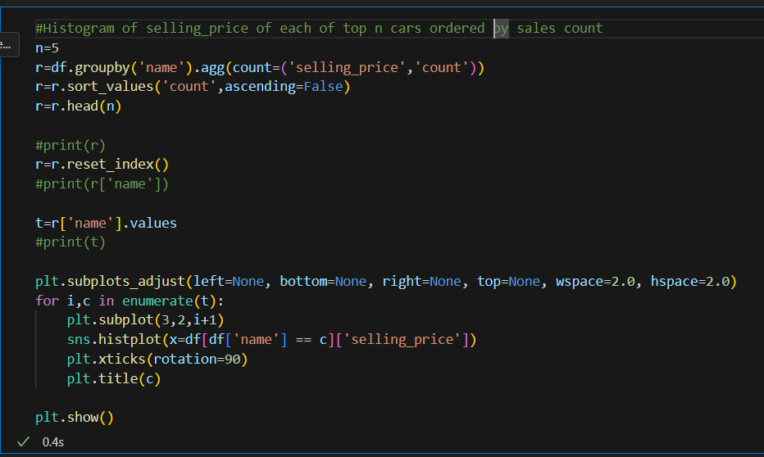
Histogram of selling price of top n cars(not brands) by sales count

Slide 45
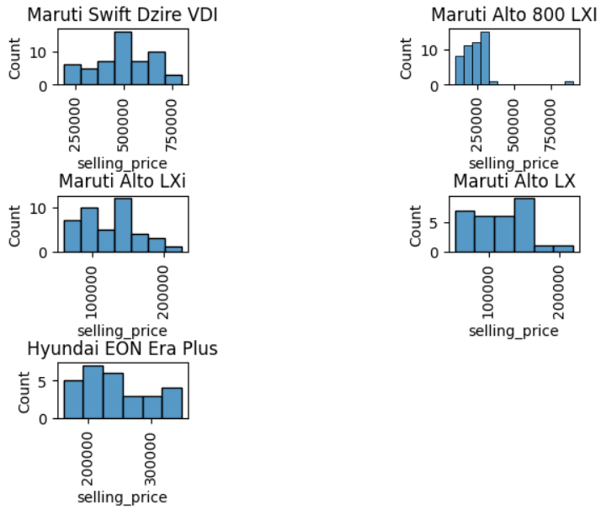
Histogram of selling price of top n cars(not brands) by sales count
Insight: It is observed that there is a great variation for selling price of car even for the same car name. It must be varying because of year and km driven or other factors

Slide 46
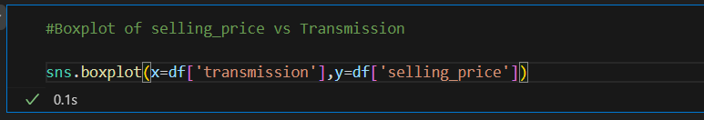
Boxplot of selling price vs transmission

Slide 47
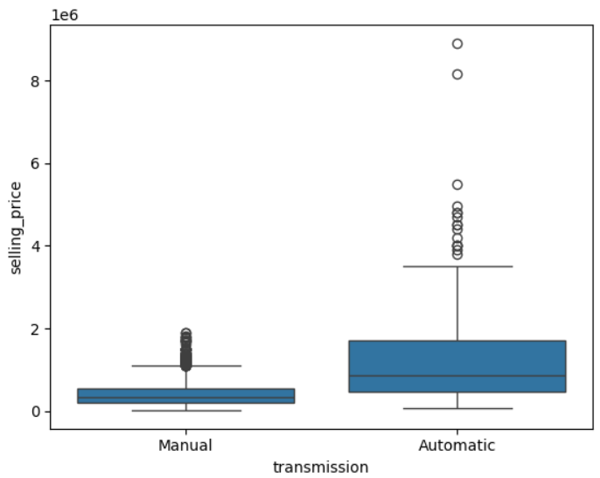
Box plot of selling price vs transmission
The selling price of automatic transmission is significantly higher than the selling price of manual transmission

Slide 48
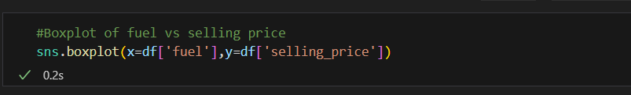
Boxplot of selling price vs fuel

Slide 49
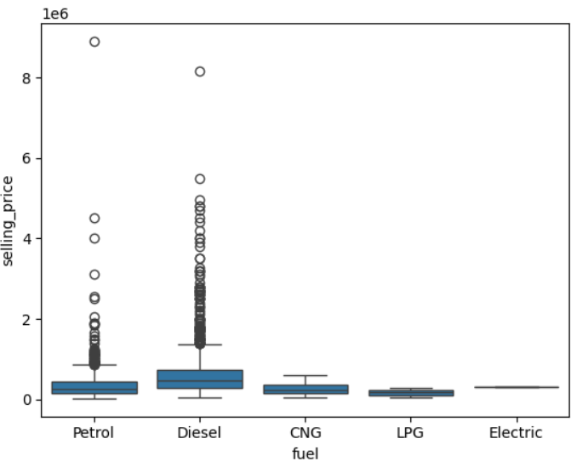
Boxplot of selling price vs fuel
Price of diesel cars is higher(by more than 1 lakh) than other fuel cars.

Slide 50
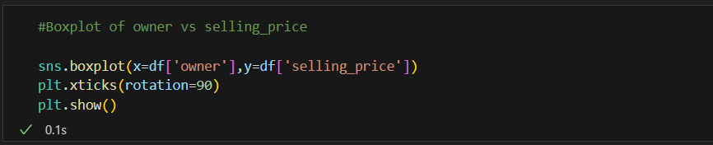
Boxplot of owner vs selling price

Slide 51
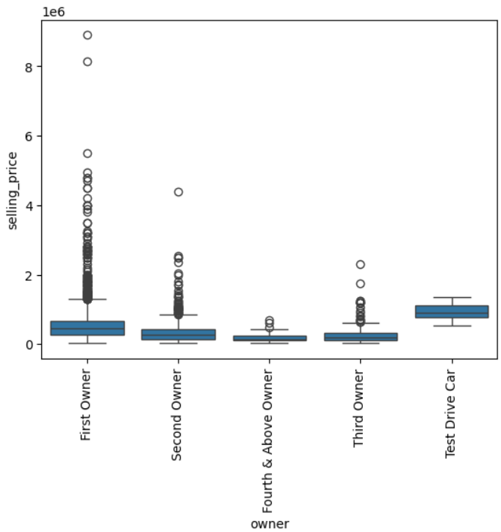
Boxplot of owner vs selling price
The cars owned by First Owner are more expensive(about 1-2 lakhs) then the cars owned by Second owner.

Slide 52
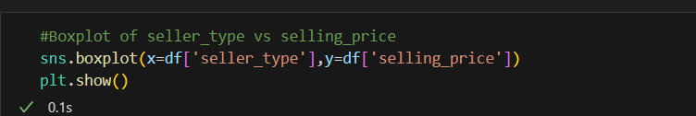
Boxplot of seller type vs selling price

Slide 53
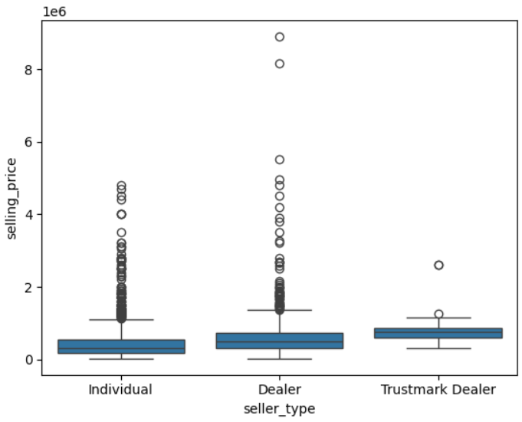
Boxplot of seller type vs selling price
It is observed that cars sold by dealers have price greater(about1-2 lakhs) then individuals. Trustmark dealer’s cars are priced even greater.

Slide 54
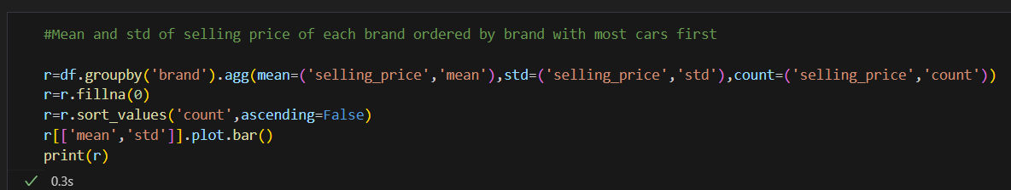
Mean and std of selling price of each brand

Slide 55
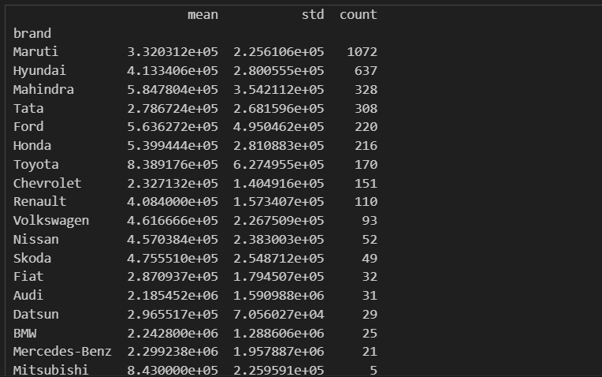
Mean and std of selling price for each brand
The std is high for example for Maruti brand for which there are significant number of cars(above 1000)

Slide 56
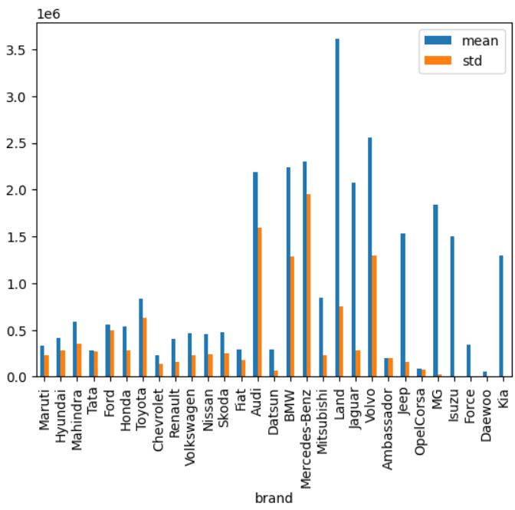
Mean and std of selling price for each brand
For top brand Maruti the std is around 2.2 lakhs suggesting a huge variation in prices.

Slide 57
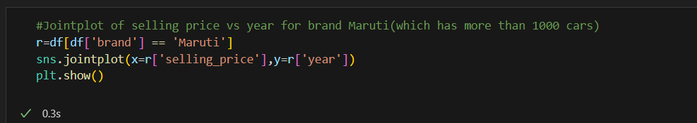
Jointplot of selling price vs year for brand Maruti

Slide 58

Jointplot of selling price vs year for brand Maruti
The selling price of each car varies between 1 lakh and 10 lakh even for recent models(2019).

Slide 59

KDE Plot for selling price for brand Maruti

Slide 60

KDE Plot for selling price for brand Maruti
It is seen that majority of the cars are between 0-4 lakhs and minority of cars are above 4 lakhs for brand Maruti.

Slide 61

For particular car name scatterplot of selling price vs km driven

Slide 62

For particular car name scatterplot of selling price vs km driven
There is no relationship between selling price and km driven for particular car name

Slide 63

For particular car name scatterplot of selling price vs year

Slide 64

For particular car name scatterplot of selling price vs year
It seems the selling price increases with model year. However they seems to be variation in selling price for each year which can be attributed to other features.

Slide 65

KDE Plot of different years for brand Maruti

Slide 66

KDE Plot of different years for brand Maruti
Successive years have more cars shifting to the right side, but there are still some cars on the left side.

Slide 67
Advanced EDA

Slide 68

Find fuel type wise selling price where selling price is greater than average of that fuel type

Slide 69

Find fuel type wise selling price where selling price is greater than average of that fuel type

Slide 70

Find seller type wise selling price where selling price is greater than avg selling price for seller type

Slide 71

Find seller type wise selling price where selling price is greater than avg selling price for seller type

Slide 72

Find year wise selling price for year 2006 and onwards. Find the percentage contribution of each year. Find running sum and running percentage.

Slide 73

Find year wise selling price for year 2006 and onwards. Find the percentage contribution of each year. Find running sum and running percentage.

Slide 74

Extend q3 by computing yoy percentage change in sales

Slide 75

Extend q3 by computing yoy percentage change in sales

Slide 76
Step 4
Outlier Treatment

Slide 77

Outlier treatment

Slide 78

Outlier treatment

Slide 79

Step 5
One Hot Encoding

Slide 80

One Hot Encoding

Slide 81
Step 6
Split into X and y

Slide 82

Split into X and y

Slide 83
Step 7
Choose train and test datasets

Slide 84

Choose train and test datasets

Slide 85
Step 8
Apply various ML regression models

Slide 86

eval_model function

Slide 87

Linear Regression

Slide 88

Bagging Linear Regression

Slide 89

KNN Regression

Slide 90

Bagging KNN Regressor

Slide 91

Decision Tree Regression

Slide 92

Decision Tree Regression

Slide 93

Ridge Regression

Slide 94

Lasso Regression

Slide 95

Random Forest Regression

Slide 96

Random Forest Regression

Slide 97

Adaboost Regression

Slide 98

Gradient Boost Regression

Slide 99

XGBoost Regression

Slide 100

Compare all models

Slide 101

Compare all models

Slide 102
Step 9
Save the various models along with the best model

Slide 103


Slide 104

Step 10
Sample 20 points and store it in sample.csv file

Slide 105


Slide 106
Step 11
Load the best model and perform prediction on sample dataset

Slide 107


Slide 108
Step 12
Create app.py, requirements.txt

Slide 109

Create app.py

Slide 110

Create requirements.txt

Slide 111
Step 13
Upload the app.py,requirements.txt, pickle files to github repo

Slide 112

Upload the app.py,requirements.txt,pickle files to github repo

Slide 113
Step 14
Deploy on streamlit cloud

Slide 114

Deploy on streamlit cloud

Slide 115
GitHub Repository Link
https://github.com/laxmiprasad-iyer/data-science-capstone-project
Streamlit app cloud link
https://data-science-capstone-project-gaxwq7o84zuexkdzrj5v82.streamlit.app

Slide 116
Thank You

