Slide 1
Docker Essentials

Slide 2




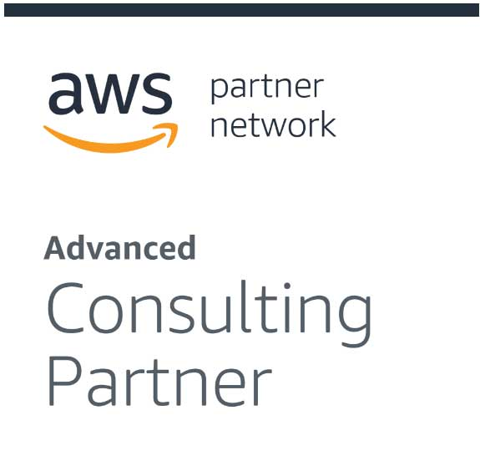

About CloudThat​
9+
350k+
100+
100+
350+
Years in Business
Professional Trained
Corporates Trained
Projects Delivered
Cloud Certifications
Leader in Training and Consulting on Cloud, Security, AI/ML, IoT and DevOps
Trained over 350k+ professionals across technologies and geographies
Proven track record of training delivery for all stages of employee lifecycle
Strong team of 125+ certified cloud experts with
industry consulting experience
Robust consulting division brings industry prospective to training delivery

Slide 3
Pre Requisites
AWS Account
Know how to instantiate EC2 VM and connect via SSH
Knowledge of Basic Linux commands will be helpful

Slide 4
Objectives
Day 1:
Micro Services
Intro to Container
Docker
Docker Volumes
Day 2:
Docker Networking
DockerFile and Docker Images
DockerRegistry
Docker Compose

Slide 5
House Keeping
Breaks:
Coffee Break ~ 11:00 AM - 11.15 AM (15 mins)
Lunch Break ~ 1:00 PM - 2.00 PM (1 hour)
Coffee Break ~ 3:30 PM - 3.45 PM (15 mins)

Slide 6
Containers & Docker

Slide 7
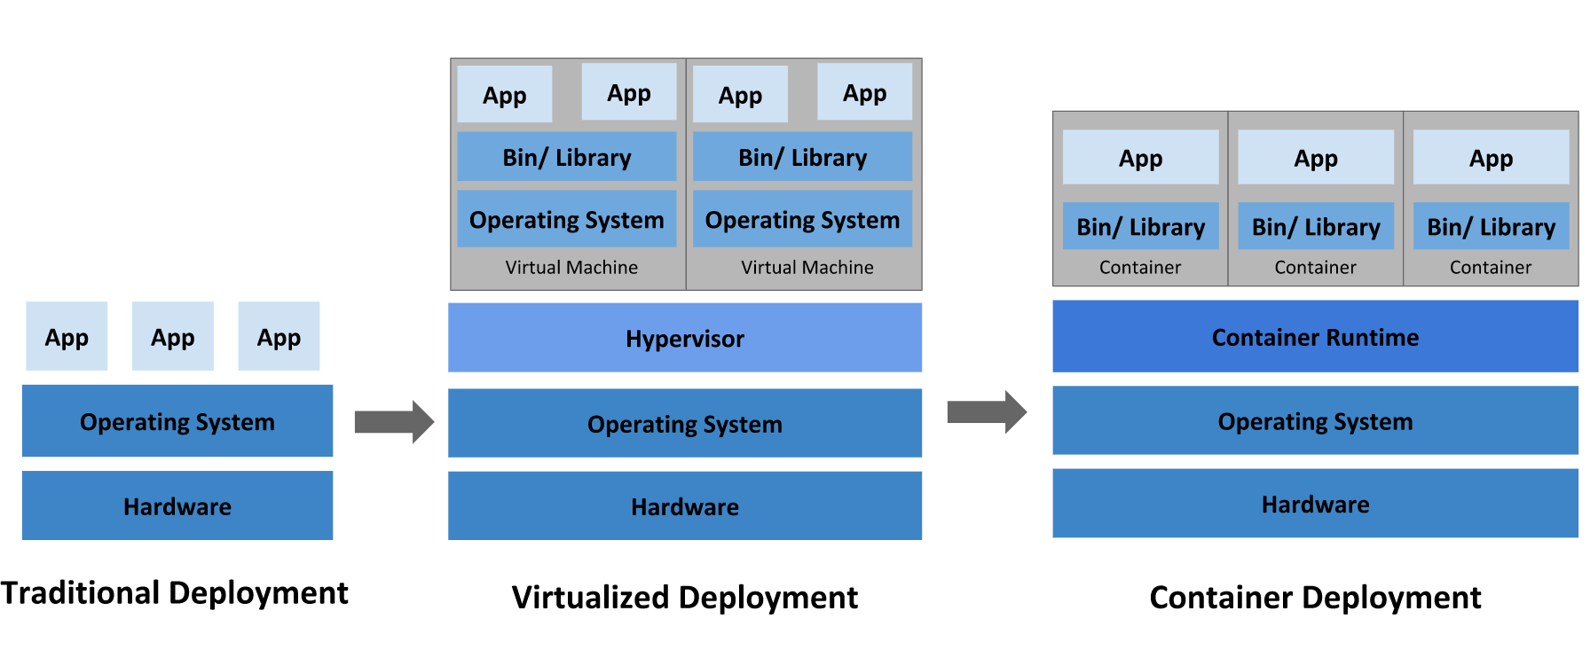
Going back in time

Slide 8
Traditional Application Deployment
Apache
MySQL
× Over- provisioning
ADS
× lack of App Isolation
X
CPU – 3 core
RAM – 8 GB
Storage – 10 GB
× Scaling
CPU – 1 core
RAM – 4 GB
Storage – 10 GB
CPU – 1 core
RAM – 8 GB
Storage – 30 GB
RHEL OS
Windows OS
× Tight coupling
(Linux kernel)
(Windows kernel)
Hardware
Hardware
CPU - 5 cores
RAM - 16 GB
Storage - 50 GB
NIC
CPU – 4 core
RAM – 16 GB
Storage – 50 GB
4 NIC
RAM – 16 GB
RAM – 32 GB
Server
OOM
ADS
Vertical Scaling (Scale Out)
Year – late 90s
After 15 days

Slide 9
Virtual Machines
snapshot
VM 1
VM 2
VM 3
VM
MySQL
ADS
MySQL
Apache
CPU – 1 core
RAM – 8 GB
Storage – 30 GB
CPU – 1 core
RAM – 3 GB
Storage – 10 GB
CPU – 2 core
RAM – 4 GB
Storage – 10 GB
VM Image
Reduced Hardware Costs
RHEL (Guest OS)
RHEL (Guest OS)
Windows (Guest OS)
RHEL (Guest OS)
Hypervisor
Process/App
Isolation
(Baremetal)
Hypervisor
Operating System
RHEL OS
Quicker Provisioning (Scaling)
Hardware
Hardware
CPU – 4 core
RAM – 16 GB
Storage – 50 GB
4 NIC
Server 1
Server 2
VMWare
Year – 2002
Spare Capacity
After 30 days

Slide 10
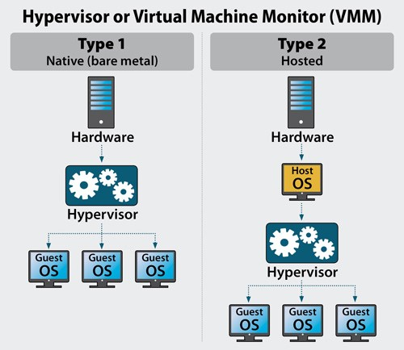
Virtualization type

Slide 11
Containers
VNIC
VNIC
10 mc
400 Mi
VM 1
VM 2
VM 3
20 mc
200 Mi
container1
MySQL
lib/bin
Debian
container2
Apache
MySQL
Apache
Apache
Lib
bin
No kernel
RHEL (Guest OS)
RHEL (Guest OS)
Guest OS
Scaling
Container Runtime (docker)
Faster Provisioning
Hypervisor
OS
virtualization
Ubuntu
Linux Kernel
H/W
virtualization
Operating System
Portability
Hardware
Hardware
Build Once Run Anywhere
Server
Rkt, cri-o

Slide 12
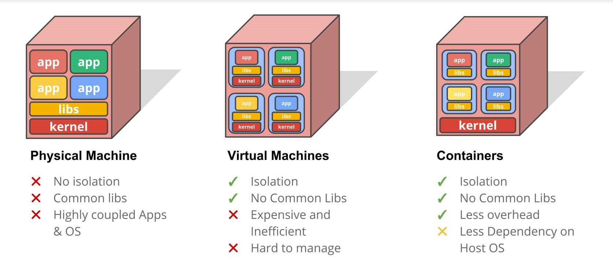
Why Containers

Slide 13
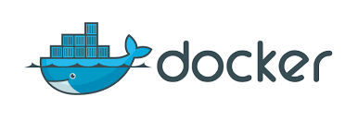
Docker
docker
noun
noun: docker; plural noun: dockers
a person employed in a port to load and unload ships
Open platform for Developers and SysAdmins to build, ship and run distributed applications
Written in Go
Primarily meant to run Linux Containers
Supported by multiple cloud platforms

Slide 14
History
Solomon Hykes, dotCloud - 2010
dotCloud renamed to Docker Inc. 2013
DockerCon EU 2017 announced Docker Enterprise Edition, Docker for Mac and Windows with built-in Kubernetes
Experienced exponential growth in the last two years.
DockerHub downloads have gone from 100 million to 50 billion.

Slide 15
Virtual Machines v/s Docker
Virtual Machine | Docker
Separates OS from its underlying hardware | Separates application from its underlying OS
Heavy | Extremely lightweight
Requires their own guaranteed resources | Resources requirements are less
Takes a lot more time to start comparatively | Takes seconds to boot up and start running
Consumes large amount of CPU and memory which makes it complex for scaling | Provides faster results with less resource utilization
Can run different kernels on different guests | Containers use the same kernel

Slide 16
Local Machine: Windows
Docker
Docker
Virtual Box: Linux VM
Docker Desktop: Hyper-V
Windows
Windows
All Windows prior to Win 10 via
Docker Toolbox
For Windows 10 Professional or Enterprise and above via Docker Desktop

Slide 17
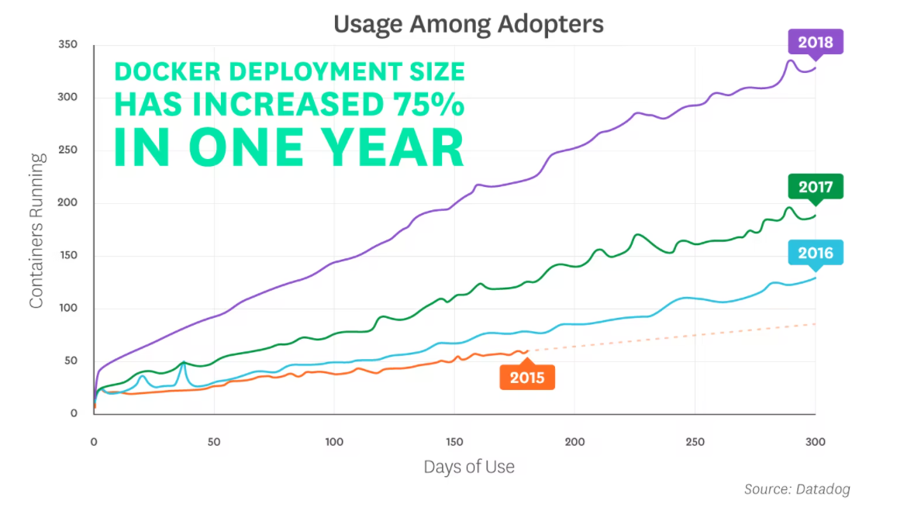
Docker Adoption
As of Feb 2021

Slide 18
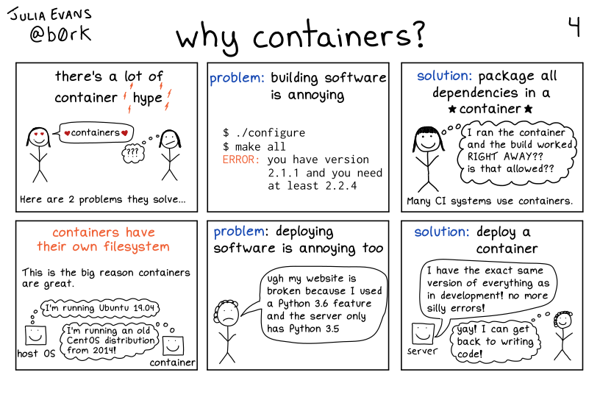
Why containers

Slide 19
Micro Services

Slide 20
Micro Services
"Microservice Architecture" is an architectural pattern to describe a particular way of designing software applications for distributed systems
Microservices break an application into independent, loosely coupled, individually deployable services
Microservices are independently deployable units of functionality within an application system.

Slide 21
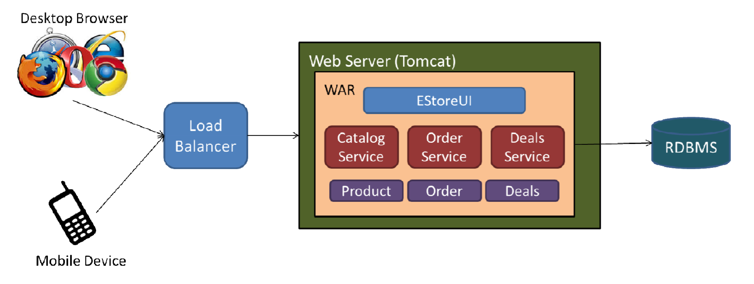
Monolith vs Micro Services

Slide 22
Challenges with monolithic application
Difficult to scale
Architecture is difficult to maintain and evolve
Lack of agility
Difficult to innovate
Long build/test/
release cycles
New release(s) takes months
Long time to add new features
Dissatisfied customers

Slide 23
Micro Services architecture
"service- oriented architecture" composed of loosely coupled services that are self-contained and can be managed independently
Services communicate with each other over the network
Services can be developed, deployed and updated independently , updating one service does not require any changes to other services.

Slide 24
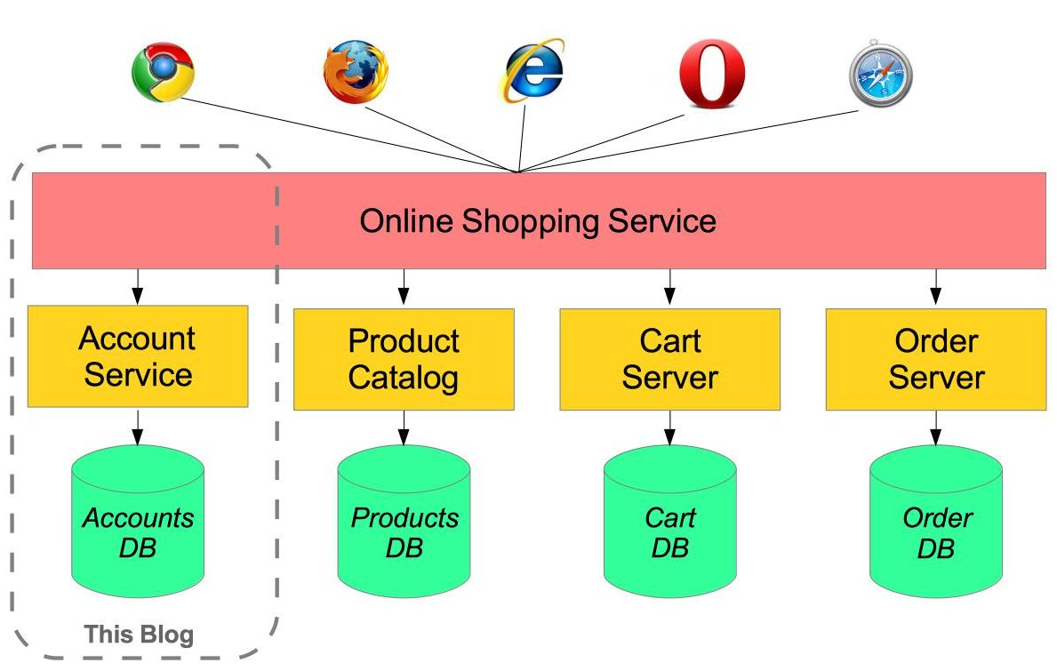
Micro Service architecture

Slide 25
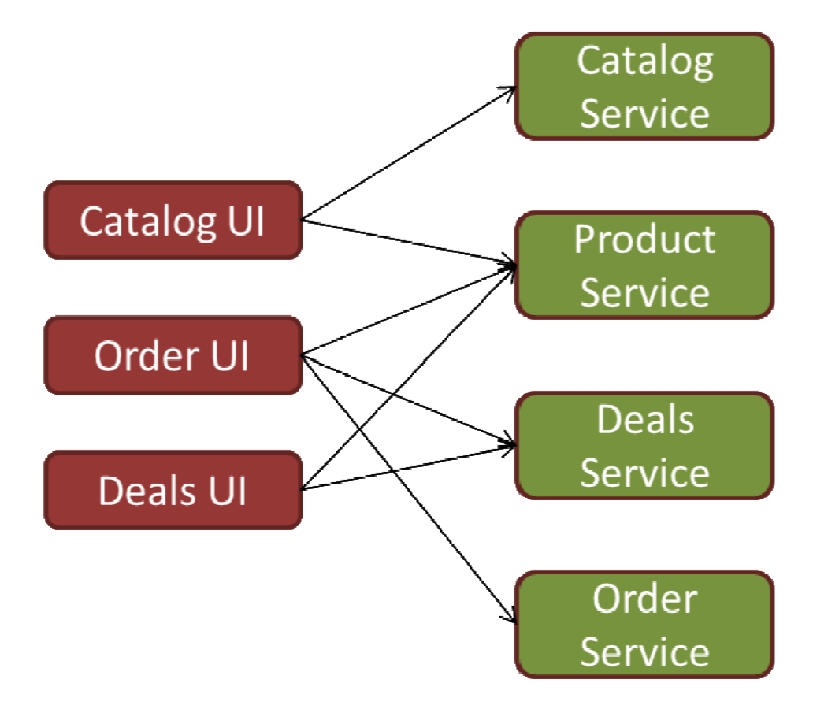
Monolith vs Micro Services

Slide 26
Characteristics
Modularization via Services
Organized around Business Capabilities
Decentralized Governance
Decentralized Data Management
Design for failure Management
Source: http://martinfowler.com/

Slide 27
Lab 1
Setting up Docker Host on AWS

Slide 28
Docker
Private IP
Public IP
VNIC
Docker CLI (client)
Putty
hub.docker.com
Download + run
API
get.docker.com
docker run ubuntu
docker run ubuntu: latest
apt
Container Runtime (dockerd)
docker run ubuntu: 18.04
Linux Kernel
download.docker.com
AMI – Ubuntu 20.04 LTS
EC2 (VM)
(Docker Host)
1 vCPU
1 GiB RAM
10 Gi

Slide 29
Running Containers

Slide 30
Container
Container Registry
hub.docker.com
Apache
Base Image
Application Images
Ubuntu
Ubuntu
Apache
Alpine
MySQL
Container Image
Busybox
Nginx
Debian
Wordpress
apt-get update
apt install –y apache2
service apache2 start

Slide 31
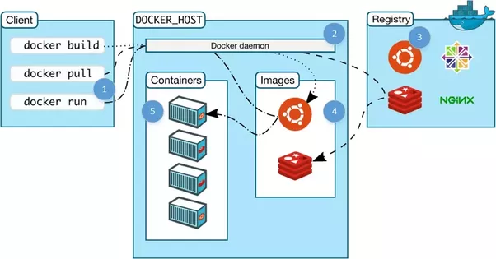
Docker architecture

Slide 32
Lab 2
Running Docker Containers
Common Docker commands

Slide 33
Container States
created
running
stopped
paused
created
/running
/stopped//paused
docker pull <image-name>
docker container create <image-name>
docker container ls -a
docker run <image-name>
docker container pause <container-id/name>
docker container stop <container-id/name>
docker container start <container-id/name>
docker container unpause <container-id/name>
docker container rm <container-id/name>

Slide 34
Container States
Created
run
restart
Running
unpause
start
pause
stop
Paused
Exited

Slide 35
Docker port mapping
http://<public_IP>:8080
http://<public_IP>:80
apache2 (80)
apache2
(80)
X
nginx (80)
nginx
(80)
EC2 (ubuntu)
EC2 (ubuntu)
apt-get update && apt –y install apache2 nginx
service apache start
docker run -d –p 80:80 apache2
service nginx start
service nginx start
docker run -d –p 8080:80 nginx
systemctl status nginx
netstat –ntlp

Slide 36
Docker Image Commands
Build / Pull
Create / Download a docker image
Create a container from the image
Save container as image
Upload image to central repository
Stop the container
Delete a container
Run
Commit
Push
Stop
Remove

Slide 37
Lab 2
Container lifecycle commands

Slide 38
Docker commit
Container registry ( hub.docker.com)
httpd:latest
myhttpd:v1
docker run –d –name ctr1 httpd
X
curl 172.17.0.2
It works
curl 172.17.0.2
EC2 (docker host)
Custom HTML page
docker commit ctr1 myhttpd:v1
docker exec –it ctr1 /bin/bash
# cd htdocs
# rm index.html
# < create custom html>
docker run -d --name ctr2 myhttpd:v1
docker rm –f ct1
docker push myhttpd:v1
docker commit ctr1 <custom_image:vers>

Slide 39
Lab 3
Docker Lifecycle

Slide 40
Application Data Management

Slide 41
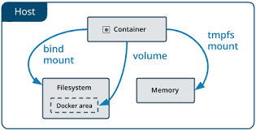
Data Persistence
Container : Thin RW layer over multiple RO layers
RW layer not persistent
3 options for Data persistence:
Bind Mount
Volume mount
tmpfs mount
Source: http://docs.docker.com

Slide 42
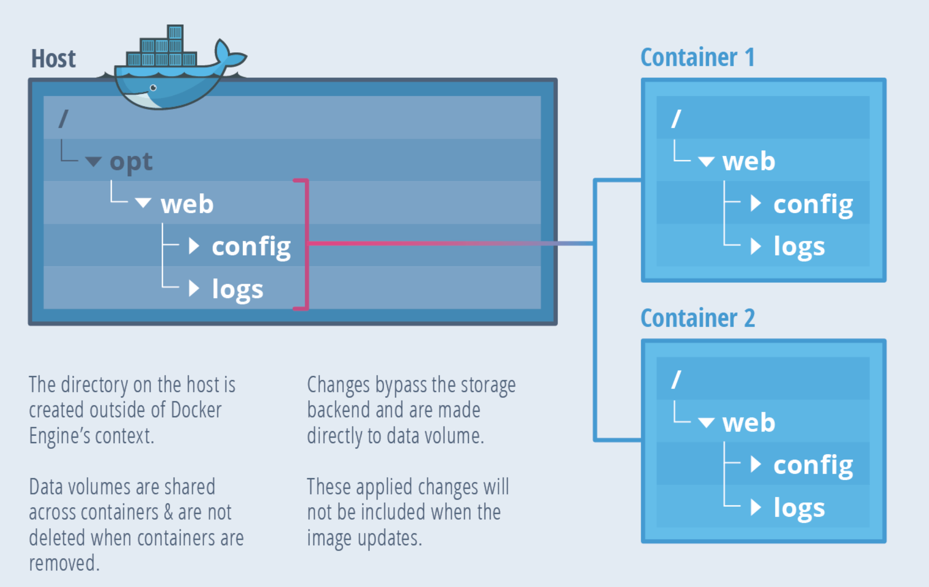
Bind Mount
Host directories are not managed or isolated by Docker
Depends on the directory structure of the host
Source: TheNewStack

Slide 43
Use Cases
For creating a single point of sharing for configuration files from host to containers.
Eg: /etc/resolv.conf is mounted from host to each container for DNS resolution
If data needs to be updated from host (source code or build artifacts)
Eg: /var/www/html is mounted to host we can modify it any time
If we know the directory structure of the host, bind mounts are performant

Slide 44
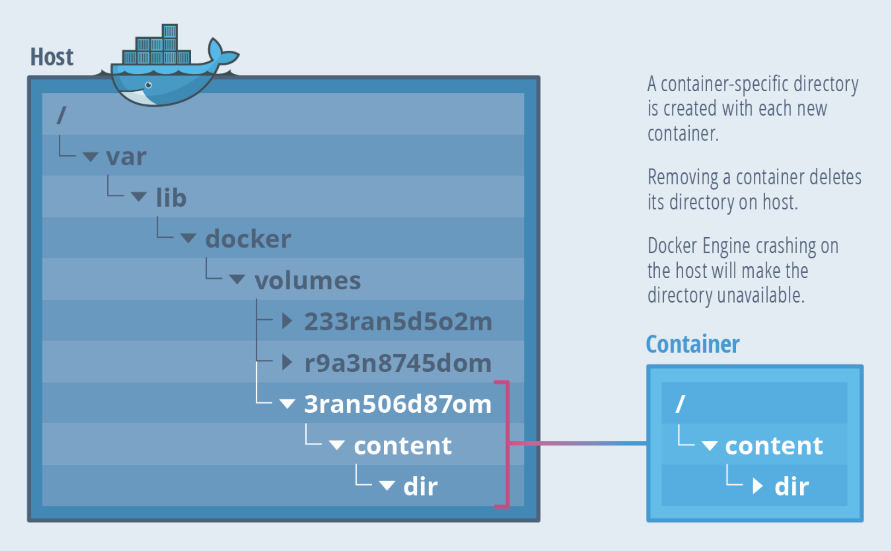
Volume Mount
Volumes are managed by Docker
Isolated from other services of host machine
Source: TheNewStack

Slide 45
Docker Volumes
Advantages:
Easy backup and migration
Easy to manage using Docker CLI and Docker API
Single volume can be shared across multiple containers
Supports both Linux and Windows environments
Commands:
docker volume create sample-vol
docker volume ls
docker volume inspect sample-vol
docker volume rm sample-vol

Slide 46
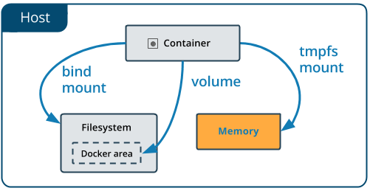
tmpfs Mount
Linux only feature
When the container stops, the tmpfs mount is removed, and files written there won’t be persisted
Cannot share between containers
Source: http://docs.docker.com

Slide 47
tmpfs Mount
tmpfs is a temporary mount between container and the host system’s memory
tmpfs mount doesn’t provide data persistency
The mount is removed when the container stops, and the files will not be persisted.
Files are created outside containers writable layer and are not stored in the host filesystem

Slide 48
Use Cases
If you don’t want your data to be persisted
If you have “secure data” that must be erased on stopping the container
If your application needs to process huge amount of data with maximum performance

Slide 49
Labs
Lab 3:
Bind Mount lab
Lab 4:
Volume Mount lab

Slide 50
Docker Networking

Slide 51
Docker Networks
Docker by default, provides three types of networks :
none
host
bridge
$ docker network ls
NETWORK ID NAME DRIVER
7fca4eb8c647 bridge bridge
9f904ee27bf5 none null
cf03ee007fb4 host host

Slide 52
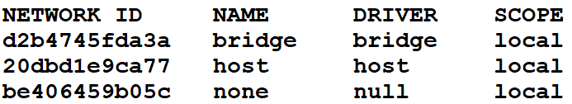
Docker
172.17.0.1
VNIC
docker0
docker run -d –name ct1 busybox
172.17.0.2
default
172.17.0.0/16
docker run -d --name ct2 busybox
ct1
172.17.0.3
ct2
docker network ls
Container Runtime (dockerd)
Linux Kernel
docker network inspect <network-name>
EC2 (VM)
(Docker Host)

Slide 53
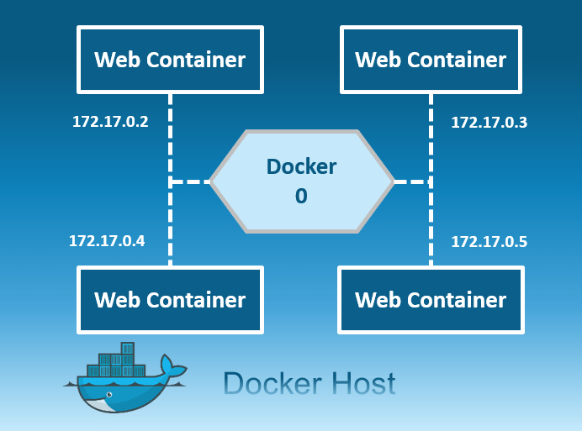
Network Flag: bridge
Connect the container to the bridge via veth interfaces
Automatically created when docker starts
docker0 is the default bridge network
Example:
$ docker run -it --name=test2 ubuntu /bin/bash
$ docker network inspect bridge

Slide 54
Default Network
docker0 created automatically on the host machine and docker run adds containers to this network
Docker creates a subnet and gateway for the bridge network
Subnet CIDR block selected randomly from a private range that are not in use on host machine
The network itself isolates the containers from external networks
Note:
Docker does not support automatic service discovery on default bridge
We can ping to container in same network
We can ping external network like google.com

Slide 55
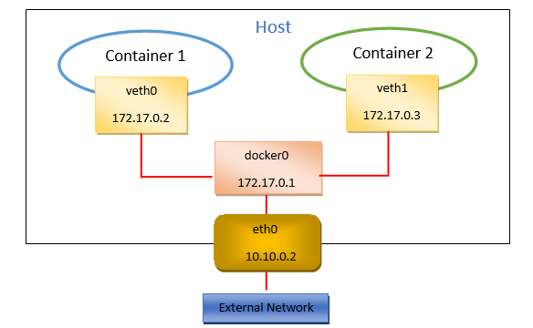
Docker0 Bridge Network

Slide 56
Bridge Network Commands
docker network ls
docker network create --driver bridge isolated-nw
docker network inspect isolated-nw
Create a container to use the new network:
docker run --network=isolated-nw -it --name=container3 ubuntu
docker network inspect isolated-nw
Can we ping other containers from this?

Slide 57
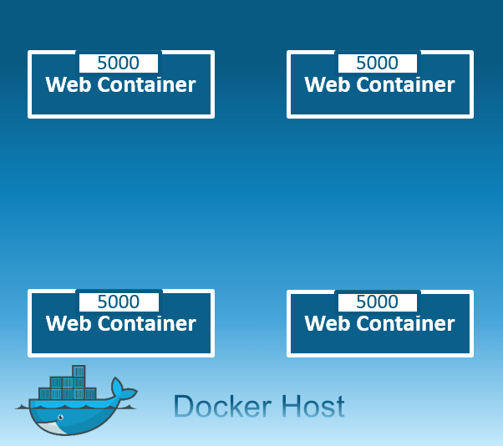
Network Flag: host
Share the host’s network stack and all interfaces
Full access to local network services and is therefore considered insecure
The container’s host name will match the host name on the host system
Example:
docker run -it --name=test2 --net=host ubuntu /bin/bash

Slide 58
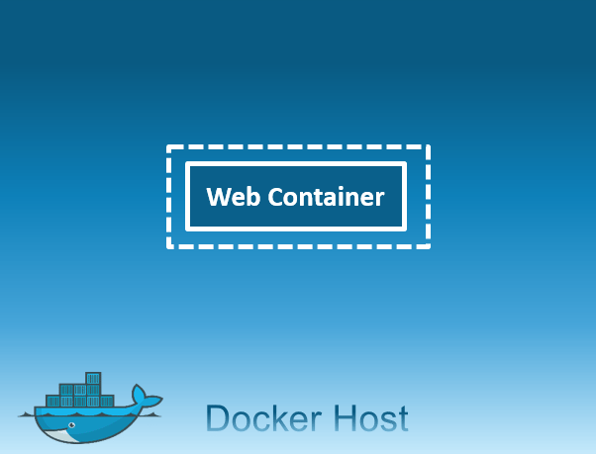
Network Flag: none
Container will not have access to any external routes
Container doesn’t have access to any other containers as well
Container will only have a local loopback interface
Example:
docker run -it --name=test2 --net=none ubuntu /bin/bash

Slide 59
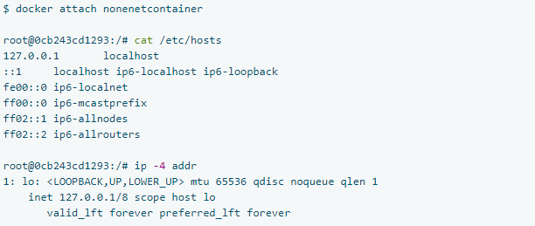
none Network

Slide 60
iptables
Linux hosts use a kernel module called iptables to manage access to network devices, including routing, port forwarding, network address translation (NAT), and other concerns.
Docker modifies iptables rules when you start or stop containers which publish ports, when you create or modify networks or attach containers to them, or for other network-related operations.

Slide 61
Quiz Q1
Which of the following are benefits of microservices
loosely coupled
Independent scaling
Independent deployment
All of the above

Slide 62
Quiz Q2
Which command can be used to list running docker containers
docker image ls
docker volume ls
docker ps
All of the above

Slide 63
Quiz Q3
Which of the following are valid states that a docker container can be in ?
running
stopped
created
All of the above

Slide 64
Lab
Lab 5
Docker Networking Lab

Slide 65
Docker Images
Been using pre-built images
What if we need custom images ?
Run base container, update, upgrade and install all required software, make an image
Drawbacks ?
Why not ‘code’ our custom image and build it ?
Dockerfile

Slide 66
Docker Images
Docker Image is an inert, immutable file
Is a snapshot of a container
Images are made up of RO layers
Images are versioned using tags
Docker run creates a Container from a given Image

Slide 67
Dockerfile
Dockerfile is a text document that contains a list of instructions a user could call on the command line to assemble an image
# Comment
INSTRUCTION arguments
Docker can build images automatically by reading the instructions
docker build
Each line / instruction results in a separate RO layer
IaC : Dockerfile enables us to create the custom image automatically

Slide 68
Docker Containers
Containers are read-write layer on top of an Image
Containers use copy-on-write (CoW) strategy
Read-write layer will hide the underlying file, but will not destroy it
When a container is deleted, all the changes made will be lost
Unless user creates another read-only layer (i.e. new image)
Combination of read-only layers with a read-write layer on top a Union File System, is called as a Container
OverlayFS

Slide 69

Docker Image layers
$ docker image ls
compute hash
192 MB
FROM ubuntu:18.04
FROM ubuntu:18.04
72300a873c2c
1 MB
FROM ubuntu:18.04
RUN apt-get-update && apt install –y apache2
RUN apt-get-update && apt install –y httpd
b10f9aa98db
1 MB
COPY index.html /var/www/html
851356ecf618
CMD [“httpd-foreground”]
120 MB
CMD [“service apache2 start && sleep 3600”]
4176fe04cefe
70 MBc
4176fe04cefe
Dockerfile

Slide 70
Understanding Docker Image layers
docker run -it --name my-ctr ubuntu /bin/bash
create a RW Layer
docker run -it --name ctr1 myctr:v1 /bin/bash
create a RW Layer
# echo “file1 ” > file1.txt
modify the
RW Layer
# echo “file2 ” > file2.txt
# rm -f file1.txt
modify the
RW Layer
# Ctrl + P + Q
docker history myctr:v2
# Ctrl + P + Q
docker diff
list changes made to base image
docker run -it --name ctr2 myctr:v2 ls /
docker diff ctr1
A / file1.txt
A / file2.txt
D / file1.txt
docker commit my-ctr myctr:v1
Create a RO Image with new layer
docker save myctr:v2 -o img.tar
docker commit ctr1 myctr:v2

Slide 71
Common Dockerfile Instructions
FROM
RUN
ENV
ADD / COPY
EXPOSE
ENTRYPOINT
CMD
https://docs.docker.com/engine/reference/builder/#usage

Slide 72
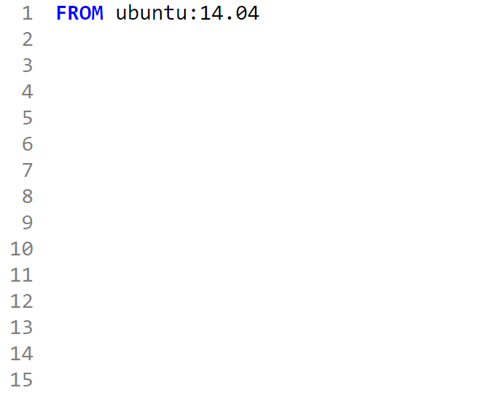
FROM
Must start with FROM
Specifies the Base Image from which you are building
Base image on which the subsequent instructions will be executed
Pulls image from public registry, if no registries are mentioned

Slide 73
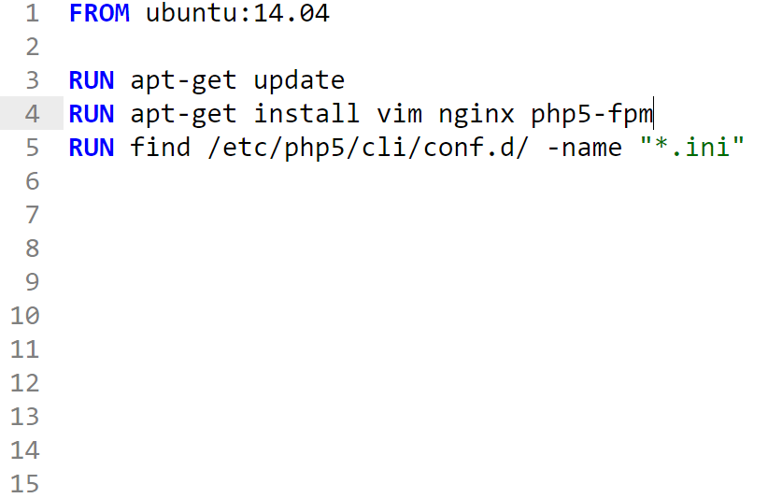
RUN
RUN instruction will execute any commands in a new layer on top of the current image and commit the results.
The resulting committed image will be used for the next step in the Dockerfile

Slide 74
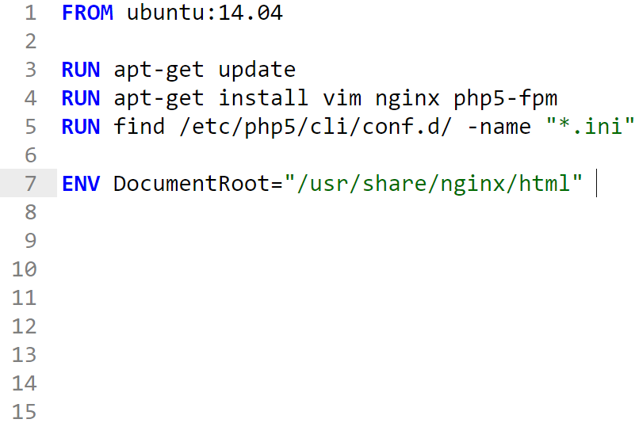
ENV
ENV instruction sets the environment variable <key> to the value <value>.
This value will be used in the environment for all subsequent instructions in the Dockerfile

Slide 75
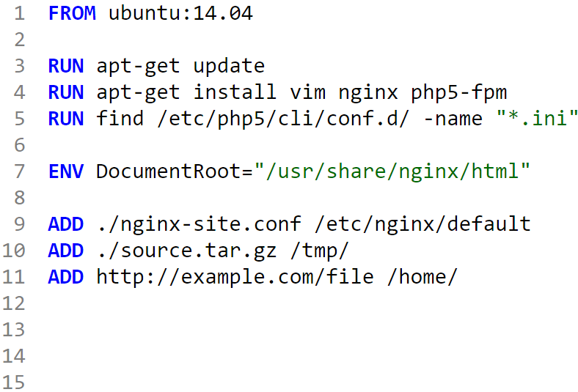
ADD / COPY
Copies file from a source path to a destination path in the container
Some compressed formats will be uncompressed
Source can be a URL as well
COPY can also be used for copying files/directory from host

Slide 76
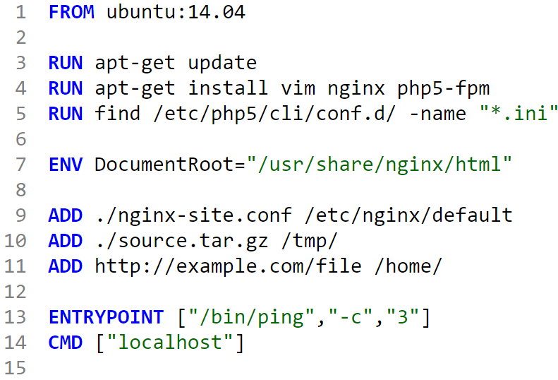
CMD
Main purpose of a CMD is to provide defaults for an ENTRYPOINT
3 Forms
Only the last CMD instruction in the Dockerfile will have an effect

Slide 77
ENTRYPOINT and CMD
Both CMD and ENTRYPOINT instructions define what command gets executed when running a container
There are few rules that describe their co-operation:
Dockerfile should specify at least one of CMD or ENTRYPOINT commands
ENTRYPOINT should be defined when using the container as an executable
CMD should be used as a way of defining default arguments for an ENTRYPOINT command
CMD will be overridden when running the container with alternative arguments
https://docs.docker.com/engine/reference/builder/#cmd
https://docs.docker.com/engine/reference/builder/#entrypoint

Slide 78
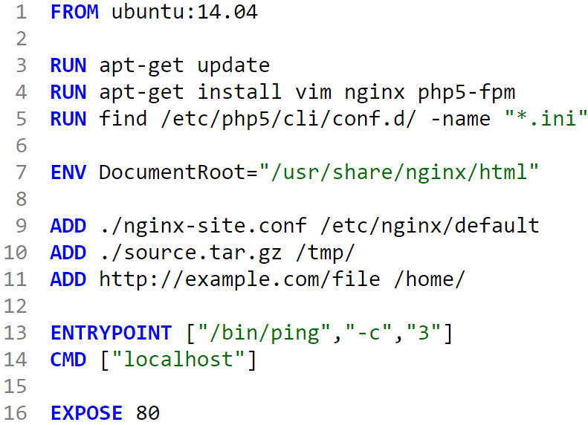
EXPOSE
EXPOSE instruction informs Docker that the container listens on the specified network ports at runtime.
You can specify protocol as well
Does not make ports of the container accessible to the host

Slide 79
ENTRYPOINT
ENTRYPOINT allows you to configure a container that will run as an executable
Execute and Shell format
ENTRYPOINT ["executable", "param1", "param2"] (exec form, preferred)
ENTRYPOINT command param1 param2 (shell form)
Only the last ENTRYPOINT instruction in the Dockerfile will have an effect

Slide 80
Docker build
Build an image on the host using Dockerfile
$ docker build -t repo/myapp .
$ docker build -t repo/myapp -f /path/to/a/Dockerfile .

Slide 81
Lab
Lab 6:
Building a custom Dockerfile for a web application

Slide 82
Docker Compose
Tries to solve the problem of multi-container applications
Can do the following:
Build/Pull image from repo
Define multiple services with inter-dependencies
Life cycle commands at the entire app level

Slide 83
Docker Compose File
Written in a .yml file
Latest version 3.7
Declare all services under ‘services’ key
High level components:
services
volumes
networks
version: ‘3'
services:
web: build: .
depends_on:
- db
- redis
redis:
image: redis
db:
image: postgres

Slide 84
Dockerfile and depends_on
Compose can pull images from Docker Hub or will use a Dockerfile to build custom images
Express dependencies between services
build:
context: .
dockerfile: Dockerfile
--------
services:
web: build: .
depends_on:
- db
- redis

Slide 85
Compose Commands
Compose has commands for managing the whole lifecycle of your application:
Start, stop and rebuild services
View the status of running services
Stream the log output of running services
Run a one-off command on a service

Slide 86
Commands
docker-compose ps
docker-compose up
docker-compose start
docker-compose logs –f
docker-compose restart
docker-compose stop
docker-compose down

Slide 87
Use Case
Development Environments
Easy for developers to work multi-component environments
Testing Environments
Entire application stack can be started/terminated by just one command.
Makes it easy to run your tests against complete stack
Deploy to remote hosts with Docker Engine & Docker Swarm

Slide 88
Lab
Lab 7:
Docker Compose Lab

