Slide 1
Gear Lending Library System WTA
Group 1: Lyza Thenumkal, Bakkiyalakshmi Ramanjulu, Nitika Goyal
Group 2: Kellie Fontes, Scott Shipp, Temourshah Ahmady
Group 3: Hesham Alsaeedi, Martina Ugwuh, Kyle McNutt
Group 4: Hatoon Almoajel, Matthew Smith, Micheal Cheung

Slide 2
Background: WTA Gear lending library
WTA lends hiking and backpacking gear
Trip leaders "check out" the gear like checking books out of a library
Admins need to manage things like:
Gear in inventory
Current and future reservations
What is still available so that other trip leaders know what they can check out, etc.

Slide 3
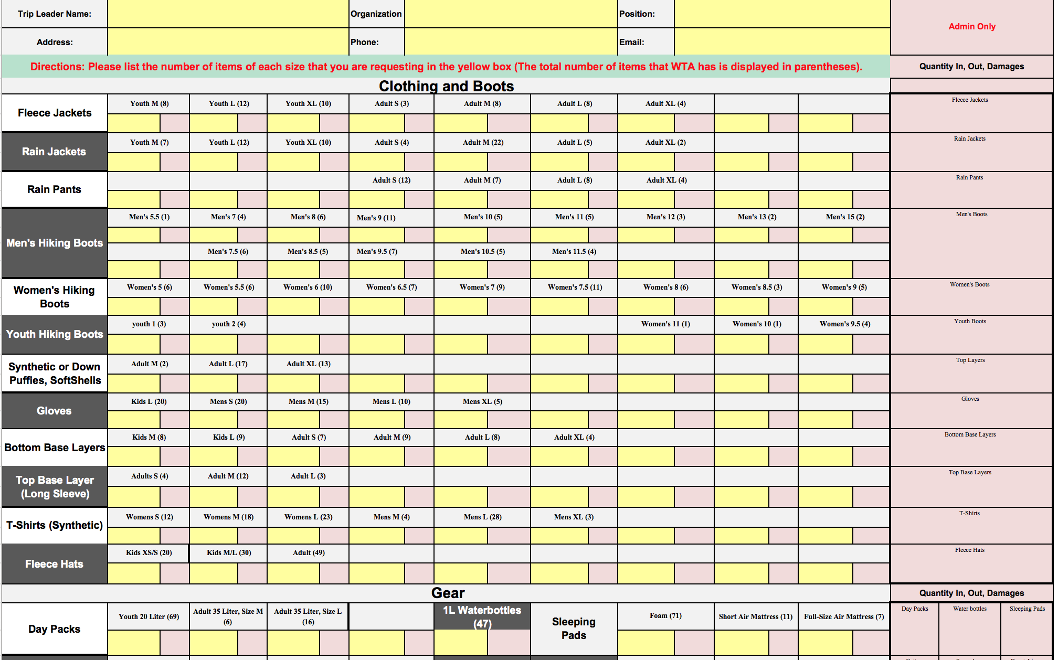
Problem Introduction
Notes:
First explain the problem that was being faced
Tedious and inefficient system to manage gear inventory.
Lots of overhead to manage gear requests.

Slide 4
Overview: WTA Gear lending library
Existing Issue | How Fixed
Manual process using multiple Excel files | Modern web application on MEAN stack
Trip leaders download an Excel file, fill it out, email it, and wait for a response | Trip leaders now create a reservation request online and can view request status at any time
Admins are required to manually verify availability of gear for requested timeframes after the request is made | Online system generates real-time view of currently available inventory and presents it to trip leaders while they fill it out
Overview

Slide 5
Overview: WTA Gear lending library
Existing Issue | How Fixed
Admins manually / externally track inventory | Inventory can be updated at any time in the system
Gear details not available to view | Trip leaders can view more information about each item while making their reservation
Admins track down the specific Excel file per reservation to manually manage gear check-in | Each reservation is stored in a single online system available at any time and checkin happens in the same system
Overview

Slide 6
overview
Summary
This new front end interface would improve the user experience greatly and allow for Leaders to have a more accurate view into what gear is currently available to borrow. All of this allows for a lower bar of entry in order to get the correct gear to more group’s and get more kids walking on some of the amazing Washington Trails.
Future plans
Possibly provide a fully functional web application that would be handed off to the WTA technical team to implement and maintain
Generate more statistical reports to identify busy seasons of the year, over- or under-utilized inventory, frequent borrowers, etc.

Slide 7
Who is your audience?
Administrator
Volunteer
Trip Leader

Slide 8





Audience personas
Administrator
Volunteer
Trip Leader
Primary system user
Receives and processes requests from the system
Manages the gear inventory
Generates reports
Assists primary system user
Works on the processing of gear requests and inventory
Leaders of a youth organization/group who request gear on behalf of youth
Searches for relevant gear
Submits/Updates/
Cancels request
Refers to request history
Relies on the system to know the pickup and dropoff
Notes:
WHAT ARE THEIR CHARACTERISTICS? WHAT DO WE KNOW ABOUT THEM?

Slide 9
WTA GLLS – Feature Summary
Feature Group | ID | Description
Gear Request Process | US-01 | View gear availability based on requested dates.
 | US-02 | View additional gear information.
 | US-03 | Create and submit a gear request.
Gear Request Management | US-04 | Modify gear request.
 | US-05 | View gear request summary.
 | US-06 | Gear pick-up/return dates reminders.
 | US-07 | Approve/Reject gear request.
 | US-08 | Manage the return of borrowed gears
Gear Inventory Management | US-09 | Update the gear inventory.
 | US-10 | View report of inventory items.
 | US-11 | View report of gear request trends across seasons.
 | US-12 | View report of gear availability.

Slide 10
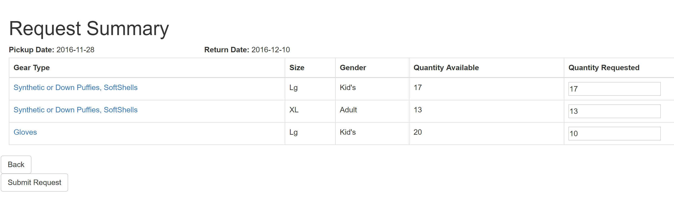
Feature 1 – Gear Request
Selecting Start Date/End Date
Viewing gears and Quantity Available
Input quantity requested
Submit request

Slide 11
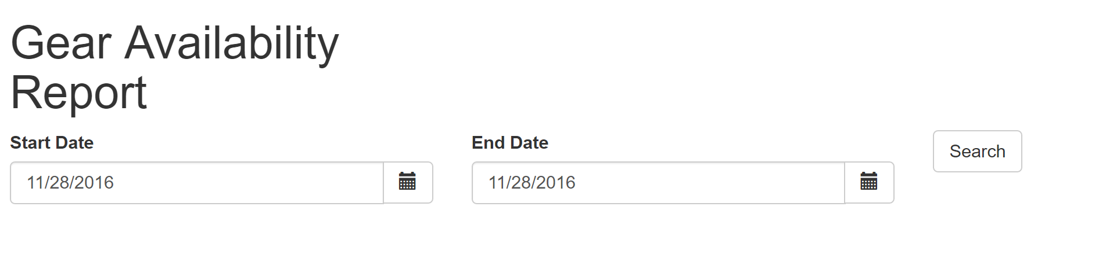
Feature 2 – Gear Availability Report
Selecting Start Date/End Date
Viewing gears and Quantity Available

Slide 12
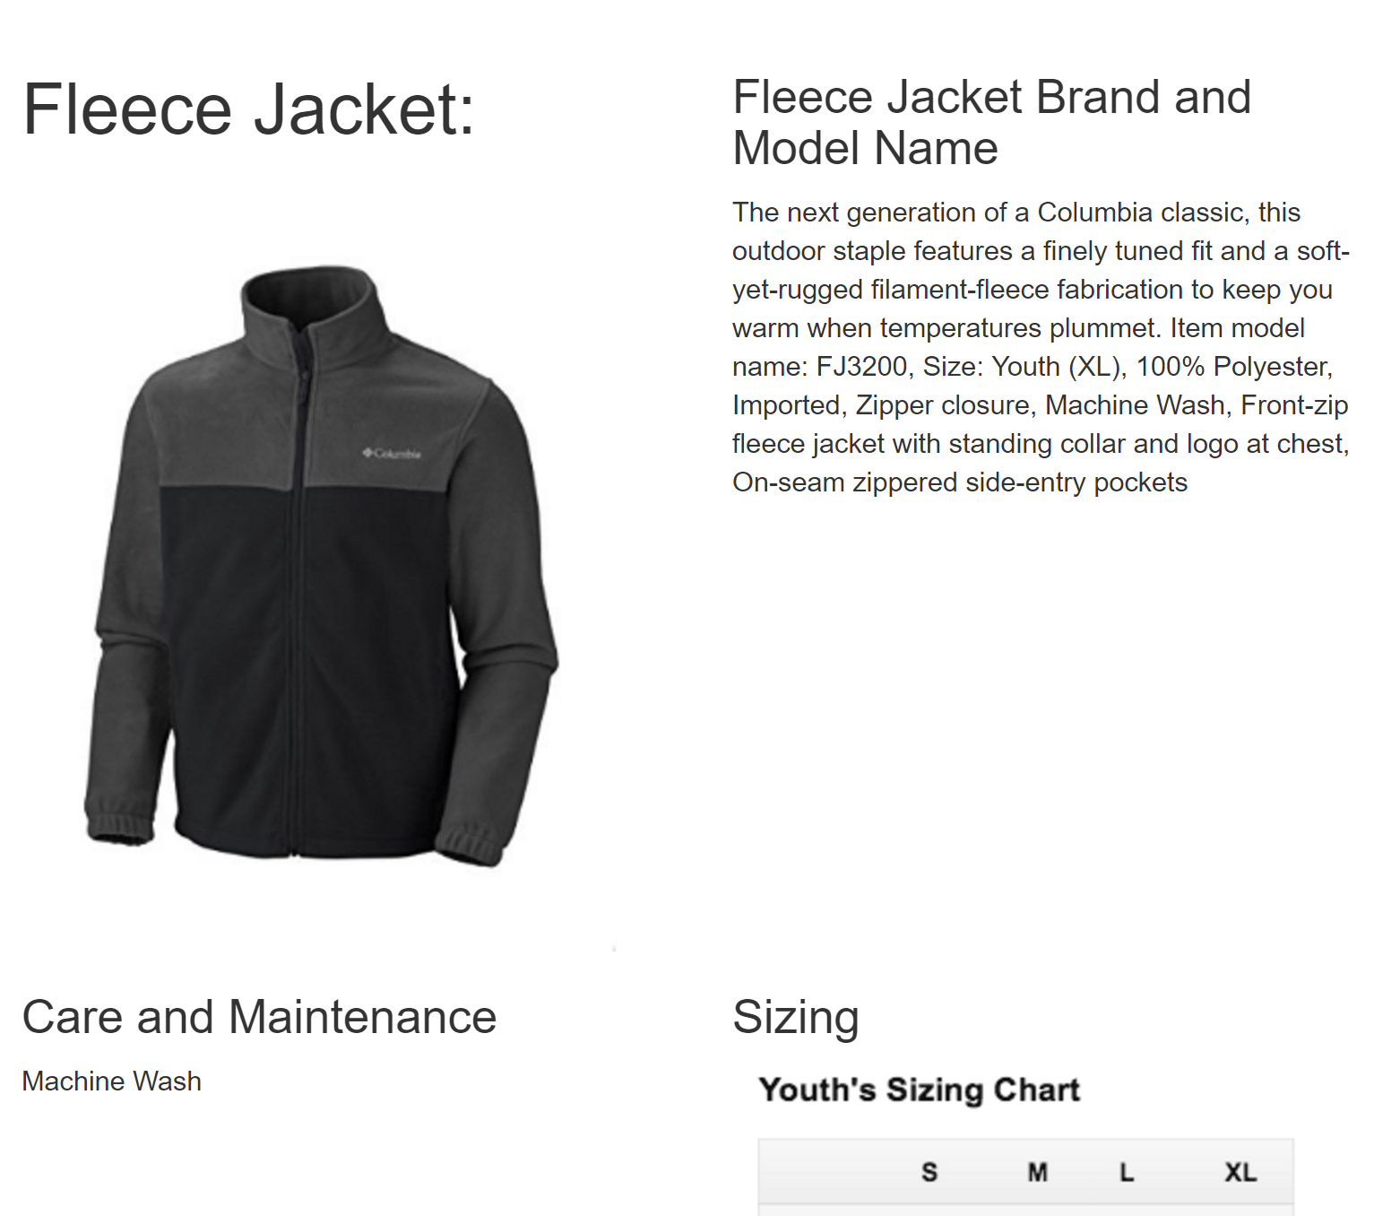
Feature 3 – Additional Gear Information
Each gear has a clickable link that has details about the gear.

Slide 13
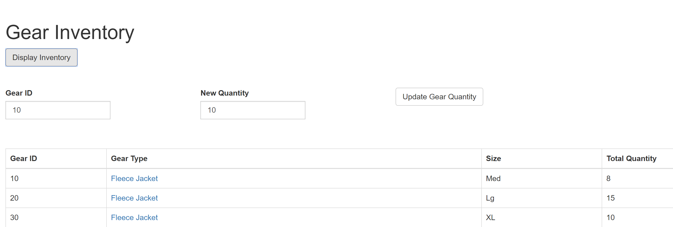
Feature 4 – Updating gear inventory
Admin can update gear quantity by typing in Gear ID and New Quantity

Slide 14
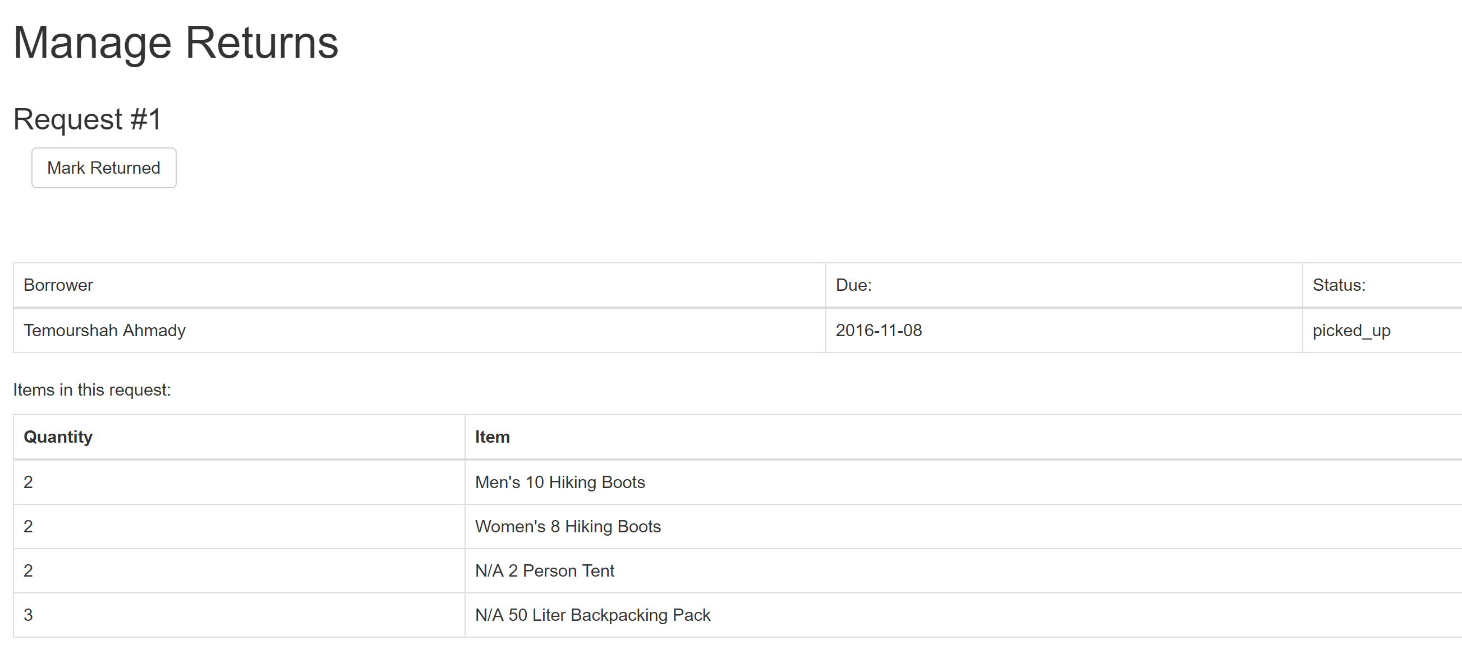
Feature 5 – Managing Gear Requests
Admin can manage the returns of borrowed gears.

Slide 15
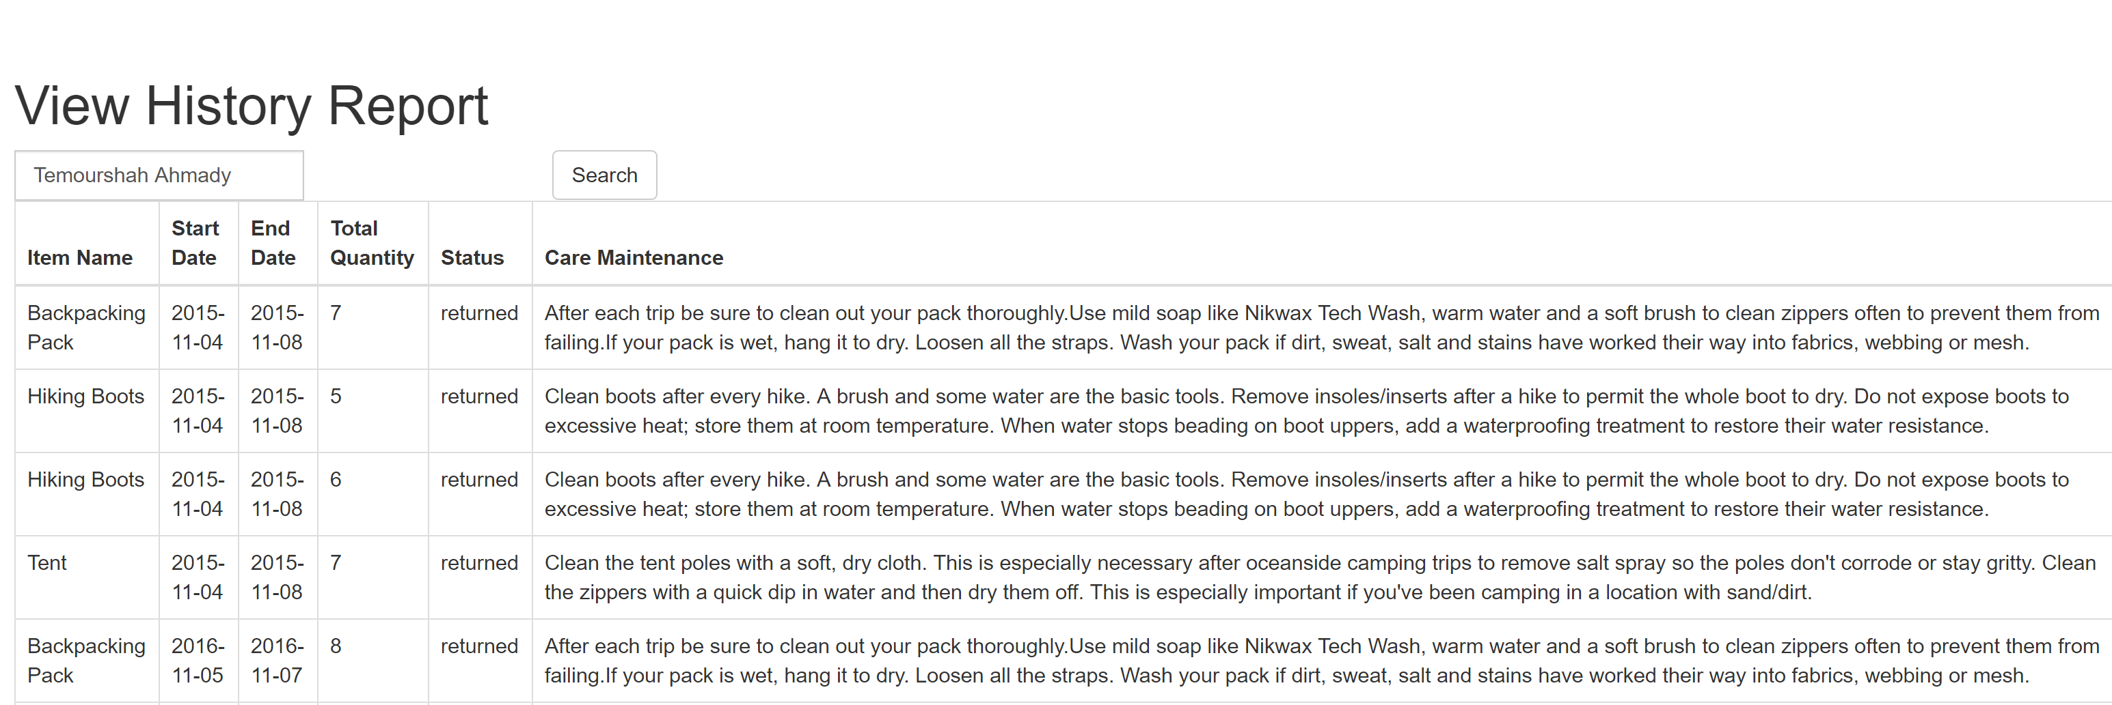
Feature 6 – History Report
Admin view gear request checkouts of a Trip Leader.

Slide 16
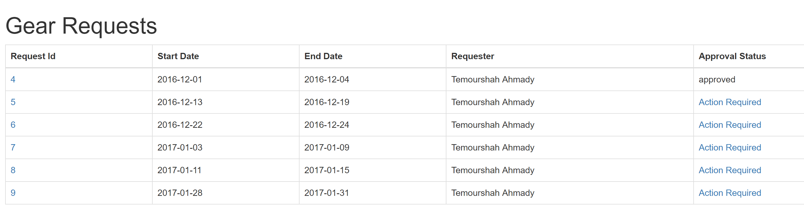
Feature 7 – Approving Gear Requests
Admin can approve or reject gear requests.

Slide 17
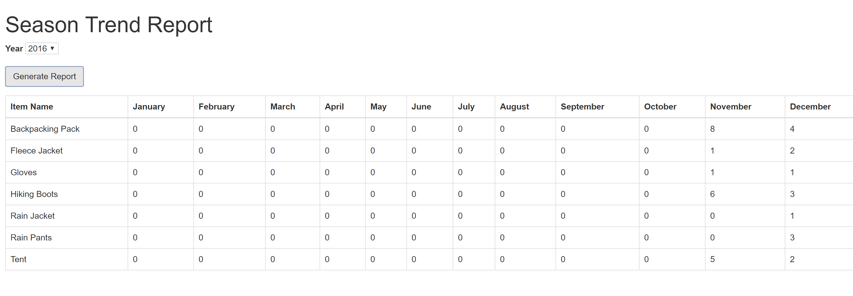
Feature 8 – Trend Report
Admin can view report of gear request trends across seasons.

Slide 18
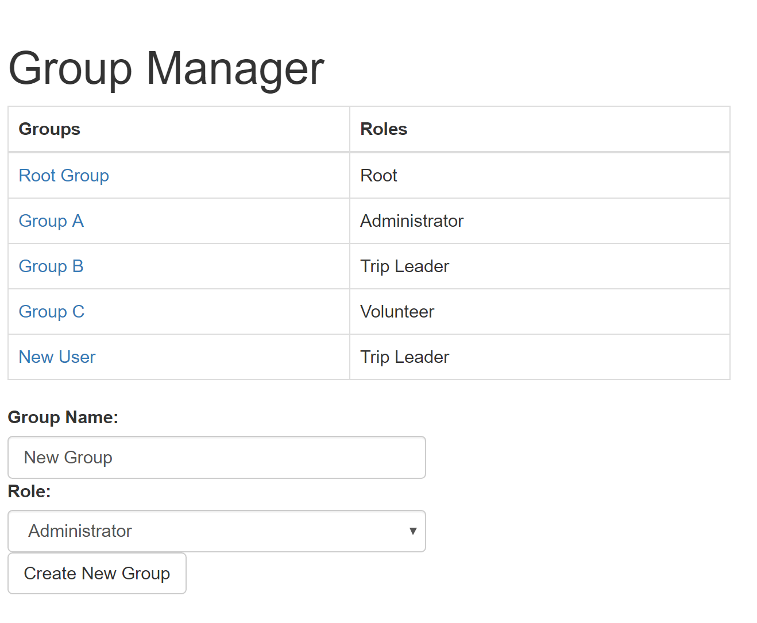
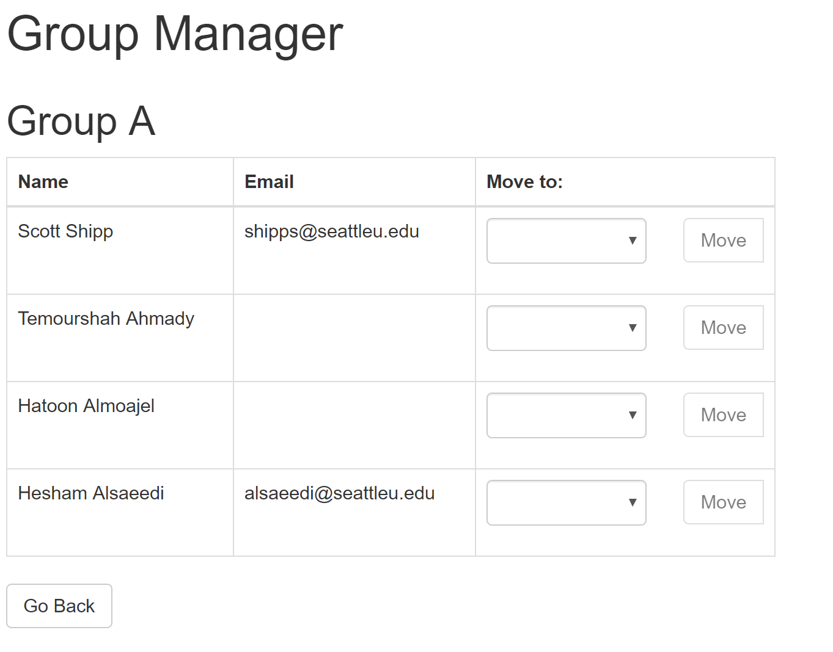
Feature 9 – Manage Groups
Admin can create new groups and assign roles to the groups.
Admin assign users to a group.

Slide 19
Feature 10 - Reminders
Trip Leader/Admin:
Email notification 2 days prior to pickup date.
Email notification 2 days prior to return date

Slide 20
Product Demo

Slide 21
The Architecture of the System

Slide 22
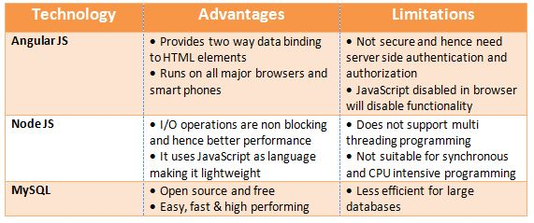
Technology used

Slide 23
Customer Feedback
Discuss whatever feedback your customer shared with you: How well does it meet their needs?
§ The new system helps the WTA to maintain gear inventory with a central repository.
§ The trip leaders can reschedule the trips and request for change in gears requested.
§ It can be accessed anywhere and anytime through browsers.
§ Reduces manual intervention.
Future enhancements they’d like to see
In future, users wants to access the new system using phone, tablet, computers etc.
General feedback
New system enhanced many features such as create gear request, generate report, enables the access to the gear library inventory, update changes in trip dates, modify gear request anytime.

Slide 24
The Process
Designing Schema: - All the teams worked on a decided single schema
Implementation of User Stories – Divided into 4 groups of 3 members. Each member had one user story.
Integration – Integrated 4 groups scenarios
Testing- Done parallel testing with development
1 Sprint = 2 weeks
Authorization/Authentication -

Slide 25
Show Your Schedule
1
2
3
4
5
6
7
8
9
10
Week
1 | 2 | 3 | 4 | 5 | 6 | 7 | 8 | 9 | 10
Design Schema
Implement User Stories
Initial Project Setup
Database Creation
User Story Services
Testing
Authorization / Authentication

Slide 26
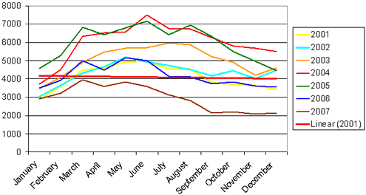
Additional enhancements - additional enhancements that could be made?
Graphical view for reports such as gear request trends across seasons.
Customizable UI

Slide 27
Project Dynamics -How did your team divide up the work?
Initial NodeJS/MySQL DB Setup - Hesham + other testers
Initial Angular UI Setup – Kyle + other testers
Implement US-11, US-01, US-07
Team# 1: Lyza, Bakkiyalakshmi, Nitika
Implement US-10, US-02, US-08
Team #2: Kellie, Scott, Temourshah
Implement US-12, US-05, US-03
Team #3: Hesham, Martina, Kyle
Implement US-04, US-06, US-09
Team #4: Michael, Hatoon, Matthew
Integration/Merging on Git - All teams

Slide 28

Inputs for future projects
Mobile-friendly version.
Integration with WTA website.
Host on the Cloud.

