Slide 1


RTRP-A-17
BHOJ REDDY ENGINEERING COLLEGE FOR WOMEN DEPARTMENT OF INFORMATION TECHNOLOGY II B Tech. II Sem. A Section Project Abstract Seminar Academic Year 2024-25 Date: - -2025 Student Council Election Hub
PRESENTED
BY
M Lavanya 23321A1239
P Laxmisree 23321A1240
D Laxmi Prasanna 23321A1241
Dr M Sandhya Rani Dr C Murugamani
Co Ordinator HOD-IT

Slide 2
CONTENTS
Introduction
Existing System
Proposed System
Functional Requirements
Non-Functional Requirements
Modules
Computational resources

Slide 3
INTRODUCTION
In many educational institutions, students elections face challenges such as manual inefficiencies, lack of transparency, security concerns and low student engagement.
Traditional voting methods, including paper ballots and in-person polling often lead to errors in vote counting, delay in results and announcements.
The absence of a centralized, secure and transparent system results in distrust among students, discouraging participation in the democratic process.
There is a need for digital, tamper proof election platform that ensures fairness, improves accessibility and provides real-time updates, making campus election more efficient and engaging.

Slide 4
EXISTING SYSTEM
Existing systems like paper ballots, manual inefficiencies, security concerns and low student engagement.
Votes are manually counted by election officials leads to human errors, voter fraud and delays in result announcements.
In some institutions, it is difficult to engage with all the students, especially in large campuses.
Lacks robust security measures (eg: multiple voting from the same user, unauthorized access).
Voting locations are typically fixed, so only students who are on campus or near the polling stations can participate. This excludes students who may be off-campus are unable to physically get to a voting station.

Slide 5
DISADVANTAGES
Lack of Transparency
Security Risks
Time – Consuming Process
Low Student Engagement
Campaigning pressure

Slide 6
PROPOSED SYSTEM
The student council election hub is a secure, transparent and efficient digital voting platform designed to modernize student elections.
This system eliminates the inefficiencies of traditional methods by integrating automated voting and strong security mechanisms.
Students can cast votes online using a web or mobile platform.
Multi-factor authentication(student ID) ensures only authorized students vote.
Each candidate can create a profile with the information about themselves, their qualifications, goals and campaign promises.

Slide 7
ADVANTAGES
Efficiency and Time-Saving
Increased Student Participation
Cost-Effective
Sustainability
Security & Data-Integrity

Slide 8
FUNCTIONAL REQUIREMENTS
These are the requirements that the end user specifically demands as basic facilities in the form of input to be given to the system, the operation performed and the output expected. They are basically the requirements stated by the user which one can see directly in the final product.
• User Management
• Vote Updates
• View Candidates rules, positions
• Cast your Vote
• Cloud Resource Management

Slide 9
NON-FUNCTIONAL REQUIREMENTS
Non-functional requirements describe the qualities or attributes that the system must have, such as performance, security, usability and scalability. It should deliver fast, seamless performance across devices. Compliance with security standards ensures data integrity, user privacy, and fraud prevention.
Performance
Security
Scalability
Usability
Maintainability

Slide 10
MODULES
1. Student Management Module
Student registration and login.
Profile management.
2. Election Management Module
Defines election rules, dates and positions.
Review and approve candidate applications.
3. Candidate Promotion Module
Candidates display their qualifications, goals and campaign promises.
Allow students to engage with candidates.
Students an submit questions to be answered by the candidates.

Slide 11
.
4. Voting & Authentication Module
Multi-factor authentication (student ID verification, login) is provided.
Ensures privacy and prevents duplicate voting.
5. Cloud Resource Management Module
Ensures scalability and optimal resource utilization.
Load balancing to handle large user volumes.
6. Security and Fraud Prevention Module
Safeguards the system from unauthorized access and fraud.
User authentication.

Slide 12
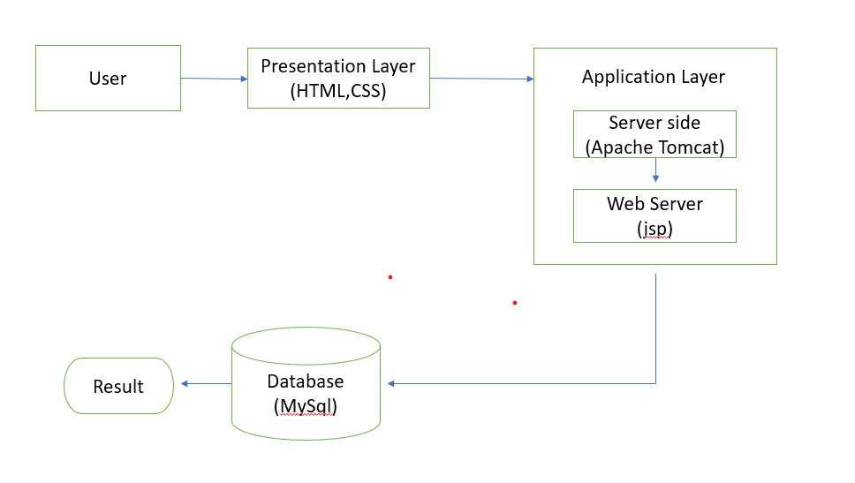
TECHNICAL ARCHITECTURE

Slide 13
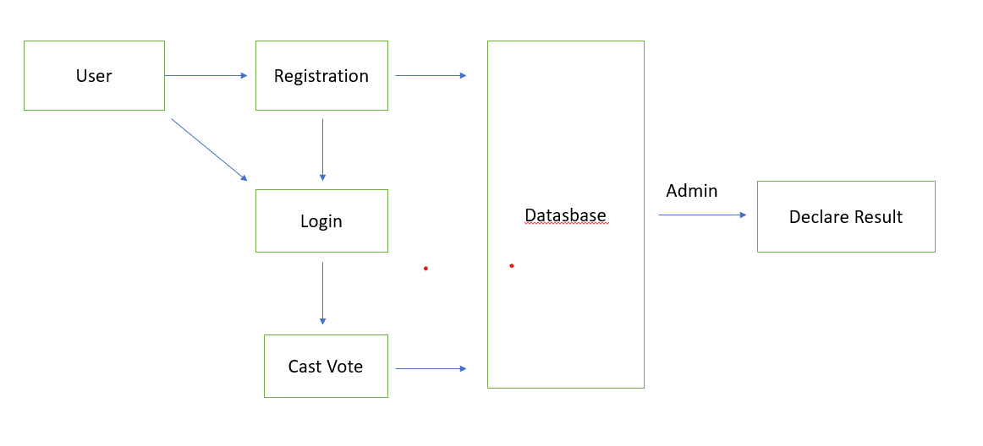
SYSTEM ARCHITECTURE

Slide 14
COMPUTATIONAL RESOURCES
Software Requirements:
Front-end : HTML, CSS, JavaScript.
Back-end : Node JS, Python.
Database Management : MySQL.
Development Tools : Visual Studio Code.

Slide 15
COMPUTATIONAL RESOURCES
Hardware Requirements:
Processor : Multi-core CPU (e.g., Intel Xenon).
RAM : 8GB or above.
Hard Disk : 100 GB or more.
Operating System : Windows 10, or Linux

Slide 16
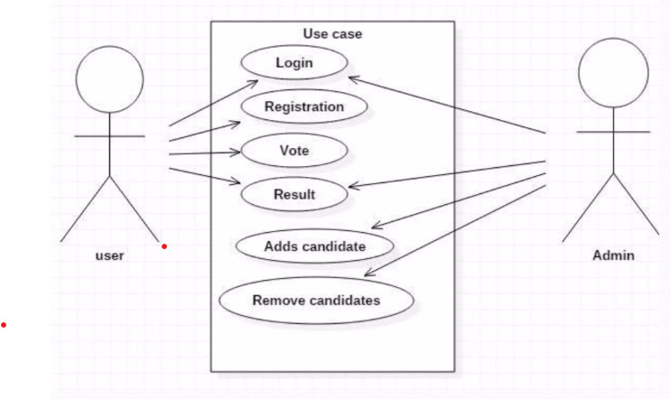
UML DIAGRAMS
Use case diagram:

Slide 17
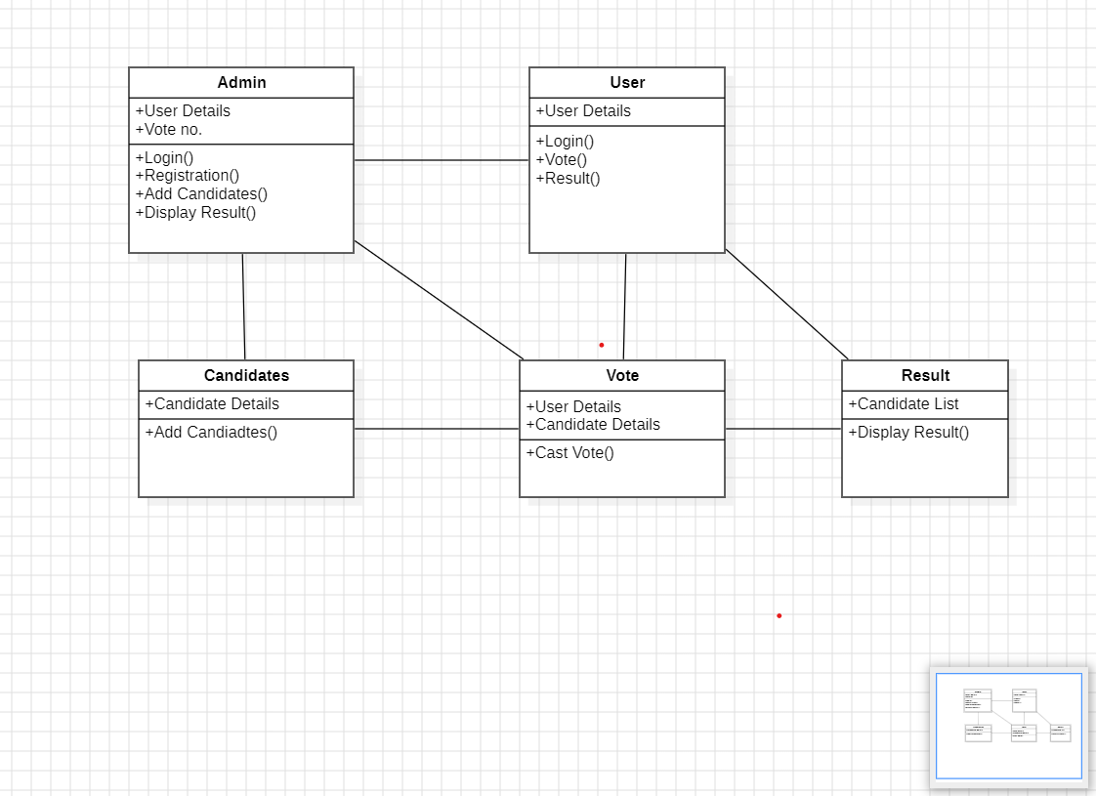
Class diagram:

Slide 18
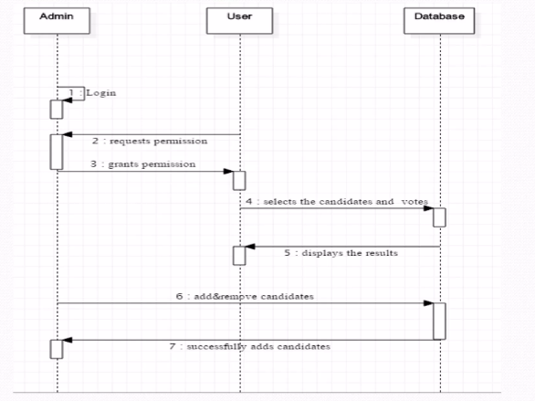
Sequence diagram:

Slide 19
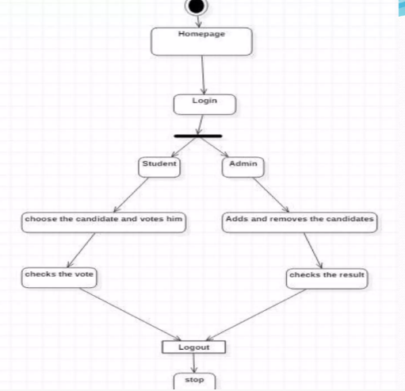
Activity diagram:

Slide 20
Implementation:
<!DOCTYPE html>
<html lang="en">
<head>
<meta charset="UTF-8">
<meta name="viewport" content="width=device-width, initial-scale=1.0">
<title>student election</title>
<link rel="icon" type="image" href="logo.1.jpg">
<link rel="stylesheet" href="style1.css">
</head>
<body>
<section class="header">
<nav>
<header class="election-header">
<h1>Student Council Election Hub</h1>
<p class="tagline">Your Vote. Your Voice. Your Future.</p>
</header>
<div class="nav-links">
<ul>
<li><a href="main.html">Home</a></li>

Slide 21
<li><a href="About.html">About</a></li>
<li><a href="register.html">Register</a></li>
<li><a href="login.html">Login</a></li>
<li><a href="add_candidate.jsp">candidate</a></li>
<li><a href="vote.jsp">vote</a></li>
</ul>
</div>
</nav>
</section>
<div class="f1">
<h1 style="text-align:center">ONLINE VOTING SYSTEM</h1><br>
<br>
<p align="center" >An online voting system is a software platform that allows groups to securely conduct votes and elections. High-quality online voting systems balance ballot security, accessibility, and the overall requirements of an organization's voting event. This system typically aims to modernize the way student government elections, club votes, or any other campus-related decisions are made</p>
</div>
<section class="Key Features">
<h1 align="center">Key Features of a Student Online Voting System:</h1>
<div class="row">
<div class="user">

Slide 22
<h2>User Authentication</h2>
<p>Students can log in to the system using their university credentials (like student IDs and passwords). Authentication ensures that only eligible students can vote.</p>
</div>
<div class="user">
<h2>Election Creation</h2>
<p>Administrators (like the student council or election organizers) can create and manage elections, including defining the candidates, voting options, and election period.</p>
</div>
<div class="user">
<h2>Voting Process</h2>
<p>Once the election starts, students can view the list of candidates and their respective platforms, or vote on specific issues (e.g., for student body president, class representatives, etc.).
Voting can be done through a simple interface with radio buttons, checkboxes, or dropdown menus.</p>
</div>
</div>
</section>
<section class="key f1">
<div class="col">
<div class="user1">
<h2>Security and Integrity</h2>
<p>The system must ensure the integrity of the voting process by preventing duplicate voting (each student can vote only once).
Secure encryption methods should be used to protect voting data and student privacy.
</p>

Slide 23
</div>
<div class="user1">
<h2>Mobile and accessibility</h2>
<p>Students can vote from their computers, tablets, or mobile phones, making the process more convenient and accessible.</p>
</div>
</div>
</section>
<br>
</body>
</html>
</p>
*{
margin: 0;
padding: 0;
}
.header{
height:950px;
width:1500px;
background-image:url("image3.1.jpg");
background-position: center;
background-size:cover;
background-repeat:no-repeat;
}

Slide 24
nav {
display: flex;
padding: 2px 6px;
justify-content: space-between;
align-items: center;
}
nav img{
width:150px;
}
.nav-links{
flex: auto;
text-align: right;
}
.nav-links ul li{
list-style: none;
display:inline-block;
padding:30px;
}
.nav-links ul li a{
font-size: 28px;
color: azure;
text-decoration: none;
}

Slide 25
.f1{
font-family: Arial, sans-serif ;
}
* {
margin: 0;
padding: 0;
box-sizing: border-box;
}
.f1{
padding:50px;
}
.f1 p{
font-family:'Times New Roman', Times, serif;
}
.row{
margin-top:5%;
display:flex;
justify-content: space-between;
text-align: center;
gap: 50px;
.user{
flex: basis 31;
background-color: rgb(31, 195, 228);
border-radius: 10px;

Slide 26
margin-bottom: 5%;
padding: 20px 12px;
box-sizing:border-box;
text-align: center;
}
.col{
margin-top:5%;
display:flex;
justify-content: space-between;
text-align: center;
gap: 5%;
}
.user1{
flex: basis 31;
background-color: rgb(31, 195, 228);
border-radius: 10px;
margin-bottom: 5%;
padding: 20px 12px;
box-sizing: border-box;
text-align: center;
}
.user1 p{
font-family: 'Times New Roman', Times, serif;
}

Slide 27
nav h1{
font: size 80px;
}
.election-header {
background: linear-gradient(to right, #0057b7, #00aaff);
color: white;
text-align: center;
padding: 60px 20px 40px;
box-shadow: 0 4px 8px rgba(0,0,0,0.1);
}
.election-header h1 {
margin: 0;
font-size: 2.8rem;
letter-spacing: 1px;
}
.election-header .tagline {
font-size: 1.2rem;
margin-top: 10px;
color: #e0f7ff;
}

Slide 28
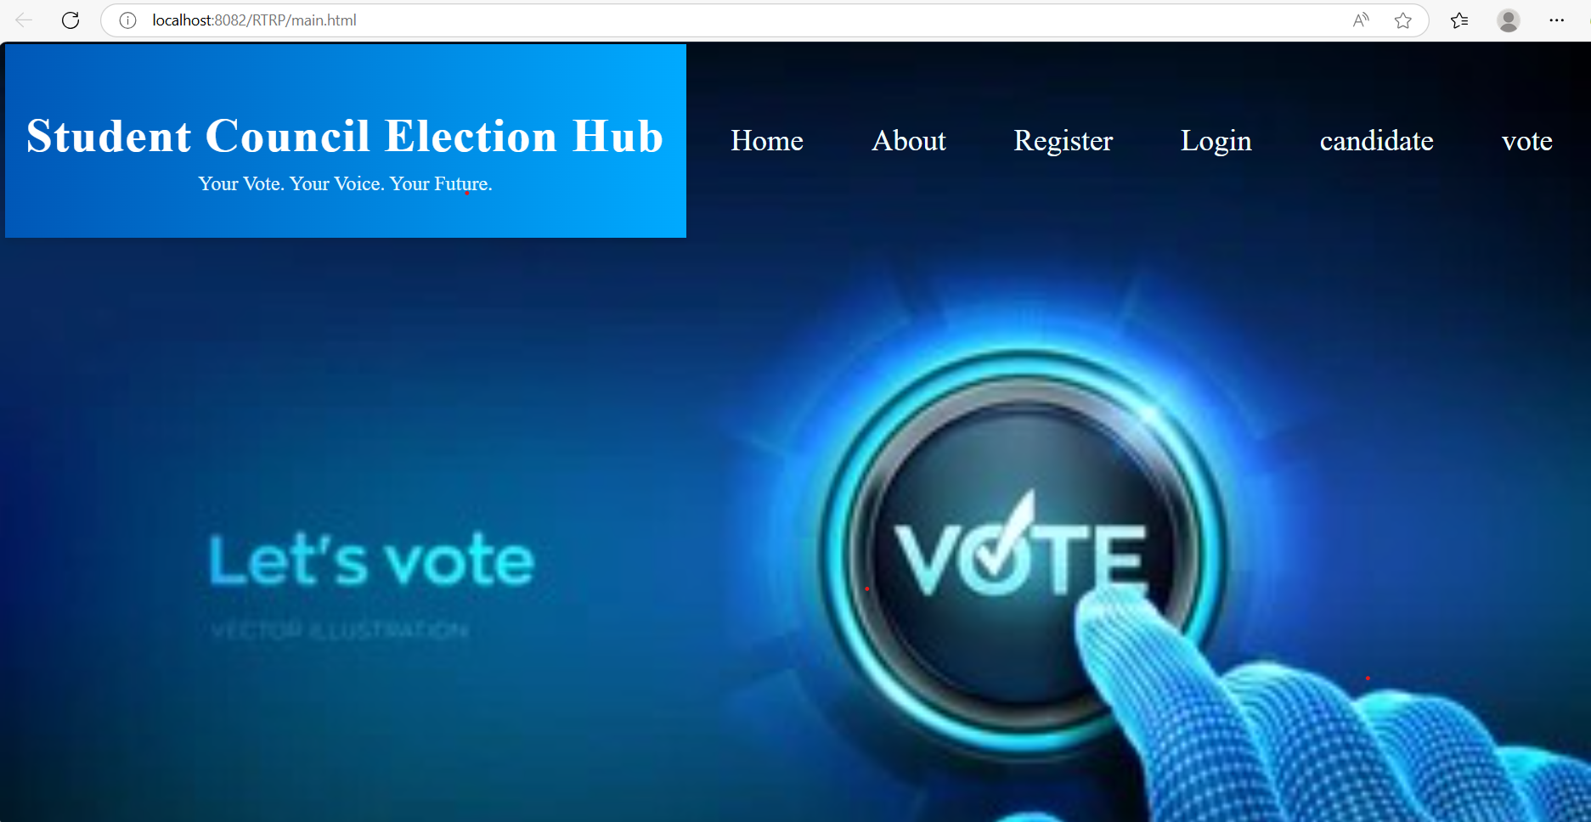
Screenshots:

Slide 29
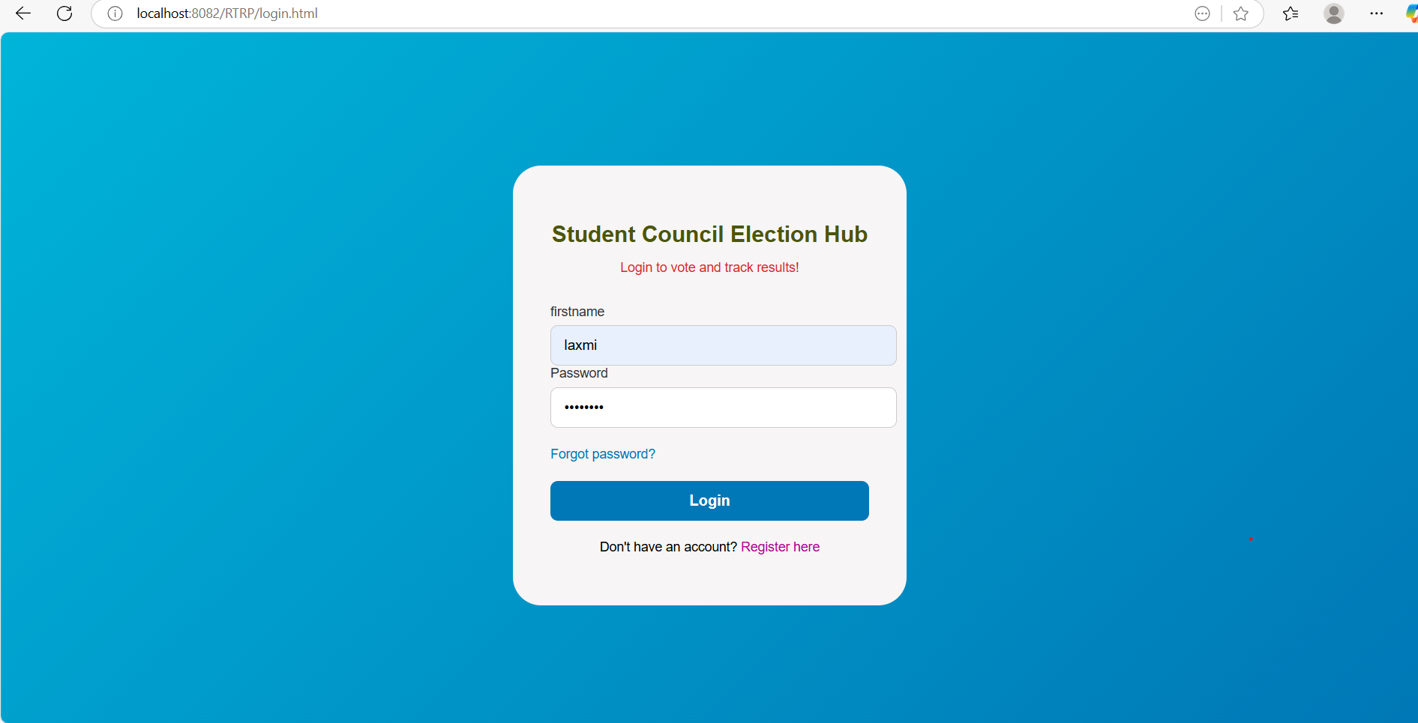

Slide 30
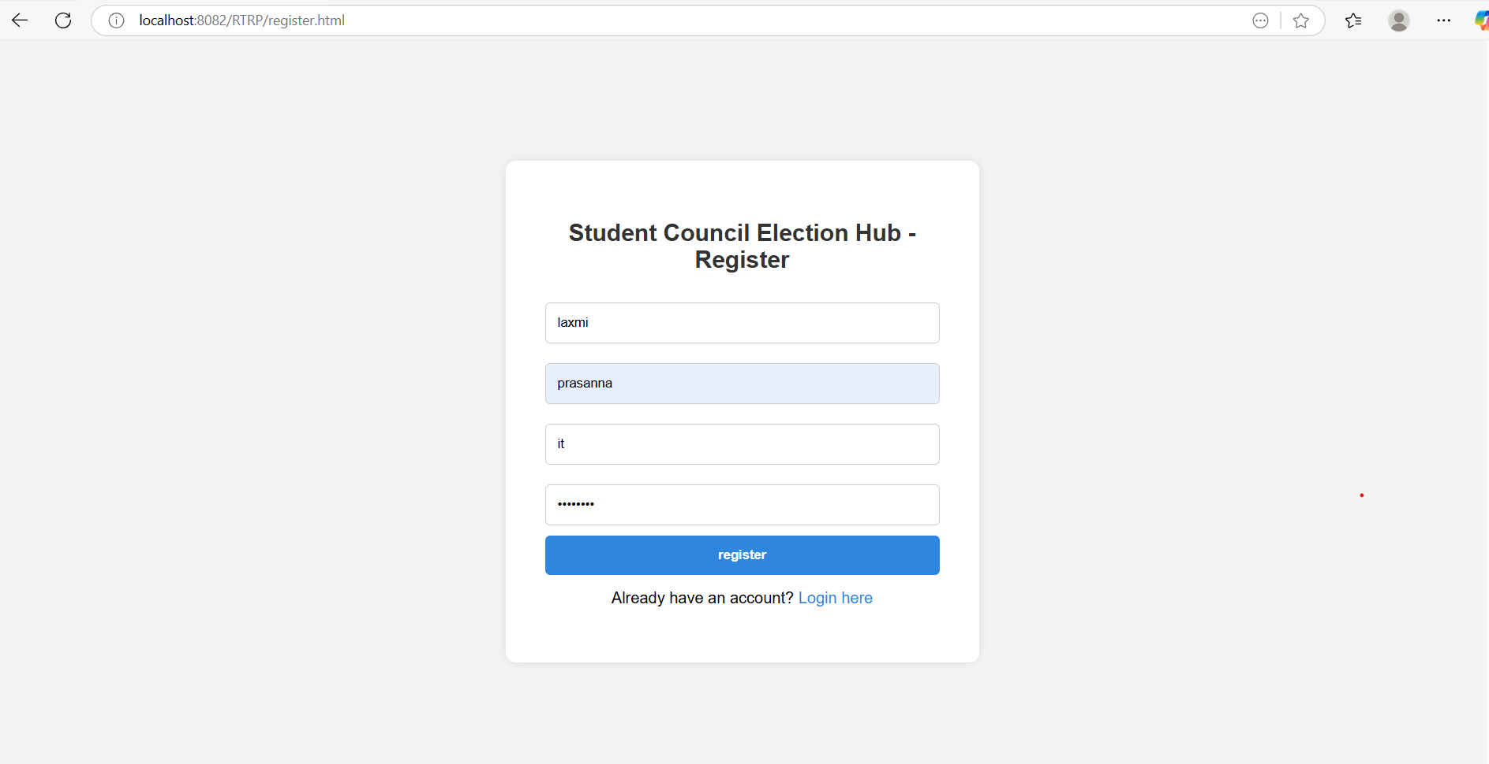

Slide 31
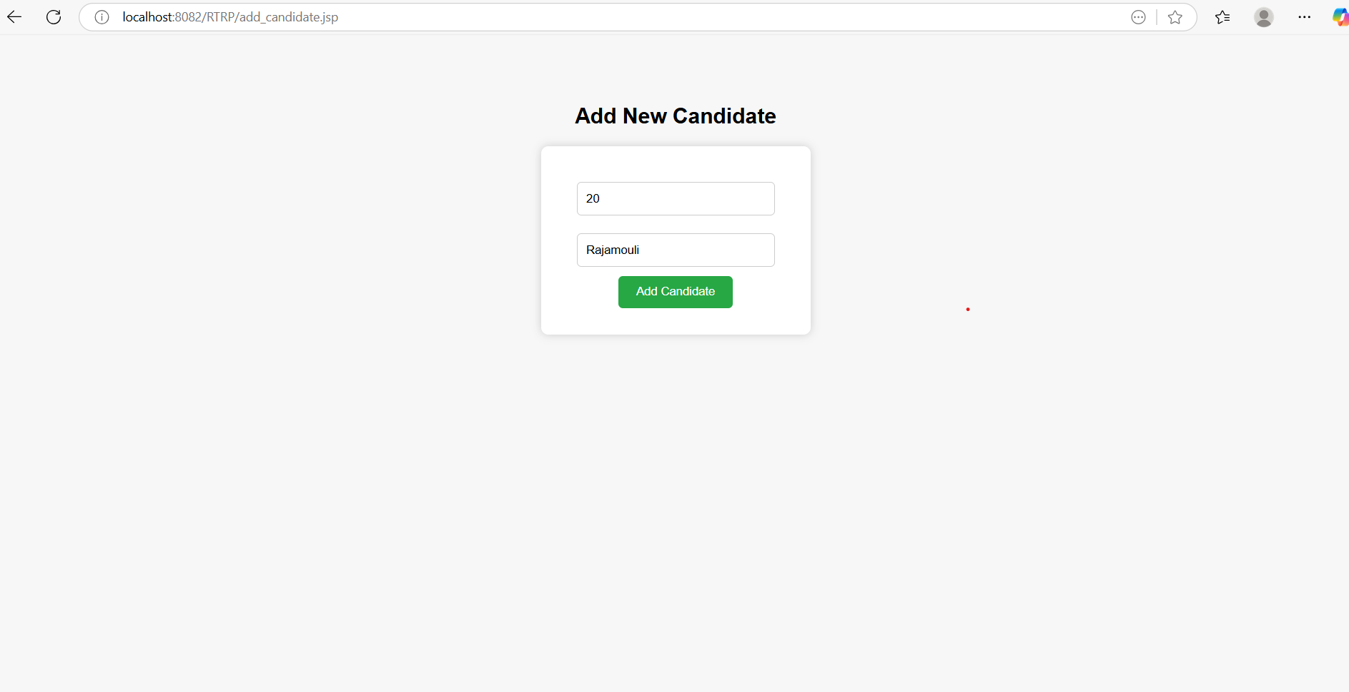

Slide 32
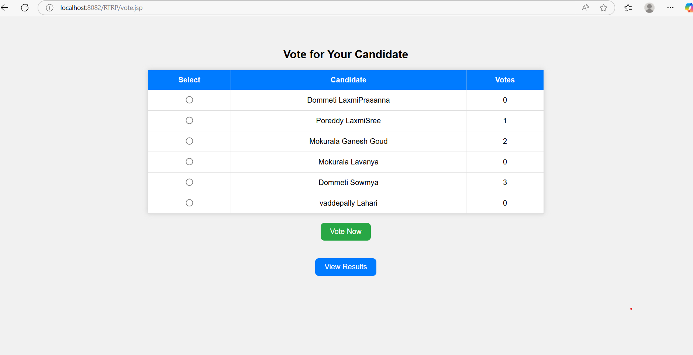

Slide 33
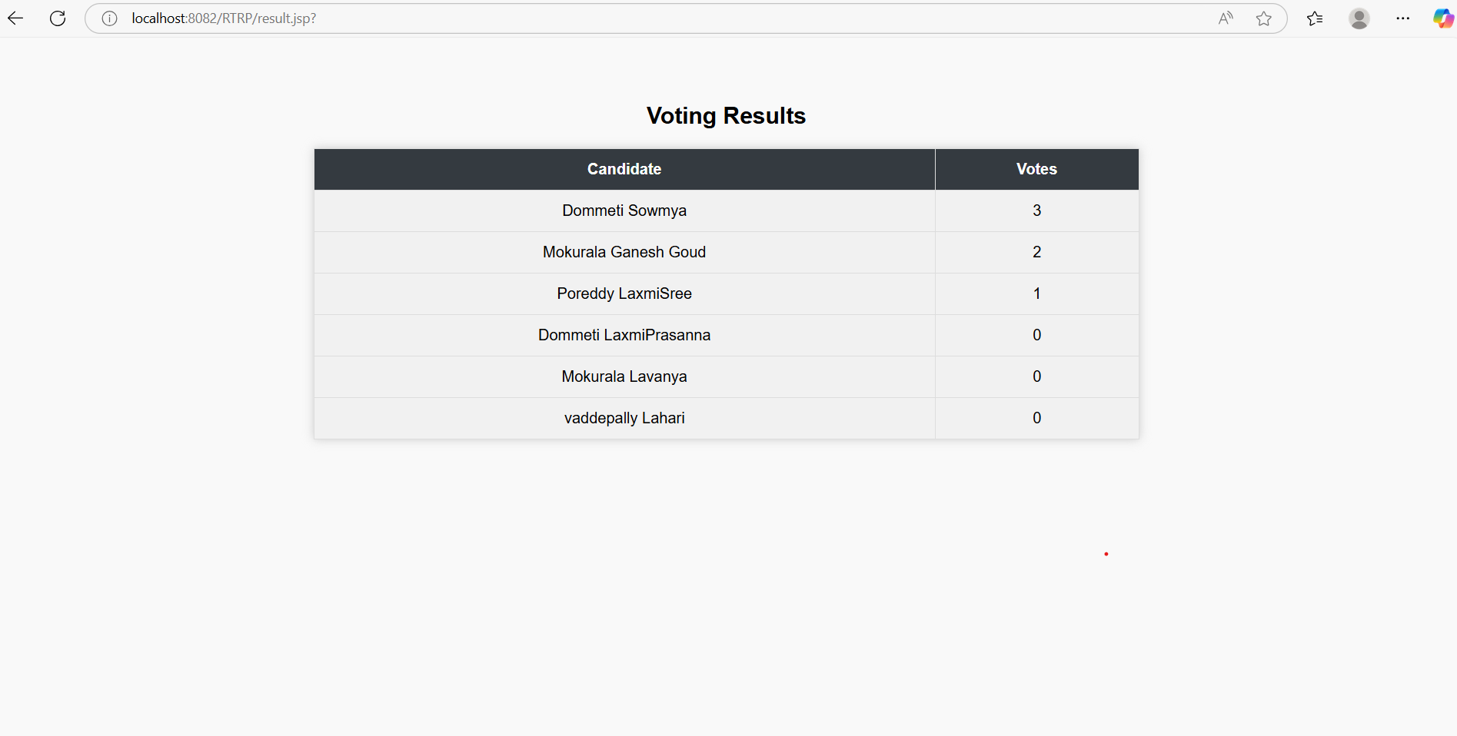

Slide 34
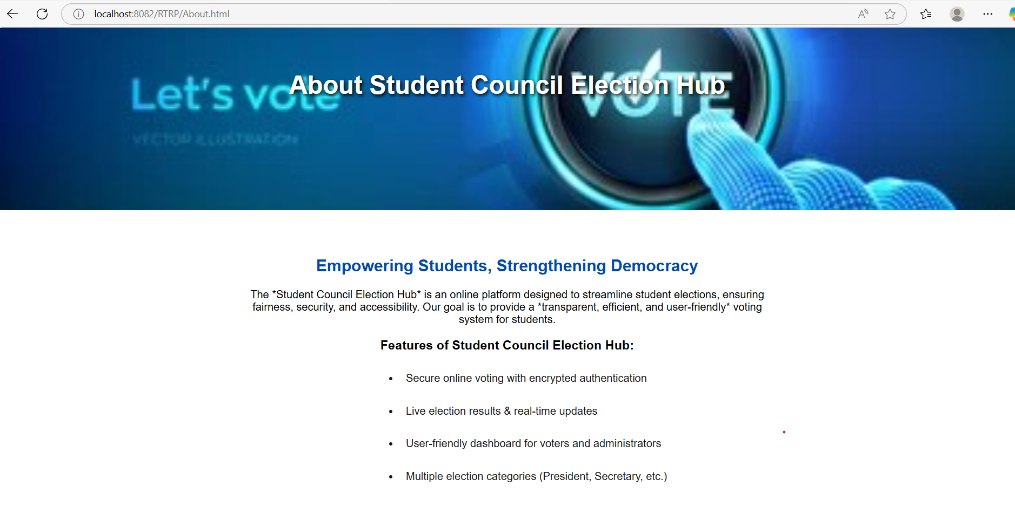

Slide 35
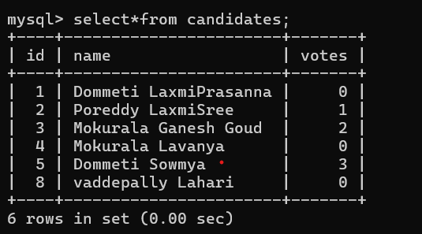

Slide 36
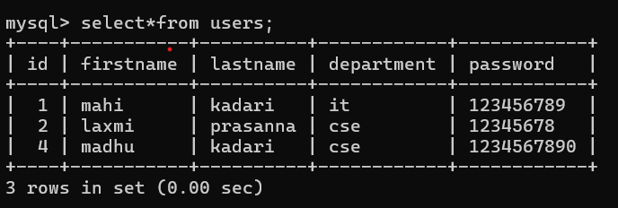

Slide 37
CONCLUSION:
The Student Council Election Hub serves as a vital platform that promotes democratic participation, transparency, and student engagement within the college community.
By providing easy access to candidate information, voting procedures, and election updates, the hub empowers students to make informed decisions and encourages active involvement in college governance.
Ultimately, it fosters leadership skills and a sense of responsibility among students, contributing to a more vibrant and attractive environment.

Slide 38
FUTURE SCOPE
Integrate real-time voting analytics
Add multimedia candidate profiles (videos, speeches, manifestos)
Enhanced Security
Implement mobile app compatibility for easier access and voting
Also tracking results successfully

Slide 39
References:
Open Source Voting System (GitHub)
Online Voting System (using MySQL)
Edutopia – Student Council Election Tips

Slide 40


