Slide 1
Project
Flight Price Prediction
Submitted by
Laxmi Narayan

Slide 2
Contents
Introduction
Data Preparation
Exploratory Data Analysis
Prediction and Modeling Techniques
Model Building and Evalution
Analysis and comparison
Conclusion

Slide 3
Introduction
Machine learning (ML) is the study of computer algorithms, which improve with experience and use of data. Machine learning algorithms build a model based on sample data (training data), and make predictions or decisions using this model without being programmed to do so.
Machine learning algorithms have a wide variety of applications, like fraud detections, email filtering etc. One such application of machine learning lies in the ‘Aviation industry’, to predict the prices of flights. There are various factors/features which impact the prices of flights — distance, flight time, number of stops etc. These factors help create a pattern to decide the price of a flight, and the machine learning models get trained on this pattern to make the predictions in future, automating the process and making the process quicker.

Slide 4
Data Preparation
he dataset contains a large number of variables that are involved in determining a used Flight Price. We obtained a csv copy (Train and Test set)of the data from kaggle.
Data Description:The dataset contains 10682records (rows) and 30 features (columns).

Slide 5
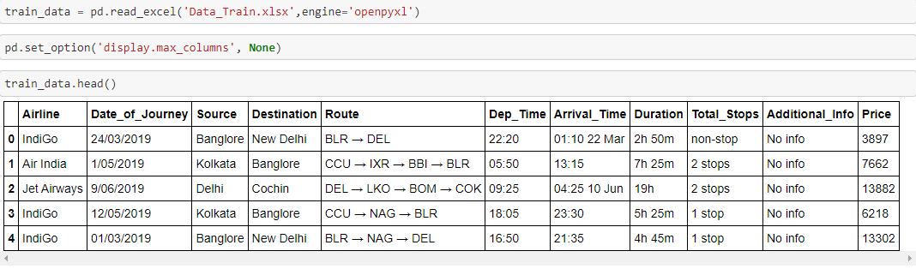
Conti..

Slide 6
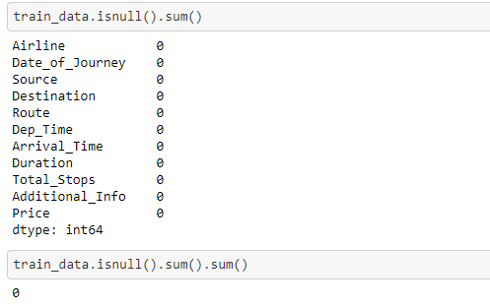
Data cleaning:Dealing with missing values

Slide 7
Feature Engineering
For hadeling categorical data. We modtly use these 2 path:
OneHotEncoder
LabelEncoder
Where OneHotEncoder is used where data are not in any order and LabelEncoder when data is in order.
So, for each Features we will use plots to find out what to be used there.

Slide 8
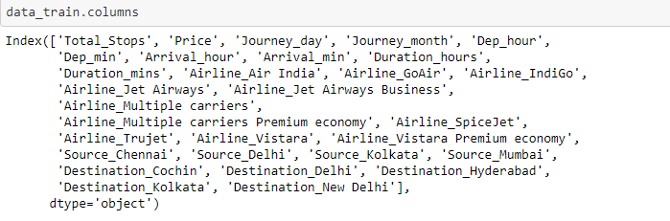
Conti..

Slide 9
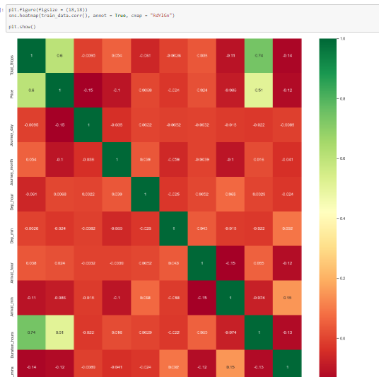
HeatMap

Slide 10
Conti..
Firstly, we want to visualize the relationships between the target variable and the variables that are highly and positively correlated with it, according to what .we saw in the heatmap.

Slide 11
Model Building
Dummies will be used for converting categorical variables into numerical variables because sklearn models allows only numerical inputs.
The train data set will be divided into two parts,80% of the data will act as training data and the remaining 20% data will be the validation data.

Slide 12
Model Selection
Let’s model each classification algorithm over the training dataset and evaluate their accuracy and standard deviation scores.
Random Forest Classifier

Slide 13
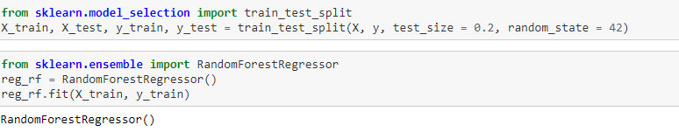
Train-Test Splitting

Slide 14
Modeling Approach
Choose an algorithm that implements the corresponding technique
Search for an effective parameter combination for the chosen algorithm
Create a model using the found parameters
Train (fit) the model on the training dataset
Test the model on the test dataset and get the results

Slide 15
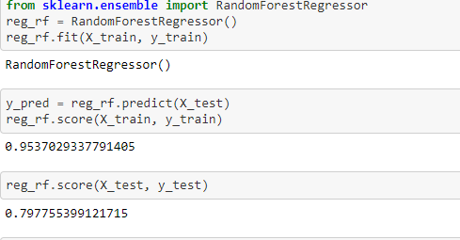
Random Forest Algorithm

Slide 16
Checking accuracy of the model
After the model evaluation , we get the accuracay for Train and Test data are 0.95and 0.79.
Model evaluation gives the results that the prediction is very accurate

Slide 17
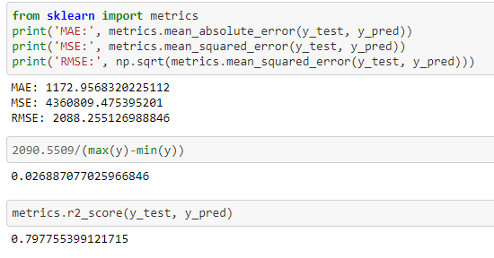
Conti..

Slide 18
Conclusion and Future Work
For better performance, we plan to judiciously design deep learning network structures, use adaptive learning rates and train on clusters of data rather than the whole dataset. To correct for overfitting in Random Forest, different selections of features and number of trees will be tested to check for change in performance.

Slide 19
Conti..
As a general conclusion for this project, it was very rewarding for us to take part in this competition because it allowed us to use what we had learned ain class directly onto real-life problems, but also to make our own research, to investigate and to try to come up with new ideas when we did not find anything that would suit what we wanted to achieve. It was for all of us an interesting first step into the world of research, and it provided us a hands-on experience of what can be done with machine learning techniques in general.

